Slide 1
Forging Collaborations Among States to Build Evidence to Inform Policymaking
Robert Goerge
March 5

Slide 2
Evidence and tools needed at the state level
What programs are effective in achieving improved employment outcomes?
Are certain programs better for specific populations than others?
What outcomes (metrics) do we need to reflect the variations in program goals?

Slide 3
Setting the federal context
Federal strategy “leveraging the value of federal data”
10-year plan to instill best practices to build a culture that leads to informed decision-making
Federal agencies are building learning agendas – priority research questions
Midwest Collaborative can contribute to this
LEHD continues to develop tools that are innovative, but it does not put the power of the data into the hands of the states

Slide 4
Illinois experience
Excellent agency leadership—IDES, IDHS and IDOC
They had a sense of what they wanted to know relative to the operation of their programs and the employment outcomes of participants
Participation in ADA classes
TANF, SNAP and subsidized child care from IDHS
Ex-offenders and those who received training while in prison
This led to them being able to bring new information to the policy discussions

Slide 5
Constructing dynamic, job-level employment measures using matched employer-employee wage data
Replicating production of LEHD indicators in the ADRF
beginning-of-period employment, end-of-period employment, accessions, new hires, recalls, separations, full-quarter employment, full-quarter accessions, full-quarter new hires, total earnings of full-quarter employees, total earnings of full-quarter accessions, and total earnings of full-quarter new hires
Illinois has been doing this with Stata
Stata programs were re-written in Python (Jupyter notebooks)
Applied to both Illinois and Missouri to confirm cross-state reliability
Now code is available in the ADRF to apply to any state to data formatted for LEHD submission

Slide 6
Trajectories of incarceration and employment in Illinois
6,142 individuals who were first imprisoned in 2006 and were between 18 and 26 years old at this time. They were followed from the beginning of calendar year 2005 to the end of the fiscal year 2015, a total of 42 quarters.
We find five clusters of trajectories—
1) primarily incarcerated;
2) intermittent employment with little recidivism;
3) unemployed after initial incarceration;
4) intermittent incarceration; and
5) working after incarceration.

Slide 7
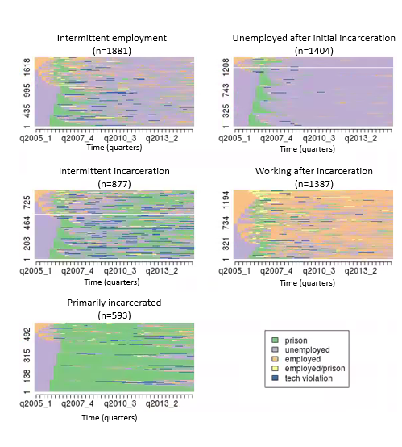
Clusters of trajectories

