Slide 1
Ohio and the Workforce Success Measures: Regional Data Possibilities
Joshua Hawley
The Ohio State University

Slide 2
Uses of OLDA for Government
Agencies use data for many purposes
To conduct research they can not using data internally (e.g., matching wage records to housing rosters)
To produce value added tools that meet priorities of multiple agencies (e.g., WIOA Scorecards)
To generate novel research (e.g., monitoring long term outcomes of WIOA youth)
To fulfil external research request that would otherwise take agency resources

Slide 3
Plans and Reports
State plans and reports are the required communications mechanisms for describing program goals and outcomes:
Ohio’s plans included a visual dashboard (workforce success measures), workforcesuccess.chrr.ohio-state.edu
It provides state, county, region, and provider outcomes

Slide 4
Workforce Success Measures
Four broad areas
Employment: two and four quarters after exit
Skills: enrollment in and completion of degrees and credentials
Wages: levels of earnings after two and four quarters of exit
Business retention: do people stay in the same job?

Slide 5
Issues to think about with this
Data Sources
Ohio administrative records from program files
Limits results to programs that have at least 10 people
Three agencies, common use of UI wage records in matches with agencies program files
https://workforcesuccess.chrr.ohio-state.edu/details

Slide 6
Definitions of program and outcome
Workforce Investment and Opportunities Act Title I (WIOA Title I) participants are those individuals identified in the quarter after the end of the program year who had received a core staff-assisted service (such as job search or placement assistance) or an intensive service (such as counseling, career planning, or job training)

Slide 7
Outcome
Completer – Definition:
Completers are included in the WSM when there is an associated identifier to enable matching with employment and credential outcomes. While most records include such identifiers, the WSM undercounts some portion of completers due to an imperfect ability to match all completers with their outcomes.

Slide 8
Employment outcomes
There are many critical data decisions on the employment outcomes
Employment and earnings outcomes are calculated using Ohio’s UI Wage data for those individuals working in Ohio
The Retention metric indicates whether an individual has the same main employer in the second calendar quarter after exit and the fourth calendar quarter after exit.
All records in the UI Wage data include a linkage identifier that enables deterministic matching of employment outcomes to program completers.
Credential outcomes are deterministically matched to program completers where possible; the remainder are linked probabilistically where sufficient personally identifiable information is included with the administrative data source to use for matching

Slide 9
What does the program data look like
Built a technical website to display the data
Both a “dashboard” and a scorecard
Dashboard = decision support
Scorecard = support on key areas (maybe a smaller footprint from dashboards)

Slide 10
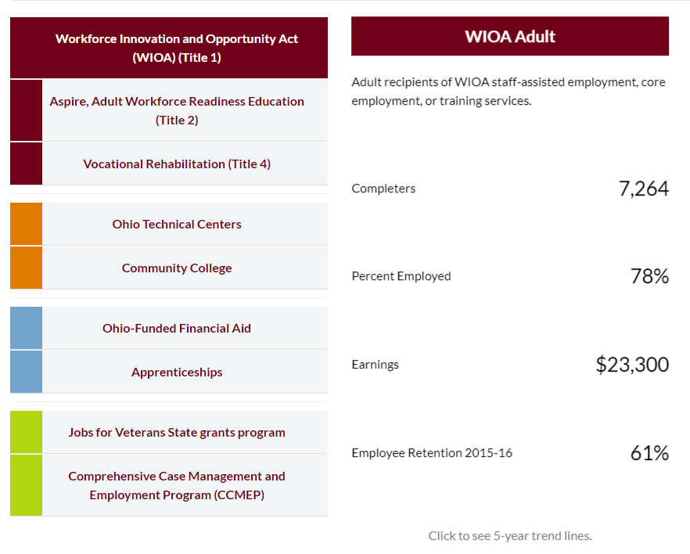
State level data displays
Summary of state level
Provides both program and outcomes
High level
Easy to read
Practical

Slide 11
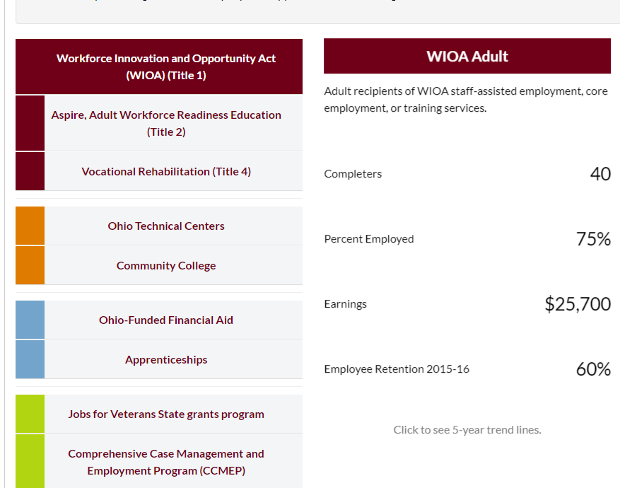
County dashboards
Each county has one, for areas
County Stats
Participation
Services
Outcomes

Slide 12
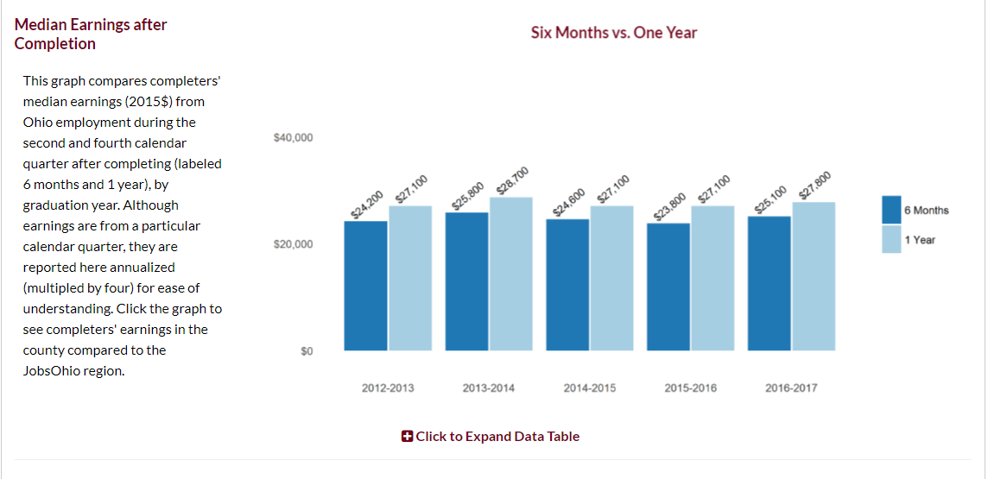
Provider
For each provider
County
College
Board
Same set of reports

Slide 13

Workforce Success Measures
Workforce Success Measures Dashboard

Slide 14
Data Use
Limits of technology
Technology, even well designed and executed tech, can’t make a government use data
Local decisions differ in the rules that the feds intent to set
Intake
Program set up
Evaluation
Simply deciding there are common measures does not mean people use the data for policy decisions

Slide 15
Weaknesses with data
Employment only includes within-state data
No federal/military/PO employment
No “off the books” or informal sector employment

Slide 16
Including Regional Data
Employment and Earnings
Regional employment measure
Employment in multiple states
Better career pathway knowledge
Education Data
Regional credential data completion (students that started in one state and finished in another)
Compare policy impacts (what happens in case of city where population is shared and cuts across political boundaries?)

Slide 17
MSAs in Cincinnati and Southeast Ohio

Slide 18
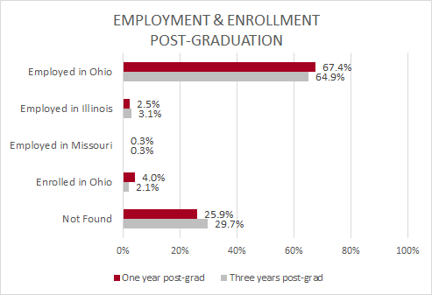
Outcomes: Cross-State Migration
Notes:
Script: This figure demonstrates the cross-state migration outcome of employment & enrollment after graduation in Ohio, Illinois, and Missouri. We looked at one year post-grad marked in red, as well as three years post-grad in grey. We expected more students to move across the border, however, it’s shown that above that over 60% of students are employed in Ohio, and very few students move to Illinois and Missouri. There is also a high percentage of records not found, which we can interpret as students moving to other states for which we don’t have the data to track them, or they are unemployed in Ohio.
NOTES FOR THIS SLIDE:
-these numbers may imply that for these three implications, people leaving Ohio for IL and MO isn’t as much of a concern as expected.
- the high % of people who weren’t found tells us that maybe there are other states that these students are moving to for which we don’t have data - bigger cities, like NY, LA, SF? Or are these students unemployed somewhere in Ohio?
^ is an option for further analysis, if data from other states becomes available, and it presents us with an unemployment analysis which could shed some light on these trends.
-this pattern is the same for three years - most of our sample *isn’t* moving to IL or MO.

Slide 19
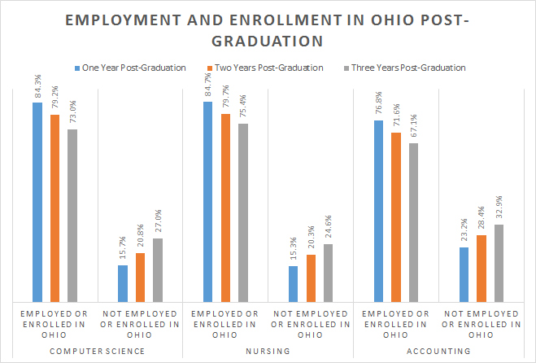
Notes:
Script: This graph further breaks down the employment and enrollment status in Ohio post-graduation, with 1 year, 2 year, and 3 year out for three main CIP codes. We see the same pattern as the previous slide, with nursing having the highest employed/enrolled in Ohio, followed by computer science and then accounting.
Explain how employment here is defined differently than in the previous tables.
Pivot to next slide - something like, “now that we have seen that people generally do not move to MO and IL, we thought it would be interesting to analyze their employment patterns and persistence”

