Slide 1
Floating point
Jinyang Li

Slide 2
Floating Point (FP) lesson plan
Normalized binary exponential notation
Strawman 32-bit FP
IEEE FP format
Rounding

Slide 3
Previously…
Unsigned n-bit integers
-
2^{n-1}
-1
1
2^{n-1}-1
2^{n}-1
+
-2
0
2
-3
3
Signed n-bit integers
What about real numbers?

Slide 4
Represent real numbers: the decimal way
Real Number | Decimal Representation
11 / 2 | (5.5)₁₀
1 / 3 | (0.3333333...)₁₀
√2 | (1.4128…)₁₀
(1.4128...)₁₀ = 1 * 10⁰ + 4 * 10⁻¹ + 1 * 10⁻² + 2 * 10⁻³ + ...

Slide 5
Binary Representation
(5.5)₁₀
= 4 + 1 + 1/2
= 2² + 2⁰ + 2⁻¹
= (101.1)₂

Slide 6
Binary Representation
(0.1)₁₀ = 2⁻⁴ + 2⁻⁵ + 2⁻⁸ + 2⁻⁹ + 2⁻¹² + 2⁻¹³ + …
= (0.0001100110011...)₂

Slide 7
Binary Representation
2^{p}
2^{p-1}
2
1
.
1/2
1/4
1/2^{q}

Slide 8
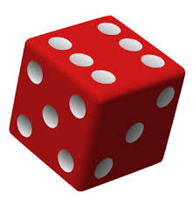
Binary representation
What’s the decimal value of (10.01)₂

Slide 9
Binary representation
What’s the decimal value of (10.01)₂
Answer: 2.25

Slide 10
Making the representation fixed width Strawman: fixed point
15 bits
16 bits
s | b₁₄ | b₁₃ | b₁₂ | … | b₁ | b₀ | b₋₁ | b₋₂ | b₋₃ | … | b₋₁₄ | b₋₁₅ | b₋₁₆
sign
Fixed position e.g. middle

Slide 11
Fixed point representation
15 bits
16 bits
s | b₁₄ | b₁₃ | b₁₂ | … | b₁ | b₀ | b₋₁ | b₋₂ | b₋₃ | … | b₋₁₄ | b₋₁₅ | b₋₁₆
sign
Example: ( 10.011 )₂
0 | 0 0 0 0 0 0 0 0 0 0 0 0 0 1 0 | 0 1 1 0 0 0 0 0 0 0 0 0 0 0 0

Slide 12
Problems of Fixed Point
15 bits
16 bits
s | b₁₄ | b₁₃ | b₁₂ | … | b₁ | b₀ | b₋₁ | b₋₂ | b₋₃ | … | b₋₁₄ | b₋₁₅ | b₋₁₆
Range?
Precision?
-
+
0

Slide 13
Problems of Fixed Point
15 bits
16 bits
s | b₁₄ | b₁₃ | b₁₂ | … | b₁ | b₀ | b₋₁ | b₋₂ | b₋₃ | … | b₋₁₄ | b₋₁₅ | b₋₁₆
Limited range and precision: e.g., 32 bits
Range: [-2¹⁵+2⁻¹⁶,2¹⁵-2⁻¹⁶ ]
Highest precision: 2⁻¹⁶
Rarely used (No built-in hardware support)

Slide 14
Floating point: key idea
Limitation of fixed point:
Even spacing results in hard tradeoff between high precision and high magnitude
How about un-even spacing between numbers?
-
+
0

Slide 15
Floating Point: decimal
Based on exponential notation (aka normalized scientific notation)
r₁₀ = +M * 10E, where 1 <= M < 10
M: significant (mantissa), E: exponent

Slide 16

Floating Point: decimal
Example:
365.25 = 3.6525 * 10²
0.0123 = 1.23 * 10⁻²
Decimal point floats to the position immediately
after the first nonzero digit.

Slide 17
Floating Point: binary
Binary exponential representation
+M * 2E, where 1 <= M < 2
M = ( 1.b₁b₂b₃…b_{n} )₂
M: significant, E: exponent
(5.5)₁₀ = (101.1)₂ = (1.011)₂ * 2²

Slide 18
Floating Point
Binary exponential representation
+M * 2E, where 1 <= M < 2
M = ( 1.b₁b₂b₃…b_{n} )₂
M: significant, E: exponent
Also called normalized
representation
(5.5)₁₀ = (101.1)₂ = (1.011)₂ * 2²

Slide 19
(Binary) normalized representation of (10.25)₁₀?

Slide 20
(Binary) normalized representation of (10.25)₁₀ ?
Answer: (10.25)₁₀ = (1010.01)₂ = (1.01001)₂ * 2³

Slide 21
Strawman FP: normalized representation in 32-bit
significant
exponent
+M * 2E, where 1 <= M < 2
M = ( 1.b₁b₂b₃…b₂₃ )₂
31
30
23
0
22
s
exp (E)
fraction (F)
(b₁b₂b₃…b₂₃)₂

Slide 22
Strawman 32-bit FP: Example
significant
exponent
+M * 2E, where 1 <= M < 2
M = ( 1.b₁b₂b₃…b₂₃ )₂
Example: (5.5)₁₀ = (101.1)₂ = (1.011)₂ * 2²
31
30
23
22
0
0 | 0000 0010 | 0110 0000 0000 0000 0000 000
( b₁b₂b₃…b₂₃ )₂

Slide 23
More Strawman 32-bit FP Examples
Example: (65)₁₀ = (1000001)₂ = (1.000001)₂ * 2⁶
31
30
23
22
0
0 | 0000 0110 | 0000 0100 0000 0000 0000 000
Another example: (10.25)₁₀ = (1010.01)₂ = (1.01001)₂ * 2³
31
30
23
22
0
0 | 0000 0011 | 0100 1000 0000 0000 0000 000

Slide 24
Strawman FP on a number line
31
30
23
22
0
s | exp (E) | frac (F)
0 0….0 0…00
1
0 0….0 0…01
1+2⁻²³
0 0….0 0…10
1+2*2⁻²³
…
0 0….0 1…11
1+(2²³-1)*2⁻²³
0 0….1 0…00
2
0 0….1 0…01
2+2⁻²²
0 0….1 0…01
2+2*2⁻²²
…
0 1….1 1…10
2²⁵⁵+(2²³-2)*2²³²
0 1….1 1…11
2²⁵⁵+(2²³-1)*2²³²
2⁻²³
2⁻²²
2²³²

Slide 25
Strawman 32-bit FP: pros and cons
1 0….01 0…00
1 0….00 0…00
0 0….01 0…00
0 0…10 0…00
0 0…11 0…00
0 0….00 0…00
-2
-1
1
2
4
8
Max: 0 1…11 1…11
2²⁵⁵+(2²³-1)*2²³²
2²³ evenly spaced numbers in each interval
The good 👍
Large range [1, 2²⁵⁵+(2²³-1)*2²³²], [-2²⁵⁵-(2²³-1)*2²³² ,-1]
Allows easy comparison: compare FPs by bit patterns
The bad 👎
No 0!
No [-1, 1]
Max precision (2⁻²³ ) not high enough
No representation of special cases: ∞

Slide 26
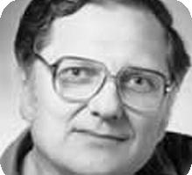
IEEE Floating Point Standard
Lots of FP implementations in 60s/70s
Code was not portable across processors
IEEE formed a committee (IEEE.754) to standardize FP format and specification.
IEEE FP standard published in 1985
Led by William Kahan
Prof. William Kahan
University of California at Berkeley
Turing Award (1989)

Slide 27
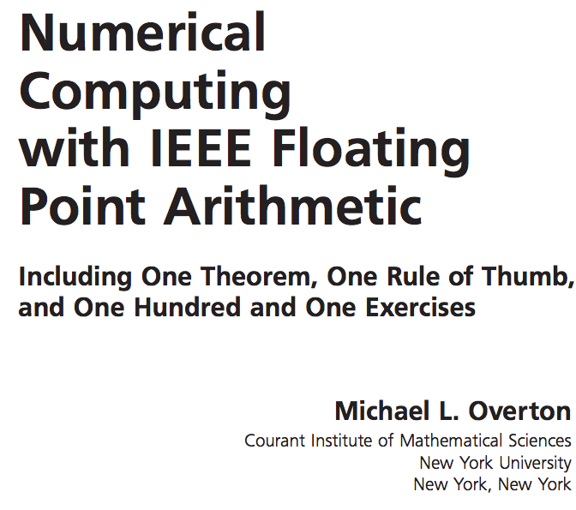

IEEE Floating Point Standard
This class only covers basic FP materials
A deep understanding of FP is crucial for numerical/scientific computing
More FP is covered in undergrad/grad classes on numerical methods

Slide 28
Goals of IEEE Standard
Consistent representation of floating point numbers
Address the limitation of our FP strawman
Correctly rounded floating point operations, using several rounding modes.
Consistent treatment of exceptional situations such as division by zero

Slide 29
IEEE FP: Carve out subsets of bit-patterns from normalized representation
+M * 2E M = ( 1.b₀b₁b₂b₃…b_{n} )₂
31
30
23
22
0
s | exp | fraction (F)
( b₀b₁b₂b₃…b_{n} )₂
For normalization representation,
exp can not be (1111 1111)₂ or (0000 0000)₀
exp_{max} = ?
exp_{min} = ?
254, (1111 1110)₂
1, (0000 0001)₂

Slide 30
IEEE FP: Represent negative exponents using bias
+M * 2E, M = ( 1.b₀b₁b₂b₃…b_{n} )₂
To represent FPs in (-1,1), we must allow negative exponent.
How to represent negative E?
2’s complement
use bias
Why? Using bias instead of 2’s complement allows simple comparison of FPs using their bit-patterns
31
30
23
22
0
s | exp = E + 127 | fraction (F)
( b₀b₁b₂b₃…b_{n} )₂

Slide 31
IEEE FP normalized representation
+M * 2E, M = ( 1.b₀b₁b₂b₃…b_{n} )₂
31
30
23
22
0
s | exp = E + 127 | fraction (F)
( b₀b₁b₂b₃…b_{n} )₂
1 0….10 0…00
1 0….01 0…00
0 0….10 0…00
0 0…11 0…00
0 0….01 0…00
-2⁻¹²⁵
-2⁻¹²⁶
2⁻¹²⁶
2⁻¹²⁵
2⁻¹²⁴
Max: 0 1…10 1…11
2¹²⁷+(2²³-1)*2¹²⁷⁻²³
2²³ evenly spaced numbers in each interval
The gap [-2⁻¹²⁶ , 2⁻¹²⁶]
is 2⁻¹²⁵

Slide 32
Represent values close and equal to 0

Slide 33
IEEE FP denormalized representation: represent values close and equal to 0
+M * 2E
Normalized Encoding:
31
30
23
22
0
s | exp = E + 127 | fraction (F)
1 <= M < 2, M = ( 1.F )₂
Denormalized Encoding:
31
30
23
22
0
s | exp =0000 0000 | fraction (F)
E = 1 – Bias = -126
0 <= M < 1, M = ( 0.F )₂

Slide 34
Zeros
+0.0
0 | 0000 0000 | 0000 0000 0000 0000 0000 000
-0.0
1 | 0000 0000 | 0000 0000 0000 0000 0000 000

Slide 35
Denormalized FP example
Smaller than the smallest E (-126)
of normalized encoding
What’s the IEEE FP format of (1.0)₂*2⁻¹²⁷?
(1.0)₂*2⁻¹²⁷= (0.1) ₂*2⁻¹²⁶
0 | 0000 0000 | 1000 0000 0000 0000 0000 000

Slide 36
What we’ve learnt so far
Normalized binary representation of real numbers
Answer: (10.25)₁₀ = (1010.01)₂ = (1.01001)₂ * 2³

Slide 37
What we’ve learnt so far: IEEE FP normalized + denormalized
31
30
23
22
0
s | exp = E + 127 | fraction (F)
If (exp!=0 && exp!=255) n = (1.F)₂ * 2^{exp-127} (normalized)
0 | 1000 0010 | 0100 1000 0000 0000 0000 000
n = (1.01001)₂ * 2¹³⁰⁻¹²⁷
s | 0000 0000 | fraction (F)
If (exp == 0) n = (0.F)₂ * 2⁻¹²⁶ (denormalized)
0 | 0000 0000 | 0100 1000 0000 0000 0000 000
n = (0.01001)₂ * 2⁻¹²⁶

Slide 38
What we’ve learnt so far: IEEE FP normalized + denormalized
0 0….00 0…00
1 0….00 0…00
1 0….10 0…00
1 0….01 0…00
0 0….10 0…00
0 0…11 0…00
0 0….01 0…00
-2⁻¹²⁵
-2⁻¹²⁶
±0
2⁻¹²⁶
2⁻¹²⁵
2⁻¹²⁴
0
Max: 0 1…10 1…11
≈ 2¹²⁸
2²³ evenly spaced numbers between successive “red marks”
2²³ evenly spaced positive denormalized numbers
Precision is higher for numbers close to zero

Slide 39
Floating Point (cont’d) lesson plan
IEEE FP special values
Revisit FP: Toy 8-bit FP
Rounding
FP operations

Slide 40
IEEE FP: special values
Special Value’s Encoding:
31
30
23
22
0
s | 1111 1111 | fraction (F)
values | sign | frac
+ | 0 | all zeros
- | 1 | all zeros
NaN | any | non-zero

Slide 41
IEEE FP: single vs. double precision
31
30
23
22
0
s | E + 127 | frac
float f = 0.1;
double d = 0.1;
single precision (32 bits)
63
62
52
51
0
s | E + 1023 | frac
double precision (64 bits)

Slide 42
single/ double precision
 | E_{min} | E_{max} | N_{min} | N_{max}
Float | -126 | 127 | 2⁻¹⁴⁹ | ≈ 2¹²⁸
Double | -1022 | 1023 | 2⁻¹⁰⁷⁴ | ≈ 2¹⁰²⁴

Slide 43
FP summary
Normalized binary representation of real numbers
IEEE FP
s | exp | fraction (F)
If exp!=0 && exp!=255, (1.F )*2^{exp-127}
If exp==0, (0.F )*2⁻¹²⁶
0 0….00 0…00
1 0….00 0…00
1 0….01 0…00
0 <= M < 1, M = ( 0.F )₂
1 0….00 0…00
0 0….10 0…00
0 0…11 0…00
0 0….01 0…00
-2⁻¹²⁵
-2⁻¹²⁶
±0
2⁻¹²⁶
2⁻¹²⁵
2⁻¹²⁴
Max: 0 1…10 1…11
2¹²⁷+(2²³-1)*2¹²⁷⁻²³
2²³ evenly spaced numbers in each interval
2²³ evenly spaced denormalized numbers in each of the two intervals

Slide 44
A toy 8-bit FP in the spirit of IEEE FP
+M * 2E
exponent: 3 bits
fraction: 4 bits
bias: 3
7
6
4
3
0
Normalized encoding
exp ≠ 000, 111
s | exp = E + 3 | frac (F)
n = ( 1.F )₂ *2^{exp-3}
7
6
4
3
0
s | 0 0 0 | frac (F)
Denormalized encoding
exp = 000
7
6
n = ( 0.F )₂* 2⁻²
s | 1 1 1
Special values encoding
exp = 111
Smallest positive number?
Range?
How many distinct numbers?

Slide 45
A toy 8-bit FP in the spirit of IEEE FP
+M * 2E
exponent: 3 bits
fraction: 4 bits
bias: 3
7
6
4
3
0
If exp!=0 && exp!=(111)₂
n = ( 1.F )₂ *2^{exp-3}
s | exp | frac (F)
Else if exp == 0
n = ( 0.F )₂* 2⁻²
(00000001)_{FP8}= 2⁻⁶
(01101111)_{FP8}= 15.5
0
2⁸ - 2⁵ -1 distinct numbers: there are 2⁸ total bit-patterns, 2⁵ special values, 0 has 2 bit-patterns.

Slide 46
Floating Point (cont’d) lesson plan
IEEE FP special values
Revisit FP: Toy 8-bit FP
Rounding
FP operations

Slide 47
FP: Rounding
Values that are represented precisely
What if the result of computation is at ?
Rounding: Use the “closest” representable value x’ for x.
4 modes:
Round-down
Round-up
Round-toward-zero
Round-to-nearest (Round-to-even in text book)

Slide 48
Round up vs. round down
-0.875
-0.75
0.5
0.625
0
Round up rounds to the right
Round(x) = x₊ (x₊>= x)
Round down rounds to the left
Round(x) = x₋ (x₋<= x)

Slide 49
Round towards zero
-0.875
-0.75
0.5
0.625
0
Rounds to the right if x < 0
Round(x) = x₊ if x < 0
Rounds to the left if x >0
Round(x) = x₋ if x < 0

Slide 50
Round to nearest; ties to even
Round to the left if x₋ is nearer to x than x₊
-0.875
-0.75
0.5
0.625
0
Round to the right if x₊ is nearer to x than x₋
In case of a tie, the one with its least significant bit equal to zero is chosen.

Slide 51
How does CPU know if some 4-byte value should be interpreted as IEEE FP or integers?
CPU uses separate registers for floating point and ints.
CPU uses different instructions for floating points and int operations.

Slide 52
Floating Point (cont’d) lesson plan
IEEE FP special values
Revisit FP: Toy 8-bit FP
Rounding
FP operations

Slide 53
Floating point operations
FP Caveats:
Invalid operation: 0/0, sqrt(-1), ∞+∞
Divide by zero: x/0→∞
Overflows: result too big to fit
Underflows: 0 < result < smallest denormalized value
Inexact: round it!
FP addition: commutative but not always associative
FP multiplication: commutative but not always associative and distributive

Slide 54
Floating point operations
Addition, subtraction, multiplication, division etc.
FP Caveats:
Invalid operation: 0/0, sqrt(-1), ∞+∞
Divide by zero: x/0→∞
Overflows: result too big to fit
Underflows: 0 < result < smallest denormalized value
Inexact: round it!

Slide 55
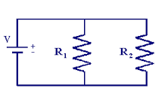

Why divide by zero = ∞?
Allow a calculation to continue and produce a valid result
Example:
If R1 or R2 is 0, overall resistance should be 0

Slide 56
Floating point addition
Commutative? x+y == y+x?
Associative? (x+y)+z = x + (y+z)?
Rounding:
(3.14+1e10)-1e10 = 0
3.14+(1e10-1e10) = 3.14
Overflow
Every number has an additive inverse?
Yes except for ∞ and NaN

Slide 57
Floating point multiplication
Commutative? x* y == y*x?
Associative? (x*y)*z = x * (y*z)?
Overflow:
(1e20*1e20)*1e-20= inf, 1e20*(1e20*1e-20)= 1e20
Rounding
(x+y)*z = x*z + y*z?
1e20*(1e20-1e20)= 0.0, 1e20*1e20 – 1e20*1e20 = NaN

Slide 58
Floating point in real world
Storing time in computer games as a FP?
Precision diminishes as time gets bigger
FP value (decimal) | Time value | FP precision | Time precision
1 | 1 sec | 1.19E-07 | 119 nanoseconds
100 | ~1.5 min | 7.63E-06 | 7.63 microseconds
10 000 | ~3 hours | 0.000977 | .976 milliseconds
1000 000 | ~11 days | 0.0625 | 62.5 milliseconds

Slide 59
Floating point in the real world
Using floating point to measure distances
FP value | Length | FP precision | Precision size
1 | 1 meter | 1.19E-07 | Virus
100 | 100 meter | 7.63E-06 | red blood cell
10 000 | 10 km | 0.000977 | toenail thickness
1000 000 | .16x earth radius | 0.0625 | credit card width
Table source: Random ASCII

Slide 60
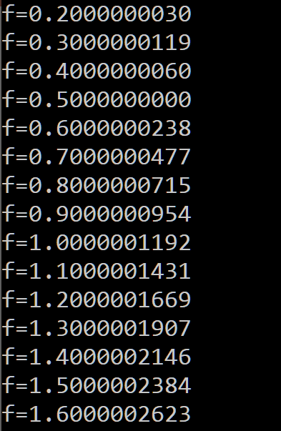
Floating point trouble
Comparing floats for equality is a bad idea!
float f = 0.1;
while (f != 1.0) {
f += 0.1;
}
Notes:
You can not represent 0.1 exactly in floating point

Slide 61
Floating point trouble
Never count using floating points
count = 0;
for (float f = 0.0; f < 1.0; f += 0.1) {
count++;
}
Notes:
You can not represent 0.1 exactly in floating point

Slide 62
You are not alone in thinking FP is hard
Many real world disasters are due to FP trickiness
Patriot Missile failed to intercept due to rounding error (1991)
Ariane 5 explosion due to overflow in converting from double to int (1996)

Slide 63
Floating point summary
FP format is based on normalized exponential notation
IEEE FP format
Normalized, denormalized, special values
Floating points are tricky
Precision diminishes as magnitude grows
overflow, rounding error

