Slide 1
CSO-Recitation 03 CSCI-UA 0201-007
R03: Assessment-01 & Debugging with gdb

Slide 2
Today’s Topics
Weekly assessment-01
Breakout exercise in Wed’s lecture
Debugging with gdb

Slide 3
Assessment 01
Answers and explanations

Slide 4
Assessment-01
No late submission allowed from assessment-02
Very few people still didn’t do it, remember to do assessment-02
Review your grades one day after the due (from assessment-02)

Slide 5
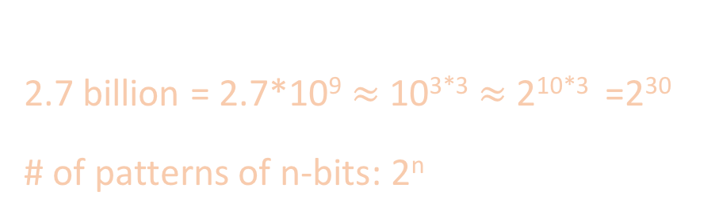
Q1
Facebook has 2.7 billion users. If it is to use an unsigned int as user-id, what's the smallest sized int can it use?
1-byte
2-byte
3-byte
4-byte
8-byte
2.7 billion = 2.7*10⁹ $≈$ 10^{3*3} $≈$2^{10*3} =2³⁰
# of patterns of n-bits: 2^{n}

Slide 6

Q2 Signed int
Which of the following signed 1-byte int (in binary format) is the smallest?
00000000
10000001
11111111
00000001
10000011
01111110
MSB represents the sign
Two’s complement: bit pattern -> signed int
$$−b_{n−1}2^{n−1}+\sum_{i=0}^{n−2}{b_{i}2^{i}}$$

Slide 7
Q3 binary to hex & Q4 overflow(unsigned)
Q3: Convert bit pattern 10111110 to hex notation. You must prefix your answer with 0x.
0xbe
Q4: Which of the following 1-byte unsigned subtraction operation will overflow?
0xff - 0x0f
0x0f - 0xff
0x01 - 0x0f
0x0f - 0x01
1011 -> 2^3+2^1+2^0=11 -> b
1110 -> 2^3+2^2+2^1=14 -> e
Size (bytes) | Bit pattern of smallest | Bit pattern of largest | Range
1 | 0x00 | 0xff | [0, 2^8-1]
2 | 0x0000 | 0xffff | [0, 2^16-1]
4 | 0x00000000 | 0xffffffff | [0, 2^32-1]
8 | .. | .. | ..

Slide 8
Q5 Overflow (signed)
Which of the following 1-byte signed addition operation will overflow?
0xff + 0xfe
0x1f + 0xff
0x71 + 0x70
0x05 + 0xfe
0x80 + 0x8f
Change it to bit patterns -> addition/subtraction -> see whether
two positive numbers add to a negative number
two negative numbers add to a positive number
0xff + 0xfe:
11111111 -> -1
11111110 -> -2
111111101 -> -2^7+2^6+2^5+…+2^2+2^0=-3
c) 0x71 + 0x70:
01110001 -> 2^6+2^5+2^4+2^0
01110000 -> 2^6+2^5+2^4
10000001 -> -2^7+2^0 =-126

Slide 9
Q5 Overflow (signed)
Which of the following 1-byte signed addition operation will overflow?
0xff + 0xfe
0x1f + 0xff
0x71 + 0x70
0x05 + 0xfe
0x80 + 0x8f
Some “special” bit patterns:
Smallest: 0x80
Biggest: 0x7f
0xff : -1

Slide 10
Q6 Hex to int
If x has bit pattern 0xffffffff, what's the value of x?
-1, if x is signed int
-1, if x is unsigned int
2^{32}-1, if x is unsigned int
2^{31}-1, if x is unsigned int

Slide 11
Q7 & Q9 Git
Q7: You've created a new file named quiz.html in your cloned git repository, which command or sequence of commands must you run in order for this file to be saved to github.com?
git add quiz.html; git commit -m "my commit message"; git push origin master
Q9: Which Git command do you use to check the list of untracked and/or modified files in your repository?
git status

Slide 12
Q8 Makefile
Which of the following statement about Makefile is wrong?
A target is the thing we are trying to build
Object files can be either a target and some other target's dependencies
Each rule can only have one command
By default, running the make command builds the first target

Slide 13
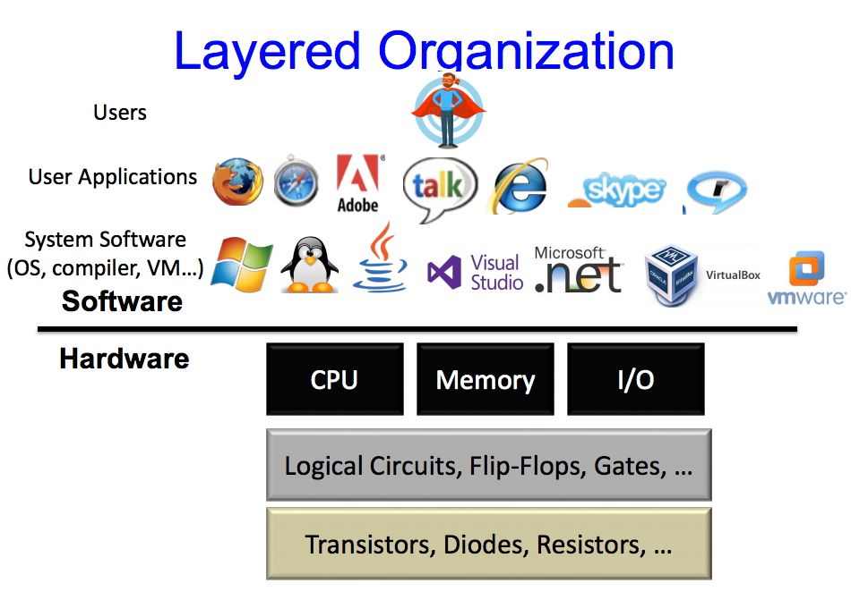
Q10 Virtual Machine
In the layered structure of a Computer, which layer does the Virtual Machine (like the Oracle VirtualBox you're all are using) AND the OS which is installed on it (lubuntu) belong to?
User Applications AND System Software
System Software AND System Software
CPU AND System Software
CPU AND User Applications

Slide 14
Breakout exercise

Slide 15
Review IEEE FP
+M * 2E
Normalized Encoding
Denormalized Encoding
Zeros
Special values
Using bias in representing E
Represent values close and equal to 0

Slide 16
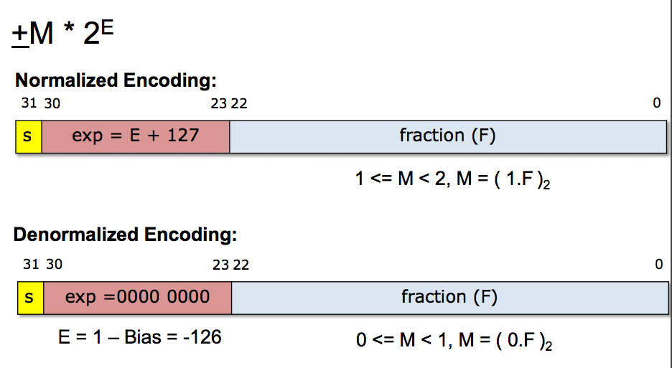
Review IEEE FP
E = exp – bias
exp cannot be (11111111)₂ or (00000000)₂

Slide 17
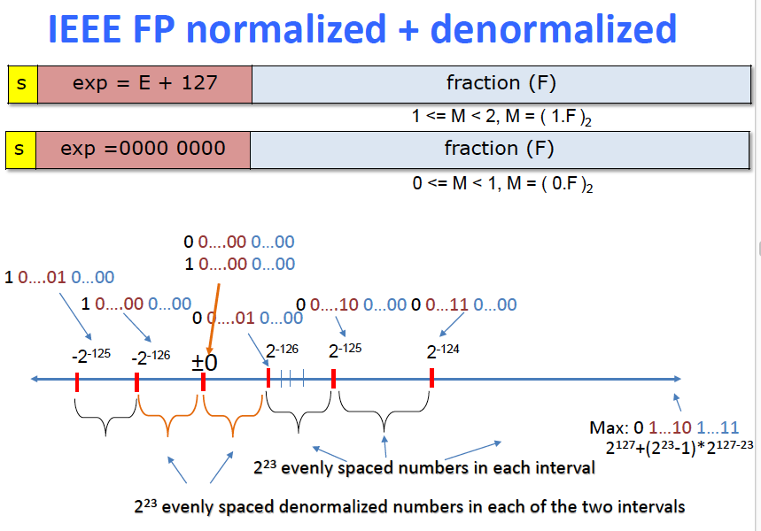
Review IEEE FP

Slide 18
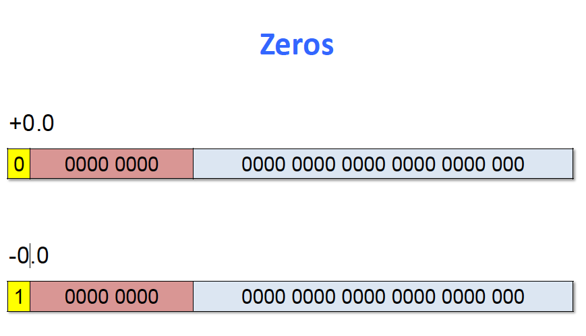
Review IEEE FP

Slide 19
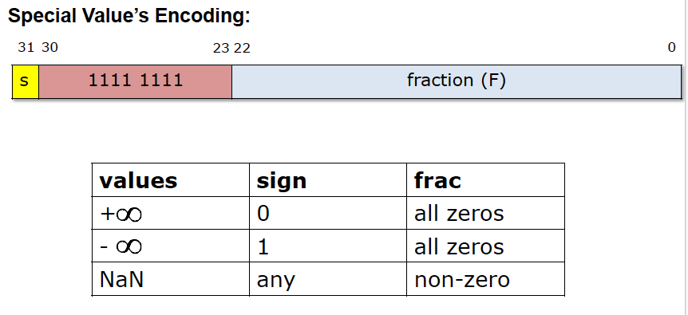
Review IEEE FP

Slide 20
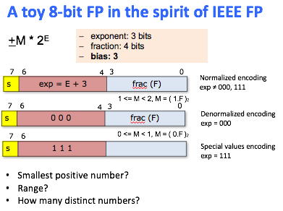
Breakout exercise
Smallest positive number?
Denormalized encoding
0 000 0001
E=1-bias = 1-3 = -2
M=(0.F)₂=(0.0001)₂ = 2⁻⁴
FP= M*2E = 2⁻⁴ * 2⁻² = 2⁻⁶
Range? (largest number)
Normalized encoding
0 110 1111
E=exp-bias = (110)₂-3 = 6-3 =3
M=(1.F)₂=(1.1111)₂ = 2-2⁻⁴ (=2⁰+2⁻¹+2⁻²+2⁻³+2⁻⁴)
FP= M*2E = (2-2⁻⁴)*2³=2⁴-2⁻¹=15.5
Range: [-15.5, 15.5] / [-(2-2⁻⁴)*2³, (2-2⁻⁴)*2³]

Slide 21
Breakout exercise
How many distinct numbers?
Don’t count the special values
Method 1:
Total bit-patterns: 2⁸
Special values:
X 111 XXXX
2*2⁴ =2⁵
0: 2 bit patterns
# distinct numbers = 2⁸ – 2⁵ -1
Method-2:
Normalized: 2 * (2³-2) * 2⁴
Denormalized: 2 * 1* 2⁴ -1
2⁸-2⁶+2⁵-1 = 2⁸-2⁵(2-1)-1 = 2⁸-2⁵-1

Slide 22
Getting started with GDB
How to use it and why you should

Slide 23
What is debugging?
Just because your code compiles doesn’t mean it does what you want
It could loop forever, crash, or otherwise just not work correctly
Writing tests helps you find out that your code doesn’t work correctly, but you might need more help figuring out why your code doesn’t correctly
A debugger can help you by providing a number of helpful tools
In this class we will use gdb, the GNU debugger

Slide 24
What is debugging?
GDB lets you
Run your program
Stop your program at a certain point
Print out the values of certain variables at that point
Examine what your program is doing
Change things within your program to see if it helps

Slide 25
How do you use GDB?
Add the -g flag when you compile with gcc
This flag tells gcc to include debugging information that gdb can use
gcc -g main.c -o myprogram
Run your program with gdb
Run gdb ./myprogram
You will then be given an interactive shell where you can issue commands to gdb
Run your program, look at variables, etc., using the commands
To exit the program just type quit (or just q)

Slide 26
Some common gdb commands
help
Gdb provides online documentation. Just typing help will give you a list of topics. Or just type help command and get information about any other command.
Short Name | Long Name | What do it do?
r | run | Begins executing the program – you can specify arguments after the word run
s | step | Execute the current source line and stop before the next source line, going inside functions and running their code too
n | next | Continue until the next source line, counting called functions as a single line
p | print | Prints the value of an expression or variable
l | list | Prints out source code
q | quit | Exit gdb
step through the program one line at a time

Slide 27
Some more advanced gdb commands
Set the breakpoint at the beginning of the function
Short Name | Long Name | What do it do?
b | break | Sets a breakpoint at a specified location (either a function name or line number)
c | continue | Continues executing after being stopped by a breakpoint
bt | backtrace | Prints out information on the call stack, i.e. where in the program's execution it is being stopped at
f | frame | Prints information on the current frame / allows you to change frames
i | info | Prints out helpful information (e.g. info args and info locals)

Slide 28
Debugging an infinite loop
Set a breakpoint inside the loop
Or just run it and hit control-c (signal)
list the code
This is so you can see the loop condition
step over the code
Check the values involved in the loop condition
Are they changing the right way? Are the variables changing at all?

Slide 29
Debugging a crash
run your program
Use bt to see the call stack
You can also use where to see where you were last running
Use frame to go to where your code was last running
Use list to see the code that ran
Check the locals and args to see if they are bad

