Slide 1
Memory hierarchy: caching
Jinyang Li
Based on Patterson and Hennessy’s slides

Slide 2
What we’ve learnt so far
Single cycle RISC-V CPU design
5 stage pipelined RISC-V CPU
Pipelining challenges: hazards
Must stall (bubble) to ensure correctness
3 types of hazards:
Structure (To mitigate, add resources)
Data (To mitigate, do forwarding/bypassing)
Control (Predict/speculate)

Slide 3
Today’s lesson plan
Memory hierarchy
Caching
Performance
Design

Slide 4
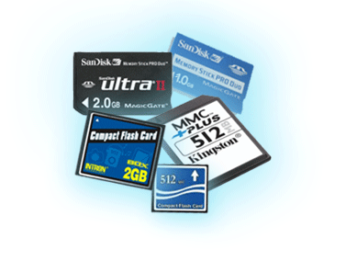

Programmers want fast and unlimited memory, but…
Processor
Flip-flop
< 0.5ns
fastest
smallest
Memory
SRAM
Integrated on chip
0.5-2.5ns
$500-$1000/GB
Memory
DRAM
50-70ns
$7-$15/GB
speed
size
Memory
Flash
5-50𝜇s
$0.75-$1/GB
Memory
Magnetic
disk
slowest
$0.05-$0.1/GB
5-20ms
biggest

Slide 5

DRAM Technology
Data stored as a charge in a capacitor
Single transistor used to access the charge
Must periodically be refreshed
Read contents and write back
Double data rate (DDR) DRAM
Transfer on rising and falling clock edges
2666 *10⁶ transfers/sec
8 bytes per transfer

Slide 6
Flash Storage
Nonvolatile semiconductor storage
Compared to DRAM
100x – 1000x slower
Compared to magnetic disk
100× – 1000× faster than magnetic disk
Smaller, lower power, more robust
Flash bits wears out after 1000’s of accesses
Wear leveling: remap data to less used blocks

Slide 7
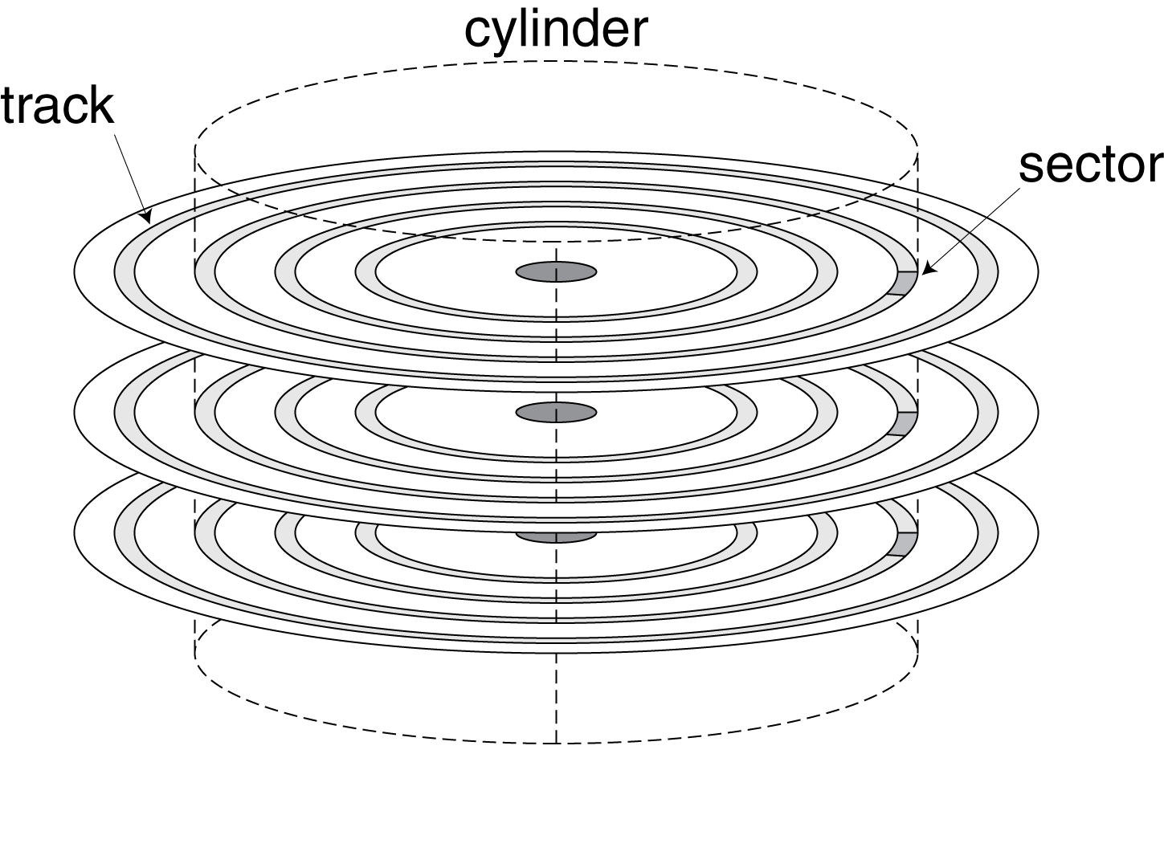
Magnetic disk
Nonvolatile, rotating magnetic storage
Data is stored in sectors
512 bytes in size
Data access time includes:
Seek time: move the heads to the right track
Typically, 4-5ms
Rotational time: wait till head is over the right sector
= ½ /rotation frequency, e.g. ½/(15000/60)=2ms
Data transfer time
E.g. 512B/ 100MB/s = 0.005ms
e.g. Transfer 512Bytes

Slide 8
How to give programmers the illusion of fast and vast memory? Caching!
Copy recently accessed (and nearby) items from disk to smaller DRAM memory
Copy more recently accessed (and nearby) items from DRAM to smaller SRAM memory
Referred to as
main memory
Referred to as
cache memory (integrated on CPU chip)
Done at the granularity
of a block or line
This lecture: focus on cache memory only

Slide 9
Why caching works? Principle of locality
Programs access a small proportion of their address space at any time
Temporal locality
Items accessed recently are likely to be accessed again soon
e.g., instructions in a loop, induction variables
Spatial locality
Items near those accessed recently are likely to be accessed soon
E.g., sequential instruction access, array data

Slide 10
Direct Mapped Cache
Direct mapped: each mem block can only be cached at one location
(Block address) modulo (#Blocks in cache)
11111111
11111110
Block address
Byte offset within a block
…
11111000
Memory Addr:
1 | 1 | 1 | 1 | 0 | 1 | 1 | 1
11110111
111
110
…
101
100
(11000)₂ % 8 = (000)₂
011
00001000
(01000)₂ % 8 = (000)₂
010
00000111
001
…
00000001
(00000)₂ % 8 = (000)₂
000
8-byte data
00000000
Suppose cache has 8 blocks
#Blocks =TotalMem/BlockSize =2⁸/2³

Slide 11
Direct Mapped Cache
Direct mapped: each mem block can only be cached at one location
(Block address) modulo (#Blocks in cache)
11111111
Block address
Byte offset within a block
11111110
…
11111000
Memory Addr:
1 | 1 | 1 | 1 | 0 | 1 | 1 | 1
111
11110111
110
…
101
100
Use lower-order x-bits of block address
to index into the cache with 2^{x} blocks.
011
00001000
010
00000111
001
…
00000001
000
8-byte data
00000000
#Blocks =TotalMem/BlockSize =2⁸/2³
Suppose cache has 8 blocks or 8 “lines”

Slide 12
Tags and Valid Bits
How to track which mem block is stored in a cache location?
Store tag
What if there is no data in a location?
Store a valid-bit
Valid?
Tag
Data
111
110
1
10
101
Block address
Byte offset
100
011
Memory Addr:
1 | 1 | 1 | 1 | 0 | 1 | 1 | 1
010
001
Tag
Cache index
000
8-byte data
Suppose cache has 8 blocks or 8 “lines”

Slide 13
Cache Example
8-blocks, 8-bytes/block, direct mapped
Initial state
Valid?
Tag
Data
111
110
101
100
011
010
001
000
N
N
N
N
N
N
N
N

Slide 14
Cache Example
Memory addr accessed: 10110xxx
Valid?
Tag
Data
111
110
101
100
011
010
001
000
N
N
N
N
N
N
N
N

Slide 15
Cache Example
Memory addr accessed: 11010xxx
Valid?
Tag
Data
111
110
101
100
011
010
001
000
N
Y | 10 | 8-bytes starting at mem[10110]
N
N
N
N
N
N

Slide 16
Cache Example
Memory addr accessed: 10110xxx
Valid?
Tag
Data
111
110
101
100
011
010
001
000
N
Y | 10 | 8-bytes starting at mem[10110]
N
N
N
Y | 11 | 8-bytes starting at mem[11010]
N
N

Slide 17
Cache Example
Memory addr accessed: 00010xxx
Valid?
Tag
Data
111
110
101
100
011
010
001
000
N
Y | 10 | 8-bytes starting at mem[10110]
N
N
N
Y | 11 | 8-bytes starting at mem[11010]
N
N

Slide 18
Cache Example
Valid?
Tag
Data
111
110
101
100
011
010
001
000
N
Y | 10 | 8-bytes starting at mem[10110]
N
N
N
Y | 00 | 8-bytes starting at mem[00010]
N
N

Slide 19
Another example: Larger Block Size
64-bit memory address
64 cache blocks, 16 bytes/block
63
10
9
4
3
0
Tag
Index
Offset
??
??
??
22 bits
6 bits
4 bits

Slide 20
Block Size Considerations
Larger blocks should reduce miss rate
Due to spatial locality
But in a fixed-sized cache
Larger blocks ⇒ fewer of them
More competition ⇒ increased miss rate
Larger blocks ⇒ pollution
Larger miss penalty
Can override benefit of reduced miss rate

Slide 21
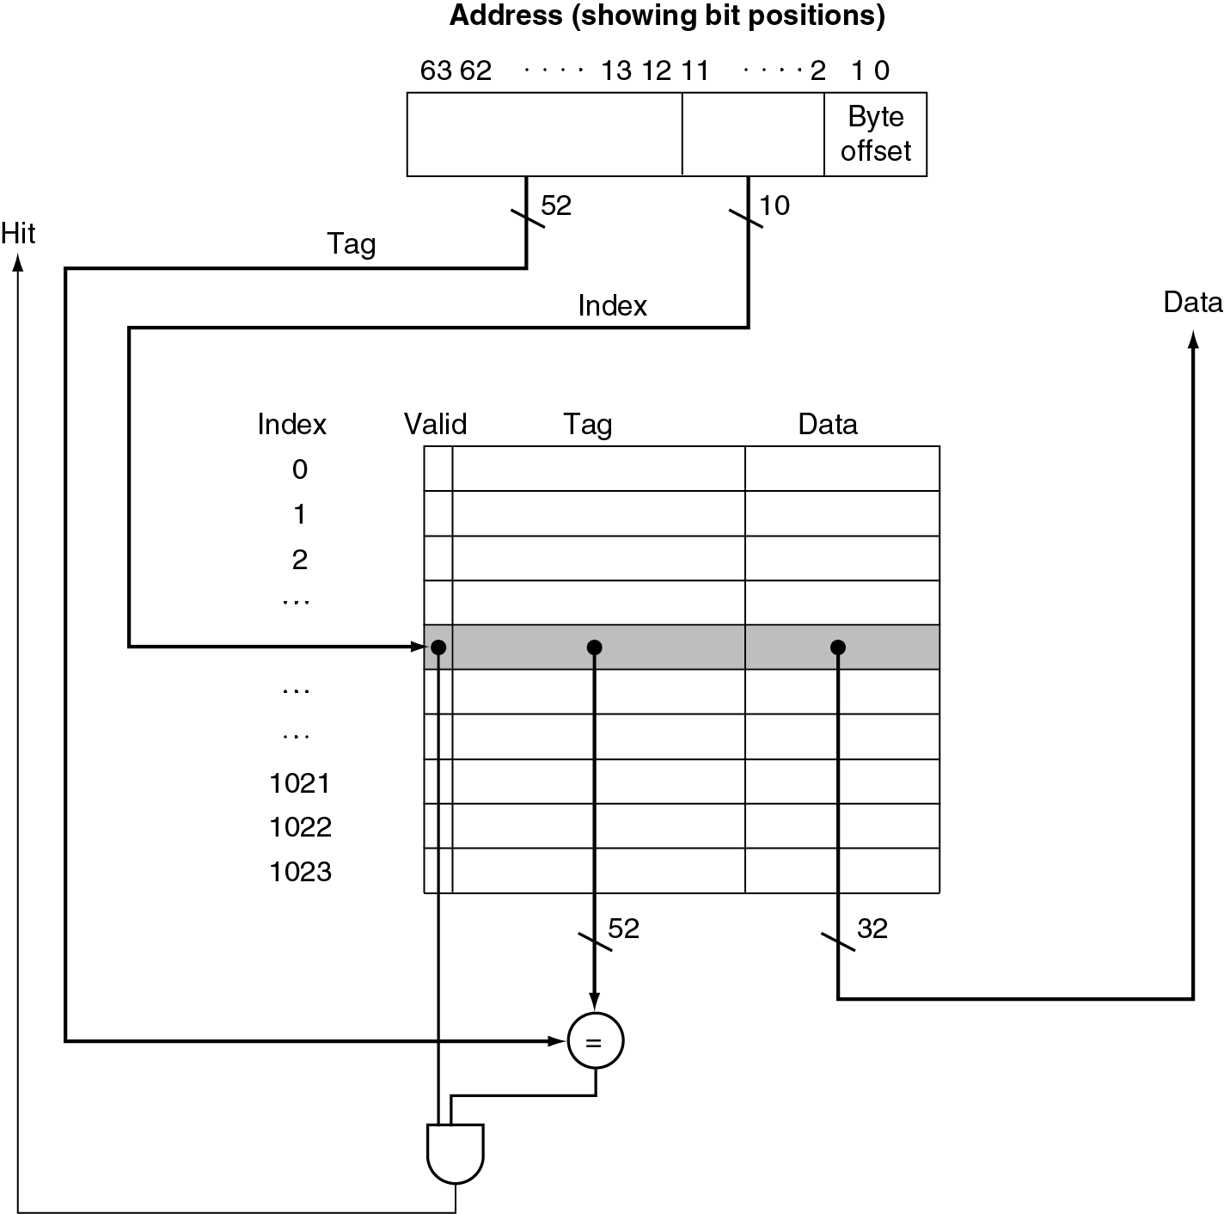
Hardware of direct mapped cache

Slide 22
Cache Misses
On cache hit, CPU proceeds normally
On cache miss
Stall the CPU pipeline
Fetch block from next level of hierarchy
Instruction cache miss
Restart instruction fetch
Data cache miss
Complete data access
Very expensive: usually 20~100 cycles

Slide 23
Write-Through vs write-back
Write-through: On write hit, update memory upon write
Write-back: On write hit, update cache only
Keep track of whether a block in cache is dirty
When a dirty block is replaced, write it back to memory

Slide 24
Measuring Cache Performance

Slide 25
Cache Performance Example
Given
I-cache miss rate = 2%
D-cache miss rate = 4%
Miss penalty = 100 cycles
Base CPI (ideal cache) = 2
Load & stores are 36% of instructions
Miss cycles per instruction
I-cache: 0.02 × 100 = 2
D-cache: 0.36 × 0.04 × 100 = 1.44
Actual CPI = 2 + 2 + 1.44 = 5.44
Ideal CPU is 5.44/2 =2.72 times faster

Slide 26
Average Access Time
Hit time is also important for performance
Average memory access time (AMAT)
AMAT = Hit time + Miss rate × Miss penalty
Example
CPU with 1ns clock, hit time = 1 cycle, miss penalty = 20 cycles, I-cache miss rate = 5%
AMAT = 1 + 0.05 × 20 = 2ns
2 cycles per instruction

Slide 27
Reducing cache miss: Associative Cache
Fully associative
Allow a given block to go in any cache entry
Require all entries to be searched at once
Need a comparator per cache entry (expensive)
n-way set associative
Divide cache into sets each of which contains n entries
Block number determines which set
(Block number) modulo (#Sets in cache)
Fully-associative within the set: search n entries of a set at once
n comparators (less expensive)

Slide 28
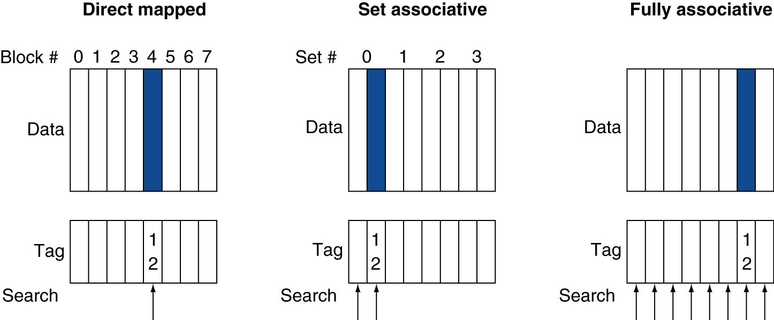
Associative Cache Example
Cache locations of a memory block with block address 12

Slide 29
Associativity Example
Block access sequence: 0, 8, 0, 6, 8
Direct mapped
Block address | Cache index | Hit/miss | Cache content after access
 |  |  | 0 | 1 | 2 | 3
0 | 0 | miss | Mem[0]
8 | 0 | miss | Mem[8]
0 | 0 | miss | Mem[0]
6 | 2 | miss | Mem[0] |  | Mem[6]
8 | 0 | miss | Mem[8] |  | Mem[6]
2-way set associative
Block address | Cache index | Hit/miss | Cache content after access
 |  |  | Set 0 |  | Set 1
0 | 0 | miss | Mem[0]
8 | 0 | miss | Mem[0] | Mem[8]
0 | 0 | hit | Mem[0] | Mem[8]
6 | 0 | miss | Mem[0] | Mem[6]
8 | 0 | miss | Mem[8] | Mem[6]

Slide 30
How Much Associativity
Increased associativity decreases miss rate
But with diminishing returns
Simulation of a system with 64KB D-cache, 16-word blocks, SPEC2000 benchmark
1-way: 10.3%
2-way: 8.6%
4-way: 8.3%
8-way: 8.1%

Slide 31
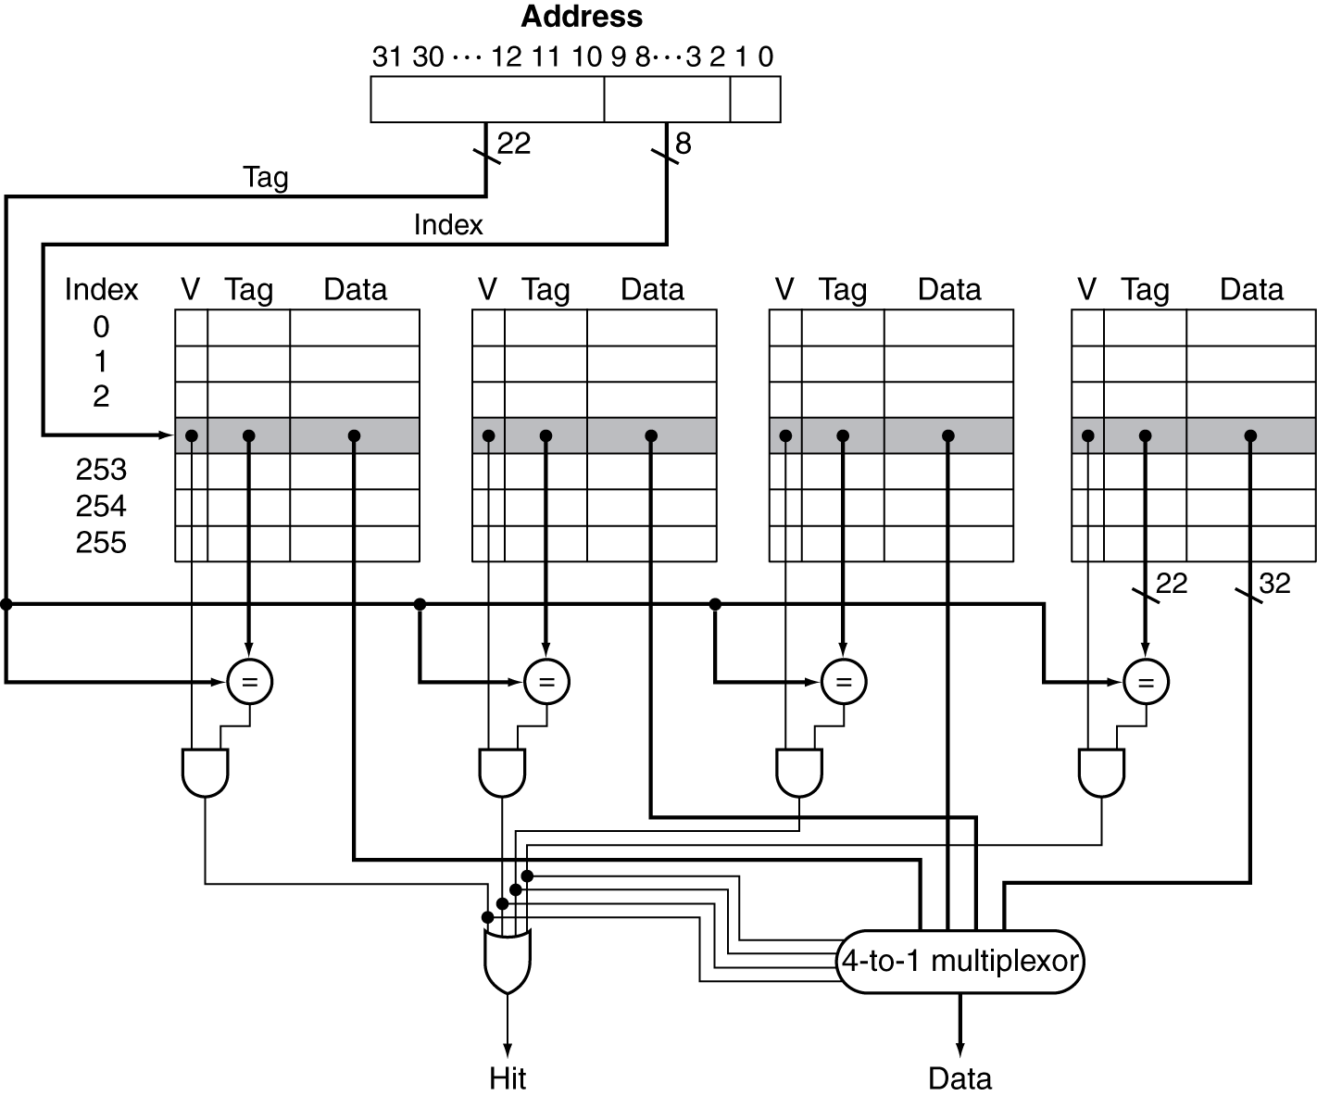
4-way set Associative Cache Organization

Slide 32
Replacement Policy
Direct mapped: no choice
Set associative
Prefer non-valid entry, if there is one
Otherwise, choose among entries in the set
Least-recently used (LRU)
Choose the one unused for the longest time
Hardware implementation: simple for 2-way, manageable for 4-way, too hard beyond that

Slide 33
Multilevel Caches
Primary cache attached to CPU
Small, but fast
Level-2 cache services misses from primary cache
Larger, slower, but still faster than main memory
Main memory services L-2 cache misses
High-end systems include L-3 cache

Slide 34
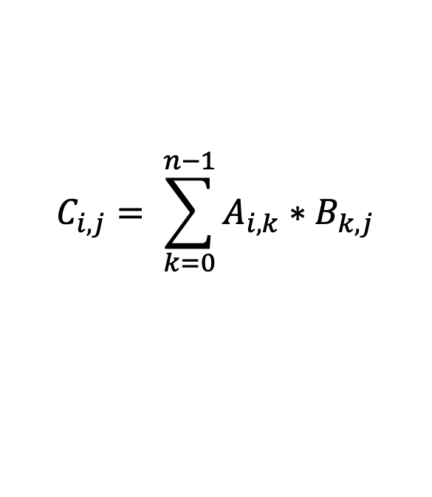
Software Optimization via Blocking
Goal: maximize accesses to data before it is replaced
Example: Naïve matrix multiplication (DGEMM)
$$C_{i,j}= \sum_{k=0}^{n−1}{A_{i,k}∗B_{k,j}}$$
for (int i = 0; i < n; i++) {
for (int j = 0; j < n; j++) {
double cij = 0;
for( int k = 0; k < n; k++ )
cij += A[i+k*n] * B[k+j*n];
C[i+j*n] = cij;
}
}

Slide 35


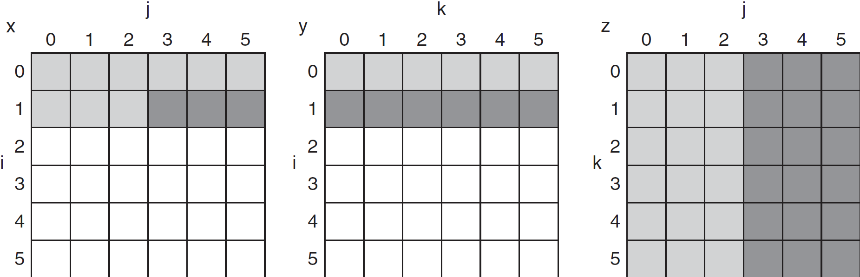
DGEMM access pattern
older accesses
Cache hit?
Cache hit?
new accesses
C
A
B

Slide 36
Blocked DGEMM
#define BLOCKSIZE 32
void do_block (int n, int si, int sj, int sk, double *A, double*B, double *C)
{
for (int i = si; i < si+BLOCKSIZE; ++i)
for (int j = sj; j < sj+BLOCKSIZE; ++j)
{
double s = 0;
for( int k = sk; k < sk+BLOCKSIZE; k++ )
s += A[i+k*n] * B[k+j*n];
C[i+j*n] += s; //accumulate s to C[i][j] */
}
}
void dgemm (int n, double* A, double* B, double* C)
{
for ( int sj = 0; sj < n; sj += BLOCKSIZE )
for ( int si = 0; si < n; si += BLOCKSIZE )
for ( int sk = 0; sk < n; sk += BLOCKSIZE )
do_block(n, si, sj, sk, A, B, C);
}

Slide 37
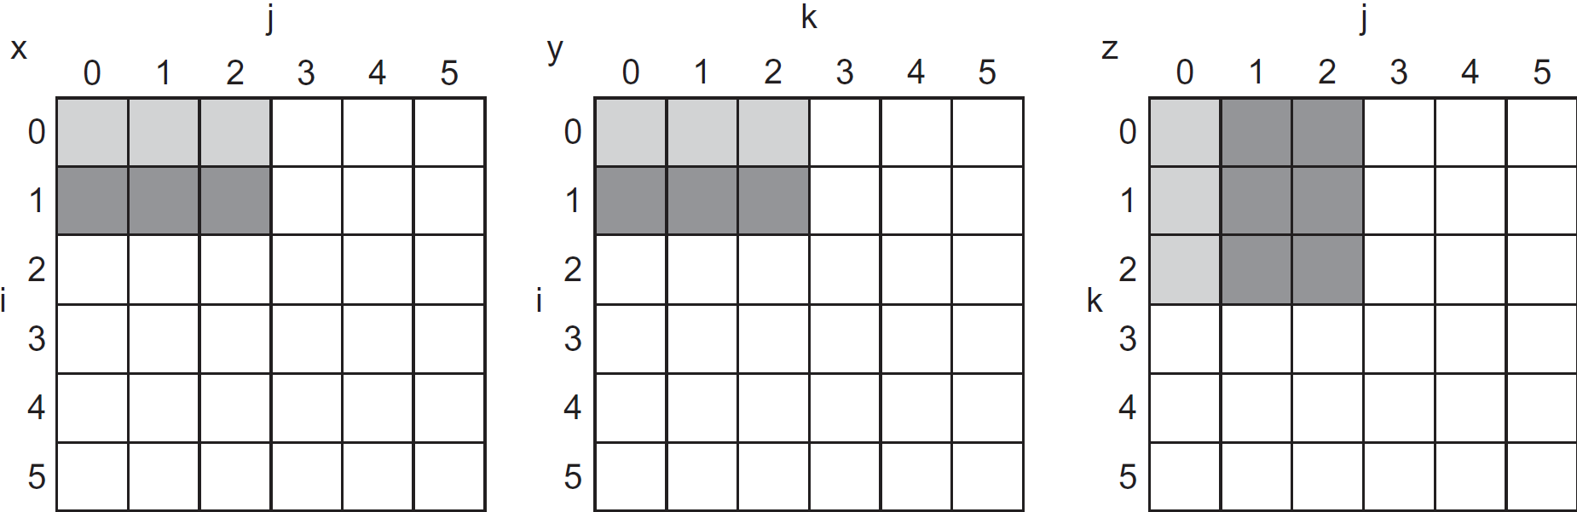
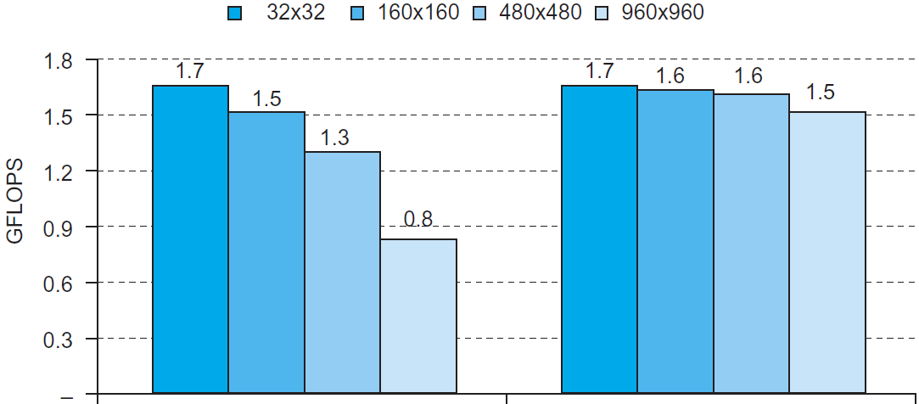
Blocked DGEMM Access Pattern
C
A
B
Unoptimized
Blocked

Slide 38
Summary
Memory hierarchy
Caching works due to principles of locality
Direct mapped vs. set-associate cache
Software optimization via blocking

