Slide 1
CSO-Recitation 13 CSCI-UA 0201-007
R13: Assessment 11 & Assessment 12 & Lab5 & FSM

Slide 2
Today’s Topics
Assessment 11
Assessment 12
Lab5
Sequential Logic, FSM

Slide 3
Before we start…
Lab5 due is postponed to Dec 14
Lab6 is changed to be optional..
If completed, it gives you an extra 5% of your total grade
A final-assessment on the final week
5% of your total grade
just another assessment, not a final exam thing, don’t worry~

Slide 4
Assessment 11

Slide 5
Q1 Explicit list
Which of the following statements are true about explicit list?
The explicit list design explicitly chains together all chunks of the heap into a linked list.
The explicit list design explicitly only chains together all free chunks of the heap into a linked list.
The explicit list design incurs more memory overhead than the implicit list design because it uses extra space in the header to store the next/prev fields.
malloc(...) in the explicit list design is faster than that of implicit list because it does not need to scan over allocated chunks.
free(...) in the explicit list design is faster than that of implicit list because it does not need to scan over allocated chunks.
Only store next/prev pointers in free chunks

Slide 6
Q2 Buddy system
A special case of segregated list:
each freelist has identically-sized blocks
block sizes are power of 2
allocate:
Recursive split in half
free:
Recursively merge
Which of the following statements are true about the buddy system?
All chunks have sizes that are powers-of-2.
During free(...), coalescing only happens once by merging the freed chunk with its buddy of the same size if the buddy is free.
During free(...), coalescing is done recursively by repeatedly merging the freed chunk with its buddy of the same size and repeating the merge process for the resulting larger free chunk until its buddy is no longer free.
The design maintains multiple free lists each of which contains free chunks of the same (powers-of-2) size.
The design maintains a single free list containing all free chunks.

Slide 7
Q3 Lab4 implicit list
This series of questions assume the implicit list design of Lab4. Chunks have headers but not footers. The header is of size 16-bytes, expressed in the following C type
```
typedef struct {
size_t size; //8-byte size of the chunk including header
size_t allocated; // 8-byte allocation status. 0 means free, non-zero means allocated
} header_t;
```

Slide 8
Q3.1 Heap consistency invariants
Which of the following must always be true (aka invariants) if the heap is correct and not corrupted?
The sizes of all chunks--as found by traversing the entire heap--must add up to mem_heapsize().
There are no consecutive free chunks in the heap, if the implementation merges a freed chunk with its next free chunk.
The address of the last byte of the last chunk--as found by traversing the entire heap--must be equal to mem_heap_hi().
The size of every chunk must be multiples of 16.
The number of chunks found in the heap must be equal to the number of mm_malloc requests handled by the heap.
possible, no merge with prev here

Slide 9
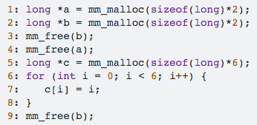
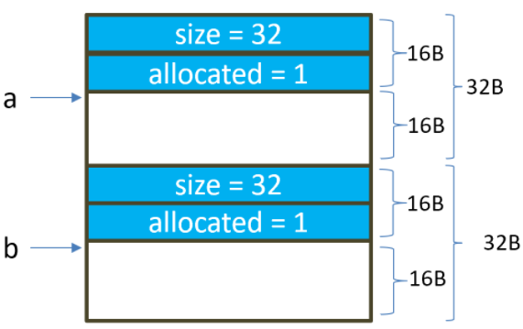
Q3.2 Consequences of double free
Assuming you have a fixed-size heap of 64 bytes. Furthermore, suppose the heap looks like the following after executing the first 2 lines of user code.
which of the following statement is true?
After executing line 4, the heap contains two free chunks of size 32 bytes each.
After executing line 4, the heap contains one free chunk of size 64B.
After executing line 5, variable c has the same value as a.
After executing line 5, variable c is NULL.
should do merge when free

Slide 10
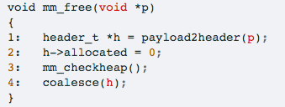
Q3.3 Consequences of double free, continued
Continuing from Q3.2, what happens during the execution of line 9 (user doubling free b)?
Assume that your implementation of `mm_free looks like follows:
mm_free returns immediately because it can notice that b has already been freed before.
Line 2 of mm_free would set c2 to zero.
Line 2 of mm_free would set c3 to zero.
Line 2 of mm_free would set c4 to zero.
mm_checkheap would fail because its heap traversal would find two chunks, one of whose size is not a multiple of 16.
mm_checkheap would fail because its heap traversal would find two chunks, the sum of whose sizes does not add up to mem_heapsize()
mm_checkheap would not fail because its heap traversal would find only one chunk, whose size is 64 and whose status is allocated.

Slide 11

Q3.4 Consequences of overflow on the heap
This question assumes the following sequence of user code
Assume the state of the heap after executing line 1 and 2 is the same as the picture in Q3.2. What of the following statements are true after finishing executing the loop (line 3-5)?
There will be a segmentation fault because the loop writes a2 and a3, both of which lies beyond the allocated space of 16 bytes.
The header of the chunk for the payload pointed to by b is overwritten by the loop.
The header of the chunk for the payload pointed to by b has size 2.
The header of the chunk for the payload pointed to by b has size 3.
If one invokes mm_checkheap() after finishing the loop, one would likely find that the heap is inconsistent (assuming uninitialized memory contains random values)
allocated status=3

Slide 12

Q4 Boolean expression equality
Which of the following Boolean expression equality holds?
A+1=1
A+(B⋅C)=(A⋅B)+(A⋅C)
A+A=A
A+A=1
A⋅A=A
A⋅A=0
$\overline{A+B}$​=$\overline{A}$⋅$\overline{B}$
$\overline{A+B}$​=$\overline{A}+\overline{B}$
$\overline{A∙B}$​=$\overline{A}+\overline{B}$
$\overline{A∙B}$​=$\overline{A}$⋅$\overline{B}$
A+(B⋅C)=(A+B)⋅(A+C)

Slide 13
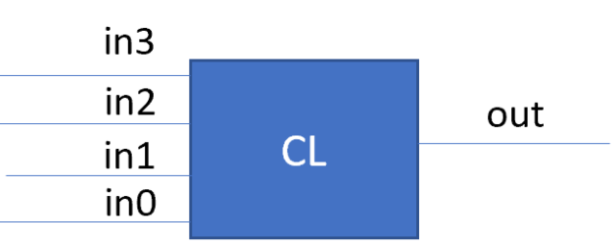
Q5 Combinatorial circuit
Suppose you are asked to build a combinatorial circuit to determine if an unsigned 4-bit integer is some multiple of 3. Note that 0 is considered to be a multiple of 3.
In the above picture, the output signal out is 1 if and only if the 4-bit unsigned integer represented by in3, in2, in1, in0 (in0 is the least significant bit) is some multiples of 3.
Q5.1 Truth table
What is the size of the truth table in terms of the number of rows needed to express the is-multiples-of-3 combinatorial circuit? To facilitate autograding, write your answer as a decimal number.
16
#row of truth table:
have 4 input signals, each represents 1 bit
how many bit patterns?
2^4 = 16

Slide 14
Q5.2 From Truth Table to CL
If you are to implement the is-multiples-of-3 combinatorial circuit as a sum (OR) of products (AND), how many AND gates do you need to use?
6
unsigned integer: 0~15
is multiple of 3: 0, 3, 6, 9, 12, 15
6 AND gates

Slide 15
Assessment 12

Slide 16

Q1 Boolean laws
Which of the following Boolean laws hold? Below, A, B, C could refer to either a Boolean variable or a Boolean expression
R1: A+0=A
R2: A+0=0
R3: A+1=1
R4: A+1=A
R5: A⋅(B+C)=A⋅B + A⋅C
R6: A + $\overline{A}$=1
R7: A ⋅ $\overline{A}$= 0
Basic law:
A ⋅0 =0, A ⋅1=A
A+0=A, A+1=1
Distribution law
Inverse law

Slide 17

Q2 Simplify boolean expression
Simplify boolean expression (A+B) ⋅($\overline{A}$+ $\overline{B}$).
You may write `*` for ⋅, and write `barA` for $\overline{A}$ (or `barB` or $\overline{B}$)
(A+B)*(barA+barB)
=(A+B)*barA + (A+B)*barB
=barA*a + barA*B + barB*A + barB*B
=0+barA*B+barB*A+0
=barA*B+barB*A
Distribution law
Distribution law
Inverse law
Basic law

Slide 18
Q3 Simplify boolean expression
When simplifying the Boolean expression in Q2, which of the Boolean laws in shown Q1 are needed?
R1
R2
R3
R4
R5
R6
R7

Slide 19
Q4 Boolean circuit
If you are to use a single logic gate to implement the simplified expression in Q2. Which gate should you use?
AND
OR
NOR
NAND
XOR
None of the above
NAND(A,B) = bar(A*B) = barA+barB
XOR(A,B) = A*barB + B*barA

Slide 20
Q5 Gate delay
What can be said about the gate delay (aka the number of gates along the longest path through a piece of logic) of an arbitrary combinatorial circuit built using sum of product representation? (Note: please ignore inverters when counting gate delays)
≤2
≥2
could be any delay
How to build a combinatorial circuit?
truth table
sum of product
Gate delay?
“sum of product” – OR all ANDs
if no OR, no AND:
gate delay=0
if no OR:
gate delay=1
otherwise: gate delay=2

Slide 21
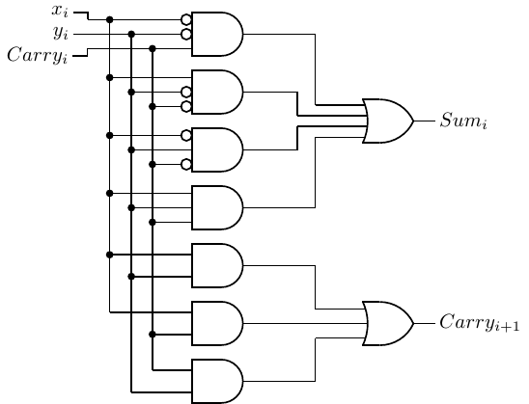
Gate delay
1-bit adder:

Slide 22
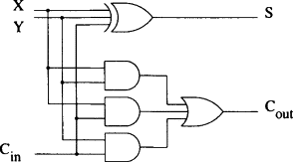
Gate delay
1-bit adder:

Slide 23
Ripple carry
If a 1-bit adder's gate delay is 2, then what is the gate delay of a 32-bit ripple carry?
To facilitate autograding, please write your answer as a single decimal number.
64
ripple carry:
compute carry-bit one by one -> huge delay
gate delay = gate_delay(1-bit adder) * #bits
= 2* 32 =64

Slide 24
Q7 Clocks
Which of the following statements about the role of clocks in a digital system are correct?
Clocks are needed for state elements.
Clocks are needed for combinatorial logic.
Clocks help determine when a state element is updated to a new value.
Clocks always run at 1GHz in all digital logic.
The longer the gate delay of the combinatorial circuit, the faster the clock can be used in the corresponding sequential logic.
The longer the gate delay of the combinatorial circuit, the slower the clock can be used in the corresponding sequential logic.
The gate delay of the combinatorial circuit has no effect on the corresponding sequential logic.
clock frequency = 1/ clock_period
delay of CL must be less than one clock cycle

Slide 25
Q8 3 lights
In the lecture example on "electronic eyes" (see slide 25 of https://nyu-cso.github.io/notes/arch-seq.pdf). The desired pattern of lights (left, middle, right light) to be lit up is: left, middle, right, middle, left, middle, right ...
What is the minimum number of distinct state values needed for a FSM to implement this electronic eyes device?
To facilitate autograding, please write your answer as a single decimal number.
4
M->
L
R
<-M

Slide 26
Q9 3 lights, modified
For the same lecture example on "electronic eyes", if the desired pattern of lights to be lit up is: left, middle, right, left, middle, right..., what is the minimum number of distinct state values needed for a FSM to implement this electronic eye device?
3
L
M
R

Slide 27
Q10 3 lights, modified again
For the same lecture example on "electronic eyes", if the desired pattern of lights to be lit up is: left, middle, middle, right, middle, middle, left, middle, middle, right, middle, middle..., what is the minimum number of distinct state values needed for a FSM to implement this electronic eye device?
6
If I’m standing in L now:
my next -> M
If I’m standing in R:
my next -> M
If I’m standing in M:
my next can be [R, L], or
My next can be M:
my next can be [R, L]
4

Slide 28
Q10 3 lights, modified again
For the same lecture example on "electronic eyes", if the desired pattern of lights to be lit up is: left, middle, middle, right, middle, middle, left, middle, middle, right, middle, middle..., what is the minimum number of distinct state values needed for a FSM to implement this electronic eye device?
6
M->
M->M->R
L
MM
R
L
<-M
M->
R
M->M->L
<-M

Slide 29
Lab5
using Logisim Evolution

Slide 30
Setup
Clone the Lab 5 repository – new link (campuswire)
cd lab5new-<YourGithubUsername>
wget https://nyu-cso.github.io/labs/logisim-evolution-2.15.jar
download the Java runtime environment:
sudo apt-get install default-jre
Launch Logisim by typing (in your lab5new repo):
java -jar logisim-evolution-2.15.jar
Save frequently when you work~

Slide 31
Part 2 exercise FSM
There are 4 states
what you write on the arrow edge is “transition condition”
0/1: bit before the backslash represents input, after the backlash is the output.
it represents that at what condition we need to transit from which state to which state..

Slide 32
Sequential logic
Building Blocks

Slide 33
Sequential Logic
There is memory
Outputs depend on prior state as well as the current inputs
State can be stored and used later
We rely on clock signals
Clock signals tell us when things should happen
We should only write to state when the clock is set a certain way

Slide 34
SR Latch
Constructed from two NOR gates
You can either Set the latch (make it remember 1), or Reset it (make it remember 0)
Two inputs: S and R
Two outputs: Q and NOT Q
Q is what it remembers, NOT Q is the opposite
Both S and R cannot be 1 at the same time, or sadness occurs

Slide 35
D Latch
Constructed from some additional logic and an SR Latch
Two inputs: C and D
You can have the latch remember D as long as C is true
Two outputs: Q and NOT Q
Q is what the latch remembers, NOT Q is the inverse
Ensures that S and R inputs to the SR Latch aren’t both true

Slide 36
D Flip Flop
Constructed from some additional logic and two D latches
Same inputs and outputs as D latches
But, the output is only stored on a chosen clock edge

Slide 37
Finite State Machines

Slide 38
Finite State Machines
There are a number of states, inputs, and outputs
To the beat of the clock, we read in inputs and go to new states, and set the outputs
Both the output and the next state are defined by the current state and the inputs
You can think of it as following a flow chart “when I’m on this step, and this is true, I go here”

Slide 39
An FSM Example
The NYC Subway Turnstile
There is a lock controlled by the FSM
If the user didn’t pay yet then the lock is active and the user can’t push through
If the user pays the lock unlocks until they push through
Draw an FSM for this
Write out a truth table
Create the circuit

Slide 40
An FSM Example
pay
Lock
Unlock
push through
pay
push through
current state | input | next state
(lock / unlock) | (pay / push through)

