Slide 1
Floating point
Jinyang Li

Slide 2
Floating Point lesson plan
Binary Scientific notation
FP8 example
IEEE FP standard
Rounding
FP operations caveats

Slide 3
Previously…
Unsigned n-bit integers
-
2^{n-1}
-1
1
2^{n-1}-1
2^{n}-1
+
-2
0
2
-3
3
Signed n-bit integers
What about real numbers?

Slide 4
Represent real numbers: the decimal way
Real Number | Decimal Representation
11 / 2 | (5.5)₁₀
1 / 3 | (0.3333333...)₁₀
√2 | (1.4128…)₁₀
(1.4128...)₁₀ = 1 * 10⁰ + 4 * 10⁻¹ + 1 * 10⁻² + 2 * 10⁻³ + ...

Slide 5
Binary Representation
(5.5)₁₀
= 4 + 1 + 1/2
= 2² + 2⁰ + 2⁻¹
= (101.1)₂
2^{p}
2^{p-1}
2
1
.
1/2
1/4
1/2^{q}

Slide 6
Binary Representation
(0.1)₁₀ = 2⁻⁴ + 2⁻⁵ + 2⁻⁸ + 2⁻⁹ + 2⁻¹² + 2⁻¹³ + …
= (0.0001100110011...)₂
2^{p}
2^{p-1}
2
1
.
1/2
1/4
1/2^{q}

Slide 7
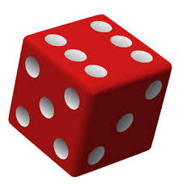
Binary representation
What’s the decimal value of (10.01)₂

Slide 8
Binary representation
What’s the decimal value of (10.01)₂
Answer: 2.25

Slide 9
Making the representation fixed width Strawman: fixed point
3 bits
4 bits
s
sign
Fixed position e.g. middle
Example: ( 10.011 )₂
0 | 0 | 1 | 0 | 0 | 1 | 1 | 0

Slide 10
Problems of Fixed Point
3 bits
4 bits
s
Range?
Precision?
-
+
0

Slide 11
Problems of Fixed Point
3 bits
4 bits
s
Limited range [-2³+2⁻⁴,2³-2⁻⁴ ]
Limited precision 2⁻⁴
Equivalent to integer with a scaling factor

Slide 12
Floating Point is based on scientific notation
Scientific notation in decimal:
365.25 = 3.6525 * 10²
0.0123 = 1.23 * 10⁻²
Normalize mantissa
+M * 10E, where 1 <= M < 10
E: exponent
M: mantissa

Slide 13
Floating Point: binary scientific notation
Binary scientific notation
+M * 2E, where 1 <= M < 2 (aka M = (1.b₁b₂b₃…b_{n} )₂
(5.5)₁₀ = (101.1)₂ = (1.011)₂ * 2²

Slide 14
(Binary) normalized representation of (10.25)₁₀?

Slide 15
(Binary) normalized representation of (10.25)₁₀ ?
Answer: (10.25)₁₀ = (1010.01)₂ = (1.01001)₂ * 2³

Slide 16
Floating Point (cont’d) lesson plan
Scientific notation
FP8 example
IEEE FP standard
Rounding
FP operations caveats

Slide 17
An example FP8 representation: E4M3
+M * 2E, where 1 <= M < 2 (aka M = (1.b₁b₂b₃)₂
Example: (5.5)₁₀ = (101.1)₂ = (1.011)₂ * 2²
exponent (E)
fraction(M)
s

Slide 18

An example FP8 representation: E4M3
+M * 2E, where 1 <= M < 2 (aka M = (1.b₁b₂b₃)₂
Example: (0.1875)₁₀ = (0.0011)₂ = (1.1)₂ * 2⁻³
exponent = E + bias, bias=${ 2}^{(e−1)}−1$= 7
exponent (E)
fraction (M)
s

Slide 19
FP8 (E4M3) on the number line
exponent (E)
fraction (M)
s
Larger the bit pattern, larger FP magnitude
2⁵
2⁶
2⁷
2⁸
0
0x7f
2⁻⁷
2⁻⁶
2⁻⁵
2⁻⁴
0

Slide 20
FP8 (E4M3): denormalized (subnormal) number
exponent (E)
fraction (M)
s | 0 | 0 | 0 | 0 | b₁ | b₂ | b₃
+M * 2^{1-bias}, where M = (0.b₁b₂b₃)₂
2⁵
2⁶
2⁷
2⁸
0
0x7f
2⁻⁶
2⁻⁵
2⁻⁴
0
What is encoding for (1.01)₂ x 2⁻⁷ ?

Slide 21

IEEE Floating Point Standard
Lots of FP implementations in 60s/70s
Code was not portable across processors
IEEE formed a committee (IEEE.754) to standardize FP format and specification.
IEEE FP standard published in 1985
Led by William Kahan
Prof. William Kahan
University of California at Berkeley
Turing Award (1989)

Slide 22
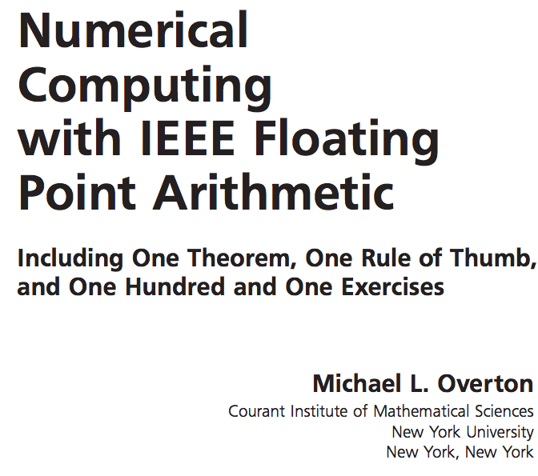

IEEE Floating Point Standard
This class only covers basic FP materials
A deep understanding of FP is crucial for numerical/scientific computing
More FP is covered in undergrad/grad classes on numerical methods

Slide 23
Goals of IEEE Standard
Consistent representation of floating point numbers
Address the limitation of our FP strawman
Correctly rounded floating point operations, using several rounding modes.
Consistent treatment of exceptional situations such as division by zero

Slide 24
IEEE FP32 normalized + denormalized
31
30
23
22
0
s | exp = E + 127 | fraction (F)
If (exp!=0 && exp!=255) n = (1.F)₂ * 2^{exp-127} (normalized)
0 | 1000 0010 | 0100 1000 0000 0000 0000 000
n = (1.01001)₂ * 2¹³⁰⁻¹²⁷
s | 0000 0000 | fraction (F)
If (exp == 0) n = (0.F)₂ * 2⁻¹²⁶ (denormalized)
0 | 0000 0000 | 0100 1000 0000 0000 0000 000
n = (0.01001)₂ * 2⁻¹²⁶

Slide 25
IEEE FP32: special values
Special Value’s Encoding:
31
30
23
22
0
s | 1111 1111 | fraction (F)
values | sign | frac
+ | 0 | all zeros
- | 1 | all zeros
NaN | any | non-zero

Slide 26
IEEE FP32: single vs. double precision
31
30
23
22
0
s | E + 127 | frac
float f = 0.1;
double d = 0.1;
single precision (32 bits)
63
62
52
51
0
s | E + 1023 | frac
double precision (64 bits)

Slide 27
single/ double precision
 | E_{min} | E_{max} | N_{min} | N_{max}
Float | -126 | 127 | 2⁻¹⁴⁹ | ≈ 2¹²⁸
Double | -1022 | 1023 | 2⁻¹⁰⁷⁴ | ≈ 2¹⁰²⁴

Slide 28
FP summary
Normalized binary representation of real numbers
IEEE FP
s | exp | fraction (F)
If exp!=0 && exp!=255, (1.F )*2^{exp-127}
If exp==0, (0.F )*2⁻¹²⁶
0 0….00 0…00
1 0….00 0…00
1 0….01 0…00
0 <= M < 1, M = ( 0.F )₂
1 0….00 0…00
0 0….10 0…00
0 0…11 0…00
0 0….01 0…00
-2⁻¹²⁵
-2⁻¹²⁶
±0
2⁻¹²⁶
2⁻¹²⁵
2⁻¹²⁴
Max: 0 1…10 1…11
2¹²⁷+(2²³-1)*2¹²⁷⁻²³
2²³ evenly spaced numbers in each interval
2²³ evenly spaced denormalized numbers in each of the two intervals

Slide 29
Floating Point lesson plan
Scientific notation
FP8 example
IEEE FP standard
Rounding
FP operations caveats

Slide 30
FP: Rounding
Values that are represented precisely
What if the result of computation is at ?
Rounding: Use the “closest” representable value x’ for x.
4 modes:
Round-down
Round-up
Round-toward-zero
Round-to-nearest (Round-to-even in text book)

Slide 31
Round up vs. round down
-0.875
-0.75
0.5
0.625
0
Round up rounds to the right
Round(x) = x₊ (x₊>= x)
Round down rounds to the left
Round(x) = x₋ (x₋<= x)

Slide 32
Round towards zero
-0.875
-0.75
0.5
0.625
0
Rounds to the right if x < 0
Round(x) = x₊ if x < 0
Rounds to the left if x >0
Round(x) = x₋ if x < 0

Slide 33
Round to nearest; ties to even
Round to the left if x₋ is nearer to x than x₊
-0.875
-0.75
0.5
0.625
0
Round to the right if x₊ is nearer to x than x₋
In case of a tie, the one with its least significant bit equal to zero is chosen.

Slide 34
How does CPU know if some 4-byte value should be interpreted as IEEE FP or integers?
CPU uses separate registers for floating point and ints.
CPU uses different instructions for floating points and int operations.

Slide 35
Floating Point (cont’d) lesson plan
Scientific notation
FP8 example
IEEE FP standard
Rounding
FP operations caveats

Slide 36
Floating point operations
FP Caveats:
Invalid operation: 0/0, sqrt(-1), ∞+∞
Divide by zero: x/0→∞
Overflows: result too big to fit
Underflows: 0 < result < smallest denormalized value
Inexact: round it!
FP addition: commutative but not always associative
FP multiplication: commutative but not always associative and distributive

Slide 37
Floating point operations
Addition, subtraction, multiplication, division etc.
FP Caveats:
Invalid operation: 0/0, sqrt(-1), ∞+∞
Divide by zero: x/0→∞
Overflows: result too big to fit
Underflows: 0 < result < smallest denormalized value
Inexact: round it!

Slide 38
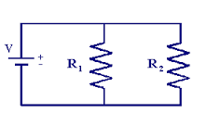

Why divide by zero = ∞?
Allow a calculation to continue and produce a valid result
Example:
If R1 or R2 is 0, overall resistance should be 0

Slide 39
Floating point addition
Commutative? x+y == y+x?
Associative? (x+y)+z = x + (y+z)?
Rounding:
(3.14+1e10)-1e10 = 0
3.14+(1e10-1e10) = 3.14
Overflow
Every number has an additive inverse?
Yes except for ∞ and NaN

Slide 40
Floating point multiplication
Commutative? x* y == y*x?
Associative? (x*y)*z = x * (y*z)?
Overflow:
(1e20*1e20)*1e-20= inf, 1e20*(1e20*1e-20)= 1e20
Rounding
(x+y)*z = x*z + y*z?
1e20*(1e20-1e20)= 0.0, 1e20*1e20 – 1e20*1e20 = NaN

Slide 41
Floating point in real world
Storing time in computer games as a FP?
Precision diminishes as time gets bigger
FP value (decimal) | Time value | FP precision | Time precision
1 | 1 sec | 1.19E-07 | 119 nanoseconds
100 | ~1.5 min | 7.63E-06 | 7.63 microseconds
10 000 | ~3 hours | 0.000977 | .976 milliseconds
1000 000 | ~11 days | 0.0625 | 62.5 milliseconds

Slide 42
Floating point in the real world
Use floating point for distance measures in computer games
FP value | Length | FP precision | Precision size
1 | 1 meter | 1.19E-07 | Virus
100 | 100 meter | 7.63E-06 | red blood cell
10 000 | 10 km | 0.000977 | toenail thickness
1000 000 | .16x earth radius | 0.0625 | credit card width
Table source: Random ASCII

Slide 43
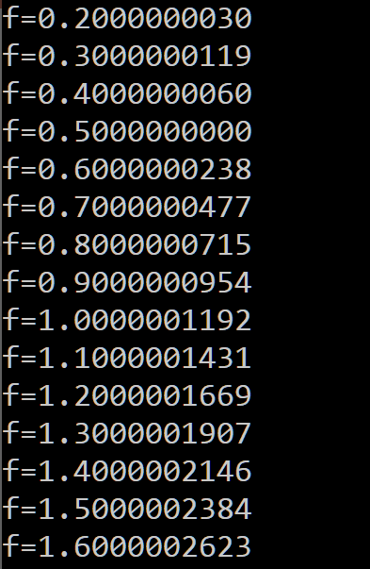
Floating point trouble
Comparing floats for equality is a bad idea!
float f = 0.1;
while (f != 1.0) {
f += 0.1;
}
Notes:
You can not represent 0.1 exactly in floating point

Slide 44
Floating point trouble
Never count using floating points
count = 0;
for (float f = 0.0; f < 1.0; f += 0.1) {
count++;
}
Notes:
You can not represent 0.1 exactly in floating point

Slide 45
You are not alone in thinking FP is hard
Many real world disasters are due to FP trickiness
Patriot Missile failed to intercept due to rounding error (1991)
Ariane 5 explosion due to overflow in converting from double to int (1996)

Slide 46
Floating point summary
FP format is based on binary scientific notation
IEEE FP format
Normalized, denormalized, special values
Floating points are tricky
Precision diminishes as magnitude grows
overflow, rounding error

