Slide 1
C - Basics, Bitwise Operator
Jinyang Li
Based on Tiger Wang’s slides

Slide 2
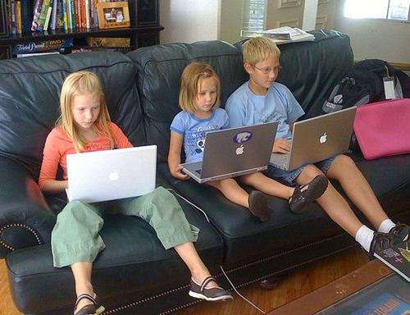
Python programmers

Slide 3
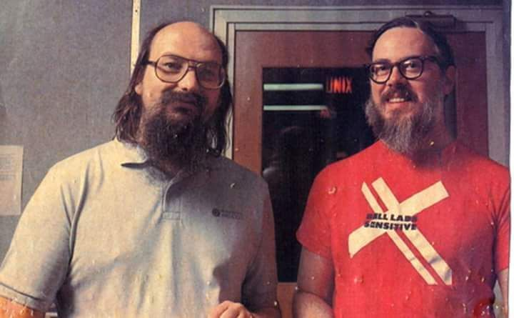
C programmers
Notes:
Ken Thompson
Dennis Richie

Slide 4
C is an old programming language
C | Java | Python
1972 | 1995 | 2000 (2.0)
Procedure | Object oriented | Procedure & object oriented
Compiled to machine code, runs on bare machine | Compiled to bytecode, runs by another piece of software | Scripting language, interpreted by software
static type | static type | dynamic type
Manual memory management | Automatic memory management with GC
Tiny standard library | Very Large library |  | Humongous library

Slide 5
Why learn C for CSO?
C is a systems language
Language for writing OS and low-level code
Systems written in C:
Linux, Windows kernel, MacOS kernel
MySQL, Postgres
Apache webserver, NGIX
Java virtual machine, Python interpreter
Why learning C for CSO?
simple, low-level, “close to the hardware”

Slide 6
“Hello World”
1 #include <stdio.h>
2
3 int main()
4 {
printf("hello, world\n");
return 0;
}

Slide 7
“Hello World”
1 #include <stdio.h>
2
3 int main()
4 {
printf("hello, world\n");
return 0;
}
Header file
Standard Library
gcc helloworld.c –o helloworld

Slide 8
Compiling
C Program Preprocessor
Source Codes [*.i]
Source Codes [*.c, *.h]
gcc –E *.c
gcc helloworld.c –o helloworld

Slide 9
Compiling
C Program Preprocessor
Source Codes [*.i]
C Program Compiler
Source Codes [*.c, *.h]
gcc –E *.c
gcc –S *.i
Assembly Codes [*.s]
gcc helloworld.c –o helloworld

Slide 10
Compiling
C Program Preprocessor
Source Codes [*.i]
C Program Compiler
Source Codes [*.c, *.h]
gcc –E *.c
gcc –S *.i
Assembly Codes [*.s]
gcc helloworld.c –o helloworld
gcc –c *.s
Binary
Codes [*.o]
Assembler

Slide 11
Compiling
C Program Preprocessor
Source Codes [*.i]
C Program Compiler
Source Codes [*.c, *.h]
gcc –E *.c
gcc –S *.i
Assembly Codes [*.s]
Executable file [a.out,
helloworld]
gcc helloworld.c –o helloworld
gcc *.o
gcc –c *.s
Linker
Binary
codes [*.o]
Assembler
Notes:
xxd -b hello

Slide 12
Three basic elements
Variables
Basic data objects manipulated in a program
Operator
What is to be done to them
Expressions
Combine the variables and constants to produce new values

Slide 13
Variables
Initial value
Declaration: int a = 1;
Type
Name

Slide 14
Variables
If uninitialized, variable can have any value
Declaration: int a;
Type
Name
Value assignment: a = 0;

Slide 15
Primitive Types
64 bits machine
type | size (bytes) | example
(unsigned) char | 1 | char c = ‘a’
(unsigned) short | 2 | short s = 12
(unsigned) int | 4 | int i = 1
(unsigned) long | 8 | long l = 1
float | 4 | float f = 1.0
double | 8 | double d = 1.0
pointer | 8 | int *x = &i
Old C has no native boolean type. A non-zero integer represents true, a zero integer represents false
C99 has “bool” type, but one needs to include <stdbool.h>

Slide 16
Implicit conversion
int main()
{
int a = -1;
unsigned int b = 1;
if (a < b) {
printf("%d is smaller than %d\n", a, b);
} else if (a > b) {
printf("%d is larger than %d\n”, a, b);
}
return 0;
}
$gcc test.c
$./a.out
-1 is larger than 1
No compiler warning!
Compiler converts types to the one with the largest data type (e.g. char → unsigned char → int → unsigned int)

Slide 17
Implicit conversion
int main()
{
int a = -1;
unsigned int b = 1;
if (a < b) {
printf("%d is smaller than %d\n", a, b);
} else if (a > b) {
printf("%d is larger than %d\n”, a, b);
}
return 0;
}
-1 is implicitly cast to unsigned int (4294967295)₁₀

Slide 18
Explicit conversion (casting)
int main()
{
int a = -1;
unsigned int b = 1;
if (a < (int) b) {
printf("%d is smaller than %d\n", a, b);
} else if (a > (int) b) {
printf("%d is larger than %d\n”, a, b);
}
return 0;
}

Slide 19
Operators
Arithmetic | +, -, *, /, %, ++, --
Relational | ==, !=, >, <, >=, <=
Logical | &&, ||, !
Bitwise | &, |, ^, ~, >>, <<
Arithmetic, Relational and Logical operators are identical to java’s

Slide 20
Bitwise operator &
x | y | x&y
0 | 0 | 0
0 | 1 | 0
1 | 0 | 0
1 | 1 | 1
This is a truth table
( 0 1 1 0 1 0 0 1 )₂
&
( 0 1 0 1 0 1 0 1 )₂
Result of 0x69 & 0x55
( 0 1 0 0 0 0 0 1 )₂

Slide 21
Example use of &
& is often used to mask off bits
any bit & 0 = 0
any bit & 1 = unchanged
int clear_msb(int x) {
}
return x & 0x7fffffff;

Slide 22
Bitwise operator |
x | y | x|y
0 | 0 | 0
0 | 1 | 1
1 | 0 | 1
1 | 1 | 1
( 0 1 1 0 1 0 0 1 )₂
|
( 0 1 0 1 0 1 0 1 )₂
Result of 0x69 | 0x55
( 0 1 1 1 1 1 0 1 )₂

Slide 23
Example use of |
| can be used to turn some bits on
any bit | 1 = 1
any bit | 0 = unchanged
int set_msb(int x) {
}
return x | 0x80000000;

Slide 24
Bitwise operator ~
x | ~x
0 | 1
1 | 0
~
( 0 1 1 0 1 0 0 1 )₂
result of ~0x69
( 1 0 0 1 0 1 1 0 )₂

Slide 25
Bitwise operator ^ (XOR)
x | y | x^y
0 | 0 | 0
0 | 1 | 1
1 | 0 | 1
1 | 1 | 0
( 0 1 1 0 1 0 0 1 )₂
result of 0x69^0x55
^
( 0 1 0 1 0 1 0 1 )₂
( 0 0 1 1 1 1 0 0 )₂

Slide 26
Bitwise operator <<
x << y, shift bit-vector x left by y positions
Throw away bits shifted out on the left
Fill in 0’s on the right
 | 0 1 1 0 1 0 0 1
result of 0x69 << 3 | 0 1 0 0 1 0 0 0

Slide 27
Bitwise operator >>
x >> y, shift bit-vector x right by y positions
Throw away bits shifted out on the right
(Logical shift) Fill with 0’s on left
 |  | 1 0 1 0 1 0 0 1
Logical | result of 0xa9 >> 3 | 0 0 0 1 0 1 0 1

Slide 28
Bitwise operator >>
x >> y, shift bit-vector x right by y positions
Throw away bits shifted out on the right
(Logical shift) Fill with 0’s on the left
(Arithmetic shift) Replicate msb on the left
 |  | 1 0 1 0 1 0 0 1
Arithmetic | result of 0xa9 >> 3 | 1 1 1 1 0 1 0 1

Slide 29
Which shift is used in C ?
Arithmetic shift for signed numbers
Logical shifting on unsigned numbers
#include <stdio.h>
int main()
{
int a = -1;
unsigned int b = 1;
printf("%d %d\n", a>>10, b>>10);
}
Result: -1 0

Slide 30
Which shift is used?
Arithmetic shift for signed numbers
Logical shifting on unsigned numbers
#include <stdio.h>
int main()
{
int a = -1;
unsigned int b = 1;
printf("%d %d\n", (unsigned int)a>>10, b>>10);
}
Result: 4194303 0

Slide 31
Example use of shift
int
int
unsigned multiply_by_two(unsigned int x) {
}
return x << 1;

Slide 32
Example use of shift
int
int
unsigned divide_by_two(unsigned int x)
{
}
return x >> 1;

Slide 33
Example use of shift
// clear bit at position pos
// rightmost bit is at 0th pos
int clear_bit_at_pos(int x, int pos) {
}
unsigned int mask = 1 << pos;
return x & (~mask);

Slide 34
Example use of shift
// set bit at position pos
// rightmost bit is at 0th pos
int set_bit_at_pos(int x, int pos)
{
}
unsigned int mask = 1 << pos;
return x | mask;

Slide 35
C’s Control flow
Same as Java
conditional:
if ... else if... else
switch
loops: while, for
continue
break

Slide 36
goto statements allow jump anywhere
goto label
for(...) {
for(...) {
for(...) {
goto error
}
}
}
error:
code handling error

Slide 37
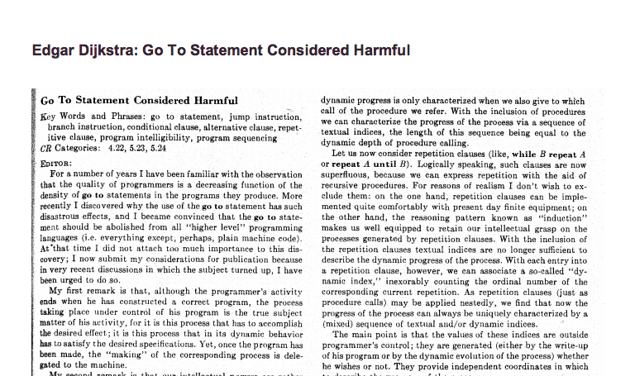
Avoid goto’s whenever possible

Slide 38
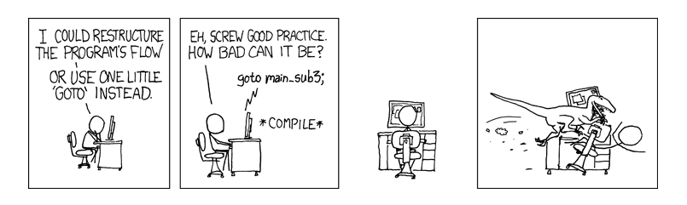
Avoid goto’s whenever possible

Slide 39
Exercises
Given a number, write a function to decide if it is even?
bool isEven(int n) {
}

Slide 40
Exercises
Given a number, write a function to decide if it is even?
bool isEven(int n) {
return (n & 0x1) == 0;
}

Slide 41
Exercises
Given a number, write a function to decide if it is even?
bool isEven(int n) {
return (n % 2) == 0;
}

Slide 42
Exercises
Given a number, write a function to decide if it is a power of two?
bool isPowerOfTwo(unsigned int n) {
}

Slide 43
Exercises
Given a number, write a function to decide if it is a power of two?
bool isPowerOfTwo(unsigned int n) {
if (n==0) return false;
while (n > 1) {
if (n % 2) // (n%2)!=0
return false;
n = n >> 1;
}
return true;
}

Slide 44
Exercises
Given a number, write a function to decide if it is a power of two?
bool isPowerOfTwo(unsigned int n) {
return (n & (n-1)) == 0;
// n&(n-1) clears rightmost bit-of-1 in n
}

Slide 45
Exercises
Given a number, write a function to decide if it is a power of two?
bool isPowerOfTwo(unsigned int n) {
return n != 0 && (n & (n-1)) == 0;
}
Notes:
-2147483648

Slide 46
Exercises
Count the number of ones in the binary representation of the given number ?
(n > 0)
int count_one(int n) {
}
Notes:
-2147483648

Slide 47
Exercises
Count the number of ones in the binary representation of the given number ?
(n > 0)
int count_one(int n) {
int count = 0;
while (n != 0 ) {
count += (n % 2);
n = (unsigned int)n>>1;
}
return count;
}
Notes:
-2147483648

Slide 48
Exercises
Count the number of ones in the binary representation of the given number ?
bool count_one(int n) {
}
A trick – clear the rightmost bit-of-1: n & (n -1)

Slide 49
Exercises
Count the number of ones in the binary representation of the given number ?
int count_one(int n) {
int count = 0;
while(n != 0) {
n = n&(n-1);
count++;
}
return count;
}

