Slide 1
CSO-Recitation 06 CSCI-UA 0201-007
R06: Assessment 05 & Strings & Linked list

Slide 2
Today’s Topics
Assessment 05
Strings
Linked list

Slide 3
Assessment 05

Slide 4
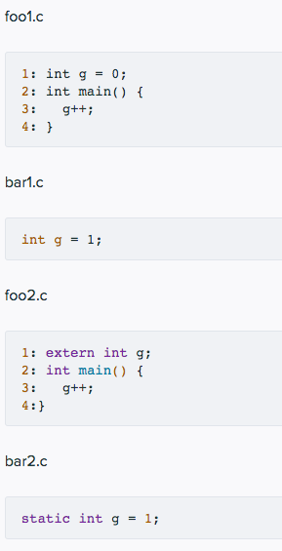
Q1 Basic C
Below are 4 C source files and their contents.
Q1.1 foo1.c
Which of the following statements are true?
The command gcc foo1.c creates a binary executable file called a.out
The command gcc -c foo1.c creates a non-executable object file called foo1.o
The command gcc foo1.c results in an error.
After executing line 3, variable g has value 1.
After executing line 3, variable g could have any value.
Notes:
If you don’t specify the object file name, it will generate a.out by default.

Slide 5
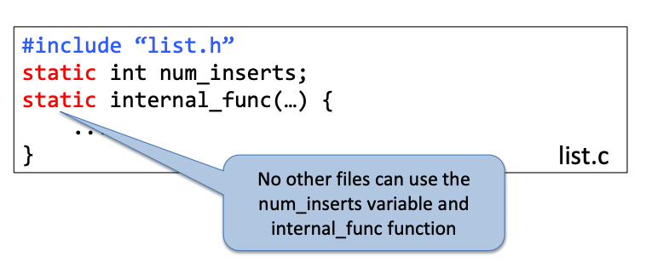
Q2 Static and extern
Q2.1 foo2.c
Which of the following statements are true?
The command gcc foo2.c creates a binary executable file called a.out.
The command gcc -c foo2.c creates a non-executable object file called foo2.o.
The command gcc foo2.c results in an error.
The command gcc foo2.c bar1.c creates a binary executable file called a.out.
The command gcc foo2.c bar1.c results in an error.
The command gcc foo2.c bar2.c creates a binary executable file called a.out.
The command gcc foo2.c bar2.c results in an error.
Notes:
A: it cannot create the file since g is declared, but not defined.
G: they are in different files

Slide 6
Q2 Static and extern
Q2.2
Suppose this command gcc foo2.c bar1.c bar2.c generates executable a.out, which of the following is true about executing a.out?
The global variable g in bar1.c and bar2.c have the same underlying same memory location.
The global variable g in bar1.c and bar2.c have different underlying same memory locations.
The variable g in foo2.c refers to the global variable g defined in bar1.c.
The variable g in foo2.c refers to the global variable g defined in bar2.c.
The command gcc foo2.c bar1.c bar2.c would result in an error.
Notes:
A B: Two different variables: the scope is different
C: a static variable cannot be referred from a different file

Slide 7
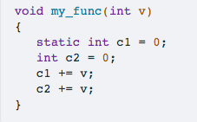
Q3 Static for local variable
The following shows the code for function my_func
Q3.1 basic
Local variable c1 is allocated upon each invocation of my_func and de-allocated upon its return.
Local variable c2 is allocated upon each invocation of my_func and de-allocated upon its return.
Local variable c1 and c2 always have the same value right before the return of my_func.
Local variable c1 has scope within function my_func and cannot be referred to from outside of this function.
Local variable c2 has scope within function my_func and cannot be referred to from outside of this function.
When “static” prefix local variables:
Initialized once, never deallocated
Any change persists across function invocations
like a global variable, except with local scope
Notes:
A: static variable is allocated at the first invocation, and it wouldn’t be de-allocated
B: it will be de-allocated each time when the function returns
C: the value of c1 will be added accumulatively
D E: both of the scope is within the funciton

Slide 8
Q3 Static for local variable
Suppose one executes the following code snippet:
my_func(10);
my_func(20);
Which of the following statements are true?
Right before returning from my_func(20), variable c1 has value 20.
Right before returning from my_func(20), variable c1 has value 30.
Right before returning from my_func(20), variable c2 has value 20.
Right before returning from my_func(20), variable c2 has value 30.

Slide 9
Execution Breakdown
c1 is allocated and assigned with value 0 // c1=0
my_func(10)
c2 allocated and assigned with value 0 // c2=0
c1+=10 // c1=10
c2+=10 // c2=10
Function return (c2 is de-allocated)
my_func(20)
c2 allocated and assigned with value 0 // c2=0
c1+=10 // c1=30
c2+=20 // c2=20
Notes:
Execution breakdown

Slide 10
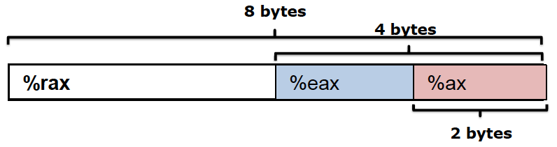
Q4 register
After x86 CPU executes instruction movq $0x12345678, %rax, which of the following is true?
The higher order 4-byte of register %rax are all zeros.
The higher order 4-bytes of register %rax remain the same as before the movq instruction is executed.
Register %eax has value 0x00000000
Register %eax has value 0x12345678
Register %eax is not changed by the movq instruction.
Register %ax has value 0x1234
Register %ax has value 0x5678
Notes:
A & B. Movq is writing 8 bytes. And the higher 4 bytes of that number is zero, so is %rax
C & D & E. eax is the lower 4 bytes of %rax, which is 0x12345678
F & G. %ax is the lower 2 bytes of %rax, which is 0x5678

Slide 11
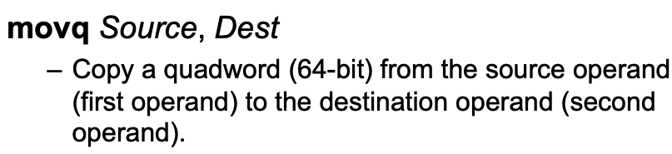
Q5 mov
Suppose register %rax stores C variable long *x. Which of the following instruction corresponds to the C statement *x = 10;
movq $10, %rax
movq $10, (%rax)
movq (%rax), $10
movq %rax, $10
long *x
x is a pointer to long (8 bytes, 64 bits)
*x=10;
de-referencing x, assign the value 10
x is an address stored in %rax, use (%rax) to deference it.
Notes:
Movq is storing the value 1st operand into 2nd operand, hence C&D are incorrect

Slide 12
Q6 mov
Suppose register %rax stores C variable int x. Which of the following instruction corresponds to the C statement x = 10;
movl $10, %eax
movq $10, %eax
movl $10, (%rax)
movq $10, (%rax)
int x
x is an integer with 4 bytes
x=10;
assign the value 10 to x
x is a variable stored in %eax

Slide 13
Q7 mov
Given instruction movl $eax, (%rbx), what are likely data types for the variable stored in %rbx?
long
unsigned long
int
unsigned int
int*
unsigned int*
long*
unsigned long*
(%rbx)
Deference %rbx => %rbx stores a pointer
movl
4 bytes => %rbx stores a pointer which points to a data of 4 bytes
long is 8 bytes
the movl instruction does not distinguish between signed/unsigned

Slide 14
Q8 mov
Which of the following statements are true?
During a program's execution, its instructions are stored on disk while its program data is stored in the memory.
During a program's execution, both its instructions and program data are stored in the memory.
Compilers must generate explicit instructions to increment PC (aka %rip)
CPU automatically increments PC (aka %rip) as instructions are executed.
An executable file compiled for ARM can be directly executed by an x86 CPU.
An executable file compiled for ARM can not be directly executed by an x86 CPU.

Slide 15
Strings
Arrays of chars

Slide 16
What are strings?
They are arrays of the type char, which is typically one byte
Char literals are in single quotes ‘ ’
String literals are in double quotes “ “
Unlike other arrays, strings have a way of knowing the length even at runtime
Strings are stored with the last byte set to 0 (or ‘\0’)
C strings are called “null terminated”
So you can find the length by looping over the string, keeping a counter, and stopping when you find a char equal to zero
There is also a standard library function for this, strlen

Slide 17
Defining a string
?
?
0
‘d’
‘l’
‘r’
‘o’
‘w’
‘ ’
‘o’
‘l’
‘l’
‘e’
‘h’
0x7F0D
0x7F0C
0x7F0B
char *arr = “hello world”;
char arr[12] = “hello world”;
The literal “hello world” includes the null-terminator.
0x7F0A
0x7F09
0x7F08
0x7F07
0x7F06
0x7F05
0x7F04
0x7F03
0x7F02
0x7F01
0x7F00

Slide 18
Array of pointers: argv
argv is an array of strings (pointers to char)
the strings are your arguments
argv[0] is the name of the executable file
argv has argc many elements

Slide 19
Linked list
A linear data structure

Slide 20
Why linked list?
NULL
Head
12
99
5
Data
Next
Like arrays, Linked List is a linear data structure.
Unlike arrays, linked list elements are not stored at a contiguous location; the elements are linked using pointers.
Arrays have limitations:
The size of the arrays are fixed (pre-defined)
Inserting (Deleting) a new element in an array of elements is expensive
because the room has to be created for the new elements and existing elements have to be shifted.

Slide 21
Advantages and Drawbacks
Advantages over arrays:
Dynamic size
Ease of insertion/deletion
Drawbacks:
Random access is not allowed
We have to access elements sequentially starting from the first node. (Traverse)
Extra memory space for a pointer is required with each element of the list.
Not cache friendly
Since array elements are contiguous locations, there is locality of reference which is not there in case of linked lists.

Slide 22
Linked list
A linked list is represented by a pointer to the first node of the linked list
It is called the head
If the linked list is empty, then the value of the head is NULL
Each node in a list consists of at least two parts:
data
Pointer (or Reference) to the next node
In the case of the last node in the list,
the next field contains NULL - it is set as a null pointer.
In C, we can represent a node using struct
nodes are defined as (e.g.) node using typedef
node *head

Slide 23
Initialize the linked list
The list is initialized by creating a node *head which is set to NULL
The variable head is now a pointer to NULL, but as nodes are added to the list, head will be set to point to the first node
In this way, head becomes the access point for sequential access to the list.

Slide 24
Linked list
Linked list insertion
Linked list Deletion
Search an element in a linked list
Traverse a linked list
Find length of a linked list
…

Slide 25
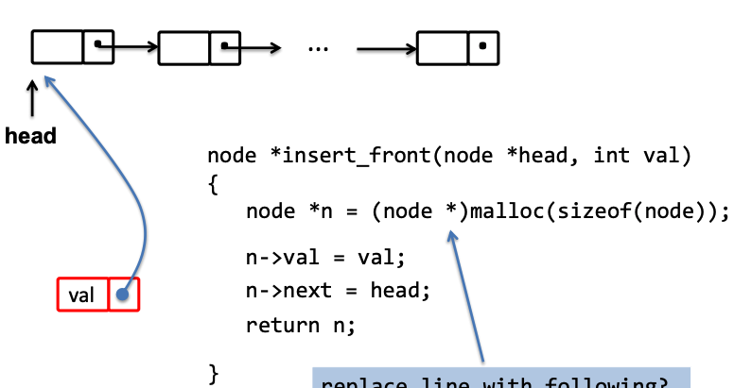
Linked list
In class, we pass the header pointer,
ask it to return a new head
the caller is responsible for updating it itself
In lab-2, we pass a pointer to pointer parameter (pointer to the head pointer),
to allow changing the head pointer directly instead of returning the new one
note that there’s no return value; It’s not needed.

Slide 26
Inserting a node
NULL
Head
A
B
C
S
How can we insert a node in a sorted linked list?
Insert a node at the front of the linked list
insert_front
Insert a node after a given node
Think: how can I know my S should be inserted between A and B?
If by comparing A and S I know S should be at the position after A, then how can I know S should be after B or between A and B?
Insert a node at the end of the linked list

Slide 27
Inserting a node
Data
Next
NULL
A
C
B
How can we insert a node in a linked list sorted by each node’s data?
Assume data are all unique
Four cases
List is empty: insert_front
Smaller than the head: insert_front
Larger than some node with data A but smaller than A’s next node (data C):
Insert a node after A before C
Larger than all nodes:
Insert a node at the end of the linked list
Too many corner cases! Any tricks to simplify it (to one case)?
Sentinel node
Notes:
When initialize a list, put two dummy nodes with minimum data and maximum data. This way, the list is always non-empty, and there is never a node smaller/larger than head node. Thus we reduce to only have the 3rd case. You can search for sentinel node for detail. However, in your lab you should not use this trick, but should implement the vanilla version as shown in this slide.

Slide 28
Inserting a node
Four cases
List is empty: insert_front
Smaller than the head: insert_front
Larger than some node with data A but smaller than A’s next node (data C):
Insert a node after A before C
Larger than all nodes:
Insert a node at the end of the linked list
Head
Next
NULL
-inf
+inf
Q: What if we only add one sentinel node with –inf, instead of both –inf and +inf?
Head
NULL
-inf
Notes:
When initialize a list, put two dummy nodes with minimum data and maximum data. This way, the list is always non-empty, and there is never a node smaller/larger than head node. Thus we reduce to only have the 3rd case. You can search for sentinel node for detail. However, in your lab you should not use this trick, but should implement the vanilla version as shown in this slide.

Slide 29
Dynamic memory allocation
Each time you need to manually allocate data, use malloc
void *malloc(size_t size);
If you need to manually de-allocate
void free(void *ptr);

Slide 30
More on linked list
Implement a hash table
see clear instructions on our website lab-2 page
A hash table is an array of linked lists with a hash function
A hash function basically just takes things and puts them in different “buckets” (hash table’s array of entries)
Each “bucket" just points to a linked list here

