Slide 1
CSO-Recitation 13 CSCI-UA 0201-007
R13: Assessment 11

Slide 2
Assessment 11

Slide 3

Q1 Boolean laws
Which of the following Boolean laws hold? Below, A, B, C could refer to either a Boolean variable or a Boolean expression
R1: A+0=A
R2: A+0=0
R3: A+1=1
R4: A+1=A
R5: A⋅(B+C)=A⋅B + A⋅C
R6: A + $\overline{A}$=1
R7: A ⋅ $\overline{A}$= 0
Basic law:
A ⋅0 =0, A ⋅1=A
A+0=A, A+1=1
Distribution law
Inverse law

Slide 4

Q2 Simplify boolean expression
Simplify boolean expression (A+B) ⋅($\overline{A}$+ $\overline{B}$).
You may write `*` for ⋅, and write `barA` for $\overline{A}$ (or `barB` or $\overline{B}$)
(A+B)*(barA+barB)
=(A+B)*barA + (A+B)*barB
=barA*A + barA*B + barB*A + barB*B
=0+barA*B+barB*A+0
=barA*B+barB*A
Distribution law
Distribution law
Inverse law
Basic law

Slide 5
Q3 Simplify boolean expression
When simplifying the Boolean expression in Q2, which of the Boolean laws in shown Q1 are needed?
R1
R2
R3
R4
R5
R6
R7

Slide 6
Q4 Boolean circuit
If you are to use a single logic gate to implement the simplified expression in Q2. Which gate should you use?
AND
OR
NOR
NAND
XOR
None of the above
NAND(A,B) = bar(A*B) = barA+barB
XOR(A,B) = A*barB + B*barA

Slide 7
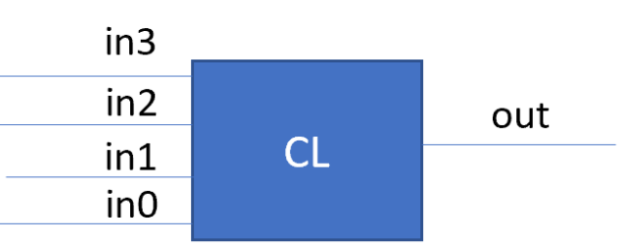
Q5 Combinatorial circuit
In this question, you are asked to implement a combinatorial circuit that takes a 4-bit input and outputs a single bit indicating whether the unsigned 4-bit integer represented by b3​b2​b1​b0​ is a prime number or not.
Q5.1 Truth table
How many total rows does the truth table corresponding to the 4-bit prime number detector circuit have?
16
#row of truth table:
have 4 input signals, each represents 1 bit
how many bit patterns?
2^4 = 16

Slide 8
Q5.2 Truth Table
How many of the rows in the truth table of Q5.1 corresponds to the output bit value o=1?
6
Prime: 2, 3, 5, 7, 11, 13

Slide 9
Q5.3 Product of terms
The prime number detector circuit can be built as a sum of products where each product term corresponds to a row in Q5.2. Please write the product term that corresponds to the input b3b2b1b0 = (1011)2
B3 Barb2 b1 b0
(1011)2 = 11, is a prime
output = 1
b3, b1, b0 = 1, remain the same
b2 = 0, => Barb2

Slide 10
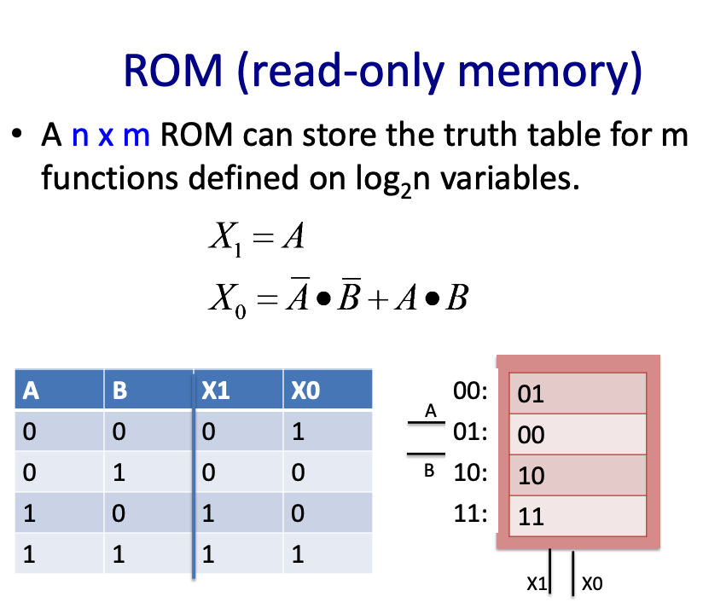
Q5.4 ROM
If you are to using a ROM to implement the prime number detector circuit. What is the minimal size of the ROM required?
4 variables
h = 2^4 = 16
i.e. #input bit patterns
w = 1 (one bit to indicate whether this is a prime number or not)

Slide 11
Q5.4 ROM
Following Q5.4, what is the value of the ROM entry at index or address (1010)2​?
0
(1010)2 = 10, not a prime
output = 0

Slide 12
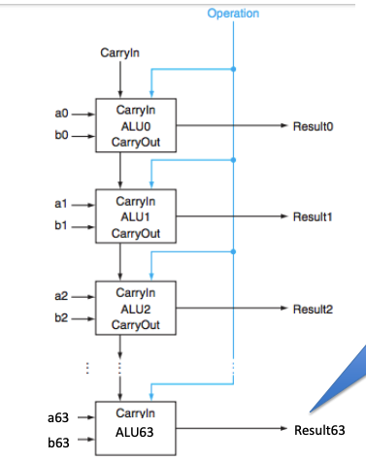
Q6 Ripple carry
If a 1-bit adder's gate delay is 2, then what is the gate delay of a 32-bit ripple carry?
64
ready at t=0
ready at t=2
ready at t=4
ready at t=6
a32
b32
ALU32
Result 32
ready at t=2*32

Slide 13
Q6 Ripple carry
If a 1-bit adder's gate delay is 2, then what is the gate delay of a 32-bit ripple carry?
64
ripple carry:
compute carry-bit sequentially
gate delay = (1-bit adder’s gate_delay) * #adders
= 2* 32 =64

Slide 14
Lab 4 Optimization

Slide 15
Simple implicit list implementation
First-fit algorithm
Simply optimized realloc function (3 cases):
Shrink: directly decrease the size
Expand:
Next chunk is a free chunk, and the size is sufficient: utilize the next chunk
Otherwise, free the current chunk and allocate a new one

Slide 16
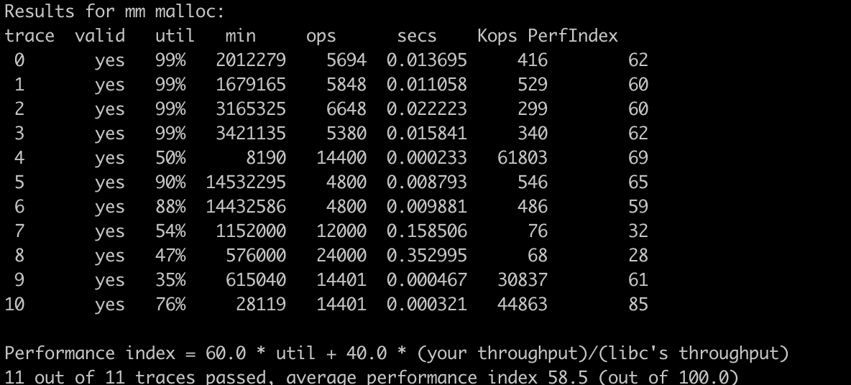
Simple implicit list implementation
Even though the utilization is high, performance is low
Utilization is low.

Slide 17
Simple implicit list implementation

Slide 18
Simple implicit list implementation
First try to optimize these two traces (realloc trace)

Slide 19
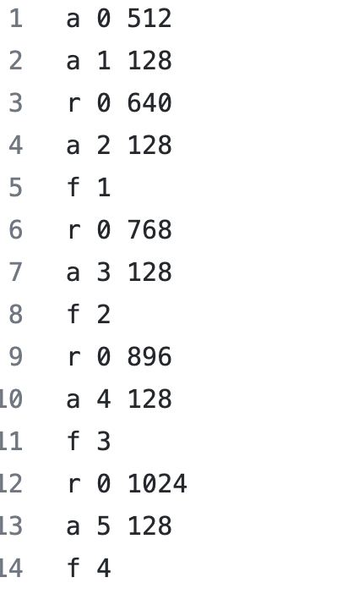
realloc trace

Slide 20
realloc trace
Heap start
512, f
512, a
128, a
384, f
128, f
128, a
640, a

Slide 21
realloc trace
Heap start
512, f
512, a
128, a
384, f
128, f
128, a
640, f
640, a
768, a

Slide 22
realloc trace
…
640, a
768, a
768, f
896, a

Slide 23
realloc trace - optimization
Heap start
512, f
512, a
128, a
384, f
128, f
128, a
640, a
Ask for os for the remaining size (768 – 640)
128, a

Slide 24
realloc trace - optimization
Heap start
512, f
512, a
128, a
384, f
128, f
128, a
768, a
640, a
Ask for os for the remaining size (768 – 640)
128, a

Slide 25
realloc trace - optimization
Heap start
512, f
512, a
128, a
All malloc(128) will be put near the start of the heap
384, f
128, f
128, a
768, a
640, a
128, a

Slide 26
realloc trace - optimization
Heap start
512, f
512, a
128, a
384, f
128, f
128, a
768, a
640, a
All realloc will just increase the size of the last chunk
Increase when realloc
128, a

Slide 27
realloc trace - optimization
Before:
After:

Slide 28
binary trac
64, a
a 0 64
a 1 448
a 2 64
a 3 448
a 4 64
a 5 448
…
f 1
f 3
f 5
…
a 4000 512
a 4001 512
a 4002 512
a 4003 512
…
448, a
64, a
448, a
…

Slide 29
binary trace
64, a
a 0 64
a 1 448
a 2 64
a 3 448
a 4 64
a 5 448
…
f 1
f 3
f 5
…
a 4000 512
a 4001 512
a 4002 512
a 4003 512
…
448, f
64, a
448, f
…

Slide 30
binary trace
64, a
a 0 64
a 1 448
a 2 64
a 3 448
a 4 64
a 5 448
…
f 1
f 3
f 5
…
a 4000 512
a 4001 512
a 4002 512
a 4003 512
…
Too small for 512
448, f
64, a
Too small for 512
448, f
…
512, a
512, a
…

Slide 31
binary trace - optimization
We can separate the memory allocation for small and large chunks
Try to put the small chunks together
JRockit JVM follows this principle (https://docs.oracle.com/cd/E13150_01/jrockit_jvm/jrockit/geninfo/diagnos/garbage_collect.html)
a 0 64
a 1 448
a 2 64
a 3 448
a 4 64
a 5 448
…
f 1
f 3
f 5
…
a 4000 512
a 4001 512
a 4002 512
a 4003 512
…
64, a
Small chunks
64, a
…
448, a
448, a
Large chunks
…

Slide 32
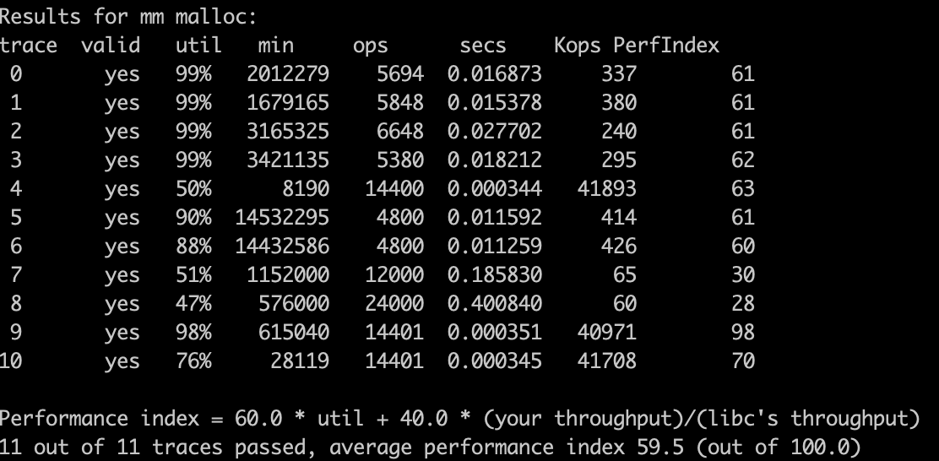
binary trace - optimization
Before:
After:

Slide 33
Other optimization
To optimize utilization:
Add footer to fully utilize the free chunks (coalesce adjacent free chunks is possible)
To optimize the performance:
Use segregated and explicit list to find a suitable chunk faster
Use next fit instead of first fit

Slide 34
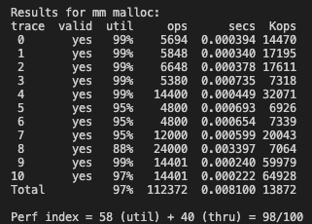

Slide 35
Adders

Slide 36
Faster adder: carry lookahead
Ripple carry
Delay: 64*1BitAdderGateDelay,☹️, Gate count: 64*c 🙂
Brute-force (truth table->PLA)
Delay: 2 🙂, Gate count: O(2^(64+64)) ☹️
In between: Carry lookahead
Long delay in ripple carry caused by carry bits dependency!
Idea: compute all carry bits at a time

Slide 37
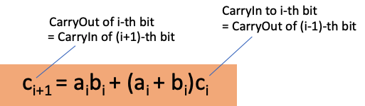

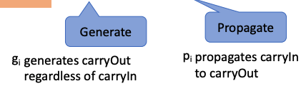

Faster adder: carry lookahead (4-bit)
$c_{1}=g_{0}+p_{0}c_{0}$
$c_{2}=g_{1}+p_{1}c_{1}$
$=g_{1}+p_{1}\left(g_{0}+p_{0}c_{0}\right)=g_{1}+p_{1}g_{0}+p_{1}p_{0}c_{0}$
$c_{3}=g_{2}+p_{2}g_{1}+p_{2}p_{1}g_{0}+p_{2}p_{1}p_{0}c_{0}$
$c_{4}=g_{3}+p_{3}p_{2}g_{1}+p_{3}p_{2}p_{1}g_{0}+p_{3}p_{2}p_{1}p_{0}c_{0}$
to get rid of ci+1’s dependency on ci, plug in the expr for ci

Slide 38

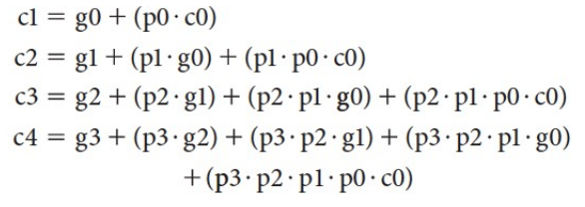
Faster adder: carry lookahead (4-bit)
Ripple carry
Carry Lookahead
carryIn (c0)
carryIn (c0)
CarryIn CarryOut
a0
CarryIn CarryOut
a0
p0 g0
ci needs i multi-input AND gates
at least 1+2+…+N=O(N^2) gates
Not so good with large N
b0
Carry Lookahead
b0
c1
c1
CarryIn CarryOut
a1
CarryIn CarryOut
p1 g1
a1
Delay of c0=>c4 is 3
b1
b1
c2
c2
CarryIn CarryOut
CarryIn CarryOut
p2 g2
a2
a2
b2
How many gates asymptotically do we need?
b2
c3
c3
p3 g3
CarryIn CarryOut
a3
CarryIn CarryOut
a3
Delay of c0=>c4 is 2*4=8
b3
b3
carryOut (c4)
carryOut (c4)

Slide 39
Time && space comparison
 | Time (Delay) | Space (# gates)
Ripple carry | O(N) | O(N)
Carry lookahead | O(1) | O(N^2)
chaining N/M M-bit carry lookahead | O(N/M) | O(M^2*N/M)=O(NM)
Hierarchical M-bit carry lookahead | O(log_M N) | O(NM)

Slide 40
16-bit adder
Strawman: : chaining 4-bit carry lookahead
carryIn (c0)
carryIn (c0)
4-bit adder with carry lookahead
a0..3
CarryIn CarryOut
a0
CarryIn CarryOut
p0 g0
b0..3
b0
Carry Lookahead
Problem: high delay (3*4=12)
c1
c4
a4..7
CarryIn CarryOut
a1
CarryIn CarryOut
p1 g1
b4..7
b1
c2
c8
p2 g2
a8..11
CarryIn CarryOut
a2
CarryIn CarryOut
b8..11
b2
c3
c12
p3 g3
CarryIn CarryOut
CarryIn CarryOut
a12..15
a3
b12..15
b3
carryOut (c4)
carryOut (c16)

Slide 41
carryIn (c0)
a0
CarryIn CarryOut
p0 g0
b0
Carry Lookahead
c1
a1
CarryIn CarryOut
p1 g1
b1
c2
CarryIn CarryOut
p2 g2
a2
b2
c3
p3 g3
a3
CarryIn CarryOut
b3
carryOut (c4)

Slide 42
16-bit adder
carryIn (c0)
Similar problem: carry bits dependency
Borrow the idea of carry-lookahead to compute c4 c8 c12 c16 at a time?
a0..3
CarryIn CarryOut
b0..3
c4
a4..7
CarryIn CarryOut
b4..7
c8
a8..11
CarryIn CarryOut
b8..11
c12
a12..15
CarryIn CarryOut
b12..15
carryOut (c16)

Slide 43
16-bit adder
carryIn (c0)
Similar problem: carry bits dependency
Borrow the idea of carry-lookahead to compute c4 c8 c12 c16 at a time
Need to compute “super” propagate (P0…P3) and “super” generate (G0…G3) for each 4-bit adder
a0..3
CarryIn CarryOut
P0 G0
p0 g0
b0..3
Carry Lookahead
c4
a4..7
CarryIn CarryOut
p1 g1
P1 G1
b4..7
c8
CarryIn CarryOut
p2 g2
a8..11
P2 G2
b8..11
c12
p3 g3
CarryIn CarryOut
a12..15
P3 G3
b12..15
carryOut (c16)

Slide 44
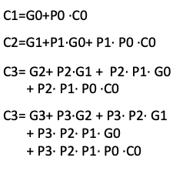
16-bit adder
carryIn (c0)
carryIn (C0)
Super propagate:
P0=p0·p1·p2·p3
Super generate:
G0=g3+ p3·g2 + p3· p2·g1+ p3· p2·p1 ·g0
The carry bits are the same:
CarryIn CarryOut
a0..3
CarryIn CarryOut
a0
P0 G0
p0 g0
p0 g0
Carry Lookahead
b0
Carry Lookahead
b0..3
c1
P0
C1
CarryIn CarryOut
a4..7
CarryIn CarryOut
p1 g1
a1
p1 g1
P1 G1
b1
b4..7
c2
C2
CarryIn CarryOut
p2 g2
CarryIn CarryOut
p2 g2
a2
G0
a8..11
P2 G2
b2
b8..11
c3
C3
p3 g3
p3 g3
CarryIn CarryOut
CarryIn CarryOut
a3
a12..15
P3 G3
b3
b12..15
carryOut (c4)
carryOut (C4)

Slide 45
Sequential logic
Building Blocks

Slide 46
Sequential Logic
There is memory
Outputs depend on prior state as well as the current inputs
State can be stored and used later
We rely on clock signals
Clock signals tell us when things should happen
We should only write to state when the clock is set a certain way

Slide 47
SR Latch, D Latch and D Flip Flop
Demo

Slide 48
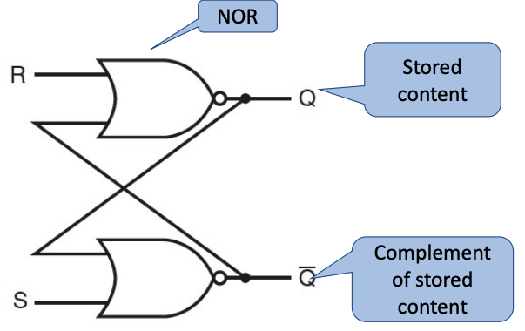
SR Latch
Constructed from two NOR gates
You can either Set the latch (make it remember 1), or Reset it (make it remember 0)
Two inputs: S and R
Two outputs: Q and NOT Q
Q is what it remembers, NOT Q is the opposite
Both S and R cannot be 1 at the same time, or sadness occurs

Slide 49
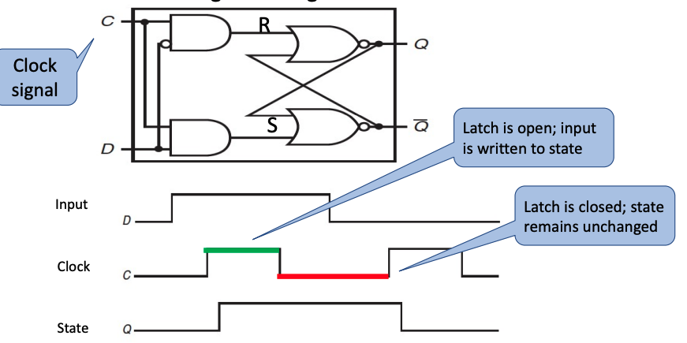
D Latch
Constructed from some additional logic and an SR Latch
Two inputs: C and D
You can have the latch remember D as long as C is true
Two outputs: Q and NOT Q
Q is what the latch remembers, NOT Q is the inverse
Ensures that S and R inputs to the SR Latch aren’t both true

Slide 50
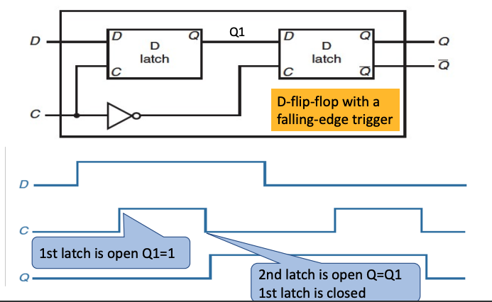
D Flip Flop
Constructed from some additional logic and two D latches
Same inputs and outputs as D latches
But, the output is only stored on a chosen clock edge

Slide 51
Lab5
using Logisim Evolution

Slide 52
Setup
Clone the Lab 5 repository – new link (campuswire)
cd lab5new-<YourGithubUsername>
wget https://nyu-cso.github.io/labs/logisim-evolution-2.15.jar
download the Java runtime environment:
sudo apt-get install default-jre
Launch Logisim by typing (in your lab5new repo):
java -jar logisim-evolution-2.15.jar
Save frequently when you work~

Slide 53
Finite State Machines

Slide 54
Finite State Machines
There are a number of states, inputs, and outputs
To the beat of the clock, we read in inputs and go to new states, and set the outputs
Both the output and the next state are defined by the current state and the inputs
Can be expressed as a flowchart or a truth table

Slide 55
An FSM example
There are 4 states
Nodes represent states
Initial state is 00
“x/y” on the arrow edge is “transition condition”
when input=x, follow this edge to transit into the pointed state
set output=y in the meantime

Slide 56
An FSM example
We are here
read input ”0”

Slide 57
An FSM example
move to here
set output=1
read input ”1”

Slide 58
An FSM example
move to here
set output=1

Slide 59
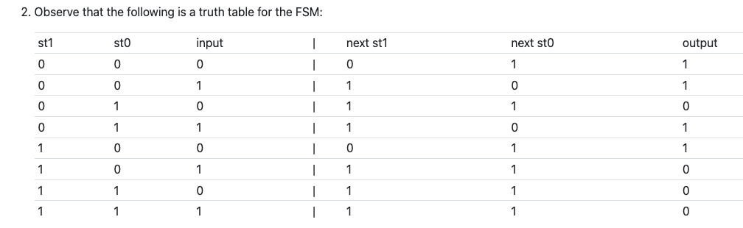
An FSM example
The corresponding truth table

Slide 60
Another FSM Example
The NYC Subway Turnstile
There is a lock controlled by the FSM
If the user didn’t pay yet then the lock is active and the user can’t push through
If the user pays, the lock unlocks until they push through
Draw an FSM for this
Write out a truth table
Create the circuit

Slide 61
Another FSM Example
pay
Lock
Unlock
push
pay
push
current state | input | next state
(lock / unlock) | (pay / push)

Slide 62
Another FSM Example
pay
Lock
Unlock
push
pay
push
current state | input | next state
(lock / unlock) | (pay / push)

