Slide 1
CSO-Recitation 08 CSCI-UA 0201-007
R08: Assessment 06 & Assembly

Slide 2
Today’s Topics
Assessment 06
Assembly
Some exercises
give some senses about lab3

Slide 3
Assessment 06

Slide 4
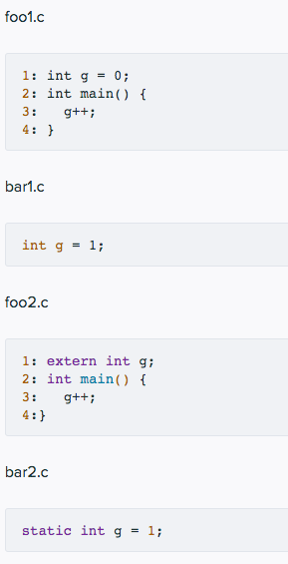
Q1 Static and extern
Below are 4 C source files and their contents.
Q1.1 foo1.c
Which of the following statements are true?
The command gcc foo1.c creates a binary executable file called a.out
The command gcc -c foo1.c creates a non-executable object file called foo1.o
The command gcc foo1.c results in an error.
After executing line 3, variable g has value 1.
After executing line 3, variable g could have any value.

Slide 5
Q1 Static and extern
Q1.2 foo2.c
Which of the following statements are true?
The command gcc foo2.c creates a binary executable file called a.out.
The command gcc -c foo2.c creates a non-executable object file called foo2.o.
The command gcc foo2.c results in an error.
The command gcc foo2.c bar1.c creates a binary executable file called a.out.
The command gcc foo2.c bar1.c results in an error.
The command gcc foo2.c bar2.c creates a binary executable file called a.out.
The command gcc foo2.c bar2.c results in an error.

Slide 6
Q1 Static and extern
Q1.3 Value of g
If I want to have variable g to have value 2 right before returning from main function, what command should be used to generate the executable file?
gcc foo1.c
gcc foo2.c
gcc foo1.c bar1.c
gcc foo1.c bar2.c
gcc foo2.c bar1.c
gcc foo2.c bar2.c
gcc foo1.c foo2.c
gcc foo1.c bar1.c bar2.c
gcc foo2.c bar1.c bar2.c
gcc foo1.c foo2.c bar1.c bar2.c
1
error
error
1
2
error
error
error
2
error

Slide 7
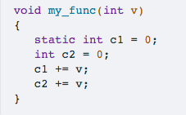
Q2 Static for local variable
The following shows the code for function my_func
Q2.1 basic
Local variable c1 is allocated upon each invocation of my_func and de-allocated upon its return.
Local variable c2 is allocated upon each invocation of my_func and de-allocated upon its return.
Local variable c1 and c2 always have the same value right before the return of my_func.
Local variable c1 has scope within function my_func and cannot be referred to from outside of this function.
Local variable c2 has scope within function my_func and cannot be referred to from outside of this function.
When “static” prefix local variables:
Initialized once, never deallocated
like a global variable, except with local scope

Slide 8
Q2 Static for local variable
Suppose one executes the following code snippet:
my_func(10);
my_func(20);
Which of the following statements are true?
Right before returning from my_func(20), variable c1 has value 20.
Right before returning from my_func(20), variable c1 has value 30.
Right before returning from my_func(20), variable c2 has value 20.
Right before returning from my_func(20), variable c2 has value 30.

Slide 9
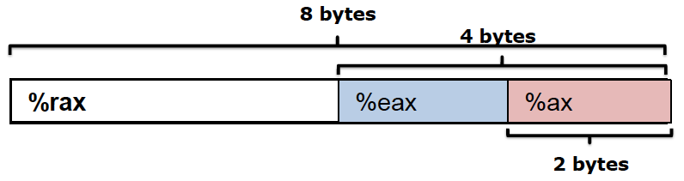
Q3 register
After x86 CPU executes instruction movq $0x12345678, %rax, which of the following is true?
The higher order 4-byte of register %rax are all zeros.
The higher order 4-bytes of register %rax remain the same as before the movq instruction is executed.
Register %eax has value 0x00000000
Register %eax has value 0x12345678
Register %eax is not changed by the movq instruction.
Register %ax has value 0x1234
Register %ax has value 0x5678

Slide 10
Q4 illegal instructions
Which of the following instructions are not legitimate x86-64 instructions?
movq %rax, %rbx
movq (%rax), %rbx
movq (%rax), (%rbx)
movq %rax, %rip
movq $1, %rax
Moving data
movq src dst
Operand types
Immediate: constant integer data
immediate can only be source
Register: one of the general purpose register
Memory
no memory-memory mov

Slide 11
Q5 mov
Suppose register %rax stores C variable long *x. Which of the following instruction corresponds to the C statement *x = 10;
movq $10, %rax
movq $10, (%rax)
movq (%rax), $10
movq %rax, $10
long *x
x is a pointer to long
*x=10;
de-referencing x, assign the value 10
x is an address stored in %rax, use (%rax) to deference it.

Slide 12
Q6 GDB -- Segmentation fault
Inside GDB, what operations can help us debug a segmentation fault?
run code and hit control-c
use backtrace to see the call stack trace
use up or frame to go to where your code was last running
use p to print some value or info locals to check if local variables are bad

Slide 13
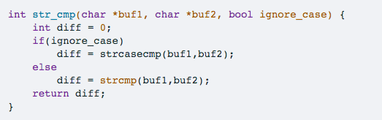
Q7 String manipulation
Q7.1 What does this function return for the following arguments?
ignore_case = true
buf1 = "Develop and use skills and knowledge."
buf2 = "Develop and use Skills and Knowledge."
It returns 0
It returns a non-zero integer
strcasecmp is a case insensitive comparison of 2 char arrays
strcmp is a case sensitive comparison of 2 char arrays

Slide 14
Q7 String manipulation
Q7.2 What does this function return for the following arguments?
ignore_case = false
buf1 = "Develop and use skills and knowledge."
buf2 = "Develop and use Skills and Knowledge."
It returns 0
It returns a non-zero integer
diff = ‘s’-’S’;
strcasecmp is a case insensitive comparison of 2 char arrays
strcmp is a case sensitive comparison of 2 char arrays

Slide 15
Q7 String manipulation
Q7.3 What does this function return for the following arguments?
ignore_case = false
buf1 = "Develop and use skills and knowledge."
buf2 = "Develop and use skills and knowledge."
It returns 0
It returns a non-zero integer
strcasecmp is a case insensitive comparison of 2 char arrays
strcmp is a case sensitive comparison of 2 char arrays

Slide 16
Assembly
Assembly programming

Slide 17
Important Instructions
Instruction | What it does
mov src, dest | dest = src
add src, dest | dest = dest + src
sub src, dest | dest = dest - src
imul src, dest | dest = dest * src
inc dest | dest = dest + 1

Slide 18
Moving data - Instruction operands
src and dest can be one of three things
An immediate
A constant value, prefaced with $
Eg. $0, or $0xabcdabcd
dest cannot be an immediate
A register
One of the 16 general purpose registers
Eg. %eax, %rax, %rsi..
A location in memory
(Register): Consider registers as pointers, and get the value at an address in memory with various “addressing modes”
Eg. (%rax), 10(%rax), 10(%rax, rbx, 4)
You cannot perform a mov from memory into memory
How big is what you are getting from memory, in bytes?

Slide 19
Instruction Suffixes
Suffix | Name | Size (Bytes)
b | byte | 1
w | word | 2
l | long | 4
q | quadword | 8

Slide 20
Memory Addressing Modes
Direct addressing
Given a register, use the value located at the memory address contained in the register
Register name in parens
Eg. mov (%rax), %rbx
With displacement
Use the value in memory located at the register value plus a constant displacement
Have the constant appear before the parens
Eg. mov 10(%rax), %rbx

Slide 21
Memory Addressing Modes
Complete
We have a constant displacement, a starting point, an offset, and constant to scale the offset by…
D(Rb, Ri, S)
The address at Rb + Ri*S + D, where S and D are constant and Rb and Ri are registers
Eg. movq 10(%rax, %rbx, 4), %rcx
If the displacement is 0 or the scale is 1, you may leave them out

Slide 22
Lea src, dest
Lea: Load Effective Address
Take the address expression from src, and save it to dest
Do not access memory, just compute the address from the offsets, index, base, and scale, and then save the computed address in dest
Can also be used to quickly add registers and store the result in a third register

Slide 23
RFLAGS
A special purpose register that stores some status about the executed instructions
Different bits tell us different things
Instructions may set those bits depending on what has happened
These include arithmetic instructions like add or sub, as well as instructions like cmp

Slide 24
RFLAGS
Flag | Meaning
ZF | Result was 0
SF | The most significant bit of the result
CF | Set if the result borrowed from or carried out of the most significant bit
OF | Overflow for signed arithmetic
The CPU doesn’t know if operands are signed or unsigned
So, it calculates both the signed overflow (OF) and the unsigned overflow (CF) for each instruction
That is, OF is set assuming both are signed
CF is set assuming both are unsigned

Slide 25
How to decide whether there is overflow?
Unsigned int:
you can look at whether there is a carry/borrow of the MSB
Signed int:
for machine:
if there is carry-in but no carry-out of MSB
or, there is no carry-in but there’s carry out of MSB
for human:
if two positive numbers add to a negative number
or, two negative numbers add to a positive number

Slide 26
Instructions set/read RFLAGS
Instructions that set RFLAGS
Regular arithmetic instructions
add, sub, imul, inc
Special flag-setting instructions
cmp, test
Instructions that read RFLAGS
Instructions that read RFLAGS to set register values
Set
Instructions that read RFLAGs to set %rip
jmp

Slide 27
cmp
Same as sub (dest-src), except it doesn’t store the result in dest
It does, however, still change the RFLAGS I just mentioned
This makes it useful for comparisons and conditions

Slide 28
jmp
jmp label
Continues executing from the label, unconditionally
label is where to jump to
It acts like goto in C

Slide 29
Conditional Jumps
je label
Jump if ZF is set
jne label
Jump if ZF is not set
jg label
Jump if ZF is not set and SF and OF are the same
jl label
Jump if SF and OF are not the same
ja label
Jump if CF and ZF are both not set

Slide 30
Exercises

Slide 31
Lab3 -- Uncover the mystery
Very much like a puzzle game
In this lab, we give you 5 object files, ex1_sol.o, ex2_sol.o, ..., ex5-sol.o, and withhold their corresponding C sources
Each object file implements a particular mystery function (e.g. ex1_sol.o implements the function ex1)
We ask you to deduce what these mystery functions do based on their x86-64 assembly code
Write the corresponding C function that accomplishes the same thing

Slide 32
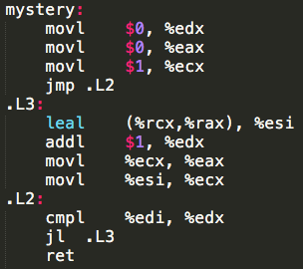
Exercise
Try to figure out what the assembly code does, and write C code that does the same thing in `main.c`.
Notes:
https://repl.it/@AnqiZ/Exercise

