Slide 1
CSO-Recitation 07 CSCI-UA 0201-007
R07: Assessment 05 & Assembly & lab2

Slide 2
Today’s Topics
Assessment 06
Assembly
Using GDB to debug assembly

Slide 3
Assessment 06

Slide 4
Q1 %eax
Suppose register %eax corresponds to the C variable x of some integer type. If the value of %eax is 0xffffffff, what potentially could be the type and value of x?
type: int, value: -1
type: int, value: -2^{31}
type: long, value: -1
type: long, value: -2^{63}
type: unsigned int, value: 2^{32}-1
type: unsigned int, value 2^{32}
type: unsigned long, value 2^{32}-1
type: unsigned long, value 2^{32}

Slide 5
Q2 movq
Suppose register %rdi and %rsi corresponds to C variable x and y, respectively. Given machine instruction movq (%rdi, %rsi, 8), %rax, what can you infer to be the most likely type of x and y, respectively?
long and long
long * and long
long * and long *
int * and long
int and int
int * and int
int * and int *
(%rdi, %rsi, 8) => val(%rdi)+val(%rsi)*8 is a pointer
Pointer arithmetic
=> %rdi (x) is a pointer
=> %rsi (y) is used for offset
movl (%rdi, %rsi, 4), %rax
val(x) (%rdi)
val(x) + 8y
(%rdi + 8*%rsi)
 | … | ///////////////
Typically this is indexing an array. Since “+8y” here, more likely the element is 8-byte.

Slide 6
Q2 movq
Suppose register %rdi and %rsi corresponds to C variable x and y, respectively. Given machine instruction movq (%rdi, %rsi, 8), %rax, what can you infer to be the most likely type of x and y, respectively?
long and long
long * and long
long * and long *
int * and long
int and int
int * and int
int * and int *
Typically this is indexing an array. Since “+8y” here, more likely the element is 8-byte.
long x[10] = {0};
long y = 1;
x[y] <= the address is val(x)+8*y
Q: x[y] == *(x+8*y)?
No! Pointer arithmetic:
The code x+8*y evaluates to val(x)+8*y*sizeof(long) = val(x)+64*y
x[y] == *(x+y)
movl (%rdi, %rsi, 4), %rax

Slide 7
Q3 Deference pointers
Suppose %rsi corresponds to C variable y of some pointer type. Which of the following instructions dereference the pointer y?
leaq (%rsi), %rax
movq (%rsi), %rax
movq %rsi, %rax
subq %rax, (%rsi)
subq %rax, %rsi
none of the above
derefence the pointer y stored in register %rsi:
(%rsi)
lea: no memory access!

Slide 8
Q4 Basic machine execution
Which of the following statements are true?
Accessing data stored in memory is as fast as accessing data stored in CPU registers.
Accessing data stored in memory is much slower than accessing data in CPU registers.
A C program is compiled into x86 instructions which are directly executed by the CPU.
A Java program is compiled into x86 instructions which are directly executed by the CPU.
One can use %rip as an operand for the mov instruction
%rip: store the address of the instructions
only 16 general purpose registers

Slide 9
Q5 mov vs. lea
Let a be an array of int elements. Suppose %rdi stores the address of a[0], and %rsi stores index i of type long. Which of the following instruction or sequence of instructions result in %eax storing a[i]?
leal (%rdi, %rsi, 4), %eax
movl (%rdi, %rsi, 4), %eax
movl (%rsi, %rdi, 4), %eax
leal (%rdi, %rsi, 8), %eax
movl (%rdi, %rsi, 8), %eax
movl (%rsi, %rdi, 8), %eax
salq $2, %rsi
addq %rdi, %rsi
movl (%rsi), %eax
salq $2, %rsi
movl (%rsi, %rdi), %eax
a is an array of int
a[i] == *(a+i)
(%rdi, %rsi, 4)
salq src, dest => dest=dest << src
arithmetic left shift
salq $2, %rsi
== 4 * %rsi
now, %rsi -> 4i
then, %rsi=%rsi+%rdi=4i+the address of a[0]=address of a[i]
then, derefence it to get the value of a[i]
Notes:
A: address of a[i]

Slide 10
Debugging with GDB without C source files
Notes:
Q6 is about gdb on assembly. So before that, let’s refresh our mem about gdb and see how we can debug assembly using gdb.

Slide 11
Recap: Some common gdb commands
help
Gdb provides online documentation. Just typing help will give you a list of topics. Or just type help command and get information about any other command.
Short Name | Long Name | What do it do?
r | run | Begins executing the program – you can specify arguments after the word run
s | step | Execute the current source line and stop before the next source line, going inside functions and running their code too
n | next | Continue until the next source line, counting called functions as a single line
p | print | Prints the value of an expression or variable
l | list | Prints out source code
q | quit | Exit gdb
step through the program one line at a time

Slide 12
Recap: Some more advanced gdb commands
Set the breakpoint at the beginning of the function
Short Name | Long Name | What do it do?
b | break | Sets a breakpoint at a specified location (either a function name or line number)
c | continue | Continues executing after being stopped by a breakpoint
bt | backtrace | Prints out information on the call stack, i.e. where in the program's execution it is being stopped at
f | frame | Prints information on the current frame / allows you to change frames
i | info | Prints out helpful information (e.g. info args and info locals)
Segmentation fault (core dumped)

Slide 13
Recap: Debugging with C source code
Set a breakpoint
run your program
Nest/step to run one line of code
Use list to see the source code that ran
Use print var to examine the variable named var
Check the locals (info locals) and args (info args) to see if they are bad
Optionally use bt/where to examine the call stack
Optionally use frame to navigate the call stack

Slide 14
Debugging without C source code
Next/step to run one line of code
No C source code.
Instead, use ni/si to run one line of assembly
Use list to see the source code that ran
Instead: use disas to see the assembly that ran
Use print var to examine the variable named var
Check the locals (info locals) and args (info args) to see if they are bad
Variable names generally disappear; Instead, examine registers/memory contents that stores the variables
Use print $reg to examine the register name reg
E.g. print $rsi
Alternatively, use info registers to see all the registers
Use x address to examine the content stored in ‘address’

Slide 15

Other useful command and options
Delete specified breakpoint id.
info breakpoints
d <id>
print accepts format
p[rint][/format] expr, where format can be
E.g. p/x $rip prints the register %rip in hex format
To examine the assembly code of a function
Use disas [func_name]
E.g., disas ex1 prints for function ex1
Alternatively, use x/[count][format] [func_name]
A more descriptive source: https://web.cecs.pdx.edu/~apt/cs322/gdb.pdf

Slide 16
Q6 Lab3 with gdb
For the next series of questions, you need to use gdb to run Lab3's tester_sol which is the executable tester linked with ex_sol{1-5}.o.
Q6.1 ex1
Stop execution in the first invocation of function ex1 (use breakpoints).
Examine ex1's machine instructions. What is the value of register %rsi prior to executing the first instruction of ex1? (%rsi contains the second function argument).
(Please write the value as a decimal number)
100

Slide 17
Q6 Lab3 with gdb
Q6.2 ex1
During tester_sol's first invocation of function ex1, what is the value of register %eax prior to the function's return? (Write the value as a decimal number)
1
Q6.3 ex2
During tester_sol's first invocation of function ex2, what is the value of register %rsi prior to executing the first instruction of ex2? (%rsi contains the second function argument).
(Please write the value as a decimal number)
4

Slide 18
Q6 Lab3 with gdb
Q6.4 ex2 (%rdi)
During tester_sol's first invocation of function ex2, what is the value of register %rdi prior to executing the first instruction of ex2? (%rdi contains the first function argument).
Please write %rdi's value as a decimal number.
Q6.5 ex2 (%rdi)
This question is the same as Q6.4, except that please write %rdi's value as a hex number (your answer should include the prefix 0x)
Seem problematic
The result is a bit random. One possible result for Q6.4 is 140737488347056
Let‘s skip for now

Slide 19
Q6 Lab3 with gdb
Q6.4 ex2 (%rdi)
During tester_sol's first invocation of function ex2, what is the value of register %rdi prior to executing the first instruction of ex2? (%rdi contains the first function argument).
Please write %rdi's value as a decimal number.
140737488347056
140737488347024
Q6.5 ex2 (%rdi)
This question is the same as Q6.4, except that please write %rdi's value as a hex number (your answer should include the prefix 0x)

Slide 20
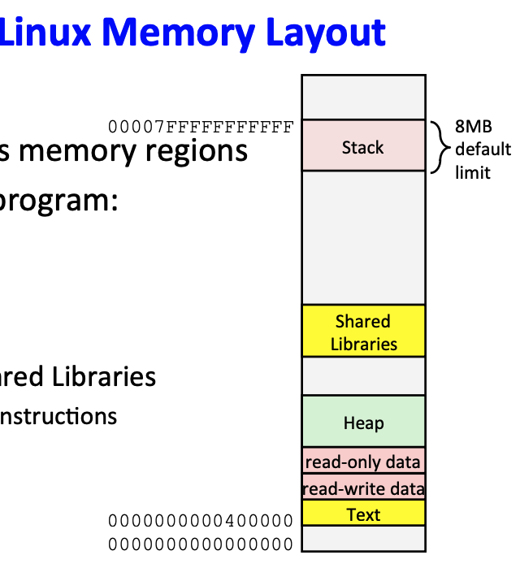
Q6 Lab3 with gdb
Q6.6 ex2 (%rdi)
By looking at your answers for Q6.4 and Q6.5, guess the most likely data type for the variable stored in %rdi (which is the first argument of function ex2)?
unsigned long
long
int
unsigned int
some pointer type
none of the above
A few clues:
The value starts with 0x7fff..xxx
More precisely, this is likely a pointer to stack memory

Slide 21

Q6 Lab3 with gdb
Q6.7 ex2
The machine instructions for ex2 contain the following instruction
For which values of %ecx would the jump to instruction at address 0x55555555492a occur?
zero
any positive value
any negative value
1
None of the above
testq src dst: like andq src, dst except dst is unchanged
set ZF, SF appropriately
jle label: less or euqal (signed)
(SF^OF) | ZF
when ZF?
val(%ecx)=0
when SF^OF ?
OF -> 0
so SF should be set (SF-> 1). When?
val(%ecx) is negative

Slide 22
Assembly
C is for people

Slide 23
Why Assembly
In the real world, computers don’t “understand” code
They only “understand” a set of instructions
To run code
1. The CPU fetches an instruction from the memory at the PC(program counter)
2. The CPU decodes that instruction
3. If needed, the CPU fetches data from memory
4. The CPU performs computations
5. If needed, the CPU writes data to memory
6. The CPU increments the PC to the next instruction

Slide 24
Why Assembly
Computers don’t “understand” assembly either, but assembly maps much more closely to machine instructions than C code
Assembly code involves instruction “mnemonics”
For x86_64, These are things like addq, movq, imul

Slide 25
X86 general purpose registers
Accessing memory is very, very slow compared to the rest of what a CPU can do
Registers are fast temporary storage
X86-64 ISA: 16 8-byte general purpose registers
Originally there were 8, all 16-bits large
%ax, %bx, %cx, %dx, %si, %di, %bp, %sp
These have 32-bit counterparts – add an e, eg %eax, %esp
These also have 64-bit counterparts – add an r, eg %rax, %rsp
With 64 bits came 8 more registers, %r8 to %r15
These have 32-bit counterparts - add a d, eg %r8d
These have 16-bit counterparts – add a w, eg %r8w
All registers also allow you to access their lowest 8 bits
%ax, %bx, %cx, and %dx, allow you to access their upper 8 bits

Slide 26
X86 general purpose registers
Accessing memory is very, very slow compared to the rest of what a CPU can do
Registers are fast temporary storage
X86-64 ISA: 16 8-byte general purpose registers
8 of them were evolved from 16-bit ISA, %rax, %rbx, %rcx, %rdx, %rsi, %rdi, %rbp, %rsp
Lower 32-bit – replace r with e, eg %eax, %esp
Lower 16-bit– remove r, eg %ax, %sp
With 64 bits came 8 more registers, %r8 to %r15
Lower 32-bit - add a d, eg %r8d
Lower 16-bit – add a w, eg %r8w
Lower 8-bit – add a b, eg %r8b
%ax, %bx, %cx, and %dx, allow you to access their upper 8 bits (replace ”x” with “h”)
Notes:
Because x86-64 evolved from a 32-bit ISA which in turn evolved from a 16-bit ISA, each GPR has a set of subregisters that hold the lower 8, 16 and 32 bits of the full 64-bit register.

Slide 27
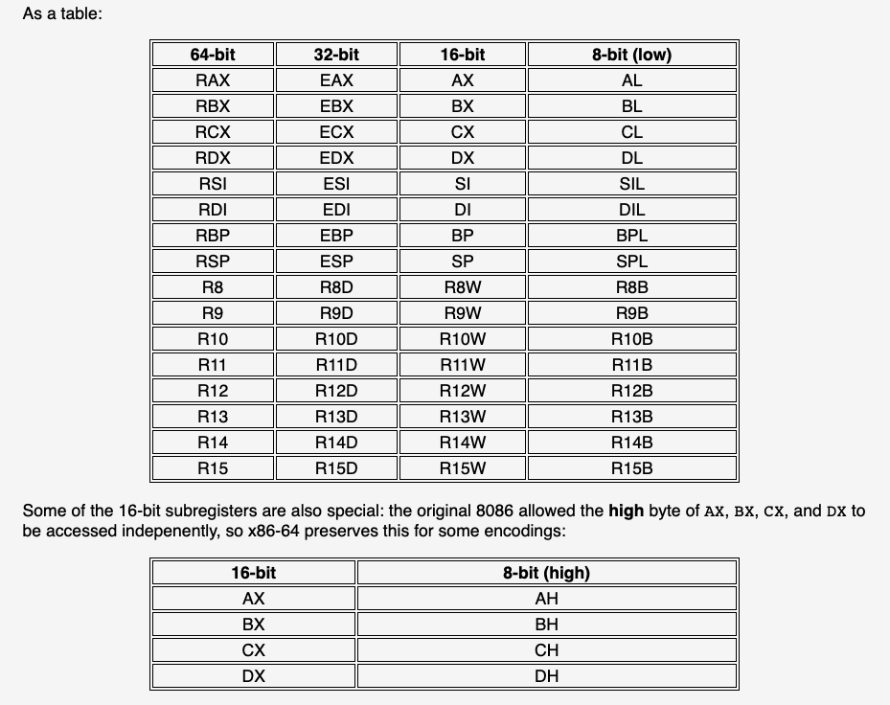
https://blog.yossarian.net/2020/11/30/How-many-registers-does-an-x86-64-cpu-have

Slide 28
Important Instructions
Instruction | What it does
mov src, dest | dest = src
add src, dest | dest = dest + src
sub src, dest | dest = dest - src
imul src, dest | dest = dest * src
inc dest | dest = dest + 1

Slide 29
Usage of registers
rdi, rsi, rdx, rcx, r8, r9: used for pass the parameters (follow the sequence)
void function(int x, int y)
{
….
}
When enter the function, x is stored in %edi, and y is stored in %esi.

Slide 30
Backups

Slide 31
Memory Addressing Modes
Direct addressing
Given a register, use the value located at the memory address contained in the register
Register name in parens
Eg. mov (%rax), %rbx
With displacement
Use the value in memory located at the register value plus a constant displacement
Have the constant appear before the parens
Eg. mov 10(%rax), %rbx

Slide 32
Memory Addressing Modes
Complete
We have a constant displacement, a starting point, an offset, and constant to scale the offset by…
D(Rb, Ri, S)
The address at Rb + Ri*S + D, where S and D are constant and Rb and Ri are registers
Eg. movq 10(%rax, %rbx, 4), %rcx
If the displacement is 0 or the scale is 1, you may leave them out

Slide 33
Lea src, dest
Lea: Load Effective Address
Take the address expression from src, and save it to dest
Do not access memory, just compute the address from the offsets, index, base, and scale, and then save the computed address in dest
Can also be used to quickly add registers and store the result in a third register

Slide 34
More about lab2
Debugging & Some valuable questions

Slide 35
More on debugging
Program received signal SIGSEGV, Segmentation fault.
GDB will tell you where your code segfaulted
GDB can tell you what values are what
why your code segfaulted

Slide 36
Debugging a crash
run your program
Use bt to see the call stack
You can also use where to see where you were last running
Use frame to go to where your code was last running
Use list to see the code that ran
Check the locals (info locals) and args (info args) to see if they are bad

Slide 37
More on debugging
Program received signal SIGSEGV, Segmentation fault.
GDB will tell you where your code segfaulted
GDB can tell you what values are what
why your code segfaulted
Program get stuck
infinite loop

Slide 38
Debugging an infinite loop
Just run it inside gdb and hit control-c (signal)
list the code
This is so you can see the loop condition
step over the code
Check (print) the values involved in the loop condition
Are they changing the right way? Are the variables changing at all?

Slide 39
Loop in a linked list
When I insert a node into the linked list, what will cause a loop?
1
2
3
4
5
1
2
3
4

Slide 40
Loop in a linked list
When I insert a node into the linked list, what will cause a loop?
I need to insert n6 between n3 and n4:
suppose our head now points to n3
head -> next = n6
n6 -> tuple.key = keys
n6 -> tuple.value= value
n6 -> next = head->next
1
2
3
4
5
1
2
3
4
5
6

Slide 41
Loop in a linked list
When I insert a node into the linked list, what will cause a loop?
I need to insert n6 between n3 and n4:
suppose our head now points to n3
n6 -> next = head->next
n6 -> tuple.key = keys
n6 -> tuple.value= value
head -> next = n6
1
2
3
4
5
1
2
3
4
5
6

Slide 42
More on debugging
Program received signal SIGSEGV, Segmentation fault.
GDB will tell you where your code segfaulted
GDB can tell you what values are what
why your code segfaulted
Program get stuck
infinite loop
GDB can print structs!
p *head will print the fields of the struct pointed to by head
GDB can interpret numbers however you tell it to!
Use the x command to view the data at a memory address
x buf means print the value at buf
x/10b means print 10 (10) bytes (b) – can be used to “x/8b $rdi”
use p command with /x to print number in hex notation: p /x val

Slide 43
Function pointer
In lab2, we invoke the function by function pointer accum
Like normal data pointers (int *, char *, ..), we can have pointers to functions
A function pointer points to code, not data. Typically a function pointer stores the start of executable code
A function’s name can also be used to get functions’ address
In general, function pointer refer to functions of any signature. return type does not necessarily have to be void
Like normal data pointers, a function pointer can be passed as an argument and can also be returned from a function
why this useful?

Slide 44
Function pointer
Like normal data pointers, a function pointer can be passed as an argument and can also be returned from a function
We can invoke different functions into one function by using a function pointer
as long as the different functions using the same parameters and have the same return types
In C, we can use function pointers to avoid code redundancy

Slide 45
Testing
When you fail in one test case, it does not mean you can only have bugs in this function implementation
Even if you have passed the previous test cases..
No one test can help you test all possible bugs in your code
Led to an interesting research topic:
Proof of Program Correctness

