Slide 1
CSO-Recitation 14 CSCI-UA 0201-007
R14: Assessment 13 & ALU & RegFile & Pipeline

Slide 2
Today’s Topics
Assessment 13
Review pipelined CPU

Slide 3
Something you may care about..
The overall grade decomposition published on campuswire #206
1 lab required:
Lab5: due Dec 16 11pm
2 assessments to do:
Assessment-14: release this Friday 9am and due Sat 9am
Final assessment: release this Sunday 9pm and due next Monday 9pm
Optional lab6:
postpone to due Dec 17 11pm

Slide 4
Assessment 13
Q1 Single-cycle CPU

Slide 5
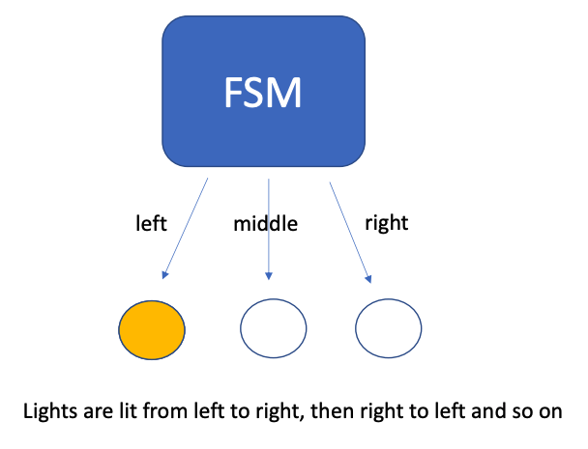
Q1 FSM
In the lecture example on "electronic eyes" (see slide 28 of https://nyu-cso.github.io/notes/arch-seq.pdf). The desired pattern of lights to be lit up is: left, middle, right, middle, left, middle, right ...
What is the minimum number of distinct state values needed for a FSM to implement this electronic eyes device?
4
next/ light middle
L
M1
next/ light left
next/ light right
M2
R
next/ light middle

Slide 6
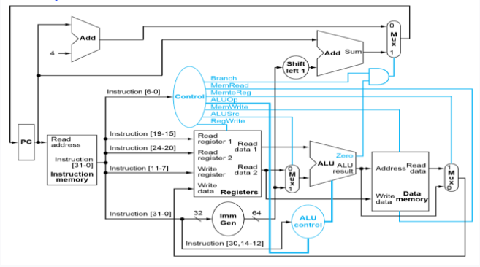
Q2 single-cycle CPU
Q2.1 Data path
Suppose the RISC-V instruction being executed is add x6, x7, x8, where x6 is the destination register, and x7/x8 are the 1st/2nd source register operand, respectively.
What are the values corresponding to Instruction[11-7] that are fed into the "write register" pins of the RegisterFile?
00110
Write register → register code
The code of register xi is i.
For example, the code of x5 is (00101)₂,
x6: (00110)₂
Note: use 5 bits since we have 32 registers

Slide 7
Q2.2 Control path
There are 3 Mux in the Figure whose selectors are to be set by the control logic, located at the top-right, bottom-middle, and bottom-right.
Which of the following instructions' execution cause the top-right Mux's selector to be set to 1?
add x6, x7, x8 //x6 = x7+x8
beq x6, x7, 100, if x6 and x7 have the same value.
beq x6, x7, 100, regardless of whether x6 and x7 have the same value.
ld x5, 40(x6) //load a doubleword (8-byte) from Memory[x6+40]Memory[x6+40] to register x5
addi x6, x7, 200 //x6 = x7+200
sd x5, 40(x6) //store a doubleword (8-byte) from register x5 to Memory[x6+40]Memory[x6+40]

Slide 8
Q2.2 Control path
Control which branch to take next (SB-type instruction)
Control whether write what read from memory back to register
Control the input for ALU

Slide 9
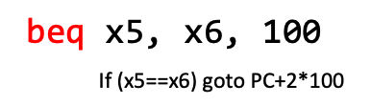
Q2.2 Control path
Control which how to compute next PC (SB-type instruction)
PC=PC+4
PC=target address (e.g. PC+2*100)

Slide 10
Q2.2 Control path
There are 3 Mux in the Figure whose selectors are to be set by the control logic, located at the top-right, bottom-middle, and bottom-right.
Which of the following instructions' execution cause the top-right Mux's selector to be set to 1?
add x6, x7, x8 //x6 = x7+x8
beq x6, x7, 100, if x6 and x7 have the same value.
beq x6, x7, 100, regardless of whether x6 and x7 have the same value.
ld x5, 40(x6) //load a doubleword (8-byte) from Memory[x6+40]Memory[x6+40] to register x5
addi x6, x7, 200 //x6 = x7+200
sd x5, 40(x6) //store a doubleword (8-byte) from register x5 to Memory[x6+40]Memory[x6+40]

Slide 11
Q2.3 Control path
Continuing from Q2.2, which of the following instructions cause the value for the bottom-middle Mux's selector (aka ALUSrc) to be set to 1?
add x6, x7, x8
beq x6, x7, 100, if x6 and x7 have the same value.
beq x6, x7, 100, regardless of whether x6 and x7 have the same value.
ld x5, 40(x6)
addi x6, x7, 200
sd x5, 40(x6)

Slide 12
Q2.3 Control path
Control ALU input
1 -> select Imm
0 -> select read data 2 (i.e. register)

Slide 13
Q2.3 Control path
Continuing from Q2.2, which of the following instructions cause the value for the bottom-middle Mux's selector (aka ALUSrc) to be set to 1?
add x6, x7, x8
beq x6, x7, 100, if x6 and x7 have the same value.
beq x6, x7, 100, regardless of whether x6 and x7 have the same value.
ld x5, 40(x6)
addi x6, x7, 200
sd x5, 40(x6)
x6 + 40 (imm)
x7 + 200 (imm)
x6 + 40 (imm)

Slide 14
Q2.3 Control path
sd x5, 40(x6)
x6
x6 + 40
40
x5

Slide 15
Q2.5 Control path
Which of the following instructions cause the value of the RegWrite input to the RegisterFile to be set?
add x6, x7, x8
beq x6, x7, 100, if x6 and x7 have the same value.
beq x6, x7, 100, regardless of whether x6 and x7 have the same value.
ld x5, 40(x6)
addi x6, x7, 200
sd x5, 40(x6)

Slide 16
Q2.5 Control path
Set when we want to store a value into a register
If set, write to this register
With this data

Slide 17
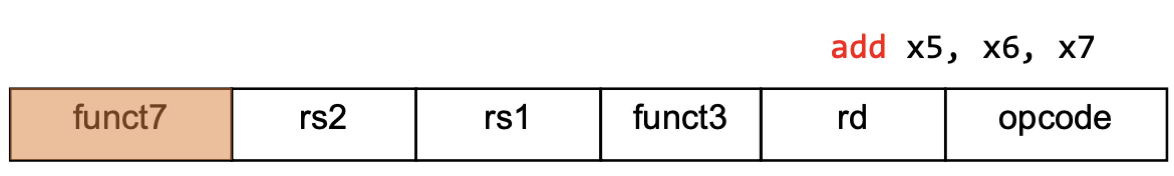
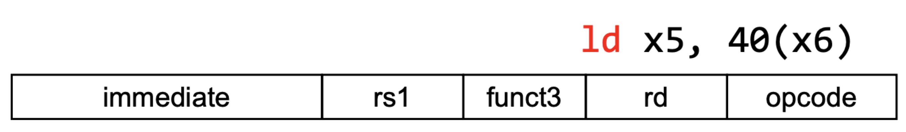
Q2.5 Control path
Which of the following instructions cause the value of the RegWrite input to the RegisterFile to be set?
add x6, x7, x8
beq x6, x7, 100, if x6 and x7 have the same value.
beq x6, x7, 100, regardless of whether x6 and x7 have the same value.
ld x5, 40(x6)
addi x6, x7, 200
sd x5, 40(x6)
[11:7] rd
x5= memory[x6+40]
[11:7] rd
write in memory: memory[x6+40]=x5

Slide 18
Q2.5 Control path
Set when we want to store a value into a register
With what data?
If set, write to this register
With this data

Slide 19
Q2.4 Control path
Data from memory
Set when we want to store a value into a register
With what data?
If set, write to this register
With this data
Data from ALU

Slide 20
Q2.4 Control path
Control what to write back to the register
1 -> select read data
ld x5, 40(x6)
x5=Mem[x6+40]
0 -> select ALU result
add x6, x7, x8
x6=x7+x8

Slide 21
Q2.4 Control path
Continuing from Q2.3, which of the following instructions cause the value for the bottom-right Mux's selector (aka MemToReg) to be set to 1?
add x6, x7, x8
beq x6, x7, 100, if x6 and x7 have the same value.
beq x6, x7, 100, regardless of whether x6 and x7 have the same value.
ld x5, 40(x6)
addi x6, x7, 200
sd x5, 40(x6)

Slide 22
Q2.2 Control path
6
x6
5
x6+40
memory[x6+40]
40
memory[x6+40]
x5= memory[x6+40]

Slide 23
Pipeline
Design & Hazards

Slide 24
RISC-V Pipeline
Pipeline increases throughput by overlapping execution of multiple instructions
We split the instruction memory from the data memory
Otherwise reading data would delay reading an instruction
There are 5 stages in the RISC-V pipeline
Instruction Fetch – IF
It takes a cycle to read an instruction from instruction memory
Instruction Decode – ID
Decode the instruction, read registers, and predict branching
Execute – EX
Performs computations using the ALU or performs shift operations
Memory Access - MEM
Read or write to memory
Write Back – WB
Write results to registers

Slide 25
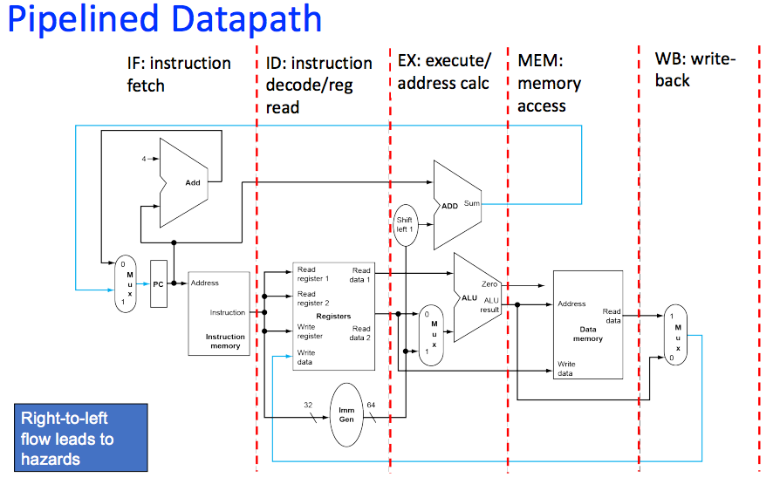
RISC-V Pipeline
Pipeline increases throughput by overlapping execution of multiple instructions
We split the instruction memory from the data memory
Otherwise reading data would delay reading an instruction
There are 5 stages in the RISC-V pipeline

Slide 26
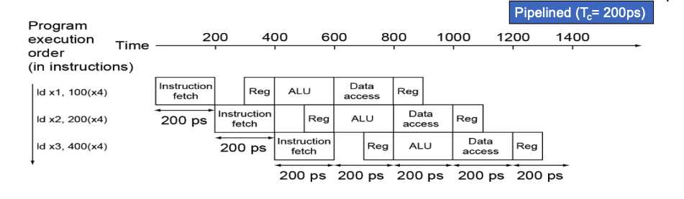
Pipeline latency and throughput
Latency=max(stage time) * #stages
e.g., stage times is
IF: 200ps; 1st Reg: 100ps; ALU: 200ps; Data access: 200ps; 2nd Reg: 100ps;
max(stage time)=200ps=clock cycle
latency=200ps*5=1ns
Throughput=1/max(stage time)=clock rate
e.g., 1/200ps

Slide 27
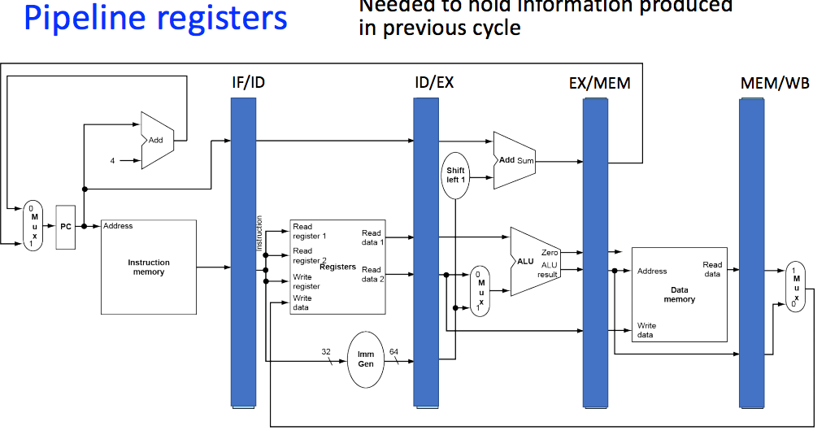
Pipeline Registers
In between each stage of the pipeline, we have registers store information
Each stage reads from the previous register to figure out what to do
Each stage writes to the next register to pass the instruction along

Slide 28
Assessment 13
Q2&3 Pipelined CPU

Slide 29
Q3 Pipelining performance
clock rate=throughtput=1/max stage time
old: 1/200
new: 1/400
old 2x faster
 | IF | ID | EX | MEM | WB | max
old | 200 | 100 | 200 | 200 | 100 | 200
new |  |  | 400 |  |  | 400

Slide 30
Q3 Pipelining performance
Suppose the 5 stage pipeline has the following latency for each pipeline stage, 200ps (Instruction fetch aka IF), 100ps (Register read aka ID), 200ps (ALU operation aka EX), 200ps (Data access aka MEM), 100ps (Register write aka WB).
Suppose we build a new CPU by adding the multiplication function to ALU, which causes the ALU latency to increase from 200ps to 400ps. Which of the following statements are true?
The new CPU has twice the instruction throughput of the original one.
The old CPU has twice the instruction throughput as fast as the new one.
The ALU latency increase would cause the new CPU to run at a slower clock rate than the old CPU.
The ALU latency increase would cause the new CPU to run at a faster clock rate than the old CPU.

Slide 31
Q4 Pipelining performance
Suppose we change the RISC-V ISA to restrict load/store instructions to use a base register only (without an immediate offset/displacement). Thus, load/store instructions no longer need to use the ALU to compute addresses. As a result, we can change the CPU to overlap the data access (aka MEM) and ALU operation (aka EX) into one stage, resulting in a 4-stage pipeline. Note that in the merged MEM-EX stage, an instruction either performs data access or ALU operation, but not both. Hence the merged stage still takes 200ps, same as the latency of either MEM or EX in Q2.

Slide 32
Q4
Merge

Slide 33
Q4
Merge
EX
IF
ID
WB
MEM
load/store instructions no longer need to use the ALU to compute addresses
Why we can merge them in a single stage?
Because there is no dependency.
No dependency => parallelism

Slide 34
Q4
Merge
Mem only depends on 2nd stage

Slide 35
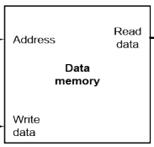
Q4
Merge

Slide 36
Q4.1 Clock speed
 | IF | ID | EX | MEM | WB | max
old | 200 | 100 | 200 | 200 | 100 | 200
new |  |  | 200 |  |  | 200
clock cycle (=max) remains unchanged
How does the new 4-stage design affect the clock speed?
Clock for 4-stage pipelined CPU must run faster than that in the 5-stage pipelined CPU.
Clock for 4-stage pipelined CPU must run slower than that in the 5-stage pipelined CPU.
Clock for 4-stage pipelined CPU can run at the same speed as that of the 5-stage pipelined CPU.

Slide 37
Q4.2 Instruction latency
How does the new 4-stage design affect the instruction latency?
instruction latency (e.g. for load) for 4-stage pipelined CPU is lower than that in the 5-stage pipelined CPU.
instruction latency (e.g. for load) for 4-stage pipelined CPU is higher than that in the 5-stage pipelined CPU.
instruction latency (e.g. for load) for 4-stage pipelined CPU is the same as that in the 5-stage pipelined CPU.
Instruction latency:
5-stage: 200ps*5
4-stage:
200ps*4

Slide 38
Pipeline hazard
However, not always true => hazard.
No dependency => parallelism
Pipeline: parallelly execute the instructions:
For a specific instruction, a stage depends on the previous stage.
But we can utilize the independency across instructions
We can execute the next instruction without waiting for the finish of the previous instruction => pipeline

Slide 39
Pipeline hazard
x5 = 0, x6 = 1, x7 = 1
add x5, x6, x7 (x5 = x6 + x7)
add x4, x5, x6 (x4 = x5 + x6)
x4 should be 3
add x5, x6, x7
IF
ID
EX
MEM
WB
add x4, x5, x6
IF
ID
EX
MEM
WB

Slide 40
Pipeline hazard
x5 = 0, x6 = 1, x7 = 1
add x5, x6, x7 (x5 = x6 + x7)
add x4, x5, x6 (x4 = x5 + x6)
x4 should be 3
add x5, x6, x7
IF
ID
EX
MEM
WB
add x4, x5, x6
IF
ID
EX
MEM
WB

Slide 41
Pipeline hazard
x5 = 0, x6 = 1, x7 = 1
add x5, x6, x7 (x5 = x6 + x7)
add x4, x5, x6 (x4 = x5 + x6)
x4 should be 3
x6 = 1
x7 = 1
add x5, x6, x7
IF
ID
EX
MEM
WB
add x4, x5, x6
IF
ID
EX
MEM
WB
inst

Slide 42
Pipeline hazard
x5 = 0, x6 = 1, x7 = 1
add x5, x6, x7 (x5 = x6 + x7)
add x4, x5, x6 (x4 = x5 + x6)
x4 should be 3
The result hasn’t written back to x5!
IF
ID
EX
MEM
add x5, x6, x7
ID
out
= 2
WB
add x4, x5, x6
IF
ID
EX
MEM
WB
Why?
x5 = 0
x6 = 1

Slide 43
Pipeline hazard
x5 = 0, x6 = 1, x7 = 1
add x5, x6, x7 (x5 = x6 + x7)
add x4, x5, x6 (x4 = x5 + x6)
x4 should be 3
add x5, x6, x7
IF
ID
EX
MEM
WB
add x4, x5, x6
IF
ID
EX
out
= 1
MEM
WB
Wrong! Should be 3

Slide 44
Pipeline hazard
Sometimes instructions depend on each other
In fact, that is very often the case, that some instruction uses the result of a previous instruction
This becomes an issue, however, when an instruction depends on a value that has been computed but not written back yet

Slide 45
Hazard Motivation
Consider the following C Program:
int calc(int a, int b, int c) {
a = a + b;
a = a + c;
return a;
}
Which becomes :
add x10, x10, x11
add x10, x10, x12
What might cause sadness here?

Slide 46
Pipeline hazard
Structure Hazard
Caused by limited hardware resources.
Solution: add resources (e.g., separating inst. and data mem)
Data Hazard
Control Hazard
Caused by the dependency between instructions:
The execution of i2 depends on some output of i1.
=> wouldn’t happen in sequential model, because i2 is executed after finishing i1 and thus i2 can always see the output of i1.

Slide 47
Pipeline hazard
Structure Hazard
Caused by limited hardware resources.
Solution: add resources (e.g., separating inst. and data mem)
Data Hazard
Control Hazard
i2 must wait for the finish of i1?
Can we get the output sooner and thus doesn’t affect the execution of i2?
Caused by the dependency between instructions:
The execution of i2 depends on some output of i1.
=> wouldn’t happen in sequential model, because i2 is executed after finishing i1 and thus i2 can always see the output of i1.

Slide 48
Forwarding
x5 = 0, x6 = 1, x7 = 1
add x5, x6, x7 (x5 = x6 + x7)
add x4, x5, x6 (x4 = x5 + x6)
x4 should be 3
add x5, x6, x7
IF
ID
EX
MEM
WB
Forwarding
out
= 2
add x4, x5, x6
IF
ID
EX
MEM
WB
x5 = 0
x6 = 1

Slide 49
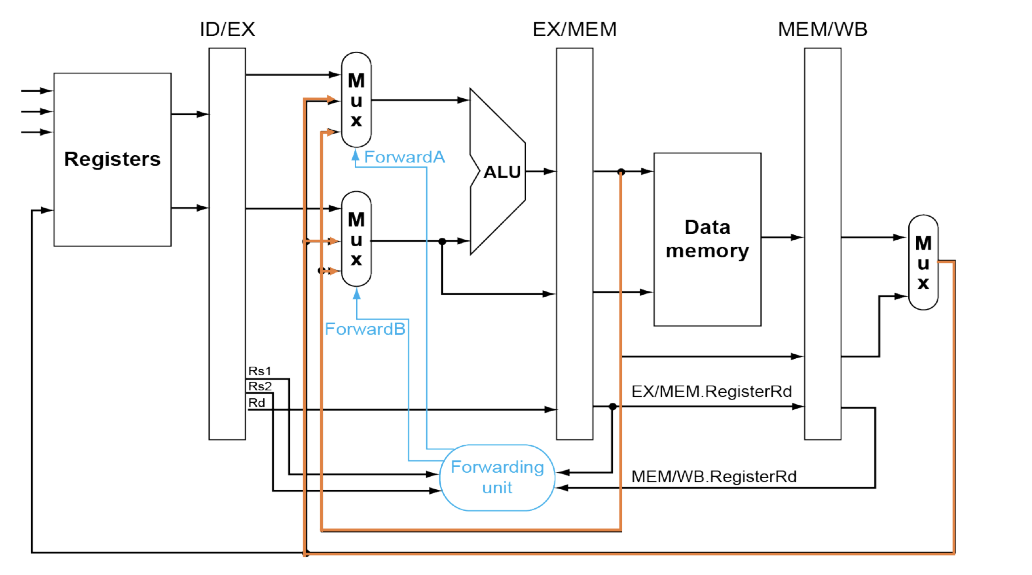
Forwarding
x5 = 0, x6 = 1, x7 = 1
add x5, x6, x7 (x5 = x6 + x7)
add x4, x5, x6 (x4 = x5 + x6)
x4 should be 3

Slide 50
Forwarding
x5 = 0, x6 = 1, x7 = 1
add x5, x6, x7 (x5 = x6 + x7)
add x4, x5, x6 (x4 = x5 + x6)
x4 should be 3
add x5, x6, x7
IF
ID
EX
MEM
WB
add x4, x5, x6
IF
ID
EX
out
= 3
MEM
WB
Correct!

Slide 51
Forwarding
The input of some stage s2 in i2 depends on the output of some stage s1 in i1:
E.g. i2’s input of EX stage depends on the i1’s output of EX stage
Trying to forward i1’s output of s1 to i2’s s2.
But this doesn’t work all the time.
Need to delay i2’s s2 until i1 has the output.
How? By adding bubble (nop instruction)
Sometimes i1 cannot have the output at the time when i2 needs it (e.g., i2’s input of EX depends on i1’s output of MEM)

Slide 52
Bubble
x5 = 0, x6 = 1, mem[101] = 1
i1: ld x5, x6(100) (x5 = mem[x6 + 100])
i2: add x4, x5, x6 (x4 = x5 + x6)
x4 should be 2
i1: ld x5, x6(100)
IF
ID
EX
MEM
WB
i2: add x4, x5, x6
IF
ID
EX
MEM
WB
input of i2’s EX stage depends on the output of i1’s MEM stage

Slide 53
Bubble
x5 = 0, x6 = 1, mem[101] = 1
i1: ld x5, x6(100) (x5 = mem[x6 + 100])
i2: add x4, x5, x6 (x4 = x5 + x6)
x4 should be 2
However, when i2 starts EX stage, i1 just starts its MEM stage!
=> We do not have the correct input yet!
i1: ld x5, x6(100)
IF
ID
EX
MEM
WB
i2: add x4, x5, x6
IF
ID
EX
MEM
WB
input of i2’s EX stage depends on the output of i1’s MEM stage

Slide 54
Bubble
x5 = 0, x6 = 1, mem[101] = 1
i1: ld x5, x6(100) (x5 = mem[x6 + 100])
i2: add x4, x5, x6 (x4 = x5 + x6)
x4 should be 2
However, when i2 starts EX stage, i1 just starts its MEM stage!
=> We do not have the correct input yet!
IF
ID
EX
MEM
WB
i1: ld x5, x6(100)
We need to delay i2’s EX stage,
so that i1 can prepare the required output.
How many bubbles?
i2: add x4, x5, x6
IF
ID
EX
MEM
WB
input of i2’s EX stage depends on the output of i1’s MEM stage

Slide 55
Bubble
x5 = 0, x6 = 1, mem[101] = 1
i1: ld x5, x6(100) (x5 = mem[x6 + 100])
i2: add x4, x5, x6 (x4 = x5 + x6)
x4 should be 2
How many bubbles?
How many cycles it needs for i1 to prepare the output before i2 uses it.
i1: ld x5, x6(100)
IF
ID
EX
MEM
WB
IF
When i2 starts EX, i1 starts MEM.
i1 just needs 1 more cycle and then it can provide the output.
ID
EX
MEM
WB
i2: add x4, x5, x6
WB

Slide 56
Bubble
x5 = 0, x6 = 1, mem[101] = 1
i1: ld x5, x6(100) (x5 = mem[x6 + 100])
i2: add x4, x5, x6 (x4 = x5 + x6)
x4 should be 2
How many bubbles?
How many cycles it needs for i1 to prepare the output before i2 uses it.
i1 has just finished MEM
i1: ld x5, x6(100)
IF
ID
EX
MEM
WB
out
= 1
bubble
IF
ID
EX
MEM
WB
i2: add x4, x5, x6
IF
ID
EX
MEM
WB
x5 = 0
x6 = 1
When i2 starts EX,

Slide 57
Bubble
x5 = 0, x6 = 1, mem[101] = 1
i1: ld x5, x6(100) (x5 = mem[x6 + 100])
i2: add x4, x5, x6 (x4 = x5 + x6)
x4 should be 2
How many bubbles?
How many cycles it needs for i1 to prepare the output before i2 uses it.
i1 has just finished MEM
i1: ld x5, x6(100)
IF
ID
EX
MEM
WB
out
= 1
i2: add x4, x5, x6
IF
ID
EX
MEM
WB
x5 = 0
x6 = 1
When i2 starts EX,

Slide 58
Bubble
x5 = 0, x6 = 1, mem[101] = 1
i1: ld x5, x6(100) (x5 = mem[x6 + 100])
i2: add x4, x5, x6 (x4 = x5 + x6)
x4 should be 2
How many bubbles?
How many cycles it needs for i1 to prepare the output before i2 uses it.
i1: ld x5, x6(100)
IF
ID
EX
MEM
WB
out
= 1
bubble
IF
ID
EX
MEM
WB
i2: add x4, x5, x6
IF
ID
EX
MEM
WB
x5 = 0
x6 = 1

Slide 59
Bubble
x5 = 0, x6 = 1, mem[101] = 1
i1: ld x5, x6(100) (x5 = mem[x6 + 100])
i2: add x4, x5, x6 (x4 = x5 + x6)
x4 should be 2
How many bubbles?
How many cycles it needs for i1 to prepare the output before i2 uses it.
i1: ld x5, x6(100)
IF
ID
EX
MEM
WB
bubble
IF
ID
EX
MEM
WB
i2: add x4, x5, x6
IF
ID
EX
MEM
WB
out
= 2

Slide 60
Pipeline hazard
Structure Hazard
Caused by limited hardware resources.
Solution: add resources (e.g., separating inst. and data mem)
Data Hazard
Solution: forwarding
works for EX-hazard & MEM-hazard
Load-use Hazard:
Solution: stall and insert bubble
Control Hazard
Solution: insert bubble
Reduce branch delay: by predicting branch in ID stage

Slide 61
Hazard Fix
There are two approaches to avoiding hazards
Forwarding
Be able to send data to an earlier location in the pipeline before write back
We do this by adding some multiplexers in the EX stage to choose between more recent values and the value from the register file
Stalling
Add a “bubble” to the pipeline to give us time to resolve the hazard
We do this by setting some of the controls to 0 and by preventing the PC from changing

Slide 62
Q4.3 Instruction throughput
How does the new 4-stage design affect the instruction throughput?
instruction throughput for 4-stage pipelined CPU is lower than that in the 5-stage pipelined CPU, under ideal (no hazard) scenarios.
instruction throughput for 4-stage pipelined CPU is higher than that in the 5-stage pipelined CPU, under ideal (no hazard) scenarios.
instruction throughput for 4-stage pipelined CPU is the same as that in the 5-stage pipelined CPU, under ideal (no hazard) scenarios.
4-stage pipelined CPU tends to have fewer hazards than 5-stage pipelined CPU.
4-stage pipelined CPU tends to have more hazards than 5-stage pipelined CPU.
4-stage pipelined CPU has the same amount of hazards as 5-stage pipelined CPU.
throughput is still 1/200ps

Slide 63
Q4.3 Instruction throughput
More stages, tend to have more hazards
E.g. sequential model: 1 stage, no hazards
Why?
Suppose i2 depends on the output of i1
Intuitively, with more stages, there are more cases that i1 is still in process when i2 needs the input, and causes a hazard.

Slide 64
Q4.3 Instruction throughput
i1: add x5, x6, x7
Nop
i2: add x4, x5, x6
i1 hasn’t written it back
=> hazard!
i1: add x5, x6, x7
IF
ID
EX
MEM
WB
When i2 tries to read x5
nop
IF
ID
EX
MEM
WB
i2: add x4, x5, x6
IF
ID
EX
MEM

Slide 65
Q4.3 Instruction throughput
i1: add x5, x6, x7
Nop
i2: add x4, x5, x6
i1 has just written it back
=> No hazard
IF
ID
EX
i1: add x5, x6, x7
ID
WB
nop
IF
ID
EX
WB
i2: add x4, x5, x6
IF
ID
EX
When i2 tries to read x5

Slide 66
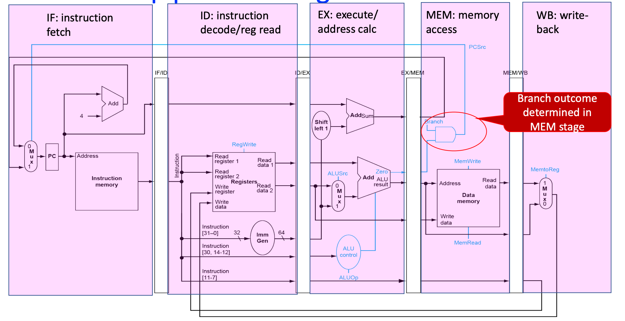
Control hazard
assume x5 = 0 x6 = 0
beq x5, x6, 100
add x1, x2, x3
…
Should jump to here:
add x7, x8, x9
How many bubbles?
Note: jump instruction can decide the address of the next instruction in MEM stage

Slide 67
Control hazard
assume x5 = 0 x6 = 0
i1: beq x5, x6, 100
add x1, x2, x3
…
Should jump to here:
i2: add x7, x8, x9
How many bubbles?
How many bubbles?
How many cycles it needs
for i1 to prepare the output
before next instruction uses it.
Q2: How many cycles does i1 need to finish that stage before i2 needs it?
Q1: what (the output of which stage of i1) does i2 need to correctly execute?
IF
ID
EX
MEM
i1: beq x5, x6, 100
ID
WB
IF
ID
EX
MEM
i2: add x7, x8, x9
ID
WB

Slide 68
Control hazard
assume x5 = 0 x6 = 0
i1: beq x5, x6, 100
add x1, x2, x3
…
Should jump to here:
i2: add x7, x8, x9
How many bubbles?
How many bubbles?
How many cycles it needs
for i1 to prepare the output
before next instruction uses it.
Q1: what (the output of which stage of i1) does i2 need to correctly execute?
IF
ID
EX
MEM
i1: beq x5, x6, 100
ID
WB
IF
ID
EX
MEM
i2: add x7, x8, x9
ID
WB
i2 needs the instruction address
=> decided by MEM stage in i1

Slide 69
Control hazard
assume x5 = 0 x6 = 0
i1: beq x5, x6, 100
add x1, x2, x3
…
Should jump to here:
i2: add x7, x8, x9
How many bubbles?
How many bubbles?
How many cycles it needs
for i1 to prepare the output
before next instruction uses it.
Q2: How many cycles does i1 need to finish that stage before i2 needs it?
i1 should finish MEM before i2 starts IF
i1 starts MEM at cycle k, i2 starts IF at cycle k+1
IF
ID
EX
MEM
i1: beq x5, x6, 100
ID
WB
IF
ID
EX
MEM
i2: add x7, x8, x9
ID
WB
i2 needs the instruction address
=> decided by MEM stage in i1

Slide 70
Control hazard
assume x5 = 0 x6 = 0
i1: beq x5, x6, 100
add x1, x2, x3
…
Should jump to here:
i2: add x7, x8, x9
How many bubbles?
How many bubbles?
How many cycles it needs
for i1 to prepare the output
before next instruction uses it.
Q2: How many cycles does i1 need to finish that stage before i2 needs it?
Currently, i1 starts MEM at cycle k, i2 starts IF at cycle ?
IF
ID
EX
MEM
i1: beq x5, x6, 100
ID
WB
IF
ID
EX
MEM
i2: add x7, x8, x9
ID
WB
i2 needs the instruction address
=> decided by MEM stage in i1

Slide 71
Control hazard
assume x5 = 0 x6 = 0
i1: beq x5, x6, 100
add x1, x2, x3
…
Should jump to here:
i2: add x7, x8, x9
How many bubbles?
How many bubbles?
How many cycles it needs
for i1 to prepare the output
before next instruction uses it.
Q2: How many cycles does i1 need to finish that stage before i2 needs it?
k - 2
k - 1
k
IF
ID
EX
MEM
i1: beq x5, x6, 100
ID
WB
IF
ID
EX
MEM
i2: add x7, x8, x9
ID
WB
i2 needs the instruction address
=> decided by MEM stage in i1

Slide 72
Control hazard
assume x5 = 0 x6 = 0
i1: beq x5, x6, 100
add x1, x2, x3
…
Should jump to here:
i2: add x7, x8, x9
How many bubbles?
How many bubbles?
How many cycles it needs
for i1 to prepare the output
before next instruction uses it.
Q2: How many cycles does i1 need to finish that stage before i2 needs it?
i1 should finish MEM before i2 starts IF
i1 starts MEM at cycle k, i2 starts IF at cycle k+1
k - 2
k - 1
k
IF
ID
EX
MEM
Delay i2 for 3 cycles!
=> Insert 3 bubbles
i1: beq x5, x6, 100
ID
WB
IF
ID
EX
MEM
i2: add x7, x8, x9
ID
WB
i2 needs the instruction address
=> decided by MEM stage in i1

Slide 73
Control hazard
Q2: How many cycles does i1 need to finish that stage before i2 needs it?
How many bubbles?
How many cycles it needs
for i1 to prepare the output
before next instruction uses it.
i1 has just finished MEM
i1: beq x5, x6, 100
IF
ID
EX
MEM
WB
IF
ID
EX
MEM
bubble
IF
ID
EX
bubble
IF
ID
When i2 starts IF
WB
bubble
i2: add x7, x8, x9
IF

Slide 74
Control hazard
Q2: How many cycles does i1 need to finish that stage before i2 needs it?
How many bubbles?
How many cycles it needs
for i1 to prepare the output
before next instruction uses it.
i1 has just finished MEM
i1: beq x5, x6, 100
IF
ID
EX
MEM
WB
IF
ID
EX
MEM
bubble
IF
ID
EX
bubble
IF
ID
When i2 starts IF
WB
bubble
i2: add x7, x8, x9
IF

Slide 75
Control hazard – current design
assume x5 = 0 x6 = 0
beq x5, x6, 100
i3: xxx
Should jump to here:
i2: xxx
How many bubbles?
However, result of x5==x6 is not available until EX
=> EX-IF dependency
How many bubbles?
How many cycles it needs for i1 to prepare the output before next instruction uses it.
2
IF
ID
EX
i1: beq x5, x6, 100
ID
WB
i3: xxx
IF
ID
EX
WB
Current design fetches i3 (PC+4)
Wrong instruction!!
What instruction to fetch??
PC+200 If x5==x6, otherwise PC+4
PC+200 in this case

Slide 76
Control hazard – design #1
Idea: always insert 2 bubbles for branch
assume x5 = 0 x6 = 0
beq x5, x6, 100
xxx
Should jump to here:
i2: xxx
How many bubbles?
out: x5==x6
IF
ID
EX
i1: beq x5, x6, 100
ID
WB
nop
IF
ID
EX
WB
nop
IF
ID
EX
IF
ID
EX
i2: xxx
mux

Slide 77
Control hazard – design #1’s problem
What if x5!=x6?
Actually no bubbles needed!
assume x5 = 0 x6 = 1
beq x5, x6, 100
i3: xxx // PC+4
…
i2: xxx // PC+200:
How many bubbles?
IF
ID
EX
i1: beq x5, x6, 100
ID
WB
i3: xxx
IF
ID
EX
WB
Fetch PC+4

Slide 78
Control hazard – design #2
What if x5!=x6?
Actually no bubbles needed!
assume x5 = 0 x6 = 1
beq x5, x6, 100
i3: xxx // PC+4
…
i2: xxx // PC+200:
How many bubbles?
Nop Controler
out: x5==x6?
nops if x5==x6
IF
ID
EX
i1: beq x5, x6, 100
ID
WB
i2: xxx
IF
ID
EX
WB
xxx
IF
ID
EX
IF
ID
EX
xxx
mux

Slide 79
Q4.4 others
How does the new 4-stage design affect the overall program performance?
Assuming no hazards, programs always execute faster under the 4-stage pipelined CPU than the original 5-stage pipeline.
Assuming no hazards, programs always execute slower under the 4-stage pipelined CPU than the original 5-stage pipeline.
Assuming no hazards, programs always execute at the same speed under the 4-stage pipelined CPU as the original 5-stage pipeline.
Assuming no hazards, programs can execute slower under the 4-stage pipelined CPU than the original 5-stage pipeline, because more instructions are needed (to calculate memory addresses for load/store).

Slide 80
Common question for lab5
Incomplete problem: Some circuits will be tested together
try to finish all circuits in one exercise, and check again
When implementing
Don't change the contents above the dash line, and
use Tunnels (not pins) as inputs and outputs
Building sub-circuits/sub-components and use Tunnels will help a lot
especially for complex implementation, i.e. bonus exercise: Logical Shift Right

Slide 81
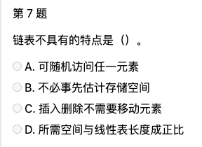
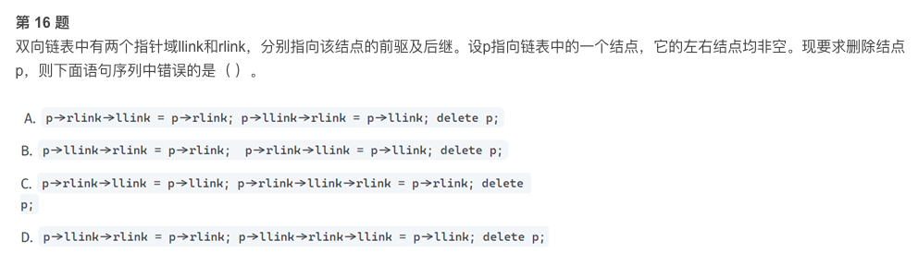
TODO
Find some exercises regarding topics
bits bytes ints, floats, pointers
Link link
Buffer overflow
assembly to c
malloc

Slide 82
Lab6
ALU & RegFile

Slide 83
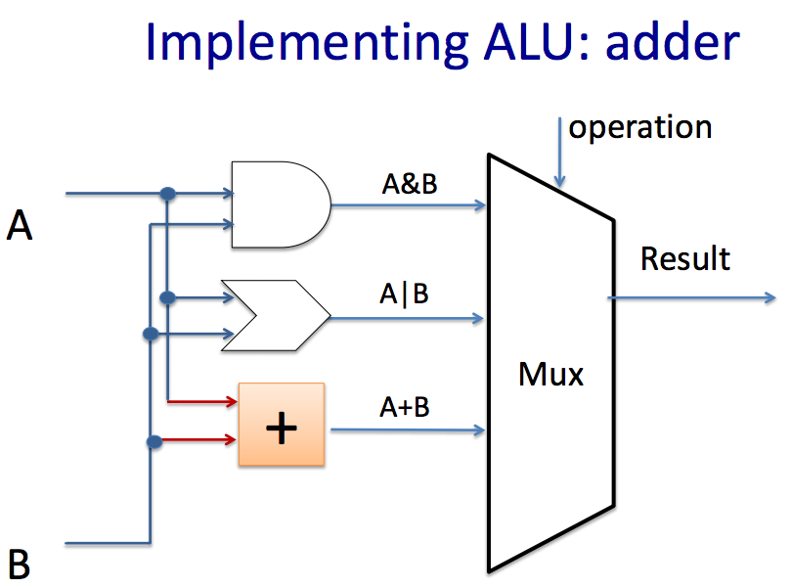
ALU
2 inputs, 1 ALU selector, 1 output(result)
You need to implement 14 instructions
add, sub, and, or, xor, srl, divu,…
allowed and encouraged to use built-in Logisim blocks to implement the arithmetic operations
combinatorial circuits
how to build any combinatorial circuits?
think about srl(unsigned right shift), sra(signed right shift), sll(left shift)
How to select the result?
“ALUSel”, MUX
Building sub-circuits and using Tunnels is helpful.

Slide 84
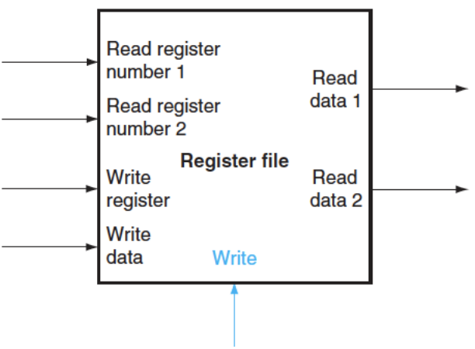
Register File
Register file: a set of registers that can be read and written
It’s a state element
Six inputs:
clock, rs1, rs2, rd, write data, RegWEn
Two outputs:
Read data 1, Read data 2
Step:
build register
Lab asks to implement 9 registers instead of 32
Provide some outputs for testing and debugging purposes
build register file

Slide 85
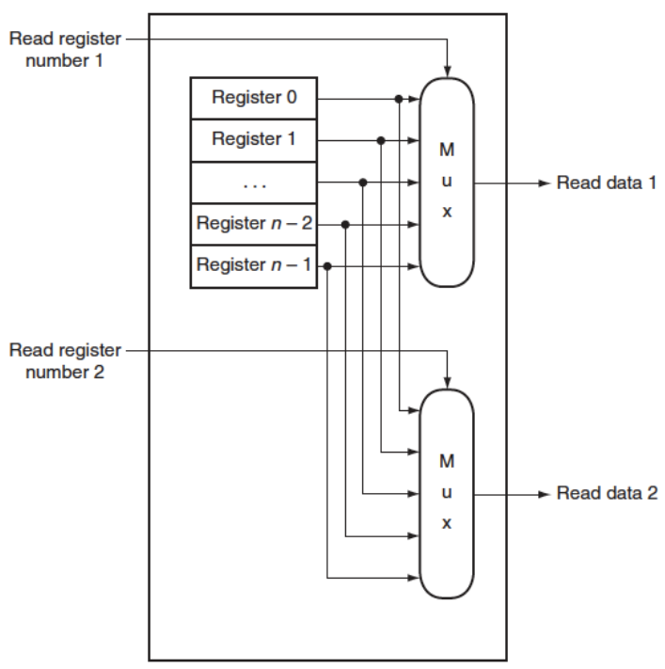
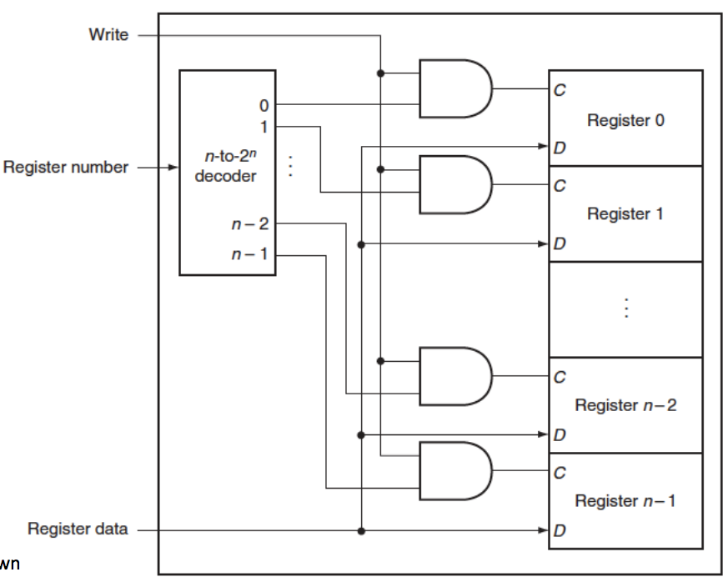
Register File
Think about DEMUX
Read:
Write:

Slide 86

Congrats to all
Great job!
Thanks for attending and supporting!
Good luck to all your final works~

