Slide 1
C - Basics, Bitwise Operator
Jinyang Li

Slide 2
Lesson plan
Overview
C program organization
Bitwise operators
Control flow

Slide 3
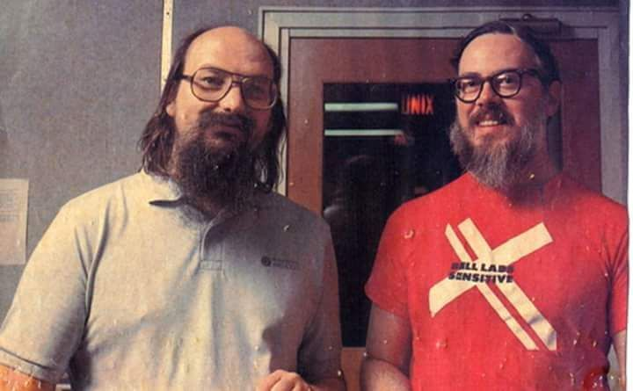
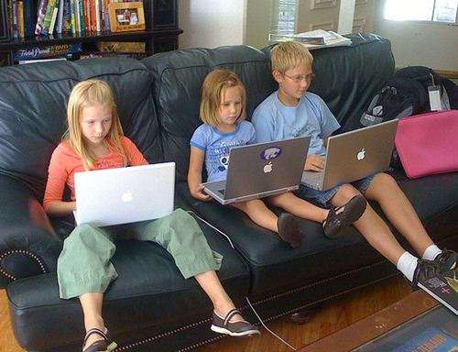
C is an old programming language
C (1972)
Java (1995) Python (2.0, 2000)
Notes:
Ken Thompson
Dennis Richie

Slide 4
C is an old programming language
C | Java | Python
1972 | 1995 | 2000 (2.0)
Procedure | Object oriented | Procedure & object oriented
Compiled to machine code, runs directly on hardware | Compiled to bytecode, runs by another piece of software | Scripting language, interpreted by software
static type | static type | dynamic type
Manual memory management | Automatic memory management with GC
Tiny standard library | Very Large library |  | Humongous library

Slide 5
Why learn C for CSO?
C is a systems language
Language for writing OS and low-level code
System software written in C:
Linux, Windows kernel, MacOS kernel
MySQL, Postgres
Apache webserver, NGIX
Java virtual machine, Python interpreter
Why learning C for CSO?
simple, low-level, “close to the hardware”

Slide 6
The simplest C program: “Hello World”
#include <stdio.h>
int main()
{
printf("hello, world\n");
return 0;
}
Equivalent to “importing” a library package
A function “exported” by stdio.h
hello.c
Compile:
gcc hello.c –o hello
Run
./hello
If –o is not given, output executable file is a.out

Slide 7
C program with multiple files: naïve organization
int sum(int x, int y)
{
return x+y;
}
#include <stdio.h>
#include <assert.h>
Void test_sum()
{
int r = sum(1,1);
assert(r == 2);
}
int main()
{
test_sum();
}
#include <stdio.h>
int main()
{
printf(“sum=%d\n”, sum(-1,1));
}
sum.c
main.c
Compile:
gcc sum.c test.c –o test
gcc sum.c main.c
test.c
Run:
./test
Sum.c compiled twice.
Wasteful
./a.out

Slide 8
C program with multiple files: *.h vs *.c files
Equivalent to “importing” a package
int sum(int x, int y)
{
return x+y;
}
#include <stdio.h>
#include <assert.h>
void test_sum()
{
int r = sum(1,1);
assert(r == 2);
}
int main()
{
test_sum();
}
#include <stdio.h>
int main()
{
printf(“sum=%d\n”, sum(-1,1));
}
#include “sum.h”
#include “sum.h”
sum.c
main.c
int sum(int x, int y);
sum.h
test.c

Slide 9
Common compilation sequence
(Binary)
object file main.o
linking
Source Code main.c
gcc –c main.c
(Binary) Executable a.out
gcc main.o sum.o
Source Code sum.c
gcc –c sum.c
(Binary)
object file sum.o
(Binary) Executable test
Source Code test.c
gcc –c test.c
(Binary)
object file test.o
gcc test.o sum.o –o test
C project uses the make tool to automate compiling with dependencies.
all: a.out test
test: test.o sum.o
gcc $^ -o $@
a.out: main.o sum.o
gcc $^ -o $@
%.o: %.c
gcc –c $^
Makefile
Notes:
xxd -b hello

Slide 10

Basic C
C’s syntax is very similar to Java
Java borrowed its syntax from C
Initial value
If uninitialized,
variable can have any value
Variable declaration: int a = 1;
Type
Name

Slide 11
Primitive Types (64-bit machine)
Either a character or an intger
type | size (bytes) | example
(unsigned) char | 1 | char c = ‘a’
(unsigned) short | 2 | short s = 12
(unsigned) int | 4 | int i = 1
(unsigned) long | 8 | long l = 1
float | 4 | float f = 1.0
double | 8 | double d = 1.0
pointer | 8 | int *x = &i
Next lecture
Old C has no native boolean type. A non-zero integer represents true, a zero integer represents false
C99 has “bool” type, but one needs to include <stdbool.h>

Slide 12
Implicit conversion
int main()
{
int a = -1;
unsigned int b = 1;
if (a < b) {
printf("%d is smaller than %d\n", a, b);
} else if (a > b) {
printf("%d is larger than %d\n”, a, b);
}
return 0;
}
$gcc test.c
$./a.out
-1 is larger than 1
No compiler warning!
Compiler converts int types to the one with the larger value (e.g. char → unsigned char → int → unsigned int)
-1 is implicitly cast to unsigned int (4294967295)₁₀

Slide 13
Explicit conversion (casting)
int main()
{
int a = -1;
unsigned int b = 1;
if (a < (int) b) {
printf("%d is smaller than %d\n", a, b);
} else if (a > (int) b) {
printf("%d is larger than %d\n”, a, b);
}
return 0;
}

Slide 14
Lesson Plan
Bitwise operators
Control Flow
goto
Function & variable storage

Slide 15
Operators
Arithmetic | +, -, *, /, %, ++, --
Relational | ==, !=, >, <, >=, <=
Logical | &&, ||, !
Bitwise | &, |, ^, ~, >>, <<
Arithmetic, Relational and Logical operators are identical to java’s

Slide 16
Bitwise AND: &
Truth table (of boolean function AND)
x | y | x AND y
0 | 0 | 0
0 | 1 | 0
1 | 0 | 0
1 | 1 | 1
How many rows if function has n boolean (aka 1-bit) inputs?
2^{n}
Operator & applies AND bitwise to two integers
( 0 1 1 0 1 0 0 0 )₂
&
( 0 1 0 1 0 1 0 1 )₂
Result of 0x68 & 0x55
( 0 1 0 0 0 0 0 0 )₂

Slide 17
Example use of &
& is often used to mask off bits
b & 0 = 0
b & 1 = b
?
b is any bit
?
int clear_msb(int x) {
}
return x & 0x7fffffff;

Slide 18
Bitwise OR: |
x | y | x OR y
0 | 0 | 0
0 | 1 | 1
1 | 0 | 1
1 | 1 | 1
Operator | applies OR bitwise to two integers
( 0 1 1 0 1 0 0 0 )₂
Result of 0x68 | 0x55
|
( 0 1 0 1 0 1 0 1 )₂
( 0 1 1 1 1 1 0 1 )₂

Slide 19
Example use of |
| can be used to turn some bits on
b | 1 = 1
b | 0 = b
?
?
int set_msb(int x) {
}
return x | 0x80000000;

Slide 20
Bitwise NOT: ~
x | NOT x
0 | 1
1 | 0
Operator ~ applies NOT bitwise to two integers
~
( 0 1 1 0 1 0 0 0 )₂
result of ~0x68
( 1 0 0 1 0 1 1 1 )₂

Slide 21
Bitwise XOR: ^
x | y | x XOR y
0 | 0 | 0
0 | 1 | 1
1 | 0 | 1
1 | 1 | 0
Operator ^ applies XOR bitwise to two integers
( 0 1 1 0 1 0 0 0 )₂
result of 0x68^0x55
^
( 0 1 0 1 0 1 0 1 )₂
( 0 0 1 1 1 1 0 1 )₂

Slide 22
Bitwise left-shift: <<
x << y, treat x as a bit-vector, shift x left by y positions
Throw away bits shifted out on the left
Fill in 0’s on the right
result of 0x69<<3 ?
(0 1 1 0 1 0 0 1)₂
=(0 1 0 0 1 0 0 0)₂

Slide 23
Bitwise right-shift: >>
x >> y, shift bit-vector x right by y positions
Throw away bits shifted out on the right
Logical shift: Fill with 0’s on left
Arithmetic shift: Replicate msb on the left
Result of (logical) right-shift: 0xa9 >> 3
(1 0 1 0 1 0 0 1)₂
=(0 0 0 1 0 1 0 1)₂
Result of (arithmetic) right-shift: 0xa9 >> 3
=(1 1 1 1 0 1 0 1)₂

Slide 24
Which shift is used in C ?
Arithmetic shift for signed numbers
Logical shifting on unsigned numbers
int a = 1;
a = a>>31;
int b = -1;
b = b >>31;
unsigned int b = 0xffffffff;
b = b >>31;
b = 1
??
a=0 b=-1
??
??

Slide 25
Example use of shift
int multiply_by_powers_of_two(int x, int p)
{
}
return x << p;
int divide_by_powers_of_two(int x, int p)
{
}
return x >> p;
Caveat: right-shift rounds down, different from integer division “/” which rounds towards zero.
e.g. -1>>1=-1, but -1/2 = 0

Slide 26
Example use of shift
// clear bit at position pos
// rightmost bit is at 0th pos
int clear_bit_at_pos(int x, int pos) {
}
unsigned int mask = 1 << pos;
return x & (~mask);

Slide 27
C’s Control flow
Same as Java
Conditional:
if ... else if ... else
switch
Loops: while, do while, for
continue
break

Slide 28
goto allows jump anywhere
while (cond) {
...
}
B:
...
for(...) {
for(...) {
for(...) {
goto error
}
}
}
error:
code handling error
Any control flow primitive can be
expressed as a bunch of goto’s.
A:
if (cond == false) goto B;
...
goto A
B:
...
May be the only acceptable scenario for goto
There’s no goto in Java or core Python
There’s no try/catch or try/except in C

Slide 29
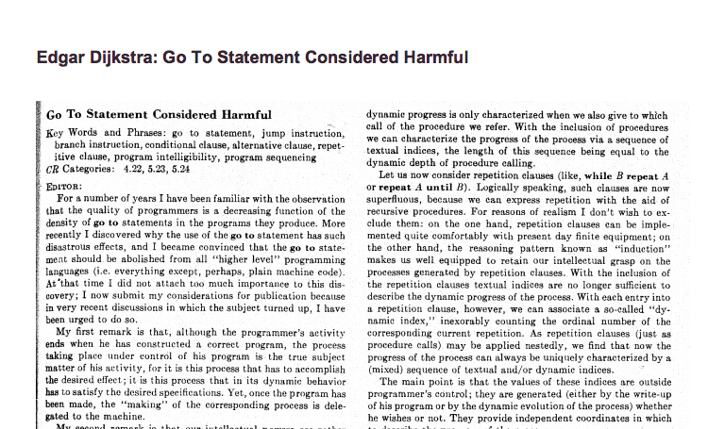
Avoid goto’s whenever possible

Slide 30
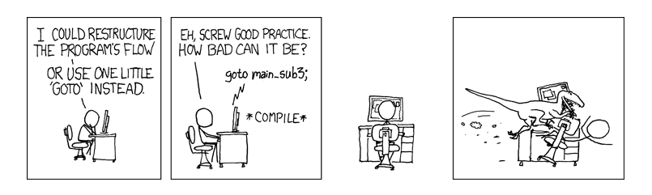
Avoid goto’s whenever possible

Slide 31
C is a procedural-language
C program consists of functions
Also called procedures or subroutines
Why breaking code into functions?
Readability and Reusability
Keep functions short
General rules of thumb
Small enough to keep the code in your head
Fits on screen without scrolling

Slide 32
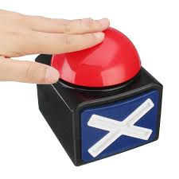
Variable and its storage: local variable
Local variables are
defined inside a function
int add(int a, int b)
{
int r = a + b;
return r;
}
You can view function arguments
as local variables defined in
function body
r’s scope is in function add
Local variable scope:
Within the function/block the local variable is declared
Local variables with the same name in different scopes are unrelated
Shadowing: Nested variable “hides” the outer variable of the same name in areas where they are both in scope
int add(int a, int b)
{
int r = a;
{
int r;
r += b;
}
return r;
}
What does add compute?

Slide 33
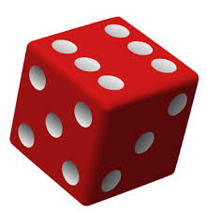
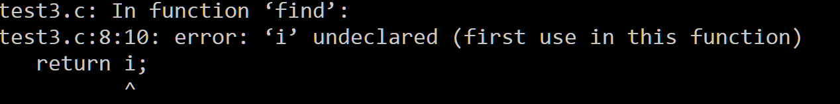
Variable and its storage: local variable scope
int find(int start, int end)
{
for (int i = start; i < end; i++) {
if ((i % 3) == 0)
break;
}
return i;
}
$gcc –std=c99 test.c

Slide 34
Variable and its storage: local variable scope
int find(int start, int end)
{
int r;
for (int i = start; i < end; i++) {
if ((i % 3) == 0) {
r = i;
break;
}
}
return r;
}
Correct?

Slide 35
Variable and its storage: local variable storage
Local variable storage:
allocated upon function invocation, not initialized
deallocated upon function return
void add(int a, int b)
{
int result = a + b;
return;
}
int main()
{
int result = 0;
add(1, 2);
printf(“r=%d\n”, result);
}
Program output?

Slide 36
Variable and its storage: global variable
Global variables are defined
outside any function
#include <stdio.h>
int r = 0;
int sum(int a, int b)
{
r = a + b;
}
int main()
{
sum(1,2);
printf(“r=%d\n”, r);
}
int r = 0;
Global variable scope:
Can be accessed from within any function
May be shadowed
Global variable storage
Allocated upon program start, initialized to 0
Deallocated when entire program exits

Slide 37
Function invocation: pass by value
C (and Java) passes arguments by value
void swap(int x, int y)
{
int tmp = x;
x = y;
y = tmp;
}
int main()
{
int x = 1;
int y = 2;
swap(x, y);
printf(“x: %d, y: %d”, x, y);
}
?
?
Result x: 1, y: 2

Slide 38
Function invocation: pass by value
void swap(int x, int y)
{
int tmp = x;
x = y;
y = tmp;
}
int main()
{
int x = 1;
int y = 2;
swap(x, y);
printf(“x: %d, y: %d”, x, y);
}
main.x:
main.y:
…
swap.x:
swap.y:
swap.tmp:

Slide 39

Breakout time!
Notes:
https://forms.gle/HbKYeKWCCgREpoKm6

Slide 40
Breakout exercises
Clear fraction fields of 10.0 --> ??
Clear fraction field of 0.2 → ??
8.0
0.125
float clear_exp_field(float f)
{
int fi = *(int *)&f; //re-interpret bit-pattern of f as int
int r = 0; //TODO: add your code here
return *(float *)&r; //re-interpret bit-pattern of r as float
}
r = (fi >> 23) <<23;

Slide 41
Example use of shift
// set bit at position pos
// rightmost bit is at 0th pos
int set_bit_at_pos(int x, int pos)
{
}
unsigned int mask = 1 << pos;
return x | mask;

Slide 42
Exercises
Given a number, write a function to decide if it is even?
bool isEven(int n) {
}

Slide 43
Exercises
Given a number, write a function to decide if it is even?
bool isEven(int n) {
return (n & 0x1) == 0;
}

Slide 44
Exercises
Given a number, write a function to decide if it is even?
bool isEven(int n) {
return (n % 2) == 0;
}

Slide 45
Exercises
Given a number, write a function to decide if it is a power of two?
bool isPowerOfTwo(unsigned int n) {
}

Slide 46
Exercises
Given a number, write a function to decide if it is a power of two?
bool isPowerOfTwo(unsigned int n) {
if (n==0) return false;
while (n > 1) {
if (n % 2) // (n%2)!=0
return false;
n = n >> 1;
}
return true;
}

Slide 47
Exercises
Given a number, write a function to decide if it is a power of two?
bool isPowerOfTwo(unsigned int n) {
return (n & (n-1)) == 0;
// n&(n-1) clears rightmost bit-of-1 in n
}

Slide 48
Exercises
Given a number, write a function to decide if it is a power of two?
bool isPowerOfTwo(unsigned int n) {
return n != 0 && (n & (n-1)) == 0;
}
Notes:
-2147483648

Slide 49
Exercises
Count the number of ones in the binary representation of the given number ?
(n > 0)
int count_one(int n) {
}
Notes:
-2147483648

Slide 50
Exercises
Count the number of ones in the binary representation of the given number ?
(n > 0)
int count_one(int n) {
int count = 0;
while (n != 0 ) {
count += (n % 2);
n = (unsigned int)n>>1;
}
return count;
}
Notes:
-2147483648

Slide 51
Exercises
Count the number of ones in the binary representation of the given number ?
bool count_one(int n) {
}
A trick – clear the rightmost bit-of-1: n & (n -1)

Slide 52
Exercises
Count the number of ones in the binary representation of the given number ?
int count_one(int n) {
int count = 0;
while(n != 0) {
n = n&(n-1);
count++;
}
return count;
}

