Slide 1
CSO-Recitation 09 CSCI-UA 0201-007
R09: Assessment 07 & More Assembly

Slide 2
Today’s Topics
Assessment 07
More Assembly
Procedure calls & data segment
Breakout exercises

Slide 3
Assessment 07

Slide 4
Q1 %eax
Suppose register %eax corresponds to the C variable x of some integer type. If the value of %eax is 0xffffffff, what potentially could be the type and value of x?
type: int, value: -1
type: int, value: -2^{31}
type: long, value: -1
type: long, value: -2^{63}
type: unsigned int, value: 2^{32}-1
type: unsigned int, value 2^{32}
type: unsigned long, value 2^{32}-1
type: unsigned long, value 2^{32}

Slide 5
Q2 movq
Suppose register %rdi and %rsi corresponds to C variable x and y, respectively. Given machine instruction movq (%rdi, %rsi, 8), %rax, what can you infer to be the most likely type of x and y, respectively?
long and long
long * and long
long * and long *
int * and long
int and int
int * and int
int * and int *
movq (%rdi, %rsi, 8), %rax
(%rdi, %rsi, 8)
*(x+8y)
x+8y is a pointer
y is an integer type, since %rsi, y should be long type
x is also 8 bytes, here, more likely to be long * type
movl (%rdi, %rsi, 4), %rax

Slide 6
Q3 Deference pointers
Suppose %rsi corresponds to C variable y of some pointer type. Which of the following instructions dereference the pointer y?
leaq (%rsi), %rax
movq (%rsi), %rax
movq %rsi, %rax
subq %rax, (%rsi)
subq %rax, %rsi
none of the above
derefence the pointer y stored in register %rsi:
(%rsi)
lea: no memory access!

Slide 7
Q4 Basic machine execution
Which of the following statements are true?
Accessing data stored in memory is as fast as accessing data stored in CPU registers.
Accessing data stored in memory is much slower than accessing data in CPU registers.
A C program is compiled into x86 instructions which are directly executed by the CPU.
A Java program is compiled into x86 instructions which are directly executed by the CPU.
One can use %rip as an operand for the mov instruction
only 16 general purpose registers

Slide 8
Q5 mov vs. lea
Let a be an array of int elements. Suppose %rdi stores the address of a[0], and %rsi stores index i of type long. Which of the following instruction or sequence of instructions result in %eax storing a[i]?
leal (%rdi, %rsi, 4), %eax
movl (%rdi, %rsi, 4), %eax
movl (%rsi, %rdi, 4), %eax
leal (%rdi, %rsi, 8), %eax
movl (%rdi, %rsi, 8), %eax
movl (%rsi, %rdi, 8), %eax
salq $2, %rsi
addq %rdi, %rsi
movl (%rsi), %eax
salq $2, %rsi
movl (%rsi, %rdi), %eax
a is an array of int
a[i] == *(a+i)
(%rdi, %rsi, 4)
salq src, dest => dest=dest << src
arithmetic left shift
salq $2, %rsi
== 4 * %rsi
now, %rsi -> 4i
then, %rsi=%rsi+%rdi=4i+&a[0]
then, derefence it to get the value of a[i]

Slide 9
Q6 Lab3 with gdb
For the next series of questions, you need to use gdb to run Lab3's tester_sol which is the executable tester linked with ex_sol{1-5}.o.
Q6.1 ex1
Stop execution in the first invocation of function ex1 (use breakpoints).
Examine ex1's machine instructions. What is the value of register %rsi prior to executing the first instruction of ex1? (%rsi contains the second function argument).
(Please write the value as a decimal number)
100

Slide 10
Q6 Lab3 with gdb
Q6.2 ex1
During tester_sol's first invocation of function ex1, what is the value of register %eax prior to the function's return? (Write the value as a decimal number)
1
Q6.3 ex2
During tester_sol's first invocation of function ex2, what is the value of register %rsi prior to executing the first instruction of ex2? (%rsi contains the second function argument).
(Please write the value as a decimal number)
4

Slide 11
Q6 Lab3 with gdb
Q6.4 ex2 (%rdi)
During tester_sol's first invocation of function ex2, what is the value of register %rdi prior to executing the first instruction of ex2? (%rdi contains the first function argument).
Please write %rdi's value as a decimal number.
140737488347056
140737488347024
Q6.5 ex2 (%rdi)
This question is the same as Q6.4, except that please write %rdi's value as a hex number (your answer should include the prefix 0x)

Slide 12
Q6 Lab3 with gdb
Q6.6 ex2 (%rdi)
By looking at your answers for Q6.4 and Q6.5, guess the most likely data type for the variable stored in %rdi (which is the first argument of function ex2)?
unsigned long
long
int
unsigned int
some pointer type
none of the above

Slide 13

Q6 Lab3 with gdb
Q6.7 ex2
The machine instructions for ex2 contain the following instruction
For which values of %ecx would the jump to instruction at address 0x55555555492a occur?
zero
any positive value
any negative value
1
None of the above
testq src dst: like andq src, dst except dst is unchanged
set ZF, SF appropriately
jle label: less or euqal (signed)
(SF^OF) | ZF
when ZF?
val(%ecx)=0
when SF^OF ?
OF -> 0
so SF should be set (SF-> 1). When?
val(%ecx) is negative

Slide 14
Procedure calls
Calling functions

Slide 15
How do you call functions?
How do you actually start executing the code of a function?
Well, we know about jmp, does that help us? Why not?
Do you need to do something before calling a function?
What?

Slide 16
How do you call functions?
mystrlen: main:
movl $0, %eax jmp mystrlen
jmp .condition
.loop:
addl $1, %eax
.condition:
movb (%rdi,%rax), %bl
cmp $0, %bl
jne .loop

Slide 17
How do you call functions?
mystrlen: main:
movl $0, %eax jmp mystrlen
jmp .condition
.loop:
addl $1, %eax
.condition:
movb (%rdi,%rax), %bl
cmp $0, %bl
jne .loop

Slide 18
How do you call functions?
mystrlen: main:
movl $0, %eax //Where are the arguments?
jmp .condition jmp mystrlen
.loop:
addl $1, %eax
.condition:
movb (%rdi,%rax), %bl
cmp $0, %bl
jne .loop
// How do we get back?

Slide 19
Remember where we came from
A function that calls another (a caller) knows what it is calling
A function that is called (a callee) does not know who its caller is
But it needs to know where to restore execution when it is done
It is the responsibility of the caller to tell the callee where to restore execution
We want to restore execution on the instruction after we called the function
We store this return address on the stack
callq handles this for us

Slide 20
Set up registers
The first six arguments are stored in this order:
%rdi, %rsi, %rdx, %rcx, %r8, %r9
So when calling a function, you must set those registers to the correct value for that argument
The return value is stored in %rax
Functions may feel free to use the argument registers and the return value register, as well as %r10, and %r11
If the caller was using the argument registers for something, it must save them first, as the callee may use those registers for any purpose
It can save them to the stack
This is also true of the registers %r10, %r11, and %rax
The callee must save certain registers if it plans on using them
They are %rbx, %r12, %13, %r14, %rbp, and %rsp

Slide 21
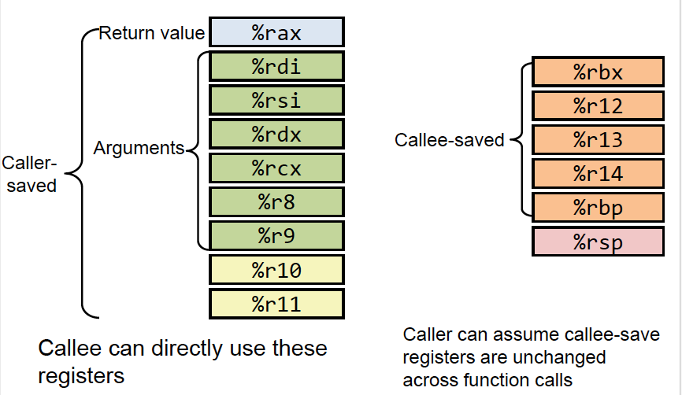
Set up registers

Slide 22
The stack
The register %rsp points to the top of the stack
The stack grows downwards
We use it to store return addresses as well as registers whose values we don’t want to lose
We use it to store the 7th, 8th, 9th etc. function arguments
We also use it to store local variables
You can use pushq and popq to add and remove things from the stack

Slide 23
The Stack
pushq src
Takes one operand
DECREASES %rsp by 8
THEN stores the operand at the memory location given by the new %rsp

Slide 24
The Stack
popq dst
Takes one operand
Takes the value in memory located at %rsp and stores it in the operand
THEN INCREASES %rsp by 8

Slide 25
The Stack
callq label
Takes one operand
DECREASES %rsp by 8
THEN stores the return address at the memory location given by the new %rsp
THEN jumps to the operand
Push
return address on stack

Slide 26
The Stack
retq
Takes no operands
Jumps to the location given by the value in memory located at %rsp
THEN INCREASES %rsp by 8

Slide 27
Data segment
Stack
Heap
Statically-allocated data
Code segment
Local variable
Local variables
Stack
C’s primitive data type and pointer – registers whenever possible
Array, struct
Global variables
global variable / static global variable
Dynamic allocated variables
e.g. malloc
Heap
Dynamically allocated variable
Global Variable
executable instructions

Slide 28
Example of Array/Struct accessing
Array Accessing Example
int getnum(int *arr, long i) { return arr[i];}
Suppose %rdi contains arr; %rsi contains i; %eax is to contain arr[i]
movl (%rdi, %rsi, 4), %eax
char* getpointer(char **arr, long i) { return arr[i];}
Suppose %rdi contains arr; %rsi contains I; %rax is to contain arr[i]
movq (%rdi, %rsi, 8), %rax

Slide 29
Example of Array/Struct accessing
typedef struct node {
long id;
char *name;
struct node *next;
}node;
void init_node(node*n, long id, char *name){
n->id=id;
n->name=name;
n->next=NULL;
}
id | name | next
0 8 16 24
movq %rsi, (%rdi)
movq %rdx, 8(%rdi)
movq $0, 16(%rdi)

Slide 30
Exercise
Notes:
https://forms.gle/esDkxPLGTttSAcKLA

