Slide 1
Carnegie Mellon
Computer Systems Organization
https://nyu-cso.github.io
Jinyang Li

Slide 2
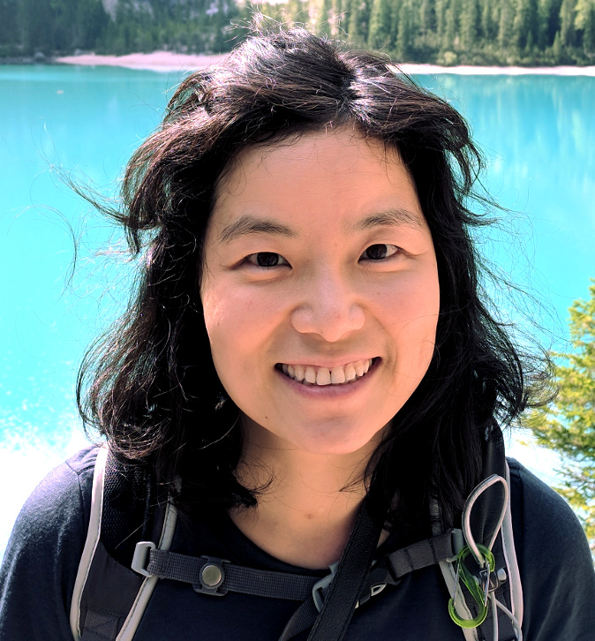

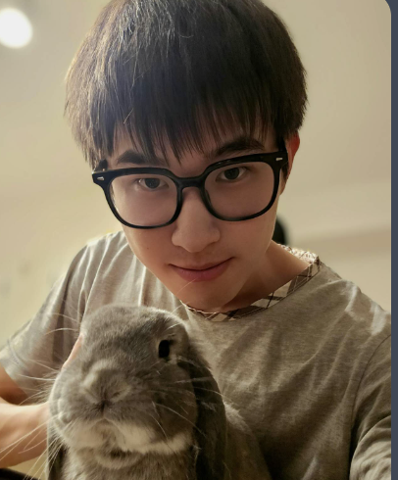
Carnegie Mellon
Course information
Lecturer: Prof. Jinyang Li
MW 3:30-4:45pm, 60 Fifth Ave 150
Recitation instructor:
David Pissarra
F 12:30-1:45pm, Silv 206
Course Assistants:
Zhanghan Wang & David Pissarra

Slide 3


Course Goal
Beyond learning how to program
Learn the gritty internals of how a computer system works
You after CS101, 102
You after CS201, 202

Slide 4
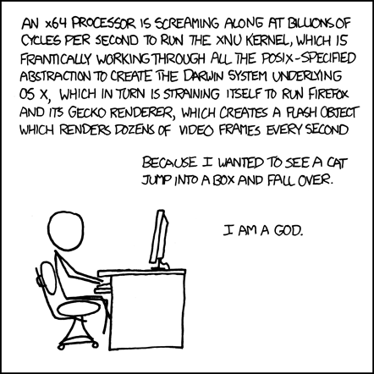
Goal: learn how computer systems work
Covered
by CSO
To be covered
by OS (202)

Slide 5

Components of a computer

Slide 6
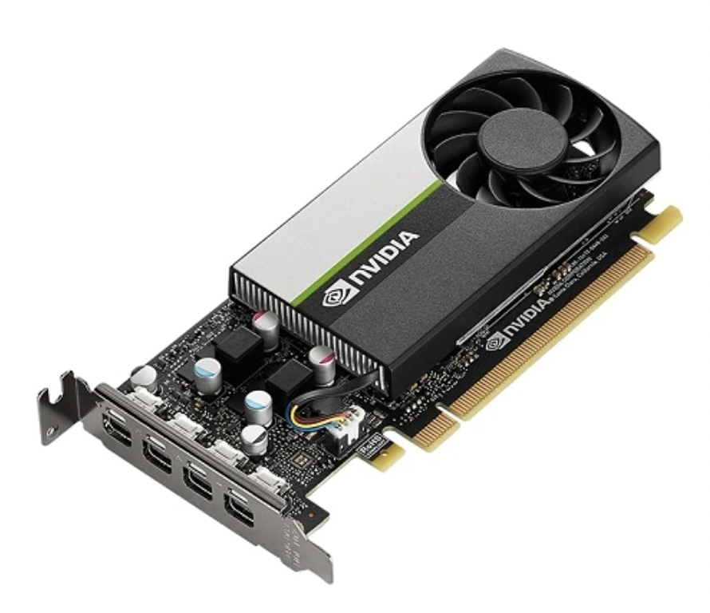
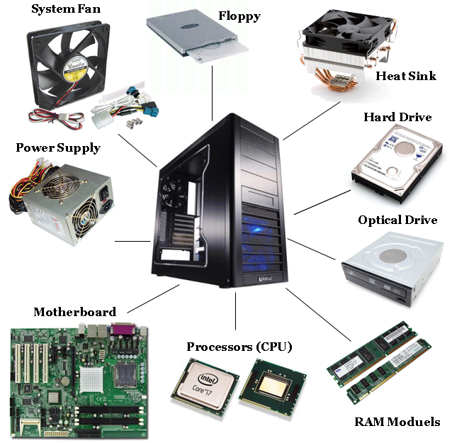
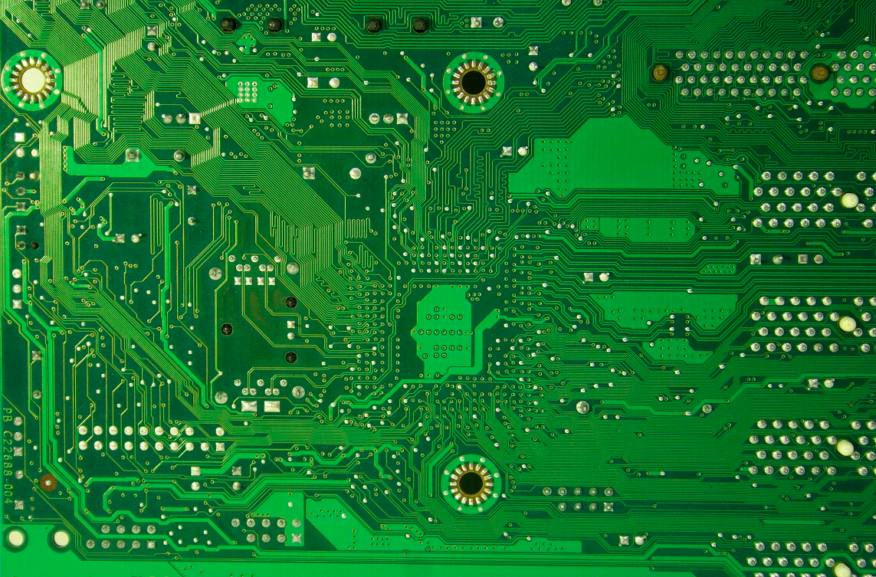
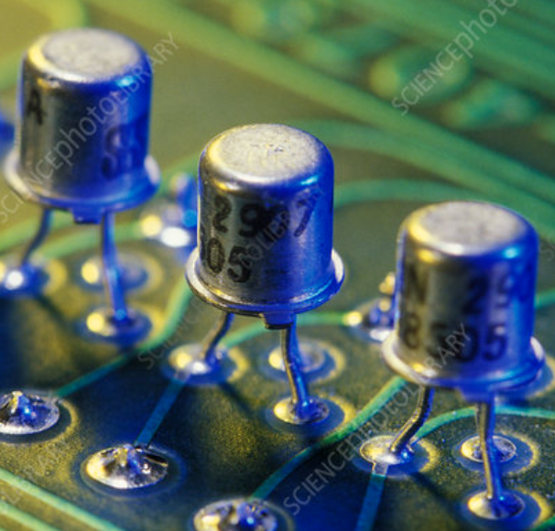
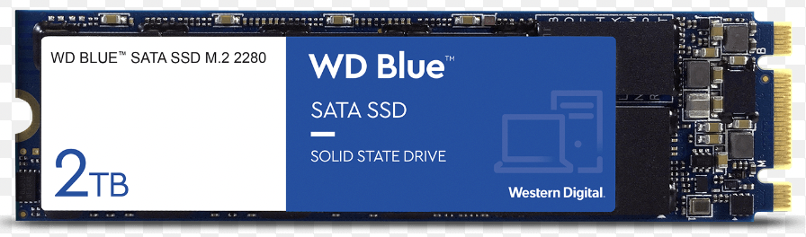
Components of a computer: hardware
GPU
SSD
Printed
Circuits
Transistors
Memory

Slide 7


Components of a computer: hardware + software
Printed Circuit

Slide 8
Layered Organization
Software
Hardware

Slide 9
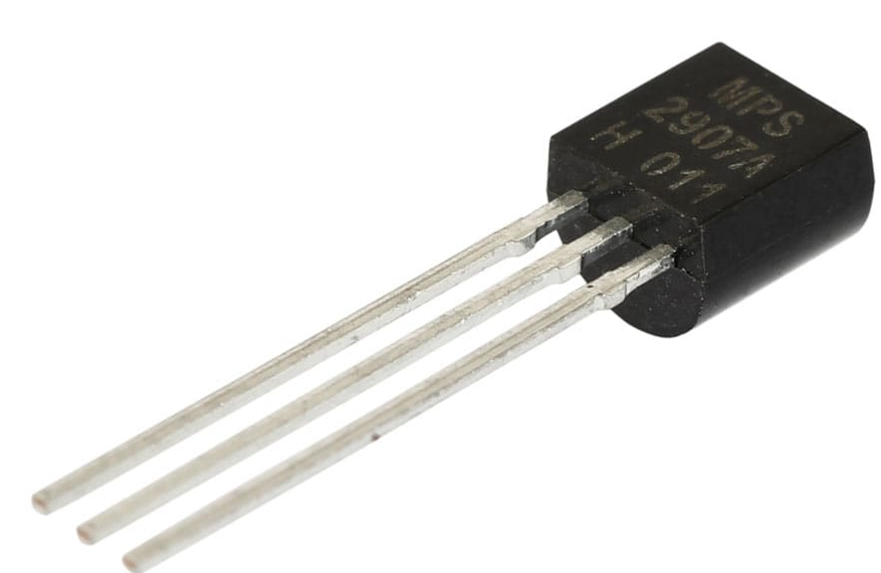
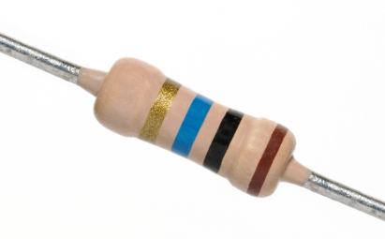

Layered Organization
Software
Hardware
Transistors
Diodes
Resistors

Slide 10
Layered Organization
Software
Hardware
Logical Circuits,
Flip-Flops, Gates
Transistors
Diodes
Resistors

Slide 11
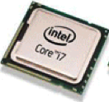
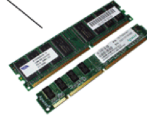
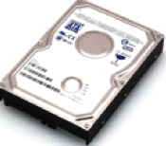
Layered Organization
Software
Hardware
CPU, Memory, Disk
Logical Circuits,
Flip-Flops, Gates
Transistors
Diodes
Resistors

Slide 12
Layered Organization
Software
Hardware
CPU
Memory
I/O
Logical Circuits, Flip-Flops, Gates, …
Transistors, Diodes, Resistors, …

Slide 13







Layered Organization
System Software
(OS, compiler, VM…)
Software
Hardware
CPU
Memory
I/O
Logical Circuits, Flip-Flops, Gates, …
Transistors, Diodes, Resistors, …

Slide 14






Layered Organization
User Applications
System Software
(OS, compiler, VM…)
Software
Hardware
CPU
Memory
I/O
Logical Circuits, Flip-Flops, Gates, …
Transistors, Diodes, Resistors, …

Slide 15

Layered Organization
Users
User Applications
System Software
(OS, compiler, VM…)
Software
Hardware
CPU
Memory
I/O
Logical Circuits, Flip-Flops, Gates, …
Transistors, Diodes, Resistors, …

Slide 16
Layered Organization
User Applications
Apps
System Software
Operating System
Software
Hardware
CPU
Memory
I/O
Logical Circuits, Flip-Flops, Gates, …
Transistors, Diodes, Resistors, …

Slide 17
Abstraction
User Applications
Apps
System Software
Operating System
Software
Hardware
CPU
Memory
I/O
Abstract Interface
Logical Circuits, Flip-Flops, Gates, …
Transistors, Diodes, Resistors, …

Slide 18
Scope of this class
User Applications
Apps
System Software
Operating System
Software
Hardware
CPU
Memory
I/O
Abstract Interface
Logical Circuits, Flip-Flops, Gates, …
Transistors, Diodes, Resistors, …

Slide 19
Scope of this class
How do applications run on a computer?
Hardware/software interface
How do CPU/memory work?
overview of computer architecture

Slide 20
Schedule
https://nyu-cso.github.io
C Programming
overview
bit, byte and int
float point
[C] basics, bitwise operator, control flow
[C] scopes rules, pointers, arrays
[C] structs, mallocs
[C] large program (linked list)

Slide 21
Schedule
https://nyu-cso.github.io
C Programming
overview
bit, byte and int
float point
[C] basics, bitwise operator, control flow
[C] scopes rules, pointers, arrays
[C] structs, mallocs
[C] large program (linked list)
Machine Prog: ISA, Compile, movq
Machine Prog: Control Code (condition, jump instruction)
Machine Prog: Array allocation and access
Machine Prog: Procedure calls
Machine Prog: Structure, Memory Layout
Machine Prog: Buffer Overflow
Assembly (X86)

Slide 22
Schedule
https://nyu-cso.github.io
C Programming
overview
bit, byte and int
float point
[C] basics, bitwise operator, control flow
[C] scopes rules, pointers, arrays
[C] structs, mallocs
[C] large program (linked list)
Machine Prog: ISA, Compile, movq
Machine Prog: Control Code (condition, jump instruction)
Machine Prog: Array allocation and access
Machine Prog: Procedure calls
Machine Prog: Structure, Memory Layout
Machine Prog: Buffer Overflow
Code optimizations
Dynamic Memory Allocation
Dynamic Memory Allocation continued
Assembly (X86)
Dynamic Memory
Allocation

Slide 23
Schedule
https://nyu-cso.github.io
overview
bit, byte and int
float point
[C] basics, bitwise operator, control flow
[C] scopes rules, pointers, arrays
[C] structs, mallocs
[C] large program (linked list)
Machine Prog: ISA, Compile, movq
Machine Prog: Control Code (condition, jump instruction)
Machine Prog: Array allocation and access
Machine Prog: Procedure calls
Machine Prog: Structure, Memory Layout
Machine Prog: Buffer Overflow
Code optimizations
Dynamic Memory Allocation
Dynamic Memory Allocation continued
Logic Design
Logic Design continued
Sequential implementation
Pipelined implementation
C Programming
Assembly (X86)
Dynamic Memory
Allocation
Architecture

Slide 24
Schedule
https://nyu-cso.github.io
C Programming
overview
bit, byte and int
float point
[C] basics, bitwise operator, control flow
[C] scopes rules, pointers, arrays
[C] structs, mallocs
[C] large program (linked list)
Machine Prog: ISA, Compile, movq
Machine Prog: Control Code (condition, jump instruction)
Machine Prog: Array allocation and access
Machine Prog: Procedure calls
Machine Prog: Structure, Memory Layout
Machine Prog: Buffer Overflow
Code optimizations
Virtual memory: Address Spaces/ Translation, Goal
Virtual memory: Page table/physcial to virtual
Process
Dynamic Memory Allocation I: malloc, free
Dynamic Memory Allocation II: design allocator
Dynamic Memory Allocation III: futher optimization
Memory, cache
Memory, cache
Assembly (X86)
Dynamic Memory
Allocation
Architecture
Memory & Cache

Slide 25
Course logistics
Website: https://nyu-cso.github.io
Syllabus
Reading preparation
lecture/recitation slides
Lab instructions
Forum: Campuswire
Q&A
NYU Brightspace
Gradescope
Lab submission, weekly assessments
Zoom links, Zoom recordings
Use Campuswire instead of Brightspace for Q&A.

Slide 26
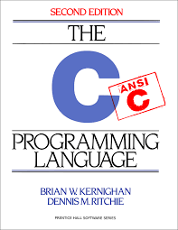
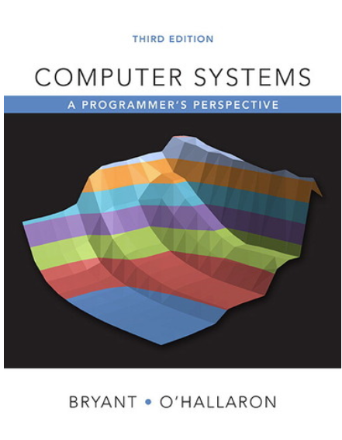
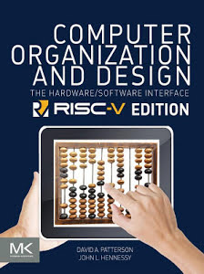
Textbooks
The C Programming Language 2nd ed,
Kernighan and Ritchie
Computer Systems -- A programmer's perspective, 3rd ed, Bryant and O’Hallaron.
Computer organization and design (RISC-V edition), Patterson and Hennessy

Slide 27
Grade Breakdown
5 programming labs
1% each
4 in-person tests
Each test covers a corresponding programming lab plus related concepts.
11% each
Class participation
Recitation participation (5%)
Other participation (lecture, online forum): 1%
In-person final exam (80 minutes)
45%

Slide 28
5 individual programming labs
Programming environment:
(Mostly) your laptop
Learn to use:
a text editor to write code
git for version control
Submission:
Push to github
Submit and have it graded via Gradescope
Late policy:
6 (cumulative) grace days in total over the semester.
3 max. grace days for each lab.

Slide 29
Recitation mini-quiz
Start next week
To be done in-class in-person via Gradescope:
15 minutes in the beginning
Multiple choice questions and short answers
Based on current week’s lecture materials
Answers discussed immediately during recitation
Counts towards recitation participation: 5%

Slide 30
To thrive in CSO, you should …
Before lecture:
Read assigned book chapters
During lecture/recitation:
Ask questions
Don’t be shy to ask me to repeat.
Labs
Start early
Getting help:
Campuswire
Office hours (see post on Campuswire)

Slide 31
Integrity, Collaboration and AI Policy
Carnegie Mellon
Almost all the evaluation is based on in-person test/exam.
This means “yes” to:
All forms of collaboration.
E.g. work on programming labs with your buddies
Study together etc.
AI tools (including coding agents) and traditional web search and other online materials
Acknowledge your usage for such tools for each lab.
You have no AI nor internet access during tests/exams.
Warning: Do not outsource your thinking to AI. Train your brain—or you’ll do badly on the exams.

