Slide 1
Sequential Logic
Jinyang Li

Slide 2
What we’ve learnt so far
Combinatorial logic
E.g. Multiplexors (Mux), Decoders
Two ways of building a CL
Truth table → sum of products circuits
ROM
ALU
Compute all operations (+, OR, AND, NOR), multiplexer picks the result
Building a 64-bit adder
Ripple carry chains together 1-bit adders
Carry lookahead

Slide 3
Today’s lesson plan
Sequential circuit: Memory (state) elements
Sequential circuit: Finite State Machine

Slide 4
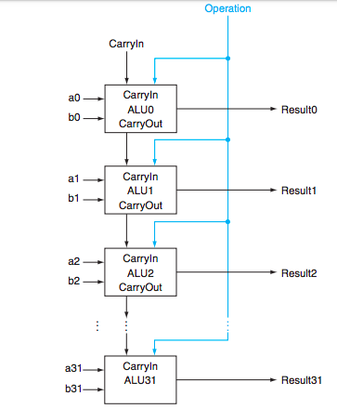
Downside of ripple carry?
Must wait for sequential evaluation of all 64 1-bit adders
a63
ALU63
Result63
b63

Slide 5
In search of a faster adder
Ripple carry:
Delay: 64*1BitAdderGateDelay, Gate count: 64*c
Brute-force (truth table->PLA)
Delay: 2, Gate count: O(2⁶⁴⁺⁶⁴)
Clever designs in between?
Idea #1: (Carry lookahead) compute multiple carry-bits at a time

Slide 6
Faster adder: carry lookahead
Idea #1: (Carry lookahead) compute multiple carry-bits at a time
CarryIn to i-th bit
CarryOut of i-th bit
= CarryOut of (i-1)-th bit
= CarryIn of (i+1)-th bit
c_{i+1} = a_{i}b_{i} + (a_{i} + b_{i})c_{i}
c_{i+1} = g_{i} + p_{i}c_{i}
g_{i} = a_{i}b_{i} , p_{i}= a_{i} + b_{i}
Generate
Propagate
p_{i}
g_{i}
generates carryOut
regardless of carryIn
propagates carryIn
to carryOut

Slide 7
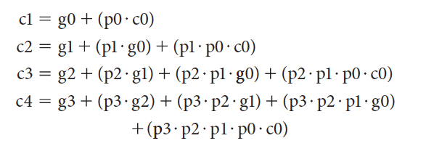
Faster adder: carry lookahead
Idea #1: (Carry lookahead) compute multiple carry-bits at a time
Computing all carry-bits of a 4-bit adder:
Delay?
3
4-bit ripple carry delay: 2 * 4

Slide 8
Faster adder: carry lookahead
Idea #1: (Carry lookahead) compute multiple carry-bits at a time
Computing all result bits in a 4-bit adder:
$s_{i}=\overline{c_{i}}∙$ $a_{i}∙b_{i}+c_{i}∙\overline{a_{i}}∙b_{i}+c_{i}∙a_{i}∙\overline{b_{i}} , i=0,..,3$

Slide 9
Faster adder: carry lookahead
Build a 16-bit adder with carry-ahead 4-bit adders
carryIn (C0)
a[0:3]
P0 = p3· p2· p1· p0
ALU0
carry
lookahead
P1 = p7· p6· p5· p4
b[0:3]
P0
p0
G0
g0
P2 = p11· p10· p9· p8
C1
P3 = p15· p14· p13· p12
C1=G0+P0 ·C0
a[4:7]
ALU1
C2=G1+P1·G0+ P1· P0 ·C0
P1
p1
G0 = g3+ p3·g2 +
p3· p2·g1+ p3· p2·p1 ·g0
b[4:7]
G1
g1
C3= G2+ P2·G1 + P2· P1· G0
+ P2· P1· P0 ·C0
C2
G1 = g7+ p7·g6 +
p7· p6·g5+ p7· p6·p5 ·g4
a[8:11]
C3= G3+ P3·G2 + P3· P2· G1
+ P3· P2· P1· G0
+ P3· P2· P1· P0 ·C0
ALU2
p2
P2
b[8:11]
G2
g2
G2 = g11+ p11·g10 +
p11· p10·g9+ p11· p10·p9·g8
C3
a[12:15]
p3
G3 = g15+ p15·g14 +
p15·p14·g13+ p15·p14·p13·g12
P3
ALU3
g3
b[12:15]
G3
carryOut (C4)

Slide 10
Two types of logic circuits
Combinatorial circuit
PLA: Truth table → sum of products PLA circuit
ROM (read-only memory): Addresses (inputs)→ contents (outputs)
Sequential circuit
output is dependent on both input and state (memory elements)
Today’s lesson

Slide 11
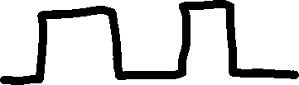

Sequential logic requires clock
When should the state element be updated?
State element
Clock signal
Clock
period
Clock
period
Clock frequence = 1/clock_period

Slide 12
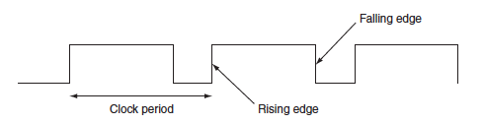
Clocks
Edge-triggered clocking: state content only changes on active clock edge

Slide 13
Sequential logic requires clock
State changed to 1
State changed to 0
State changed to 1
State
element
Clock signal
Clock
period
Clock
period
Clock frequence = 1/clock_period

Slide 14
Sequential logic requires clock
Combinatorial logic
State
element 2
State
element 1
Delay of CL must be less than one clock cycle
Valid content is read from state element 1
Clock cycle
Valid content is written into state element 2

Slide 15
Sequential logic requires clock
Combinatorial logic
State
element
Valid content is read from state element
Clock cycle
Valid content is written into state element

Slide 16
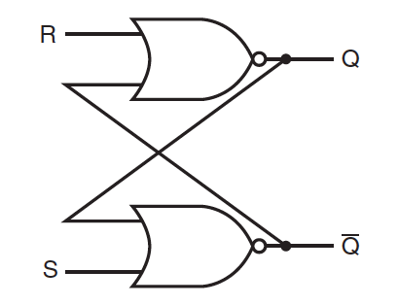
Memory (state) elements: unlocked S-R Latch
NOR
Stored content
S (set) | R (reset)
0 | 0 | keeps existing value
1 | 0 | Q=1
0 | 1 | Q=0
1 | 1 | Invalid
Complement of stored content

Slide 17
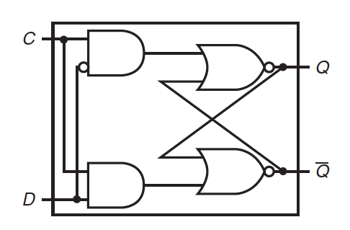
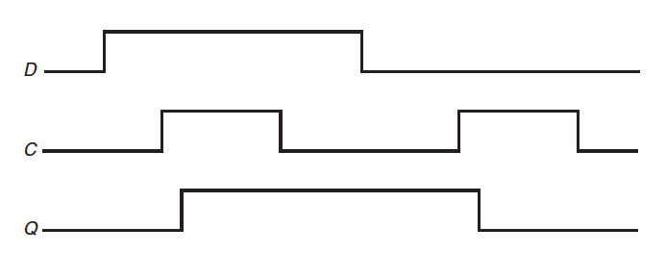
Memory element: clocked D latch
D latch: state is changed as long as clock is asserted
R
Clock signal
S
Latch is open; input is written to state
Input
Latch is closed; state remains unchanged
Clock
State

Slide 18
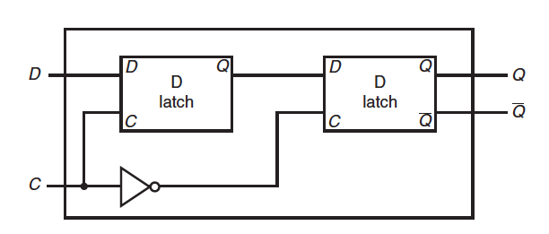
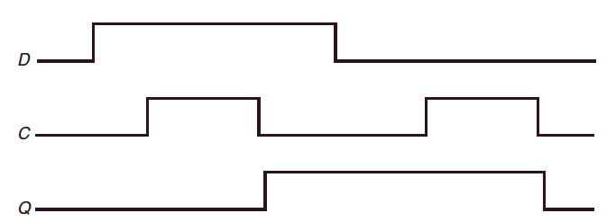
Memory element: Flip-flop
Flip-flop: state is changed only on (rising or falling) clock edge
Q1
D-flip-flop with a
falling-edge trigger
1st latch is open Q1=1
2nd latch is open Q=Q1
1st latch is closed

Slide 19
Finite State Machine
Combinatorial logic → truth table
Sequential logic → F(inite) S(tate) M(achine)
Input and current state determine next state and outputs

Slide 20
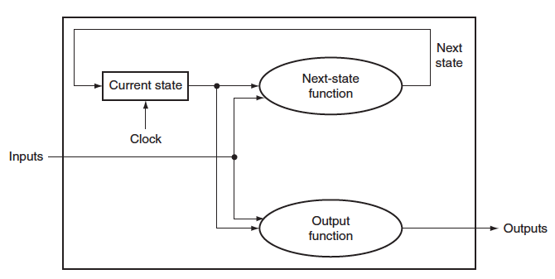
Finite State Machine
New state is computed every clock cycle
Combinatorial
logic

Slide 21

FSM example: traffic light control
How many bits needed to represent state values?
State:
NSgreen: traffic light is green in N-S (red in E-W)
EWgreen: traffic light is green in E-W (red in N-S)
Inputs:
NScar: car detected in N-S
EWcar: car detected in E-W
Outputs:
NSlite: 1 if state=NSgreen
EWlite: 1 if state=EWgreen

Slide 22
FSM example: traffic light control
NSgreen
EWgreen
NScar
EWcar
EWcar
NScar
Clock speed?
Clock cycles once every 30 seconds

Slide 23
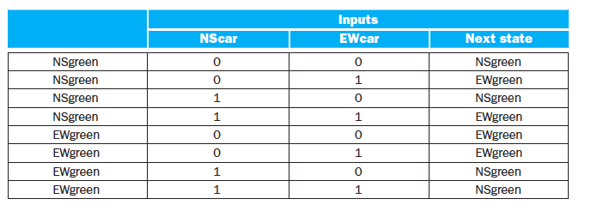
FSM example: traffic light
FSM is determined by NextState function and Output function
NScar
NSg
EWg
EWcar
EWcar
NScar

Slide 24
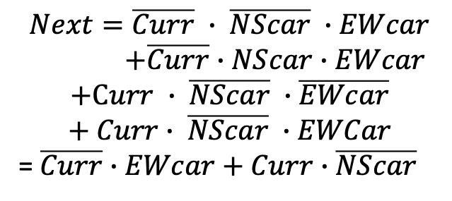
FSM example: traffic light
FSM is determined by NextState function and Output function
Current State
0 (Nsgreen)
0 (Nsgreen)
0 (Nsgreen)
0 (Nsgreen)
1 (Ewgreen)
1 (Ewgreen)
1 (Ewgreen)
1 (Ewgreen)
0 (Nsgreen)
1 (Ewgreen)
0 (Nsgreen)
1 (Ewgreen)
1 (Ewgreen)
1 (Ewgreen)
0 (Nsgreen)
0 (Nsgreen)
$$Next=\overline{Curr} ∙ \overline{NScar} ∙EWcar$$
$+\overline{Curr}$ $∙NScar∙EWcar$
$$+Curr ∙ \overline{NScar} ∙\overline{EWcar}$$
$$+ Curr∙ \overline{NScar} ∙EWCar$$
= $\overline{Curr}∙EWcar+Curr∙$ $\overline{NScar}$

Slide 25
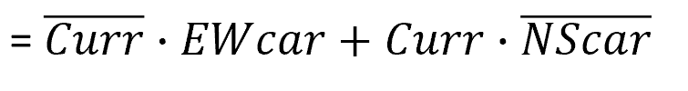
FSM traffic light: next state function
Next
State element
EWcar
NScar

Slide 26
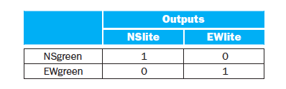
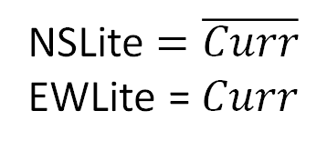
FSM traffic light: output function
0
1
NSLite $=\overline{Curr}$
EWLite = $Curr$

Slide 27
FSM traffic light: output function
State register
NSLite
EWLite

Slide 28
Another FSM example: Electronic eye
State transition diagram?
FSM
left
middle
right
Lights are lit from left to right, then right to left and so on

Slide 29
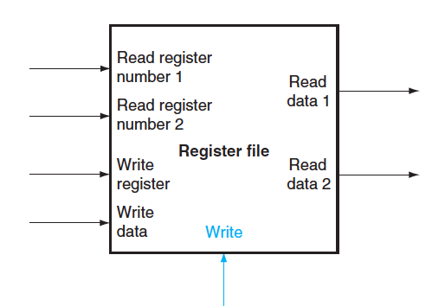
Memory element: Register file
Register file: a set of registers that can be read and written
😕Why reading two registers at a time?

Slide 30
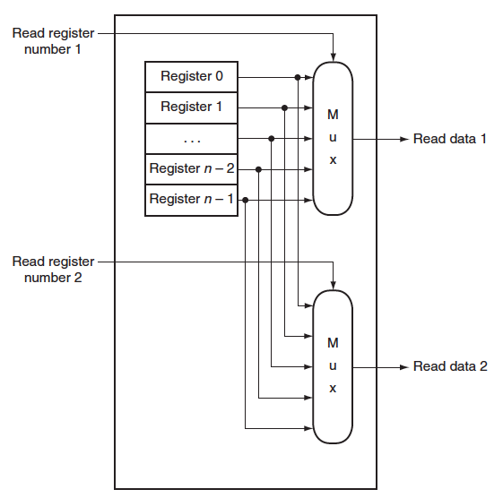
Register file: Read
Clock signal is assumed and not drawn

Slide 31
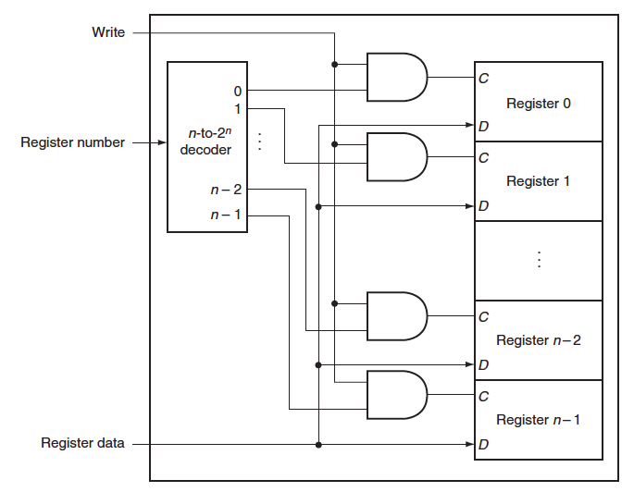
Register file: Write
Clock signal is assumed and not drawn

Slide 32
Register file
What if the same register is read and written in the same clock cycle?
Return register value written in an earlier cycle
Write of new value occurs on the clock edge (at the end of the current cycle)
Some register file can read value currently being written
Requires additional logic in the register file

Slide 33
Summary
Memory (state) elements
Requires a clock signal to know when to update state value
Unclocked S-R latch → Clocked D latch → Flip-flop
Sequential logic
Finite state machine
Decompose into two CL functions
Next state function: compute next state value based on current state value and inputs
Output function: compute output based on current state value and inputs

Slide 34

Happy Thanksgiving!
Stay safe!

