Slide 1
Sequential Logic
Jinyang Li

Slide 2
What we’ve learnt so far
Combinatorial logic
Truth table → sum of products circuits
E.g. Multiplexors (Mux), Decoders
ALU
Ripple carry
Carry lookahead

Slide 3
Two types of logic circuits
Combinatorial circuit
Truth table → sum of products
ROM
Sequential circuit
output is dependent on both input and state (memory elements)
Today’s lesson

Slide 4
ROM-based implementation of CL
ROM (read-only memory)
Width
00
00101
11010
11110
00010
01
Height 2^{n}
10
11
ROM of 2 address lines and 5 bits per entry

Slide 5
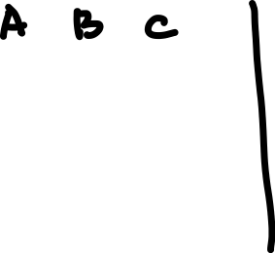

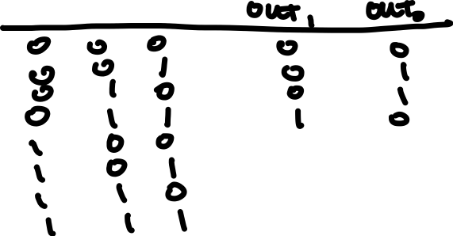
ROM-based implementation of CL
Example CL : Count # of 1’s in 3-bit inputs
000:
001:
010:
011:
100:
101:
110:
111:
00
01
01
10
01
10
10
11
ROM of height 8 width 2

Slide 6

ROM vs. PLA (sum of products)
ROM contains more entries than PLA (2^{n})
000:
001:
010:
011:
100:
101:
110:
111:
00
01
01
10
01
10
10
11
A
B
C
More efficient!
Easy!
7 products (AND)
8 entries

Slide 7
Two types of logic circuits
Combinatorial circuit
Truth table → sum of products
ROM
Sequential circuit
output is dependent on both input and state (memory elements)

Slide 8


Sequential logic require clocks
When should the state element be updated?
State
element
Clock signal
Clock
period
Clock
period
Clock frequence = 1/clock_period

Slide 9
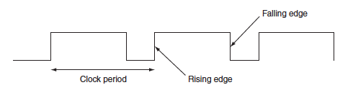
Clocks
Edge-triggered clocking: state content only changes on active clock edge

Slide 10
Sequential logic require clocks
State changed to 1
State changed to 0
State changed to 1
State
element
Clock signal
Clock
period
Clock
period
Clock frequence = 1/clock_period

Slide 11
Sequential logic require clocks
Combinatorial logic
State
element 2
State
element 1
Delay of CL must be less than one clock cycle
Valid content is read from state element 1
Clock cycle
Valid content is written into state element 2

Slide 12
Sequential logic require clocks
Combinatorial logic
State
element
Valid content is read from state element
Clock cycle
Valid content is written into state element

Slide 13
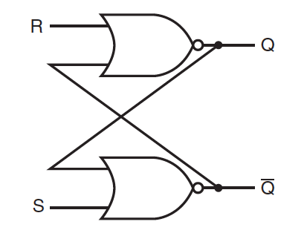
Memory (state) elements: unlocked S-R Latch
NOR
Stored content
S (set) | R (reset)
0 | 0 | keeps existing value
1 | 0 | Q=1
0 | 1 | Q=0
1 | 1 | Invalid
Complement of stored content

Slide 14
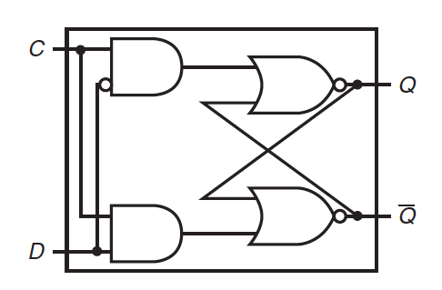
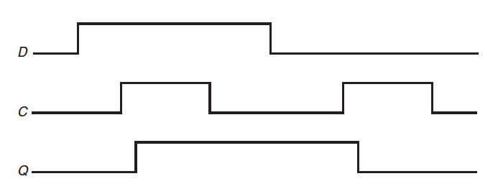
Memory element: clocked D latch
D latch: state is changed as long as clock is asserted
R
Clock signal
S
Latch is open; input is written to state
Input
Latch is closed; state remains unchanged
Clock
State

Slide 15
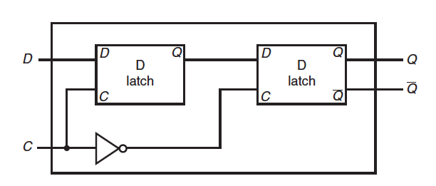
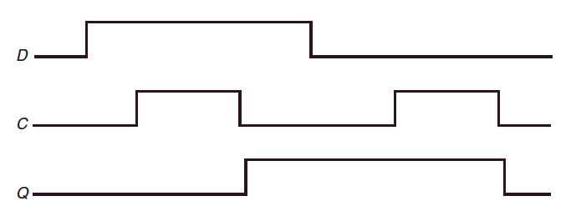
Memory element: Flip-flop
Flip-flop: state is changed only on (rising or falling) clock edge
Q1
D-flip-flop with a
falling-edge trigger
1st latch is open Q1=1
2nd latch is open Q=Q1
1st latch is closed

Slide 16
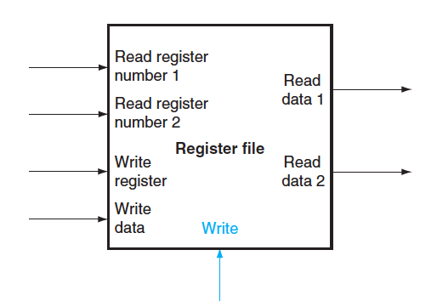
Memory element: Register file
Register file: a set of registers that can be read and written

Slide 17
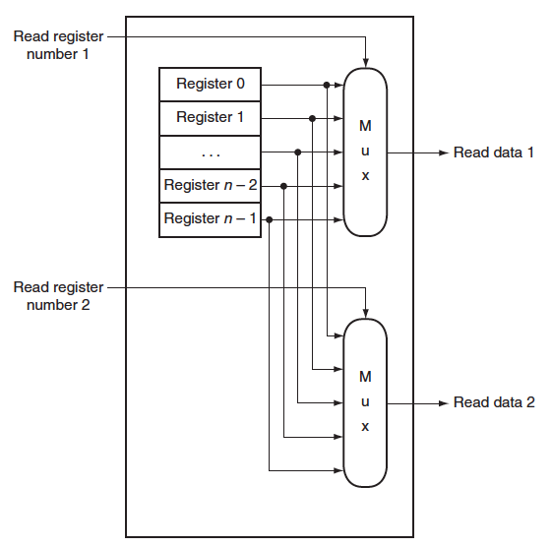
Register file: Read

Slide 18
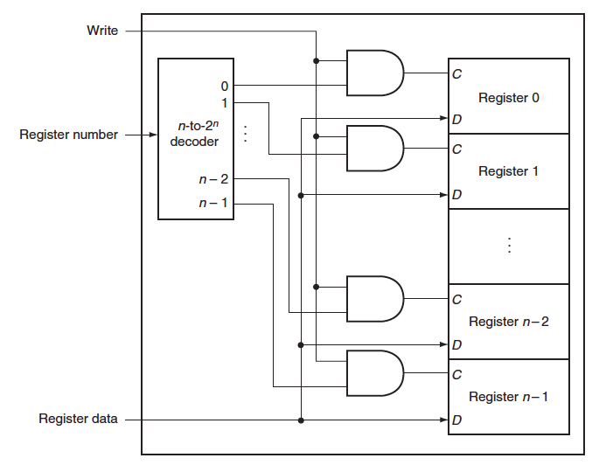
Register file: Write
Clock signal is assumed and not drawn

Slide 19
Register file
What if the same register is read and written in the same clock cycle?
Return value written in an earlier cycle
Write of new value occurs on the clock edge (at the end of the current cycle)
Some register file can read value currently being written
Requires additional logic in the register file

Slide 20
Finite State Machine
Combinatorial logic → truth table
Sequential logic → F(inite) S(tate) M(achine)
Input and current state determine next state and outputs

Slide 21
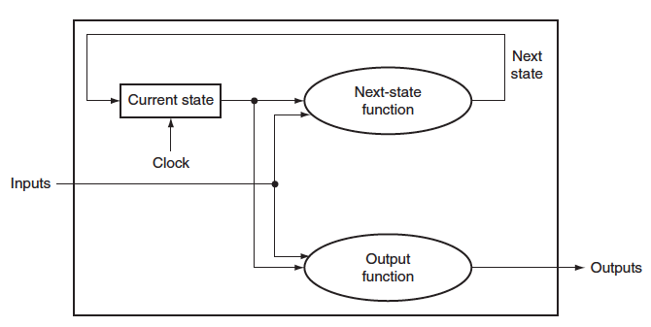
Finite State Machine
New state is computed every clock cycle
Combinatorial
logic

Slide 22

FSM example: traffic light control
State:
NSgreen: traffic light is green in N-S (red in E-W)
EWgreen: traffic light is green in E-W (red in N-S)
Inputs:
NScar: car detected in N-S
EWcar: car detected in E-W
Outputs:
NSlite: 1 if state=NSgreen
EWlite: 1 if state=EWgreen

Slide 23
FSM example: traffic light control
NSgreen
EWgreen
NScar
EWcar
EWcar
NScar
Clock cycles once every 30 seconds

Slide 24
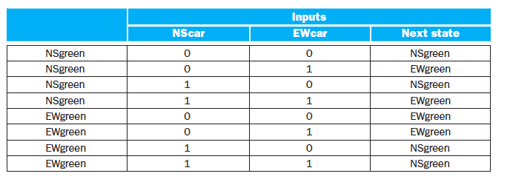
FSM example: traffic light
FSM is determined by NextState function and Output function
How many bits needed to represent state?
NScar
NSg
EWg
EWcar
EWcar
NScar

Slide 25

FSM example: traffic light
FSM is determined by NextState function and Output function
Current State
0 (Nsgreen)
0 (Nsgreen)
0 (Nsgreen)
0 (Nsgreen)
1 (Ewgreen)
1 (Ewgreen)
1 (Ewgreen)
1 (Ewgreen)
0 (Nsgreen)
1 (Ewgreen)
0 (Nsgreen)
1 (Ewgreen)
1 (Ewgreen)
1 (Ewgreen)
0 (Nsgreen)
0 (Nsgreen)
$$Next=\overline{Curr} ∙ \overline{NScar} ∙EWcar$$
$+\overline{Curr}$ $∙NScar∙EWcar$
$$+Curr ∙ \overline{NScar} ∙\overline{EWcar}$$
$$+ Curr∙ \overline{NScar} ∙EWCar$$
= $\overline{Curr}∙EWcar+Curr∙$ $\overline{NScar}$

Slide 26
FSM traffic light: next state function
State register
EWcar
NScar

Slide 27
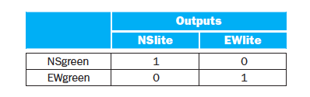
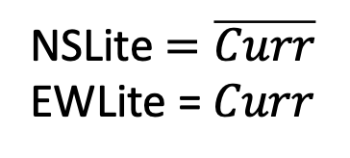
FSM traffic light: output function
0
1
NSLite $=\overline{Curr}$
EWLite = $Curr$

Slide 28
FSM traffic light: output function
State register
NSLite
EWLite

