Slide 1
Building an ALU
Jinyang

Slide 2
What we’ve learnt so far
Basic logic design
Logic circuits == Boolean expressions
How to build a combinatorial logic circuit
Specify the truth table
Output is the sum of products
Common CL
Decoder
Multiplexer

Slide 3
Lesson plan
1-bit ALU
Logical ops: AND/OR/XOR/shift
Arithmetic ops: addition, subtraction, multiplication, division

Slide 4
Array of logic elements
So far, our circuits work on 1-bit inputs/outputs
How to build circuits with n-bit inputs/outputs?
Bus: a collection of data lines treated together as a single signal
in3
64
in2
64
64
64
out
in1
MUX
64
in0
2
sel

Slide 5
Array of logic elements
64-bit multiplexor: an array of 64 1-bit multiplexors
In3₆₃
In2₆₃
In1₆₃
MUX
Out₆₃
In0₆₃
…
1st bit of input
In3₁
In2₁
In1₁
MUX
Out₁
In0₁
0th bit (LSB) of input
In3₀
In2₀
In1₀
MUX
Out₀
In0₀
sel

Slide 6
ALU overview
Example
Op
00 | A & B
01 | A | B
10 | A + B
operation
A
ALU
Result
B

Slide 7
Implementing ALU: AND
operation
A&B
A|B
Result
Mux
A+B

Slide 8
Implementing ALU: AND
operation
A&B
A
Result
A|B
Mux
A+B
B

Slide 9
Implementing ALU: OR
operation
A&B
A
Result
A|B
Mux
A+B
B

Slide 10
Implementing ALU: adder
operation
A&B
A
Result
A|B
Mux
+
A+B
B

Slide 11
1-bit adder
CarryIn
A
+
Sum
B
CarryOut

Slide 12
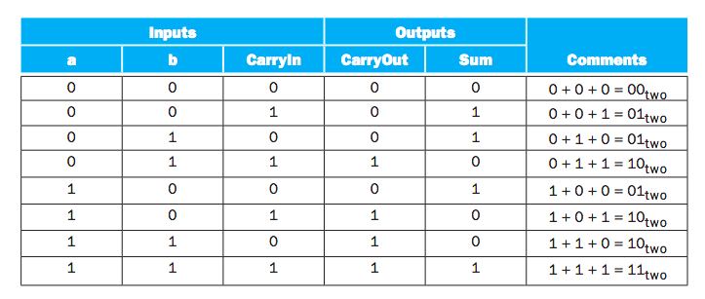
1-bit adder
CarryIn
A
+
Sum
B
CarryOut
Brute force PLA

Slide 13

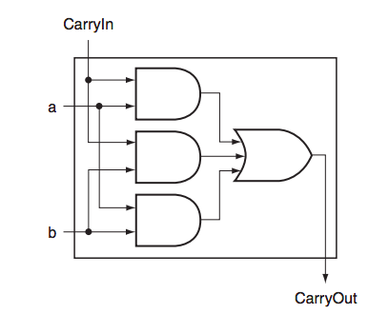
1-bit adder
We can do better than PLA for CarryOut

Slide 14
1-bit adder

Slide 15




Subtraction
Idea: a – b = a + (-b)
How to calculate 2’s complement?

Slide 16
Subtraction in1-bit ALU
Set Binvert=1
carryIn=1
Op=(10)₂
to compute A-B
operation
BInvert
carryIn
A
A&B
Result
A|B
Mux
+
A±B
B
Subtraction reuses hardware for addition
Mux
carryOut

Slide 17
Extend 1-bit ALU to 64-bit
operation
BInvert
carryIn
A
A&B
Result
A|B
Mux
+
A±B
B
Mux
carryOut

Slide 18
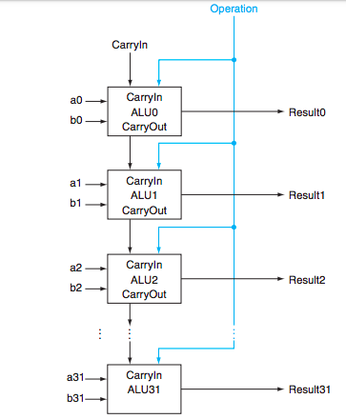
Simple 64-bit adder: ripple carry
a63
ALU63
Result63
b63

Slide 19
Extend ALU to include slt
RISC-V slt instruction: Result = (A < B) ? 1 : 0 Signed
X86 equivalent: cmpq %rbx,%rax setl %rcx
BInvert
carryIn
operation
A
New input Less is 0 for bits1:63
Mux
Result
B
+
Less
Mux
carryOut

Slide 20

Extend ALU to include slt
A < B iff:
(A-B) is negative (MSB is 1)
(A-B) overflowed
But not both
BInvert
carryIn
operation
A
Wire to “Less” input of the least significant bit ALU
Mux
Result
+
B
Less
Mux
carryOut
Set (MSB==1)
XOR
Overflow
detection
Overflow

Slide 21
Downside of ripple carry?
Must wait for sequential evaluation of all 64 1-bit adders
a63
ALU63
Result63
b63

Slide 22
In search of faster adder
Ripple carry:
Delay: 64, Gate count: 64*c
Brute-force (truth table->PLA)
Delay: 2, Gate count: O(2⁶⁴⁺⁶⁴)
Clever designs in between?
Idea #1: (Carry lookahead) compute multiple carry-bits at a time

Slide 23
Faster adder: carry lookahead
Idea #1: (Carry lookahead) compute multiple carry-bits at a time
CarryIn to i-th bit
CarryOut of i-th bit
= CarryOut of (i-1)-th bit
= CarryIn of (i-1)-th bit
c_{i+1} = a_{i}b_{i} + (a_{i} + b_{i})c_{i}
c_{i+1} = g_{i} + p_{i}c_{i}
g_{i} = a_{i}b_{i} , p_{i}= a_{i} + b_{i}
Generate
Propagate
p_{i}
g_{i}
generates carryOut
regardless of carryIn
propagates carryIn
to carryOut

Slide 24
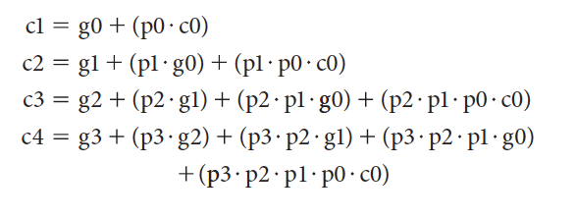
Faster adder: carry lookahead
Idea #1: (Carry lookahead) compute multiple carry-bits at a time
Computing all carry-bits of a 4-bit adder:
Delay?
3
4-bit ripple carry delay: 2 * 4

Slide 25
Faster adder: carry lookahead
Idea #1: (Carry lookahead) compute multiple carry-bits at a time
Computing all result bits in a 4-bit adder:
$s_{i}=\overline{c_{i}}∙$ $a_{i}∙b_{i}+c_{i}∙\overline{a_{i}}∙b_{i}+c_{i}∙a_{i}∙\overline{b_{i}} , i=0,..,3$

Slide 26
Faster adder: carry lookahead
Build a 16-bit adder with carry-ahead 4-bit adders
carryIn (C0)
a[0:3]
P0 = p3· p2· p1· p0
ALU0
carry
lookahead
b[0:3]
P0
p0
P1 = p7· p6· p5· p4
G0
g0
P2 = p11· p10· p9· p8
C1
P3 = p15· p14· p13· p12
a[4:7]
ALU1
P1
p1
b[4:7]
G1
g1
G0 = g3+ p3·g2 +
p3· p2·g1+ p3· p2·p1 ·g0
C2
G1 = g7+ p7·g6 +
p7· p6·g5+ p7· p6·p5 ·g4
a[8:11]
ALU2
p2
P2
b[8:11]
G2
g2
G2 = g11+ p11·g10 +
p11· p10·g9+ p11· p10·p9·g8
C3
a[12:15]
p3
G3 = g15+ p15·g14 +
p15·p14·g13+ p15·p14·p13·g12
P3
ALU3
g3
b[12:15]
G3
carryOut (C4)

