Slide 1
Pipelined CPU
Jinyang Li
Based on the slides of Patterson and Hennessy

Slide 2
What we’ve learnt so far
Combinatorial logic
ALU
Sequential logic
Clocks and basic state elements (SR latch, D latch, flip-flop)
The single-cycle CPU design

Slide 3
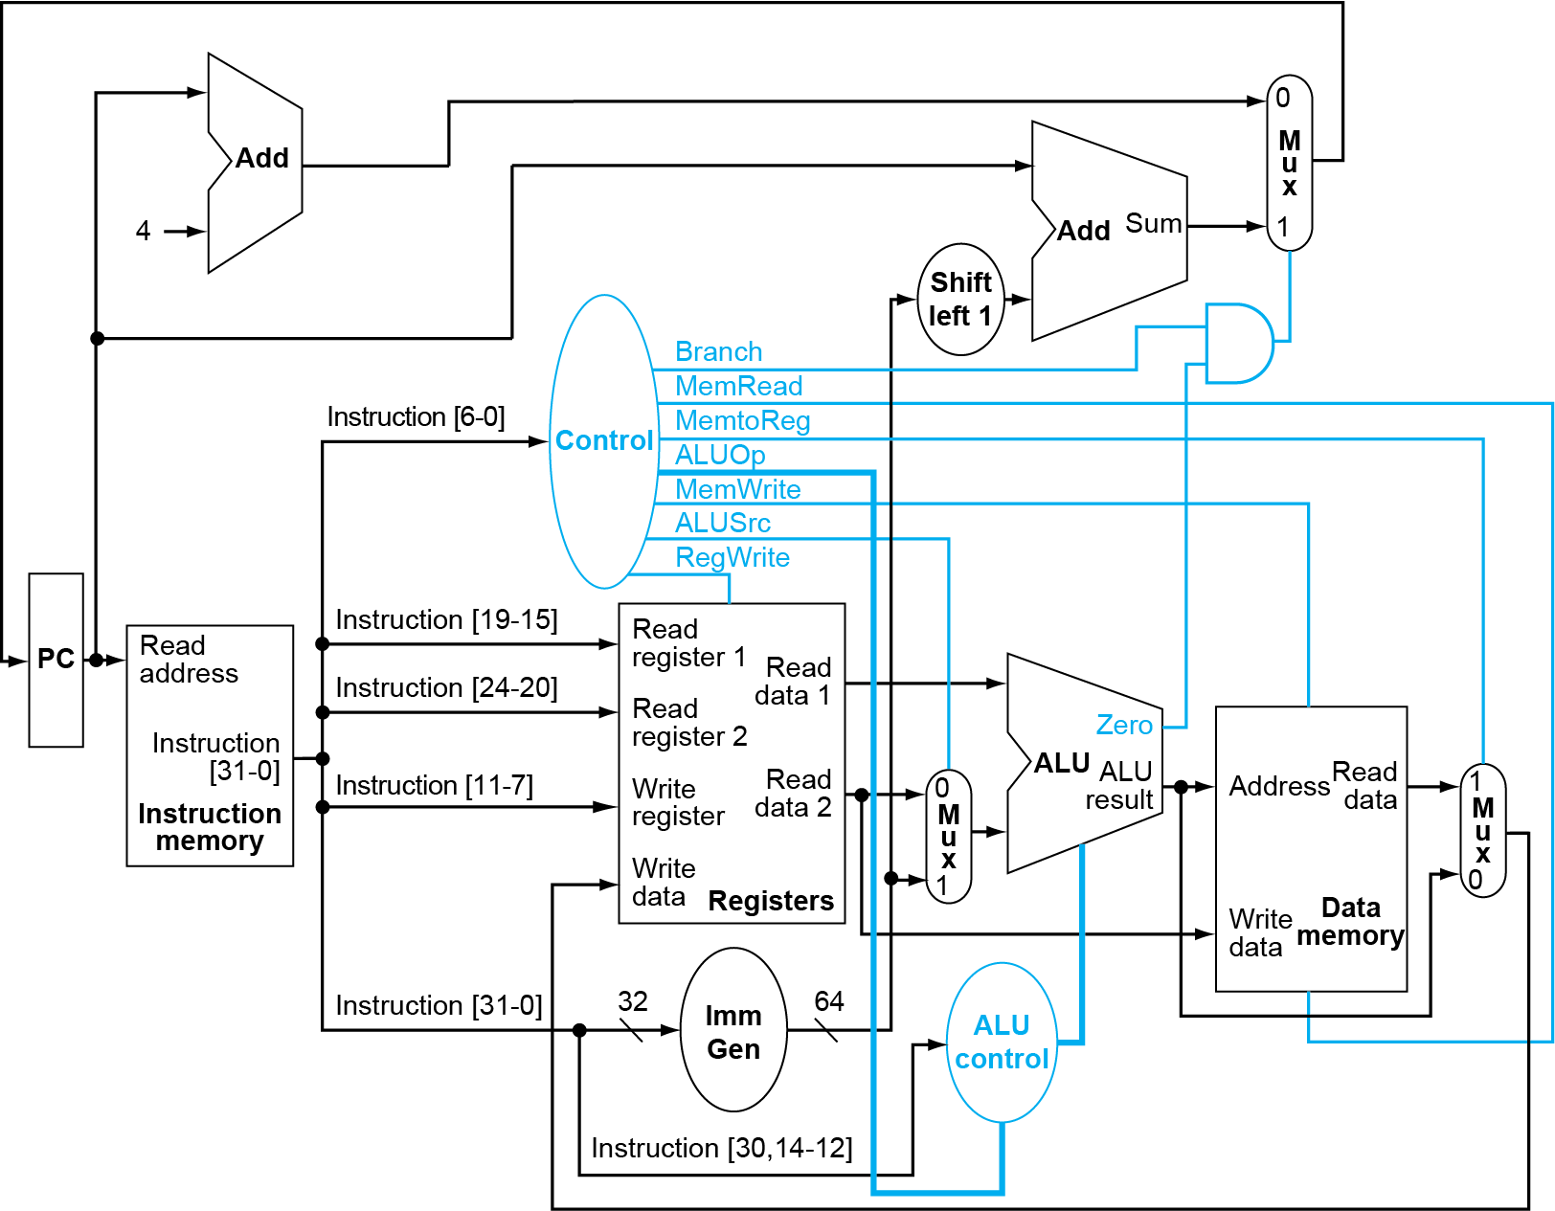
Single-cycle CPU uses a slow clock
1 picosecond = 10⁻¹² sec
Load instruction latency (in ps)
200
instruction
fetch
+ 100
register
read
+ 200
ALU
+ 200
data
access
+ 100
register
write
Clock cycle >= 800 ps

Slide 4
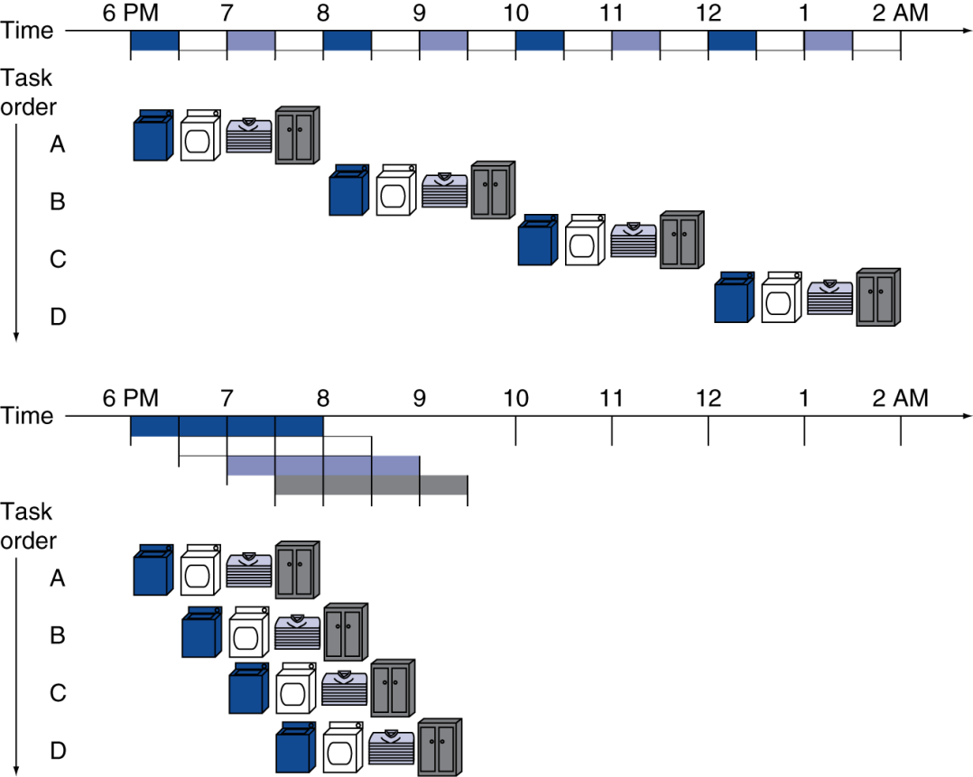
Pipelining: a laundry analogy
wash
dry
fold
store
Pipelined laundry: overlapping execution
Parallelism improves performance

Slide 5
RISC-V Pipeline
Five stages, one step per stage
IF: Instruction fetch from memory
ID: Instruction decode & register read
EX: Execute operation or calculate address
MEM: Access memory operand
WB: Write result back to register

Slide 6
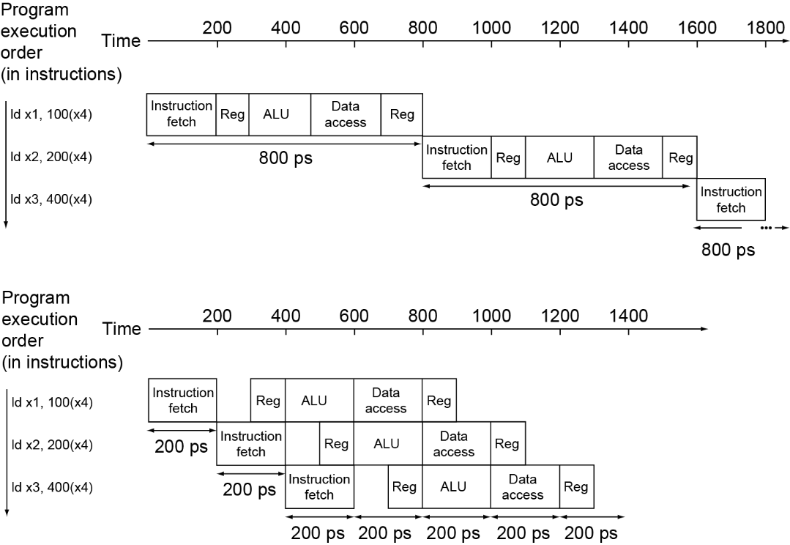
Pipeline Performance
Single-cycle (T_{c}= 800ps)
Pipelined (T_{c}= 200ps)

Slide 7
Pipeline Speedup
Pipelining increases throughput (instructions/sec)
Latency (time for each instruction) does not decrease
If all stages are balanced (i.e., all take the same time)
throughput_{pipelined} = number-of-stages * throughput_{nonpipelined}
If not balanced, speedup is less
Throughput = 1/time between instructions

Slide 8
Pipelining and ISA Design
RISC-V ISA designed for pipelining
All instructions are 32-bits
Easier to fetch and decode in one cycle
c.f. x86: 1- to 17-byte instructions
Few and regular instruction formats
Can decode and read registers in one step
Load/store addressing
Can calculate address in 3rd stage, access memory in 4th stage

Slide 9
Pipeline challenges: hazards
Situations that prevent starting the next instruction in the next cycle
Structure hazards
A required resource is busy
Data hazard
Need to wait for previous instruction to complete its data read/write
Control hazard
Deciding on control action depends on previous instruction

Slide 10
Structure Hazards
Conflict use of a single resource
Example: Suppose CPU uses a single memory
Load/store requires data access
Instruction fetch would have to stall for that cycle
Would cause a pipeline “bubble”
Solution: Use separate instruction/data memories

Slide 11
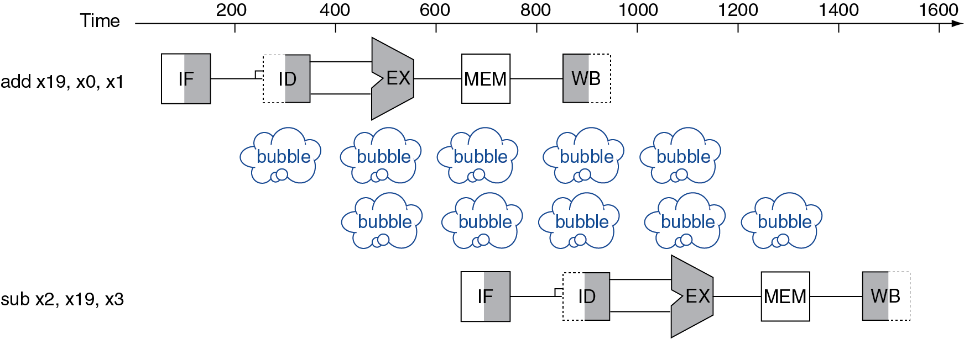
Data Hazards
An instruction depends on the previous instruction to complete its data read/write
add x19, x0, x1 sub x2, x19, x3

Slide 12
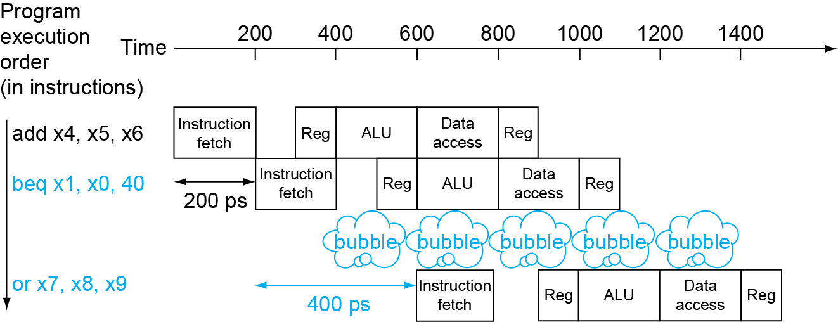
Control hazard
Wait until branch outcome determined before fetching next instruction

Slide 13
A basic pipelined RISC-V CPU

Slide 14
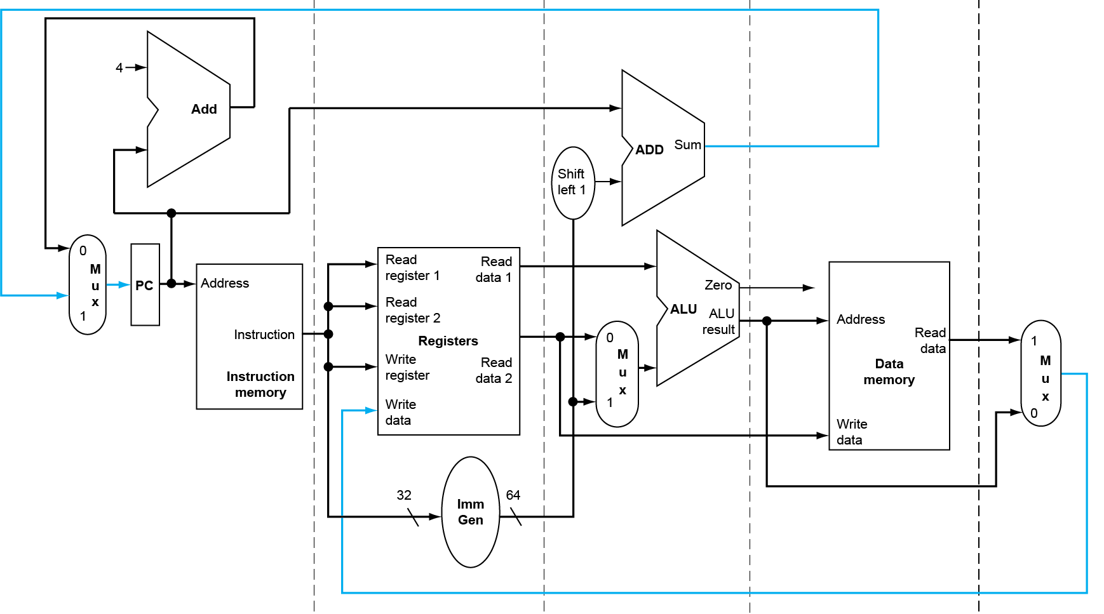
Pipelined Datapath
IF: instruction
fetch
ID: instruction
decode/reg
read
EX: execute/
address calc
MEM: memory access
WB: write-back
Right-to-left flow leads to hazards

Slide 15
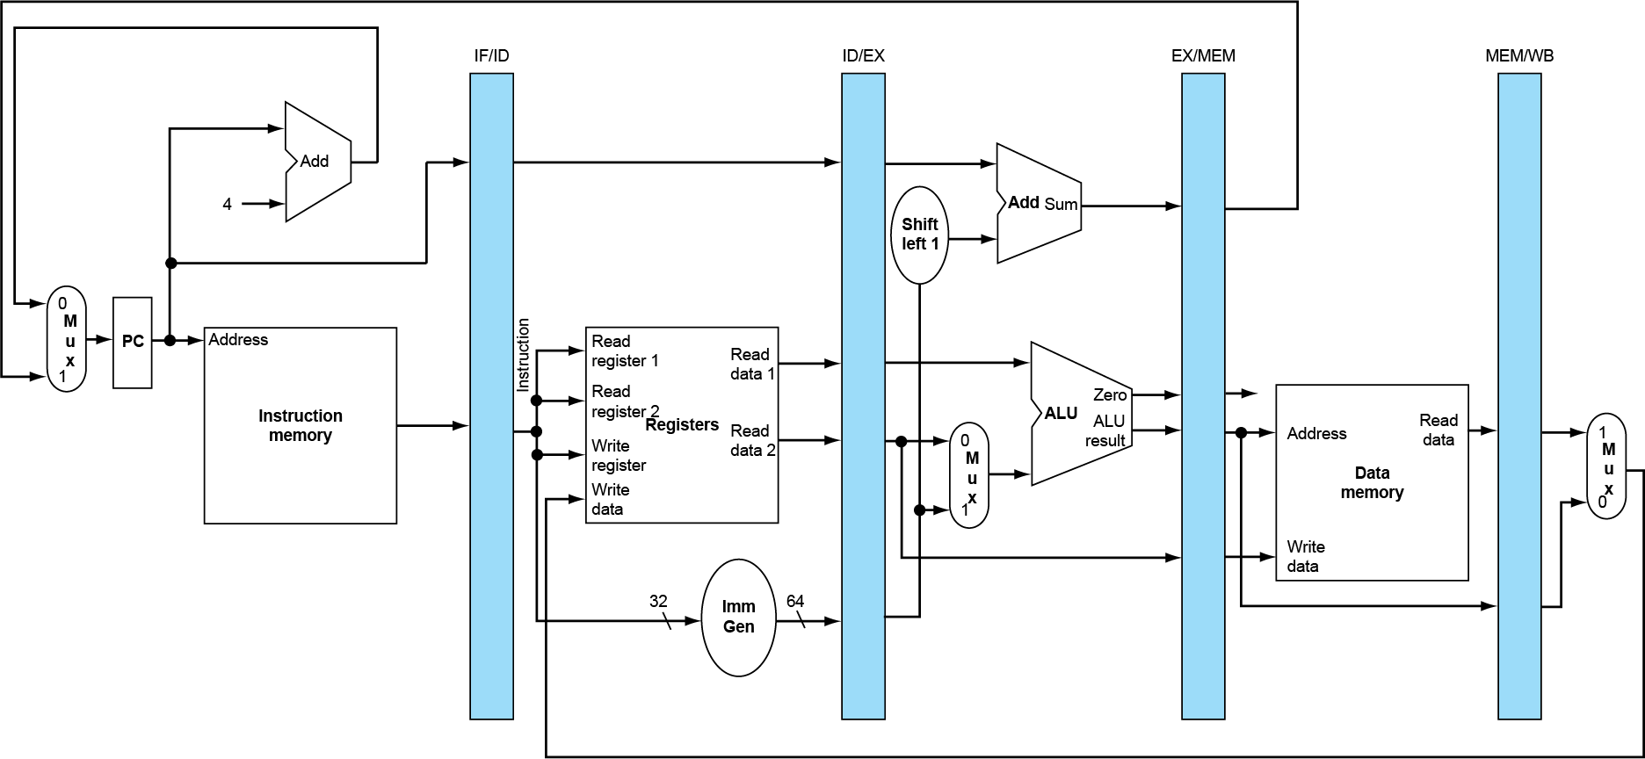
Pipeline registers
Needed to hold information produced in previous cycle
IF/ID
ID/EX
EX/MEM
MEM/WB

Slide 16
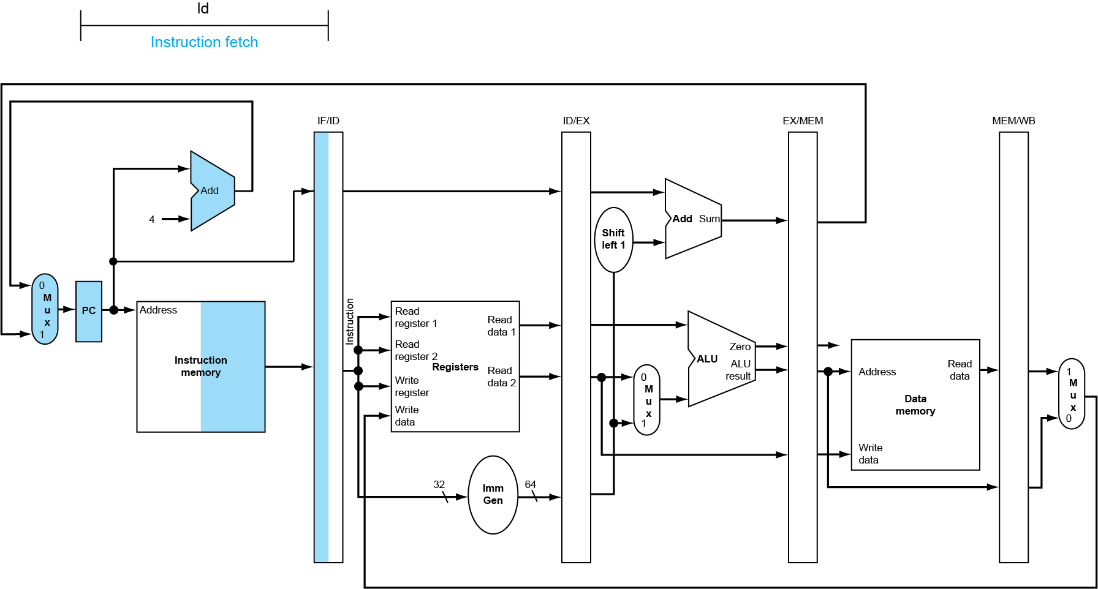
IF for Load, Store
Single-clock-cycle diagram shows the state of an entire datapath
during a single clock cycle
Right-shading indicates read access

Slide 17
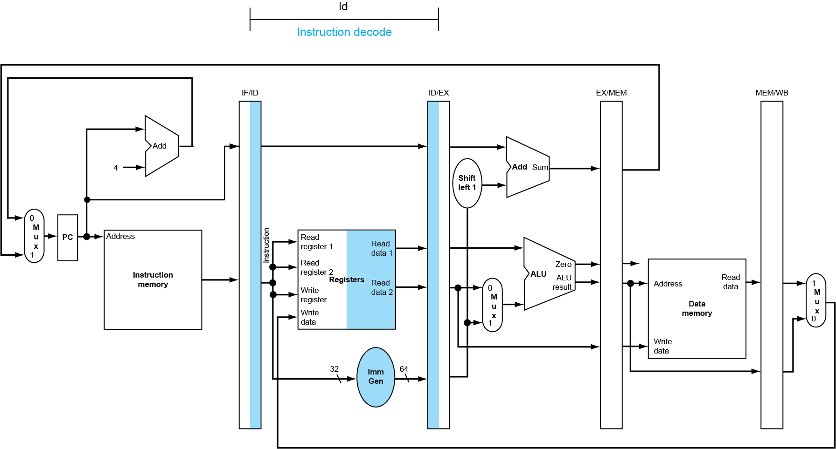
ID for Load, Store, …

Slide 18
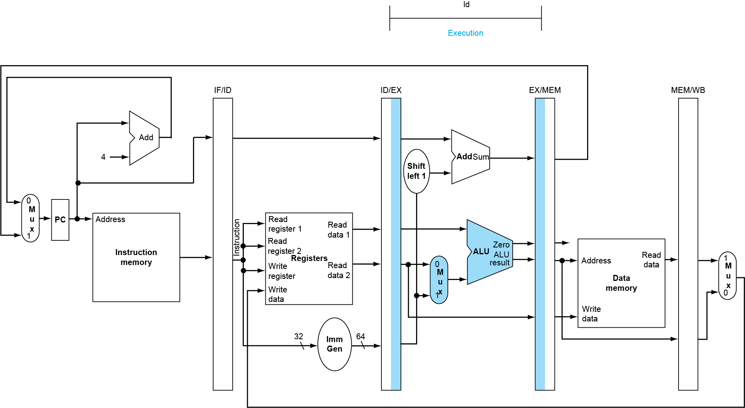
EX for Load

Slide 19
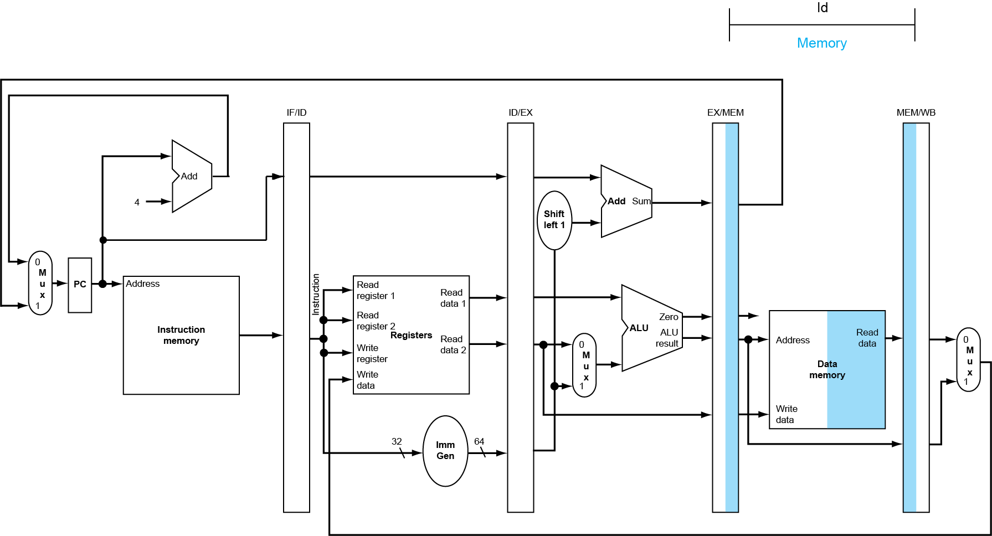
MEM for Load

Slide 20
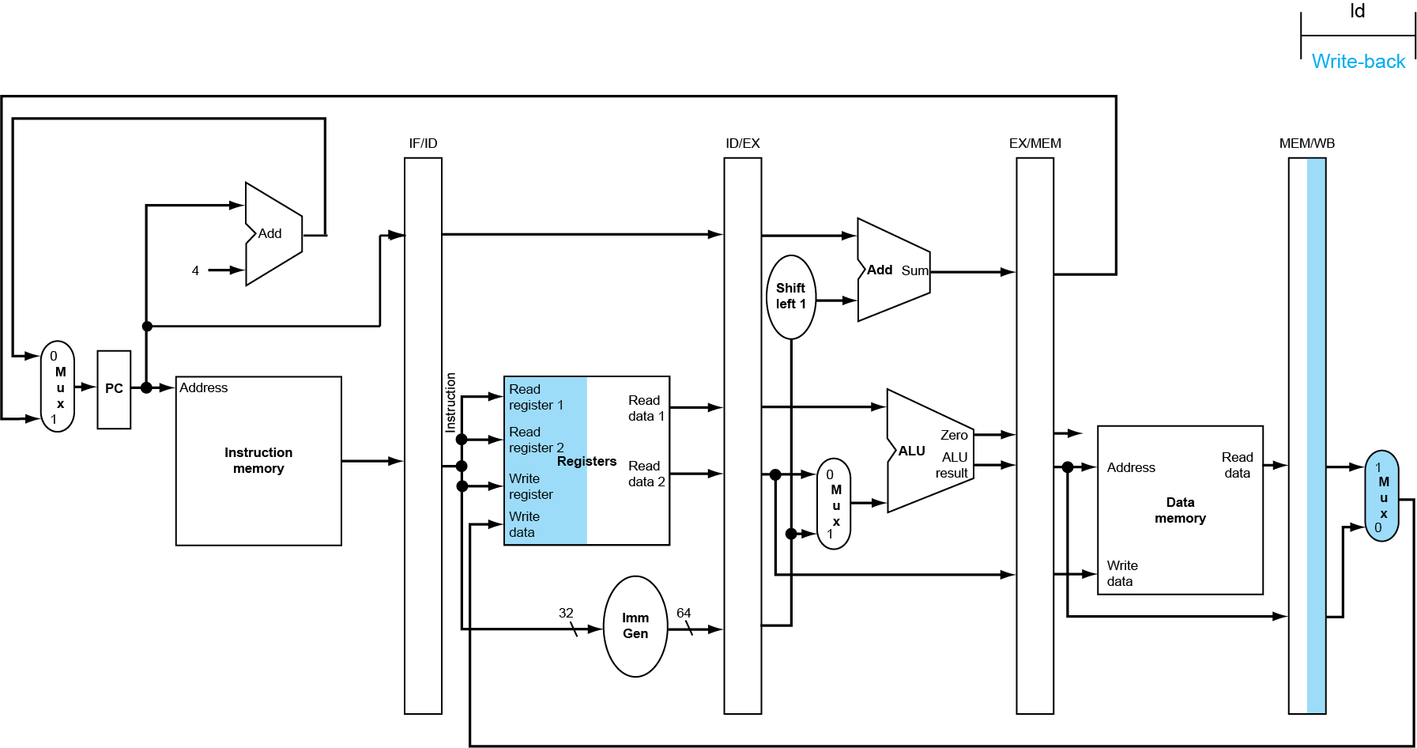
WB for Load
Wrong register number

Slide 21
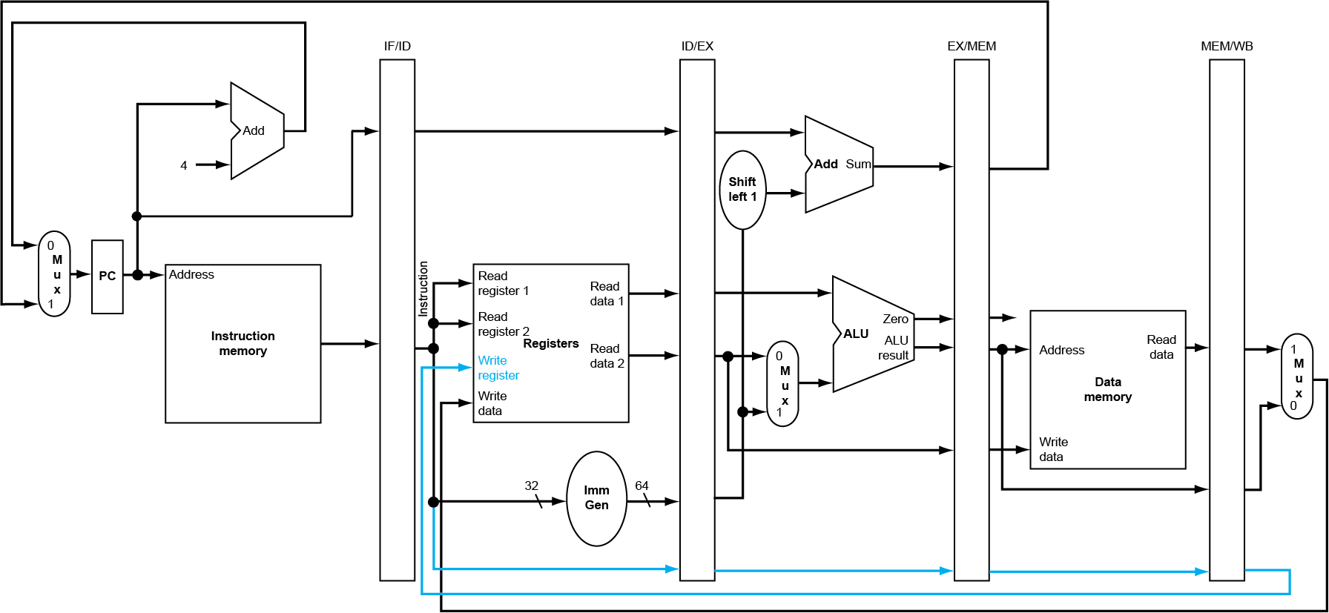
Corrected Datapath for Load

Slide 22
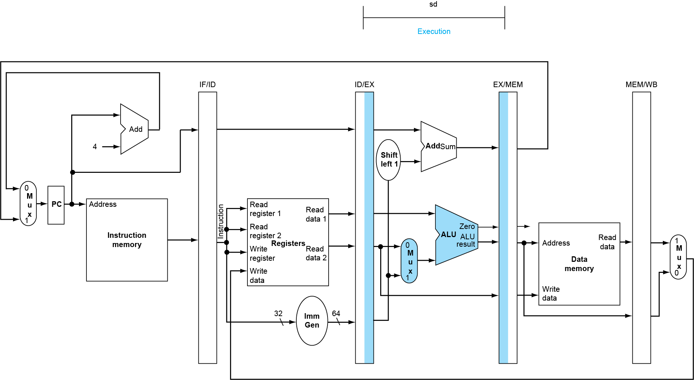
EX for Store

Slide 23
MEM for Store

Slide 24
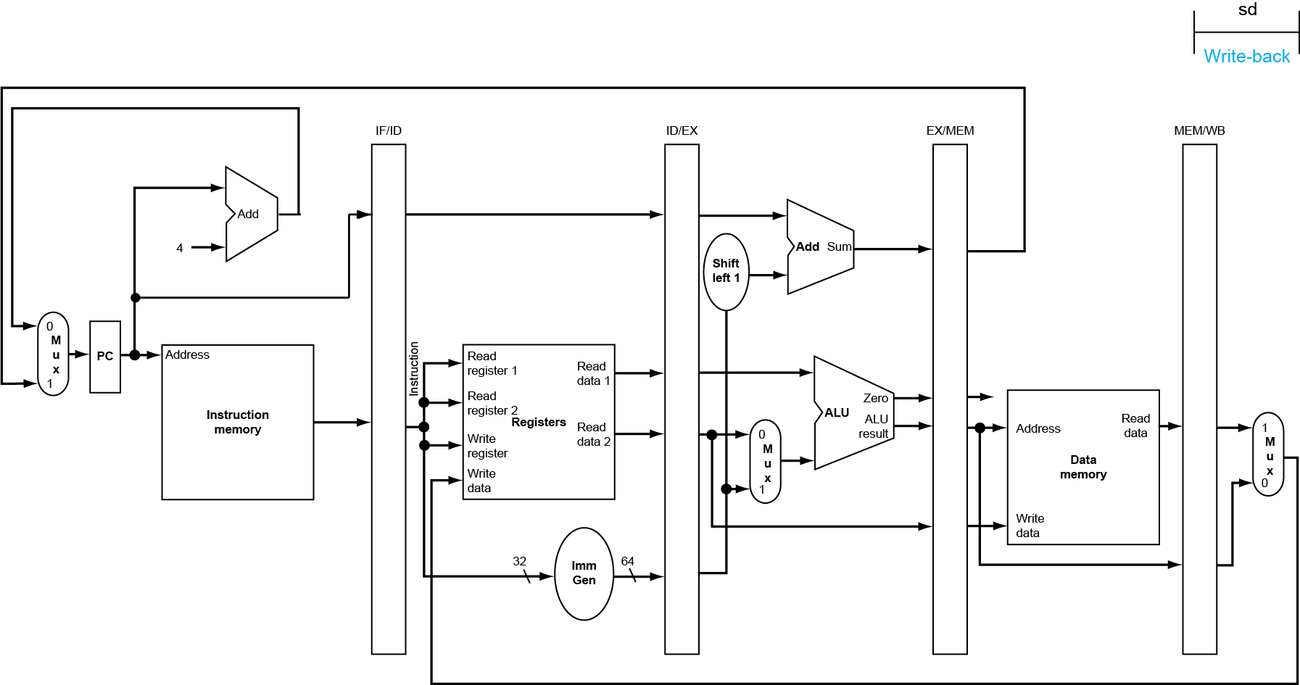
WB for Store

Slide 25
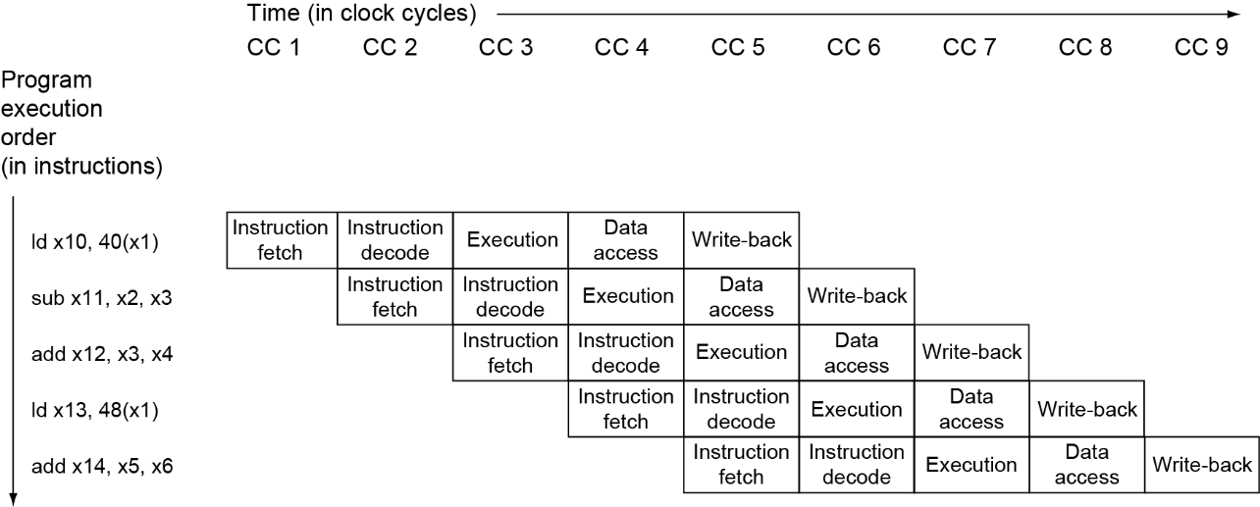
Multi-Cycle Pipeline Diagram
Traditional form

Slide 26
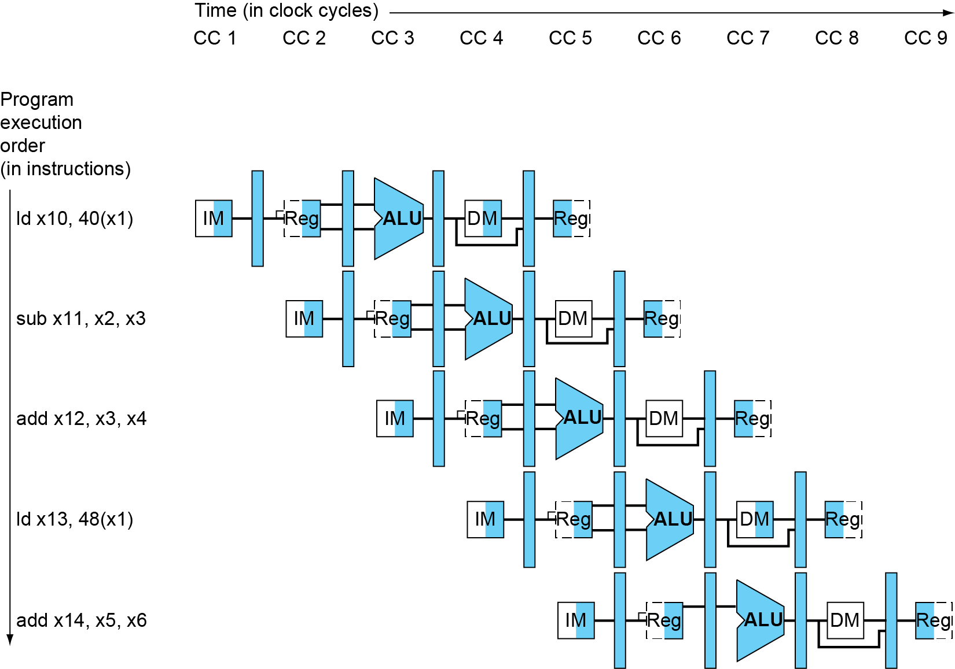
Multi-Cycle Pipeline Diagram
Form showing resource usage

Slide 27
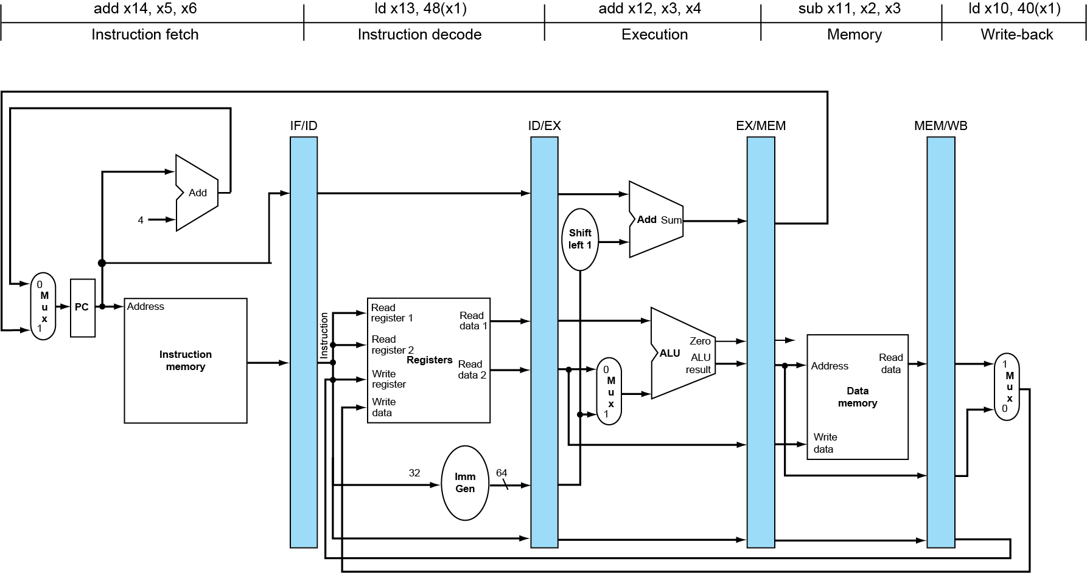
Single-Cycle Pipeline Diagram
State of pipeline in a given cycle

Slide 28
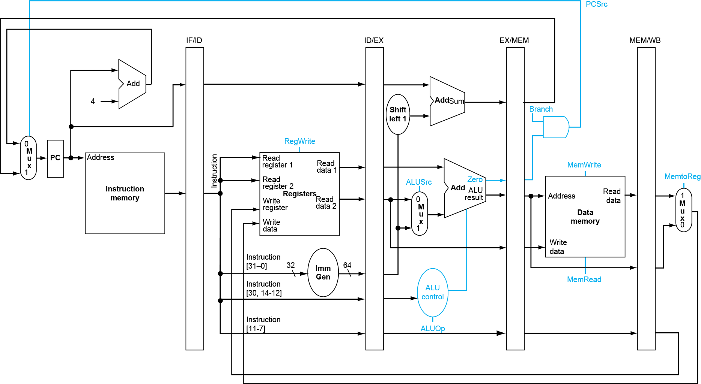
Pipelined Control (Simplified)
Set in WB
Set in EX
Set in MEM

Slide 29
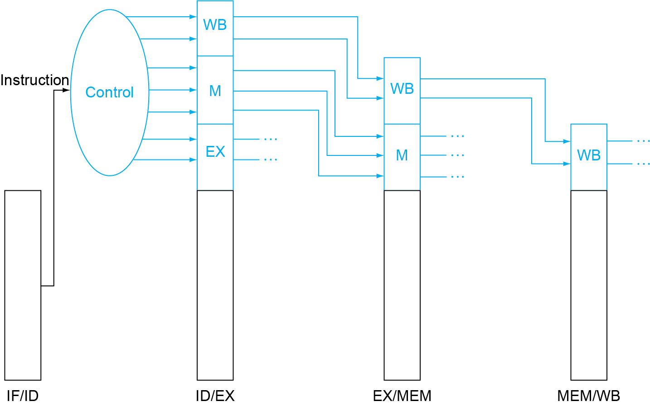
Pipelined Control
Control signals derived from instruction, same as
in single-cycle implementation
ALUSrc
MemWrite
MemToReg
ALUOp
Branch
RegWrite
PCSrc

Slide 30
Data Hazards in ALU Instructions
Example instruction sequence:
sub x2, x1,x3 and x12,x2,x5 or x13,x6,x2 add x14,x2,x2 sd x15,100(x2)
Solution: forwarding (aka bypassing)
Use result when it’s computed; don’t wait for it to be stored in register

Slide 31
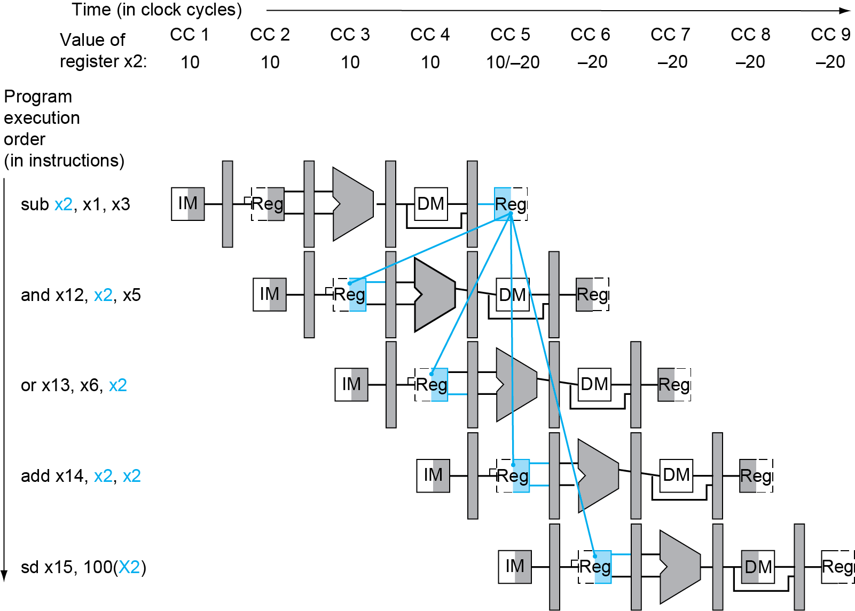
Dependencies & Forwarding
Data hazards

Slide 32
Detecting the Need to Forward
Pass register numbers along pipeline
e.g., ID/EX.RegisterRs1: register number for Rs1 in ID/EX pipeline register
ALU operand register numbers (in EX stage) are:
ID/EX.RegisterRs1
ID/EX.RegisterRs2
Data hazards when
1a. EX/MEM.RegisterRd = ID/EX.RegisterRs1
1b. EX/MEM.RegisterRd = ID/EX.RegisterRs2
2a. MEM/WB.RegisterRd = ID/EX.RegisterRs1
2b. MEM/WB.RegisterRd = ID/EX.RegisterRs2
EX-hazard:
Fwd from EX/MEM pipeline reg
Mem-hazard: Fwd from MEM/WB pipeline reg

Slide 33
Detecting the Need to Forward
But only if forwarding instruction will write to a register!
EX/MEM.RegWrite, MEM/WB.RegWrite
And only if Rd for that instruction is not x0
EX/MEM.RegisterRd ≠ 0, MEM/WB.RegisterRd ≠ 0

Slide 34
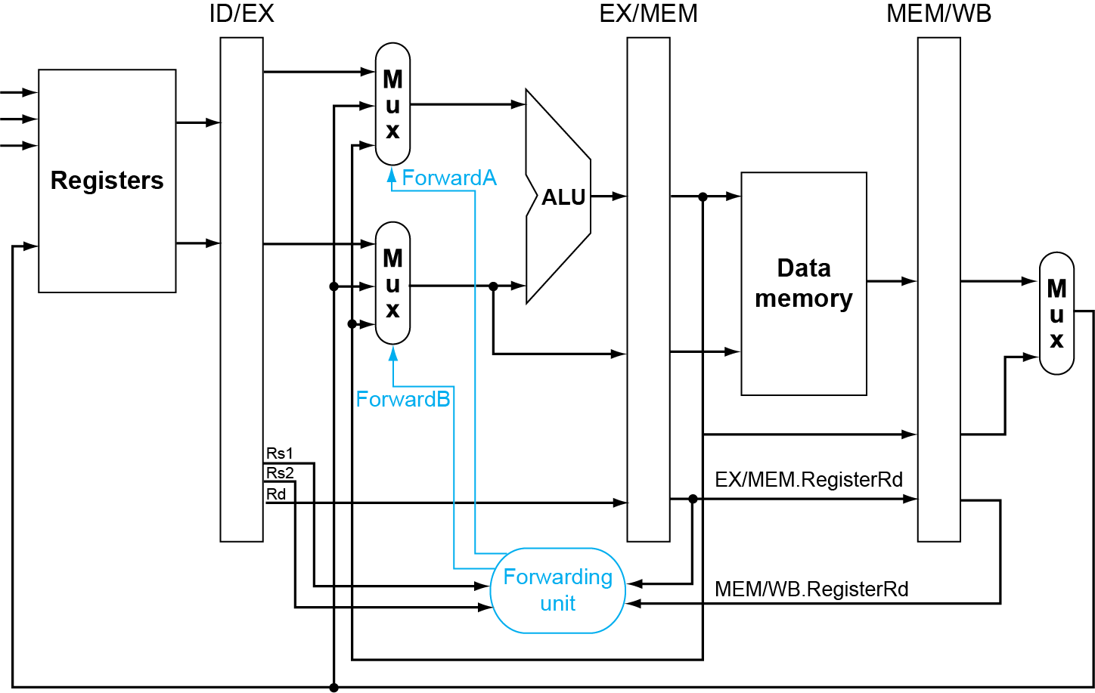
Forwarding Paths

Slide 35


Double Data Hazard
Consider the sequence:
add x1,x1,x2 add x1,x1,x3 add x1,x1,x4
Both hazards occur
Want to use the most recent
Revise MEM hazard condition
Only fwd if EX hazard condition isn’t true
MEM hazard
EX hazard

Slide 36

Load-Use Hazard Detection
Load-use hazard cannot be resolved using forwarding alone
ld x2, 20(x1)
Cannot be forwarded
and x4, x2, x5
Check load-use hazard using condition
ID/EX.MemRead and ((ID/EX.RegisterRd = IF/ID.RegisterRs1) or (ID/EX.RegisterRd = IF/ID.RegisterRs1))
If detected, stall and insert bubble

Slide 37
How to Stall the Pipeline
Force control values in ID/EX register to 0
EX, MEM and WB do nop (no-operation)
Prevent update of PC and IF/ID register
Using instruction is decoded again
Following instruction is fetched again
1-cycle stall allows MEM to read data for ld
Can subsequently forward to EX stage

Slide 38
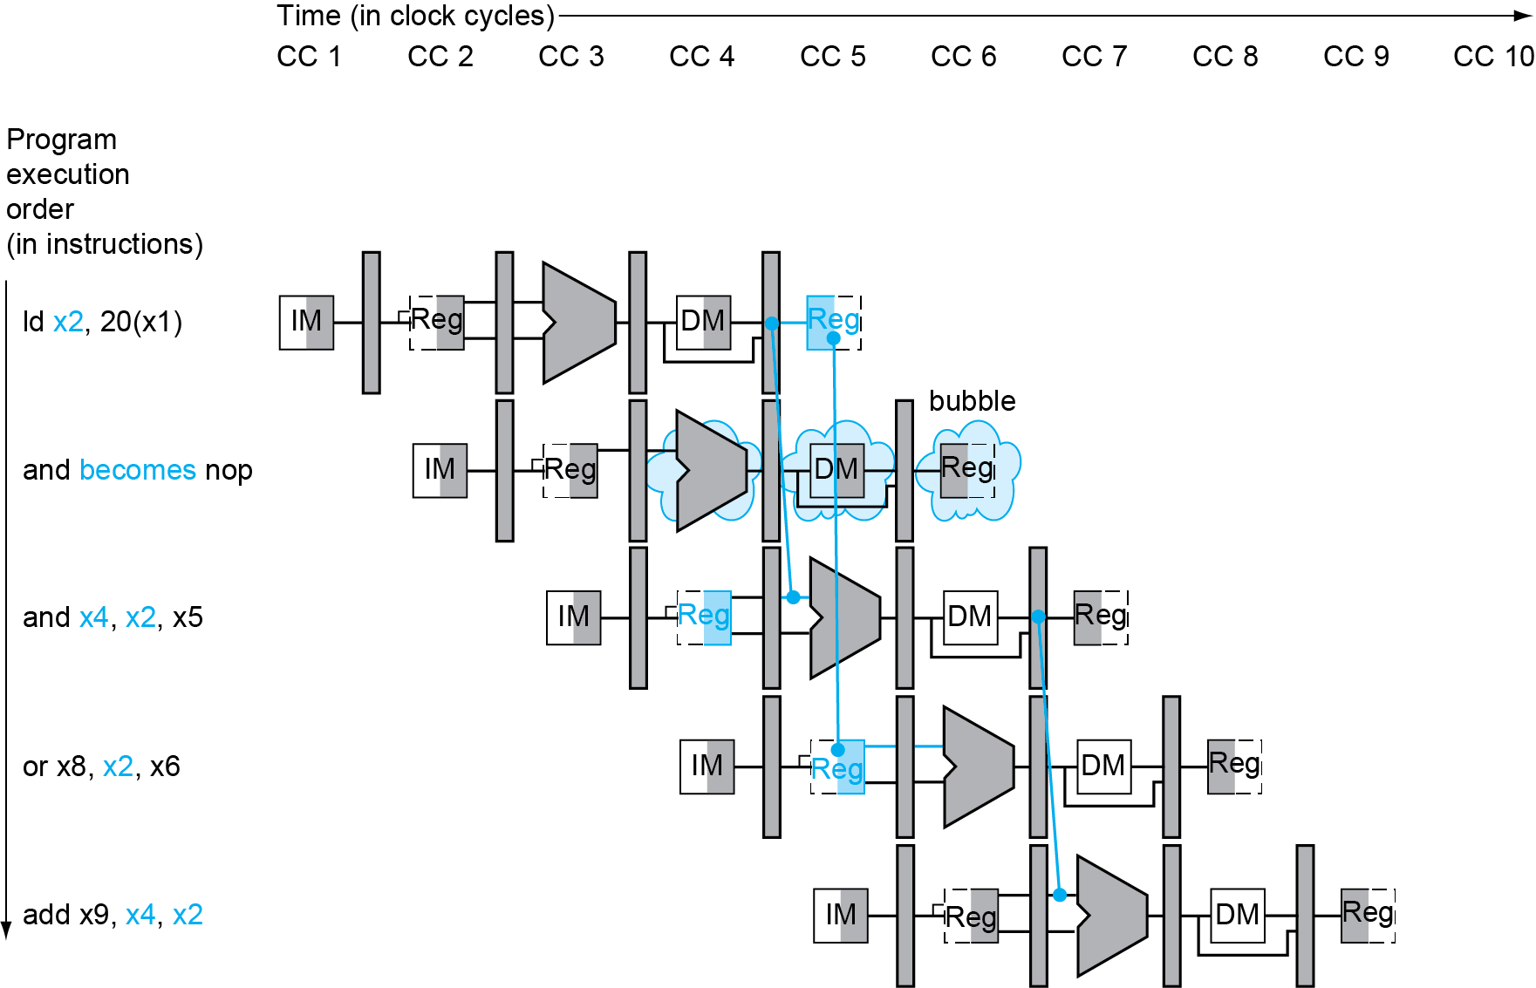
Load-Use Data Hazard
Stall inserted here

Slide 39
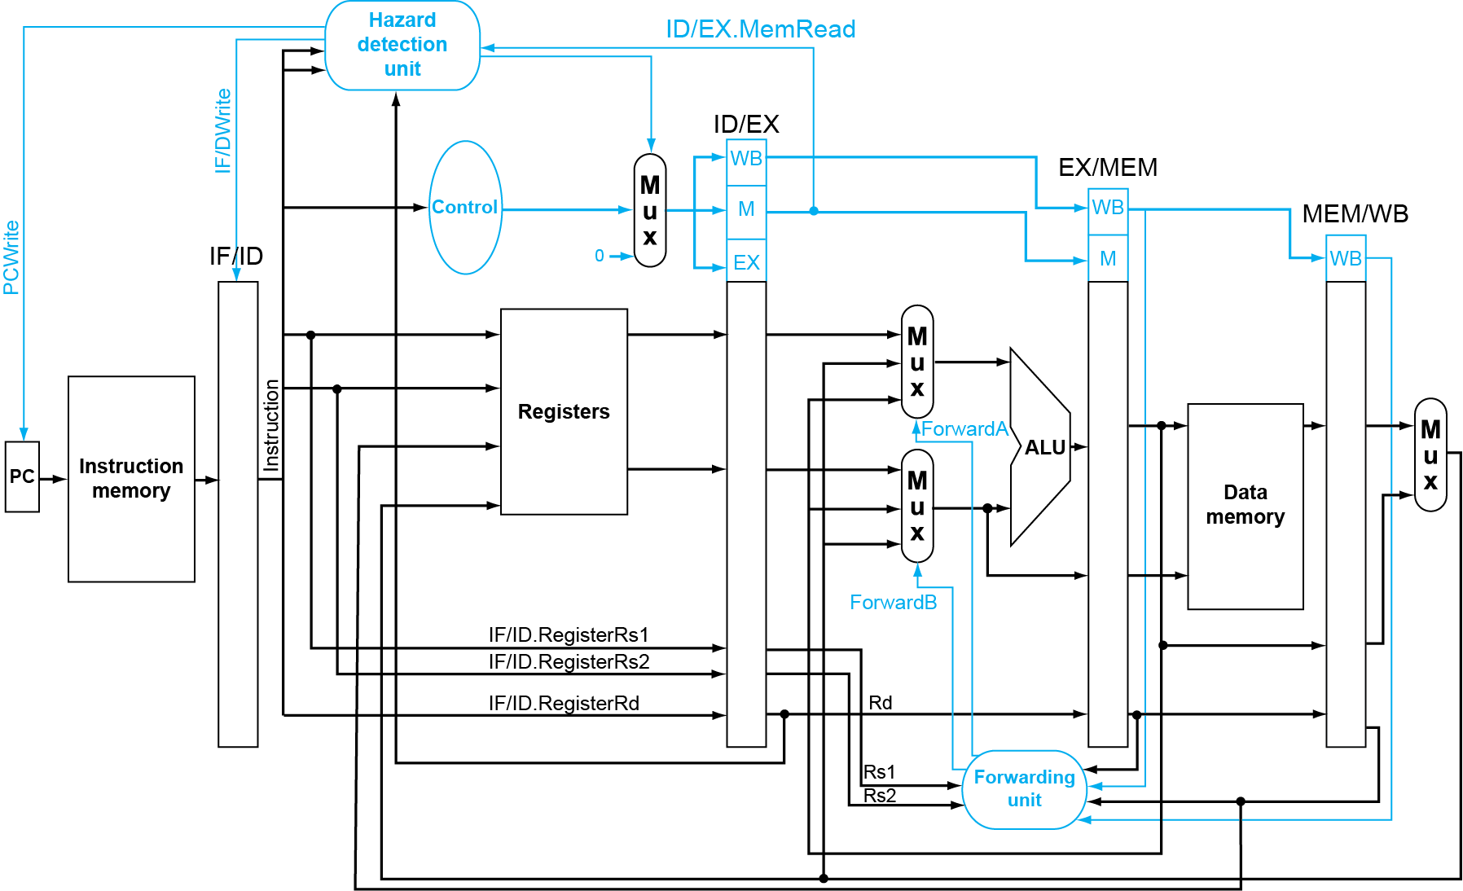
Datapath with Hazard Detection
If hazard is detected, set WB/MEM/EX controls to zero (so no registers/memory is written)

Slide 40
Summary
Pipeline increases throughput by overlapping execution of multiple instructions
Pipeline hazard
Structure (solution: add resources)
Data (solution: forwarding)
Control (next class)
Pipeline stalls

