Slide 1
Memory hierarchy: caching
Jinyang Li
Based on Patterson and Hennessy’s slides

Slide 2
What we’ve learnt so far
Single cycle RISC-V CPU design
5 stage pipelined RISC-V CPU
Pipelining challenges: hazards
Must stall (bubble) to ensure correctness
3 types of hazards:
Structure (To mitigate, add resources)
Data (To mitigate, do forwarding/bypassing)
Control (Predict/speculate)

Slide 3
Today’s lesson plan
Memory hierarchy
Caching
Performance
Design

Slide 4
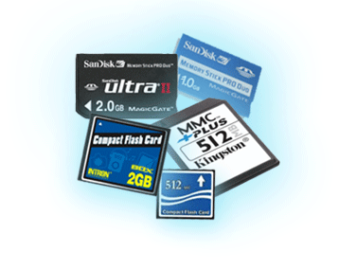

Programmers want fast and unlimited memory, but…
Processor
Flip-flop
< 0.5ns
fastest
smallest
Memory
SRAM
Integrated on chip
0.5-2.5ns
$500-$1000/GB
Memory
DRAM
50-70ns
$7-$15/GB
speed
size
Memory
Flash
5-50𝜇s
$0.75-$1/GB
Memory
Magnetic
disk
slowest
$0.05-$0.1/GB
5-20ms
biggest

Slide 5

DRAM Technology
Data stored as a charge in a capacitor
Single transistor used to access the charge
Must periodically be refreshed
Read contents and write back
Double data rate (DDR) DRAM
Transfer on rising and falling clock edges
2666 *10⁶ transfers/sec
8 bytes per transfer

Slide 6
Flash Storage
Nonvolatile semiconductor storage
Compared to DRAM
100x – 1000x slower
Compared to magnetic disk
100× – 1000× faster than magnetic disk
Smaller, lower power, more robust
Flash bits wears out after 1000’s of accesses
Wear leveling: remap data to less used blocks

Slide 7
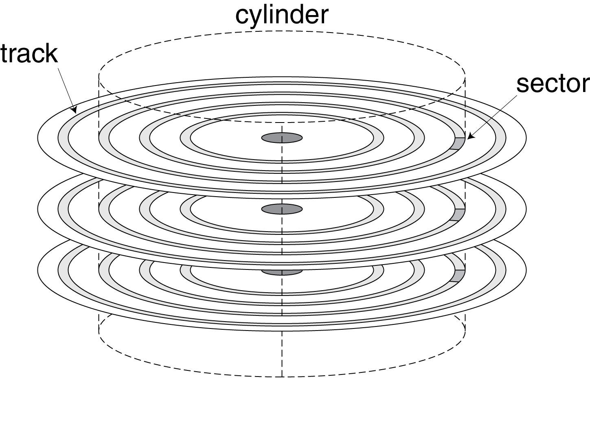
Magnetic disk
Nonvolatile, rotating magnetic storage
Data is stored in sectors
512 bytes in size
Data access time includes:
Seek time: move the heads to the right track
Typically, 4-5ms
Rotational time: wait till head is over the right sector
= ½ /rotation frequency, e.g. ½/(15000/60)=2ms
Data transfer time
E.g. 512B/ 100MB/s = 0.005ms
e.g. Transfer 512Bytes

Slide 8
How to give programmers the illusion of fast and vast memory? Caching!
Copy recently accessed (and nearby) items from disk to smaller DRAM memory
Copy more recently accessed (and nearby) items from DRAM to smaller SRAM memory
Referred to as
main memory
Referred to as
cache memory (integrated on CPU chip)
Done at the granularity
of a block or line
We will focus on cache memory only

Slide 9
Why caching works? Principle of locality
Programs access a small proportion of their address space at any time
Temporal locality
Items accessed recently are likely to be accessed again soon
e.g., instructions in a loop, induction variables
Spatial locality
Items near those accessed recently are likely to be accessed soon
E.g., sequential instruction access, array data

Slide 10
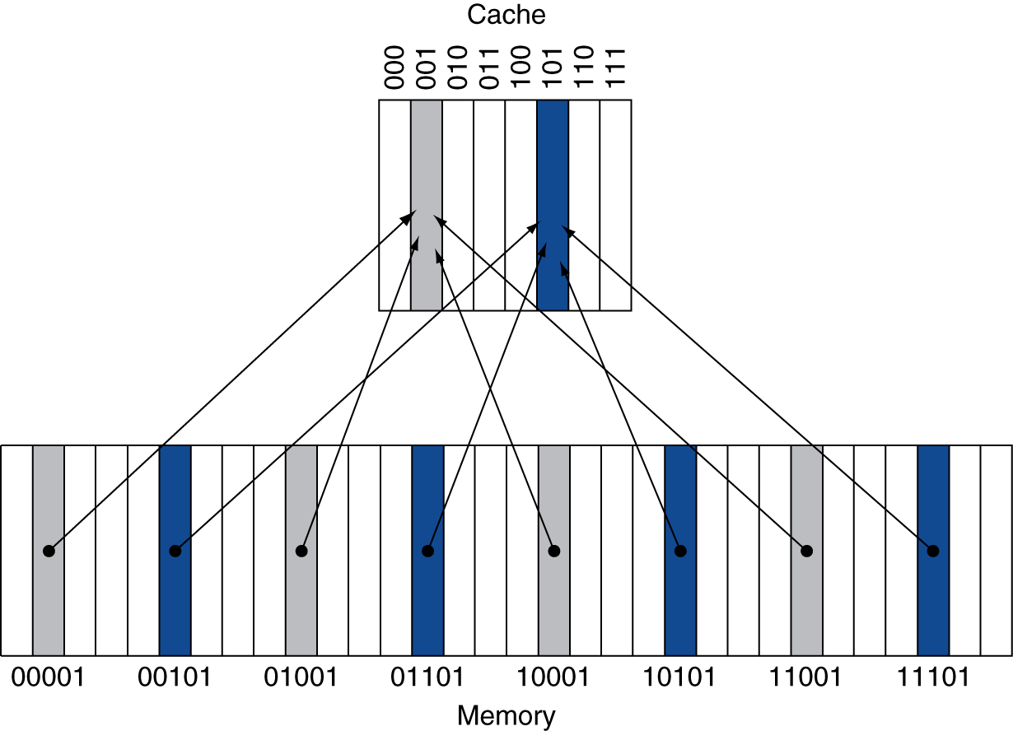
Direct Mapped Cache
How to check if an access has previously been cached?
Location in cache determined by address
Direct mapped: only one choice
(Block address) modulo (#Blocks in cache)
#Blocks is a power of 2
Use low-order address bits

Slide 11
Tags and Valid Bits
How do we know which particular block is stored in a cache location?
Store block address as well as the data
Actually, only need the high-order bits
Called the tag
What if there is no data in a location?
Valid bit: 1 = present, 0 = not present
Initially 0

Slide 12
Cache Example
8-blocks, 1 word/block, direct mapped
Initial state
Index | V | Tag | Data
000 | N
001 | N
010 | N
011 | N
100 | N
101 | N
110 | N
111 | N

Slide 13
Cache Example
Word addr | Binary addr | Hit/miss | Cache block
22 | 10 110 | Miss | 110
Index | V | Tag | Data
000 | N
001 | N
010 | N
011 | N
100 | N
101 | N
110 | Y | 10 | Mem[10110]
111 | N

Slide 14
Cache Example
Word addr | Binary addr | Hit/miss | Cache block
26 | 11 010 | Miss | 010
Index | V | Tag | Data
000 | N
001 | N
010 | Y | 11 | Mem[11010]
011 | N
100 | N
101 | N
110 | Y | 10 | Mem[10110]
111 | N

Slide 15
Cache Example
Word addr | Binary addr | Hit/miss | Cache block
22 | 10 110 | Hit | 110
26 | 11 010 | Hit | 010
Index | V | Tag | Data
000 | N
001 | N
010 | Y | 11 | Mem[11010]
011 | N
100 | N
101 | N
110 | Y | 10 | Mem[10110]
111 | N

Slide 16
Cache Example
Word addr | Binary addr | Hit/miss | Cache block
16 | 10 000 | Miss | 000
3 | 00 011 | Miss | 011
16 | 10 000 | Hit | 000
Index | V | Tag | Data
000 | Y | 10 | Mem[10000]
001 | N
010 | Y | 11 | Mem[11010]
011 | Y | 00 | Mem[00011]
100 | N
101 | N
110 | Y | 10 | Mem[10110]
111 | N

Slide 17
Cache Example
Word addr | Binary addr | Hit/miss | Cache block
18 | 10 010 | Miss | 010
Index | V | Tag | Data
000 | Y | 10 | Mem[10000]
001 | N
010 | Y | 10 | Mem[10010]
011 | Y | 00 | Mem[00011]
100 | N
101 | N
110 | Y | 10 | Mem[10110]
111 | N

Slide 18
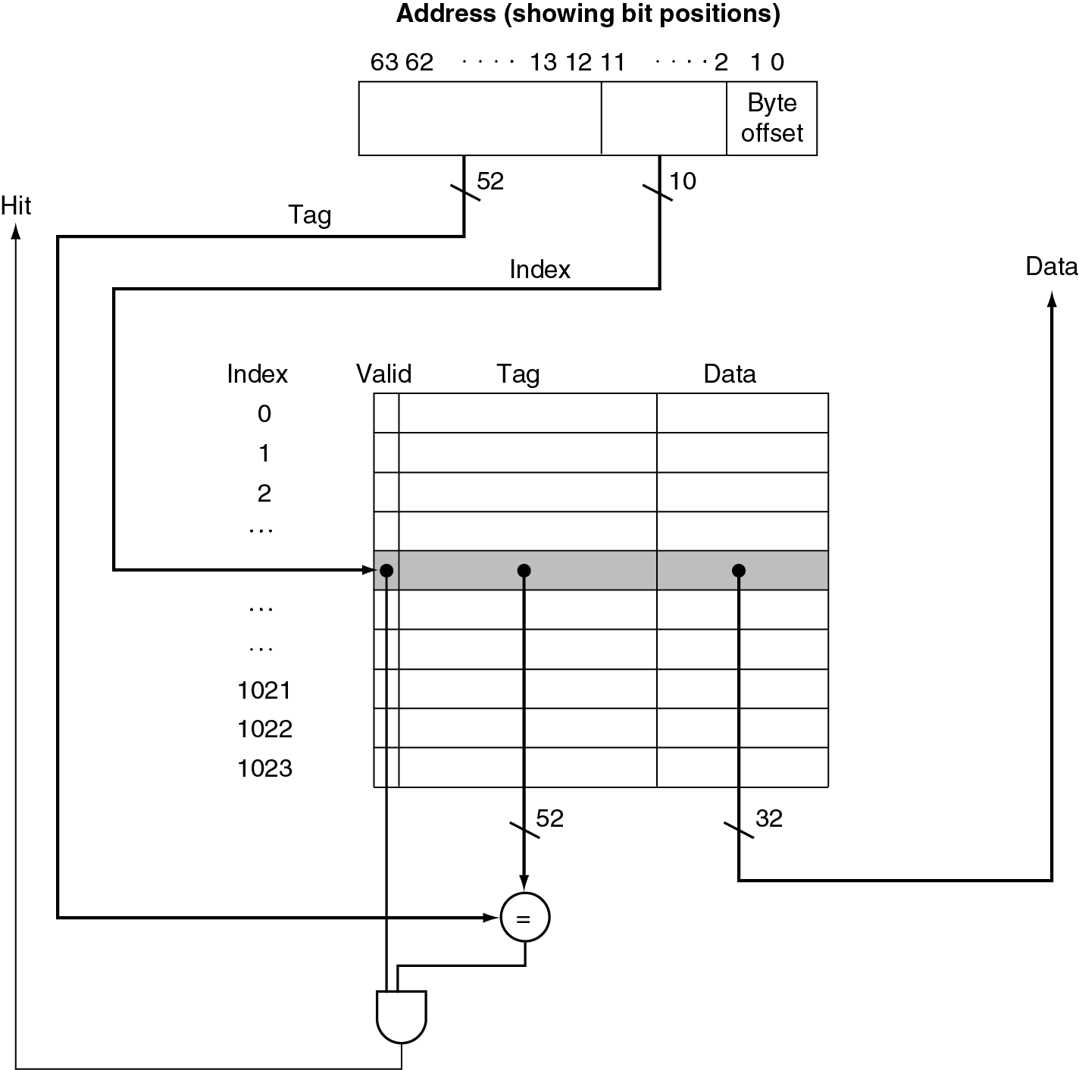
Hardware of direct mapped cache
# of bits here is
determined by block size

Slide 19
Example: Larger Block Size
64 blocks, 16 bytes/block
To what block number does address 1200 map?
Block address = ⎣1200/16⎦ = 75
Block number = 75 modulo 64 = 11
63
10
9
4
3
0
Tag
Index
Offset
22 bits
6 bits
4 bits

Slide 20
Block Size Considerations
Larger blocks should reduce miss rate
Due to spatial locality
But in a fixed-sized cache
Larger blocks ⇒ fewer of them
More competition ⇒ increased miss rate
Larger blocks ⇒ pollution
Larger miss penalty
Can override benefit of reduced miss rate

Slide 21
Cache Misses
On cache hit, CPU proceeds normally
On cache miss
Stall the CPU pipeline
Fetch block from next level of hierarchy
Instruction cache miss
Restart instruction fetch
Data cache miss
Complete data access

Slide 22
Write-Through vs write-back
Write-through: On write hit, update memory upon write
But, writes take longer
Solution: write buffer
Holds data to be written to memory so CPU continues immediately
Only stalls on write if write buffer is already full
Write-back: On write hit, update cache only
Keep track of whether a block in cache is dirty
When a dirty block is replaced, write it back to memory

Slide 23
Measuring Cache Performance

Slide 24
Cache Performance Example
Given
I-cache miss rate = 2%
D-cache miss rate = 4%
Miss penalty = 100 cycles
Base CPI (ideal cache) = 2
Load & stores are 36% of instructions
Miss cycles per instruction
I-cache: 0.02 × 100 = 2
D-cache: 0.36 × 0.04 × 100 = 1.44
Actual CPI = 2 + 2 + 1.44 = 5.44
Ideal CPU is 5.44/2 =2.72 times faster

Slide 25
Average Access Time
Hit time is also important for performance
Average memory access time (AMAT)
AMAT = Hit time + Miss rate × Miss penalty
Example
CPU with 1ns clock, hit time = 1 cycle, miss penalty = 20 cycles, I-cache miss rate = 5%
AMAT = 1 + 0.05 × 20 = 2ns
2 cycles per instruction

Slide 26
Associative Caches
Fully associative
Allow a given block to go in any cache entry
Requires all entries to be searched at once
Comparator per entry (expensive)
n-way set associative
Divide cache into sets each of which contains n entries
Block number determines which set
(Block number) modulo (#Sets in cache)
Search all entries in a given set at once
n comparators (less expensive)

Slide 27
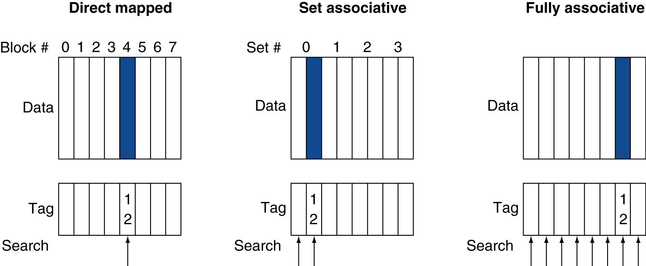
Associative Cache Example
Cache locations of a memory block with address 12

Slide 28
Associativity Example
Block access sequence: 0, 8, 0, 6, 8
Direct mapped
Block address | Cache index | Hit/miss | Cache content after access
 |  |  | 0 | 1 | 2 | 3
0 | 0 | miss | Mem[0]
8 | 0 | miss | Mem[8]
0 | 0 | miss | Mem[0]
6 | 2 | miss | Mem[0] |  | Mem[6]
8 | 0 | miss | Mem[8] |  | Mem[6]
2-way set associative
Block address | Cache index | Hit/miss | Cache content after access
 |  |  | Set 0 |  | Set 1
0 | 0 | miss | Mem[0]
8 | 0 | miss | Mem[0] | Mem[8]
0 | 0 | hit | Mem[0] | Mem[8]
6 | 0 | miss | Mem[0] | Mem[6]
8 | 0 | miss | Mem[8] | Mem[6]

Slide 29
How Much Associativity
Increased associativity decreases miss rate
But with diminishing returns
Simulation of a system with 64KB D-cache, 16-word blocks, SPEC2000 benchmark
1-way: 10.3%
2-way: 8.6%
4-way: 8.3%
8-way: 8.1%

Slide 30
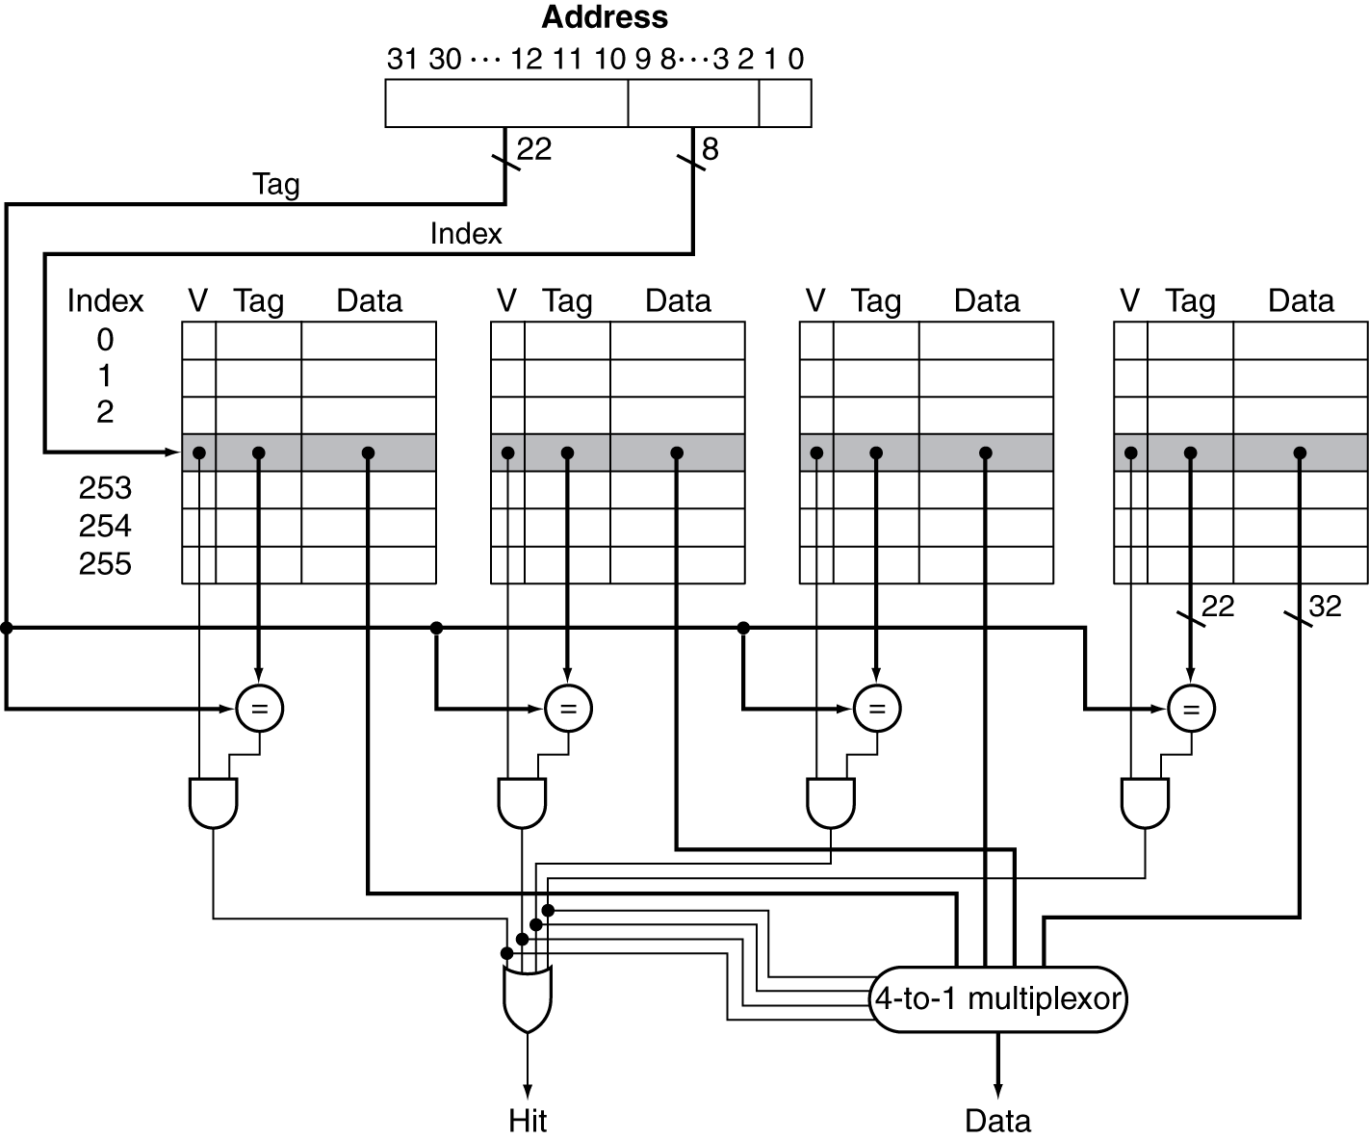
Set Associative Cache Organization

Slide 31
Replacement Policy
Direct mapped: no choice
Set associative
Prefer non-valid entry, if there is one
Otherwise, choose among entries in the set
Least-recently used (LRU)
Choose the one unused for the longest time
Hardware implementation: simple for 2-way, manageable for 4-way, too hard beyond that

Slide 32
Multilevel Caches
Primary cache attached to CPU
Small, but fast
Level-2 cache services misses from primary cache
Larger, slower, but still faster than main memory
Main memory services L-2 cache misses
High-end systems include L-3 cache

Slide 33
Software Optimization via Blocking
Goal: maximize accesses to data before it is replaced
Consider inner loops of DGEMM:
for (int j = 0; j < n; ++j)
{
double cij = C[i+j*n];
for( int k = 0; k < n; k++ )
cij += A[i+k*n] * B[k+j*n];
C[i+j*n] = cij;
}

Slide 34
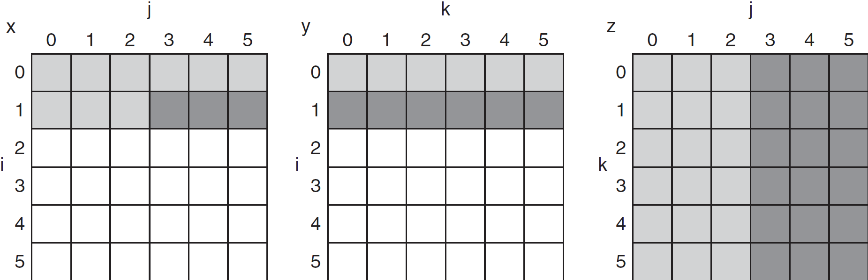
DGEMM Access Pattern
older accesses
new accesses
C
A
B

Slide 35
Blocked DGEMM
#define BLOCKSIZE 32
void do_block (int n, int si, int sj, int sk, double *A, double*B, double *C)
{
for (int i = si; i < si+BLOCKSIZE; ++i)
for (int j = sj; j < sj+BLOCKSIZE; ++j)
{
double cij = C[i+j*n]; /* cij = C[i][j] */
for( int k = sk; k < sk+BLOCKSIZE; k++ )
cij += A[i+k*n] * B[k+j*n];/* cij+=A[i][k]*B[k][j] */
C[i+j*n] = cij;/* C[i][j] = cij */
}
}
void dgemm (int n, double* A, double* B, double* C)
{
for ( int sj = 0; sj < n; sj += BLOCKSIZE )
for ( int si = 0; si < n; si += BLOCKSIZE )
for ( int sk = 0; sk < n; sk += BLOCKSIZE )
do_block(n, si, sj, sk, A, B, C);
}

Slide 36
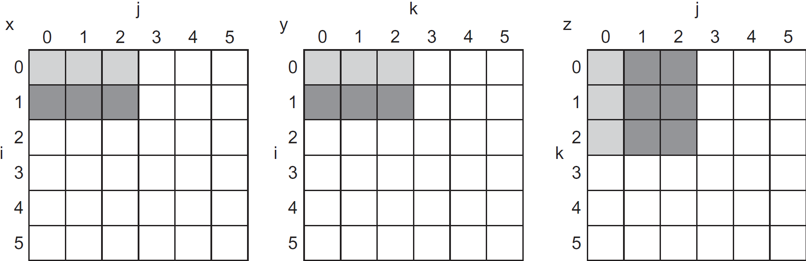
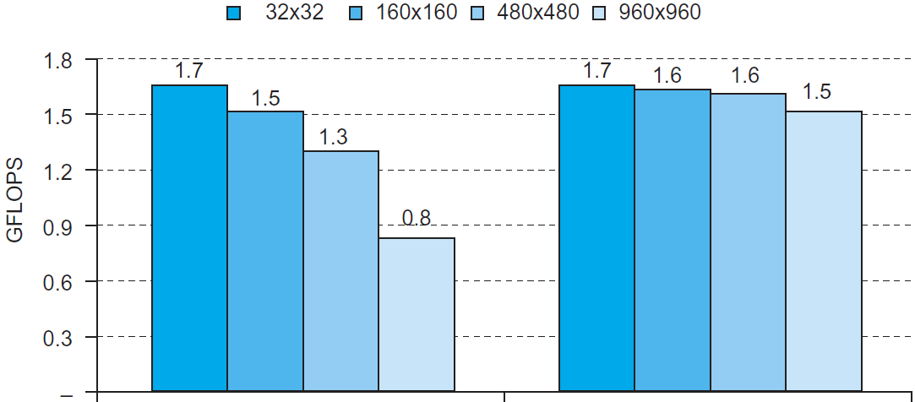
Blocked DGEMM Access Pattern
C
A
B
Unoptimized
Blocked

Slide 37
Summary
Memory hierarchy
Caching works due to principles of locality
Direct mapped vs. set-associate cache
Software optimization via blocking

