Slide 1
CSO-Recitation 10 CSCI-UA 0201-007
R10: Assessment 08 & Buffer overflow & Compiler optimization

Slide 2
Today’s Topics
Assessment 08
Breakout exercises
Buffer overflow
Compiler optimization

Slide 3
Assessment 08

Slide 4
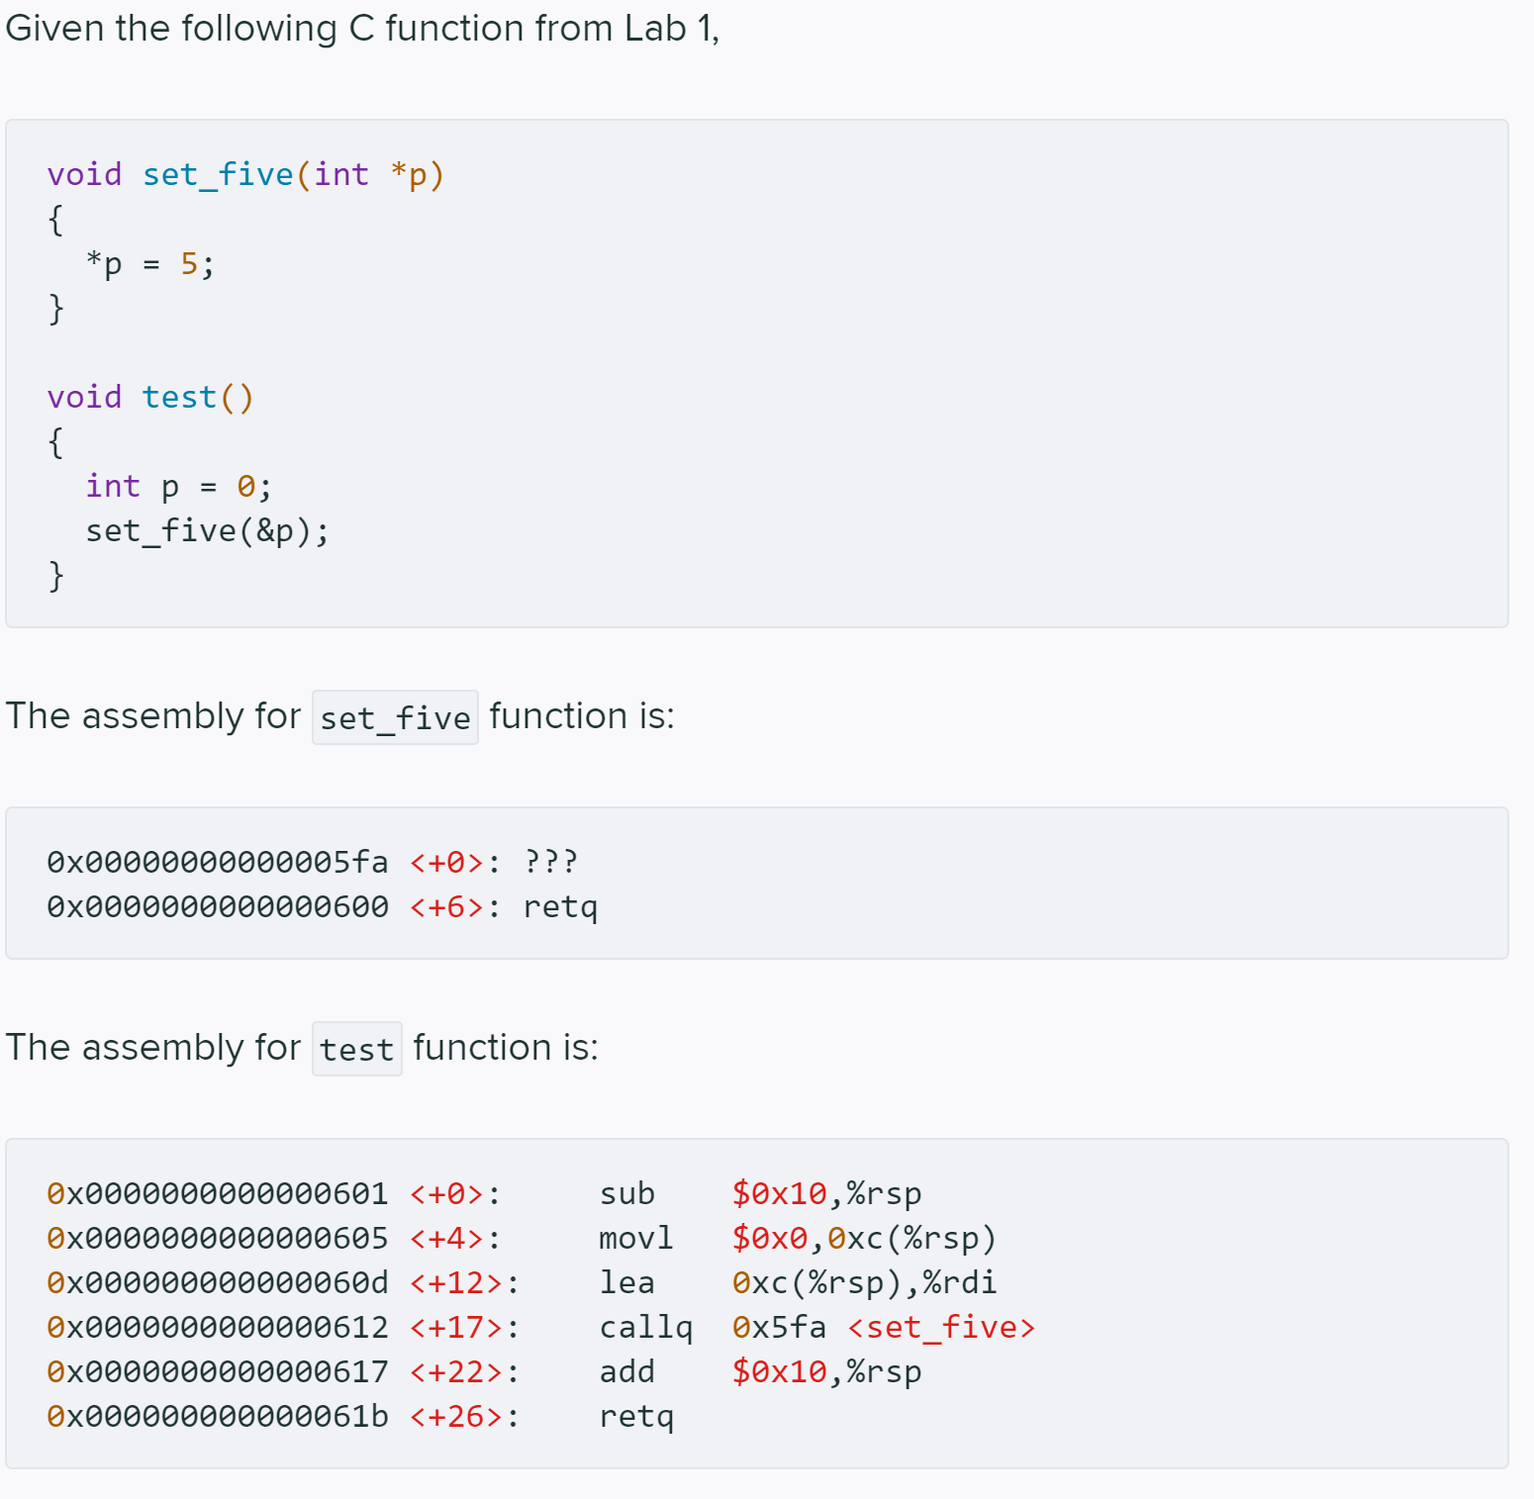
Q1 Set_five

Slide 5
Q1.1 %rsp
Under normal program execution, suppose the value of %rsp is 0x7fff856001d8 just prior to executing the first instruction of test. What is the value of %rsp just prior to executing the first instruction of set_five?
0x7fff856001d8
0x7fff856001c8
0x7fff856001e8
0x7fff856001c0
0x7fff856001d0
0x7fff856001c4
0x7fff856001cc
None of the above
val(%rsp)= 0x7fff856001d8
sub $0x10, %rsp
val(%rsp)= 0x7fff856001c8
callq 0x5fa <set_five>
callq label
DECREASES %rsp by 8
THEN stores the return address at the memory location given by the new %rsp
THEN jumps to the operand
callq 0x5fa <set_five>
val(%rsp)= 0x7fff856001c0

Slide 6
Q1.2
Under normal program execution, what is the 8-byte value stored under the address specified by %rsp just prior to executing the first instruction of set_five?
0x7fff856001d8
0x7fff856001c0
0x000000000000060d
0x0000000000000612
0x0000000000000617
It could be any arbitrary 8-byte value
callq label
DECREASES %rsp by 8
THEN stores the return address at the memory location given by the new %rsp
THEN jumps to the operand
callq 0x5fa <set_five>
val(%rsp)= 0x7fff856001c0
val( (%rsp) ) =0x0000000000000617

Slide 7
Q1.3
After executing instruction 0x0000000000000600 <+6>: retq in set_five, what's new %rip value?
0x000000000000060d
0x0000000000000612
0x0000000000000617
0x0000000000000604
0x0000000000000608
retq
Jumps to the location given by the value in memory located at %rsp
%rip = mem[%rsp]
val( (%rsp) ) =0x0000000000000617
THEN INCREASES %rsp by 8
%rsp= %rsp+8

Slide 8
Q1.4 p's location
Where is the local variable p stored?
some register
memory (data segment)
memory (stack)
memory (heap)
Local variables -> stack
If C’s primitive data type and pointer
registers
stack
Here, 0xc(%rsp) -> some place in memory
-> stack

Slide 9
Q1.5 p's location
If your answer of 1.4 is memory, where in memory (aka what address) is p stored (assuming the value of %rsp is 0x7fff856001d8 just prior to executing the first instruction of test)?
0x7fff856001d8
0x7fff856001c8
0x7fff856001d4
0x7fff856001d0
0x7fff856001cc
val(%rsp)= 0x7fff856001d8
sub $0x10, %rsp
val(%rsp)= 0x7fff856001c8
where in memory is p stored
0xc(%rsp)
0x7fff856001d4

Slide 10
Q1.6 set_five
What's the missing first instruction of set_five (aka the instruction corresponding to ???)
`movl $0x5,(%rdi)`
`movq $0x5,(%rdi)`
`movl $0x5,(%rsi)`
`movq $0x5,(%rdi)`
`movl $0x5, %edi`
`movq $0x5, %rdi`
`movl $0x5, %esi`
`movq $0x5, %rsi`
*p=5;
p -> the first argument
store in %rdi
mov $0x5, (%rdi)
p is int * type
movl $0x5, (%rdi)

Slide 11
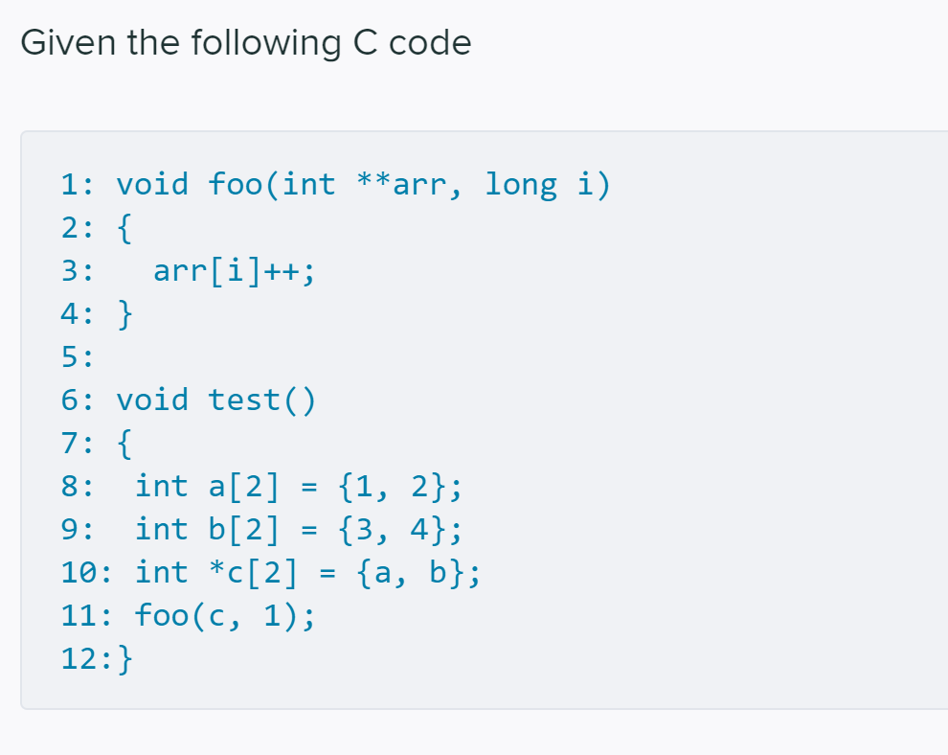
Q2 array → Q2.1
What is the value of *c[1] after executing line 11?
1
2
3
4
5
None of the above
c’s type is int **
c[i] == *(c+i)
c+i -> int ** (pointer arithmetic)
c[1]==*(c+1) -> int *
c[1] == b == &b[0]
c[1]++;
pointer arithmetic
c[1] = c[1]+1 == &b[1]
*c[1]==b[1]==4

Slide 12
Q2.2 arr[i]++
If Line 3 is realized using one instruction, what's that instruction?
`addl $0x8,(%rdi,%rsi,8)`
`addl $0x4,(%rdi,%rsi,8)`
`addl $0x8,(%rdi,%rsi,4)`
`addl $0x4,(%rdi,%rsi,4)`
`addq $0x8,(%rdi,%rsi,8)`
`addq $0x4,(%rdi,%rsi,8)`
`addq $0x8,(%rdi,%rsi,4)`
`addq $0x4,(%rdi,%rsi,4)`
arr[i]++;
arr[i]
(%rdi, %rsi, size)
arr -> int **, arr[i] -> int * -> 8-byte
(%rdi, %rsi, 8)
arr[i] = arr[i]+1;
add: dest = dest + src
dest == arr[i] -> int * -> 8-byte
addq
src
arr[i]=arr[i]+1 is a pointer arithmetic
“+1” -> 1*size(element)
arr[i] -> int *, arr[i][j] -> int -> 4-byte
1*4 == 0x4
addq $0x4, (%rdi,%rsi,8)

Slide 13
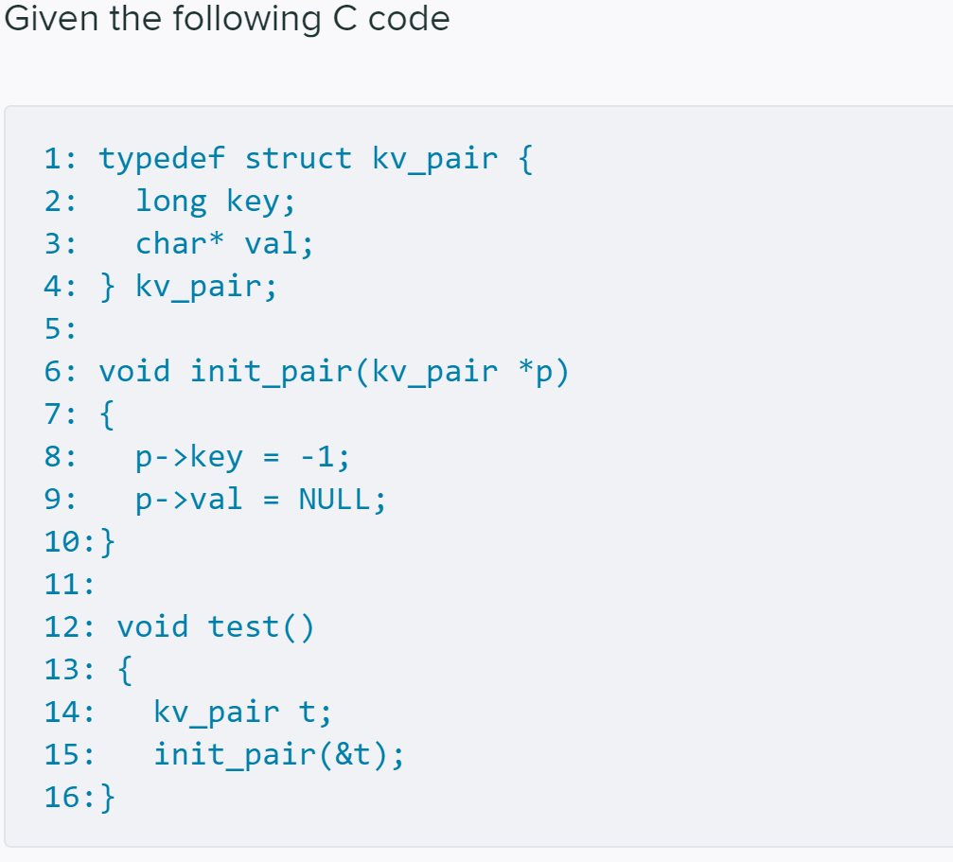
Q3 → Q3.1 location of p
Where is the local variable t in test stored?
some register
memory (data segment)
memory (stack)
memory (heap)

Slide 14
Q3.2 p->val
If Line 9 is realized using one instruction, what is that instruction?
`movl $0x0,0x4(%rdi)`
`movq $0x0,0x4(%rdi)`
`movl $0x0,0x8(%rdi)`
`movq $0x0,0x8(%rdi)`
`movl $0x0,0x4(%rsi)`
`movq $0x0,0x4(%rsi)`
`movl $0x0,0x8(%rsi)`
`movq $0x0,0x8(%rsi)`
p->val = NULL;
p is kv_pair * type
stored in memory (stack)
(%rdi)
the start address of p->val
0x8(%rdi)
because first 8-byte stores “key”, next 8-byte stores “val”
“val” has type char *
8-byte
movq
movq $0x0, 0x8(%rdi)

Slide 15
Exercises
Discuss the answer

Slide 16
Ex1
1. Consider the following scenario:
%rsp is 0x7fffffffe448
The following instructions execute:
```
pushq %rbp
pushq %rax
```
What is the new value for %rsp?
pushq src
DECREASES %rsp by 8
THEN stores the operand at the memory location given by the new %rsp
%rsp -> 0x7fffffffe448
0x7fffffffe440
0x7fffffffe438
0x7fffffffe438

Slide 17
Ex2
callq label
DECREASES %rsp by 8
THEN stores the return address at the memory location given by the new %rsp
THEN jumps to the operand
%rsp -> 0x7fffffffe448
0x7fffffffe440
retq
Jumps to the location given by the value in memory located at %rsp
THEN INCREASES %rsp by 8
0x7fffffffe448
2. Consider the following scenario:
%rsp is 0x7fffffffe448
The following instructions execute:
```
callq my_cool_function
```
While `my_cool_function` is executing, what is the value for %rsp?
When `my_cool_function` executes `retq`,what will be the value for %rsp?

Slide 18
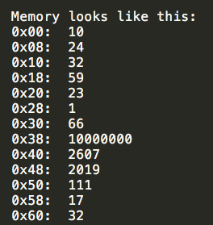
Ex3
3. Consider the following scenario:
%rsi is 5
%rdi is 8
The following instructions execute:
```
leaq 40(%rdi, %rsi, 8), %rax
```
What is the value of %rax?
“lea” is no memory access, only do arithmetic calculation
leaq 40(%rdi, %rsi, 8), %rax
val(%rax) = val(%rdi)+8*val(%rsi)+40
=8+8*5+40 = 88 = 0x58

Slide 19
Ex4
4. Consider the following scenario:
%rsi is 5
%rdi is 8
The following instructions execute:
```
movq 40(%rdi, %rsi, 8), %rax
```
What is the value of %rax?
movq 40(%rdi, %rsi, 8), %rax
val(%rax) = mem[val(%rdi)+8*val(%rsi)+40]
= mem[0x58]
= 17

Slide 20
Buffer Overflow
Not all buggy memory references access “illegal” memory

Slide 21
Buffer Overflow
Have learnt about the memory layout
If an instruction tries to access some invalid memory
Segmentation fault occurs
But not all buggy memory references access “illegal” memory
Buffer overflow exploits

Slide 22
Buffer Overflow
Buffer overflow on the stack
Buffer overflow overwrites the return address
attackers may carefully chosen return address, executes malicious code
code injection buffer overflow attacks

Slide 23
Defenses
Write correct code to avoid overflow vulnerability
Use safe APIs to limit buffer lengths
Use a memory-safe language
Mitigate attacks despite buggy code
will be an always on-going project, attack and defense itself are alternately developed
Security research domain
One idea to prevent control flow hijiacking: catch over-written return address before invocation
place special value (“canary”) just beyond buffer
GCC implementation: -fstack-protector

Slide 24
Compiler optimization
Tries to minimize or maximize some attributes of an executable computer program

Slide 25
Optimizing compiler
Goal: generate efficient, correct machine code
generally implemented using a sequence of optimizing transformations
algorithms which take a program and transform it to produce a semantically equivalent output program that uses fewer resources and/or executes faster
The compiler performs optimization based on the knowledge it has of the program
Compiling multiple files at once to a single output file mode allows the compiler to use information gained from all of the files when compiling each of them
Common optimization
code motion
use simpler instructions
reuse common subexpressions

Slide 26
Optimization -- GCC
Without any optimization option, the compiler’s goal is to reduce the cost of compilation and to make debugging produce the expected results
Turning on optimization flags makes the compiler
attempt to improve the performance and/or code size at the expense of compilation time and possibly the ability to debug the program
When debugging your code, it may help to disable optimizations
Add –O0 to the Makefile CFLAGS
Depending on the target and how GCC was configured, a slightly different set of optimizations may be enabled at each -O level
You can invoke GCC with -Q --help=optimizers to find out the exact set of optimizations that are enabled at each level

Slide 27
Optimization -- GCC
gcc’s optimization levels: -O, -O2, -O3, -Og, -O0, -Os, -Ofast
With -O, the compiler tries to reduce code size and execution time
without performing any optimizations that take a great deal of compilation time
-O2 optimize even more
turns on all optimization flags specified by -O, and it also turns on some other optimization flags: e.g. -finline-small-functions…
-Og optimize debugging experience
offering a reasonable level of optimization while maintaining fast compilation and a good debugging experience
enables all -O1 optimization flags except for those that may interfere with debugging

