Slide 1
Floating point
Jinyang Li

Slide 2
Floating Point lesson plan
Binary Scientific notation
FP8 example
IEEE FP standard
Rounding
FP operations caveats

Slide 3
Previously…
Unsigned n-bit integers
-
-2^{n-1}
-1
1
2^{n-1}-1
2^{n}-1
+
-2
0
2
-3
3
Signed n-bit integers
What about real numbers?

Slide 4
Represent real numbers: the decimal way
Real Number | Decimal Representation
11 / 2 | (5.5)₁₀
1 / 3 | (0.333...)₁₀
√2 | (1.414…)₁₀
(1.414...)₁₀ = 1 * 10⁰ + 4 * 10⁻¹ + 1 * 10⁻² + 4 * 10⁻³ + ...

Slide 5
Binary Representation
(5.5)₁₀
= 4 + 1 + 1/2
= 2² + 2⁰ + 2⁻¹
= (101.1)₂
2^{p}
2^{p-1}
2
1
.
1/2
1/4
1/2^{q}

Slide 6
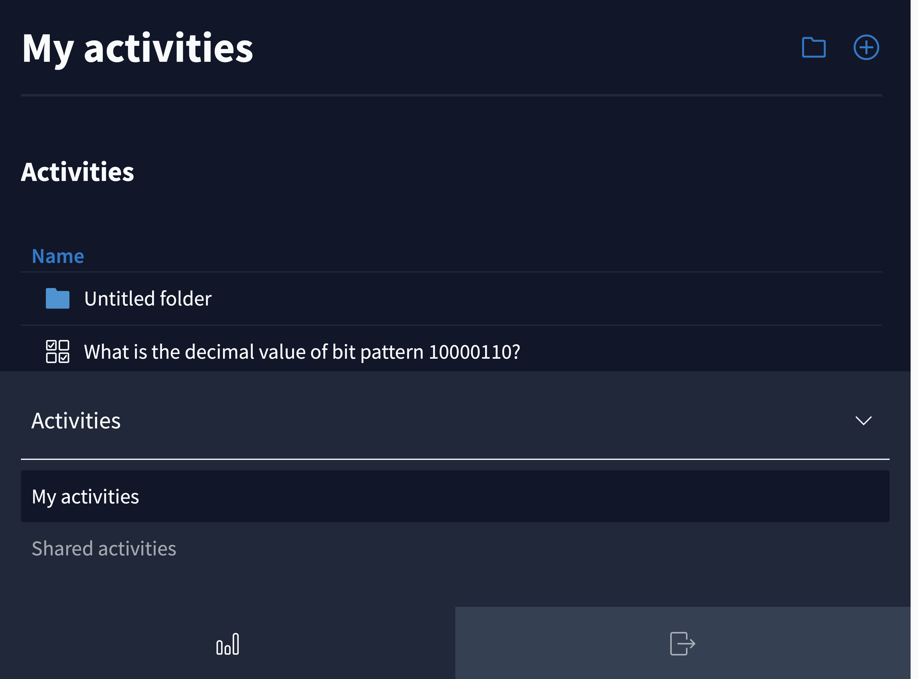

Slide 7
Binary Representation
2^{p}
2^{p-1}
2
1
.
1/2
1/4
1/2^{q}

Slide 8
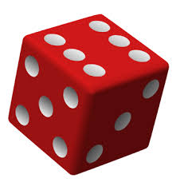
Binary representation
What’s the decimal value of (10.01)₂

Slide 9
Binary representation
What’s the decimal value of (10.01)₂
Answer: 2.25

Slide 10
How to make the representation fixed width?
Strawman: fixed point
3 bits
4 bits
s
sign
Fixed position e.g. middle
Example: ( 10.011 )₂
0 | 0 | 1 | 0 | 0 | 1 | 1 | 0

Slide 11
Problems of Fixed Point
3 bits
4 bits
s
Range?
Precision?
-
+
0

Slide 12
Problems of Fixed Point
3 bits
4 bits
s
  Limited range [-2³+2⁻⁴,2³-2⁻⁴ ]
  Limited precision 2⁻⁴
  Equivalent to integer with a scaling factor

Slide 13
Floating Point is based on scientific notation
Scientific notation in decimal:
365.25 = 3.6525 * 10²
0.0123 = 1.23 * 10⁻²
Normalize mantissa
+M * 10E, where 1 <= M < 10
E: exponent
M: mantissa

Slide 14
Floating Point: binary scientific notation
Binary scientific notation
+M * 2E
where 1 <= M < 2, aka M = (1.b₁b₂b₃…b_{n} )₂
(5.5)₁₀ = (101.1)₂ = (1.011)₂ * 2²

Slide 15
(Binary) normalized representation of (10.25)₁₀?

Slide 16
(Binary) normalized representation of (10.25)₁₀ ?
Answer: (10.25)₁₀ = (1010.01)₂ = (1.01001)₂ * 2³

Slide 17
Floating Point lesson plan
Scientific notation
FP8 example
IEEE FP standard
Rounding
FP operations caveats

Slide 18
An example FP8 representation: E4M3
+M * 2E, where 1 <= M < 2, aka M = (1.b₁b₂b₃)₂
Example: (0.1875)₁₀ = (0.0011)₂ = (1.1)₂ * 2⁻³
exponent
fraction(M)
s

Slide 19

An example FP8 representation: E4M3
+M * 2E, where 1 <= M < 2, aka M = (1.b₁b₂b₃)₂
Example: (0.1875)₁₀ = (0.0011)₂ = (1.1)₂ * 2⁻³
E = exponent - bias, bias=${ 2}^{(e−1)}−1$= 7
exponent
fraction (M)
s

Slide 20
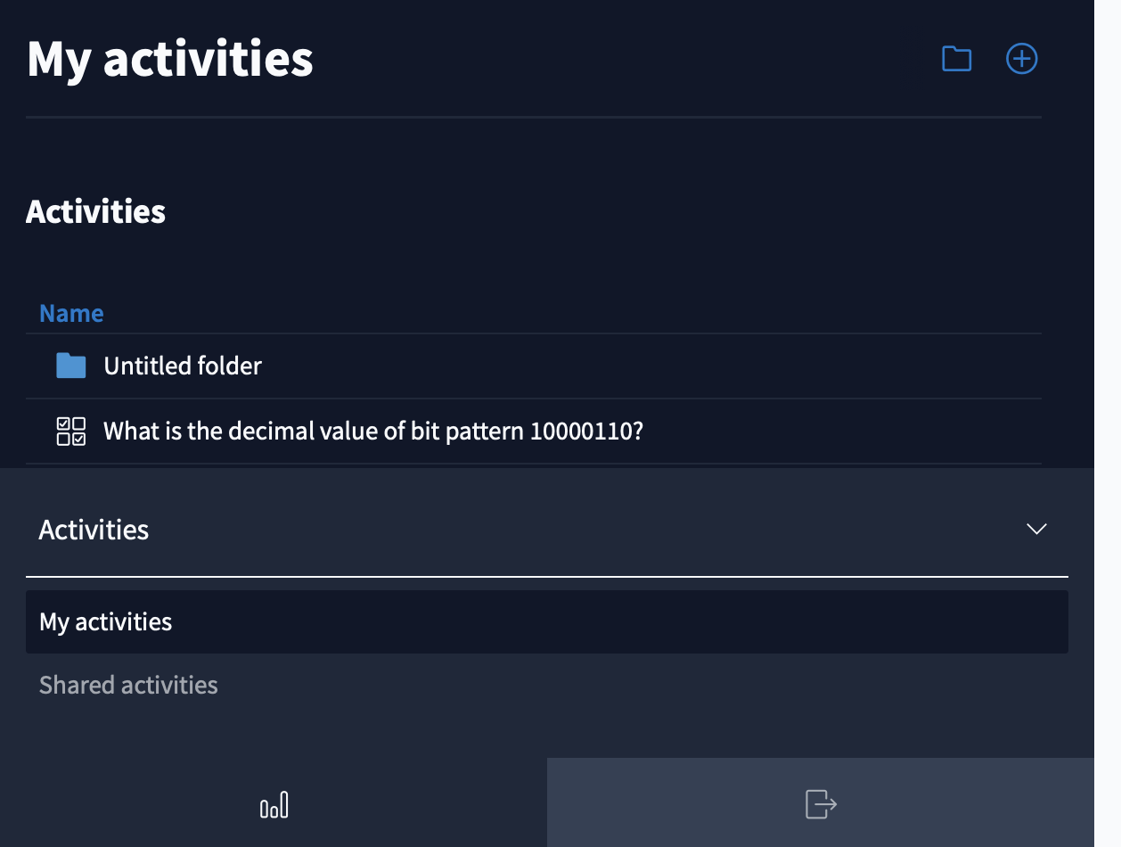

Slide 21
FP8 (E4M3) on the number line
exponent
fraction (M)
s
Larger the bit pattern, larger FP magnitude

Slide 22
FP8 (E4M3) on the number line
exponent (E)
fraction (M)
s
Larger the bit pattern, larger FP magnitude
2⁵
2⁶
2⁷
2⁸
0
0x7f
2⁻⁷
2⁻⁶
2⁻⁵
2⁻⁴
0
Having normalized representation only leaves a disproportionally large gap around zero.

Slide 23
FP8 (E4M3): denormalized (subnormal) number
exponent (E)
fraction (M)
s | 0 | 0 | 0 | 0 | b₁ | b₂ | b₃
What’s the value of (00000101)₂
+M * 2^{1-bias}, where M = (0.b₁b₂b₃)₂
= (0.101)₂ x 2⁻⁶ ?
2⁵
2⁶
2⁷
2⁸
0
0x7f
2⁻⁶
2⁻⁵
2⁻⁴
0

Slide 24
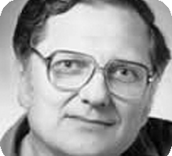
IEEE Floating Point Standard
Lots of FP implementations in 60s/70s
  Code was not portable across processors
IEEE formed a committee (IEEE.754) to standardize FP format and specification.
  IEEE FP standard published in 1985
  Led by William Kahan
Prof. William Kahan
University of California at Berkeley
Turing Award (1989)

Slide 25
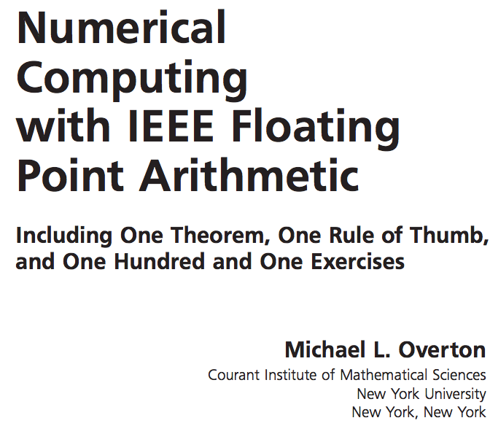

IEEE Floating Point Standard
This class only covers basic FP materials
A deep understanding of FP is crucial for numerical/scientific computing
  More FP is covered in undergrad/grad classes on numerical methods

Slide 26
Goals of IEEE Standard
Consistent representation of floating point numbers at various widths
Correctly rounded floating point operations, using several rounding modes.
Consistent treatment of exceptional situations such as division by zero

Slide 27
IEEE FP32 normalized + denormalized
31
30
23
22
0
s | E = exp - 127 | fraction (F)
If (exp!=0 && exp!=255) n = (1.F)₂ * 2^{exp-127} (normalized)
0 | 1000 0010 | 0100 1000 0000 0000 0000 000
n = (1.01001)₂ * 2¹³⁰⁻¹²⁷
s | 0000 0000 | fraction (F)
If (exp == 0) n = (0.F)₂ * 2⁻¹²⁶ (denormalized)
0 | 0000 0000 | 0100 1000 0000 0000 0000 000
n = (0.01001)₂ * 2⁻¹²⁶

Slide 28
IEEE FP32: special values
Special Value’s Encoding:
31
30
23
22
0
s | 1111 1111 | fraction (F)
values | sign | frac
+ | 0 | all zeros
- | 1 | all zeros
NaN | any | non-zero

Slide 29
IEEE FP32: single vs. double precision
31
30
23
22
0
s | E + 127 | frac
float f = 0.1;
double d = 0.1;
single precision (32 bits)
63
62
52
51
0
s | E + 1023 | frac
double precision (64 bits)

Slide 30
single/ double precision
 | E_{min} | E_{max} | N_{min} | N_{max}
Float | -126 | 127 | 2⁻¹⁴⁹ | ≈ 2¹²⁸
Double | -1022 | 1023 | 2⁻¹⁰⁷⁴ | ≈ 2¹⁰²⁴

Slide 31
FP summary
Normalized binary representation of real numbers
IEEE FP
s | exp | fraction (F)
If exp!=0 && exp!=255, (1.F )*2^{exp-127}
If exp==0, (0.F )*2⁻¹²⁶
0 0….00 0…00
1 0….00 0…00
1 0….01 0…00
0 <= M < 1, M = ( 0.F )₂
1 0….00 0…00
0 0….10 0…00
0 0…11 0…00
0 0….01 0…00
-2⁻¹²⁵
-2⁻¹²⁶
±0
2⁻¹²⁶
2⁻¹²⁵
2⁻¹²⁴
Max: 0 1…10 1…11
2¹²⁷+(2²³-1)*2¹²⁷⁻²³
2²³ evenly spaced numbers in each interval
2²³ evenly spaced denormalized numbers in each of the two intervals

Slide 32
Floating Point lesson plan
Scientific notation
FP8 example
IEEE FP standard
Rounding
FP operations caveats

Slide 33
FP: Rounding
Values that are represented precisely
  What if the result of computation is at ?
Rounding: Use the “closest” representable value x’ for x.
  4 modes:
  Round-down
  Round-up
  Round-toward-zero
  Round-to-nearest (Round-to-even in text book)

Slide 34
Round up vs. round down
-0.875
-0.75
0.5
0.625
0
Round up rounds to the right
Round(x) = x₊ (x₊>= x)
Round down rounds to the left
Round(x) = x₋ (x₋<= x)

Slide 35
Round towards zero
-0.875
-0.75
0.5
0.625
0
Rounds to the right if x < 0
Round(x) = x₊ if x < 0
Rounds to the left if x >0
Round(x) = x₋ if x < 0

Slide 36
Round to nearest; ties to even
Round to the left if x₋ is nearer to x than x₊
-0.875
-0.75
0.5
0.625
0
Round to the right if x₊ is nearer to x than x₋
In case of a tie, the one with its least significant bit equal to zero is chosen.

Slide 37
How does CPU know if some 4-byte value should be interpreted as IEEE FP or integers?
CPU uses separate registers for floating point and ints.
CPU uses different instructions for floating points and int operations.

Slide 38
Floating Point lesson plan
Scientific notation
FP8 example
IEEE FP standard
Rounding
FP operations caveats

Slide 39
Floating point operations
FP Caveats:
  Invalid operation: 0/0, sqrt(-1), ∞+∞
  Divide by zero: x/0→∞
  Overflows: result too big to fit
  Underflows: 0 < result < smallest denormalized value
  Inexact: round it!
FP addition: commutative but not always associative
FP multiplication: commutative but not always associative and distributive

Slide 40
Floating point operations
Addition, subtraction, multiplication, division etc.
FP Caveats:
  Invalid operation: 0/0, sqrt(-1), ∞+∞
  Divide by zero: x/0→∞
  Overflows: result too big to fit
  Underflows: 0 < result < smallest denormalized value
  Inexact: round it!

Slide 41
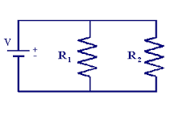

Why divide by zero = ∞?
Allow a calculation to continue and produce a valid result
Example:
If R1 or R2 is 0, overall resistance should be 0

Slide 42
Floating point addition
Commutative? x+y == y+x?
Associative? (x+y)+z = x + (y+z)?
  Rounding:
  (3.14+1e10)-1e10 = 0
  3.14+(1e10-1e10) = 3.14
  Overflow
Every number has an additive inverse?
  Yes except for ∞ and NaN

Slide 43
Floating point multiplication
Commutative? x* y == y*x?
Associative? (x*y)*z = x * (y*z)?
  Overflow:
  (1e20*1e20)*1e-20= inf, 1e20*(1e20*1e-20)= 1e20
  Rounding
(x+y)*z = x*z + y*z?
  1e20*(1e20-1e20)= 0.0, 1e20*1e20 – 1e20*1e20 = NaN

Slide 44
Floating point in real world
Storing time in computer games as a FP?
Precision diminishes as time gets bigger
FP value (decimal) | Time value | FP precision | Time precision
1 | 1 sec | 1.19E-07 | 119 nanoseconds
100 | ~1.5 min | 7.63E-06 | 7.63 microseconds
10 000 | ~3 hours | 0.000977 | .976 milliseconds
1000 000 | ~11 days | 0.0625 | 62.5 milliseconds

Slide 45
Floating point in the real world
Use floating point for distance measures in computer games
FP value | Length | FP precision | Precision size
1 | 1 meter | 1.19E-07 | Virus
100 | 100 meter | 7.63E-06 | red blood cell
10 000 | 10 km | 0.000977 | toenail thickness
1000 000 | .16x earth radius | 0.0625 | credit card width
Table source: Random ASCII

Slide 46
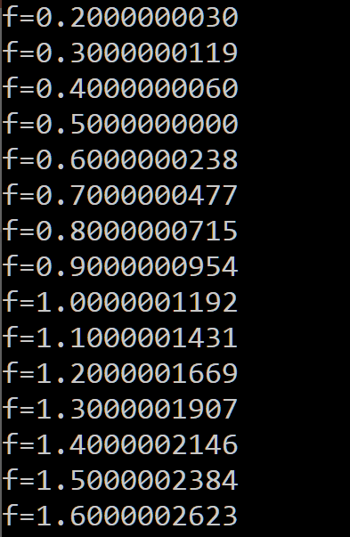
Floating point trouble
Comparing floats for equality is a bad idea!
float f = 0.1;
while (f != 1.0) {
f += 0.1;
}
Notes:
You can not represent 0.1 exactly in floating point

Slide 47
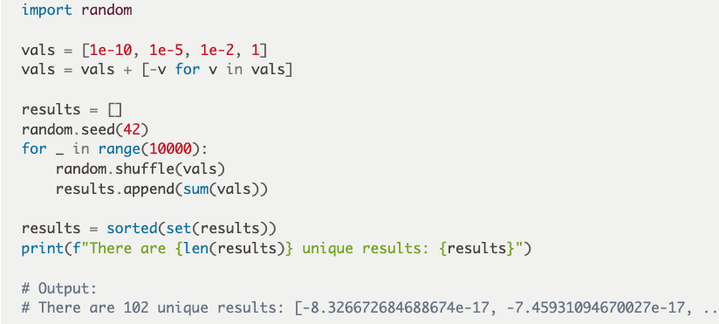
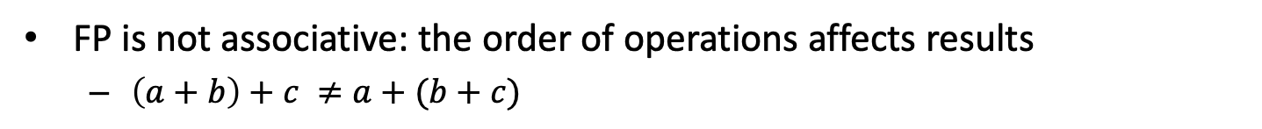
Floating point trouble
FP is not associative: the order of operations affects results
  $\left(a+b\right)+c ≠a+(b+c)$
0.1+1e20 - 1e20
>>> 0
0.1 + (1e20-1e20)
>>> 0.1
Horace He, “Defeating Nondeterminism in LLM Inference
“
Notes:
You can not represent 0.1 exactly in floating point

Slide 48
Floating point trouble
Never count using floating points
count = 0;
for (float f = 0.0; f < 1.0; f += 0.1) {
count++;
}
Notes:
You can not represent 0.1 exactly in floating point

Slide 49
FP point trouble
Many real world disasters are due to FP trickiness
  Patriot Missile failed to intercept due to rounding error (1991)
  Ariane 5 explosion due to overflow in converting from double to int (1996)

Slide 50
Floating point summary
FP format is based on binary scientific notation
IEEE FP format
  Normalized, denormalized, special values
Floating points are tricky
  Precision diminishes as magnitude grows
  overflow, rounding error

