Slide 1
CSO-Recitation 08 CSCI-UA 0201-007
R08: Assessment 07 & Assembly

Slide 2
Today’s Topics
Assessment 07
Some exercises
give some senses about lab3

Slide 3
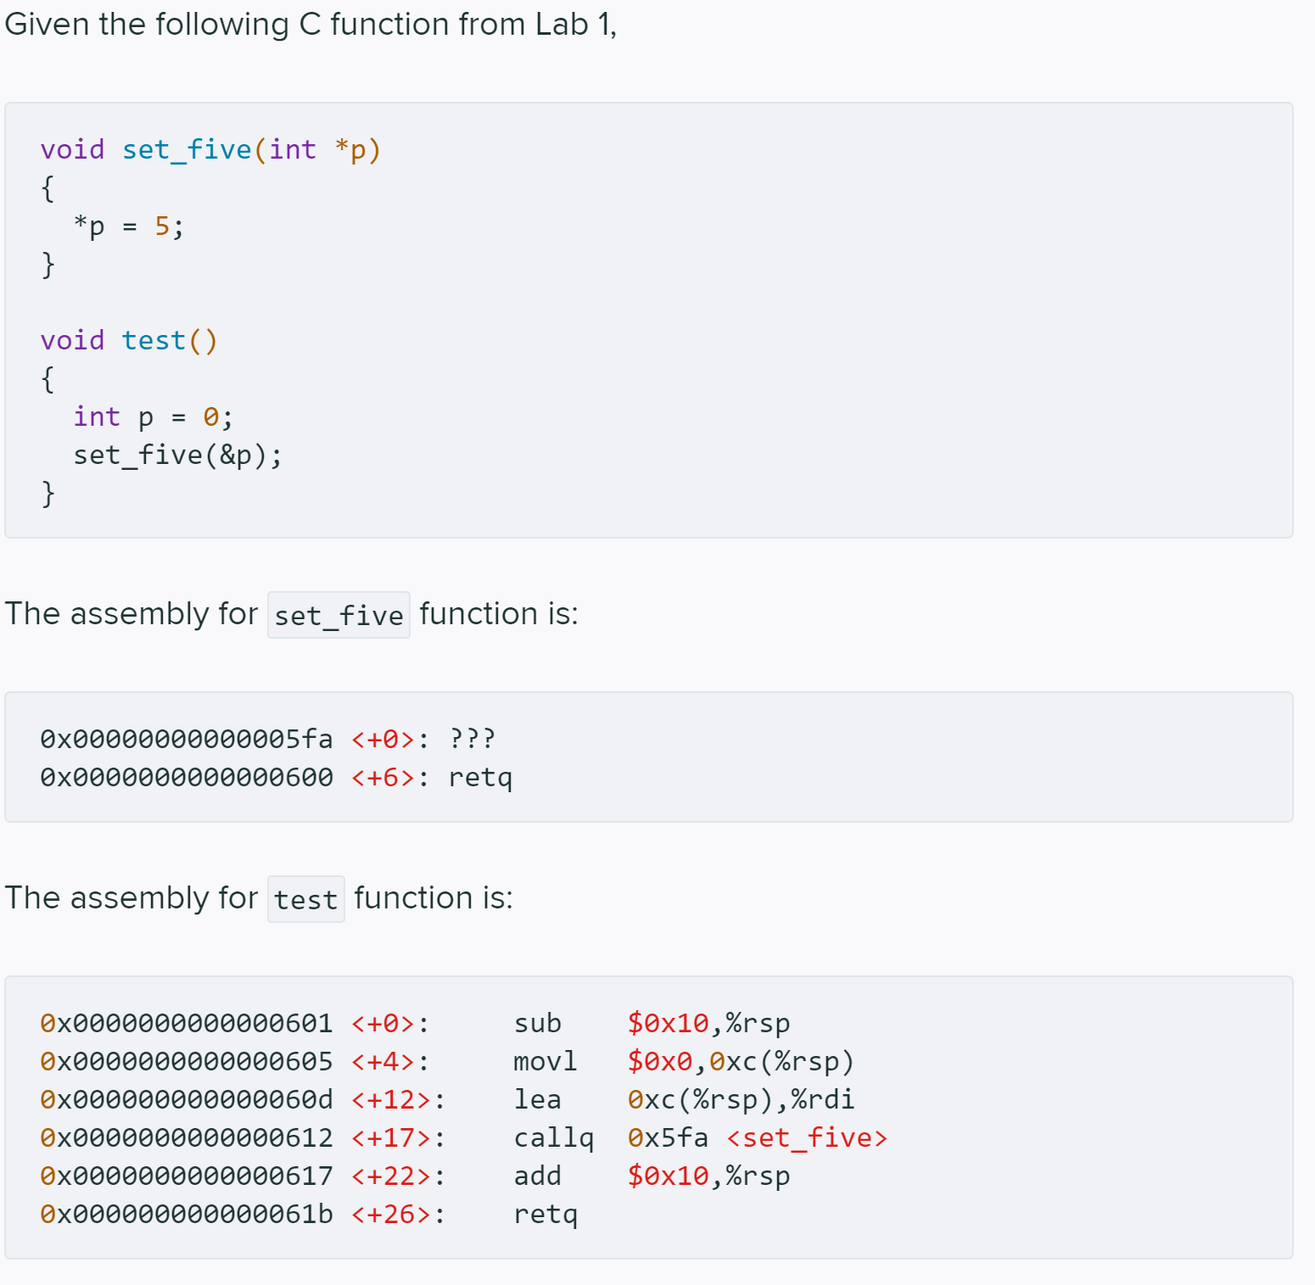
Q1 Set_five

Slide 4
Q1.1 %rsp
Under normal program execution, suppose the value of %rsp is 0x7fff856001d8 just prior to executing the first instruction of test. What is the value of %rsp just prior to executing the first instruction of set_five?
0x7fff856001d8
0x7fff856001c8
0x7fff856001e8
0x7fff856001c0
0x7fff856001d0
0x7fff856001c4
0x7fff856001cc
None of the above
val(%rsp)= 0x7fff856001d8
sub $0x10, %rsp
val(%rsp)= 0x7fff856001c8
callq 0x5fa <set_five>
callq label
DECREASES %rsp by 8
THEN stores the return address at the memory location given by the new %rsp
THEN jumps to the operand
callq 0x5fa <set_five>
val(%rsp)= 0x7fff856001c0

Slide 5
Q1.1 %rsp
Under normal program execution, suppose the value of %rsp is 0x7fff856001d8 just prior to executing the first instruction of test. What is the value of %rsp just prior to executing the first instruction of set_five?
0x7fff856001d8
0x7fff856001c8
0x7fff856001e8
0x7fff856001c0
0x7fff856001d0
0x7fff856001c4
0x7fff856001cc
None of the above
0x7fff856001d8
%rsp
0x7fff856001d4
0x7fff856001d0
0x7fff856001cc
0x7fff856001c8
0x7fff856001c4
0x7fff856001c0

Slide 6
Q1.1 %rsp
Under normal program execution, suppose the value of %rsp is 0x7fff856001d8 just prior to executing the first instruction of test. What is the value of %rsp just prior to executing the first instruction of set_five?
0x7fff856001d8
0x7fff856001c8
0x7fff856001e8
0x7fff856001c0
0x7fff856001d0
0x7fff856001c4
0x7fff856001cc
None of the above
0x7fff856001d8
%rsp
0x7fff856001d4
0x7fff856001d0
0x7fff856001cc
0x7fff856001c8
0x7fff856001c4
0x7fff856001c0

Slide 7
Q1.1 %rsp
Under normal program execution, suppose the value of %rsp is 0x7fff856001d8 just prior to executing the first instruction of test. What is the value of %rsp just prior to executing the first instruction of set_five?
0x7fff856001d8
0x7fff856001c8
0x7fff856001e8
0x7fff856001c0
0x7fff856001d0
0x7fff856001c4
0x7fff856001cc
None of the above
0x7fff856001d8
0x0
0x7fff856001d4
0x7fff856001d0
0x7fff856001c8 + 0xc
= 0x7fff856001d4
0x7fff856001cc
0x7fff856001c8
%rsp
0x7fff856001c4
0x7fff856001c0

Slide 8
Q1.1 %rsp
Under normal program execution, suppose the value of %rsp is 0x7fff856001d8 just prior to executing the first instruction of test. What is the value of %rsp just prior to executing the first instruction of set_five?
0x7fff856001d8
0x7fff856001c8
0x7fff856001e8
0x7fff856001c0
0x7fff856001d0
0x7fff856001c4
0x7fff856001cc
None of the above
0x7fff856001d8
0x0
0x7fff856001d4
0x7fff856001d0
0x7fff856001c8 + 0xc
= 0x7fff856001d4
= %rdi
0x7fff856001cc
0x7fff856001c8
%rsp
0x7fff856001c4
0x7fff856001c0

Slide 9
Q1.1 %rsp
Under normal program execution, suppose the value of %rsp is 0x7fff856001d8 just prior to executing the first instruction of test. What is the value of %rsp just prior to executing the first instruction of set_five?
0x7fff856001d8
0x7fff856001c8
0x7fff856001e8
0x7fff856001c0
0x7fff856001d0
0x7fff856001c4
0x7fff856001cc
None of the above
0x7fff856001d8
0x0
1. Decrease %rsp by 8
0x7fff856001d4
0x7fff856001d0
0x7fff856001c8 + 0xc
= 0x7fff856001d4
= %rdi
0x7fff856001cc
0x7fff856001c8
%rsp
0x7fff856001c4
0x7fff856001c0

Slide 10
Q1.1 %rsp
Under normal program execution, suppose the value of %rsp is 0x7fff856001d8 just prior to executing the first instruction of test. What is the value of %rsp just prior to executing the first instruction of set_five?
0x7fff856001d8
0x7fff856001c8
0x7fff856001e8
0x7fff856001c0
0x7fff856001d0
0x7fff856001c4
0x7fff856001cc
None of the above
0x7fff856001d8
0x0
Decrease %rsp by 8
Store the return address at %rsp
0x7fff856001d4
0x7fff856001d0
0x7fff856001c8 + 0xc
= 0x7fff856001d4
= %rdi
0x7fff856001cc
Return to the next instruction after calling
0x7fff856001c8
0x00000000
0x7fff856001c4
0x00000617
0x7fff856001c0
%rsp

Slide 11
Q1.1 %rsp
Under normal program execution, suppose the value of %rsp is 0x7fff856001d8 just prior to executing the first instruction of test. What is the value of %rsp just prior to executing the first instruction of set_five?
0x7fff856001d8
0x7fff856001c8
0x7fff856001e8
0x7fff856001c0
0x7fff856001d0
0x7fff856001c4
0x7fff856001cc
None of the above
0x7fff856001d8
0x0
0x7fff856001d4
0x7fff856001d0
0x7fff856001cc
0x7fff856001c8
0x00000000
0x7fff856001c4
0x00000617
0x7fff856001c0
%rsp

Slide 12
Q1.2
Under normal program execution, what is the 8-byte value stored under the address specified by %rsp just prior to executing the first instruction of set_five?
0x7fff856001d8
0x7fff856001c0
0x000000000000060d
0x0000000000000612
0x0000000000000617
It could be any arbitrary 8-byte value
callq label
DECREASES %rsp by 8
THEN stores the return address at the memory location given by the new %rsp
THEN jumps to the operand
callq 0x5fa <set_five>
val( (%rsp) ) =0x0000000000000617

Slide 13
Q1.2
Under normal program execution, what is the 8-byte value stored under the address specified by %rsp just prior to executing the first instruction of set_five?
0x7fff856001d8
0x7fff856001c0
0x000000000000060d
0x0000000000000612
0x0000000000000617
It could be any arbitrary 8-byte value
0x7fff856001d8
0x0
0x7fff856001d4
0x7fff856001d0
0x7fff856001cc
0x7fff856001c8
0x00000000
0x7fff856001c4
0x00000617
0x7fff856001c0
%rsp

Slide 14
Q1.3
After executing instruction 0x0000000000000600 <+6>: retq in set_five, what's new %rip value?
0x000000000000060d
0x0000000000000612
0x0000000000000617
0x0000000000000604
0x0000000000000608
retq
Jumps to the location given by the value in memory located at %rsp
%rip = mem[%rsp]
val( (%rsp) ) =0x0000000000000617
THEN INCREASES %rsp by 8
%rsp= %rsp+8

Slide 15
Q1.3
After executing instruction 0x0000000000000600 <+6>: retq in set_five, what's new %rip value?
0x000000000000060d
0x0000000000000612
0x0000000000000617
0x0000000000000604
0x0000000000000608
0x7fff856001d8
0x0
0x7fff856001d4
0x7fff856001d0
0x7fff856001cc
Return to the next instruction after calling
0x7fff856001c8
0x00000000
0x7fff856001c4
0x00000617
0x7fff856001c0
%rsp
15

Slide 16
Q1.3
After executing instruction 0x0000000000000600 <+6>: retq in set_five, what's new %rip value?
0x000000000000060d
0x0000000000000612
0x0000000000000617
0x0000000000000604
0x0000000000000608

Slide 17
Q1.4 p's location (WIP)
Where is the local variable p stored?
some register
memory (data segment)
memory (stack)
memory (heap)
char, int, long, … (primitive data types) =>
use registers whenever possible
stack otherwise
local array/struct variables => stack
Register or stack? Look at the code.
‘&p’ => p is on memory => stack

Slide 18
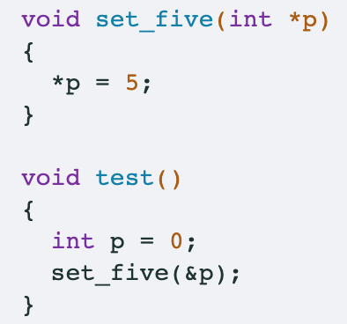
Q1.5 p's location
If your answer of 1.4 is memory, where in memory (aka what address) is p stored (assuming the value of %rsp is 0x7fff856001d8 just prior to executing the first instruction of test)?
0x7fff856001d8
0x7fff856001c8
0x7fff856001d4
0x7fff856001d0
0x7fff856001cc
0x7fff856001d8
0x0
0x7fff856001d4
0x7fff856001d0
0x7fff856001cc
0x7fff856001c8
%rsp
0x7fff856001c4
0x7fff856001c0

Slide 19
Q1.5 p's location
If your answer of 1.4 is memory, where in memory (aka what address) is p stored (assuming the value of %rsp is 0x7fff856001d8 just prior to executing the first instruction of test)?
0x7fff856001d8
0x7fff856001c8
0x7fff856001d4
0x7fff856001d0
0x7fff856001cc

Slide 20
Q1.5 p's location
If your answer of 1.4 is memory, where in memory (aka what address) is p stored (assuming the value of %rsp is 0x7fff856001d8 just prior to executing the first instruction of test)?
0x7fff856001d8
0x7fff856001c8
0x7fff856001d4
0x7fff856001d0
0x7fff856001cc
0x7fff856001d8
0x0
0x7fff856001d4
0x7fff856001d0
0x7fff856001c8 + 0xc
= 0x7fff856001d4
= %rdi
0x7fff856001cc
0x7fff856001c8
%rsp
0x7fff856001c4
%rdi stores the first argument to the call
0x7fff856001c0

Slide 21
Q1.5 p's location
If your answer of 1.4 is memory, where in memory (aka what address) is p stored (assuming the value of %rsp is 0x7fff856001d8 just prior to executing the first instruction of test)?
0x7fff856001d8
0x7fff856001c8
0x7fff856001d4
0x7fff856001d0
0x7fff856001cc

Slide 22
Q1.5 p's location
If your answer of 1.4 is memory, where in memory (aka what address) is p stored (assuming the value of %rsp is 0x7fff856001d8 just prior to executing the first instruction of test)?
0x7fff856001d8
0x7fff856001c8
0x7fff856001d4
0x7fff856001d0
0x7fff856001cc
val(%rsp)= 0x7fff856001d8
sub $0x10, %rsp
val(%rsp)= 0x7fff856001c8
where in memory is p stored
0xc(%rsp)
0x7fff856001d4

Slide 23
Q1.6 set_five
%rdi stores the first argument to the call
%rdi=p
What's the missing first instruction of set_five (aka the instruction corresponding to ???)
`movl $0x5,(%rdi)`
`movq $0x5,(%rdi)`
`movl $0x5,(%rsi)`
`movq $0x5,(%rdi)`
`movl $0x5, %edi`
`movq $0x5, %rdi`
`movl $0x5, %esi`
`movq $0x5, %rsi`
0x7fff856001d8
0x0
0x7fff856001d4
0x7fff856001d0
0x7fff856001cc
0x7fff856001c8
0x00000000
0x7fff856001c4
0x00000617
0x7fff856001c0
%rsp

Slide 24
Q1.6 set_five
%rdi stores the first argument to the call
%rdi=p
What's the missing first instruction of set_five (aka the instruction corresponding to ???)
`movl $0x5,(%rdi)`
`movq $0x5,(%rdi)`
`movl $0x5,(%rsi)`
`movq $0x5,(%rdi)`
`movl $0x5, %edi`
`movq $0x5, %rdi`
`movl $0x5, %esi`
`movq $0x5, %rsi`
p: int * => movl
Pointer is 64-bit => %rdi

Slide 25
Question
After executing instruction 0x0000000000000600 <+6>: retq in set_five, what's new %rsp value?
0x7fff856001d8
0x0
0x7fff856001d4
0x7fff856001d0
0x7fff856001cc
0x7fff856001c8
0x00000000
0x7fff856001c4
0x00000617
0x7fff856001c0
%rsp
Notes:
0x7fff856001c8

Slide 26
Q1.6 set_five
What's the missing first instruction of set_five (aka the instruction corresponding to ???)
`movl $0x5,(%rdi)`
`movq $0x5,(%rdi)`
`movl $0x5,(%rsi)`
`movq $0x5,(%rdi)`
`movl $0x5, %edi`
`movq $0x5, %rdi`
`movl $0x5, %esi`
`movq $0x5, %rsi`
*p=5;
p -> the first argument
store in %rdi
mov $0x5, (%rdi)
p is int * type
movl $0x5, (%rdi)

Slide 27
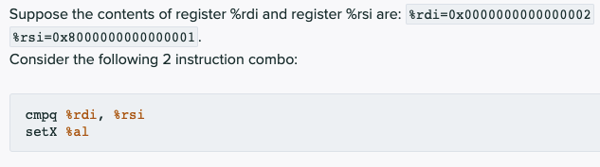
Q2 cmp and set

Slide 28

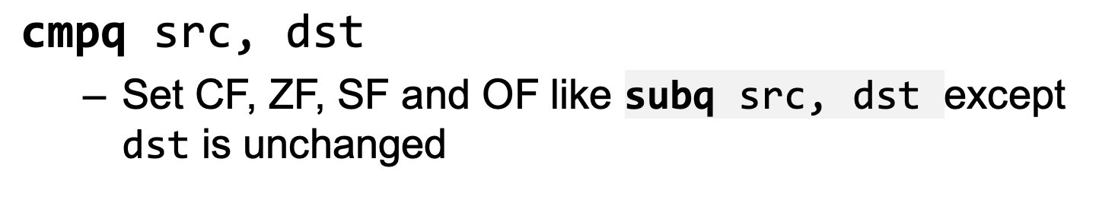
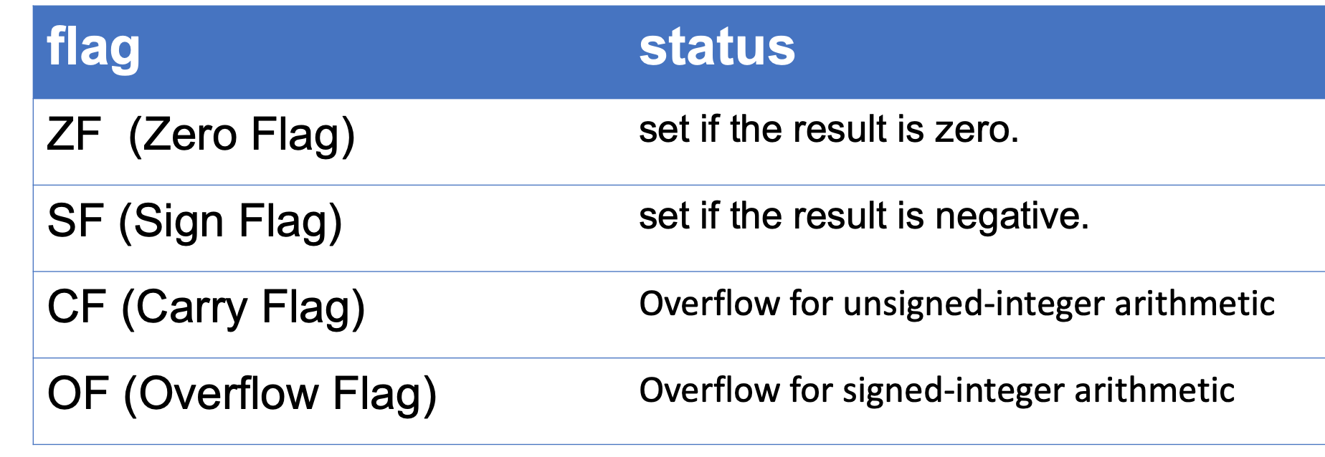
Q2.1 RFLAGS
%rdi=0x0000000000000002
%rsi=0x8000000000000001.
In Q2, which of the following status flags are set after executing cmpq %rdi, %rsi (aka the rest are cleared)?
ZF
SF
CF
OF
Q1: dst=dst-src or dst=src-dst?
✅

Slide 29
Q2.1 RFLAGS
%rdi=0x0000000000000002
%rsi=0x8000000000000001.
In Q2, which of the following status flags are set after executing cmpq %rdi, %rsi (aka the rest are cleared)?
ZF
SF
CF
OF
dst=dst-src
%rsi-%rdi = 0x7fff…ff
SF=MSB=0

Slide 30
CF and OF
The CPU doesn’t know if operands are signed or unsigned
So, it calculates both the signed overflow (OF) and the unsigned overflow (CF) for each instruction
OF is set assuming both operands are signed
CF is set assuming both operands are unsigned

Slide 31
Q2.1 RFLAGS
In Q2, which of the following status flags are set after executing cmpq %rdi, %rsi (aka the rest are cleared)?
ZF
SF
CF
OF
Unsigned range: 0 ~ 2^64 - 1
%rdi = 2
%rsi = 2^63 + 1
%rsi - %rdi = 2^63 – 1: in the range
%rdi=0x0000000000000002
%rsi=0x8000000000000001.
%rsi-%rdi = 0x7fff…ff
SF=MSB=0, not set
CF: treat as unsigned
=> no overflow, not set
OF: treat as signed =>
=> overflow, set
Signed range: -2^63 ~ 2^63 - 1
%rdi = 2
%rsi = -2^63 + 1
%rsi - %rdi = -2^63 – 1: out of the range
Tricks to quickly decide whether the signed/unsigned computation is overflow: see the previous recitation slides.

Slide 32
How to decide whether there is overflow?
Machine:
Unsigned: there is a carry/borrow of the MSB
Signed:
if there is carry-in but no carry-out of MSB
or, there is no carry-in but there’s carry out of MSB

Slide 33
Q2.1 RFLAGS
%rdi=0x0000000000000002
%rsi=0x8000000000000001.
In Q2, which of the following status flags are set after executing cmpq %rdi, %rsi (aka the rest are cleared)?
ZF
SF
CF
OF
Q1: dst=dst-src or dst=src-dst?
✅
%rsi-%rdi = 0x7fff…ff
SF=MSB=0
CF: treat as unsigned => no overflow
OF: treat as signed =>
%rsi < 0, rdi > 0,
%rsi - %rdi > 0 => overflow

Slide 34
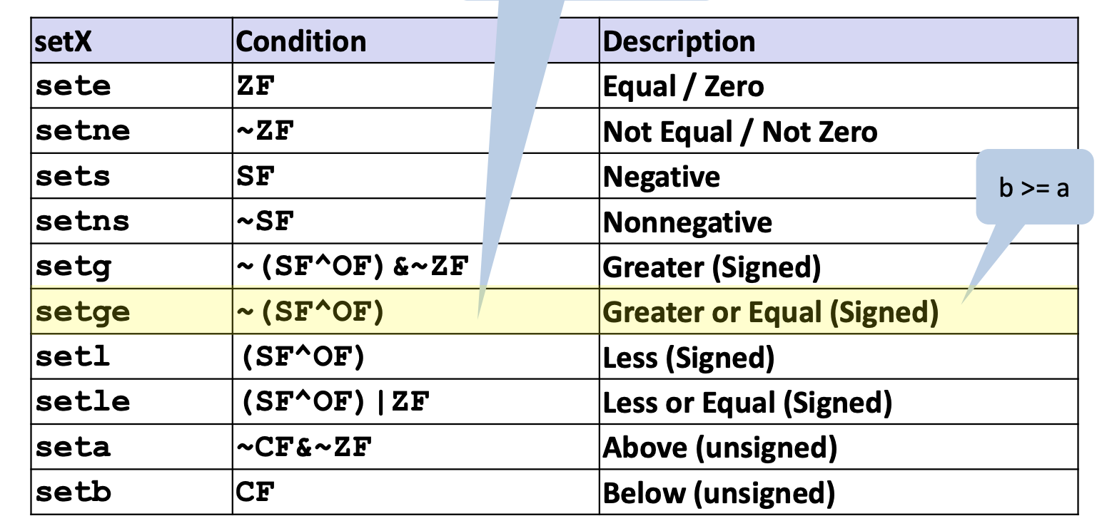
Q2.2 Set instruction
%rdi=0x0000000000000002
%rsi=0x8000000000000001.
In Q2, which of the following setX instruction would result in register %al being 1 after execution?
sete %al
setne %al
sets %al
setns %al
setg %al
setge %al
setl %al
setle %al
seta %al
setb %al
rsi >= rdi,
under
signed
interpretation

Slide 35
Exercise
%rdi=0x8000000000000002
%rsi=0x8000000000000001.
Which of the following status flags are set after executing cmpq %rdi, %rsi (aka the rest are cleared)?
ZF
SF
CF
OF
%rsi - %rdi = 0xffffffffffffffff
SF = MSB = 1
CF = 1
Notes:
SF & CF

Slide 36
Exercise
After running `cmpl %eax %ebx`, what are the status of CF and OF?
eax | ebx | CF | OF
0x7fffffff | 0x00000000
0x7fffffff | 0xffffffff
0x80000000 | 0x00000000
0x80000000 | 0x80000000
1
0
0
0
1
1
0
0

Slide 37
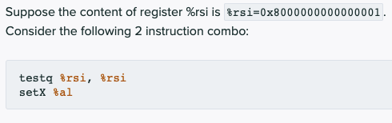
Q3 Test and set

Slide 38

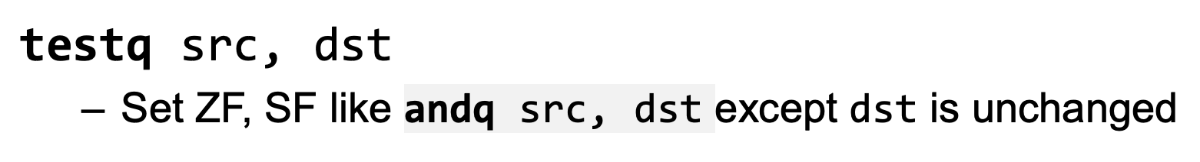
Q3.1 RFLAGS
%rsi=0x8000000000000001
In Q3, which of the following status flags are set after executing testq %rsi, %rsi (aka the rest are cleared)?
ZF
SF
CF
OF
%rsi and %rdi =0x80…01
SF=MSB=1
CF, OF: test/and clears CF, OF

Slide 39
Q3.2 Set instruction
ZF=0, SF=1, CF=0, OF=0
In Q3, which of the following setX instruction would result in register %al being 1 after execution?
sete %al
setne %al
sets %al
setns %al
setg %al
setge %al
setl %al
setle %al
seta %al
setb %al

Slide 40
Important Instructions
Instruction | What it does
mov src, dest | dest = src
add src, dest | dest = dest + src
sub src, dest | dest = dest - src
imul src, dest | dest = dest * src
inc dest | dest = dest + 1

Slide 41
Moving data - Instruction operands
src and dest can be one of three things
An immediate
A constant value, prefaced with $
Eg. $0, or $0xabcdabcd
dest cannot be an immediate
A register
One of the 16 general purpose registers
Eg. %eax, %rax, %rsi..
A location in memory
(Register): Consider registers as pointers, and get the value at an address in memory with various “addressing modes”
Eg. (%rax), 10(%rax), 10(%rax, rbx, 4)
You cannot perform a mov from memory into memory
How big is what you are getting from memory, in bytes?

Slide 42
Instruction Suffixes
Suffix | Name | Size (Bytes)
b | byte | 1
w | word | 2
l | long | 4
q | quadword | 8

Slide 43
Memory Addressing Modes
Direct addressing
Given a register, use the value located at the memory address contained in the register
Register name in parens
Eg. mov (%rax), %rbx
With displacement
Use the value in memory located at the register value plus a constant displacement
Have the constant appear before the parens
Eg. mov 10(%rax), %rbx

Slide 44
Memory Addressing Modes
Complete
We have a constant displacement, a starting point, an offset, and constant to scale the offset by…
D(Rb, Ri, S)
The address at Rb + Ri*S + D, where S and D are constant and Rb and Ri are registers
Eg. movq 10(%rax, %rbx, 4), %rcx
If the displacement is 0 or the scale is 1, you may leave them out

Slide 45
Lea src, dest
Lea: Load Effective Address
Take the address expression from src, and save it to dest
Do not access memory, just compute the address from the offsets, index, base, and scale, and then save the computed address in dest
Can also be used to quickly add registers and store the result in a third register

Slide 46
RFLAGS
A special purpose register that stores some status about the executed instructions
Different bits tell us different things
Instructions may set those bits depending on what has happened
These include arithmetic instructions like add or sub, as well as instructions like cmp

Slide 47
Instructions set/read RFLAGS
Instructions that set RFLAGS
Regular arithmetic instructions
add, sub, imul, inc
Special flag-setting instructions
cmp, test
Instructions that read RFLAGS
Instructions that read RFLAGS to set register values
Set
Instructions that read RFLAGs to set %rip
jmp

Slide 48
cmp
Same as sub (dest-src), except it doesn’t store the result in dest
It does, however, still change the RFLAGS I just mentioned
This makes it useful for comparisons and conditions

Slide 49
jmp
jmp label
Continues executing from the label, unconditionally
label is where to jump to
It acts like goto in C

Slide 50
Conditional Jumps
je label
Jump if ZF is set
jne label
Jump if ZF is not set
jg label
Jump if ZF is not set and SF and OF are the same
jl label
Jump if SF and OF are not the same
ja label
Jump if CF and ZF are both not set

Slide 51
Exercises

Slide 52
Lab3 -- Uncover the mystery
Each implements a function
For your convenience to run the assembly
??? (C code)
compile
ex1_sol.o
ex2_sol.o
…
link
tester_sol
Your task: guess the C code
This is the real test you need to pass
They should behave equivalently
Write it down here
ex1.c
ex2.c
…
compile
ex1.o
ex2.o
…
link
tester
To view assembly code: objdump -d -M suffix ./tester_sol > tester_sol.s
Search for function label <ex1>

Slide 53
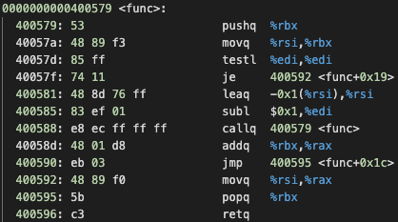
Exercise
Hint:
??? func(??? x, ??? y)
{
???
}
Guess what’s the C code for function func
git clone https://github.com/lazycal/test.git
Notes:
long func(int x, long y)
{
if (x == 0) return y;
return func(x - 1, y - 1) + y;
}

Slide 54
Solution
long func(int x, long y)
{
if (x == 0) return y;
return func(x - 1, y - 1) + y;
}

Slide 55
Exercise
After running `cmpl %eax %ebx`, what are the status of CF and OF?
eax | ebx | CF | OF
0x7fffffff | 0x00000000
0x7fffffff | 0xffffffff
0x80000000 | 0x00000000
0x80000000 | 0x80000000
1
0
0
0
1
1
0
0

Slide 56
Exercise
Guess what’s the C code for function m
wget https://raw.githubusercontent.com/DingDTest/Recitation-examples/main/r08/example_func2
Notes:
long func(int x, long y)
{
if (x == 0) return y;
return func(x - 1, y - 1) + y;
}

Slide 57
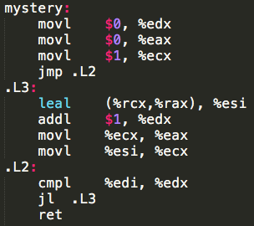
Exercise
Try to figure out what the assembly code does, and write C code that does the same thing in `main.c`.
Notes:
https://repl.it/@AnqiZ/Exercise

