Slide 1
CSO-Recitation 05 CSCI-UA 0201-007
R05: Assessment 03 & Pointers & Arrays

Slide 2
Today’s Topics
Assessment 03
Pointers
Arrays

Slide 3
Assessment 03

Slide 4
Q1 Make
compile
.c file
.o file
Link
executable file
compile
.c file
.o file
What does this make rule do?
prog: main.o util.o
gcc main.o util.o -o prog
It compiles object files main.o and util.o and generates the object file prog
It links object files main.o and util.o and generates the executable file prog
It compiles and links object files main.o and util.o and generates the executable file prog
It links object files main.c and util.c and generates the object file prog

Slide 5
Q2 C program organization
Which of the following statements are true about C program?
A header file (*.h) includes the implementation of functions to be used in other source files.
A header file (*.h) includes the signature (aka declaration) of functions to be used in other source files.
Every source file (*.c) must contain a main function.
Each C binary executable file is compiled from exactly one file.
One can execute an object file, e.g. test.o by typing ./test.o

Slide 6
Q3 Floating point (smallest #)
What's the bit-pattern of the smallest positive single precision float point number?
0x70000001
0x80000001
0x00000001
0x0007ffff
0x7f800000
0x7f7fffff
Smallest positive FP:
denormalized encoding
0000 0000 0xxx xx… xx

Slide 7
Q4 Floating point (largest #)
What's the bit-pattern of the largest positive single precision floating point number? (∞ does not count)
0x70000001
0x80000001
0x00000001
0x0007ffff
0x7f800000
0x7f7fffff
Largest positive FP:
normalized encoding
0xxx xxxx xxxx xx… xx
A: 0111 0000 000…01
E: 0111 1111 1000 0..0 -> special value
F: 0111 1111 0111 11..1

Slide 8
Q5 Floating point (precision)
What the highest and lowest precision for single precision floating points?
2⁻¹⁴⁹ and 2¹⁰⁵
2⁻¹⁵⁰ and 2¹⁰⁴
2⁻¹⁴⁹ and 2¹⁰⁴
2⁻¹⁵⁰ and 2¹⁰⁵
2⁻²³ and 2²³
2⁻¹²⁶ and 2¹²⁷
2⁻¹²⁷ and 2¹²⁷
highest precision:
smallest positive – 0
smallest positive:
0000 0000 0000 0… 01
E=1-127=-126, M=(0.F)₂ = 2⁻²³
FP=2⁻²³*2⁻¹²⁶ = 2⁻¹⁴⁹
2⁻¹⁴⁹
lowest precision:
largest positive – second largest positive
largest positive:
0111 1111 0111 11..11
E=exp-127=2⁸-2-127 = 127
M=(1.F)₂=2⁰+2⁻¹+2⁻²+…+2⁻²³=2-2⁻²³
FP=(2-2⁻²³)*2¹²⁷
second largest positive:
0111 1111 0111 11..10
E=exp-127=2⁸-2-127 = 127
M=2⁰+2⁻¹+2⁻²+…+2⁻²²=2-2⁻²²
FP=(2-2⁻²²)*2¹²⁷
(2-2⁻²³)*2¹²⁷ - (2-2⁻²²)*2¹²⁷ = (2⁻²²-2⁻²³)*2¹²⁷
=2⁻²³*2¹²⁷=2¹⁰⁴

Slide 9

Q6 Left-shift
Which value is the closest to 1<<20
1000
1 million
1 billion
2000
2 million
2 billion
1<<20
0..0100..000
2²⁰ = (2¹⁰)² = 1024² $≈$ (10³)² = 10⁶

Slide 10
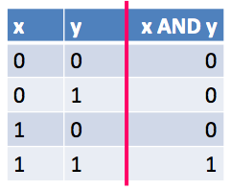
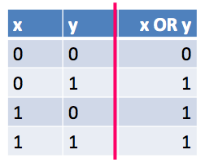
Q7 Bit-wise ops
Variable x is of type unsigned int. Which of the following statements returns the most significant byte of x?
(char)x
(char)(x >> 24)
(char)(x | 0xff000000)
(char)(x & 0xff000000)
None of the above
least significant byte
least significant byte
0x00
0xXXXXXXXX
| 0xFF000000
0xFFXXXXXX
0xXXXXXXXX
& 0xFF000000
0xXX000000

Slide 11
Q8 Floating point (find exp)
Given a 4-byte bit-pattern 0x72deadbe representing a single-precision floating point number, what's its corresponding 8-bit exponent field?
0xe5
11100101
0x72deadbe
0111 0010 1101 ….
1110 0101
0xe5

Slide 12
Q9 Floating point (clear exp)
& is often used to mask off bits: b&0 = 0
| can be used to turn some bits on: b|1=1
Suppose fi is an unsigned int whose bit pattern represents a single-precision floating point number, which of the following statements clears the exponent field of corresponding floating point number?
fi = fi & 0x100fffff
fi = fi & 0x807fffff
fi = fi & 0x80ffffff
fi = fi & (0xff<<23)
fi = fi | (0xff<<23)
fi = fi & (~(0xff<<23))
fi = fi & (~(1<<23))
clear the exponent field
fi & mask
mask = 1000 0000 0111 1..1
mask = 0x807fffff
mask = ~(0xff<<23)
= ~0x7f800000
= 0x807fffff
fi & 0111 1111 1000 00.. 00
fi | 0111 1111 1000 00.. 00
fi & 1000 0000 0111 11.. 11
fi & 1111 1111 0111 11.. 11

Slide 13
Q10 GDB
Inside GDB, a program may stop because of
a signal, e.g. one sent by users typing "Ctrl-C".
a breakpoint
step command
all of the mentioned

Slide 14
Pointers
A variable that stores a memory address

Slide 15
What are pointers?
They are variables that store addresses
Pointers can have different types, depending on what they point to
But they remain the same size – for us on a 64-bit system, 8 bytes (64 bits)
If I want the value of a variable var -> var
If I want the address of a variable var -> &var
If var is a pointer, then I can get the value of the variable that var points to -> *var
Type | Value | Address
int
float
char
pointer
an integer number
memory address
a floating point number
memory address
a character/byte
memory address
memory address
memory address

Slide 16
What are pointers?
They are variables that store addresses
Pointers can have different types, depending on what they point to
But they remain the same size – for us on a 64-bit system, 8 bytes (64 bits)
Two primary operations
& - called “reference”
Gets the address of a variable / array element
You perform this to get the value for a pointer
* - called “de-reference”
Gets the value located at a memory address
You perform this on the pointer

Slide 17
How do you use pointers?
Say you have a variable var
int var = 10;
You can make a pointer called ptr using this code
int *ptr;
ptr can be set to point to var with the reference operator
ptr = &var;
The value of ptr is now the address of var, not its value
To get the value, de-reference:
*ptr //this equals to 10
*ptr = 5; // this sets var to 5

Slide 18
Pointer types
Why do we need pointer types?
Without it, making mistakes like de-referencing a number by accident would be common
Without it, pointer arithmetic wouldn’t work
What is pointer arithmetic?
If you have a pointer called ptr, the value of ptr+1 is based off the type of ptr
If ptr is a char*, then ptr+1 is the memory address of next char after ptr
If ptr is an int*, then ptr+1 is the memory address of next int after ptr
ptr+n means “start at ptr, and go forward as many bytes as n copies of what ptr points to take up”

Slide 19
Function arguments and pointers
In C, arguments are passed by value
Means that when you call a function, the arguments are copied from the caller to the function’s stack frame
This means that if a function modifies one of its arguments, it is not modified for whoever called the function
If you want to pass a reference, you must use pointers
Then the function can modify the variable by dereferencing the pointer

Slide 20
Arrays
Contiguous, homogenous data

Slide 21
What are arrays?
Basically, they are chunks of memory that hold a number of elements of the same data type
This memory is contiguous, that is, the elements are all touching
You can define an int array like this
int my_array[5];
This will make an array of 5 ints (20 bytes)
You can initialize the array as follows:
int my_array[5] = {1, 2, 3, 4, 5};
You can also set it to all zeroes using int my_array[5]={0};
You can index with the [] operator
my_array[0] gets the first element of my_array
my_array[0] = 5 sets the first elelment of my_array to 5

Slide 22
Defining an array
int arr[5];
The value of an array is the address of its first element
The value of arr is 0x7F00
arr==&arr[0]
Let a pointer points to the 1st element of this array
int *p = arr;
int *p = &arr[0];
Array and pointer can be syntactically equivalent
*p == p[0], here also *p==arr[0]
*arr (==arr[0]) / *(arr+2) ==arr[2]
?
?
?
?
?
?
?
?
?
?
?
0x7F16
0x7F15
0x7F14
0x7F13
0x7F12
0x7F11
0x7F10
0x7F0C
0x7F08
0x7F04
0x7F00

Slide 23
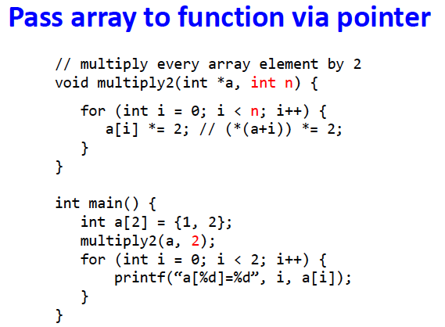
Pointer and array
One difference between an array name and a pointer
A pointer is a variable
p = arr; / p++; are legal
But an array name is not a variable..
cannot write things like arr++; / arr=p; (illegal)
When an array name is passed to a function,
What it passed is the location of the initial element
So within the called function, this argument is a local variable, and so an array name parameter is a pointer, that is, a variable containing an address

Slide 24
Indexing an array
int arr[5];
Arrays can be index like so
arr[2] = 5;
This will set the third element of arr to 5
This is the same as *(arr + 2) = 5;
Which is to say, this is done by taking the value of arr, 0x7F00, and adding 2 to it according to pointer arithmetic
The size of int is 4, so we are going 8 bytes passed arr, 8 + 0x7F00 = 0x7F08
?
?
?
?
?
?
?
?
5
?
?
0x7F16
0x7F15
0x7F14
0x7F13
0x7F12
0x7F11
0x7F10
0x7F0C
0x7F08
0x7F04
0x7F00

Slide 25
Arrays and functions
Array names act as pointers to the array’s first element
To use a function with an array, we use pointers
But we need to also pass the number of elements in this array to function

Slide 26
Pointers to pointers (Pointer arrays)
Since pointers are variable themselves, they can be stored in arrays just as other variables can
char *a[2];
Let a pointer points to the 1st element of this array (of pointers)
char **p = &a[0]; / char **p=a;
An array of pointers
Think about what can this do?

