Slide 1
Pipelined CPU
Jinyang Li
Based on the slides of Patterson and Hennessy

Slide 2
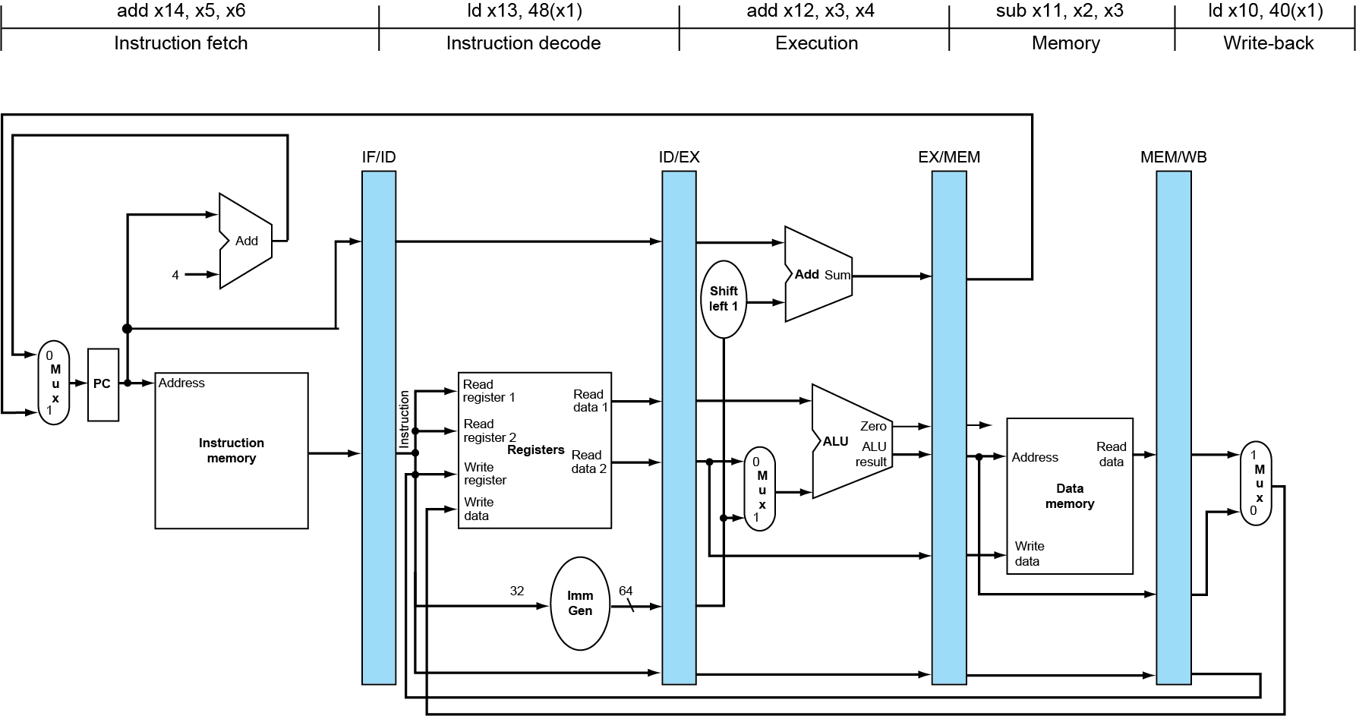
What we’ve learnt: basic 5-stage pipeline (datapath)

Slide 3
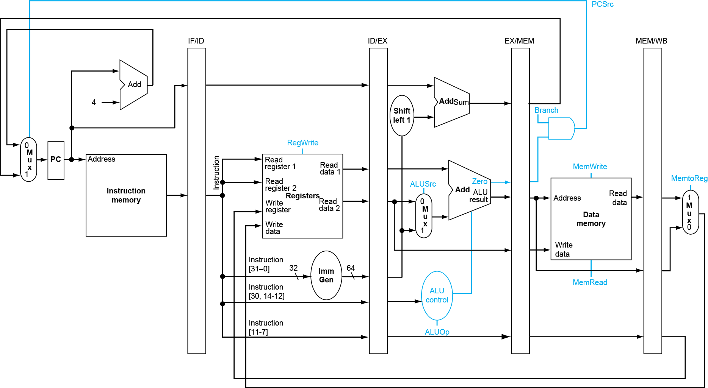
Pipelined Control (Simplified)
Set in WB
Set in EX
Set in MEM

Slide 4
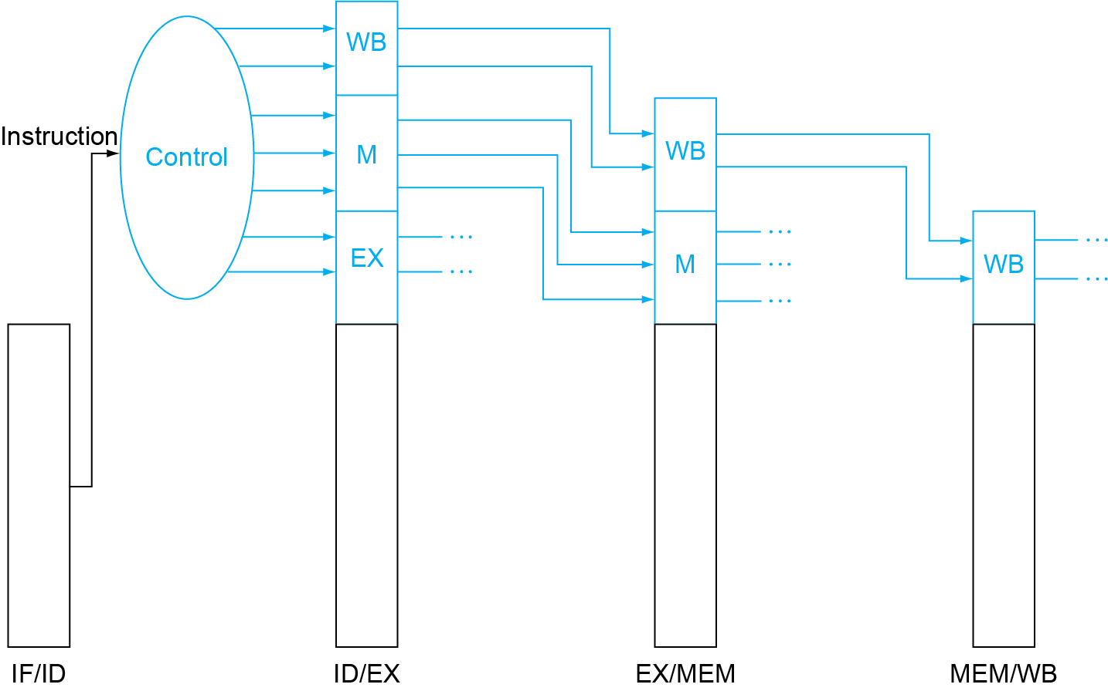
Pipelined Control
Control signals derived from instruction, same as
in single-cycle implementation
ALUSrc
MemWrite
MemToReg
ALUOp
Branch
RegWrite
PCSrc

Slide 5
Data Hazards in ALU Instructions
Example instruction sequence:
sub x2, x1,x3 and x12,x2,x5 or x13,x6,x2 add x14,x2,x2 sd x15,100(x2)
Solution: forwarding (aka bypassing)
Use result after it’s computed; don’t wait for it to be stored in register

Slide 6
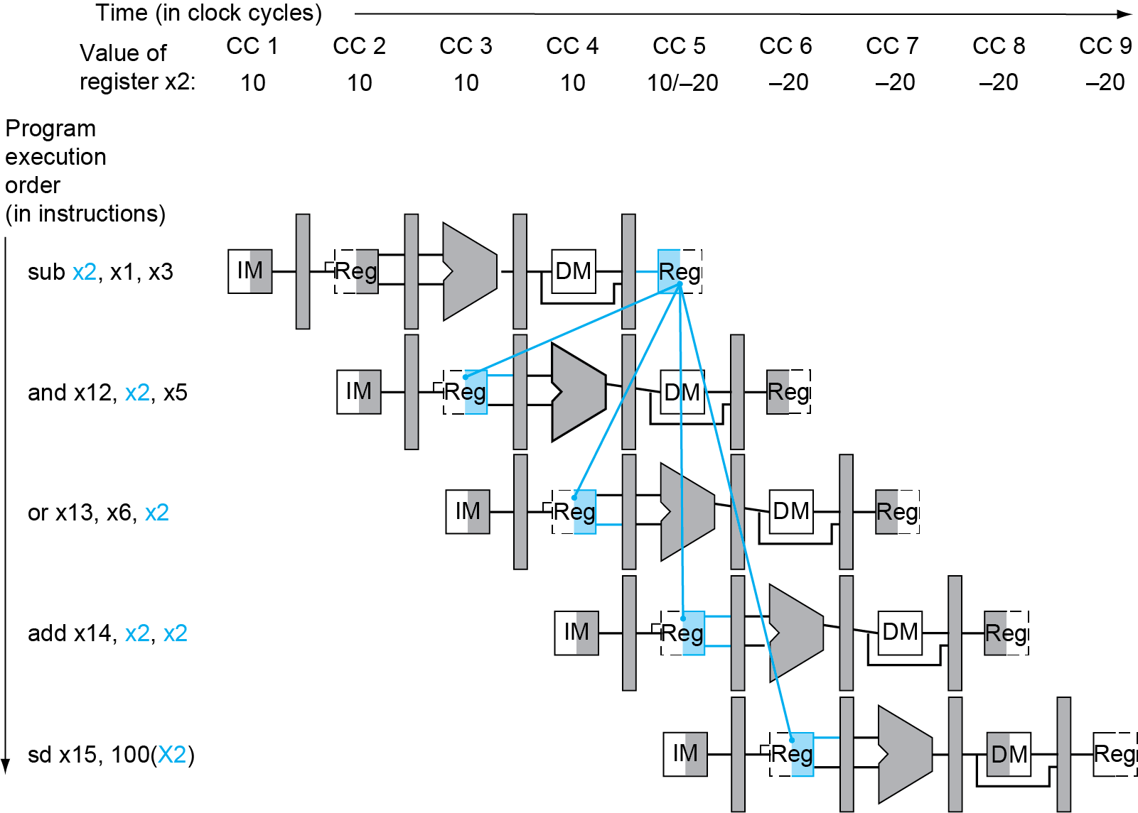
Data hazard in ALU instructions
Data hazards

Slide 7
Using forwarding to resolve data hazard (cycle-4)
add x14,x2,x2
or x13,x6,x2
and x12,x2,x5
sub x2,x1,x3
Notes:
Draw lines

Slide 8
Using forwarding to resolve data hazard (cycle-5)
sd x15,100(x2)
add x14,x2,x2
or x13,x6,x2
and x12,x2,x5
sub x2,x1,x3
Notes:
Draw lines

Slide 9
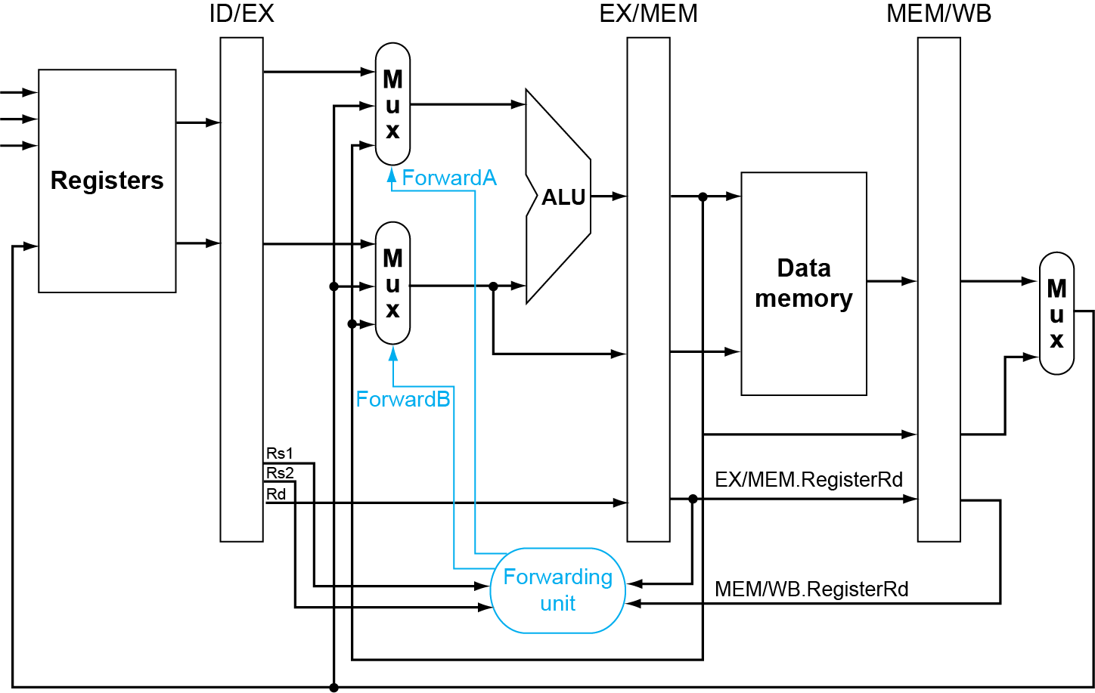
Forwarding Paths
EX-hazard
MEM-hazard

Slide 10
Detecting when to use forwarded data
Pass register numbers along pipeline
e.g., ALU operand register numbers (in EX stage) are:
ID/EX.RegisterRs1, ID/EX.RegisterRs2
Data hazards when
1a. EX/MEM.RegisterRd = ID/EX.RegisterRs1
1b. EX/MEM.RegisterRd = ID/EX.RegisterRs2
2a. MEM/WB.RegisterRd = ID/EX.RegisterRs1
2b. MEM/WB.RegisterRd = ID/EX.RegisterRs2
EX-hazard:
Fwd from EX/MEM pipeline reg
Mem-hazard: Fwd from MEM/WB pipeline reg

Slide 11
Detecting when to use forwarded data
But only if forwarding instruction will write to a register!
EX/MEM.RegWrite, MEM/WB.RegWrite
And only if Rd for that instruction is not x0
EX/MEM.RegisterRd ≠ 0, MEM/WB.RegisterRd ≠ 0
X0 is always 0 in RISC-V

Slide 12


Double Data Hazard
MEM hazard
Consider the sequence:
add x1,x1,x2 add x1,x1,x3 add x1,x1,x4
Both EX- Mem-hazards occur
use the most recent
aka, only fwd Mem-hazard if EX hazard condition isn’t true
EX hazard

Slide 13

Load-Use Data hazard Detection
Load-use hazard cannot be resolved using forwarding alone
ld x2, 20(x1)
Cannot be forwarded
and x4, x2, x5
Check load-use hazard using condition
ID/EX.MemRead and ((ID/EX.RegisterRd = IF/ID.RegisterRs1) or (ID/EX.RegisterRd = IF/ID.RegisterRs1))
If detected, stall and insert bubble

Slide 14
How to Stall the Pipeline (aka insert bubble)
Force control values in ID/EX register to 0
EX, MEM and WB do nop (no-operation)
Prevent update of PC and IF/ID register
Current instruction is decoded again
Following instruction is fetched again
1-cycle stall allows MEM to read data for ld
Can subsequently forward to EX stage

Slide 15
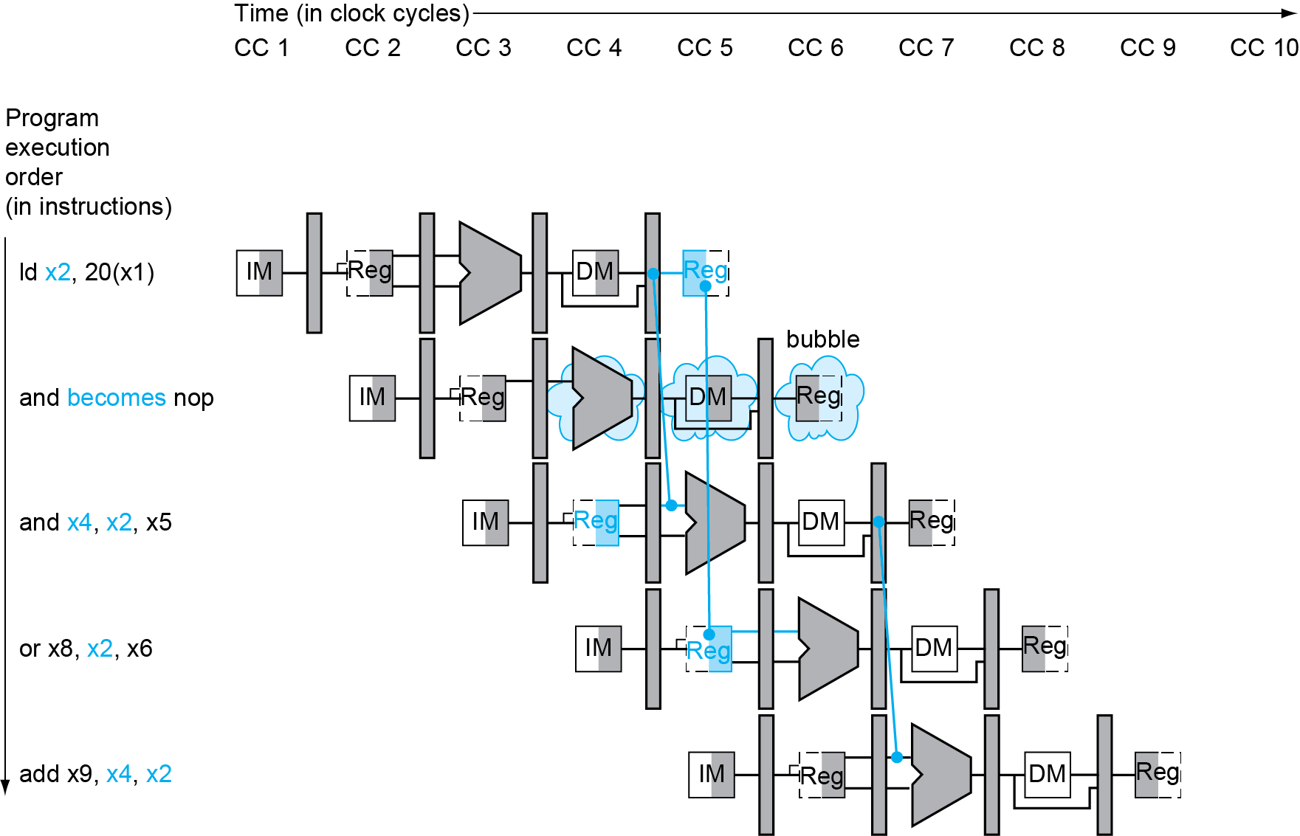
Load-Use Data Hazard
Stall inserted here

Slide 16
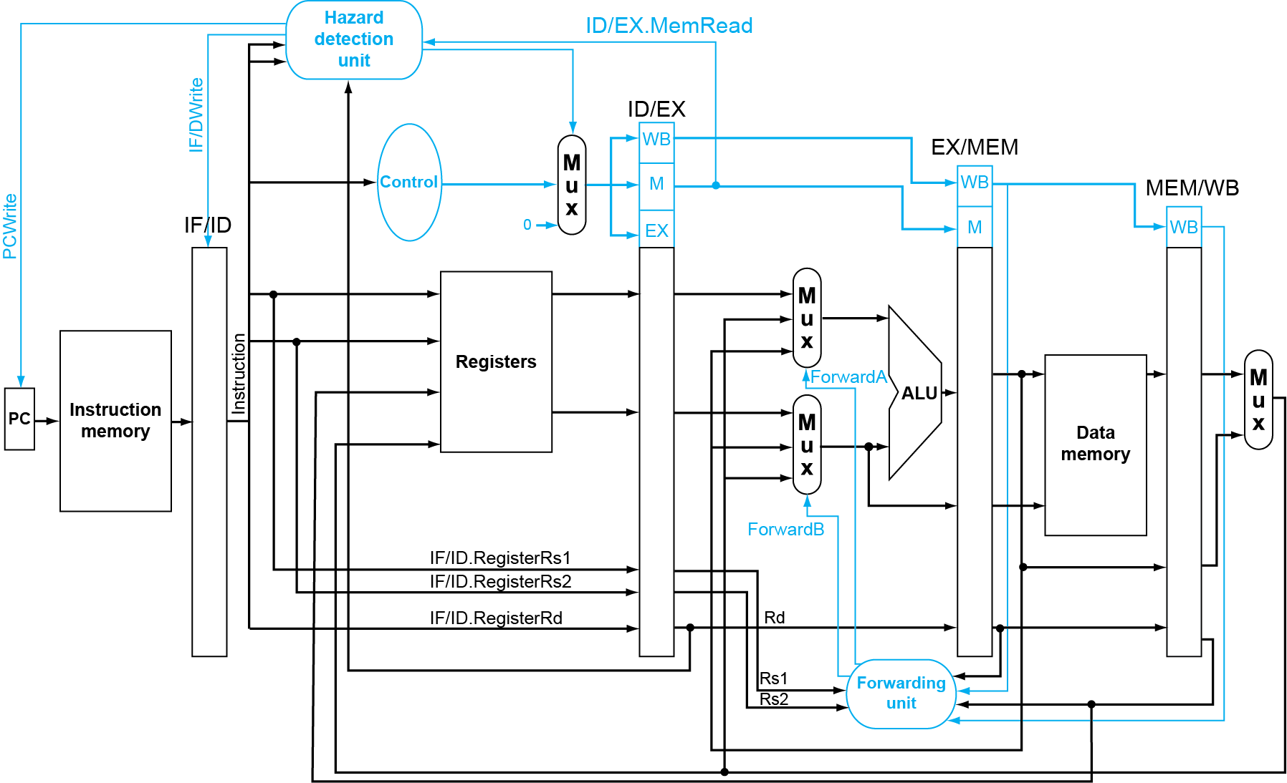
Datapath with Hazard Detection
If hazard is detected, set WB/MEM/EX controls to zero (so no registers/memory is written)

Slide 17
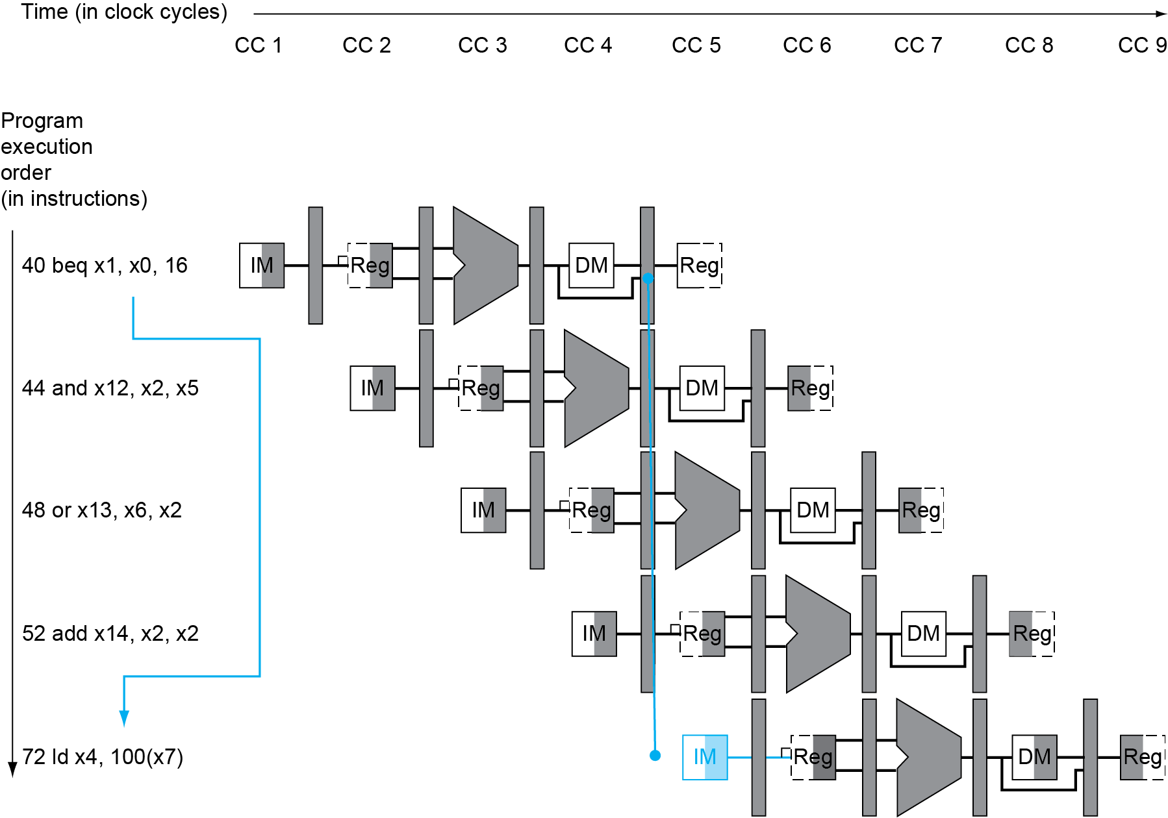
Branch Hazard
If branch outcome is determined in MEM
Instruction address
If x1==x0
Pc = pc+16*2
Flush 3 instructions (set controls to 0)
PC

Slide 18
Reducing Branch Delay
Add hardware to determine branch outcome earlier (e.g. ID instead of MEM) → fewer instructions to flush
36: sub x10, x4, x8 40: beq x1, x3, 16 // PC-relative branch // to 40+16*2=72 44: and x12, x2, x5 48: orr x13, x2, x6 52: add x14, x4, x2 56: sub x15, x6, x7 ... 72: ld x4, 50(x7)
How many instructions to flush
if branch outcome is known in ID?
clock-1
clock-2
clock-3
clock-4
clock-5
40: beq
IF
ID
EXE
MEM
WB
44: and
IF
ID
EXE
MEM
WB
72: ld
IF
ID
EXE
MEM
WB

Slide 19
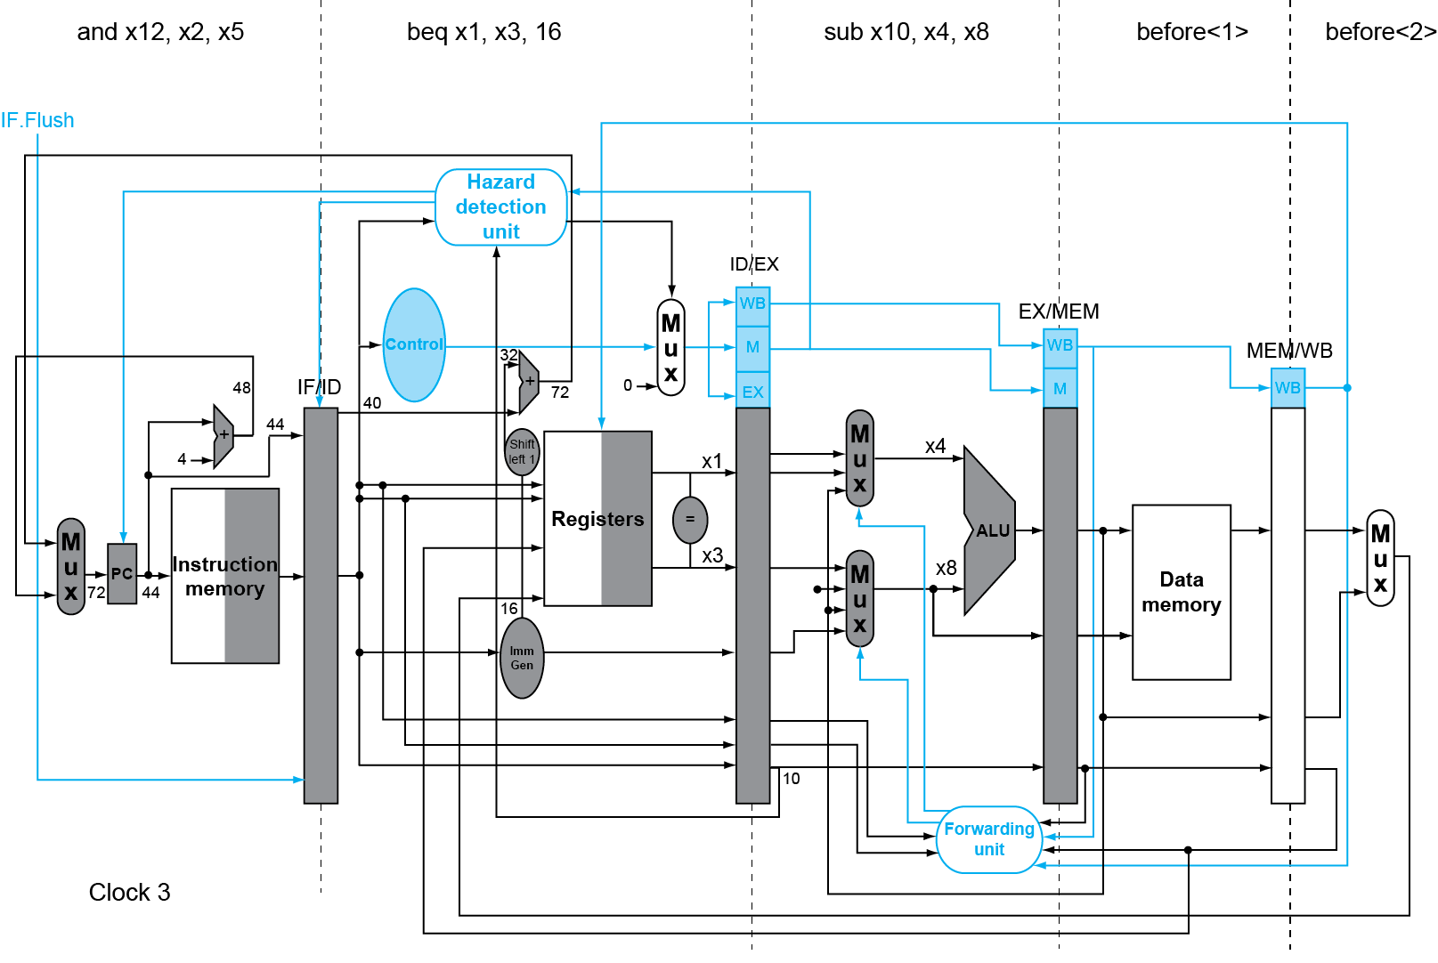
Branch determined in ID and is taken
If branch is taken, set IF/ID.Flush
Additional adder for
calculating target address
IF/ID.Flush
Clock 2
Additional comparator
to determine branch outcome

Slide 20
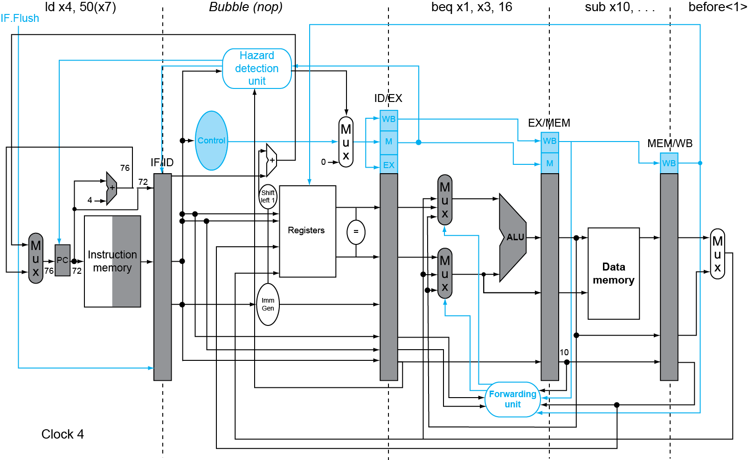
Branch determined in ID and is taken
If IF/ID.Flush is set, zero out controls so
memory/register won’t be written in MEM and WB
Clock 3

Slide 21
Dynamic Branch Prediction
Our simple 5-stage pipeline’s branch penalty is 1 bubble, but
In deeper pipelines, branch penalty is more significant
Solution: dynamic prediction
Branch prediction buffer (aka branch history table)
Indexed by recent branch instruction addresses
Stores outcome (taken/not taken)
To execute a branch
Check table, expect the same outcome
Start fetching from fall-through or target
If wrong, flush pipeline and flip prediction

Slide 22
1-Bit Predictor: Shortcoming
Inner loop branches mispredicted twice!
outer: … … inner: …
…
beq …, …, inner … beq …, …, outer
Mispredict as taken on last iteration of inner loop
Then mispredict as not taken on first iteration of inner loop next time around

Slide 23
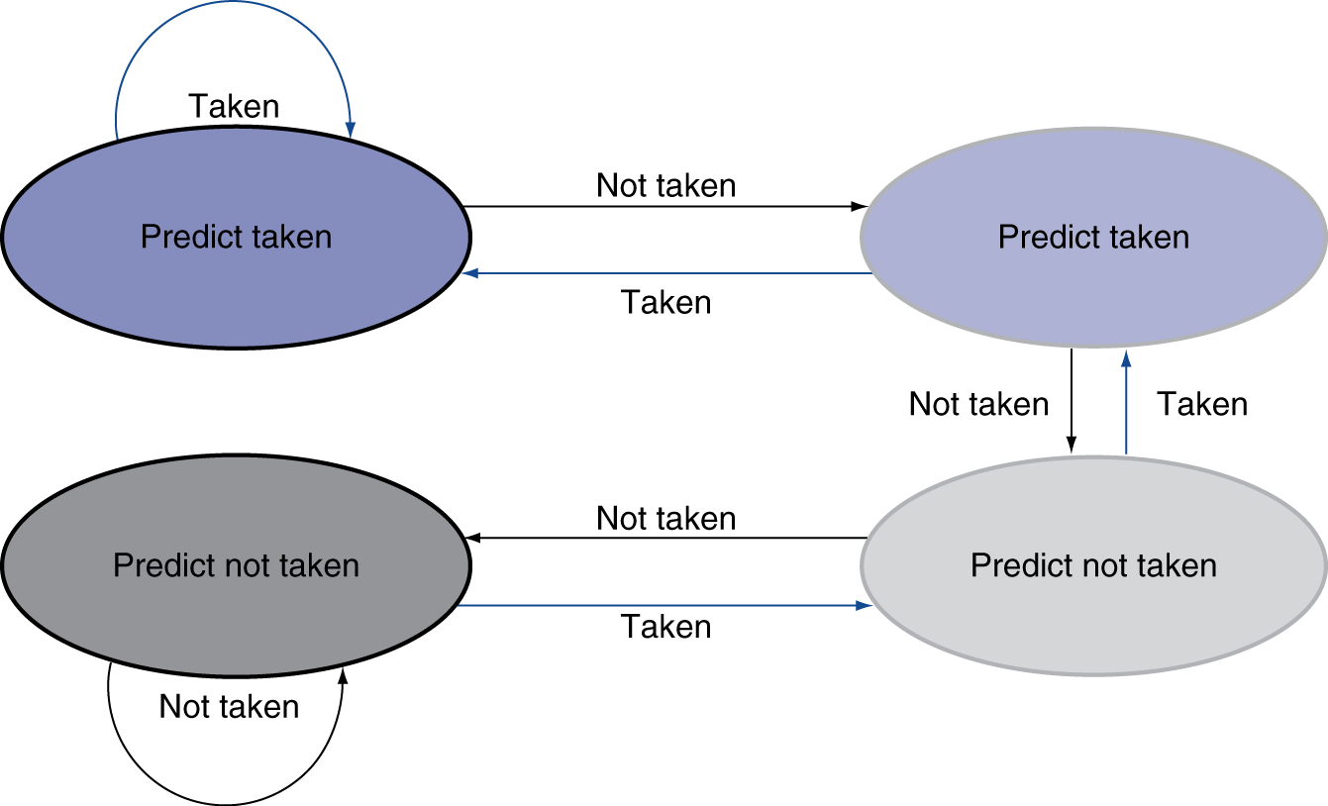
2-Bit Predictor
Only change prediction on two successive mispredictions

Slide 24
Calculating Branch Target (needed if branch is predicted taken)
Even with predictor, still need to calculate the target address
1-cycle penalty for a taken branch
Branch target buffer
Cache of target addresses
Indexed by PC when instruction fetched
If hit and instruction is branch predicted taken, can fetch target immediately

Slide 25
Exceptions and Interrupts
“Unexpected” events requiring change in flow of control
Exception
Arises within the CPU
e.g., undefined opcode, syscall, memory permission error, divide by zero, …
Interrupt
From an external I/O controller
Dealing with them without sacrificing performance is hard

Slide 26
Handling Exceptions
Save PC of offending (or interrupted) instruction
In RISC-V: Supervisor Exception Program Counter (SEPC)
Save indication of the problem
In RISC-V: Supervisor Exception Cause Register (SCAUSE)
Jump to handler (aka code in OS kernel)
Assume at 0000 0000 1C09 0000_{hex}
OS’s handler does either of the following:
Take corrective action; restart offending instruction
Terminate program; report cause

Slide 27
An Alternate Mechanism
Vectored Exception/Interrupts (x86)
Vector index (interrupt descriptor) specifies cause of exception
E.g. in x86, 0 (divide by zero), 6 (invalid opcode), …
OS sets up the Interrupt Descriptor Table
IDT[i] contains handler address, where I is vector index.

Slide 28
Exceptions in a Pipeline
Another form of control hazard
Consider malfunction on add in EX stage
add x1, x2, x1
Prevent x1 from being clobbered
Complete previous instructions
Flush add and subsequent instructions
Save PC (of offending instruction) in SEPC and set SCAUSE with cause
Transfer control to handler
Similar to mispredicted branch
Use much of the same hardware

Slide 29
Exception Example
Exception on add in
40 sub x11, x2, x4 44 and x12, x2, x5 48 orr x13, x2, x6 4c add x1, x2, x1 50 sub x15, x6, x7 54 ld x16, 100(x7) …
Handler
1C090000 sd x26, 1000(x10) 1c090004 sd x27, 1008(x10) …

Slide 30
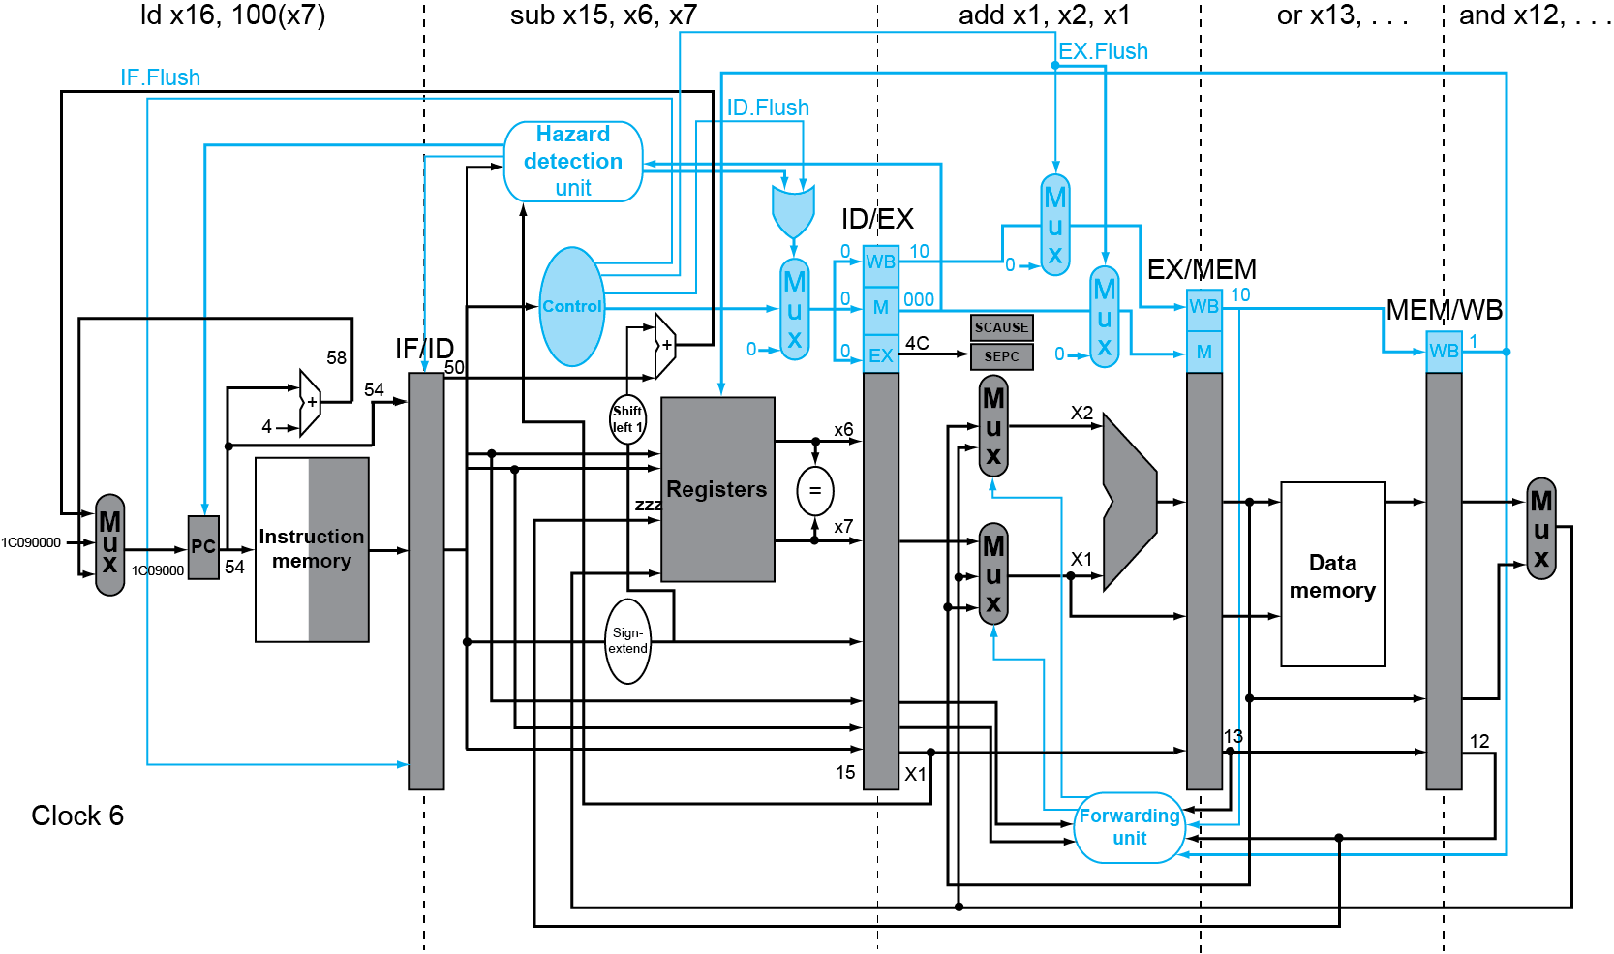
Exception Example
These signals are set
if add malfunctioned
Handler address is used for IF in next cycle

Slide 31
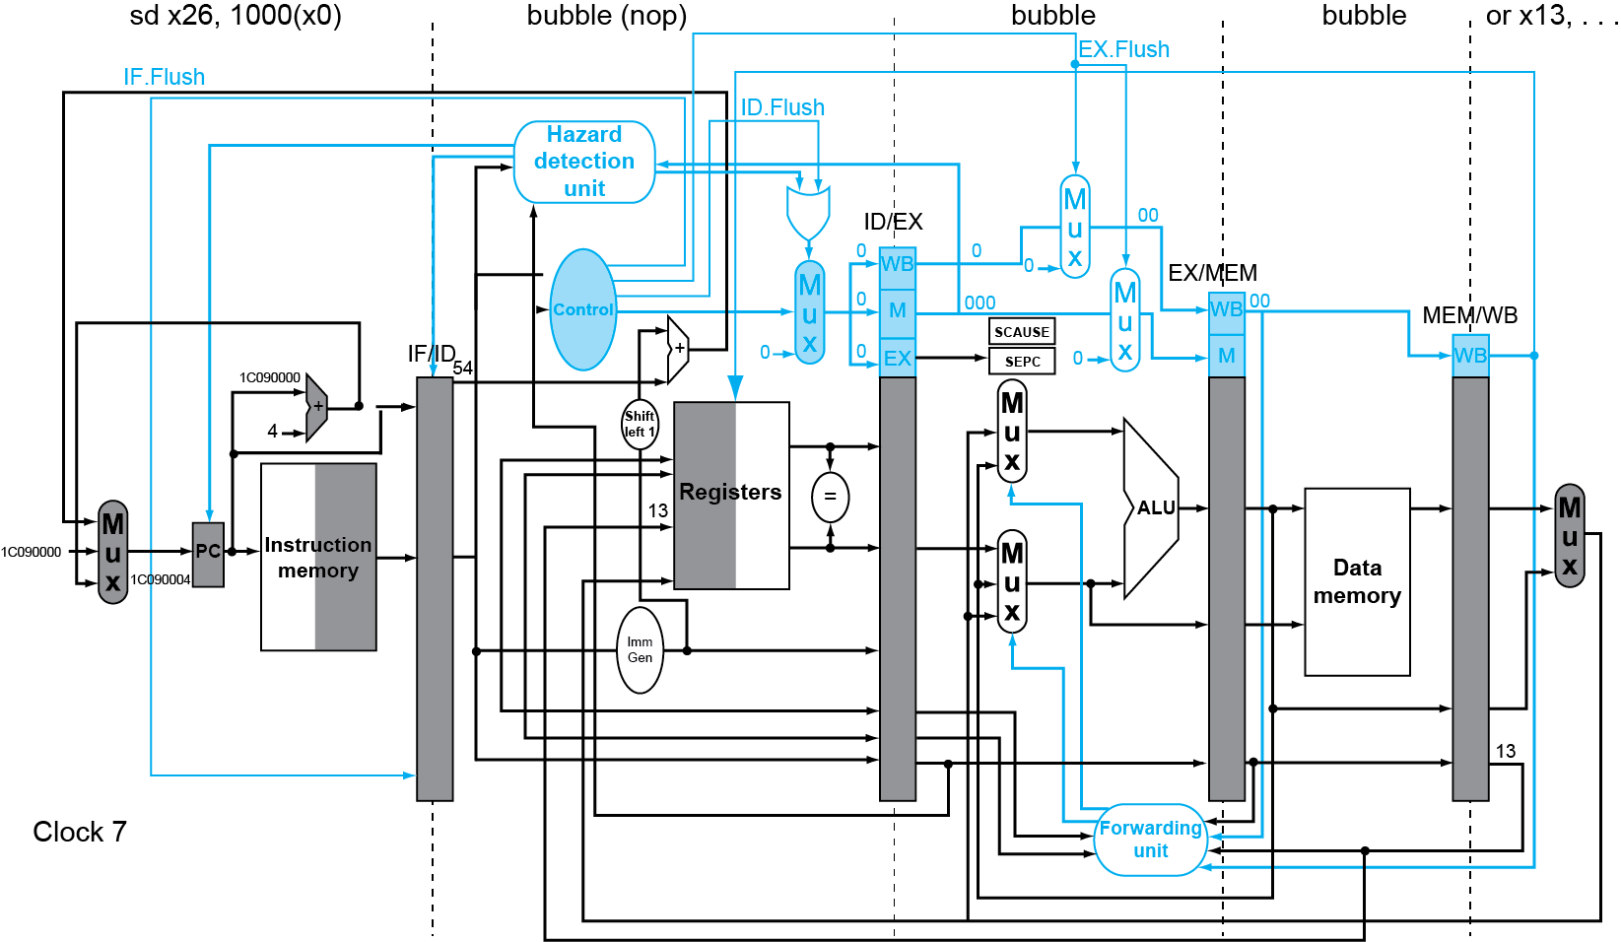
Exception Example
Offending instruction (add x1, x2, x1) becomes a bubble (so it won’t clobber registers)
Instructions in exception handler

Slide 32
Summary
Pipeline increases throughput by overlapping execution of multiple instructions
Pipeline hazard
Structure (solution: add resources)
Data (solution: forwarding)
Control (next class)
Pipeline stalls

