Slide 1
CSO-Recitation 11 CSCI-UA 0201-007
R11: Assessment 09 & Dynamic memory allocation

Slide 2
Today’s Topics
Assessment 09
Dynamic memory allocation
implement your malloc & free

Slide 3
Assessment 09

Slide 4
Q1 seg fault
Which of the following statements on segmentation faults are true?
Performing any out-of-bounds array access will result in an immediate segmentation fault.
Segmentation faults only occur when an instruction tries to write to memory.
Dereferencing a null pointer will always result in a segmentation fault.
Performing pointer arithmetic will always result in a segmentation fault.
none of the above

Slide 5
Q2 local variable
Suppose local variable a is defined as int a[16]; Which of the following statements are true?
a takes up space on the stack.
a takes up space on the heap.
subq $64, %rsp allocates space for a and addq $64, %rsp de-allocates space for a.
addq $64, %rsp allocates space for a and subq $64, %rsp de-allocates space for a.
none of the above
stack goes downwards

Slide 6
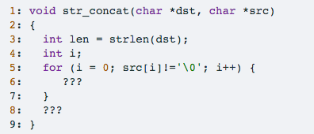
Q3 str_concat
The following C function str_concat appends the src string to the dst string, overwriting the terminating null byte at the end of dst, and then adds a terminating null byte.
Q3.1 line 5
Please fill in the code at line 6 (must be a one liner). To facilitate automatic grading, please do not have any spaces in your C statement, and make sure to include the end of the statement semicolon.
dst[len+i]=src[i];

Slide 7
Q3.2 line 7
Which of the following C statement can be used at line 8 correctly, without compilation nor runtime error?
dst[len] = '\0';
dst[len] = NULL;
dst[len] = 0;
dst[len+i] = '\0';
dst[len+i] = NULL;
dst[len+i] = 0;
NULL: means a null pointer

Slide 8
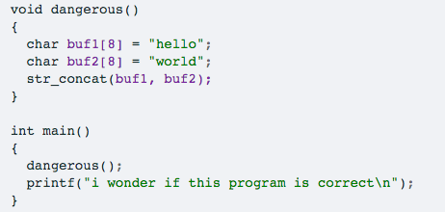
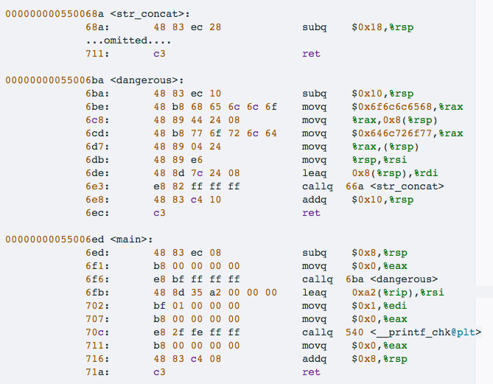
Q4. Given the following C program (which invokes str_concat defined in Q3)
Suppose the following assembly is generated for the above C program (including str_concat). Please assume that the addresses to the left of each instruction shown below are the actual addresses where the instructions are stored at during runtime.

Slide 9
Q4
rsp
-0x8

Slide 10
Q4
0x7ffd6a5e3030
0x55006fb
0x7ffd6a5e3028
0x7ffd6a5e3020
rsp
0x6f6c6c6568
0x7ffd6a5e3018
0x646c726f77
0x7ffd6a5e3010
Suppose the value of %rsp is 0x7ffd6a5e3020 just prior to executing the first instruction of dangerous

Slide 11
Q4
0x7ffd6a5e3030
0x55006fb
0x7ffd6a5e3028
0x7ffd6a5e3020
0x6f6c6c6568
0x7ffd6a5e3018
0x646c726f77
0x7ffd6a5e3010
rsp
0x7ffd6a5e3008
0x55006e8
Suppose the value of %rsp is 0x7ffd6a5e3020 just prior to executing the first instruction of dangerous

Slide 12
Q4
0x7ffd6a5e3030
0x55006fb
0x7ffd6a5e3028
0x7ffd6a5e3020
0x6f6c6c6568
0x7ffd6a5e3018
0x646c726f77
0x7ffd6a5e3010
0x7ffd6a5e3008
0x55006e8
rsp
Suppose the value of %rsp is 0x7ffd6a5e3020 just prior to executing the first instruction of dangerous

Slide 13
Q4
0x7ffd6a5e3030
0x55006fb
0x7ffd6a5e3028
00646c
0x7ffd6a5e3020
0x726f776f6c6c6568
0x7ffd6a5e3018
0x646c726f77
0x7ffd6a5e3010
0x7ffd6a5e3008
0x55006e8
rsp
Suppose the value of %rsp is 0x7ffd6a5e3020 just prior to executing the first instruction of dangerous

Slide 14
Q4
0x7ffd6a5e3030
0x500646c
0x7ffd6a5e3028
0x7ffd6a5e3020
0x726f776f6c6c6568
0x7ffd6a5e3018
0x646c726f77
0x7ffd6a5e3010
rsp
0x7ffd6a5e3008
0x55006e8
Suppose the value of %rsp is 0x7ffd6a5e3020 just prior to executing the first instruction of dangerous

Slide 15
Q4
0x7ffd6a5e3030
0x500646c
0x7ffd6a5e3028
0x7ffd6a5e3020
rsp
0x726f776f6c6c6568
0x7ffd6a5e3018
0x646c726f77
0x7ffd6a5e3010
0x7ffd6a5e3008
0x55006e8
%rip -> 0x500646c
Suppose the value of %rsp is 0x7ffd6a5e3020 just prior to executing the first instruction of dangerous

Slide 16
Q4
Q4.1 &buf1[0]
Suppose the value of %rsp is 0x7ffd6a5e3020 just prior to executing the first instruction of dangerous, what is the address of the first element of buf1 (aka &buf1[0])?
0x7ffd6a5e3018
Q4.2 &buf2[0]
Using the same premise of Q4.1 earlier, what is the address of the first element of buf2 (aka &buf2[0])?
0x7ffd6a5e3010

Slide 17
Q4
Q4.3
Using the same premise of Q4.1 earlier, what are the 8 bytes stored in the memory address 0x7ffd6a5e3020 (which is the value of %rsp just prior to executing the first instruction of dangerous)?
0x55006fb

Slide 18
Q4
Q4.4 Which of the following statements are true?
This program has no buffer overflow bugs and will execute correctly.
This program has a buffer overflow bug, but it will nevertheless execute without a problem because the compiler has protected the stack using a canary.
This program has a buffer overflow bug, but it will nevertheless execute without a problem because the compiler has allocated extra space on the stack that cushions the overflow.
This program has a buffer overflow bug which is likely to manifest as a segmentation fault.
buf1 is overflown during execution.
buf2 is overflown during execution.

Slide 19
Q4
Q4.5 last instruction
If running this program results in a segmentation fault. What is the last instruction executed before the segmentation fault occurs?
The ret instruction in main function
The ret instruction in dangerous function
The ret instruction in str_concat function
The instruction to deallocate stack in dangerous, i.e. addq $0x10,%rsp.

Slide 20
Q4
Q4.6 Bonus question
If running this program results in a segmentation fault, what is the memory address that corresponds to the illegal memory access? You should assume the same premise as Q4.1.
0x500646c

Slide 21
Dynamic Memory Allocation
For when static memory isn’t enough

Slide 22
Why Dynamic Memory?
You don’t always know how much memory you will need for your program
What if you want to write a program that finds the average value in a column?
If you did write such a program, how do you handle a user giving you a really big file, bigger than you expected?
Even if you made sure you specified a really big global variable as a static buffer, people might still give you bigger files
And why go through that trouble anyway instead of just having dynamic memory?

Slide 23
Dynamic memory and the stack
Does the stack give us dynamic memory?
In a sense, yes
However, it isn’t always suitable, because the memory gets reused after we return from a function call
By default the stack is also only a few megabytes in size

Slide 24
Dynamic memory on the heap
We can use the sbrk syscall to ask the operating system to give us more heap space
We can also use it to give back to the operating system
However, in the real world, programmers don’t often do this themselves
Why?
Instead, we usually use a library that handles things for us
API: malloc and free
Dynamic memory allocator

Slide 25
Malloc and Free
Malloc allocates us a contiguous section of memory
It returns a void*, which is just “pointer to anything”
So you cast the result of malloc to what you want, e.g. int *
Malloc can return NULL if there was an error
Free gives the memory back to the allocator
DO NOT call free twice on the same section of memory
This is undefined behavior
What you call free on must be the result of malloc
(or calloc or realloc, but I won’t discuss those)

Slide 26
Allocators
Allocators can’t move data around
How do you track what parts of the heap are freed or malloced? How do you track their sizes?
The trick is to store metadata along with the data in the heap to create a “linked list”
implicit list, explicit list
You store the status of the chunk (free or allocated), and the size of the data (which effectively points to the next chunk)
When someone asks for memory, what do you give them?
There are a number of different strategies
How to give back the memory?

Slide 27
Malloc using Implicit list
Structure of implicit list
Where to place an allocation?
Splitting a free block
Coalescing a free block

Slide 28
Malloc using Implicit list
Structure of implicit list
Implicit list means that it does not use pointers explicitly, but it can find the next node just like a linked list.
size | status
header padding
Payload (data+padding)
size | status
padding
header
(16 bytes)
size | status
header padding
Payload (data+padding)
header
(16 bytes)
16B
(multiple of 16 bytes)
Application data
(allocated blocks only)
(multiple of 16 bytes)
32B
footer
(16 bytes)
e.g. p=malloc(20);

Slide 29
Malloc using Implicit list
Where to place an allocation?
Different algorithms:
First fit → easy & fast; cause fragmentation at beginning of the heap
Best fit → good for utilization; slower
Next fit → faster than first fit; even worse fragmentation

Slide 30
Malloc using Implicit list
Splitting a free block
Happens when we do memory allocation, e.g. p10=malloc(16)
(I have found a suitable free block)
find the next chunk (according to the size you want)
set size & status
Coalescing a free block
Happens when we do free memory, e.g. free(p10)
After free, merge this free block with its next(& prev) free neighbor
find the next and prev chunk, and check its status
set size & status
(don’t forget the footer)

Slide 31
Implement Malloc using Implicit list
Malloc <malloc(size)>
get the size of the chunk to allocate
find a free chunk
ask the OS for chunk
Split chunk if necessary
set this chunk status to be allocated
return pointer to the payload
Free <free(p)>
go to the header from payload
set this chunk status to be free
coalesce

Slide 32
Malloc using Explicit free list
Based on the implicit list, because the implicit list is too slow
Structure of explicit free list
Maintain a linked list by adding 2 pointers: next & prev
points to the next/previous free chunk
only the free chunk needs to be recorded, and the allocated ones do not need
size | status
header padding
Payload (data+padding)
header
(16 bytes)
size | status
header padding
next
prev
Payload (data+padding)
header
(16 bytes)
p
free(p)

Slide 33
Implement Malloc using Explicit free list
Malloc <malloc(size)>
get the size of the chunk to allocate
find a free chunk (in your linked list – linked list traverse)
delete this chunk from the linked list
ask the OS for chunk
Split chunk if necessary
insert the new free chunk to the linked list
set this chunk status to be allocated
return pointer to the payload
Free <free(p)>
go to the header from payload
free the chunk
set this chunk status to be free
initial the next & prev pointer
coalesce
delete some chunk(s) from the linked list
insert this new free block into the linked list

