Slide 1
Arrays & Pointers
Characters & strings
Jinyang Li

Slide 2
What we’ve learnt and today’s plan
Bitwise operations
Pointers: they are addresses
  With pointers arguments, a callee can modify local variables in the caller.
Arrays: contiguous elements of the same type
  Using pointers (w/ pointer arithmetic) to access array elements

Slide 3
Array: a collection of contiguous objects with the same type

Slide 4
Array
int a[3];
...
0x10c
a[2]:
0x108
a[1]:
0x104
a:
a[0]:
0x100
...

Slide 5
Array
int a[3] = {1, 2, 3};
...
0x10c
a[2]:
0x108
a[1]:
0x104
a:
a[0]:
0x100
Assuming little Endian machine
...

Slide 6
Array
int a[3] = {1, 2, 3};
...
0x10c
0x0
0x0
0x0
0x3
a[2]:
0x108
0x0
0x0
0x0
0x2
a[1]:
0x104
0x0
0x0
0x0
0x1
a:
a[0]:
0x100
Assuming Little Endian machine
...

Slide 7
Array
int a[3] = {1, 2, 3};
p:
int *p;
0x200
...
0x10c
p = &a[0]; //equivalent to p = a;
0x0
0x0
0x0
0x3
printf(“%p\n”, p); //output?
0x100
printf(“%d\n”, *p); //output?
1
a[2]:
0x108
0x0
0x0
0x0
0x2
a[1]:
0x104
0x0
0x0
0x0
0x1
a:
a[0]:
0x100
...

Slide 8
Pointer arithmetic
int a[3] = {1, 2, 3};
p:
0x200
int *p;
p = &a[0];
...
0x10c
0x0
0x0
0x0
0x3
p = p + 1; //equivalent to p++
a[2]:
0x108
printf(“%p\n”, p); //output?
0x104
0x0
0x0
0x0
0x2
printf(“%d\n”, *p); //output?
2
a[1]:
0x104
Rule of pointer arithmetic:
p+i has address of i-th object after p, i.e.
p+i’s value is p’s value plus i*sizeof(object)
0x0
0x0
0x0
0x1
a:
a[0]:
0x100
...

Slide 9
Pointer arithmetic
int a[3] = {1, 2, 3};
p:
0x200
int *p;
p = &a[0];
...
0x10c
0x0
0x0
0x0
0x3
printf(“%p\n”, p+2); //output?
0x108
printf(“%d\n”, *(p+2)); //output?
a[2]:
3
0x108
0x0
0x0
0x0
0x2
a[1]:
0x104
Rule of pointer arithmetic:
p+i has address of i-th object after p, i.e.
p+i’s value is p’s value plus i*sizeof(object)
0x0
0x0
0x0
0x1
a:
a[0]:
0x100
...

Slide 10
Pointer arithmetic
char a[3] = {1, 2, 3};
char *p;
p = &a[0];
printf(“%p\n”, p+2); //output?
0x102
printf(“%d\n”, *(p+2)); //output?
3
p:
0x200
...
a[2]:
0x3
Rule of pointer arithmetic:
p+i has address of i-th object after p, i.e.
p+i’s value is p’s value plus i*sizeof(object)
0x102
a[1]:
0x2
0x101
a:
a[0]:
0x1
0x100
...

Slide 11
Array and pointer
int a[10];
int *p;
p = &a[0]; // a is alias for &a[0];
for (int i = 0; i < 10; i++) {
*(p+i) = 0; // p[i] is alias for *(p+i)
}

Slide 12
Array and pointer
int a[10];
int *p;
p = &a[0]; // a is alias for &a[0];
for (int i = 0; i < 10; i++) {
*(p+i) = 0; // p[i] is alias for *(p+i)
}
p = a;
p[i] = 0;

Slide 13
Out of bound access?
int a[3] = {1, 2, 3};
p:
0x200
int *p;
p = &a[0];
...
0x10c
0x0
0x0
0x0
0x3
printf(“%p\n”, p+3); //output?
0x10c
printf(“%d\n”, *(p+3)); //output?
a[2]:
0x108
??
can be any value
or segmentation fault
0x0
0x0
0x0
0x2
a[1]:
0x104
0x0
0x0
0x0
0x1
printf(“%p\n”, &a[3]); //output?
0x10c
printf(“%d\n”, a[3]); //output?
a:
a[0]:
0x100
??
can be any value
or segmentation fault
...

Slide 14
Example
same as:
int *p;
p = a;
#include <stdio.h>
int main() {
int a[3] = {100, 200, 300};
int *p = a;
*p = 400;
for (int i=0; i<3; i++) {
printf(“%d ”, a[i]);
}
printf(“\n”);
}
same as:
p[0] = 400;
Output?
400 200 300

Slide 15
Another Example
#include <stdio.h>
int main() {
int a[3] = {100, 200, 300};
int *p = a;
p++;
*p = 400;
for (int i=0; i<3; i++) {
printf(“%d ”, a[i]);
}
printf(“\n”);
}
equivalent to
*(++p) = 400;
Output?
100 400 300

Slide 16
Pass array to function via pointer
// multiply every array element by 2
void multiply2(int *a) {
for (int i = 0; i < ???; i++) {
a[i] *= 2;
}
}
int main() {
int a[2] = {1, 2};
multiply2(a);
for (int i = 0; i < 2; i++) {
printf(“a[%d]=%d”, i, a[i]);
}
}

Slide 17
Pass array to function via pointer
// multiply every array element by 2
void multiply2(int *a, int n) {
for (int i = 0; i < n; i++) {
a[i] *= 2; // (*(a+i)) *= 2;
}
}
int main() {
int a[2] = {1, 2};
multiply2(a, 2);
for (int i = 0; i < 2; i++) {
printf(“a[%d]=%d”, i, a[i]);
}
}

Slide 18
Pointer casting
int a = 0x12345678;
int *p = &a;
char *c = (char *)p;
printf(“%x\n”, *c);
Output? (when running on Intel laptop)

Slide 19
Pointer casting
int a = 0x12345678;
int *p = &a;
char *c = (char *)p;
0x10b
Intel laptop is small endian
*c is 0x78
0x10a
0x109
0x108
What is c+1? p+1?
0x12
0x107
0x34
0x106
0x56
0x105
a:
0x78
0x104
p, c

Slide 20
Pointer casting
int a = 0x12345678;
int *p = &a;
char *c = (char *)p;
0x10b
0x10a
0x109
0x108
p+1
0x12
0x107
0x34
0x106
0x56
0x105
c+1
a:
0x78
0x104
p, c

Slide 21
Pointer casting
int a = 0x12345678;
int *p = &a;
char *c = (char *)p;
0x10b
0x10a
0x109
0x108
0x12
0x107
0x34
assert(p+i == (char *)p + i*sizeof(*p))
0x106
0x56
0x105
a:
0x78
0x104
p, c
sizeof(*p), or sizeof(int) is a C built-in that
returns size of object/expression

Slide 22
Pointer casting
int a = 0x12345678;
int *p = &a;
char *c = (char *)p;
for (int i = 0; i < 4; i++) {
print(“%x “, c[i]);
}
0x10b
0x10a
0x109
0x108
Output: 0x78 0x56 0x34 0x12
0x12
0x107
0x34
0x106
0x56
0x105
c+1
a:
0x78
0x104
p, c
What about big endian?

Slide 23
Another example of pointer casting
bool is_normalized_float(float f)
{
}

Slide 24
Another example of pointer casting
bool is_normalized_float(float f)
{
unsigned int i;
i = *(unsigned int *)&f;
unsigned exp = (i&0x7fffffff)>>23;
return (exp != 0 && exp != 255);
}

Slide 25
function sizeof
sizeof(type)
  Returns size in bytes of the object representation of type
sizeof(expression)
  Returns size in bytes of the type that would be returned by expression, if evaluated.

Slide 26
function sizeof
sizeof() | result (bytes)
sizeof(int)
sizeof(long)
sizeof(float)
sizeof(double)
sizeof(int *)
64 bits machine

Slide 27
function sizeof
sizeof() | result (bytes)
sizeof(int) | 4
sizeof(long) | 8
sizeof(float) | 4
sizeof(double) | 8
sizeof(int *) | 8
64 bits machine

Slide 28
function sizeof
expr | sizeof() | result (bytes)
int a = 0; | sizeof(a)
long b = 0; | sizeof(b)
int a = 0; long b = 0; | sizeof(a + b)
char c[10]; | sizeof(c)
int arr[10]; | sizeof(arr)
 | sizeof(arr[0])
int *p = arr; | sizeof(p)
64 bits machine

Slide 29
function sizeof
expr | sizeof() | result (bytes)
int a = 0; | sizeof(a) | 4
long b = 0; | sizeof(b) | 8
int a = 0; long b = 0; | sizeof(a + b) | 8
char c[10]; | sizeof(c) | 10
int arr[10]; | sizeof(arr) | 10 * 4 = 40
 | sizeof(arr[0]) | 4
int *p = arr; | sizeof(p) | 8
64 bits machine

Slide 30
Undefined behavior
In computer programming, undefined behavior (UB) is the result of executing computer code whose behavior is not prescribed by the language specification.

Slide 31
Classic undefined behaviors
Use an uninitialized variable
int a;
int b = a + 1;
out of bound array access
int a[2] = {1, 2};
int *p = a
*(p+3) = 3;
Divide by zero
int a = 1 / 0;
integer overflow
int a = 0x7fffffff
int b = a + 1

Slide 32
Why does C have undefined behavior?
Simplify compiler’s implementation
Enable better performance

Slide 33
Classic undefined behaviors
Use uninitialized variables
  Avoid memory write
Out-of-bound array access
  Avoid runtime bound checking
Divided by zero
integer overflow
?

Slide 34
Classic undefined behaviors
At instruction set level, different architectures handle them in different ways:
Divided by zero
X86 raises an exception
MIPS and PowerPC silently ignore it.
integer overflow
X86 wraps around (with flags set)
MIPS raises an exception.

Slide 35
Classic undefined behaviors
Assumption: Unlike Java, C compilers trust the programmer not to submit code that has undefined behavior
The compiler optimizes this code under this assumption
→ Compiler may remove the code or rewrite the code in a way that programmer did not anticipate

Slide 36
Classic undefined behaviors
#include <stdio.h>
void foo(int a) {
if(a+100 < a) {
printf(”overflowed\n");
return;
}
printf(”normal is boring\n");
}
int main() {
foo(100);
foo(0x7fffffff);
}

Slide 37
Classic undefined behaviors
#include <stdio.h>
void foo(int a) {
if(a+100 < a) {
printf(“overflowed\n");
return;
}
printf(“normal is boring\n");
}
int main() {
foo(100);
foo(0x7fffffff);
}
gcc removes the check with O3

Slide 38
Characters

Slide 39
How to represent text characters?
How to associate bit patterns to integers?
  base 2
  2’s complement
How to associate bit patterns to floats?
  IEEE floating point representation (based on normalized scientific notation)
How to associate bit patterns to characters?
  by convention
  ASCII, UTF

Slide 40
ASCII: American Standard Code for Information Exchange
Developed in 60s, based on the English alphabet
use one byte (with MSB=0) to represent each character
How many unique characters can be represented?
128

Slide 41
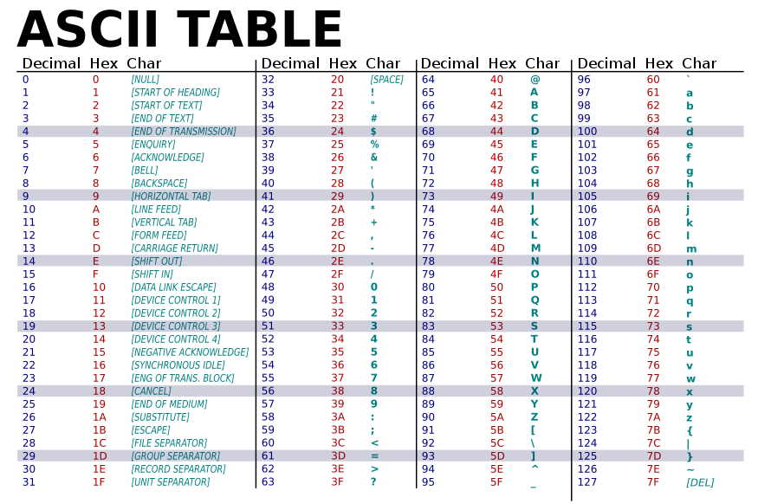

Slide 42
char
char c = ‘A’;
char c = 65;
char c = ‘\x41’;
printf(“c=%c\n”, c);
printf(“c=%d\n”, c);

Slide 43
char
char c = ‘A’;
c++;
printf(“c=%c, c=%d\n”, c, c);

Slide 44


Slide 45
C exercise 1: tolower
// tolower returns the corresponding
// lowercase character for c if c is an
// uppercase letter. Otherwise, it returns c.
char tolower(char c) {
// test if c is an uppercase letter
if (c < ‘A’ || c > ‘Z’) {
return c;
}
}

Slide 46
C exercise 1: tolower
// tolower returns the corresponding
// lowercase character for c if c is an
// uppercase letter. Otherwise, it returns c.
char tolower(char c) {
// test if c is an uppercase letter
if (c < ‘A’ || c > ‘Z’) {
return c;
}
return c + (‘a’ – ‘A’);
}
C’s standard library includes
tolower, toupper

Slide 47
C exercise 2: toDigit
// toDigit returns the corresponding integer for c
// assuming c is a valid digit character, e.g ‘1’, ‘2’,
int toDigit(char c) {
// crash if c is not a valid character
assert (c >= ‘0’ && c <= ‘9’);
}
int main() {
int d = toDigit(‘8’);
printf(“int is %d, multiply-by-2 %d\n”, d, 2*d);
}
return c – ‘0’;

Slide 48
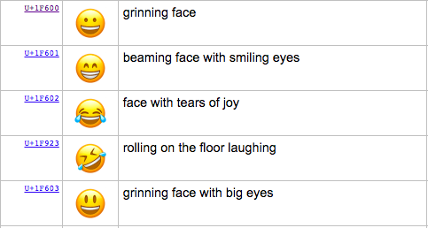
The Modern Standard: UniCode
ASCII can only represent 128 characters
  How about Chinese, Korean, all of the worlds languages? Symbols? Emojis?
Unicode standard represents >135,000 characters

Slide 49
UTF-8
UTF-8 is one encoding form for Unicode
  use 1, 2, or 4 byte to represent a character
  Unicode for ASCII characters have the same ASCII value → UTF-8 one byte code is the same as ASCII
C has no primitive support for Unicode

Slide 50
What we’ve learnt and today’s plan
Bitwise operations
Pointers & arrays
ASCII characters
Today’s lesson:
  String
  Struct
  Malloc

Slide 51
C Strings

Slide 52
Strings
String is represented as an array of chars.
  Array has no space to encode its length.
How to determine string length?
  explicitly pass around an integer representing length
// tolower_string turns every character in character array s
// into lower case
void tolower_string(char *s, int len) {
for (int i = 0; i < len; i++) {
s[i] = tolower(s[i]);
}
}

Slide 53
Strings
String is represented as an array of chars.
  Array has no space to encode its length.
How to determine string length?
  explicitly pass around an integer representing length
  C string stores a NULL character to mark the end (by convention)
void tolower_string(char *s) {
}

Slide 54
Strings
String is represented as an array of chars.
  Array has no space to encode its length.
How to determine string length?
  explicitly pass around an integer representing length
  C string stores a NULL character to mark the end (by convention)
void tolower_string(char *s) {
int i = 0;
while (s[i] != ‘\0’) {
s[i] = tolower(s[i]);
i++;
}
}

Slide 55
Copying string?
does this make a copy of “hi”?
...
char s[3] = {‘h’,‘i’,‘\0’};
char *h;
h = s;
h[0] = ‘H’;
printf(“s=%s h=%s\n”,s,h);
0x00
‘i’
s:
‘h’
0xdeadbefef12345678
...
0xde
…
h:
0x78
...

Slide 56
Copying string?
does this make a copy of “hi”?
char s[3] = {‘h’,‘i’,‘\0’};
char h[3];
h = s;
h[0] = ‘H’;
printf(“s=%s h=%s\n”,s,h);

Slide 57
Copying string
void strcpy(char *dst, char *src)
{
}
int main()
{
char s[3] = {‘h’,‘i’,‘\0’};
char h[3];
strcpy(h, s);
h[0] = ‘H’;
printf(“s=%s h=%s\n”,s,h);
}

Slide 58
Copying string
void strcpy(char *dst, char *src) {
int i = 0;
while (src[i] != ‘\0’) {
dst[i] = src[i];
i++;
}
}
int main() {
char s[3] = {‘h’,‘i’,‘\0’};
char h[3];
strcpy(h, s);
h[0] = ‘H’;
printf(“s=%s h=%s\n”,s,h);
}
strcpy is included in C std library.

Slide 59
Copying string
void strcpy(char *dst, char *src) {
int i = 0;
while (src[i] != ‘\0’) {
dst[i] = src[i];
i++;
}
}
int main() {
char s[3] = {‘h’,‘i’,‘\0’};
char h[2];
strcpy(h, s);
h[0] = ‘H’;
printf(“s=%s h=%s\n”,s,h);
}
Results in out-of-bound write!
Buffer overflow!

Slide 60
Copying string
void strncpy(char *dst, char *src, int n) {
int i = 0;
while (src[i] != ‘\0’ && i < n) {
dst[i] = src[i];
i++;
}
}
int main() {
char s[3] = {‘h’,‘i’,‘\0’};
char h[2];
strncpy(h, s, 2);
h[0] = ‘H’;
printf(“s=%s h=%s\n”,s,h);
}
strncpy is included in C std library.

Slide 61
A different way of initializing string
...
char s1[3] = {‘h’,‘i’,‘\0’};
//equivalent to
//char s1[3] = “hi”;
char *s2 = “bye”;
s1[0] = ‘H’;
s2[0] = ‘B’;
printf(“s1=%s s2=%s\n”,s1,s2);
OK
Segmentation fault (bus error)

Slide 62
A different way of initializing string
...
char s1[3] = {‘h’,‘i’,‘\0’};
//equivalent to
//char s1[3] = “hi”;
char *s2 = “bye”;
s1[0] = ‘H’;
s2[0] = ‘B’;
printf(“s1=%s s2=%s\n”,s1,s2);
0x00
‘i’
s1:
‘h’
0xdeadbefef12345678
...
0x00
…
s2:
0x21
...
0x00
‘e’
read-only
memory
‘y’
‘b’
0x0000000087654321

Slide 63
The Atoi function
// atoi returns the integer
// corresponding to the string of digits
int atoi(char *s)
{
}
int main()
{
char *s= “123”;
printf(“integer is %d\n”, atoi(s));
}

Slide 64
The Atoi function
// atoi returns the integer
// corresponding to the string of digits
int atoi(char *s) {
int result = 0;
int i = 0;
while (s[i] >= '0' && s[i] <= '9') {
result = result * 10 + (s[i] -'0');
i++;
}
return result;
}
‘1’ | ‘2’ | ‘3’ | ‘\0’
result = 1
result = 1*10+2
result = 12*10+3
end loop

Slide 65
Array of pointers
char* names[3] = {
“alice”,
“bob”,
“clark”
};
3*8 bytes
char **namep;
namep = names;
printf(“name is %s”, namep[1]);
names:
“clark”
“bob”
“alice”

Slide 66
The most commonly used array of pointers: argv
int main(int argc, char **argv)
{
for (int i = 0; i < argc; i++) {
printf(“%s\n”, argv[i]);
}
}
$ ./a.out 1 2 3
./a.out 1 2 3
argv[0] is the name of the executable

