Slide 1
Bits, Bytes, Ints
Jinyang Li
Some slides are due to Tiger Wang

Slide 2
Lesson plan
How computers represent integers in binary formats
Bit, Byte
How to make binary formats readable to humans
Hex notation
How computers add/subtract integers
Unsigned vs. signed integer representation

Slide 3
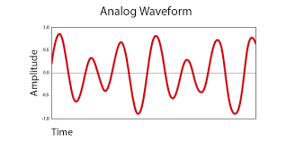

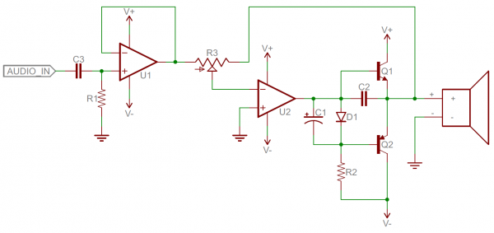
We used to process information as analog signals
Analog signals: smooth and continuous
Hard
Difficult to design
Susceptible to noise
Analog components: resistors, capacitors, inductors, diodes, etc.

Slide 4
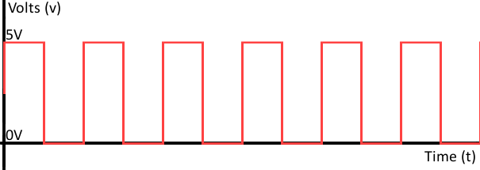

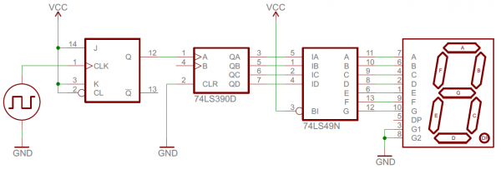
Now, we process information in digital format
1 0 1 0 1 0 1 0 1 0 1 0
Digital signals: discrete (0 or 1)
Easier
Easier to design
Robust to noise
Digital components: transistors, logic gates …

Slide 5
Digital information is represented in bits
Bit = Binary digit, 0 or 1
1 bit → 2 possible values (aka bit patterns)
1 English alphabet → 26 “values” (characters)
Need more values? Use more bits!

Slide 6
Questions
How many possible 2-bit patterns?
b₀ or b₁ can be either 0 or 1
b₁
b₀
All 2-bit patterns: 00, 01, 10, 11

Slide 7
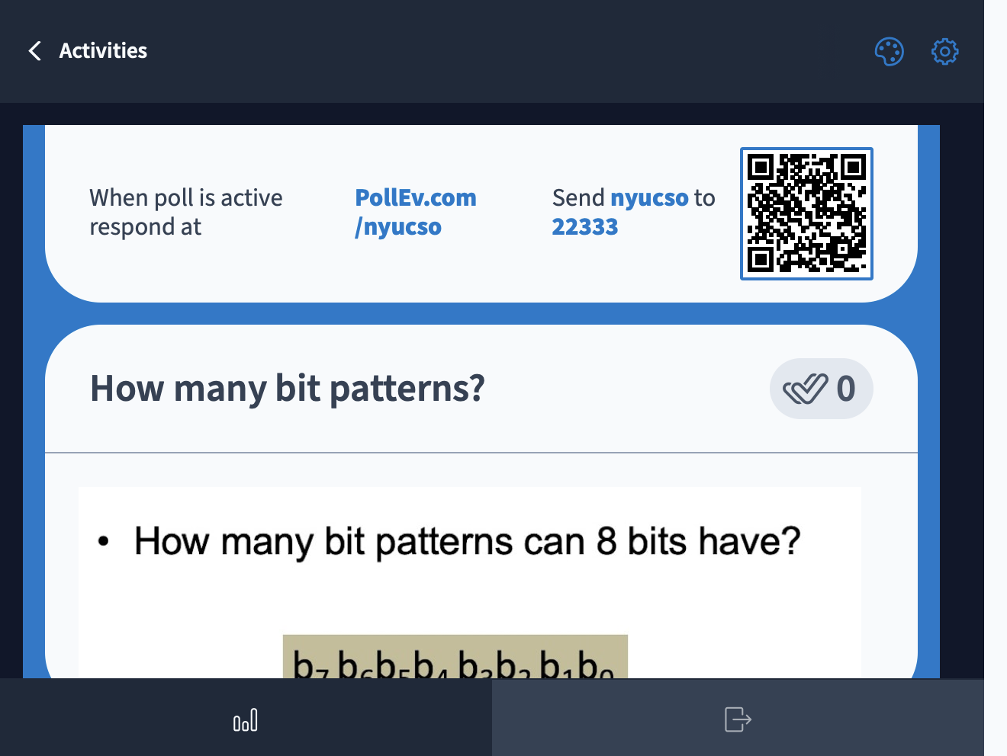

Slide 8
Questions
How many n-bit patterns?
b_{n-1 …}b₁b₀
All n-bit patterns:
0…00
0…01
0…10
0…11
…
1…11
2^{n}
b_{7 …}b₁b₀
2⁸ = 256

Slide 9
Digression: All self-respecting CS students should memorize powers of 2
2⁰ = 1
2¹ = 2
2² = 4
2³ = 8
2⁴ = 16
2⁵ = 32
2⁶ = 64
2⁷ = 128
2⁸ = 256
2⁹ = 512
2¹⁰ = 1024

Slide 10
Digression: approximations of powers of 2
2¹⁰ = 1024
≈
10³ (Kilo)
≈
2²⁰
10^{3*2} = 10⁶ (Mega)
≈
2³⁰
10^{3*3} = 10⁹ (Giga)
≈
2⁴⁰
10^{3*4} = 10¹² (Tera)
≈
2⁵⁰
10^{3*5} = 10¹⁵ (Peta)

Slide 11
Represent non-negative integer
unsigned
bits: b₁b₀
Goal: map each bit pattern to an integer
00 → 0
01 → 1
10 → 2
11 → 3
2-bits → 4 patterns
Range: [0, 3]

Slide 12
Represent unsigned integer
Bit pattern: b_{n-1}b_{n-2}…b₂b₁b₀
Range: [0, 2^{n} -1]
Base-2 representation:
b_{n-1}b_{n-2}…b₂b₁b₀ =
b_{i} is bit at i-th position (from right to left, starting at i=0)

Slide 13
Examples
Bit pattern: 00000110
Value: 0*2⁷+0*2⁶+0*2⁵+0*2⁴+0*2³+1*2²+1*2¹+0*2⁰ = 6
Notes:
128+4+2 = 134

Slide 14
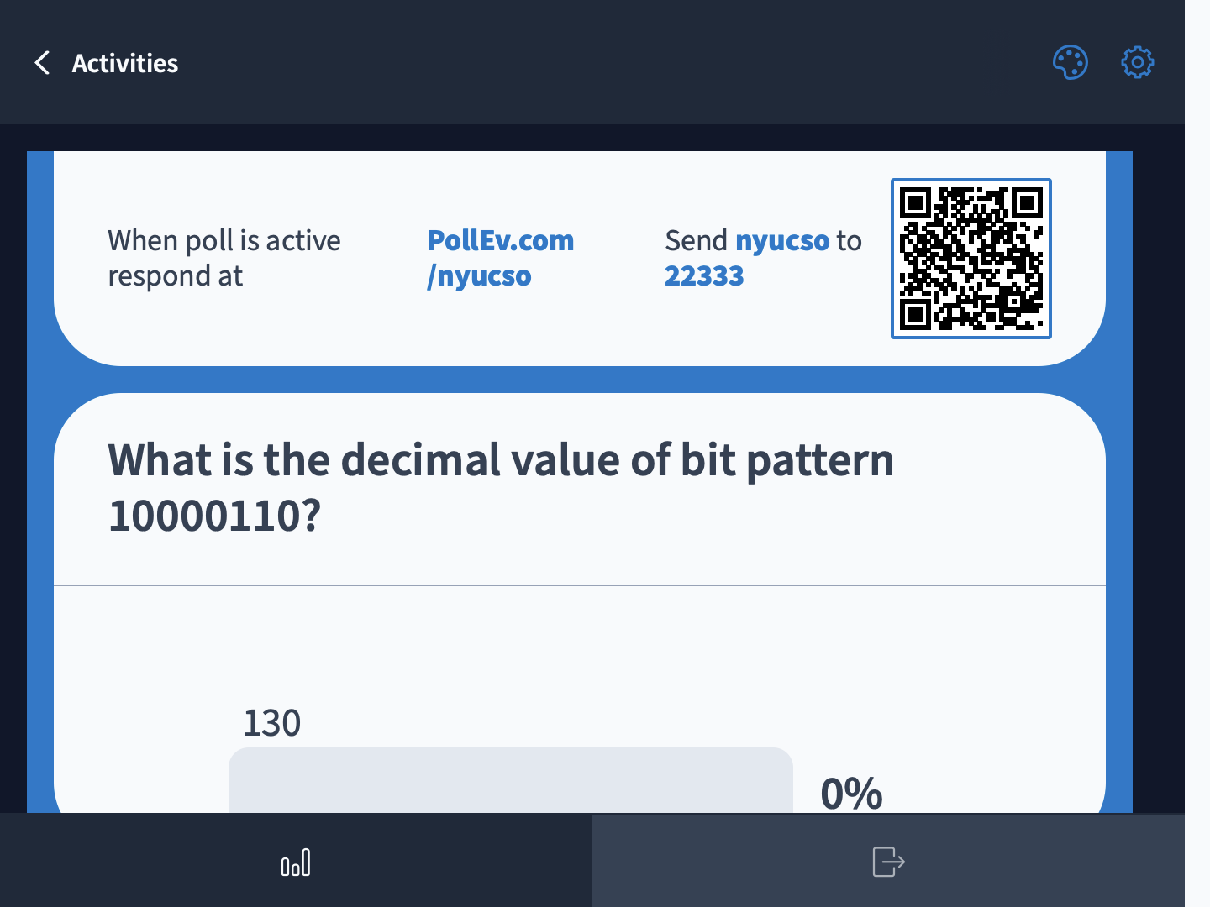
Notes:
128+4+2 = 134

Slide 15
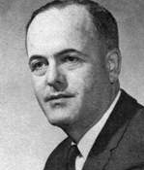
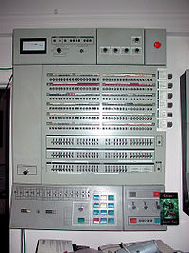
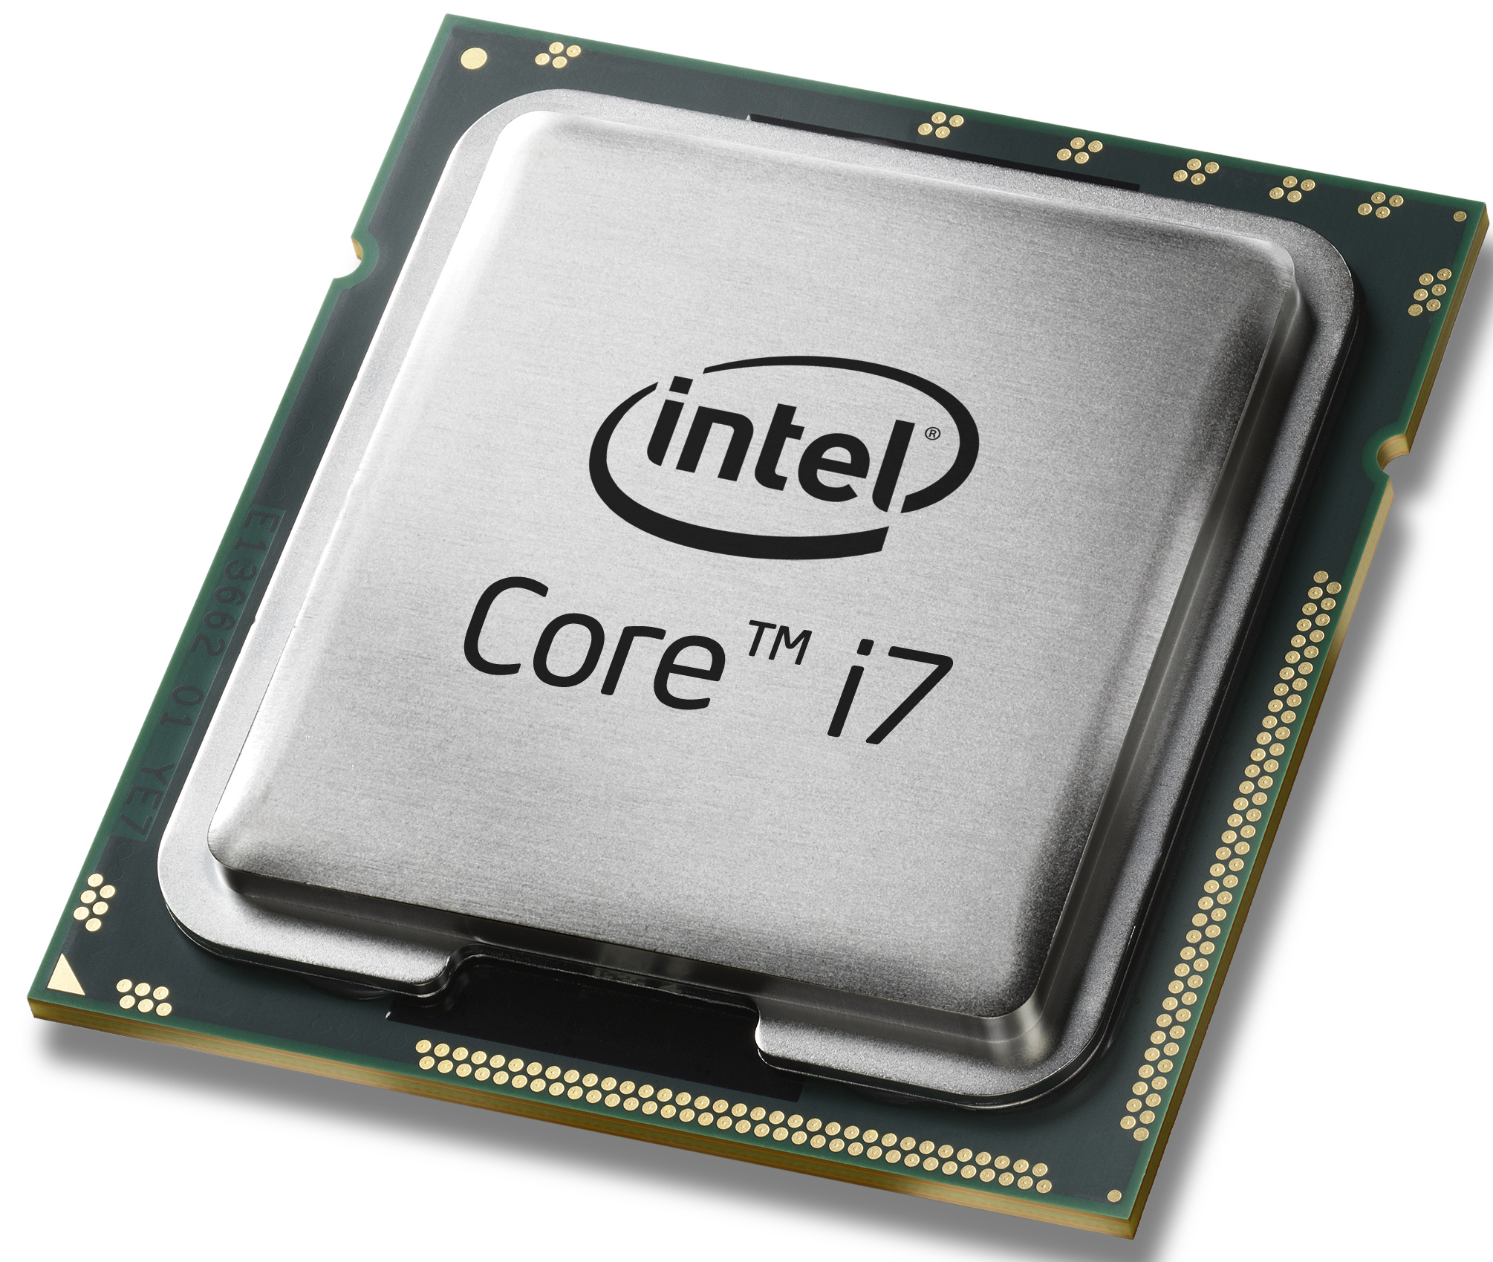
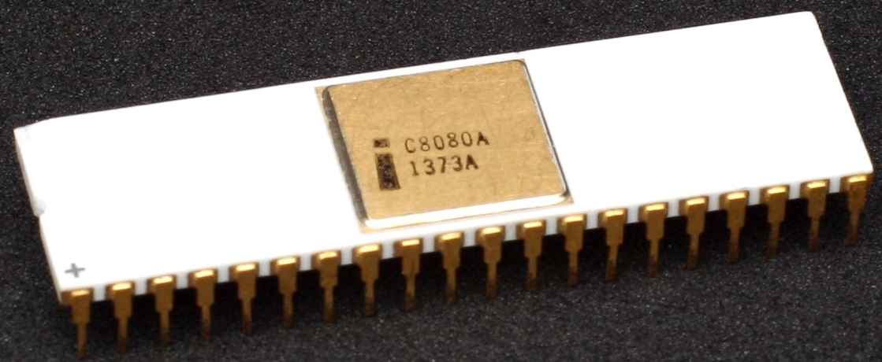
Byte
Byte: a fixed size group of bits
The term is coined by Werner Buchholz (IBM).
Long long ago, different vendors use different byte sizes
Now: Byte is 8-bit
IBM System/360, 1964
Intel 8080, 1974
Modern processors
Introduced 8-bit byte
Widely adopted
Standardized
Notes:
Why byte?

Slide 16
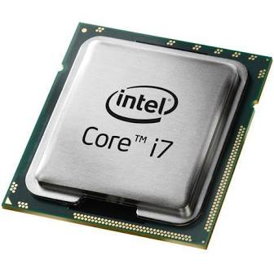
Byte
00011010
00001110
11001010
10101110
00111010
......
Memory
CPU
Byte is the smallest unit of information storage, computation and transfer
Integers are represented by 1,2,4, or 8 bytes.
Notes:
Why byte?

Slide 17
Range of unsigned integer
Size of unsigned int (bytes) | Range
1 | [0, 2⁸-1]
2 | [0, 2¹⁶-1]
4 | [0, 2³²-1]
8 | [0, 2⁶⁴-1]

Slide 18
Most and least significant bit/byte
msb: bit position with the largest positional value
lsb: bit position with the smallest positional value
1-byte unsigned int:
10011010
4-byte unsigned int:
01110011 10001101 01010011 11011010
Most significant byte
Least significant byte

Slide 19
Describing bit patterns in a human-readable way
1-byte int: 10101110
C program:
unsigned int a = 0b10101110;
If I ask you to type a 4-byte int, …

Slide 20
Describing a bit pattern: hex notation
Use one (hex) symbol to represent a group of 4 bits
Binary | Hex
0000 | 0
0001 | 1
0010 | 2
0011 | 3
0100 | 4
0101 | 5
0110 | 6
0111 | 7
Binary | Hex
1000 | 8
1001 | 9
1010 | a
1011 | b
1100 | c
1101 | d
1110 | e
1111 | f
n-bit binary pattern ➔ n/4 hex symbols
??

Slide 21
Describing a bit pattern: hex notation
10101110
a
e
C program:
unsigned int a = 0xae;

Slide 22

Breakout time!

Slide 23
Breakout exercises
What's the least significant bit of any even number?
Write the hex notation of this 2-byte bit pattern: 1111000011000011
What's the decimal value of unsigned int: 0xff
0
0xf0c2
255

Slide 24
What have we learnt
How computers represent integers
Bit, Byte
Hex notation
Q: What is 10000010 in decimal?
A: 130
Q: What's the least significant bit of any even number?
Q: What is 10001111 in hex?
A: 0x8F

Slide 25
Lesson plan
How computers represent integers
Bit, Byte
Hex notation
How computers add/subtract integers
Signed integer representation
2’s complement
A short history of processors:
from 8-bit to 64-bit machines
Byte ordering: big vs. small endian

Slide 26
What’s the result?
#include <stdio.h>
int main(void) {
unsigned char a = 0b10000011;
unsigned char b = 0b10000010;
unsigned char c = a + b;
printf("%hhu\n", c);
}
https://godbolt.org/z/Esb1q8KKf

Slide 27
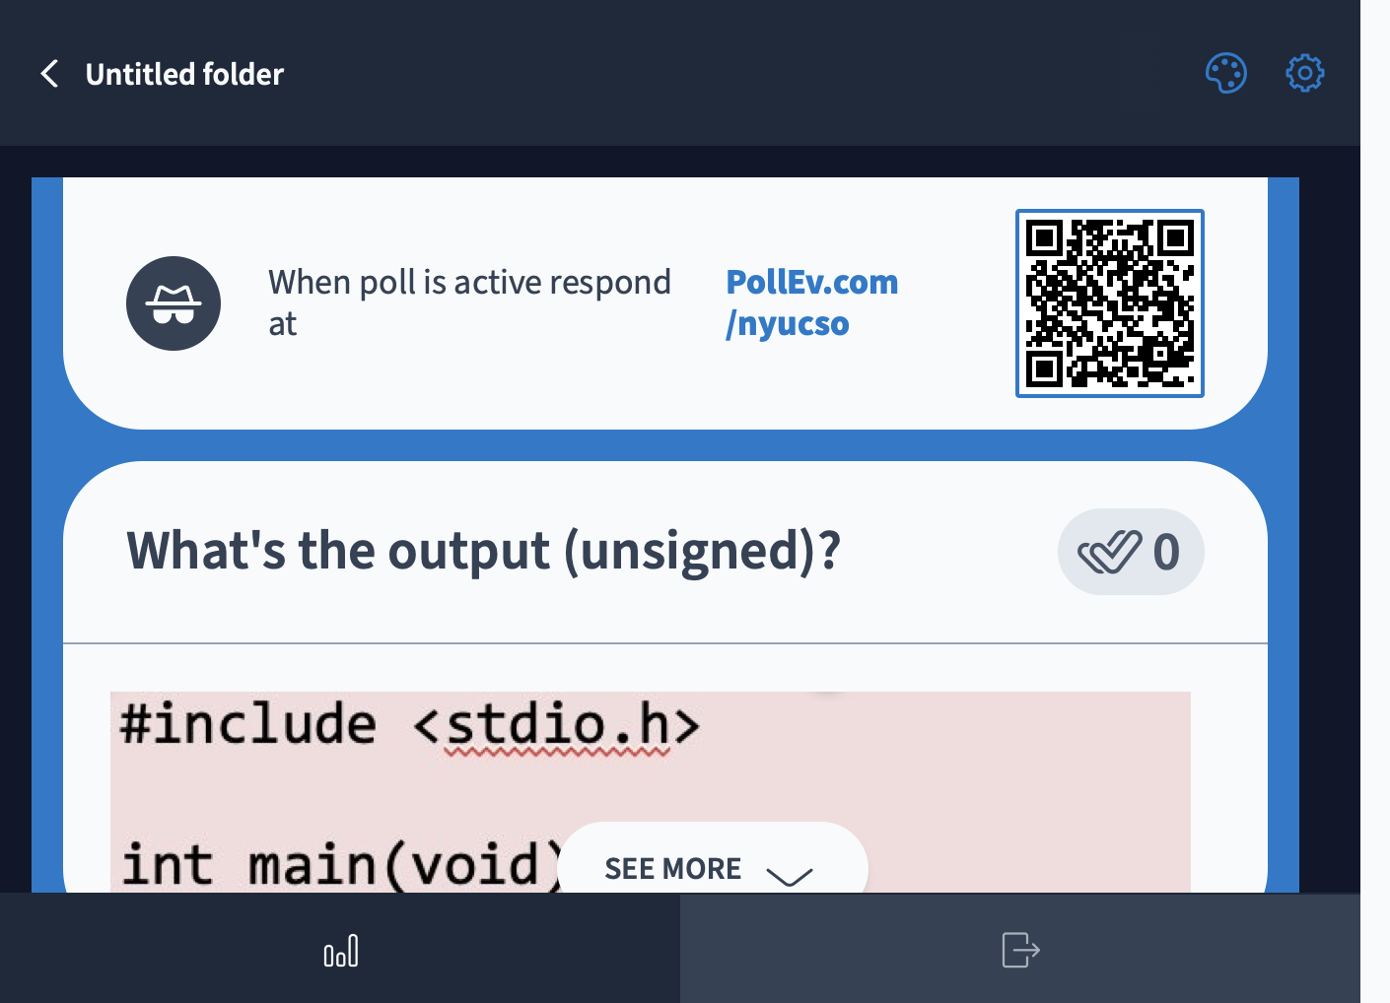

Slide 28
How computers add (unsigned integers)
0 0 0 0 0 0 1 1
+
0 0 0 0 0 0 1 0
Result: _ _ _ _ _ _ _ _

Slide 29
How computers add (unsigned integers)
1 0 0 0 0 0 1 1
+
1 0 0 0 0 0 1 0
Result: _ _ _ _ _ _ _ _

Slide 30

How to represent signed numbers? signed magnitude
Most significant bit (MSB) represents the sign
0 0 0 0 0 0 0 1₂
1
sign
magnitude
1 0 0 0 0 0 0 1₂
-1
0 0 0 0 0 0 0 1
+
1 0 0 0 0 0 0 1
-2 ???
1 0 0 0 0 0 1 0
☹Need different h/w for signed
vs. unsigned computation

Slide 31
How to represent signed numbers? Two’s complement
Unsigned int
00010110
= 0*2⁷ + 0*2⁶ + 0*2⁵ + 1*2⁴ + 0*2³ + 1*2² + 1*2¹ + 0*2⁰
10010110
= 1*2⁷ + 0*2⁶ + 0*2⁵ + 1*2⁴ + 0*2³ + 1*2² + 1*2¹ + 0*2⁰
Signed int
00010110
= 0*(-2⁷) +0*2⁶ +0*2⁵ +1*2⁴ +0*2³ +1*2² +1*2¹+0*2⁰
10010110
= 1*(-2⁷) +0*2⁶ +0*2⁵ +1*2⁴ +0*2³ +1*2² +1*2¹+0*2⁰

Slide 32
Two’s complement
Bit pattern | Unsigned value
00000000 | 0
00000001 | 1
00000010 | 2
… | …
01111111 | 2⁷-1 = 127
10000000 | 2⁷ = 128
10000001 | 2⁷ +1= 129
10000010 | 2⁷+2=130
…
11111111 | 2⁸-1 = 255
Signed value
0
1
2
…
2⁷-1 = 127
-2⁷ = -128
-2⁷ +1= -127
-2⁷ +2= -126
-2⁷+(2⁷-1) = -1

Slide 33
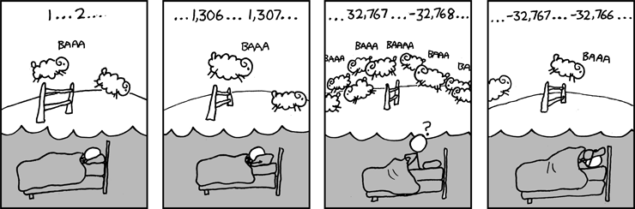
Two’s complement
Source: xkcd.com
What is the width of the signed integer being enumerated?

Slide 34
Basic facts of 2’s complement
Signed int
Size (bytes) | Bit pattern of smallest | Bit pattern of largest | Range
1
2
4
8
0x80 | 0x7f | [-2⁷, 2⁷-1]
0x8000 | 0x7fff | [-2¹⁵, 2¹⁵-1]
0x80000000 | 0x7fffffff | [-2³¹, 2³¹-1]
0x8000000000000000 | 0x7fffffffffffffff | [-2⁶³, 2⁶³-1]
🤔 Home exercise: make a similar table for unsigned int
Negative numbers ←→ MSBit=1
A sequence of 1’s (e.g. 0xff, 0xffffffff) ←→ -1

Slide 35
Two’s complement: 8-bit signed integer
00000101
= 0*(-2⁷) +0*2⁶ +0*2⁵ +0*2⁴ +0*2³ +1*2² +0*2¹+1*2⁰ = 5
11111011
= 1*(-2⁷) +1*2⁶ +1*2⁵ +1*2⁴ +1*2³ +0*2² +1*2¹+1*2⁰ = -5
00000000
= 0
11111111
= -1
10000000
= -2⁷= -128
01111111
= 2⁷-1= 127

Slide 36
How do computers add? (2’s complement)
0 0 0 0 0 1 0 1
+
1 1 1 1 1 0 1 1
Result: _ _ _ _ _ _ _ _

Slide 37
What’s the result?
#include <stdio.h>
int main(void) {
char a = 0b01111111;
char b = 0b00000001;
char c = a + b;
printf("%hhd\n", c);
}
https://godbolt.org/z/exvx3eKx7

Slide 38
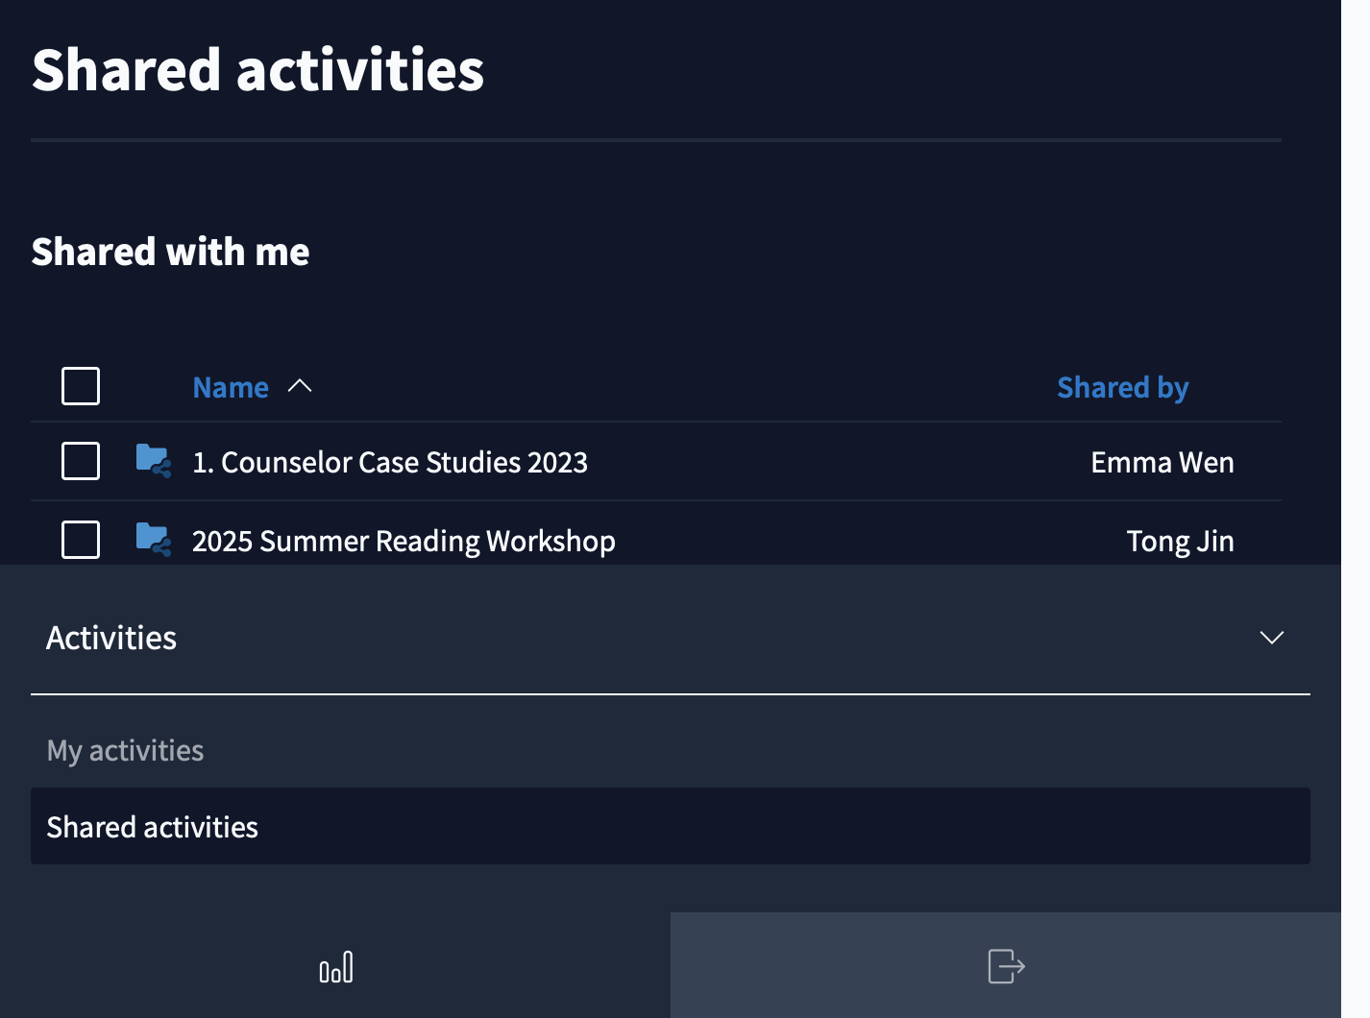

Slide 39
How do computers add? (2’s complement)
0 1 1 1 1 1 1 1
+
0 0 0 0 0 0 0 1
Result: _ _ _ _ _ _ _ _

Slide 40
How do computers subtract?
a:
0 0 0 0 0 1 0 1
0 0 0 0 0 1 0 1
b:
-
0 0 0 0 0 1 0 1
+
2’s complement of -b
result:
_ _ _ _ _ _ _ _
_ _ _ _ _ _ _ _

Slide 41
2’s complement: find a number’s negation
00000101
??
(5)₁₀
(-5)₁₀
A useful trick to do negation:
Step-1: flip all bits
00000101
(5)₁₀
Step-1: flip bits
Step-2: add 1
11111010
Step-2:
+00000001
11111011
(-5)₁₀

Slide 42
Why does the negation trick work
b with bits flipped

Slide 43
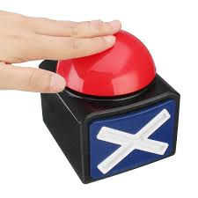
Using negation trick to find the bit-pattern of a negative number
The bit pattern of 8-bit signed integer -33?
Answer:
33 = (00100001)₂
Apply negation trick: (11011110)₂+1=(11011111)₂

Slide 44
How do computers subtract?
a:
0 0 0 0 0 1 0 1
0 0 0 0 0 1 0 1
~b (flipped b)
b:
-
0 0 0 0 0 1 0 1
+
1 1 1 1 1 0 1 0
0 0 0 0 0 0 0 1
result:
_ _ _ _ _ _ _ _
_ _ _ _ _ _ _ _
Works for both unsigned and signed subtraction!

Slide 45
How do computers add and subtract?
Same h/w mechanism for signed or unsigned integers
Subtracting is done by adding negated b
Different overflow conditions for unsigned/signed
Unsigned:
Add: carry out of msb
Subtract: no carry out of msb (aka borrow out of msb)
Signed:
Add: operands have same signs, result has opposite sign
Subtract: operands have different signs, result has opposite sign from a.

Slide 46


Unsigned addition
🤔
0 0 0 0 0 0 0 1
(1)₁₀
(3)₁₀
0 0 0 0 0 0 0 1
(1)₁₀
(129)₁₀
+
+
0 0 0 0 0 0 1 1
1 0 0 0 0 0 0 1
(4)₁₀
(130)₁₀
0 0 0 0 0 1 0 0
1 0 0 0 0 0 1 0
0 1 0 0 0 0 0 1
(65)₁₀
(64)₁₀
1 0 0 0 0 0 0 1
(129)₁₀
(254)₁₀
+
+
1 1 1 1 1 1 1 0
0 1 0 0 0 0 0 0
(129)₁₀
(127)₁₀
1 0 0 0 0 0 0 1
0 1 1 1 1 1 1 1
Overflow!

Slide 47
Signed addition
🤔
0 0 0 0 0 0 0 1
(1)₁₀
(3)₁₀
0 0 0 0 0 0 0 1
(1)₁₀
(-127)₁₀
+
+
0 0 0 0 0 0 1 1
1 0 0 0 0 0 0 1
This is what 2’s complement is designed to accomplish!
(4)₁₀
(-126)₁₀
0 0 0 0 0 1 0 0
1 0 0 0 0 0 1 0
0 1 0 0 0 0 0 1
(65)₁₀
(64)₁₀
1 0 0 0 0 0 0 1
(-127)₁₀
(-2)₁₀
+
+
1 1 1 1 1 1 1 0
0 1 0 0 0 0 0 0
(-127)₁₀
(127)₁₀
1 0 0 0 0 0 0 1
0 1 1 1 1 1 1 1
Overflow!
Overflow!

Slide 48
Unsigned subtraction
🤔
0 0 0 0 0 0 0 1
(1)₁₀
(3)₁₀
0 0 0 0 0 0 0 1
(1)₁₀
(255)₁₀
-
-
0 0 0 0 0 0 1 1
1 1 1 1 1 1 1 1
(254)₁₀
(2)₁₀
1 1 1 1 1 1 1 0
0 0 0 0 0 0 1 0
Overflow!
Overflow!
0 1 1 1 1 1 1 1
(127)₁₀
(254)₁₀
1 0 0 0 0 0 0 0
(128)₁₀
(1)₁₀
-
-
0 0 0 0 0 0 0 1
1 1 1 1 1 1 1 0
(129)₁₀
(127)₁₀
1 0 0 0 0 0 0 1
0 1 1 1 1 1 1 1
Overflow!

Slide 49
Signed subtraction
🤔
0 0 0 0 0 0 0 1
(1)₁₀
(3)₁₀
0 0 0 0 0 0 0 1
(1)₁₀
(-1)₁₀
-
-
0 0 0 0 0 0 1 1
1 1 1 1 1 1 1 1
(-2)₁₀
(2)₁₀
1 1 1 1 1 1 1 0
0 0 0 0 0 0 1 0
0 1 1 1 1 1 1 1
(127)₁₀
(-2)₁₀
1 0 0 0 0 0 0 0
(-128)₁₀
(1)₁₀
-
-
0 0 0 0 0 0 0 1
1 1 1 1 1 1 1 0
(-127)₁₀
(127)₁₀
1 0 0 0 0 0 0 1
0 1 1 1 1 1 1 1
Overflow!
Overflow!

Slide 50
Lesson plan
How computers represent integers
Bit, Byte
Hex notation
How computers add/subtract integers
Signed integer representation
2’s complement
A short history of processors:
from 8-bit to 64-bit machines
Byte ordering: big vs. small endian

Slide 51
The evolution of integer sizes in processors

Slide 52
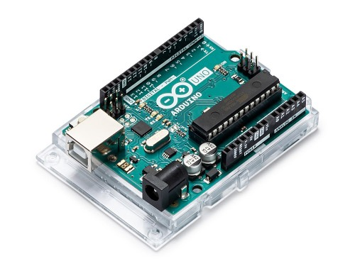
8-bit processors: Intel 8080 (1974)
0xb0
0x0f
0xa9
0xaf
CPU
0xa8
0x1e
Address: 0xa7
Arithmetic Logic
Unit
0xa7
0x4c
0xa6
0xea
Data: 0x4c
registers
0x4c
0xa5
0xcb
0xa4
0xba
0xa3
0x00
0xa2
0xff
8 bits machine: 8 bits length of
CPU register
Memory address
0xa1
0x8c
…
……
Memory
Nowadays: 8-bit processor (microcontroller)
Is used for embedded systems

Slide 53
32-bit processors: Intel 386 (1985)
0x000000b1
0x0f
CPU
0x000000b0
0xaf
Address: 0x000000a8
Arithmetic Logic
Unit
0x000000a9
0x1e
0x000000a8
0x4c
Data: 0x4c1eaf0f
registers
0x4c1eaf0f
0x000000a7
0xea
0x000000a6
0xcb
0x000000a5
0xba
0x000000a4
0x00
32 bits machine: 32 bits length of
CPU register
Memory address
0x000000a3
0xff
0x000000a2
0x8c
…
……
Memory
Most commonly used desktop/server processors
in the latest 80s to early 00s

Slide 54
64-bit processors: Intel Pentium 4 (2000)
0x00…00b7
0x0f
0x00…00a6
0xaf
CPU
0x00…00a5
0x1e
Address: 0x00……00a0
0x00…00a4
0x4c
Arithmetic Logic Unit
0x00…00a3
0xea
registers
0x00bacbea4c1eaf0f
Data: 0x00bacbea4c1eaf0f
0x00…00a2
0xcb
0x00…00a1
0xba
0x00…00a0
0x00
0x00…009f
0xff
64 bits machine: 64 bits length of
CPU register
Memory address
0x00…009e
0x8c
…
……
Memory
Nowadays:
Servers/laptops: Intel/AMD 64-bit x86 processors
Mobile phones/tablets: 64-bit ARM processors (made by Apple/Qualcomm/Samsung etc)

Slide 55
C’s Integer data types on 64-bit machine
 | Length | Min | Max
char | 1 byte | -2⁷ | 2⁷ - 1
unsigned char | 1 byte | 0 | 2⁸ - 1
short | 2 bytes | -2¹⁵ | 2¹⁵ - 1
unsigned short | 2 bytes | 0 | 2¹⁶ - 1
int | 4 bytes | -2³¹ | 2³¹ - 1
unsigned int | 4 bytes | 0 | 2³² - 1
long | 8 bytes | -2⁶³ | 2⁶³ - 1
unsigned long | 8 bytes | 0 | 2⁶⁴ - 1

Slide 56
Your first C program
#include <stdio.h>
int
main()
{
char x = -127;
char y = 0x81;
char z = x + y;
printf(“hello world sum is %d\n”, z);
}
$ gcc helloworld.c
$ ./a.out
1 0 0 0 0 0 0 1
-127
+
1 0 0 0 0 0 0 1
-127
1
0 0 0 0 0 0 1 0
2

Slide 57
Memory layout for multi-byte integers
0x00…00b0
CPU
0x00…00a9
0x00…00a8
Arithmetic Logic Unit
0x00…00a7
registers
0x00…00a6
0x00…00a5
0x00…00a4
4-byte
0x00…00a3
0x00…00a2
0x00…00a1
…
……
Memory

Slide 58
Memory layout: Little Endian
int x = 0x12345678
CPU
Arithmetic Logic Unit
registers
0x12 | 0x34 | 0x56 | 0x78
addr+3
0x12
addr+2
0x34
addr+1
0x56
x:
addr
0x78
……
Little endian:
Least significant byte stored at smallest address
Used in x86 processors (servers/laptops) and most ARM (phones/tablets) implementation
address of x
Memory

Slide 59
Advantage of Little Endian
0x12345678
+
Processor performs calculation
from the least significant bit
0x12131415
Processor can simultaneously
perform memory transfer and
calculation.

Slide 60
Another advantage of Little Endian
CPU
Arithmetic Logic Unit
registers
…
addr+3
0x12
int a = 0x12345678;
addr+2
0x34
short b = (short)a;
addr+1
0x56
b:
a:
addr
0x78
Casting a larger integer to a smaller one requires no explicit conversion.
…
……
Memory

Slide 61
Memory layout: Big Endian
int a = 0x12345678;
CPU
Arithmetic Logic Unit
registers
0x12 | 0x34 | 0x56 | 0x78
…
addr+3
0x78
addr+2
0x56
addr+1
0x34
a:
addr
0x12
…
……
Big Endian:
Most significant byte stored at smallest address
ARM processors (phones/tablets) in principle support both endian
Memory

Slide 62
Advantages of Big Endian
Quick to test whether the number is positive or negative
Examine byte stored at the address offset zero.

Slide 63
Big or Little Endian?
#include <stdio.h>
int main()
{
int x = 0x05060708;
int *p;
p = &x; //p contains the address of x
char y = *(char *)p; //y is the 1-byte value pointed to by p
printf(“y=%d\n”, y);
}
$ gcc endian.c
$ ./a.out

Slide 64
Summary
Integer representation
Unsigned (base-2)
Signed (2’s complement)
Hex notation
Operations (e.g. add,subtract) on fixed-width integers can cause overflow
Big vs. little endian

