Slide 1
Floats (continued) Intro to C programming

Slide 2
Lesson plan
Rounding
FP operations and caveats
C programming: overview
C programming: bitwise operators

Slide 3
IEEE Floating Point
Normalized Encoding:
31
30
23
22
0
s | exp = E + 127 | fraction (F)
+M * 2E
1 <= M < 2, M = ( 1.F )₂
Denormalized Encoding:
31
30
23
22
0
s | exp =0000 0000 | fraction (F)
E = 1 – bias = -126
0 <= M < 1, M = ( 0.F )₂
0 0….01 0…00
-2⁻¹²⁶
±0
2⁻¹²⁶
Denormalized numbers
Normalized numbers

Slide 4
FP: Rounding
Values that are represented precisely
What if the result of computation is at ?
Rounding: Use the “closest” representable value x’ for x.
4 modes:
Round-down
Round-up
Round-toward-zero
Round-to-nearest (Round-to-even in text book)

Slide 5
Round down vs. round up
-0.875
-0.75
0.5
0.625
0
Round up rounds to the right
Round(x) = x₊ (x₊>= x)
Round down rounds to the left
Round(x) = x₋ (x₋<= x)

Slide 6
Round towards zero
-0.875
-0.75
0.5
0.625
0
Rounds to the right if x < 0
Round(x) = x₊ if x < 0
Rounds to the left if x >0
Round(x) = x₋ if x < 0

Slide 7
Round to nearest; ties to even
Round to the left if x₋ is nearer to x than x₊
-0.875
-0.75
0.5
0.625
0
Round to the right if x₊ is nearer to x than x₋
In case of a tie, the one with its least significant bit equal to zero is chosen.

Slide 8
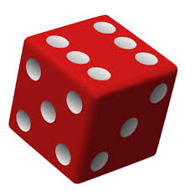
IEEE FP: single vs. double precision
31
30
23
22
0
C program:
single precision
(32 bits)
s | exp=E+127 | frac
float f = 0.1;
double d = 0.1;
63
62
52
51
0
double precision
(64 bits)
s | exp=E+1023 | frac
What’s the highest precision? (aka intervals between two denormalized numbers?)
What’s the largest positive FP?
Notes:
Smallest denormalized 0
Next smallest denormalized?
Exp=00000000 E=1-bias=-126
Frac=0….001 M=0.00….01 = 2^-23
Final number = 2^{-23}*2^{-126} = 2^-149
Exp=000…00 E=1-bias = -1022
Frac = 00…1 M=0.000…01 = 2^{-52}
Single precision
Exp=1111 1110 Frac=11…1
E = 254-127=127 M=1.1….1 = 2-2^-23 \approx. 2 = 1.1…1 + 0.00..01 = (10)_2 = (2)_10
Double precision
E = 1023 M = \approx. 2

Slide 9
IEEE FP: single vs. double precision
31
30
23
22
0
C program:
single precision
(32 bits)
s | exp=E+127 | frac
float f = 0.1;
double d = 0.1;
63
62
52
51
0
double precision
(64 bits)
s | exp=E+1023 | frac
What’s the highest precision? (aka intervals between two denormalized numbers?)
(single) 2⁻¹⁴⁹ (double) 2⁻¹⁰⁴⁵
What’s the largest positive FP?
(single) ≈2¹²⁸ (double) ≈2¹⁰²⁴

Slide 10
How does CPU know if data is FP or integer ?
4-byte data: 0x80000001
Interpret as signed int: -2³¹+1
Interpret as IEEE single-precision FP: -2⁻¹⁴⁹
CPU has separate registers for FPs and integers.
CPU uses different instructions for FPs and integer operations.

Slide 11
Floating point operations
Addition, subtraction, multiplication, division etc.
Invalid operations (resulting in NaN):
0/0
sqrt(-1)
∞+∞
Divide by zero: x/0→∞
Caveats:
Overflow: Outside the range
Underflow: 0 < result < smallest denormalized value
Inexact: due to rounding

Slide 12
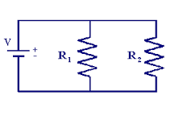

Why divide by zero = ∞?
Allow a calculation to continue and produce a valid result
Example:
If R1 or R2 is 0, overall resistance should be 0

Slide 13
Floating point addition
Commutative? x+y == y+x?
Associative? (x+y)+z = x + (y+z)?
Rounding:
(3.14+1e10)-1e10 = 0
3.14+(1e10-1e10) = 3.14
Overflow
Every number has an additive inverse?
Yes, by flipping the sign.

Slide 14
Floating point multiplication
Commutative? x* y == y*x?
Associative? (x*y)*z = x * (y*z)?
Overflow:
(1e20*1e20)*1e-20= inf, 1e20*(1e20*1e-20)= 1e20
Rounding
Distributive? (x+y)*z = x*z + y*z?
1e20*(1e20-1e20)= 0.0, 1e20*1e20 – 1e20*1e20 = NaN

Slide 15
FP precision decreases as value gets larger
Storing time in computer games as a FP?
Precision diminishes as time gets bigger
FP value (decimal) | Time value | FP precision | Time precision
1 | 1 sec | 1.19E-07 | 119 nanoseconds
100 | ~1.5 min | 7.63E-06 | 7.63 microseconds
10 000 | ~3 hours | 0.000977 | .976 milliseconds
1000 000 | ~11 days | 0.0625 | 62.5 milliseconds

Slide 16
Floating point in the real world
Using floating point to measure distances
FP value | Length | FP precision | Precision size
1 | 1 meter | 1.19E-07 | Virus
100 | 100 meter | 7.63E-06 | red blood cell
10 000 | 10 km | 0.000977 | toenail thickness
1000 000 | .16x earth radius | 0.0625 | credit card width
Table source: Random ASCII

Slide 17
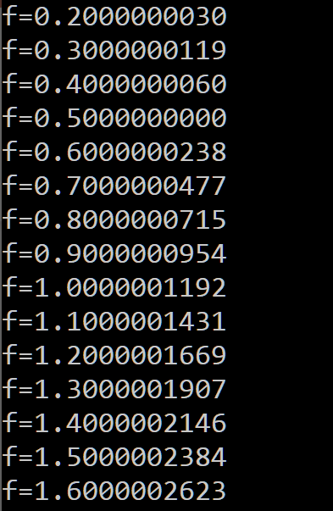
Floating point trouble
Comparing floats for equality is a bad idea!
float f = 0.1;
while (f != 1.0) {
f += 0.1;
}
Notes:
You can not represent 0.1 exactly in floating point

Slide 18

Breakout time!

Slide 19
Breakout exercises
In a shooter game, the accuracy of shooting another player 1200m away is:
Result of count?
1200 = 2¹⁰*(1.17)₁₀ Precision: 2¹⁰*2⁻²³=2⁻¹³
int count = 0;
for (int f = 0; f <= 10; f += 1) {
count++;
}
int count = 0;
for (float f = 0.0; f <= 1.0; f += 0.1) {
count++;
}
count=11
count=10
Notes:
You can not represent 0.1 exactly in floating point

Slide 20
Floating point summary
FP format is based on normalized exponential notation
Floating points are tricky
Precision diminishes as magnitude grows
overflow, rounding error
Many real world disasters due to FP trickiness
Patriot Missile failed to intercept due to rounding error (1991)
Ariane 5 explosion due to overflow in converting from double to int (1996)

