Slide 1
CSO-Recitation 11 CSCI-UA 0201-007
R11: Assessment 09 & Dynamic memory allocation

Slide 2
Today’s Topics
Assessment 09
Dynamic memory allocation
implement your malloc & free

Slide 3
Assessment 09

Slide 4
Q1 Linker
Which of the following statements are true about the C linker?
The linker takes as input C source code and outputs a binary executable file.
The linker has knowledge of the types of all variables declared or accessed in an object file.
The linker performs symbol resolution and relocation to replace each symbol reference to the symbol's address.
If x is a non-static global variable defined in source file obj.c, then x appears in the symbol table of the corresponding object file obj.o
If x is a non-static local variable defined in source file obj.c, then x appears in the symbol table of the corresponding object file obj.o
If x is a function defined in source file obj.c, then x appears in the symbol table of the corresponding object file obj.o
Linker takes .o as input
Notes:
A. Links .o files

Slide 5
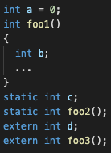
What symbol table contains
Does not contain local variables
Symbol table contains:
Global symbols
Non-static global variables & functions
Local symbols
Static functions & global variables
External symbols
External functions & variables defined in other “.o” files
Notes:
A. Links .o files

Slide 6
Q1 Linker
Which of the following statements are true about the C linker?
The linker takes as input C source code and outputs a binary executable file.
The linker has knowledge of the types of all variables declared or accessed in an object file.
The linker performs symbol resolution and relocation to replace each symbol reference to the symbol's address.
If x is a non-static global variable defined in source file obj.c, then x appears in the symbol table of the corresponding object file obj.o
If x is a non-static local variable defined in source file obj.c, then x appears in the symbol table of the corresponding object file obj.o
If x is a function defined in source file obj.c, then x appears in the symbol table of the corresponding object file obj.o
It has no knowledge of local variables
Notes:
A. Links .o files

Slide 7
Non-static globals & function definition vs declaration
Abnormally, C supports using a function without definition/declaration
(Nasty! Banned by C++)
Normally need to define / declare before use
Define in one file; declare in other files
All resolve to the only definition
Global variables:
Functions:
Defining multiple times => name collision
extern int a; | declaration
int a; | definition
int a=xxx; | definition
extern int func(); | declaration
int func(); | declaration
int func() { … } | definition

Slide 8
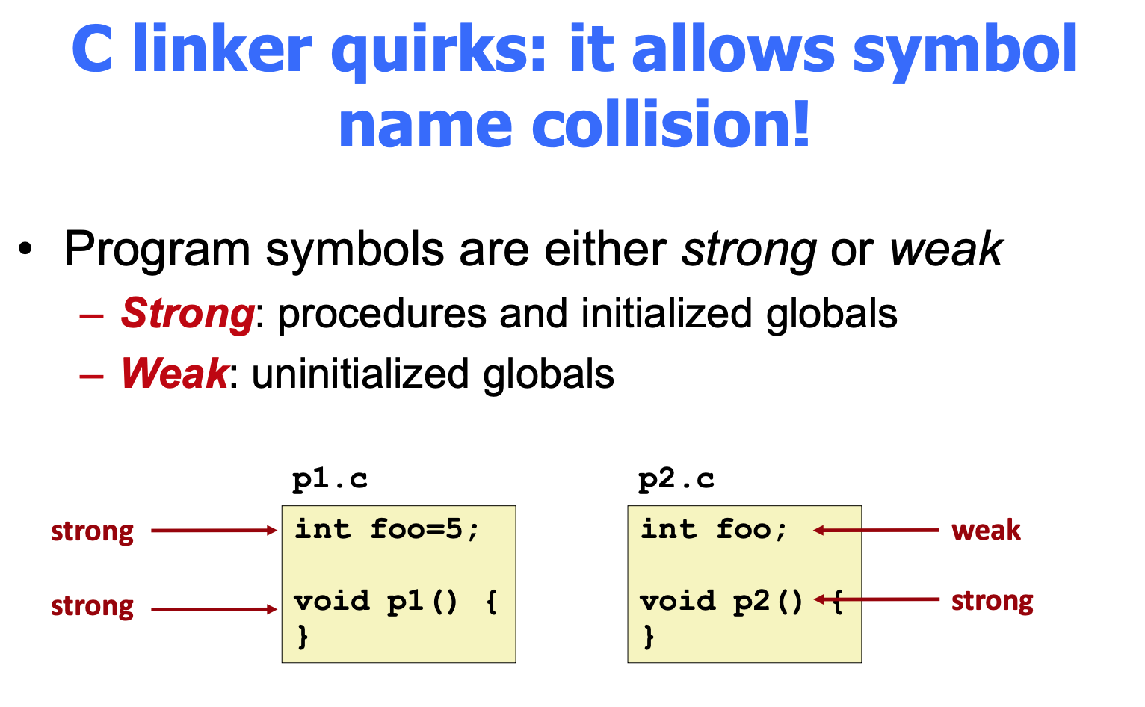
C’s name collision resolution rule
# strong symbols | name collision resolution
>=2 | link error
1 | resolve to strong symbol
0 | resolve to arbitrary one

Slide 9

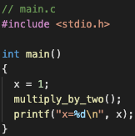
Q2 Linking vs. compile errors
x not declared before use
To generate the executable file, the following 3 steps are performed:
step-1: gcc -c foo.c
step-2: gcc -c main.c
step-3: gcc foo.o main.o
Which of the following statements are true:
There is a compilation error when performing step-1
There is a compilation error when performing step-2
There is a linking error when performing step-3
All 3 steps can be performed successfully. When running ./a.out, the output is 2
All 3 steps can be performed successfully. When running ./a.out, the output is 1
Select C or not, we give full mark

Slide 10
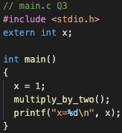
Q3 Linking vs. compile errors
resolved to the only definition of x in foo.c
This question is the same as Q2, except the main.c file has been changed to
Which of the following statements are true:
There is a compilation error when performing step-1
There is a compilation error when performing step-2
There is a linking error when performing step-3
All 3 steps can be performed successfully. When running ./a.out, the output is 2
All 3 steps can be performed successfully. When running ./a.out, the output is 1

Slide 11
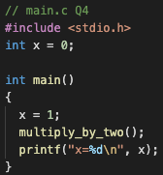
Q4 Linking vs. compile errors
2 non-static global definitions => Name collision!
This question is the same as Q2, except the main.c file has been changed to
Which of the following statements are true:
There is a compilation error when performing step-1
There is a compilation error when performing step-2
There is a linking error when performing step-3
All 3 steps can be performed successfully. When running ./a.out, the output is 2
All 3 steps can be performed successfully. When running ./a.out, the output is 1

Slide 12
Q4 Linking vs. compile errors
2 strong symbols => link error
This question is the same as Q2, except the main.c file has been changed to
Which of the following statements are true:
There is a compilation error when performing step-1
There is a compilation error when performing step-2
There is a linking error when performing step-3
All 3 steps can be performed successfully. When running ./a.out, the output is 2
All 3 steps can be performed successfully. When running ./a.out, the output is 1

Slide 13
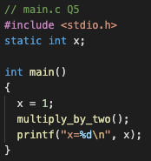
Q5 Linking vs. compile errors
static => 2 different ”x” => no name collision
This question is the same as Q2, except the main.c file has been changed to
Which of the following statements are true:
There is a compilation error when performing step-1
There is a compilation error when performing step-2
There is a linking error when performing step-3
All 3 steps can be performed successfully. When running ./a.out, the output is 2
All 3 steps can be performed successfully. When running ./a.out, the output is 1

Slide 14
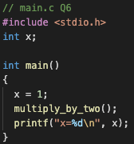
Q6 Linking vs. compile errors
Uninitialized => Weak symbol => resolved to x in foo.c
This question is the same as Q2, except the main.c file has been changed to
Which of the following statements are true:
There is a compilation error when performing step-1
There is a compilation error when performing step-2
There is a linking error when performing step-3
All 3 steps can be performed successfully. When running ./a.out, the output is 2
All 3 steps can be performed successfully. When running ./a.out, the output is 1

Slide 15
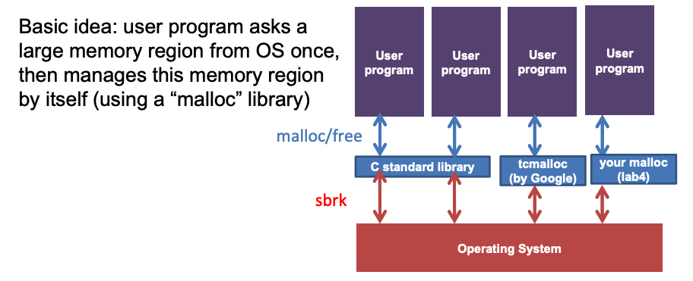
Q7 Basic malloc
Which of the following statements are true w.r.t. malloc in C?
Every call to malloc results in the memory allocator making a syscall (e.g. sbrk) to request memory from OS.
There is a special x86 instruction to handle malloc.
One must use the malloc/free functions provided by C stdlib and cannot not use any other malloc library.
malloc allocates space on the heap memory region of the running program.
malloc allocates space on the stack memory region of the running program.
Notes:
The malloc lib manages a large memory region. Only when it cannot find enough space for the malloc request, will it make the syscall of sbrk to increase the memory region.

Slide 16
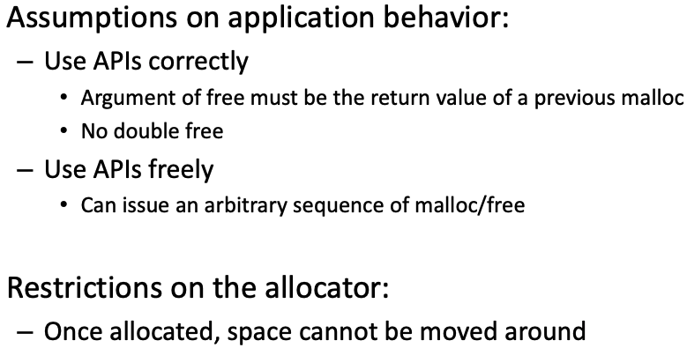
Q8 Malloc design
Which of the following are true w.r.t. C's dynamic memory allocator design?
The design can move previously allocated space to a different location to reduce fragmentation.
The design can assume that users strictly alternate calls to malloc and free.
The design can assume that the argument of free is the return value of some previous malloc calls.
The design can invoke arbitrary <stdlib.h> functions including standard library's malloc/free library calls.
None of the above.

Slide 17
Q9 Alignment
In order to ensure that the payload address is 16-byte aligned, we enforce the rule that the payload size allocated must be a multiple of 16 bytes.
Given a requested allocation of sz bytes in size (aka malloc(unsigned long sz)), which of the following C statement can round sz to the nearest multiples of 16?
sz = sz / 16;
sz = sz + sz % 16;
sz = sz + (sz % 16);
sz = sz + 16 - (sz % 16);
sz = ((size + 0xf) & ~0xf);
Result >= input sz
Result % 16 == 0
Return result nearest to input sz
result < input sz
sz=1, result=2 not multiple of 16
same
sz=16, result=32, but 16 is nearer

Slide 18
Q9 Alignment
Let t be the LSB of sz in hex
t=0 => unchanged (aligned already)
t>0 => push 1 to the 2nd LSB, set LSB=0
In order to ensure that the payload address is 16-byte aligned, we enforce the rule that the payload size allocated must be a multiple of 16 bytes.
Given a requested allocation of sz bytes in size (aka malloc(unsigned long sz)), which of the following C statement can round sz to the nearest multiples of 16?
sz = sz / 16;
sz = sz + sz % 16;
sz = sz + (sz % 16);
sz = sz + 16 - (sz % 16);
sz = ((size + 0xf) & ~0xf);
0xXX…10
result
0xXX…0f
input sz
…
…
0xXX…02
input sz
0xXX…01
input sz
Push 1 if LSB>0
Set LSB=0
0xXX…00
input sz
result

Slide 19
Q9 Alignment
In order to ensure that the payload address is 16-byte aligned, we enforce the rule that the payload size allocated must be a multiple of 16 bytes.
Given a requested allocation of sz bytes in size (aka malloc(unsigned long sz)), which of the following C statement can round sz to the nearest multiples of 16?
sz = sz / 16;
sz = sz + sz % 16;
sz = sz + (sz % 16);
sz = sz + 16 - (sz % 16);
sz = ((size + 0xf) & ~0xf);
R = size + 15 – (size + 15) % 16
size + 15
Clear the lowest 4 bits:
- (size + 15) % 16

Slide 20
Q9 Alignment
In order to ensure that the payload address is 16-byte aligned, we enforce the rule that the payload size allocated must be a multiple of 16 bytes.
Given a requested allocation of sz bytes in size (aka malloc(unsigned long sz)), which of the following C statement can round sz to the nearest multiples of 16?
sz = sz / 16;
sz = sz + sz % 16;
sz = sz + (sz % 16);
sz = sz + 16 - (sz % 16);
sz = ((size + 0xf) & ~0xf);
R = size + 15 – (size + 15) % 16
size % 16 == 0: R = size + 15 – 15 = size; R % 16 == 0
size % 16 != 0:
size + 15
Clear the lowest 4 bits:
- (size + 15) % 16

Slide 21
Q9 Alignment
In order to ensure that the payload address is 16-byte aligned, we enforce the rule that the payload size allocated must be a multiple of 16 bytes.
Given a requested allocation of sz bytes in size (aka malloc(unsigned long sz)), which of the following C statement can round sz to the nearest multiples of 16?
sz = sz / 16;
sz = sz + sz % 16;
sz = sz + (sz % 16);
sz = sz + 16 - (sz % 16);
sz = ((size + 0xf) & ~0xf);
R = size + 15 – (size + 15) % 16
size % 16 == 0: R = size + 15 – 15 = size; R % 16 == 0
size % 16 != 0:
 | … |  | …
0
16
16 * n
16 * (n + 1)
size + 15
Clear the lowest 4 bits:
- (size + 15) % 16

Slide 22
Q9 Alignment
In order to ensure that the payload address is 16-byte aligned, we enforce the rule that the payload size allocated must be a multiple of 16 bytes.
Given a requested allocation of sz bytes in size (aka malloc(unsigned long sz)), which of the following C statement can round sz to the nearest multiples of 16?
sz = sz / 16;
sz = sz + sz % 16;
sz = sz + (sz % 16);
sz = sz + 16 - (sz % 16);
sz = ((size + 0xf) & ~0xf);
R = size + 15 – (size + 15) % 16
size % 16 == 0: R = size + 15 – 15 = size; R % 16 == 0
size % 16 != 0:
size
aligned
 | … |  | …
0
16
16 * n
16 * (n + 1)
size + 15
Clear the lowest 4 bits:
- (size + 15) % 16

Slide 23
Q9 Alignment
In order to ensure that the payload address is 16-byte aligned, we enforce the rule that the payload size allocated must be a multiple of 16 bytes.
Given a requested allocation of sz bytes in size (aka malloc(unsigned long sz)), which of the following C statement can round sz to the nearest multiples of 16?
sz = sz / 16;
sz = sz + sz % 16;
sz = sz + (sz % 16);
sz = sz + 16 - (sz % 16);
sz = ((size + 0xf) & ~0xf);
gap = (size + 15) % 16
R = size + 15 – (size + 15) % 16
size % 16 == 0: R = size + 15 – 15 = size; R % 16 == 0
size % 16 != 0:
size + 15
 | … |  | …
0
16
16 * n
16 * (n + 1)
size + 15
Clear the lowest 4 bits:
- (size + 15) % 16

Slide 24
Q9 Alignment
In order to ensure that the payload address is 16-byte aligned, we enforce the rule that the payload size allocated must be a multiple of 16 bytes.
Given a requested allocation of sz bytes in size (aka malloc(unsigned long sz)), which of the following C statement can round sz to the nearest multiples of 16?
sz = sz / 16;
sz = sz + sz % 16;
sz = sz + (sz % 16);
sz = sz + 16 - (sz % 16);
sz = ((size + 0xf) & ~0xf);
R = size + 15 – (size + 15) % 16
size % 16 == 0: R = size + 15 – 15 = size; R % 16 == 0
size % 16 != 0:
size + 15 – (size + 15) % 16
 | … |  | …
0
16
16 * n
16 * (n + 1)
size + 15
Clear the lowest 4 bits:
- (size + 15) % 16

Slide 25
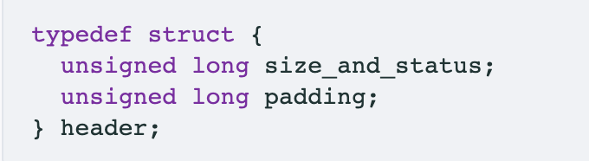
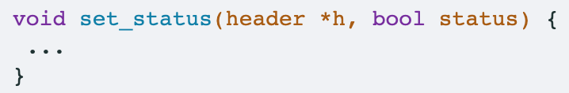
Q10 Set block status
Suppose in the implicit list design, the block header is defined as (Lecture slides 22 and 27). Please write a function to set the status of the chunk while leaving its size unchanged? What's the body of the set_status function?
h->size_and_status |= (unsigned long)status;
h->size_and_status &= (unsigned long)status;
h->size_and_status = (h->size_and_status & ~0x1) | (unsigned long)status;
h->size_and_status = ((h->size_and_status >> 1) << 1) | (unsigned long)status;
h->size_and_status ^= (unsigned long)status;

Slide 26
Q10 Set block status
Keep the highest bits.
Suppose in the implicit list design, the block header is defined as (Lecture slides 22 and 27). Please write a function to set the status of the chunk while leaving its size unchanged? What's the body of the set_status function?
h->size_and_status |= (unsigned long)status;
h->size_and_status &= (unsigned long)status;
h->size_and_status = (h->size_and_status & ~0x1) | (unsigned long)status;
h->size_and_status = ((h->size_and_status >> 1) << 1) | (unsigned long)status;
h->size_and_status ^= (unsigned long)status;
size | status (1bit)

Slide 27
Q10 Set block status
Keep the highest bits.
Suppose in the implicit list design, the block header is defined as (Lecture slides 22 and 27). Please write a function to set the status of the chunk while leaving its size unchanged? What's the body of the set_status function?
h->size_and_status |= (unsigned long)status;
h->size_and_status &= (unsigned long)status;
h->size_and_status = (h->size_and_status & ~0x1) | (unsigned long)status;
h->size_and_status = ((h->size_and_status >> 1) << 1) | (unsigned long)status;
h->size_and_status ^= (unsigned long)status;
size | status (1bit)

Slide 28
Dynamic Memory Allocation
For when static memory isn’t enough

Slide 29
Malloc using Implicit list
Structure of implicit list
Malloc
Where to place an allocation?
Splitting a free block
Free
Coalescing a free block
Realloc

Slide 30
Malloc using Implicit list (lab4)
Structure of implicit list
Implicit list means that it does not use pointers explicitly, but it can find the next chunk just like a linked list.
A chunk:
size
status
Payload (data+padding)
header
(16 bytes)
16B
Application data
(allocated blocks only)
(multiple of 16 bytes)
32B
e.g. p=malloc(20);

Slide 31
Malloc using Implicit list
Malloc:
Find a large enough free chunk
Ask_os_for_chunk if not found
Place it
Split
Set status & size

Slide 32
Malloc using Implicit list – find the chunk
Where to place an allocation?
Different algorithms:
First fit → easy & fast; cause fragmentation at beginning of the heap
Best fit → good for utilization; slower
Next fit → faster than first fit; even worse fragmentation

Slide 33
Malloc using Implicit list – place it
Splitting a free block
Compute the remaining size
If < MIN_CHUNK_SZ
return // don’t split
else:
Split into 2 chunks, and set their size & status
How large is it?
size
status
Payload (data+padding)
header
(16 bytes)
16B
Application data
(allocated blocks only)
(multiple of 16 bytes)
>=
16B

Slide 34
Malloc using Implicit list – free
h
free
free
Alloc
Alloc
Alloc
Alloc
free
nh
merge
nh2
free(void *p):
h=payload2header(p) // get chunk pointer
Set status of the chunk h
Coalescing a free block: Merge h with its next free neighbor
If next_chunk(h) is free {
Increase h’s size by next chunk’s size
}
Any problem with the impl.? Can we do better?
Use while instead of if
h
free
free
free
free
Alloc
Alloc
Alloc
free
nh
merge
nh2
merge

Slide 35
Why will there be multiple consecutive free chunks?
Free h2
Free h3
Free h1
Root cause:
Cannot coalesce with previous chunk
h1
Alloc
Alloc
Alloc
Alloc
Alloc
Alloc
Alloc
Free
Alloc
Alloc
Alloc
Alloc
Alloc
Free
Free
Alloc
Alloc
Alloc
Free
Free
Free
Alloc
Alloc
Alloc
h2
h3
no merge

Slide 36
Why will there be multiple consecutive free chunks?
Free h2
Free h3
Root cause:
Cannot coalesce with previous chunk
Solution
(not required in lab4
when implementing implicit list)
size
status
Payload (data+padding)
size
status
header
(16 bytes)
Cannot check the status of the previous chunk.
(multiple of 16 bytes)
footer
(16 bytes)

Slide 37
Malloc using Implicit list – realloc
Realloc(void *p, size_t size): here only discuss p != NULL
Resize p’s memory region to the given size
Example use case: p points to an array;
array too small for inserting new element => increase the array size
Elements deleted => shrink the array size
Brute force implementation:
q=Malloc(size);
Copy p to q;
Free(p);
Problem?
Inefficient. Consider shrinking case.

Slide 38
Malloc using Implicit list – realloc
h=payload2header(p); // get current chunk pointer
Case 1. Shrinking
Split
h
Alloc
…
alloc
free

Slide 39
Malloc using Implicit list – realloc
h=payload2header(p); // get current chunk pointer
Case 2. Expanding
Case 2.1. there is enough space in the next chunk (nh) to accommodate the increased size
Utilize the space in the next chunk.
h
alloc
free
alloc
nh

Slide 40
Malloc using Implicit list – realloc
h=payload2header(p); // get current chunk pointer
Case 2. Expanding
Case 2.2. next chunk is allocated or there is no enough space
Fall back to the brute force approach
h
alloc
alloc
nh

Slide 41
Malloc using Implicit list
Performance tip:
set debug to false
wrap any sanity check (e.g., assertions) you wrote with if (debug). E.g.,
if (debug) {
mm_checkheap(true);
}

Slide 42
Malloc using Explicit free list
Free_head
h1
free
Alloc
Alloc
Alloc
free
Implicit list is slow: each malloc can be O(#chunks)
Explicit free list: O(#free chunks)
Chain the free chunks only into a list
Important: list not necessarily in the same order as the chunks
h2
h3
h4
h5
Link list: h1 <--> h5

Slide 43
Malloc using Explicit free list
Free_head
h1
free
Alloc
Alloc
Alloc
free
Implicit list is slow: each malloc can be O(#chunks)
Explicit free list: O(#free chunks)
Chain the free chunks only into a list
Important: list not necessarily in the same order as the chunks
h2
h3
h4
free
h5

Slide 44
Malloc using Explicit free list
Free_head
h1
free
Alloc
Alloc
Alloc
free
Implicit list is slow: each malloc can be O(#chunks)
Explicit free list: O(#free chunks)
Chain the free chunks only into a list
Important: list not necessarily in the same order as the chunks
h2
h3
h4
free
h5
Link list: h4 <--> h1 <--> h5
When free a new block:
Update the head
Always insert the new free block at the head

Slide 45
Malloc using Explicit free list
Free_head
h1
free
Alloc
Alloc
Alloc
free
Implicit list is slow: each malloc can be O(#chunks)
Explicit free list: O(#free chunks)
Chain the free chunks only into a list
Important: list not necessarily in the same order as the chunks
h2
h3
h4
free
h5
Challenge: how to coalesce the consecutive free chunks?
h4 and h5 are not adjacent in the explicit link list
Traverse the link list?
No! Borrow the idea from implicit list.
Using header and footer
Link list: h4 <--> h1 <--> h5
When free a new block:
Update the head
Always insert the new free chunk at the head

Slide 46
Malloc using Explicit free list
The structure
Allocated chunk:
Free chunk:
size | status
header padding
Payload (data+padding)
size | status
padding
header
(16 bytes)
size | status
header padding
next
prev
Payload (data+padding)
size | status
padding
header
(16 bytes)
p
16 bytes
(multiple of 16 bytes)
(multiple of 16 bytes)
footer
(16 bytes)
footer
(16 bytes)

Slide 47
Implement Malloc using Explicit free list
h1
free
Alloc
free
Alloc
free
Malloc <malloc(size)>
find a free chunk (in your linked list – linked list traverse)
delete this chunk from the linked list
ask the OS for chunk if not found
Split chunk
If split succeeds
set 1st chunk status to allocated
insert the 2nd chunk to the linked list
return pointer to the payload
h2
h3_1
alloc
Insert here
h3
h3_2
free
h4
h5
Link list: h1 <---> h5 <---> h3
Link list: h1 <---> h5
Link list: h3_2 <--> h1 <---> h5

Slide 48
Implement Malloc using Explicit free list
Need to coalesce these three.
h1
free
Alloc
free
Alloc
free
Free <free(p)>
go to the header from payload
free the chunk
set this chunk status to be free
initialize the next & prev pointer
Coalesce free chunks
Use footer to find if consecutive chunks are free
If so, delete it from the linked list and merge
insert this new free block into the linked list
h2
h3_1
alloc
h3
h3_2
free
free
h4
free
h5
Link list: h3_2 <--> h1 <--> h5
=> h4 <--> h3_2 <--> h1 <--> h5
How to merge the nodes which are not adjacent to each other in the list?

Slide 49
Implement Malloc using Explicit free list
How to merge the nodes which are not adjacent to each other in the list?
=> Keep 1 node, and delete others
h1
free
Alloc
free
Alloc
free
h2
Link list: h3_2 <--> h1 <--> h5 <--> h’
h4 <--> h3_2 <--> h1 <--> h5 <--> h’
h3_2 (with updated size) <--> h1 <--> h’
h3_1
alloc
h3
h3_2
free
h4
free
h5

Slide 50
Implement Malloc using Explicit free list
h1
free
Alloc
free
Alloc
free
Free <free(p)>
go to the header from payload
free the chunk
set this chunk status to be free
initialize the next & prev pointer
Coalesce free chunks
Use footer to find if consecutive chunks are free
If so, delete it from the linked list and merge
insert this new free block into the linked list
h2
h3_1
alloc
h3
free
h3_2
free
free
free
h4
free
h5
Link list: h3_2 <--> h1 <---> h5
Coalesce with h5
Link list: h3_2 <--> h1
Coalesce with h3_2
Link list: h1
Insert h3_2
Link list: h3_2 <--> h1

