Slide 1
Building an ALU
Jinyang Li

Slide 2
What we’ve learnt so far
Basic logic design
Logic circuits == Boolean expressions
How to build a combinatorial logic circuit
Specify the truth table
Output is the sum of products (implemented in PLA, programmable logic array)
Common CL
Decoder
Multiplexer
in3
out3
out2
in2
out
decoder
Mux
out1
in1
out0
in0
2
2
S

Slide 3
Lesson plan
ROM (another way to implement CL)
ALU
Logical ops: AND/OR
Arithmetic ops: addition, subtraction…

Slide 4
ROM (read-only memory)
A combinatorial component for storing (fixed) data
Programmed in the factory or field
Width: m bits per entry
n x m ROM
log₂n inputs
for address
....
Height: n entries
...
m outputs

Slide 5
ROM (read-only memory)
A n x m ROM can store the truth table for m functions defined on log₂n variables.
2 x 2 ROM
A | B | X1 | X0
0 | 0 | 0 | 1
0 | 1 | 0 | 0
1 | 0 | 1 | 0
1 | 1 | 1 | 1
00:
01:
10:
11:
01
00
10
11
A
B
X1
X0

Slide 6
ROM (read-only memory)
Both ROM and PLA can impl. boolean functions
ROM is not as efficient for sparse functions
# of entries grows exponentially with inputs
ROM is easier to change if function changes

Slide 7
Array of logic elements
So far, our circuits work on 1-bit inputs/outputs
How to build circuits with n-bit inputs/outputs?
Bus: a collection of data lines treated together as a single signal
in3
64
in2
64
64
64
out
in1
MUX
64
in0
2
sel

Slide 8
Array of logic elements
64-bit multiplexor: an array of 64 1-bit multiplexors
0th bit (LSB) of input
In3₀
In2₀
In1₀
MUX
Out₀
In0₀
1st bit of input
In3₁
In2₁
In1₁
MUX
In0₁
Out₁
…
63rd bit of input (MSB)
In3₆₃
In2₆₃
In1₆₃
MUX
Out₆₃
In0₆₃
sel

Slide 9
ALU overview
Example
Op
00 | A & B
01 | A | B
10 | A + B
operation
A
ALU
Result
B

Slide 10
Implementing ALU: AND
operation
A&B
A|B
Result
Mux
A+B

Slide 11
Implementing ALU: AND
operation
A&B
A
Result
A|B
Mux
A+B
B

Slide 12
Implementing ALU: OR
operation
A&B
A
Result
A|B
Mux
A+B
B

Slide 13
Implementing ALU: adder
operation
A&B
A
Result
A|B
Mux
+
A+B
B

Slide 14
Implementing the adder: 1-bit adder
Recall how base-2 addition works
carryOut at pos3
carryOut at pos2 = carryIn at pos3
carryOut at pos1 = carryIn at pos2
carryOut at pos0 = carryIn at pos1
carryIn at pos0
0
0
1
1
0
0 0 1 1
c₄ c₃ c₂ c₁ c₀
a₃ a₂ a₁ a₀
+
1 0 0 1
+
b₃ b₂ b₁ b₀
1 1 0 0
s₃ s₂ s₁ s₀
At each bit position (e.g. pos1), take as inputs carryIn(c1), a1, b1,
and compute sum (s1), carryout(c2). Feed c2 to the next bit position as carryIn.

Slide 15
1-bit adder
CarryIn
A
+
Sum
B
CarryOut

Slide 16
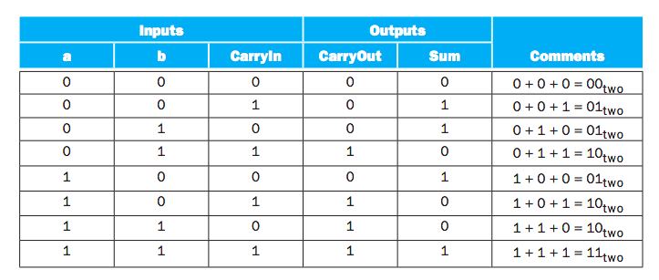
1-bit adder
CarryIn
A
+
Sum
B
CarryOut
Brute force PLA

Slide 17
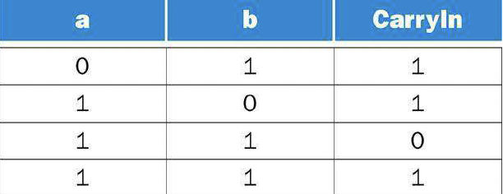
1-bit adder: computing CarryOut
Rows where CarryOut is 1
Notes:
c_out = ~a*b*c_in + a * ~b * c_in + a * b * ~c_in + a * b * c_in = (~a*b*c_in + a * b * c_in)+ (a * ~b * c_in+a * b * c_in) + (a * b * ~c_in +a * b * c_in)
= b * c_in + a*c_in + a*b
(Note that x === x + x for any Boolean formula x)

Slide 18

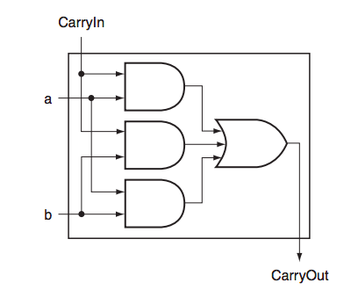
1-bit adder: computing CarryOut

Slide 19
1-bit adder: computing Sum

Slide 20







Subtraction
Idea: a – b = a + (-b)
How to calculate 2’s complement?

Slide 21
Subtraction in 1-bit ALU
Set Binvert=1
carryIn=1
Op=(10)₂
to compute A-B
operation
BInvert
carryIn
A
A&B
Result
A|B
Mux
+
A±B
B
Subtraction reuses hardware for addition
Mux
carryOut

Slide 22
Extend 1-bit ALU to 64-bit
operation
BInvert
carryIn
A
A&B
Result
A|B
Mux
+
A±B
B
Mux
carryOut

Slide 23
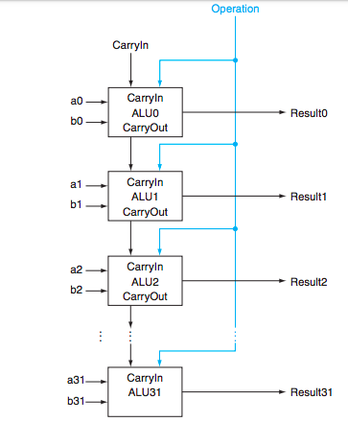
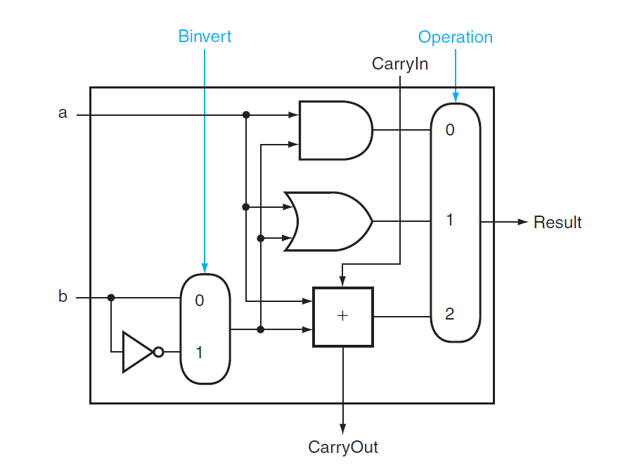
Extend 1-bit ALU to 64-bit ALU
a63
Result63
b63
ALU63

Slide 24
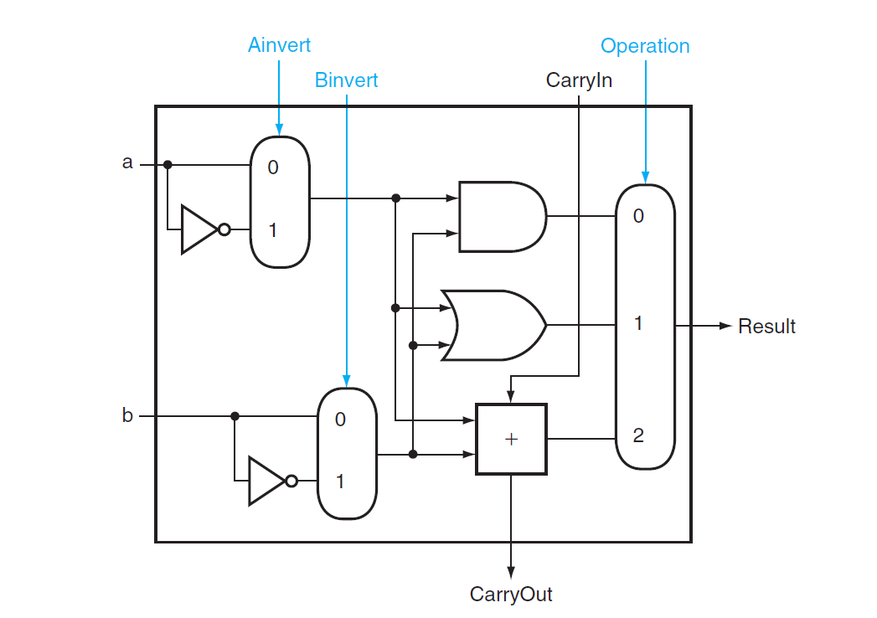
Extend ALU to include NOR
Set Binvert=1, Ainvert=1
Op=(00)₂
to compute a NOR b

Slide 25
Extend ALU to include slt
RISC-V slt (set-less-than) instruction
Result = (A < B) ? 1 : 0 Signed
X86 equivalent: cmpq %rbx,%rax setl %rcx
New input “Less”:
always 0 for bits1:63
Set to 1 for bit0 if a<b
0
1
2
Less
3
ALU unit for bits 0-62

Slide 26
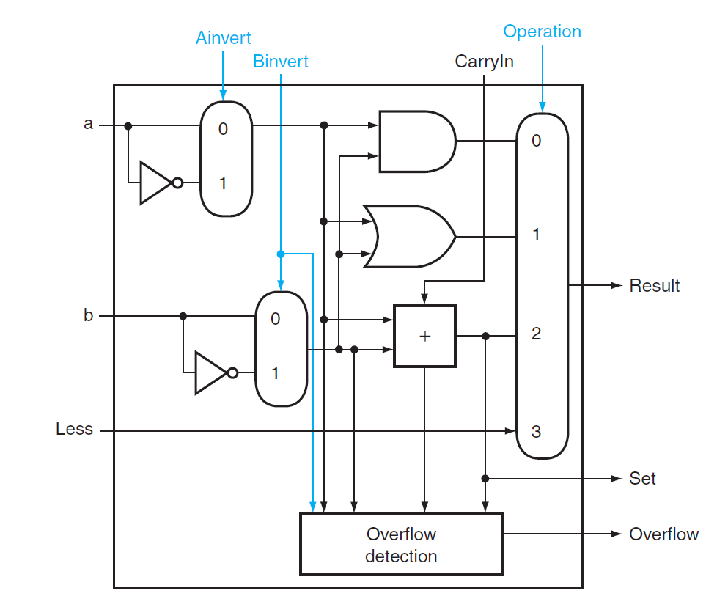

Extend ALU to include slt
A < B iff:
(A-B) is negative (MSB is 1)
(A-B) overflowed
But not both
Wire to “Less” input of the least significant bit ALU
MSB
Set
XOR
ALU unit for MSB(bit63)

Slide 27
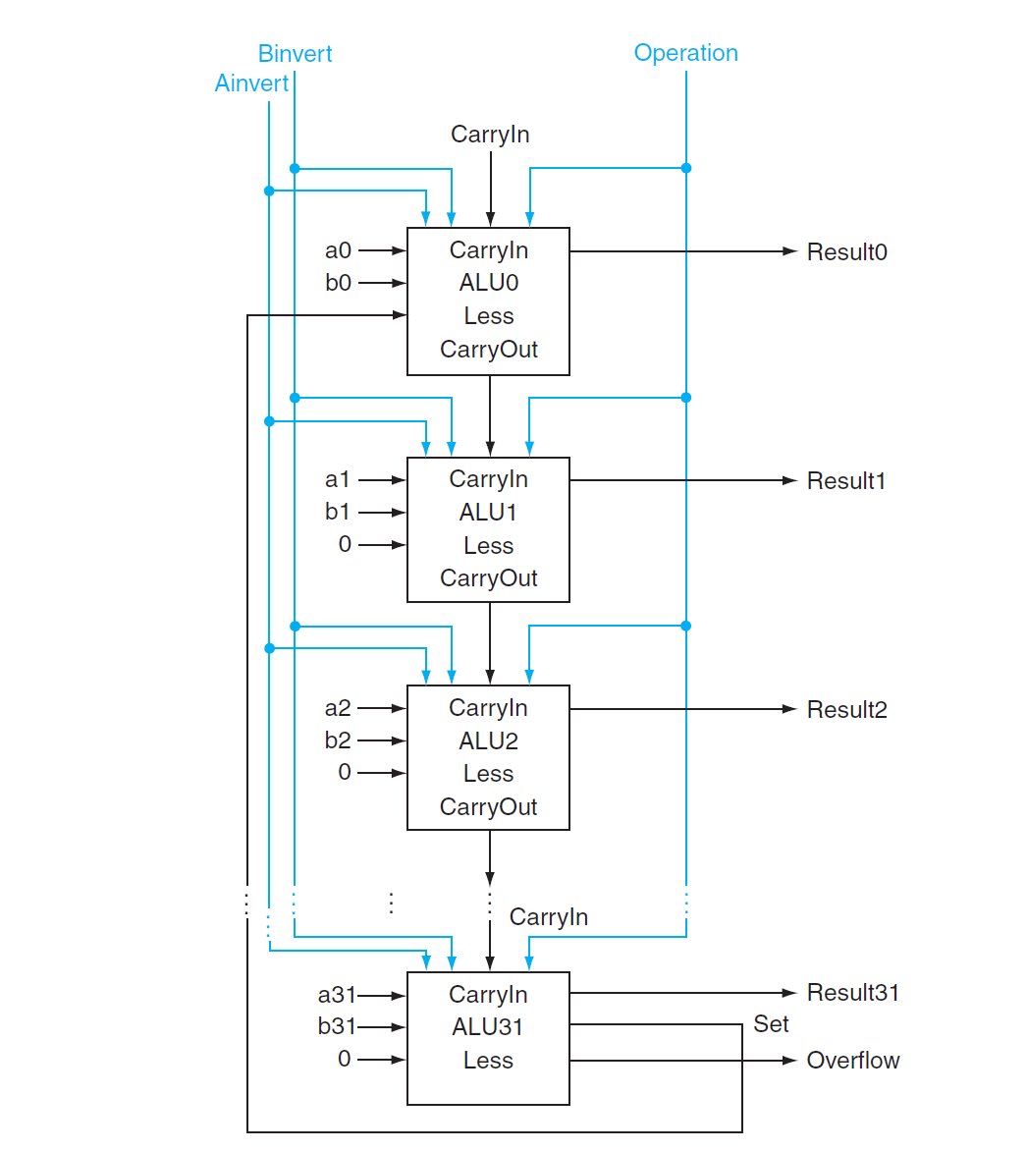
Extend ALU to include slt
a63
b63
Result63
ALU63

Slide 28
Downside of ripple carry?
Must wait for sequential evaluation of all 64 1-bit adders
a63
ALU63
Result63
b63

Slide 29
In search of a faster adder
Ripple carry:
Delay: 64, Gate count: 64*c
Brute-force (truth table->PLA)
Delay: 2, Gate count: O(2⁶⁴⁺⁶⁴)
Clever designs in between?
Idea #1: (Carry lookahead) compute multiple carry-bits at a time

Slide 30
Faster adder: carry lookahead
Idea #1: (Carry lookahead) compute multiple carry-bits at a time
CarryIn to i-th bit
CarryOut of i-th bit
= CarryOut of (i-1)-th bit
= CarryIn of (i+1)-th bit
c_{i+1} = a_{i}b_{i} + (a_{i} + b_{i})c_{i}
c_{i+1} = g_{i} + p_{i}c_{i}
g_{i} = a_{i}b_{i} , p_{i}= a_{i} + b_{i}
Generate
Propagate
p_{i}
g_{i}
generates carryOut
regardless of carryIn
propagates carryIn
to carryOut

Slide 31
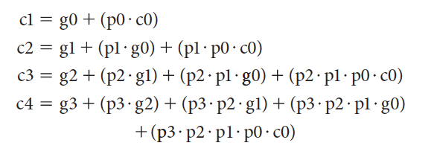
Faster adder: carry lookahead
Idea #1: (Carry lookahead) compute multiple carry-bits at a time
Computing all carry-bits of a 4-bit adder:
Delay?
3
4-bit ripple carry delay: 2 * 4

Slide 32



Faster adder: carry lookahead
Idea #1: (Carry lookahead) compute multiple carry-bits at a time
Computing all result bits in a 4-bit adder:
Notes:
This is the same as in Slide 18.

Slide 33
Faster adder: carry lookahead
Build a 16-bit adder with carry-ahead 4-bit adders
carryIn (C0)
a[0:3]
P0 = p3· p2· p1· p0
ALU0
carry
lookahead
b[0:3]
P0
p0
P1 = p7· p6· p5· p4
G0
g0
P2 = p11· p10· p9· p8
C1
P3 = p15· p14· p13· p12
a[4:7]
ALU1
P1
p1
b[4:7]
G1
g1
G0 = g3+ p3·g2 +
p3· p2·g1+ p3· p2·p1 ·g0
C2
G1 = g7+ p7·g6 +
p7· p6·g5+ p7· p6·p5 ·g4
a[8:11]
ALU2
p2
P2
b[8:11]
G2
g2
G2 = g11+ p11·g10 +
p11· p10·g9+ p11· p10·p9·g8
C3
a[12:15]
p3
G3 = g15+ p15·g14 +
p15·p14·g13+ p15·p14·p13·g12
P3
ALU3
g3
b[12:15]
G3
carryOut (C4)

Slide 34
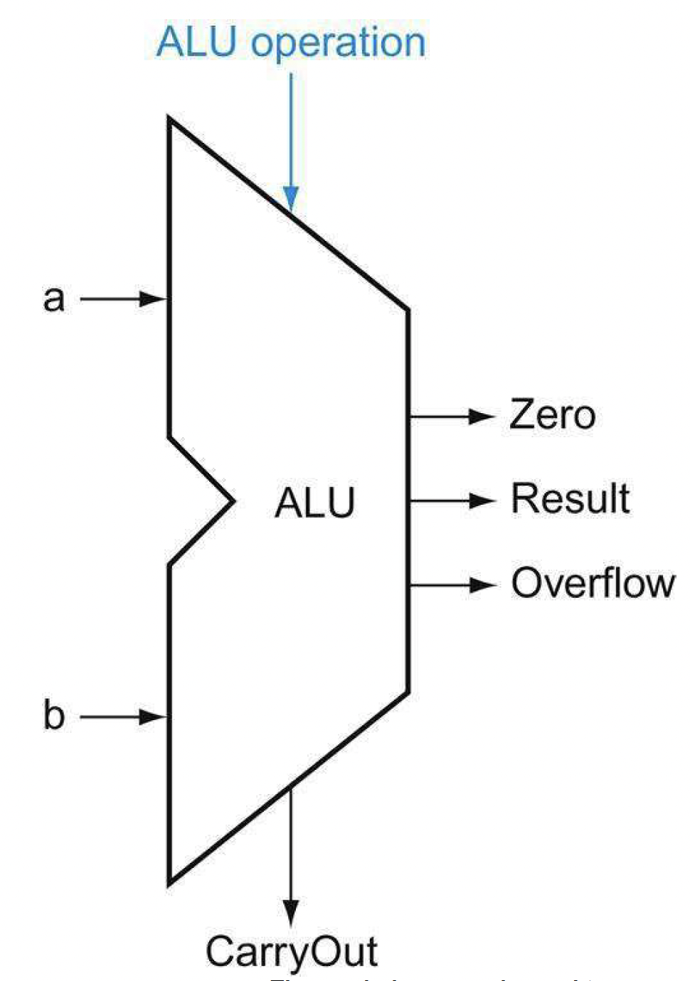
Summary
ROM
ALU
Addr
output
2 x 2 ROM
00:
01:
10:
11:
01
00
10
11
A
B
X1
X0

