Slide 1
Characters, strings, structs, malloc
Jinyang Li

Slide 2
This lecture
Characters
Strings
Structs
Dynamic Memory Allocation

Slide 3
Characters

Slide 4
How to represent text characters?
How to associate bit patterns to integers?
base 2
2’s complement
How to associate bit patterns to floats?
IEEE floating point representation (based on normalized scientific notation)
How to associate bit patterns to characters?
by convention
ASCII, UTF

Slide 5
ASCII: American Standard Code for Information Exchange
Developed in 60s, based on the English alphabet
use one byte (with MSB=0) to represent each character
How many unique characters can be represented?
128

Slide 6
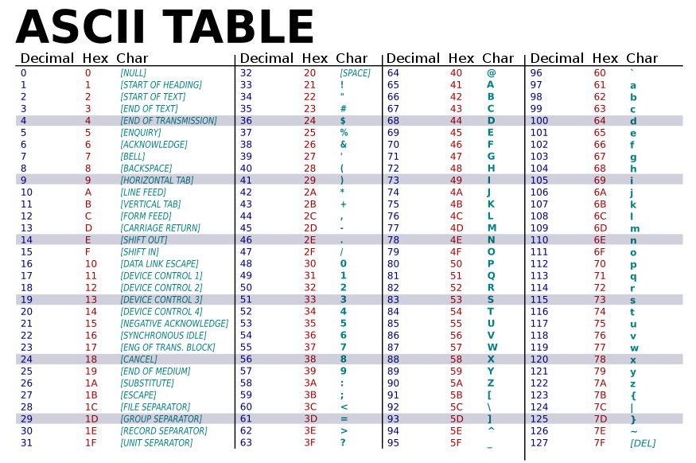

Slide 7
C exercise 1: tolower
// tolower returns the corresponding
// lowercase character for c if c is an
// uppercase letter. Otherwise, it returns c.
char tolower(char c) {
}
int main() {
char c = ‘A’;
c = tolower(c);
...
}

Slide 8
C exercise 1: tolower
// tolower returns the corresponding
// lowercase character for c if c is an
// uppercase letter. Otherwise, it returns c.
char tolower(char c) {
// test if c is an uppercase letter
if (c < ‘A’ || c > ‘Z’) {
return c;
}
}

Slide 9
C exercise 1: tolower
// tolower returns the corresponding
// lowercase character for c if c is an
// uppercase letter. Otherwise, it returns c.
char tolower(char c) {
// test if c is an uppercase letter
if (c < ‘A’ || c > ‘Z’) {
return c;
}
return c + (‘a’ – ‘A’);
}
C’s standard library includes
tolower, toupper

Slide 10
C exercise 2: toDigit
// toDigit returns the corresponding integer for c
// if c is a valid digit character, e.g ‘1’, ‘2’,
// Otherwise, it returns -1.
int toDigit(char c) {
}
int main() {
int d = toDigit(‘8’);
printf(“int is %d, multiply-by-2 %d\n”, d, 2*d);
}

Slide 11
C exercise 2: toDigit
// toDigit returns the corresponding integer for c
// if c is a valid digit character, e.g ‘1’, ‘2’,
// Otherwise, it returns -1.
int toDigit(char c) {
// test if c is a valid character
if (c < ‘0’ || c > ‘9’) {
return -1;
}
}
int main() {
int d = toDigit(‘8’);
printf(“int is %d, multiply-by-2 %d\n”, d, 2*d);
}

Slide 12
C exercise 2: toDigit
// toDigit returns the corresponding integer for c
// if c is a valid digit character, e.g ‘1’, ‘2’,
// Otherwise, it returns -1.
int toDigit(char c) {
// test if c is a valid character
if (c < ‘0’ || c > ‘9’) {
return -1;
}
return c – ‘0’;
}
int main() {
int d = toDigit(‘8’);
printf(“int is %d, multiply-by-2 %d\n”, d, 2*d);
}

Slide 13
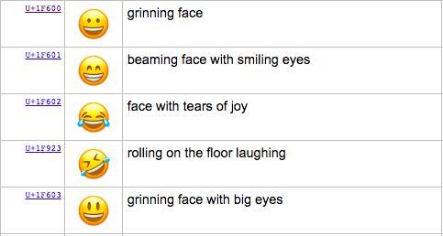
The Modern Standard: UniCode
ASCII can only represent 128 characters
How about Chinese, Korean, all of the worlds languages? Symbols? Emojis?
Unicode standard represents >135,000 characters

Slide 14
UTF-8
UTF-8 is one encoding form for Unicode
use 1, 2, or 4 byte to represent a character
Unicode for ASCII characters have the same ASCII value → UTF-8 one byte code is the same as ASCII
C has no primitive support for Unicode

Slide 15
C Strings

Slide 16
Strings
String is represented as an array of chars.
Array has no space to encode its length.
How to determine string length?
explicitly pass around an integer representing length
// tolower_string turns every character in character array s
// into lower case
void tolower_string(char *s, int len) {
for (int i = 0; i < len; i++) {
s[i] = tolower(s[i]);
}
}

Slide 17
Strings
String is represented as an array of chars.
Array has no space to encode its length.
How to determine string length?
explicitly pass around an integer representing length
C string stores a NULL character to mark the end (by convention)
void tolower_string(char *s) {
}

Slide 18
Strings
String is represented as an array of chars.
Array has no space to encode its length.
How to determine string length?
explicitly pass around an integer representing length
C string stores a NULL character to mark the end (by convention)
void tolower_string(char *s) {
int i = 0;
while (s[i] != ‘\0’) {
s[i] = tolower(s[i]);
i++;
}
}

Slide 19
Copying string?
does this make a copy of “hi”?
...
char s[3] = {‘h’,‘i’,‘\0’};
char *h;
h = s;
h[0] = ‘H’;
printf(“s=%s h=%s\n”,s,h);
0x00
‘i’
s:
‘h’
0xdeadbefef12345678
...
0xde
…
h:
0x78
...

Slide 20
Copying string?
does this make a copy of “hi”?
char s[3] = {‘h’,‘i’,‘\0’};
char h[3];
h = s;
h[0] = ‘H’;
printf(“s=%s h=%s\n”,s,h);

Slide 21
Copying string
void strcpy(char *dst, char *src)
{
}
int main()
{
char s[3] = {‘h’,‘i’,‘\0’};
char h[3];
strcpy(h, s);
h[0] = ‘H’;
printf(“s=%s h=%s\n”,s,h);
}

Slide 22
Copying string
void strcpy(char *dst, char *src) {
int i = 0;
while (src[i] != ‘\0’) {
dst[i] = src[i];
i++;
}
}
int main() {
char s[3] = {‘h’,‘i’,‘\0’};
char h[3];
strcpy(h, s);
h[0] = ‘H’;
printf(“s=%s h=%s\n”,s,h);
}
strcpy is included in C std library.

Slide 23
Copying string
void strcpy(char *dst, char *src) {
int i = 0;
while (src[i] != ‘\0’) {
dst[i] = src[i];
i++;
}
}
int main() {
char s[3] = {‘h’,‘i’,‘\0’};
char h[2];
strcpy(h, s);
h[0] = ‘H’;
printf(“s=%s h=%s\n”,s,h);
}
Results in out-of-bound write!
Buffer overflow!

Slide 24
Copying string
void strncpy(char *dst, char *src, int n) {
int i = 0;
while (src[i] != ‘\0’ && i < n) {
dst[i] = src[i];
i++;
}
}
int main() {
char s[3] = {‘h’,‘i’,‘\0’};
char h[2];
strncpy(h, s, 2);
h[0] = ‘H’;
printf(“s=%s h=%s\n”,s,h);
}
strncpy is included in C std library.

Slide 25
A different way of initializing string
...
char s1[3] = {‘h’,‘i’,‘\0’};
//equivalent to
//char s1[3] = “hi”;
char *s2 = “bye”;
s1[0] = ‘H’;
s2[0] = ‘B’;
printf(“s1=%s s2=%s\n”,s1,s2);
OK
Segmentation fault (bus error)

Slide 26
A different way of initializing string
...
char s1[3] = {‘h’,‘i’,‘\0’};
//equivalent to
//char s1[3] = “hi”;
char *s2 = “bye”;
s1[0] = ‘H’;
s2[0] = ‘B’;
printf(“s1=%s s2=%s\n”,s1,s2);
0x00
‘i’
s1:
‘h’
0xdeadbefef12345678
...
0x00
…
s2:
0x21
...
0x00
‘e’
read-only
memory
‘y’
‘b’
0x0000000087654321

Slide 27
The Atoi function
// atoi returns the integer
// corresponding to the string of digits
int atoi(char *s)
{
}
int main()
{
char *s= “123”;
printf(“integer is %d\n”, atoi(s));
}

Slide 28
The Atoi function
// atoi returns the integer
// corresponding to the string of digits
int atoi(char *s) {
int result = 0;
int i = 0;
while (s[i] >= '0' && s[i] <= '9') {
result = result * 10 + (s[i] -'0');
i++;
}
return result;
}
‘1’ | ‘2’ | ‘3’ | ‘\0’
result = 1
result = 1*10+2
result = 12*10+3
end loop

Slide 29
Array of pointers
char* names[3] = {
“alice”,
“bob”,
“clark”
};
3*8 bytes
char **namep;
namep = names;
printf(“name is %s”, namep[1]);
names:
“clark”
“bob”
“alice”

Slide 30
The most commonly used array of pointers: argv
int main(int argc, char **argv)
{
for (int i = 0; i < argc; i++) {
printf(“%s\n”, argv[i]);
}
}
$ ./a.out 1 2 3
./a.out 1 2 3
argv[0] is the name of the executable

Slide 31
Structs
Struct stores fields of different types contiguously in memory

Slide 32
Structure
Array: a block of n consecutive elements of the same type.
Struct: a collection of elements of diffferent types.

Slide 33
Structure
struct student {
int id;
char *name;
};
Fields of a struct are allocated next to each other,
but there may be gaps (padding) between them.

Slide 34
Structure
struct student {
int id;
char *name;
};
define variable t with
type “struct student”
struct student t;

Slide 35
Structure
struct student {
int id;
char *name;
};
struct student t;
t.id = 1024;
t.name = “alice”;
Access the fields of this struct

Slide 36
Typedef
typedef struct {
int id;
char *name;
} student;
struct student t;

Slide 37
Pointer to struct
typedef struct {
int id;
char *name;
} student;
student t = {1023, “alice”};
student *p = &t;
p->id = 1023;
p->name = “bob”;
printf(“%d %s\n”, t.id, t.name\n”);

Slide 38
Mallocs
Allocates a chunk of memory dynamically

Slide 39
Recall memory allocation for global and local variables
Global variables are allocated space before program execution.
Local variables are allocated when entering a function and de-allocated upon its exit.

Slide 40
Malloc
Allocate space dynamically and flexibly:
malloc: allocate storage of a given size
free: de-allocate previously malloc-ed storage
void *malloc(size_t size);
A void pointer is a pointer that has no associated data type with it. A void pointer can hold address of any type and can be casted to any type.
void free(void *ptr);

Slide 41
Malloc
Malloc is implemented as a C library
#include <stdlib.h>
int *newArray(int n) {
int *p;
p = (int*)malloc(sizeof(int) * n);
return p;
}

Slide 42
Conceptual view of a C program’s memory at runtime
Separate memory regions for global, local, and malloc-ed.
Stack
(for local variables)
Heap
(for malloced data)
...
We will refine this simple view
in later lectures
Static data
(global variables)
.....

Slide 43
Linked list in C: insertion
typedef struct {
int val;
struct node *next;
}node;
// insert val into linked list to the head
// of the linked list and return the new
// head of the list.
node*
insert(node *head, int val) {
}
int main() {
node *head = NULL;
for (int i = 0; i < 3; i++)
head = insert(head, i);
}
* this linked list implementation
is different from Lab1

Slide 44
Inserting into a linked list
.
.
.
...
head

Slide 45
Inserting into a linked list
.
.
.
...
head
node *insert(node *head, int val) {
}
node nn;
node *n = &nn;
node *n = (node *)malloc(sizeof(node));
n->val = val;
n:
val
n->next = head;

Slide 46
Inserting into a linked list
.
.
.
...
head
node *insert(node *head, int val) {
}
node *n = (node *)malloc(sizeof(node));
n->val = val;
n:
val
n->next = head;
return n;
new head

