Slide 1
Concurrency – Locking
Jinyang Li
based on Tiger Wang’s slides

Slide 2
Review of last lecture
Memory
invisible to
user code
Kernel memory
Threads share address space (memory).
Threads have separate CPU state.
Threads have separate stacks
stacks are not protected from each other
User stack 0
sp0
User stack 1
sp1
User stack 2
sp2
Process
User stack 3
sp3
thread 0
thread 1
thread 2
thread 3
Shared libraries
CPU 0
CPU 1
CPU 2
CPU 3
Runtime heap
brk
PC:
addr1
PC:
addr2
PC:
addr3
PC:
addr4
IR:
movq …
IR:
addq …
IR:
mulq …
IR:
subq …
Read/write segment
Loaded
from
the
executable
file
RSP:
sp0
RSP:
sp1
RSP:
sp2
RSP:
sp3
Read-only segment
0x400000
0
Unused

Slide 3
Review of last lecture
Create threads.
pthread_create(&tid, NULL, &start, &args);
Wait for threads to finish.
pthread_join(tid, &res);
The interleaving of threads are non-deterministics

Slide 4
This lecture
Races lead to buggy execution
Preventing races using locks

Slide 5
What are races? An example
mov 0x20072d(%rip),%eax // load global into %eax
add $0x1,%eax // update %eax by 1
mov %eax,0x200724(%rip) // restore global with %eax
global++
global: 0
Thread 1
Thread 2
global++
global++
What should be the value of global
after both threads finish?

Slide 6
What are races? An example
mov 0x20072d(%rip),%eax // load global into %eax
add $0x1,%eax // update %eax by 1
mov %eax,0x200724(%rip) // restore global with %eax
global++
global: 0
Thread 1
Thread 2
CPU 0
CPU 1
CPU 1
EAX
0
EAX
0
mov 0x20072d(%rip), %eax
mov 0x20072d(%rip), %eax
Time

Slide 7
What are races? An example
mov 0x20072d(%rip),%eax // load global into %eax
add $0x1,%eax // update %eax by 1
mov %eax,0x200724(%rip) // restore global with %eax
global++
global: 0
Thread 1
Thread 2
CPU 0
CPU 1
CPU 1
EAX
1
1
0
EAX
0
mov 0x20072d(%rip), %eax
mov 0x20072d(%rip), %eax
add $0x1,%eax
Time
add $0x1,%eax

Slide 8

What are races? An example
mov 0x20072d(%rip),%eax // load global into %eax
add $0x1,%eax // update %eax by 1
mov %eax,0x200724(%rip) // restore global with %eax
global++
global: 0
global: 1
Thread 1
Thread 2
CPU 0
CPU 1
CPU 1
EAX
1
EAX
1
mov 0x20072d(%rip), %eax
mov 0x20072d(%rip), %eax
Time
add $0x1,%eax
add $0x1,%eax
mov %eax, 0x20072d(%rip)
mov %eax, 0x20072d(%rip)
Worse. Sometimes global=2,
sometimes global=1
global = 1 ?!!

Slide 9
How to prevent race conditions?
Mutual exclusion: only one thread enters critical section at any time.
void *thread_start(void *args) {
global++;
}
void main() {
for (int i = 0; i < 10; i++) {
pthread_create(.., thread_start, NULL);
}
pthread_join(...)
}
critical section

Slide 10


How to prevent race conditions?
Use locks/mutexes to enforce mutual exclusion
In pthread library, use pthread_mutex_lock/unlock
pthread_mutex_t mu;
You can also malloc a mutex
void *thread_start(void *args) {
global++;
}
void main() {
for (int i = 0; i < 10; i++) {
pthread_create(.., thread_start, NULL);
}
pthread_join(...)
}
pthread_mutex_lock(&mu);
Blocks caller until mutx becomes unlocked (returns 0 on success)
pthread_mutex_unlock(&mu);
Unlocks mutex (returns 0 on success)
pthread_mutex_init(&mu, NULL);
You must initialize a mutex before using it

Slide 11
Lock enforces mutual exclusion
Thread 1
int global = 0;
pthread_mutex_t mu;
Thread 2
pthread_mutex_lock(&mu);
global++;
pthread_mutex_unlock(&mu);
pthread_mutex_lock(&mu);
global++;
pthread_mutex_unlock(&mu);

Slide 12
Lock enforces mutual exclusion
Thread 1
global: 0
mu: unlocked
Thread 2
CPU 0
CPU 1
EAX
0
EAX
0
Time

Slide 13
Lock enforces mutual exclusion
Thread 1
global: 0
mu: locked
Thread 2
CPU 0
CPU 1
EAX
0
EAX
0
pthread_mutex_lock(&mu);
Time

Slide 14

Lock enforces mutual exclusion
Thread 1
global: 0
mu: locked
Thread 2
CPU 0
CPU 1
EAX
0
EAX
0
pthread_mutex_lock(&mu);
pthread_mutex_lock(&mu);
Time
block and wait

Slide 15
Lock enforces mutual exclusion
Thread 1
global: 0
mu: locked
Thread 2
CPU 0
CPU 1
EAX
0
EAX
0
pthread_mutex_lock(&mu);
pthread_mutex_lock(&mu);
mov 0x20072d(%rip), %eax
Time
block and wait

Slide 16
Lock enforces mutual exclusion
Thread 1
global: 0
mu: locked
Thread 2
CPU 0
CPU 1
EAX
1
EAX
0
pthread_mutex_lock(&mu);
pthread_mutex_lock(&mu);
mov 0x20072d(%rip), %eax
Time
add $0x1,%eax
block and wait

Slide 17
Lock enforces mutual exclusion
Thread 1
global: 1
mu: locked
Thread 2
CPU 0
CPU 1
EAX
1
EAX
0
pthread_mutex_lock(&mu);
pthread_mutex_lock(&mu);
mov 0x20072d(%rip), %eax
Time
add $0x1,%eax
block and wait
mov %eax, 0x20072d(%rip)

Slide 18
Lock enforces mutual exclusion
Thread 1
global: 1
mu: locked
Thread 2
CPU 0
CPU 1
EAX
1
EAX
0
pthread_mutex_lock(&mu);
pthread_mutex_lock(&mu);
mov 0x20072d(%rip), %eax
Time
add $0x1,%eax
global++
block and wait
mov %eax, 0x20072d(%rip)

Slide 19
Lock enforces mutual exclusion
Thread 1
global: 1
mu: unlocked
Thread 2
CPU 0
CPU 1
EAX
1
EAX
0
pthread_mutex_lock(&mu);
pthread_mutex_lock(&mu);
mov 0x20072d(%rip), %eax
Time
add $0x1,%eax
global++
block and wait
mov %eax, 0x20072d(%rip)
pthread_mutex_unlock(&mu);

Slide 20
Lock enforces mutual exclusion
Thread 1
global: 1
mu: locked
Thread 2
CPU 0
CPU 1
EAX
1
EAX
0
pthread_mutex_lock(&mu);
pthread_mutex_lock(&mu);
mov 0x20072d(%rip), %eax
Time
add $0x1,%eax
global++
block and wait
mov %eax, 0x20072d(%rip)
pthread_mutex_unlock(&mu);

Slide 21
Lock enforces mutual exclusion
Thread 1
global: 1
mu: locked
Thread 2
CPU 0
CPU 1
EAX
1
EAX
1
pthread_mutex_lock(&mu);
pthread_mutex_lock(&mu);
mov 0x20072d(%rip), %eax
Time
add $0x1,%eax
global++
block and wait
mov %eax, 0x20072d(%rip)
pthread_mutex_unlock(&mu);
mov 0x20072d(%rip), %eax

Slide 22
Lock enforces mutual exclusion
Thread 1
global: 1
mu: locked
Thread 2
CPU 0
CPU 1
EAX
1
EAX
2
pthread_mutex_lock(&mu);
pthread_mutex_lock(&mu);
mov 0x20072d(%rip), %eax
Time
add $0x1,%eax
global++
block and wait
mov %eax, 0x20072d(%rip)
pthread_mutex_unlock(&mu);
mov 0x20072d(%rip), %eax
add $0x1,%eax

Slide 23
Lock enforces mutual exclusion
Thread 1
global: 2
mu: locked
Thread 2
CPU 0
CPU 1
EAX
1
EAX
2
pthread_mutex_lock(&mu);
pthread_mutex_lock(&mu);
mov 0x20072d(%rip), %eax
Time
add $0x1,%eax
global++
block and wait
mov %eax, 0x20072d(%rip)
pthread_mutex_unlock(&mu);
mov 0x20072d(%rip), %eax
global++
add $0x1,%eax
mov %eax, 0x20072d(%rip)

Slide 24
Lock enforces mutual exclusion
Thread 1
global: 2
mu: locked
Thread 2
CPU 0
CPU 1
EAX
1
EAX
2
pthread_mutex_lock(&mu);
pthread_mutex_lock(&mu);
mov 0x20072d(%rip), %eax
Time
add $0x1,%eax
global++
block and wait
mov %eax, 0x20072d(%rip)
pthread_mutex_unlock(&mu);
mov 0x20072d(%rip), %eax
global++
add $0x1,%eax
mov %eax, 0x20072d(%rip)
pthread_mutex_unlock(&mu);

Slide 25
How to lock?
Any vulnerable state must be locked before access
Vulnerable: state can be accessed by >= 2 threads, one of them is a writer.
We mentally associate a separate lock to protect a different piece of vulnerable state

Slide 26
Old example: What does mu protect?
pthread_mutex_t mu;
int global = 0;
void *thread_start(void *args) {
global++;
}
void main() {
for (int i = 0; i < 10; i++) {
pthread_create(.., thread_start, NULL);
}
pthread_join(...)
}
pthread_mutex_lock(&mu);
pthread_mutex_unlock(&mu);

Slide 27
Lock granularity: an example
const int n=10;
int accounts[total];
void transfer(int x, int y, int amount) {
accounts[x] -= amount;
accounts[y] += amount;
}
int balance(User u) {
return accounts[u.checking]+
accounts[u.saving];
}
Thread 1
Thread 2
%eax=accounts[1]=10
%eax=accounts[1]=10
%eax=%eax-10=0
%eax=%eax-10= 0
accounts[1]=%eax=0
accounts[1]=%eax=0
%eax=accounts[2]=10
%eax=%eax+10=20
accounts[2]=%eax=20
%eax=accounts[2]=20
%eax=%eax+10=30
accounts[2]=%eax=30

Slide 28

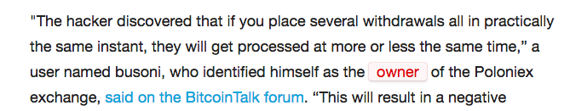
A real hack

Slide 29
Lock granularity: an example
const int n=10;
int accounts[total];
void transfer(int x, int y, int amount) {
accounts[x] -= amount;
accounts[y] += amount;
}
int balance(User u) {
return accounts[u.checking]+
accounts[u.saving];
}
How to lock?

Slide 30
One big lock is simple
const int n=10;
int accounts[total];
pthread_mutex_t mu;
void transfer(int x, int y, int amount) {
pthread_mutex_lock(&mu);
accounts[x] -= amount;
accounts[y] += amount;
pthread_mutex_unlock(&mu);
}
int balance(User u) {
pthread_mutex_lock(&mu);
int bal = accounts[u.checking]+
accounts[u.saving];
pthread_mutex_unlock(&mu);
return bal
}
What does mu protect?
What’s the downside?
Serializes execution.
Only one thread can execute
transfer() or balance() at a time

Slide 31
Fine-grained locks have better performance, but...
const int n=10;
int accounts[total];
pthread_mutex_t mu[total];
void transfer(int x, int y, int amount) {
pthread_mutex_lock(&mu[x]);
accounts[x] -= amount;
pthread_mutex_unlock(&mu[x]);
pthread_mutex_lock(&mu[y]);
accounts[y] += amount;
pthread_mutex_unlock(&mu[y]);
}
int balance(User u) {
pthread_mutex_lock(&mu[u.checking]);
int bal = accounts[u.checking];
pthread_mutex_unlock(&mu[u.checking]);
pthread_mutex_lock(&mu[u.saving]);
bal += accounts[u.saving];
pthread_mutex_unlock(&mu[u.saving]);
return bal;
}
Easy to lock incorrectly

Slide 32
Fine-grained locks have better performance, but...
const int n=10;
int accounts[total];
pthread_mutex_t mu[total];
void transfer(int x, int y, int amount) {
pthread_mutex_lock(&mu[x]);
accounts[x] -= amount;
pthread_mutex_unlock(&mu[x]);
pthread_mutex_lock(&mu[y]);
accounts[y] += amount;
pthread_mutex_unlock(&mu[y]);
}
int balance(User u) {
pthread_mutex_lock(&mu[u.checking]);
int bal = accounts[u.checking];
pthread_mutex_unlock(&mu[u.checking]);
pthread_mutex_lock(&mu[u.saving]);
bal += accounts[u.saving];
pthread_mutex_unlock(&mu[u.saving]);
return bal;
}
Thread 1
Thread 2
accounts[1] -= 10
bal = accounts[1] = 0
bal += accounts[2] = 10
accounts[2] +=10
bal=10
missing $10!!

Slide 33
Fixing Fine-grained locks
int n=10;
int accounts[total];
pthread_mutex_t mu[total];
void transfer(int x, int y, int amount) {
pthread_mutex_lock(&mu[x]);
accounts[x] -= amount;
pthread_mutex_lock(&mu[y]);
accounts[y] += amount;
pthread_mutex_unlock(&mu[x]);
pthread_mutex_unlock(&mu[y]);
}
int balance(User u) {
pthread_mutex_lock(&mu[u.checking]);
int bal = accounts[u.checking];
pthread_mutex_lock(&mu[u.saving]);
bal += accounts[u.saving];
pthread_mutex_unlock(&mu[u.checking]);
pthread_mutex_unlock(&mu[u.saving]);
return bal;
}

Slide 34
Fixing Fine-grained locks
const int n=10;
int accounts[total];
pthread_mutex_t mu[total];
void transfer(int x, int y, int amount) {
pthread_mutex_lock(&mu[x]);
accounts[x] -= amount;
pthread_mutex_lock(&mu[y]);
accounts[y] += amount;
pthread_mutex_unlock(&mu[x]);
pthread_mutex_unlock(&mu[y]);
}
int balance(User u) {
pthread_mutex_lock(&mu[u.checking]);
int bal = accounts[u.checking];
pthread_mutex_lock(&mu[u.saving]);
bal += accounts[u.saving];
pthread_mutex_unlock(&mu[u.checking]);
pthread_mutex_unlock(&mu[u.saving]);
return bal;
}
Thread 1
Thread 2
accounts[1] -= 10
accounts[2] +=10
bal = accounts[1] = 0
bal += accounts[2] = 20

Slide 35
Fine-grained locks may have deadlocks
const int n=10;
int accounts[total];
pthread_mutex_t mu[total];
void transfer(int x, int y, int amount) {
pthread_mutex_lock(&mu[x]);
accounts[x] -= amount;
pthread_mutex_lock(&mu[y]);
accounts[y] += amount;
pthread_mutex_unlock(&mu[x]);
pthread_mutex_unlock(&mu[y]);
}
int balance(User u) {
pthread_mutex_lock(&mu[u.checking]);
int bal = accounts[u.checking];
pthread_mutex_lock(&mu[u.saving]);
bal += accounts[u.saving];
pthread_mutex_unlock(&mu[u.checking]);
pthread_mutex_unlock(&mu[u.saving]);
return bal;
}
Thread 1
Thread 2
accounts[1] -= 10
bal = accounts[2] = 10

Slide 36
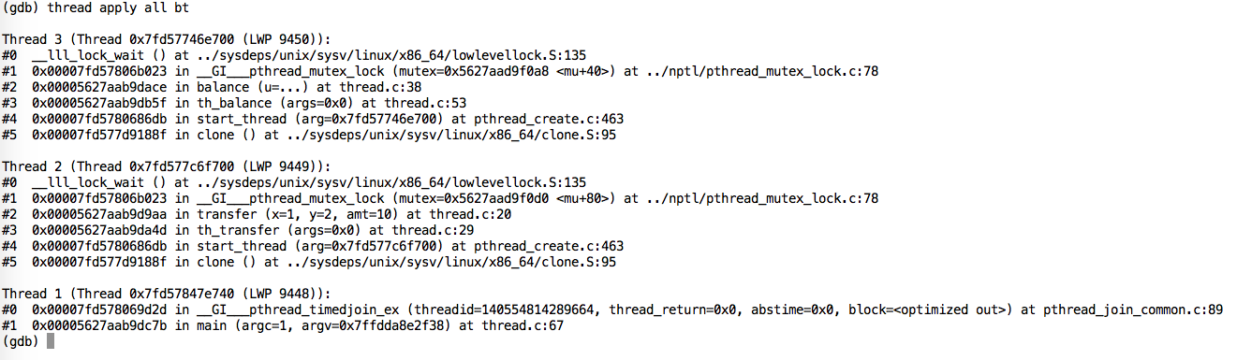
Deadlocks sound scary, but they are not
Stack traces indicate why deadlocks happen
no data corruption

Slide 37
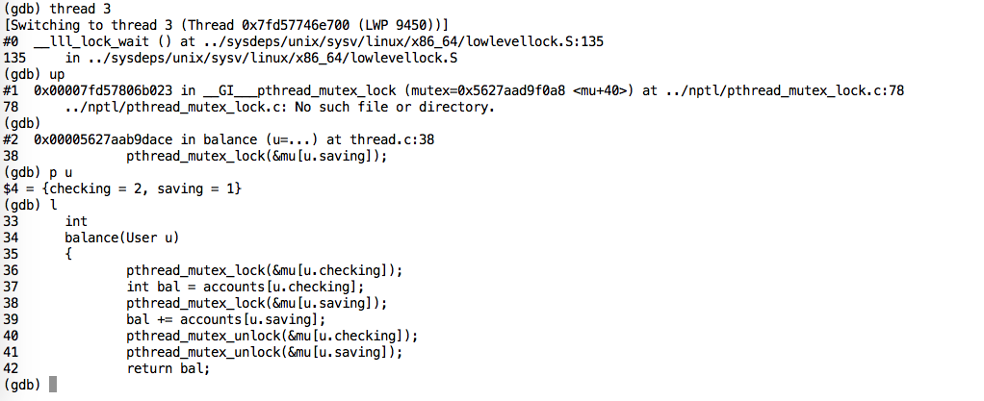
Deadlocks sound scary, but they are not
Stack traces indicate why deadlocks happen
no data corruption

Slide 38
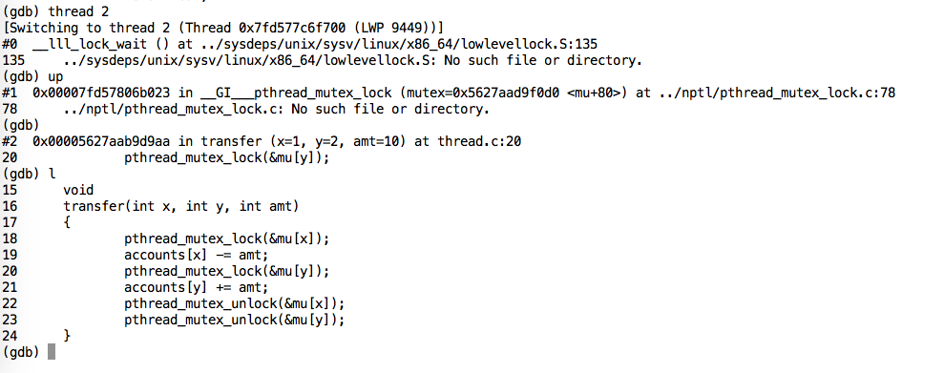
Deadlocks sound scary, but they are not
Stack traces indicate why deadlocks happen
no data corruption

Slide 39
Use lock ordering to prevent deadlock
Observation:
Deadlock occurs only if concurrent threads try to acquire locks in different order
wait for T2 (to release Y)
thread
T1
thread
T2
wait for T1 (to release X)
held lock X
held lock Y
Technique:
Each thread acquires lock in the same order

Slide 40
Fine-grained locking with no deadlocks
const int n=10;
int accounts[total];
pthread_mutex_t mu[total];
void lock_in_order(int x, int y) {
if (x > y)
swap(&x, &y);
pthread_mutex_lock(&mu[x));
pthread_mutex_lock(&mu[y]);
}
void transfer(int x, int y, int amount) {
lock_in_order(x,y);
accounts[x] -= amount;
accounts[y] += amount;
pthread_mutex_unlock(&mu[x]);
pthread_mutex_unlock(&mu[y]);
}
int balance(User u) {
lock_in_order(u.checking, u.saving);
int bal = accounts[u.checking] += accounts[u.saving];
pthread_mutex_unlock(&mu[u.checking]);
pthread_mutex_unlock(&mu[u.saving]);
return bal;
}

