Slide 1
C: Pointers and Arrays
Jinyang Li

Slide 2
What we’ve learnt in last lecture
C program’s basic organization
  *.c vs. *.h files
  Compilation workflow and the make tool

Slide 3
Lesson plan
Bitwise operators
Control flow
Pointers

Slide 4
Bitwise NOT: ~
Truth table (of boolean function NOT)
x | NOT x
0 | 1
1 | 0
Operator ~ applies NOT bitwise to two integers
~
( 0 1 1 0 1 0 0 1 )₂
result of ~0x69
( 1 0 0 1 0 1 1 0 )₂

Slide 5
Bitwise AND: &
Truth table (of boolean function AND)
x | y | x AND y
0 | 0 | 0
0 | 1 | 0
1 | 0 | 0
1 | 1 | 1
How many rows if function has n boolean (aka 1-bit) inputs?
2^{n}
Operator & applies AND bitwise to two integers
( 0 1 1 0 1 0 0 1 )₂
&
( 0 1 0 1 0 1 0 1 )₂
Result of 0x69 & 0x55
( 0 1 0 0 0 0 0 1 )₂

Slide 6
Example use of &
& is often used to mask off bits
  b & 0 = 0
  b & 1 = b
?
b is any bit
?
int clear_msb(int x) {
return ____________;
}

Slide 7
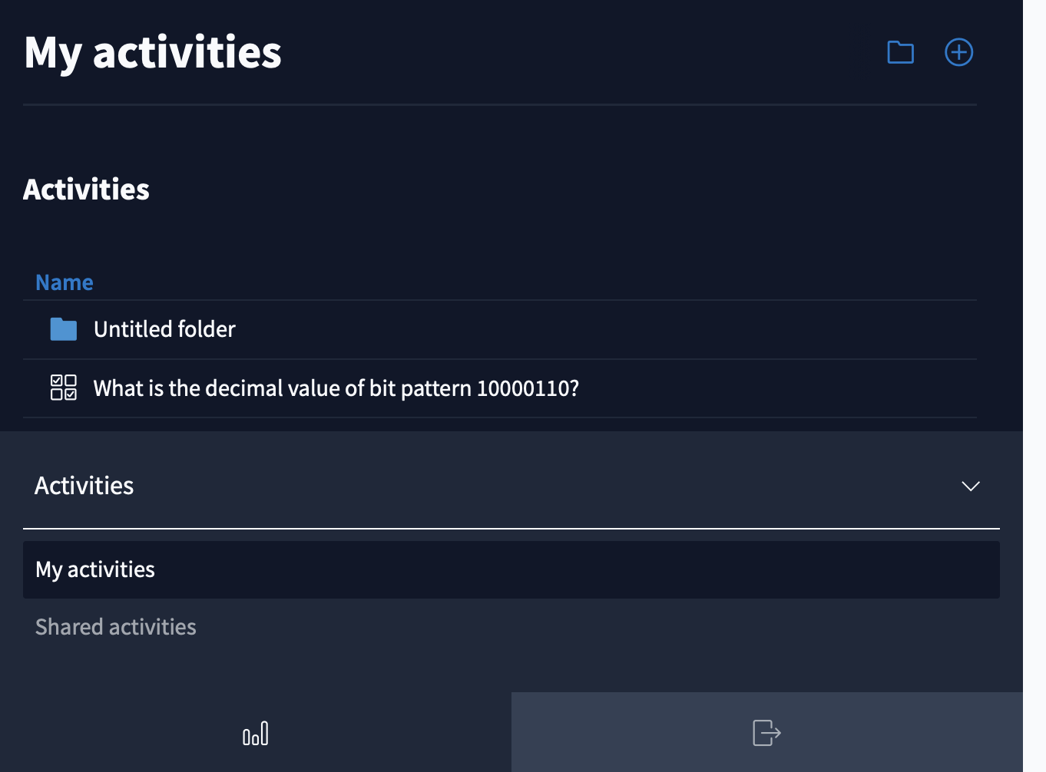

Slide 8
Example use of &
& is often used to mask off bits
  b & 0 = 0
  b & 1 = b
?
b is any bit
?
int clear_msb(int x) {
}
return x & 0x7fffffff;

Slide 9
Example use of &
Suppose a file’s permission is encoded in 3 bits
b₇
b₆
b₅
b₄
b₃
b₂
b₁
b₀
X:executable?
W:writable?
R:readable?
void check_write_permission(char perm) {
if ( ??? ) {
printf("Has write permission\n");
} else {
printf("No write permission\n");
}
}
perm & 0x02
char clear_write_permission(char perm) {
return ??
}
perm & ~0x02

Slide 10
Bitwise OR: |
x | y | x OR y
0 | 0 | 0
0 | 1 | 1
1 | 0 | 1
1 | 1 | 1
Operator | applies OR bitwise to two integers
( 0 1 1 0 1 0 0 1 )₂
Result of 0x69 | 0x55
|
( 0 1 0 1 0 1 0 1 )₂
( 0 1 1 1 1 1 0 1 )₂

Slide 11
Example use of |
| can be used to turn some bits on
  b | 1 = 1
  b | 0 = b
?
?
char set_write_permission(char x) {
}
return x | 0x02;

Slide 12
Bitwise XOR: ^
x | y | x XOR y
0 | 0 | 0
0 | 1 | 1
1 | 0 | 1
1 | 1 | 0
Operator ^ applies XOR bitwise to two integers
( 0 1 1 0 1 0 0 1 )₂
result of 0x69^0x55
^
( 0 1 0 1 0 1 0 1 )₂
( 0 0 1 1 1 1 0 0 )₂

Slide 13
Example use of XOR
^ can be used to selectively toggle a bit
  b ^ 1 = ~b
  b ^ 0 = b
char toggle_write_permission(char x) {
}
return x ^ 0x02;

Slide 14
Bitwise left-shift: <<
x << y, treat x as a bit-vector, shift x left by y positions
  Throw away bits shifted out on the left
  Fill in 0’s on the right
result of 0x69<<3 ?
(0 1 1 0 1 0 0 1)₂
=(0 1 0 0 1 0 0 0)₂

Slide 15
Bitwise right-shift: >>
x >> y, shift bit-vector x right by y positions
  Throw away bits shifted out on the right
  Logical shift: Fill with 0’s on left
  Arithmetic shift: Replicate msb on the left
Result of (logical) right-shift: 0xa9 >> 3
(1 0 1 0 1 0 0 1)₂
=(0 0 0 1 0 1 0 1)₂
Result of (arithmetic) right-shift: 0xa9 >> 3
=(1 1 1 1 0 1 0 1)₂

Slide 16
Which shift is used in C ?
Arithmetic shift for signed numbers
Logical shifting on unsigned numbers
int a = 1;
a = a>>31;
int b = -1;
b = b >>31;
unsigned int b = 129;
b = b >> 4;
b = 3
8
a=0 b=-1
??
??

Slide 17
Example use of shift
int multiply_by_powers_of two(int x, int p)
{
}
return x << p;
int divide_by_powers_of two(int x, int p)
{
}
return x >> p;
Caveat: right-shift rounds down, different from integer division “/” which rounds towards zero.
e.g. -1>>1=-1, but -1/2 = 0

Slide 18
Example use of shift
// clear bit at position pos
// rightmost bit is at 0th pos
int clear_bit_at_pos(int x, int pos) {
}
unsigned int mask = ~(1 << pos);
return x & mask;

Slide 19

Breakout time!
Notes:
https://forms.gle/HbKYeKWCCgREpoKm6

Slide 20
Breakout exercises
Clear fraction fields of 10.0 --> ??
Clear fraction field of 0.2 → ??
8.0
0.125
float clear_exp_field(float f)
{
int fi = *(int *)&f; //re-interpret bit-pattern of f as int
int r = 0; //TODO: add your code here
return *(float *)&r; //re-interpret bit-pattern of r as float
}
r = (fi >> 23) <<23;

Slide 21
Example use of shift
// set bit at position pos
// rightmost bit is at 0th pos
int set_bit_at_pos(int x, int pos)
{
}
unsigned int mask = 1 << pos;
return x | mask;

Slide 22
Lesson plan
Bitwise operators
Control flow
Pointers

Slide 23
C’s Control flow
Same as Java
conditional:
  if ... else if... else
  switch
loops: while, for
  continue
  break

Slide 24
goto statements allow jump anywhere
  goto label
while (cond) {
...
}
B:
...
for(...) {
for(...) {
for(...) {
goto error
}
}
}
error:
code handling error
Any control flow primitive can be
expressed as a bunch of goto’s.
A:
if (cond = false) goto B;
...
goto A
B:
...
The only acceptable scenario for using goto

Slide 25
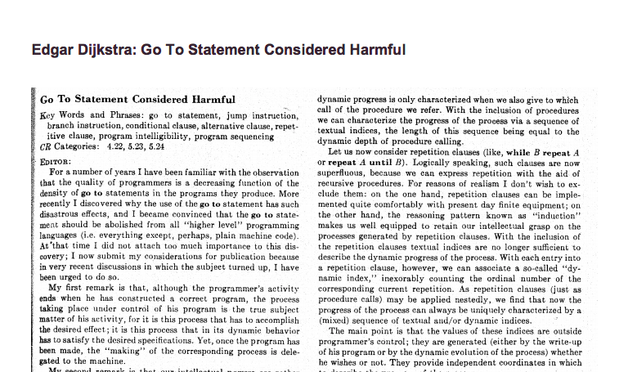
Avoid goto’s whenever possible

Slide 26
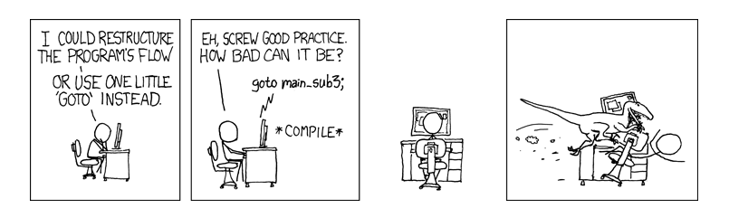
Avoid goto’s whenever possible

Slide 27
C scope rules
Local variable: defined within a procedure
  Scope: within the procedure
Global variable: defined outside of any procedure
  Scope: within the file unless exported via *.h
int x = 0;
int y = 1;
void swap(int x, int y) {
int tmp = x;
x = y;
y= x;
}
int main() {
swap(x, y);
}
Function arguments are passed-by-value

Slide 28
Pointers
Pointer is a memory address

Slide 29
Pointer
0xff
…
...
char a = 1;
0x1c
0x1b
0x1a
0x19
0x18
0x17
0x16
0x15
0x14
0x13
Addresses are 8-byte long on 64-bit machine; for brevity, I omit leading 0s.
0x12
0x11
a:
1
0x10
…

Slide 30
Pointer
0xff
…
...
char a = 1;
int b = 2;
0x1c
0x1b
0x1a
0x19
0x18
0x17
0x16
0x15
2
0x14
0x13
0x12
b:
0x11
a:
1
0x10
…

Slide 31
Pointer
Same as: char* x;
You pronounce typename from right to left
0xff
…
...
char a = 1;
0x1e
int b = 2;
0x1d
char *x;
x = &a;
& gives address of variable
0x10
0x1c
Can be combined as:
char *x = &a;
...
x:
0x15
2
0x14
0x13
0x12
what happens if I write
char x = &a;
b:
0x11
a:
1
type mismatch!
0x10
…

Slide 32
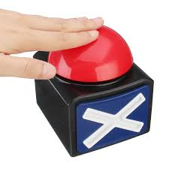
Pointer
0xff
…
...
char a = 1;
0x1e
int b = 2;
0x1d
char *x = &a;
0x10
0x1c
printf(“x=%p\n”, x);
You can print the value of a pointer variable with %p (leading zeros are not printed)
...
x:
0x15
0x10
2
0x14
Size of pointer on a 64-bit machine?
0x13
0x12
8 bytes
b:
0x11
a:
1
0x10
…

Slide 33
Pointer
…
...
char a = 1;
int b = 2;
0x1b
char *x = &a;
0x10
0x1c
...
x:
0x15
2
0x14
0x13
0x12
b:
0x11
a:
1
0x10
…

Slide 34
Pointer
…
...
char a = 1;
int b = 2;
0x1b
char *x = &a;
0x10
0x1c
* operator dereferences a pointer, not to be confused with the * in (char *) which is part of typename
*x = 3;
...
x:
0x15
2
0x14
Value of variable a after this statement?
0x13
0x12
b:
0x11
1
a:
3
0x10
…

Slide 35
Pointer
...
…
...
char a = 1;
int b = 2;
0x1b
what if x is uninitialized?
char *x = &a;
??
0x1c
Dereferencing an arbitrary address value may result in “Segmentation fault” or a random memory write
*x = 3;
...
x:
0x15
2
0x14
0x13
0x12
b:
0x11
a:
1
0x10
…

Slide 36
Pointer
...
…
...
char a = 1;
int b = 2;
Always initialize pointers!
0x1b
char *x = NULL;
0x0
0x1c
Dereferencing NULL pointer definitely results in “Segmentation fault”
*x = 3;
...
x:
0x15
2
0x14
0x13
0x12
b:
0x11
a:
1
0x10
…

Slide 37
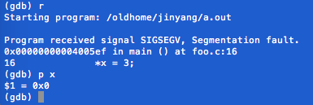
Pointer
...
…
...
char a = 1;
int b = 2;
0x1b
char *x = NULL;
0x0
0x1c
*x = 3;
...
x:
0x15
2
0x14
0x13
0x12
b:
0x11
a:
1
0x10
…

Slide 38
Pointer has different types
0x11
…
...
char a = 1;
int b = 2;
y:
0x1b
char *x = &a;
0x10
0x1c
*x = 3;
int *y = &b;
what if I write
char *y = &b;
...
*y = 127;
x:
0x15
2
0x14
127
0x13
0x12
b:
0x11
a:
3
0x10
…

Slide 40
Double Pointer
…
...
??
…
…
0x15
…
Same as:
char **xx;
xx = &x;
…
...
char a = 1;
xx:
…
0x30
int b = 2;
…
char *x = &a;
0x10
0x1c
*x = 3;
what if I write
char *xx =&x;
char **xx = &x;
...
char **xx is the same as char** xx;
x:
0x15
…
0x14
…
0x13
printf(“xx=%p *xx=%p **xx=%d\n”, xx, *xx, **xx);
…
0x12
…
0x11
a:
3
0x10
…

Slide 41
Double Pointer
...
...
0x22
0x1b
...
char a = 1;
yy:
int b = 2;
…
char *x = &a;
0x11
0x22
int *y = &b;
*x = 3;
y:
0x1b
*y = 127;
…
...
127
0x14
0x13
char **xx = &x;
0x12
int **yy = &y;
b:
0x11
printf(“yy=%p *yy=%p **yy=%d\n”, yy, *yy, **yy);
a:
3
0x10
…

Slide 42
Common confusions on *
* has two meanings!!
  part of a pointer type name, e.g. char *, char **, int *
  the deference operator.
C’s syntax for declaring multiple pointer variables on one line
char* b, c; does not work
char a = 1;
char *p = &a;
*p = 2;
char *b, *c;
char **d,**e;
C’s syntax for declaring and initializing multiple pointer variables on one line
char *f=p, *g=p;
char **m=&p, **n=&p;

Slide 43
Pass pointers to function
void swap(int* x, int* y)
{
int tmp = *x;
*x = *y;
*y = tmp;
}
…
1
0xf7
...
0xf4
main.x:
2
0xf3
...
0xf0
main.y:
…
int main()
{
int x = 1;
int y = 2;
swap(&x, &y);
printf(“x:%d, y:%d”,x,y);
}
??
swap.x:
??
swap.y:
Size and value of x, y, tmp
in swap upon function entrance?
??
swap.tmp:

Slide 44
Pass pointers to function
void swap(int* x, int* y)
{
int tmp = *x;
*x = *y;
*y = tmp;
}
…
1
0xf7
...
0xf4
main.x:
2
0xf3
...
0xf0
main.y:
…
int main()
{
int x = 1;
int y = 2;
swap(&x, &y);
printf(“x:%d, y:%d”,x,y);
}
0xf4
swap.x:
0xf0
swap.y:
??
swap.tmp:

Slide 45
Pass pointers to function
void swap(int* x, int* y)
{
int tmp = *x;
*x = *y;
*y = tmp;
}
…
1
0xf7
...
0xf4
main.x:
2
0xf3
...
0xf0
main.y:
…
int main()
{
int x = 1;
int y = 2;
swap(&x, &y);
printf(“x:%d, y:%d”,x,y);
}
0xf4
swap.x:
0xf0
swap.y:
swap.tmp:
1

Slide 46
Pass pointers to function
void swap(int* x, int* y)
{
int tmp = *x;
*x = *y;
*y = tmp;
}
…
1
0xf7
2
...
0xf4
main.x:
2
0xf3
...
0xf0
main.y:
…
int main()
{
int x = 1;
int y = 2;
swap(&x, &y);
printf(“x:%d, y:%d”,x,y);
}
0xf4
swap.x:
0xf0
swap.y:
1
swap.tmp:

Slide 47
Pass pointers to function
void swap(int* x, int* y)
{
int tmp = *x;
*x = *y;
*y = tmp;
}
…
2
0xf7
...
0xf4
main.x:
2
0xf3
1
...
0xf0
main.y:
…
int main()
{
int x = 1;
int y = 2;
swap(&x, &y);
printf(“x:%d, y:%d”,x,y);
}
0xf4
swap.x:
0xf0
swap.y:
1
swap.tmp:

Slide 48
Pass pointers to function
void swap(int* a, int* b)
{
int tmp = *a;
*a = *b;
*b = tmp;
}
…
2
0xf7
...
0xf4
main.x:
1
0xf3
...
0xf0
main.y:
…
int main()
{
int x = 1;
int y = 2;
swap(&x, &y);
printf(“x:%d, y:%d”,x,y);
}
0xf4
swap.a:
0xf0
swap.b:
1
swap.tmp:

Slide 49
Summary
Bitwise Operators: &, |, ^, >>, <<
Control flow and variable scopes
Pointers
  Pointers are memory addresses: p =&x; (p has addr of var x)
  *p … (read/write the variable pointed to by p)
Pass pointers to functions
  Allows a callee to change variables defined in caller

