Slide 1
CSO-Recitation 04 CSCI-UA 0201-007
R04: Assessment-02 & Debugging with gdb

Slide 2
Today’s Topics
Assessment 02
Breakout exercise
Debugging with gdb

Slide 3
Assessment 02

Slide 4
Q1 2's complement
What's the bit pattern (2's complement) of 32-bit signed integer -130 in hex format? (Please prefix your answer with 0x)
0xffffff7e
(130)₁₀: 00..000 1000 0010
Step 1-> flip all bits: 11..111 0111 1101
Step 2-> add 1: 11..111 0111 1110
0xffffff7e

Slide 5
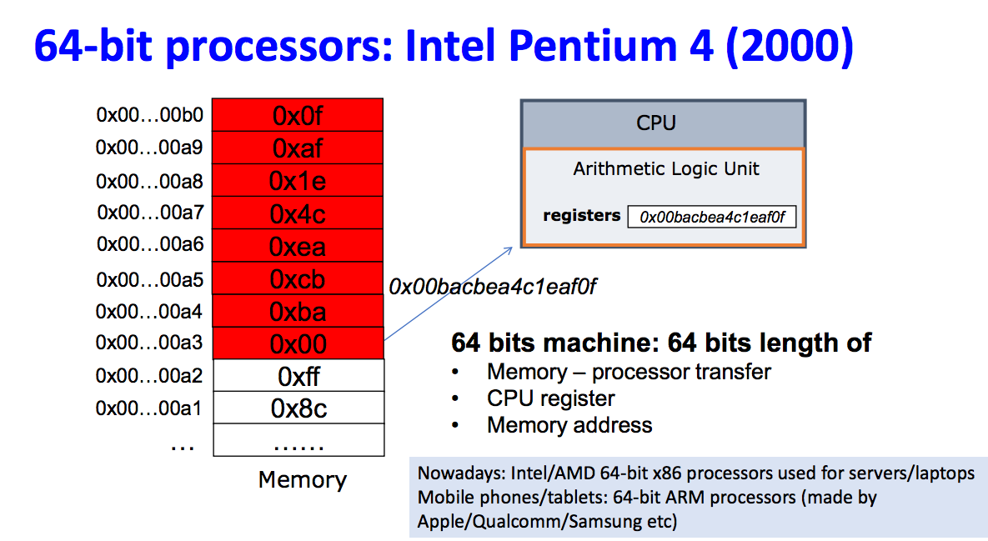
Q2 64-bit processor
Which of the following statements are true for a 64-bit processor?
its registers are 64-bit in length.
it only supports signed and unsigned integers of exactly 64-bit in length.
each memory address corresponds to 64-bit of data.
the CSO lab's virtual machine "emulates" a 64-bit processor.

Slide 6
Q3 Byte ordering
Suppose the byte values stored at memory address a, a+1, a+2, a+3, a+4, a+5, a+6, a+7 are 0x01, 0x02, 0x03, 0x04, 0x05, 0x06, 0x07, 0x08 respectively. If a Little-Endian processor is to load a 4-byte integer from memory at address a into a 4-byte register, what's the 4-byte register value after the load? (Please write your answer in hex, and prefix it with 0x)
0x04030201
Little Endian:
Least significant byte stored at smallest address
Big Endian:
Most significant byte stored at smallest address

Slide 7
Q4 Normalized Exponential Representation
Which of the following is a normalized exponential representation in either binary or decimal?
(0.11)₂*2¹
(1.00)₂*2⁻¹⁰
(10.11)₂
(78.5) ₁₀*2¹⁰
(7.85)₁₀*10¹
Binary:
Normalized exponential representation:
+ M * 2E, where 1<=M<2, M=(1.F)₂
Decimal:
Normalized Scientific notation:
+ M * 10E, where 1<=M<10

Slide 8
Q5 IEEE Floating Point
What's the value of the 32-bit IEEE floating point with bit pattern 0xc0600000? (Give your answer in the form of regular decimal fractional notation xxx.yyy with no leading nor trailing zeros)
-3.5
0xc0600000
1100 0000 0110 0000 0000 0000 0000 0000
S=1 -> -M*2E
exp=(10000000)₂ =2⁷ = 128
E= exp-bias = exp-127 =1
M=(1.1100…000)₂ = 2⁰ +2⁻¹ + 2⁻² = 1.75
-M*2E = -1.75*2¹ = -3.5

Slide 9
Q6 Signed/Unsigned int
Given a 32-bit bit pattern 0xffffffff, what is the value if we are to interpret the bit pattern
as an unsigned int or signed int?
2³¹
2³²
2³¹ -1
2³² -1
-1
- 2³¹
- 2³²
- 2³¹ +1
- 2⁻³² +1
None of the above

Slide 10
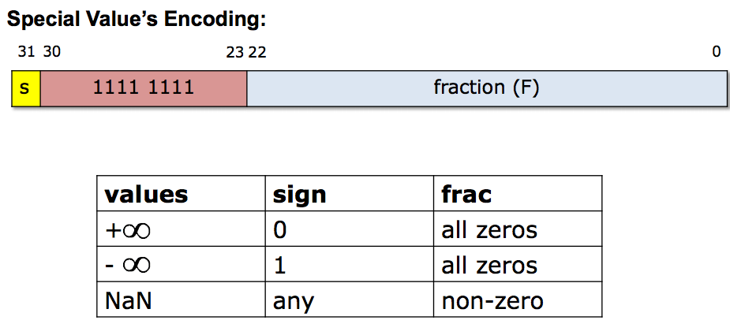

Q7 IEEE Floating Point
Given a 32-bit bit pattern 0xffffffff, what is the value if we are to interpret the bit pattern as an IEEE 32-bit floating point number.
NaN
$∞$
$−∞$
0
$≈2^{129}$
$≈{−2}^{129}$
None of the above
0xffffffff
1111 1111 1111 1111 11….11
Special values

Slide 11
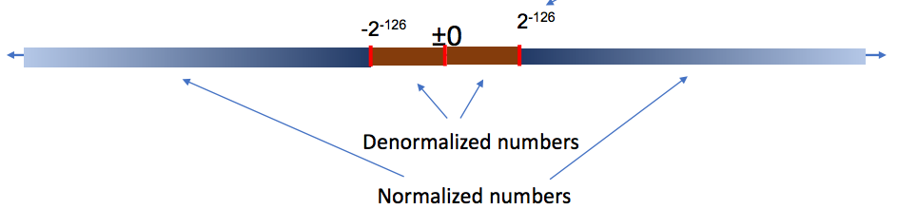
Q8 IEEE floating point 2
Which of the following statements are true about IEEE floating points?
The number zero is represented in normalized encoding
The number zero is represented in denormalized encoding
All denormalized numbers are closer to zero than normalized numbers
Some but not all denormalized numbers are closer to zero than normalized numbers.
The exponent value (E) in denormalized encoding is 1-127 = -126.
The exponent value (E) in denormalized encoding is 0-127 = -127.

Slide 12
Q9 GDB
For debugging with GDB, the commands you need to do
gcc -g main.c -o myprogram
gcc main.c
gcc main.c -o myprogram
gdb ./myprogram

Slide 13
Q10 GDB
To print the value of a variable while debugging with GDB, what command can be used.
printf
print
show
p

Slide 14
Breakout exercise

Slide 15
Breakout exercise
Suppose one clears the fraction field (least significant 23 bits) of float f1 = 10.0 and float f2=0.2, what's the resulting floats f1' and f2'?
f1=10.0
M*2E -> f1 = (1.25)₁₀ * 2³ = (1.F)₂ * 2³
1.25=2^0+2^-2 -> (1.01)₂ -> f1=(1.0100..00)₂ * 2³
clear the fraction field: f1’ = (1.00…00)₂ * 2³ = 8.0
f2=0.2 = (1.6)₁₀*2⁻³ = (1.F)₂ * 2⁻³
clear: f2’ = (1.00..00)₂ * 2⁻³ = 0.125

Slide 16
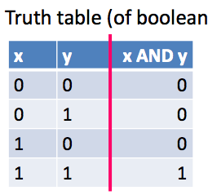
Breakout exercise
Suppose int variable fi stores the bit-pattern for a single-precision floating point, write the line of code that clears the fraction field of the floating point.
& is often used to mask off bits
b & 0 = 0, b & 1 = b
clear the fraction field -> clear the least 23 bits
fi & mask
mask: 1111 1111 1000 0000 0000 0000 0000 0000
mask: 0xff800000
fi & 0xff800000

Slide 17
Getting started with GDB
How to use it and why you should

Slide 18
Debugging with gdb
GDB lets you
Run your program
Stop your program at a certain point
Print out the values of certain variables at that point
Examine what your program is doing
Change things within your program to see if it helps

Slide 19
How do you use GDB?
Add the -g flag when you compile with gcc
This flag tells gcc to include debugging information that gdb can use
gcc -g main.c -o myprogram
Run your program with gdb
Run gdb ./myprogram
You will then be given an interactive shell where you can issue commands to gdb
Run your program, look at variables, etc., using the commands
To exit the program just type quit (or just q)

Slide 20
Some common gdb commands
help
Gdb provides online documentation. Just typing help will give you a list of topics. Or just type help command and get information about any other command.
Short Name | Long Name | What do it do?
r | run | Begins executing the program – you can specify arguments after the word run
s | step | Execute the current source line and stop before the next source line, going inside functions and running their code too
n | next | Continue until the next source line, counting called functions as a single line
p | print | Prints the value of an expression or variable
l | list | Prints out source code
q | quit | Exit gdb
step through the program one line at a time

Slide 21
Some more advanced gdb commands
Set the breakpoint at the beginning of the function
Short Name | Long Name | What do it do?
b | break | Sets a breakpoint at a specified location (either a function name or line number)
c | continue | Continues executing after being stopped by a breakpoint
bt | backtrace | Prints out information on the call stack, i.e. where in the program's execution it is being stopped at
f | frame | Prints information on the current frame / allows you to change frames
i | info | Prints out helpful information (e.g. info args and info locals)
Segmentation fault (core dumped)

Slide 22
Debugging an infinite loop
Set a breakpoint inside the loop
Or just run it and hit control-c (signal)
list the code
This is so you can see the loop condition
step over the code
Check (print) the values involved in the loop condition
Are they changing the right way? Are the variables changing at all?

Slide 23
Debugging a crash
run your program
Use bt to see the call stack
You can also use where to see where you were last running
Use frame to go to where your code was last running
Use list to see the code that ran
Check the locals (info locals) and args (info args) to see if they are bad

