Slide 1
CSO-Recitation 14 CSCI-UA 0201-007
R14: Assessment 13 & ALU & RegFile & Pipeline

Slide 2
Today’s Topics
Assessment 13
Review pipelined CPU
Lab6
Review ALU & RegFile

Slide 3
Something you may care about..
The overall grade decomposition published on campuswire #206
1 lab required:
Lab5: due Dec 14 11pm
2 assessments to do:
Assessment-14: release this Friday 9am and due Sat 9am
Final assessment: release this Sunday 9pm and due next Monday 9pm
Optional lab6:
postpone to due Dec 17 11pm

Slide 4
Assessment 13
Q1 Single-cycle CPU

Slide 5
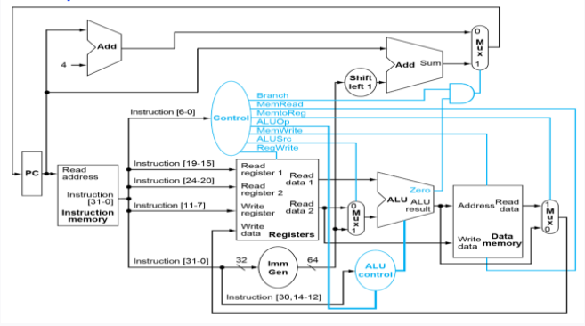
Q1 single-cycle CPU
Q1.1 Data path
Suppose the RISC-V instruction being executed is add x6, x7, x8, where x6 is the destination register, and x7/x8 are the 1st/2nd source register operand, respectively.
What are the values corresponding to Instruction[11-7] that are fed into the "write register" pins of the RegisterFile? To facilitate autograding, please write your answer in exactly 5 binary digits, with higher order bits on the left.
00110
Write register → destination register
x6
use 5-bit pattern to registers, since we have 32 registers
6: 00110

Slide 6
Q1.2 Control path
There are 3 Mux in the Figure whose selectors are to be set by the control logic, located at the top-right, bottom-middle, and bottom-right.
Which of the following instructions' execution cause the top-right Mux's selector to be set to 1?
add x6, x7, x8 //x6 = x7+x8
beq x6, x7, 100, if x6 and x7 have the same value.
beq x6, x7, 100, regardless of whether x6 and x7 have the same value.
ld x5, 40(x6) //load a doubleword (8-byte) from Memory[x6+40]Memory[x6+40] to register x5
addi x6, x7, 200 //x6 = x7+200
sd x5, 40(x6) //store a doubleword (8-byte) from register x5 to Memory[x6+40]Memory[x6+40]

Slide 7
Q1.2 Control path
Control conditional branch for SB-type instruction
Control whether write what read from memory back to register
Control the input for ALU

Slide 8
Q1.2 Control path
There are 3 Mux in the Figure whose selectors are to be set by the control logic, located at the top-right, bottom-middle, and bottom-right.
Which of the following instructions' execution cause the top-right Mux's selector to be set to 1?
add x6, x7, x8 //x6 = x7+x8
beq x6, x7, 100, if x6 and x7 have the same value.
beq x6, x7, 100, regardless of whether x6 and x7 have the same value.
ld x5, 40(x6) //load a doubleword (8-byte) from Memory[x6+40]Memory[x6+40] to register x5
addi x6, x7, 200 //x6 = x7+200
sd x5, 40(x6) //store a doubleword (8-byte) from register x5 to Memory[x6+40]Memory[x6+40]
for branch
beq: equal → set to 1

Slide 9
Q1.3 Control path
Continuing from Q1.2, which of the following instructions cause the value for the bottom-middle Mux's selector (aka ALUSrc) to be set to 1?
add x6, x7, x8
beq x6, x7, 100, if x6 and x7 have the same value.
beq x6, x7, 100, regardless of whether x6 and x7 have the same value.
ld x5, 40(x6)
addi x6, x7, 200
sd x5, 40(x6)
add dest, rs1, rs2 -> set to 0

Slide 10
Q1.4 Control path
Continuing from Q1.3, which of the following instructions cause the value for the bottom-right Mux's selector (aka MemToReg) to be set to 1?
add x6, x7, x8
beq x6, x7, 100, if x6 and x7 have the same value.
beq x6, x7, 100, regardless of whether x6 and x7 have the same value.
ld x5, 40(x6)
addi x6, x7, 200
sd x5, 40(x6)
need to do mem_to_reg for Load instruction.

Slide 11
Q1.2 Control path
6
x6
5
x6+40
memory[x6+40]
40
memory[x6+40]
x5= memory[x6+40]

Slide 12
Q1.5 Control path
RegWrite:
as long as there has write to register
no matter the MemToReg is set or not:
set to 1: mem to reg
0: write what calculated from ALU to reg
as long as the instruction has destination register
Which of the following instructions cause the value of the RegWrite input to the RegisterFile to be set?
add x6, x7, x8
beq x6, x7, 100, if x6 and x7 have the same value.
beq x6, x7, 100, regardless of whether x6 and x7 have the same value.
ld x5, 40(x6)
addi x6, x7, 200
sd x5, 40(x6)
x5= memory[x6+40]
MemWrite will be set. write in memory: memory[x6+40]=x5

Slide 13
Pipeline
Design & Hazards

Slide 14
RISC-V Pipeline
Pipeline increases throughput by overlapping execution of multiple instructions
We split the instruction memory from the data memory
Otherwise reading data would delay reading an instruction
There are 5 stages in the RISC-V pipeline
Instruction Fetch – IF
It takes a cycle to read an instruction from instruction memory
Instruction Decode – ID
Decode the instruction, read registers, and predict branching
Execute – EX
Performs computations using the ALU or performs shift operations
Memory Access - MEM
Read or write to memory
Write Back – WB
Write results to registers

Slide 15
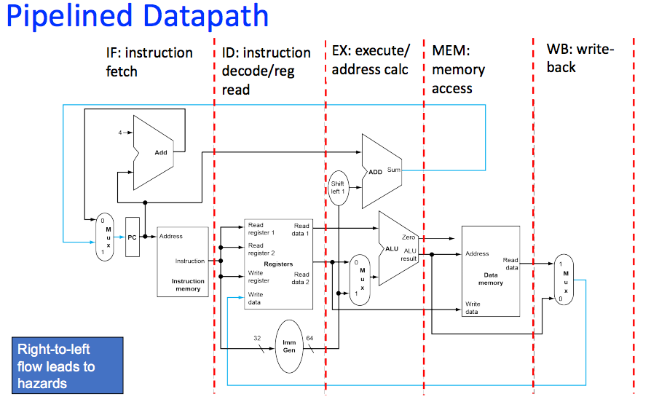
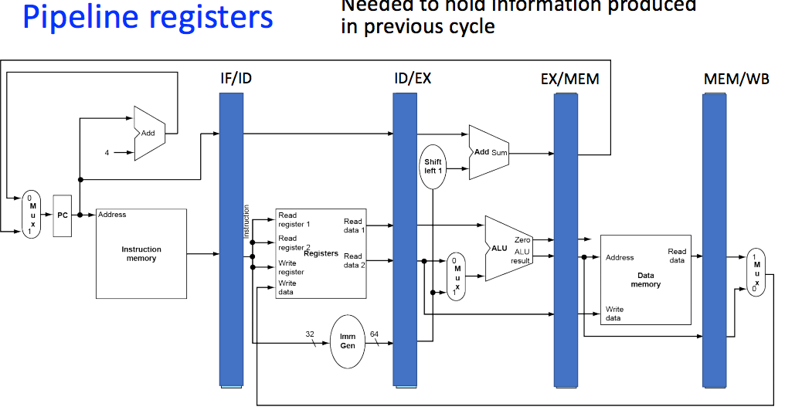
Pipeline Registers
In between each stage of the pipeline, we have registers store information
Each stage reads from the previous register to figure out what to do
Each stage writes to the next register to pass the instruction along

Slide 16
Pipeline hazard
Sometimes instructions depend on each other
In fact, that is very often the case, that some instruction uses the result of a previous instruction
This becomes an issue, however, when an instruction depends on a value that has been computed but not written back yet

Slide 17
Hazard Motivation
Consider the following C Program:
int calc(int a, int b, int c) {
a = a + b;
a = a + c;
return a;
}
Which becomes :
add x10, x10, x11
add x10, x10, x12
What might cause sadness here?

Slide 18
Pipeline hazard
Structure Hazard
Solution: add resources
Data Hazard
Solution: forwarding
works for EX-hazard & MEM-hazard
Load-use Hazard:
Solution: stall and insert bubble
Control Hazard
Solution: insert bubble
Reduce branch delay: by predicting branch in ID stage

Slide 19
Hazard Fix
There are two approaches to avoiding hazards
Forwarding
Be able to send data to an earlier location in the pipeline before write back
We do this by adding some multiplexers in the EX stage to choose between more recent values and the value from the register file
Stalling
Add a “bubble” to the pipeline to give us time to resolve the hazard
We do this by setting some of the controls to 0 and by preventing the PC from changing

Slide 20
Assessment 13
Q2&3 Pipelined CPU

Slide 21
Q2 Pipelining performance
Suppose the 5 stage pipeline has the following latency for each pipeline stage, 200ps (Instruction fetch aka IF), 100ps (Register read aka ID), 200ps (ALU operation aka EX), 200ps (Data access aka MEM), 100ps (Register write aka WB).
Suppose we build a new CPU by adding the multiplication function to ALU, which causes the ALU latency to increase from 200ps to 400ps. Which of the following statements are true?
The new CPU has twice the instruction throughput of the original one.
The old CPU has twice the instruction throughput as fast as the new one.
The latency of a load ld instruction under the new CPU is twice as long as that under the original CPU.
The latency of a load ld instruction under the old CPU is twice as long as that under the new CPU.
The ALU latency increase would cause the new CPU to run at a slower clock rate than the old CPU.
The ALU latency increase would cause the new CPU to run at a faster clock rate than the old CPU.
throughtput=1/time between instructions(clock cycle)
latency: time for each instruction = clock cycle * #stages

Slide 22
Q3 Pipelining performance
Suppose we change the RISC-V ISA to restrict load/store instructions to use a base register only (without an immediate offset/displacement). Thus, load/store instructions no longer need to use the ALU to compute addresses. As a result, we can change the CPU to overlap the data access (aka MEM) and ALU operation (aka EX) into one stage, resulting in a 4-stage pipeline. Note that in the merged MEM-EX stage, an instruction either performs data access or ALU operation, but not both. Hence the merged stage still takes 200ps, same as the latency of either MEM or EX in Q2.

Slide 23
Q3.1 Clock speed
How does the new 4-stage design affect the clock speed?
Clock for 4-stage pipelined CPU must run faster than that in the 5-stage pipelined CPU.
Clock for 4-stage pipelined CPU must run slower than that in the 5-stage pipelined CPU.
Clock for 4-stage pipelined CPU can run at the same speed as that of the 5-stage pipelined CPU.
clock speed = time of clock cycle = 200ps

Slide 24
Q3.2 Instruction latency
How does the new 4-stage design affect the instruction latency?
instruction latency (e.g. for load) for 4-stage pipelined CPU is lower than that in the 5-stage pipelined CPU.
instruction latency (e.g. for load) for 4-stage pipelined CPU is higher than that in the 5-stage pipelined CPU.
instruction latency (e.g. for load) for 4-stage pipelined CPU is the same as that in the 5-stage pipelined CPU.
Instruction latency:
previous: 200 instruction fetch + 100 register read + 200 ALU + 200 data access + 100 register write
combine ALU & data access:
200 instruction fetch + 100 register read + 200 ALU/data access + 100 register write

Slide 25
Q3.3 Instruction throughput
How does the new 4-stage design affect the instruction throughput?
instruction throughput for 4-stage pipelined CPU is lower than that in the 5-stage pipelined CPU, under ideal (no hazard) scenarios.
instruction throughput for 4-stage pipelined CPU is higher than that in the 5-stage pipelined CPU, under ideal (no hazard) scenarios.
instruction throughput for 4-stage pipelined CPU is the same as that in the 5-stage pipelined CPU, under ideal (no hazard) scenarios.
4-stage pipelined CPU tends to have fewer hazards than 5-stage pipelined CPU.
4-stage pipelined CPU tends to have more hazards than 5-stage pipelined CPU.
4-stage pipelined CPU has the same amount of hazards as 5-stage pipelined CPU.
throughput is still 1/200ps

Slide 26
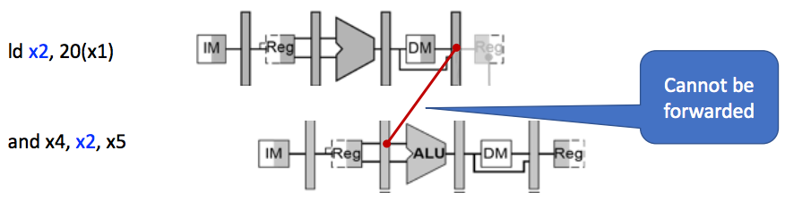
Q3.3 Instruction throughput
Then it can be fixed by forwarding!
It’s like a MEM-hazard as before

Slide 27
Q3.4 others
displacement kind of things:
handled inside CPU -> ALU
handled outside CPU -> use more instructions
How does the new 4-stage design affect the overall program performance?
Assuming no hazards, programs always execute faster under the 4-stage pipelined CPU than the original 5-stage pipeline.
Assuming no hazards, programs always execute slower under the 4-stage pipelined CPU than the original 5-stage pipeline.
Assuming no hazards, programs always execute at the same speed under the 4-stage pipelined CPU as the original 5-stage pipeline.
Assuming no hazards, programs can execute slower under the 4-stage pipelined CPU than the original 5-stage pipeline, because more instructions are needed (to calculate memory addresses for load/store).

Slide 28
Common question for lab5
Incomplete problem: Some circuits will be tested together
try to finish all circuits in one exercise, and check again
When implementing
Don't change the contents above the dash line, and
use Tunnels (not pins) as inputs and outputs
Building sub-circuits/sub-components and use Tunnels will help a lot
especially for complex implementation, i.e. lab6

Slide 29
Lab6
ALU & RegFile

Slide 30
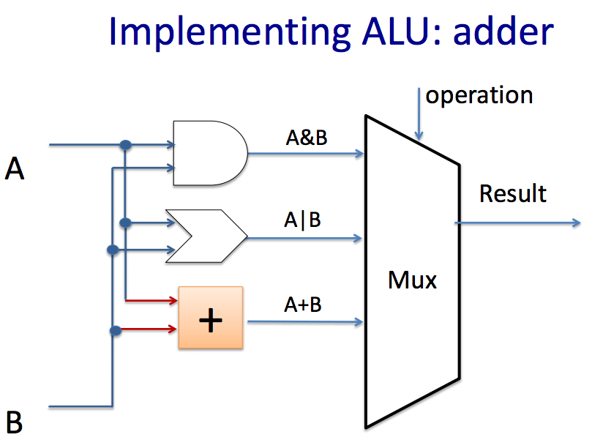
ALU
2 inputs, 1 ALU selector, 1 output(result)
You need to implement 14 instructions
add, sub, and, or, xor, srl, divu,…
allowed and encouraged to use built-in Logisim blocks to implement the arithmetic operations
combinatorial circuits
how to build any combinatorial circuits?
think about srl(unsigned right shift), sra(signed right shift), sll(left shift)
How to select the result?
“ALUSel”, MUX
Building sub-circuits and using Tunnels is helpful.

Slide 31
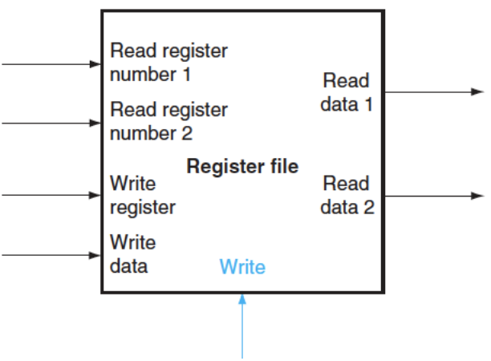
Register File
Register file: a set of registers that can be read and written
It’s a state element
Six inputs:
clock, rs1, rs2, rd, write data, RegWEn
Two outputs:
Read data 1, Read data 2
Step:
build register
Lab asks to implement 9 registers instead of 32
Provide some outputs for testing and debugging purposes
build register file

Slide 32
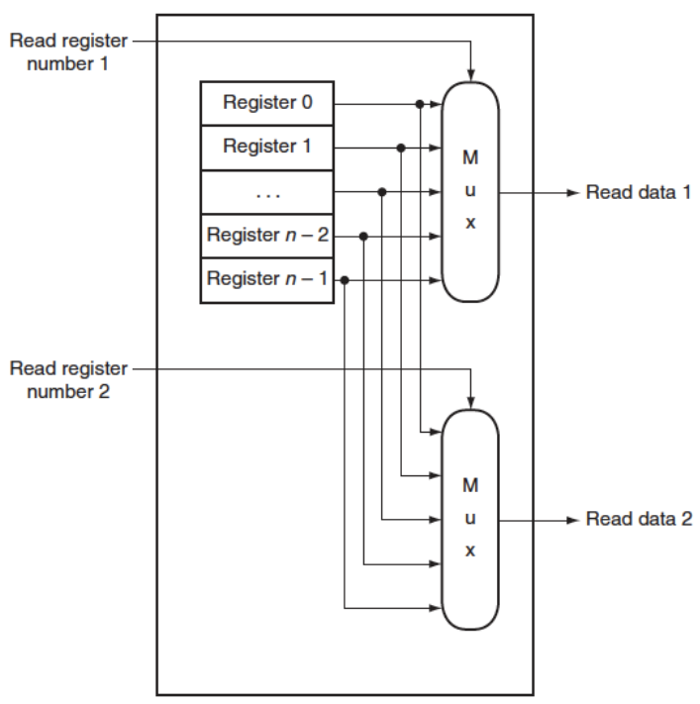
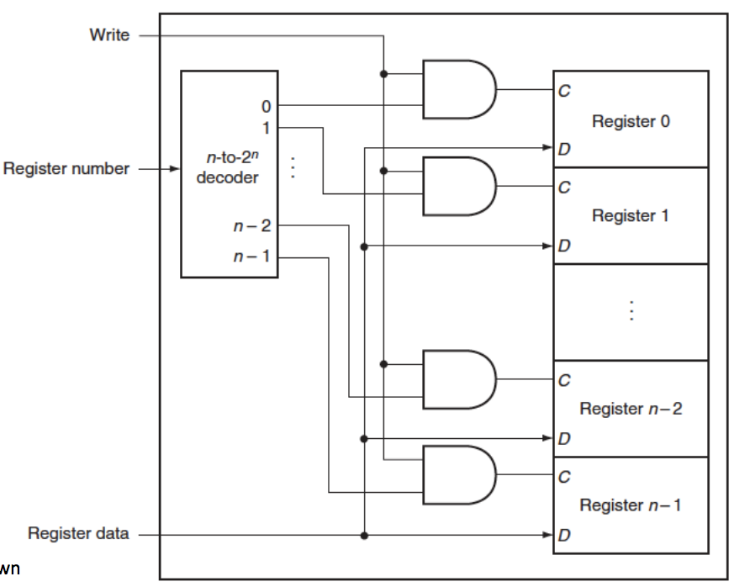
Register File
Think about DEMUX
Read:
Write:

Slide 33

Congrats to all
Great job!
Thanks for attending and supporting!
Good luck to all your final works~

