Slide 1
Pipelined CPU
Jinyang Li
Slides are based on Patterson and Hennessy

Slide 2
What we’ve learnt so far
Single cycle RISC-V CPU design
5 stage pipelined RISC-V CPU
Why pipelining? Faster (ideal throughput speedup: #-of-stages)
Pipelining challenges: hazards
Structure (how to avoid stall? add resources)
Data (how to minimize stall? forwarding)
Control

Slide 3
Today’s lesson
Handling control (branch) hazard
Handling exceptions
Briefly, more advanced topics:
Multiple-issue
Subword parallelism (SIMD)

Slide 4
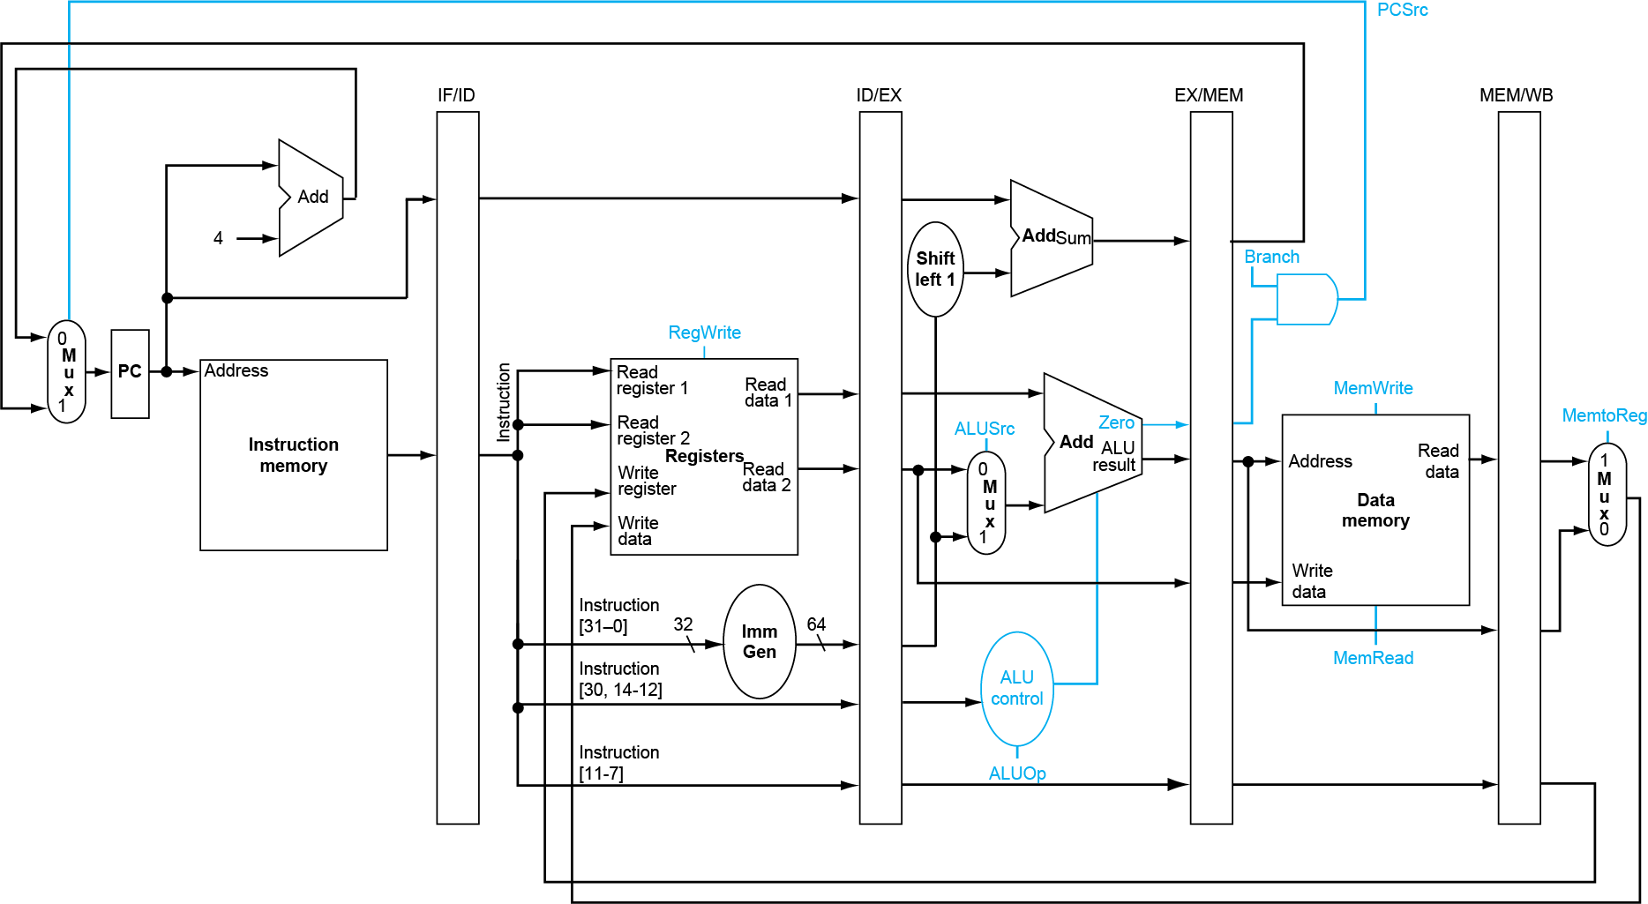
Recall our pipelined design so far
IF: instruction
fetch
ID: instruction
decode/reg read
EX: execute/
address calc
MEM: memory access
WB: write-back
Branch outcome determined in MEM stage

Slide 5
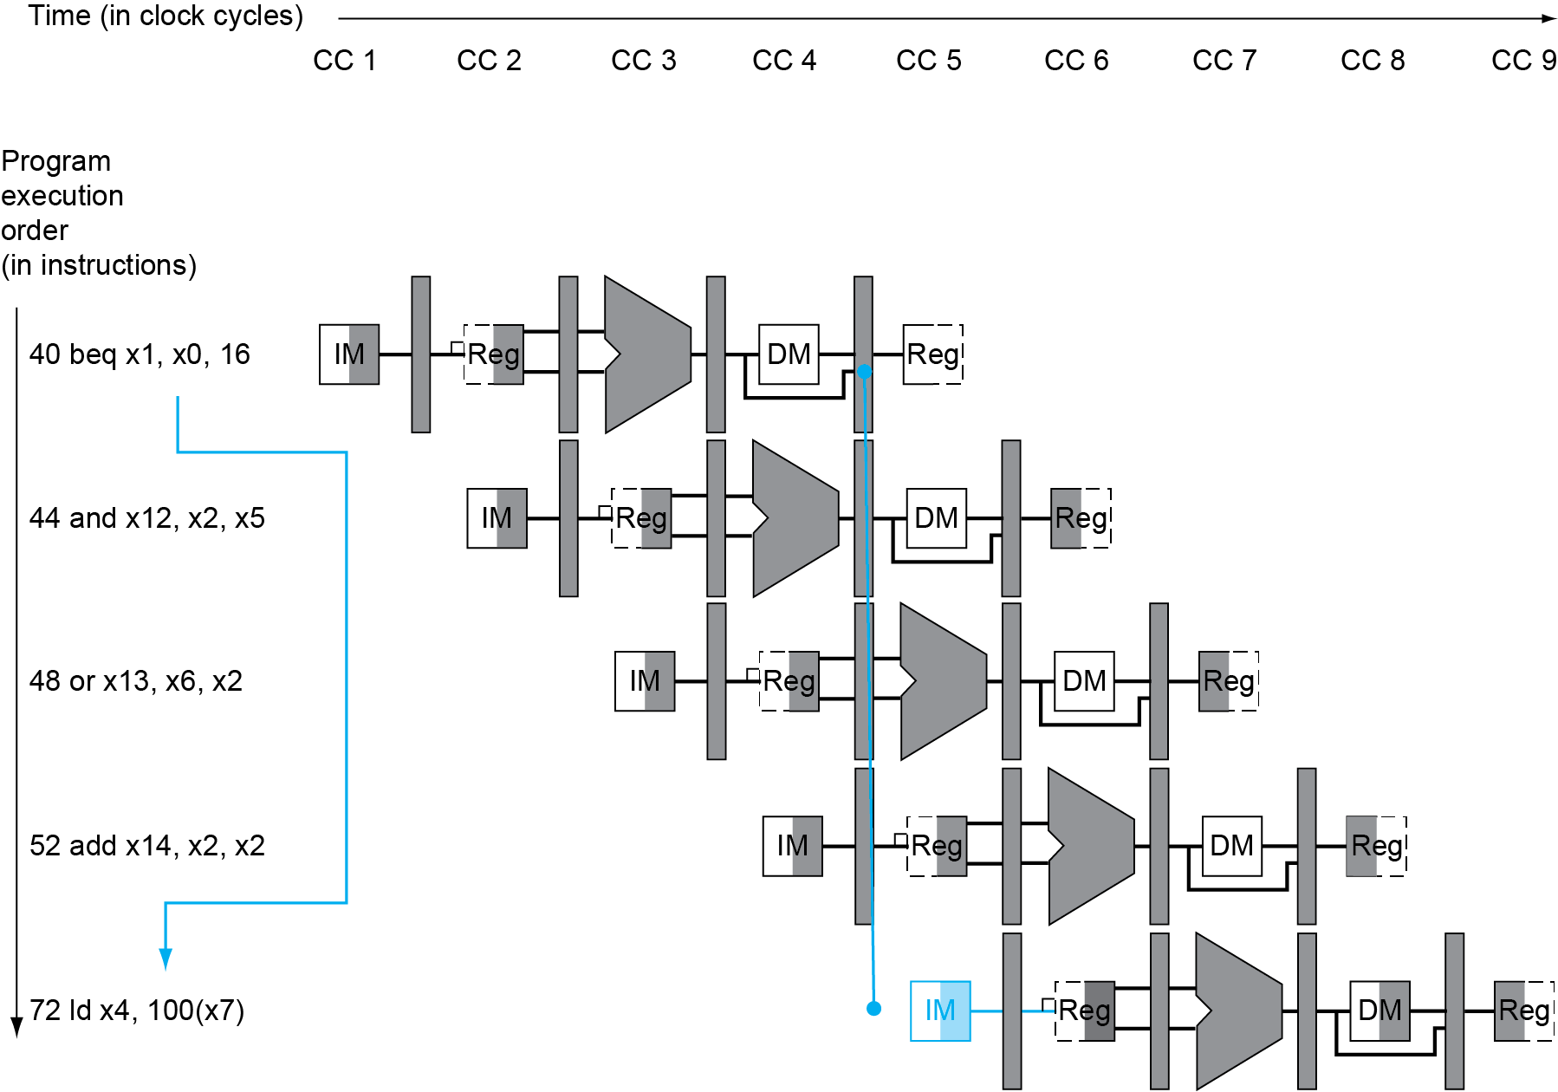
Branch Hazard
If branch outcome is determined in MEM
Instruction address
If x1==x0
Pc = pc+16*2
Flush 3 instructions (set controls to 0)
PC

Slide 6
Reducing Branch Delay
Add hardware to determine branch outcome earlier (e.g. ID instead of MEM) → fewer instructions to flush
36: sub x10, x4, x8 40: beq x1, x3, 16 // PC-relative branch // to 40+16*2=72 44: and x12, x2, x5 48: orr x13, x2, x6 52: add x14, x4, x2 56: sub x15, x6, x7 ... 72: ld x4, 50(x7)
How many instructions to flush
if branch outcome is known in ID?
clock-1
clock-2
clock-3
clock-4
clock-5
40: beq
IF
ID
EXE
MEM
WB
44: and
IF
ID
EXE
MEM
WB
72: ld
IF
ID
EXE
MEM
WB

Slide 7
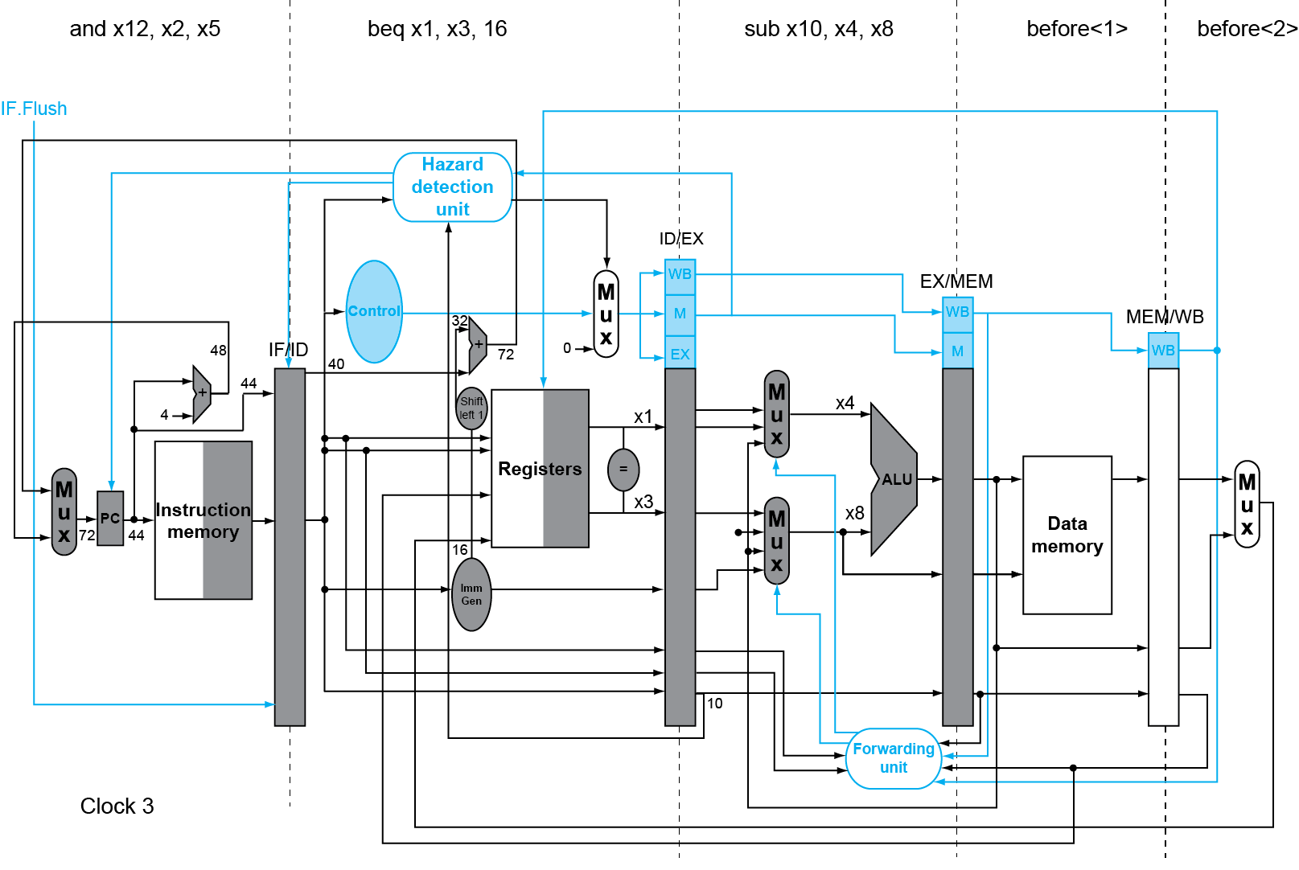
Branch determined in ID and is taken
If branch is taken, set IF/ID.Flush
Additional adder for
calculating target address
IF/ID.Flush
Clock 2
Additional comparator
to determine branch outcome

Slide 8
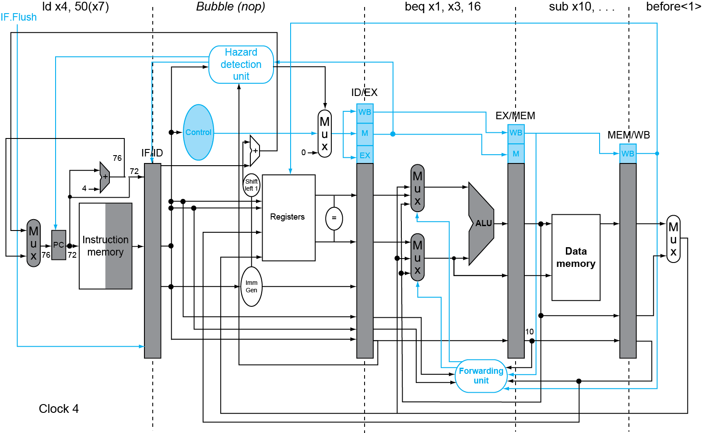
Branch determined in ID and is taken
If IF/ID.Flush is set, zero out controls so
memory/register won’t be written in MEM and WB
Clock 3

Slide 9
Dynamic Branch Prediction
Our simple 5-stage pipeline’s branch penalty is 1 bubble, but
In deeper pipelines, branch penalty is more significant
Solution: dynamic prediction
Branch prediction buffer (aka branch history table)
Indexed by recent branch instruction addresses
Stores outcome (taken/not taken)
To execute a branch
Check table, expect the same outcome
Start fetching from fall-through or target
If wrong, flush pipeline and flip prediction

Slide 10
1-Bit Predictor: Shortcoming
Inner loop branches mispredicted twice!
outer: … … inner: …
…
beq …, …, inner … beq …, …, outer
Mispredict as taken on last iteration of inner loop
Then mispredict as not taken on first iteration of inner loop next time around

Slide 11
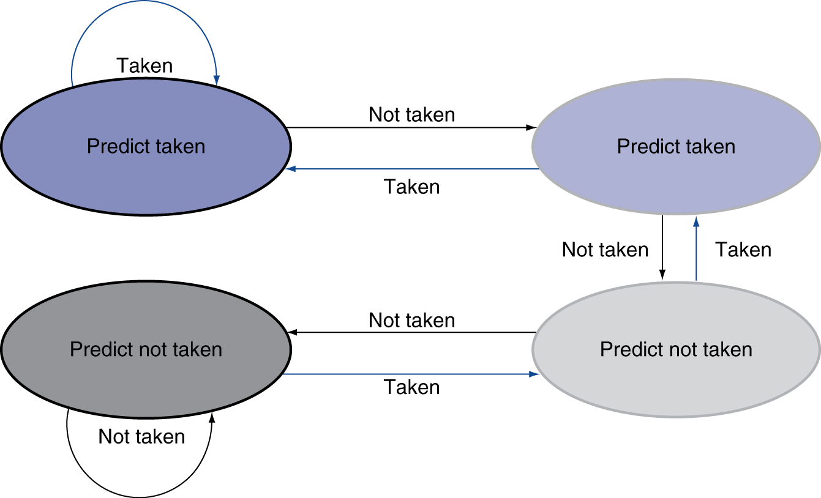
2-Bit Predictor
Only change prediction on two successive mispredictions

Slide 12
Calculating Branch Target (needed if branch is predicted taken)
Even with predictor, still need to calculate the target address
1-cycle penalty for a taken branch
Branch target buffer
Cache of target addresses
Indexed by PC when instruction fetched
If hit and instruction is branch predicted taken, can fetch target immediately

Slide 13
Exceptions and Interrupts
“Unexpected” events requiring change in flow of control
Exception
Arises within the CPU
e.g., undefined opcode, syscall, memory permission error, divide by zero, …
Interrupt
From an external I/O controller
Dealing with them without sacrificing performance is hard

Slide 14
Handling Exceptions
Save PC of offending (or interrupted) instruction
In RISC-V: Supervisor Exception Program Counter (SEPC)
Save indication of the problem
In RISC-V: Supervisor Exception Cause Register (SCAUSE)
Jump to handler (aka code in OS kernel)
Assume at 0000 0000 1C09 0000_{hex}
OS’s handler does either of the following:
Take corrective action; restart offending instruction
Terminate program; report cause

Slide 15
An Alternate Mechanism
Vectored Exception/Interrupts (x86)
Vector index (interrupt descriptor) specifies cause of exception
E.g. in x86, 0 (divide by zero), 6 (invalid opcode), …
OS sets up the Interrupt Descriptor Table
IDT[i] contains handler address, where I is vector index.

Slide 16
Exceptions in a Pipeline
Another form of control hazard
Consider malfunction on add in EX stage
add x1, x2, x1
Prevent x1 from being clobbered
Complete previous instructions
Flush add and subsequent instructions
Save PC (of offending instruction) in SEPC and set SCAUSE with cause
Transfer control to handler
Similar to mispredicted branch
Use much of the same hardware

Slide 17
Exception Example
Exception on add in
40 sub x11, x2, x4 44 and x12, x2, x5 48 orr x13, x2, x6 4c add x1, x2, x1 50 sub x15, x6, x7 54 ld x16, 100(x7) …
Handler
1C090000 sd x26, 1000(x10) 1c090004 sd x27, 1008(x10) …

Slide 18
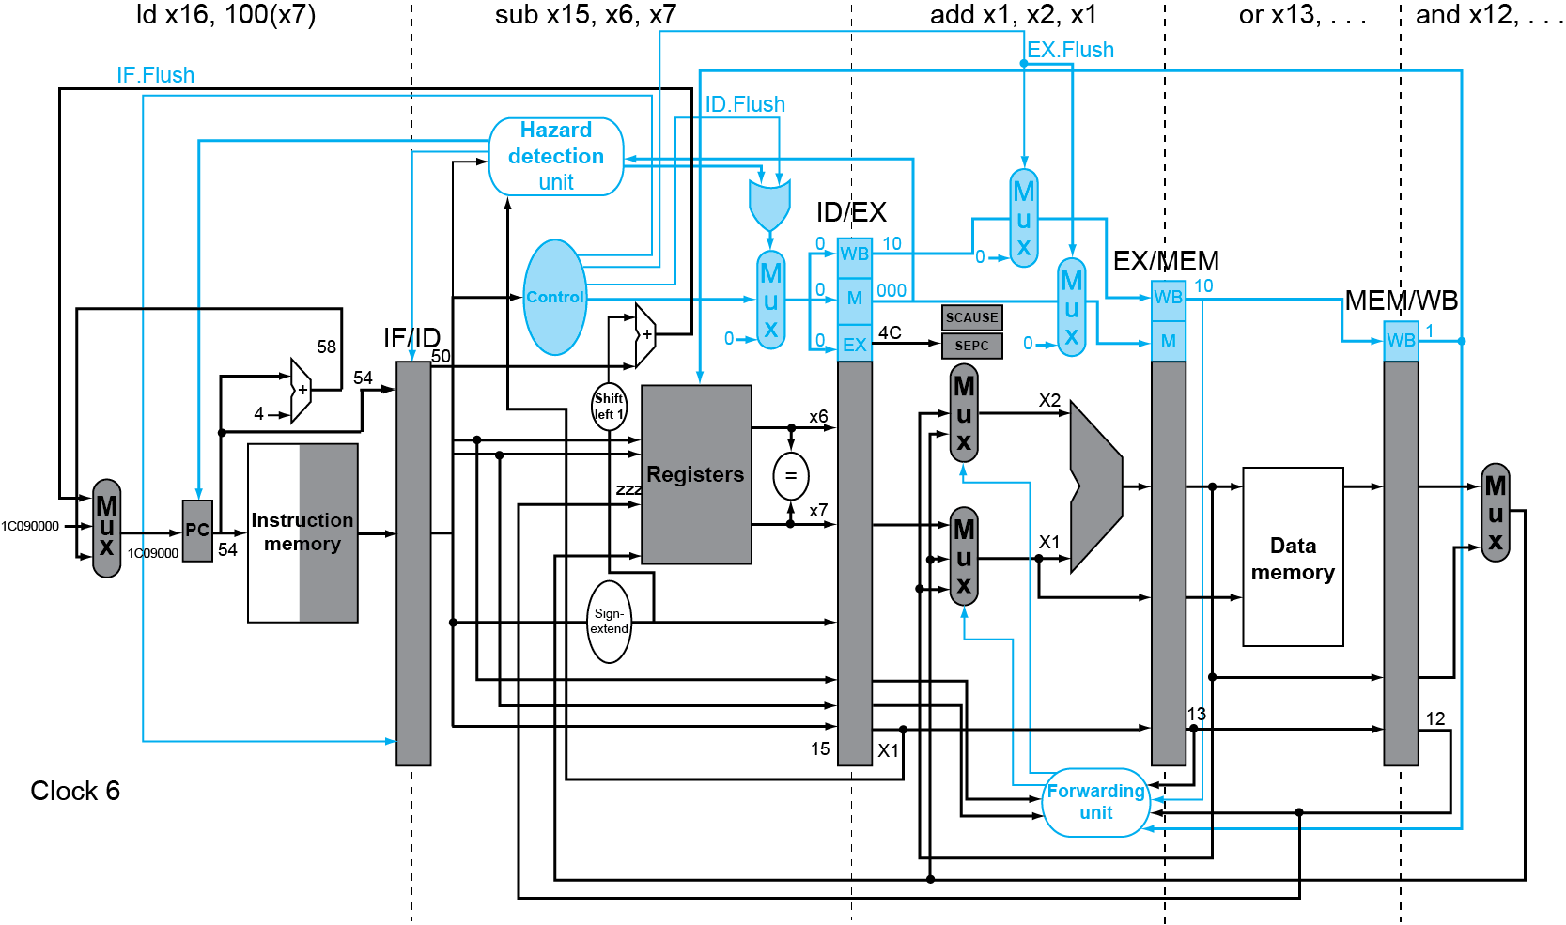
Exception Example
These signals are set
if add malfunctioned
Handler address is used for IF in next cycle

Slide 19
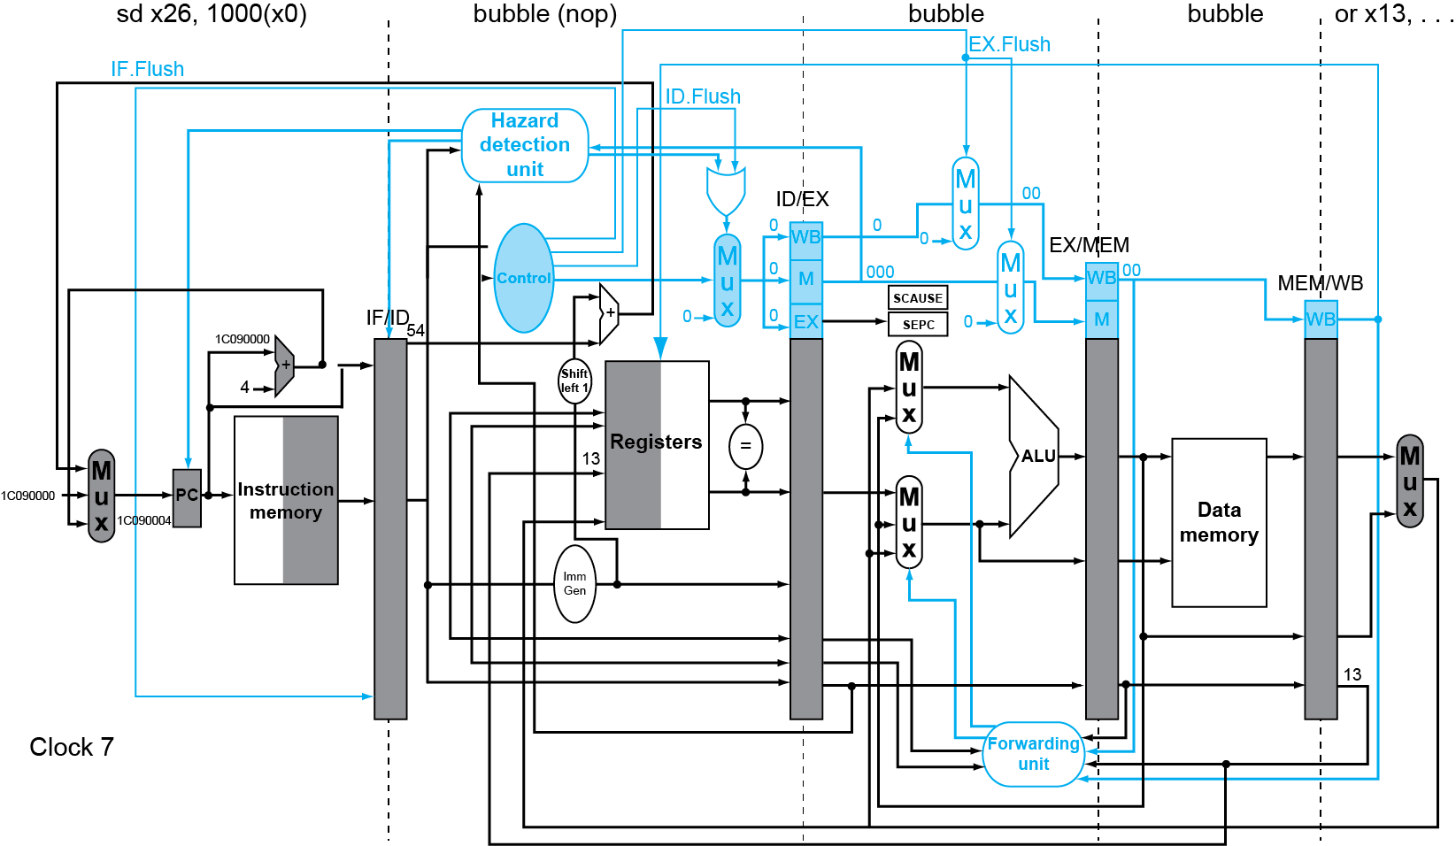
Exception Example
Offending instruction (add x1, x2, x1) becomes a bubble (so it won’t clobber registers)
Instructions in exception handler

Slide 20
Instruction-Level Parallelism (ILP)
Pipelining: execute multiple instructions in parallel
To increase ILP
Deeper pipeline
Less work per stage ⇒ shorter clock cycle
Multiple issue
Replicate pipeline stages ⇒ multiple pipelines
Start multiple instructions per clock cycle
Finish multiple Instructions Per Cycle (IPC>1)
E.g., 4GHz 4-way multiple-issue
16 billion instructions/sec, peak IPC = 4 (CPI = 1/IPC = 0.25)
Challenges: dependencies among multi-issued instructions
reduce peak IPC this

Slide 21
Multiple Issue
Static multiple issue (Very Long Instruction Word)
Compiler groups instructions to be issued together
Compiler detects and avoids hazards
Dynamic multiple issue (superscalar)
CPU examines instruction stream and chooses instructions to issue each cycle
Compiler can help by reordering instructions
CPU resolves hazards using advanced techniques at runtime

Slide 22
Static Multiple Issue
Compiler groups instructions into “issue packets”
Group >1 instructions in an issue packet to be issued in a single cycle
Instructions within a packet must have no dependencies
Reorder
Add nop
Think of an issue packet as a very long instruction
Specifies multiple concurrent operations
⇒ Very Long Instruction Word (VLIW)

Slide 23
Dynamic Multiple Issue
“Superscalar” processors
CPU decides whether to issue 0, 1, 2, … each cycle
Avoiding structural and data hazards
Avoids the need for compiler scheduling
Though it may still help
Code semantics ensured by the CPU

Slide 24
Dynamic Pipeline Scheduling
Allow the CPU to execute instructions out of order to avoid stalls
But commit result to registers in order
Example
ld x31,20(x21) add x1,x31,x2 sub x23,x23,x3 andi x5,x23,20
Can start sub while add is waiting for ld

Slide 25
Why Do Dynamic Scheduling?
Why not just let the compiler schedule code?
Not all stalls are predicable
e.g., cache misses
Can’t always schedule around branches
Branch outcome is dynamically determined
Different implementations of an ISA have different latencies and hazards

Slide 26
Does Multiple Issue Work?
Yes, but not as much as we’d like
Programs have real dependencies that limit ILP
Some dependencies are hard to eliminate
e.g., pointer aliasing
Memory delays and limited bandwidth
Hard to keep pipelines full
Speculation can help if done well

Slide 27
Multiple-issue benefits from loop unrolling
Replicate loop body to expose more parallelism
Reduces loop-control overhead
Avoid loop-carried dependency
Store followed by a load of the same register
//suppose x20=&x[0]
//x22 = &x[100]
Loop:
ld x31, 0(x1)
add x31, x31, x30
sd x30, 0(x1)
ld x29, 8(x1)
add x29, x29, x28
sd x28, 8(x1)
addi x20, x20, 16
blt x20, x22, Loop
long x[100];
…
for (int i = 0; i < 100; i++) {
x[i] *= 2;
}
//suppose x1=&x[0]
//x2 = &x[100]
Loop:
ld x31, 0(x1)
add x31, x31, x30
sd x30, 0(x1)
addi x1, x1, 8
blt x1, x2, Loop

Slide 28
Power Efficiency
Complexity of dynamic scheduling and speculations requires power
Multiple simpler cores may be better
Microprocessor | Year | Clock Rate | Pipeline Stages | Issue width | Out-of-order/ Speculation | Cores | Power
i486 | 1989 | 25MHz | 5 | 1 | No | 1 | 5W
Pentium | 1993 | 66MHz | 5 | 2 | No | 1 | 10W
Pentium Pro | 1997 | 200MHz | 10 | 3 | Yes | 1 | 29W
P4 Willamette | 2001 | 2000MHz | 22 | 3 | Yes | 1 | 75W
P4 Prescott | 2004 | 3600MHz | 31 | 3 | Yes | 1 | 103W
Core | 2006 | 2930MHz | 14 | 4 | Yes | 2 | 75W
UltraSparc III | 2003 | 1950MHz | 14 | 4 | No | 1 | 90W
UltraSparc T1 | 2005 | 1200MHz | 6 | 1 | No | 8 | 70W

Slide 29
ARM Cortex A53 and Intel i7
Processor | ARM A53 | Intel Core i7 920
Market | Personal Mobile Device | Server, cloud
Thermal design power | 100 milliWatts (1 core @ 1 GHz) | 130 Watts
Clock rate | 1.5 GHz | 2.66 GHz
Cores/Chip | 4 (configurable) | 4
Floating point? | Yes | Yes
Multiple issue? | Dynamic | Dynamic
Peak instructions/clock cycle | 2 | 4
Pipeline stages | 8 | 14
Pipeline schedule | Static in-order | Dynamic out-of-order with speculation
Branch prediction | Hybrid | 2-level
1st level caches/core | 16-64 KiB I, 16-64 KiB D | 32 KiB I, 32 KiB D
2nd level caches/core | 128-2048 KiB | 256 KiB (per core)
3rd level caches (shared) | (platform dependent) | 2-8 MB

Slide 30
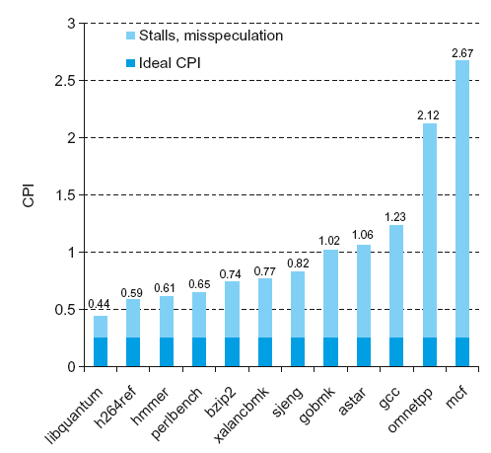
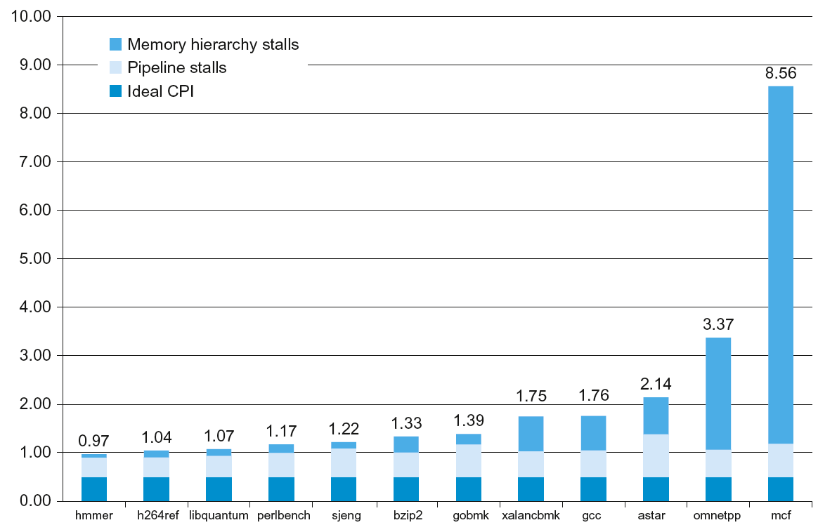
Real world processor performance
Ideal CPI=0.25 because of 4 issue
ARM Cortex-A53
Ideal CPI=0.5 because of 2 issue
Intel core i7

Slide 31
Ways to improve performance: subword parallelism
ML/graphics applications perform same operations on vectors
Partition a 128-bit adder into:
Sixteen 8-bit adds
Eight 16-bit adds
Four 32-bit adds
Also called data-level parallelism, vector parallelism, or Single Instruction, Multiple Data (SIMD)
Intel’s AVX introduces 256-bit floating point registers
8 single-precision ops
4 double-precision ops

Slide 32
Example: unoptimized matrix multiplication
1. void dgemm (int n, double* A, double* B, double* C)
2. {
3. for (int i = 0; i < n; ++i)
4. for (int j = 0; j < n; ++j)
5. {
6. double cij = C[i+j*n];
7. for(int k = 0; k < n; k++ )
8. cij += A[i+k*n] * B[k+j*n];
9. C[i+j*n] = cij;
10. }
11. }

Slide 33
Matrix Multiply: optimized C
1. #include <x86intrin.h>
2. void dgemm (int n, double* A, double* B, double* C)
3. {
4. for ( int i = 0; i < n; i+=4 )
5. for ( int j = 0; j < n; j++ ) {
6. __m256d c0 = _mm256_load_pd(C+i+j*n); /* c0 = C[i][j] */
7. for( int k = 0; k < n; k++ )
8. c0 = _mm256_add_pd(c0, /* c0 += A[i][k]*B[k][j] */
9. _mm256_mul_pd(_mm256_load_pd(A+i+k*n),
10. _mm256_broadcast_sd(B+k+j*n)));
11. _mm256_store_pd(C+i+j*n, c0); /* C[i][j] = c0 */
12. }
13. }

Slide 34
AVX Optimized Matrix multiply
256-bit wide FP register
1. vmovapd (%r11),%ymm0 # Load 4 elements of C into %ymm0
2. mov %rbx,%rcx # register %rcx = %rbx
3. xor %eax,%eax # register %eax = 0
4. vbroadcastsd (%rax,%r8,1),%ymm1 # Make 4 copies of B element
5. add $0x8,%rax # register %rax = %rax + 8
6. vmulpd (%rcx),%ymm1,%ymm1 # Parallel mul %ymm1,4 A elements
7. add %r9,%rcx # register %rcx = %rcx + %r9
8. cmp %r10,%rax # compare %r10 to %rax
9. vaddpd %ymm1,%ymm0,%ymm0 # Parallel add %ymm1, %ymm0
10. jne 50 <dgemm+0x50> # jump if not %r10 != %rax
11. add $0x1,%esi # register % esi = % esi + 1
12. vmovapd %ymm0,(%r11) # Store %ymm0 into 4 C elements

Slide 35
Ways to improve performance: loop unrolling
Replicate loop body to expose more parallelism
Reduces loop-control overhead
Avoid loop-carried dependency
Store followed by a load of the same register

Slide 36
Ways to improve performance: loop unrolling
Loop unrolling: replicate loop body
Unrolling exposes more parallelism for multi-issue pipelined CPU
Reduces loop-control overhead
Avoid loop-carried dependency
Store followed by a load of the same register
//suppose x20=&x[0]
//x22 = &x[100]
Loop:
ld x31, 0(x1)
add x31, x31, x30
sd x30, 0(x1)
ld x29, 8(x1)
add x29, x29, x28
sd x28, 8(x1)
addi x20, x20, 16
blt x20, x22, Loop
long x[100];
…
for (int i = 0; i < 100; i++) {
x[i] *= 2;
}
//suppose x1=&x[0]
//x2 = &x[100]
Loop:
ld x31, 0(x1)
add x31, x31, x30
sd x30, 0(x1)
addi x1, x1, 8
blt x1, x2, Loop

Slide 37
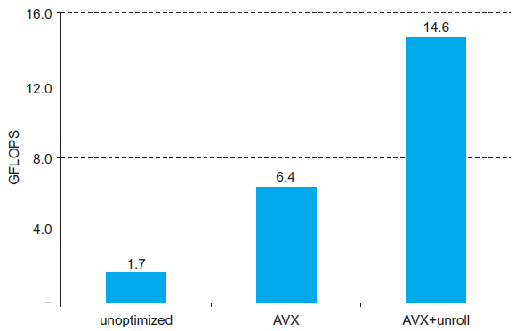
Performance Impact

Slide 38
Summary on CPU design
ISA influences design of datapath and control
Datapath and control influence design of ISA
Pipelining improves instruction throughput using parallelism
More instructions completed per second
Latency for each instruction not reduced
Hazards: structural, data, control
Multiple issue and dynamic scheduling (ILP)
Dependencies limit achievable parallelism
Complexity leads to the power wall

