Slide 1
Computer Systems Organization Recitation CSCI-UA 0201-007
R01: Introduction & Environment Setup
Many slides are based on John Westhoff’s Fall 2019 CSO recitation

Slide 2
Before we get started
Go to https://nyu-cso.github.io/labs/ and start the download for the version of VirtualBox relevant to you
Start the download for the class VM image

Slide 3
Logistics
Important things you should know

Slide 4
What is this recitation for?
Help you better understand the course contents, including but not limited to:
- Reinforce this week’s lecture content
- Review previous week’s assessment
- Some exercises meant to help with the labs/assessments
Make us all suffer by forcing us out of bed early

Slide 5
Where we release course materials
Course website
https://nyu-cso.github.io/
Recitation slides also on the course schedule page
NYU Classes
- Zoom links/recording
CampusWire
It’s your responsibility to read Instructor’s Note on Campuswire
You are encouraged to ask questions on Campuswire
GitHub
- All labs are released on GitHub
You will submit all labs on both GitHub and Gradescope
Gradescope
- Weekly mini-quiz on Gradescope

Slide 6
How to contact us
Don’t be afraid to ask questions!
If you have general questions about course contents or labs
Ask on Campuswire
Come to office hours
Register the in-person recitation
If you want to send us a private message
- Email cso-staff mailing list at cso-staff@cs.nyu.edu
- Include your name, your GitHub username, and your NYU NetID
If you want more personal tutorial or question answering

Slide 7
How are we going to proceed?
For the first two weeks, we will focus on environment setups, usage of basic tools, etc.
Today we will cover environment related setups
Next recitation will cover programming tools (6 labs, bonus)
From the third week
We will review weekly assessment, reinforce some course contents, exercises to prepare for your labs
Weekly assessments will be due Friday 9pm EST
Done on Gradescope, do it early
No late submission

Slide 8
Academic Integrity
All work must be your own – do not copy or even look at assignments done by others
Don’t ask StackOverflow or Chegg for help - if you need it, ask us!
Don’t hire someone to do your work for you
We reserve the right to use software plagiarism detection tools such as Moss
It’s not worth the risk, just don’t cheat and make us sad

Slide 9
Getting Started
Important things you must do

Slide 10
Today’s Topics
Setting up your virtual machine
Setting up your git repositories
Basic Unix commands
Program development
Editor (Sublime)
Version control (Git)

Slide 11
Today’s Goal
By the end of today’s recitation, your should
Have the class virtual machine installed
Have GitHub ready for you to submit work
An account
Lab-1 repository
Know how to submit assignments

Slide 12
Basic virtual machine setup
Follow https://nyu-cso.github.io/labs/ instructions to
Download VirtualBox 6.0.10
Download our VirtualBox image
Launch VirtualBox and import the image
Launch Lubuntu Linux
Username “lab”, password “lab12345”

Slide 13
Advanced VM setup
After finishing the basic setup, you are good to go
But if you want to
Resize the VM window to full screen nicely
Copy and paste between the VM and your laptop
Move files between your laptop and the VM
Then check our the Lab instruction page!
https://nyu-cso.github.io/labs/
Recommend it!

Slide 14
Attention: You MUST test your code in your class virtual machine
We recommend you to do your labs in your virtual machine we provide to you, and test it before submission
More tools are available for debugging in VM (gdb etc.)
Gradescope runs the same test script
In general, there should be no surprises
If you choose to do your labs outside of the class virtual machine, we will not provide any technical support should you encounter any OS-related issues in doing the labs

Slide 15
Open up a terminal
Click the “LXterminal” icon on the desktop
OR click start icon (the bottom left icon)
Click “System Tools” and then “LXterminal”
OR use the keyboard shortcut
Ctrl + Alt+ T
To copy paste in a terminal, you need to use
Ctrl + Shift + C to copy
Ctrl + Shift + V to paste
Or just right click

Slide 16
Basic Commands
Some useful commands to know:
man
ls, cd, pwd, mkdir
cp, mv, rm
echo, cat
wc
grep
ctrl-c,ctrl-d, ctrl-z, fg, bg
|, >, <, >>
apt install/search
history, ctrl-r

Slide 17
Basic Commands
Whenever you want to find out how to do something using command line, ask Google first
Here is a link contains useful command, for both beginners and experienced users:
https://github.com/jlevy/the-art-of-command-line

Slide 18
Editor
You need a good editor to code with for productivity
Popular editors used by programmers:
vim
emacs
vscode
sublime
We recommend you use Sublime Text
Which should be already installed on the VM image

Slide 19
Setup GitHub/lab1 repo
Create a GitHub account if you don’t have one
We have created for you a corresponding private lab repository on Github.com
Enroll yourself in the GitHub classroom
Create your lab-1 repository by clicking the link below
https://classroom.github.com/a/RvmnAdGI
Select your NYU NetID
Very important!
Don’t select someone else’s NetID!
If you cannot find your NetID, let me know!

Slide 20
Git Overview
Create things
Save things
Edit things
Distributed version control system
What is version control?
Manages changes to documents, source files and other collections of information
Why is version control indispensable?
History tracking: track code changes
Roll back to older version
Collaborate with others (collaborative history tracking)
We are going to use the popular “Git” as our version control system
Save the thing again

Slide 21
You need to config git first!
git config --global user.email “<Your Email>”
git config --global user.name “<Your Name>”
You can issue “git config --list” to check your configuration
Here, the <Your Email> should be the one associated with your GitHub account

Slide 22
A list of git commands you need
git clone
git status
git remote
git add <file name>
git commit -m <commit messages>
git push origin master
git pull upstream master

Slide 23


Git Overview
GitHub
GitHub:
provides hosting for software development and version control using Git.
Pull assignments from GitHub (clone lab repo)
Submit assignments to GitHub
Make changes locally
Your VM

Slide 24
Clone your lab repo locally
In command line, type:
mkdir cso-labs
cd cso-labs
git clone https://github.com/nyu-cso-fa20/clab-part1-<YourGithubUsername>.git lab1
If you copy the above command to command line, don’t let the line break
Replace <Your GitHub Username> (including the angle brackets) with your GitHub username.
cd lab1

Slide 25
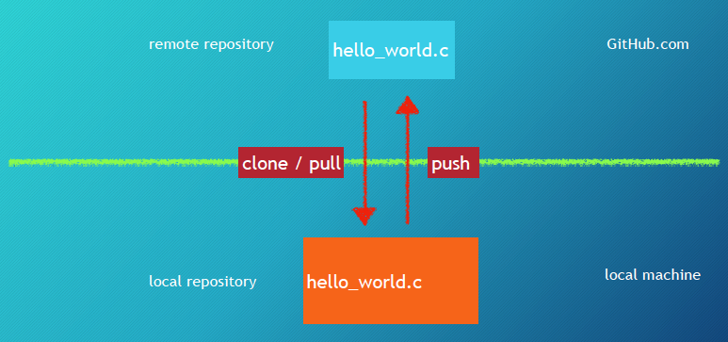
Git Setup
The remote copy is stored in some efficient format

Slide 26
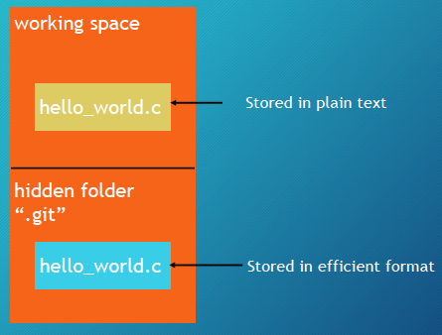
A closer look at your local repository
Local repository

Slide 27
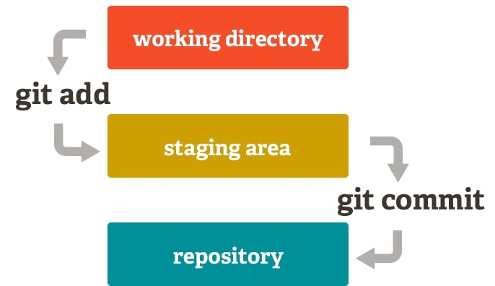
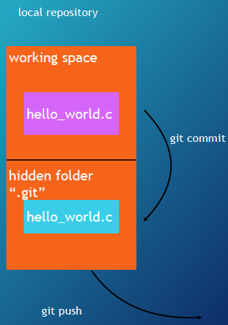
How to interact with Git
git add hello_world.c
Tell git to track changes to hello_world.c
git commit
Store tracked file to .git
git push origin master
Submit commits to your remote repository

Slide 28
For each new assignment
Create lab repo on GitHub (click link, select yourself)
Clone your lab repo locally
cd cso-labs
git clone https://github.com/nyu-cso-fa20/clab-part1-<YourGithubUsername>.git lab1
Then make changes locally in the VM
Tell git to track changes
git add filenames
Commit your changes
git commit -m “commit messages”
Push to your remote repository (on GitHub)
git push origin master

Slide 29
Git commit
When you issue “git commit”, you need to provide a message which is a short description of the changes you made
You can use “-m” option to provide the commit message
E.g.: git commit -m “my first commit”
If you don’t use “-m” option, an command line editor will pop up for you to edit the commit message
By default, nano

Slide 30
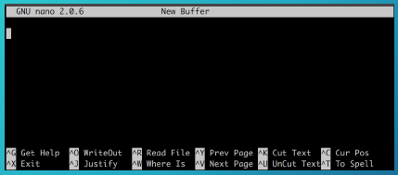
How to get out of Nano Editor
The default editor is called Nano
To add a commit message from nano
First type in some commit message
Hit Ctrl+O to save your commit message (^ means Ctrl)
Hit Ctrl+X to exit

Slide 31
Double check with “git status”
Sometimes, you might forget to do some (or all) of
git add, git commit, git push
It’s always good to check the status of your repository
git status tells you
What files are going to commit
What files are not tracked
Whether you forget to push commits to remote

Slide 32
Triple check with GitHub
Still not sure/confident about whether assignment was submitted properly?
Go to github.com, then go to your repo
Manually check if every file contains the up-to-date information

Slide 33
Git is much powerful than that
Our git introduction only covers a small part of Git
Git tutorial:
https://www.atlassian.com/git/tutorials/what-is-versioncontrol
https://try.github.io/levels/1/challenges/1

Slide 34

All the git commands you need for CSO
For beginners, it’s super easy to mess up Git
After setting lab repository, you ONLY need to use the follwing git commands:
git add filenames
git commit -m “commit message”
git push origin master
git clone your-lab-repo lab
git status
Warning: unless you know what you are doing, do not use any other git commands or git command flags

Slide 35
Ask the staff for help
If you really cannot fix conflicts or other git problems, you should ask course staff for help
You need to email the staff or attend office hours
Online makes things harder..
You should start your lab earlier
Don’t randomly issue commands to further mess things up

Slide 36
Things you should NEVER do
Don’t use git add *, git add .
Instead, you should always specify the file names you want to commit
Please don’t add complied programs to git
Don’t modify any file using GitHub website
Instead, you should always make changes locally on your laptop and then push commits to GitHub
Otherwise, there will be conflicts, which will lead to sadness

