Slide 1
CSO-Recitation 11 CSCI-UA 0201-007
R11: Assessment 10 & Combinational logic

Slide 2
Today’s Topics
Assessment 10
Lab-4
Combinational logic
How to build a combinatorial logic circuit
MUX

Slide 3
Assessment 10

Slide 4

Q1 Implicit list
Suppose your implicit list design uses both header and footer. Both have the following type (Lecture slides 30):
get_status()
get_size()
set_size_status()
set_status()
set_size()
payload2header()
payload2footer()
footer2header()
curr2prev()
…
Basic helper
Find in lecture slides

Slide 5
Q1.1 payload2header example
Suppose a user invokes free(p) using pointer p whose value is 0x789012345670. What is the memory address for the start of the chunk that contains the allocated space (payload) that should be freed? (To faciliate autograding, please write your answer in hex with prefix 0x, ignoring leading zeros and using lowercase letters)
0x789012345660
0x789012345660
size | status
header padding
Payload (data+padding)
size | status
padding
header
(16 bytes)
p=0x789012345670

Slide 6
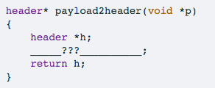
Q1.2 payload2header
`payload2header` takes as argument a pointer to the start of the payload in the chunk, and returns a pointer to the chunk's header.
Which of the following C statement to use for the missing line?
h = (header *)p - sizeof(header);
h = (header *)p - 1;
h = (header *)((char *)p - sizeof(header));
h = (char *)p - 1;
None of the above.
pointer arithmetic: -1 ⬄ -sizeof(header) bytes
logic: h=p-(sizeof(header) bytes)
pointer arithmetic: -1 ⬄ -sizeof(char)=1 bytes -sizeof(header) ⬄ -sizeof(header) bytes

Slide 7
Q1.3 header2footer example
Suppose pointer variable h points to the beginning of a chunk and has value 0x7890123456a0. If the total size of the chunk is 1KB (including header and footer fields), then what is the memory address for the footer of this chunk?
0x789012345a90
h=0x7890123456a0
size | status
header padding
Payload (data+padding)
size | status
padding
chunk size
(1KB=0x400B)
0x789012345a90
footer
(16B=0x10B)
0x789012345aa0

Slide 8
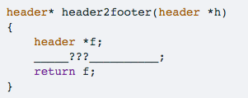
Q1.4 header2footer
`header2footer` takes as argument a pointer to the start of the chunk, and returns a pointer to the same chunk's footer.
Which of the following C statement to use for the missing line? Note that `get_size` is a helper function that returns the chunk size encoded in the header/footer field size_n_status.
f = h + 1;
f = h - 1;
f = h + get_size(h);
f = (header *)((char *)h + get_size(h));
f = h - get_size(h);
f = (header *)((char *)h - get_size(h));
f = (header *)((char *)h + get_size(h) - sizeof(header));
f = (header *)((char *)h - get_size(h) + sizeof(header));
None of the above.
Q: how many bytes does it step forward?
logic: f=h +(chunk_size bytes) -(footer_size bytes)
cast to char: +1 <=> +1 byte

Slide 9
Q1.5 footer2header example
Suppose pointer variable f points to the beginning of a chunk's footer and has value 0x789012345a90. If the total size of the chunk is 1KB (including header and footer fields), then what is the memory address for the header of this chunk?
0x7890123456a0
0x7890123456a0
size | status
header padding
Payload (data+padding)
size | status
padding
chunk size
(1KB=0x400B)
Exactly the same as Q1.3
f=0x789012345a90
footer
(16B=0x10B)
0x789012345aa0

Slide 10
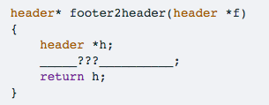
Q1.6 footer2header
`footer2header` takes as argument a pointer to the footer of the chunk, and returns a pointer to the same chunk's header.
Which of the following C statement to use for the missing line? Note that `get_size` is a helper function that returns the chunk size encoded in the header/footer field size_n_status.
h = f + 1;
h = f - 1;
h = f + get_size(f);
h = (header *)((char *)f + get_size(f));
h = f - get_size(f);
h = (header *)((char *)f - get_size(f));
h = (header *)((char *)f + sizeof(header) - get_size(f));
h = (header *)((char *)f - sizeof(header) + get_size(f));
None of the above.
logic: h=f
+(footer_size bytes) -(chunk_size bytes)

Slide 11
Q1.7 curr2prev example
Suppose pointer variable h points to the beginning of some chunk and has value 0x789012345aa0. Suppose this chunk has size 4KB and its previous chunk has size 1KB. What is the memory address for the beginning of its previous chunk?
0x7890123456a0
logic: h - size of the previous chunk
0x789012345aa0 – 1KB
0x789012345aa0 – 0x400 = 0x7890123456a0

Slide 12
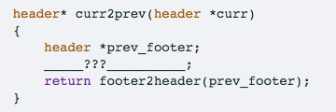
Q1.8 curr2prev example
`curr2prev` takes as argument a pointer to the current chunk's header, and returns a pointer to the previous chunk's header.
Which of the following C statement to use for the missing line? Note that footer2header is the helper function that returns a pointer to the chunk's header given a pointer to the same chunk's footer.
prev_footer = curr -1 ;
prev_footer = curr - sizeof(header);
prev_footer = (header *)((char *)curr - sizeof(header));
prev_footer = curr - 2;
prev_footer = curr - 2*sizeof(header);
prev_footer = (header *)((char *)curr - 2*sizeof(header));
None of the above.
curr2prev
curr_header2prev_footer
prev_footer2prev_header -> footer2header
curr_header2prev_footer
curr - (sizeof(header) bytes)
⬄ curr - 1
size | status
padding
size | status
header padding
prev_footer
current_header

Slide 13
Q2 Explicit list
Which of the following statements are true about explicit list?
The explicit list design explicitly chains together all chunks of the heap into a linked list.
The explicit list design explicitly only chains together all free chunks of the heap into a linked list.
The explicit list design incurs more memory overhead than the implicit list design because it uses extra space in the header to store the next/prev fields.
malloc(...) in the explicit list design is faster than that of implicit list because it does not need to scan over allocated chunks.
free(...) in the explicit list design is faster than that of implicit list because it does not need to scan over allocated chunks.

Slide 14
Q2 Explicit list, Choice C
Explicit List Allocated
Implicit List Allocated
size | status
header padding
Payload (data+padding)
size | status
padding
header
(16 bytes)
No difference
size | status
header padding
Payload (data+padding)
size | status
padding
header
(16 bytes)
>=16 bytes
>=16 bytes
footer
(16 bytes)
footer
(16 bytes)

Slide 15
Q2 Explicit list, Choice C
Explicit List Allocated
Implicit List Allocated
size | status
header padding
Payload (data+padding)
size | status
padding
No difference
size | status
header padding
Payload (data+padding)
size | status
padding

Slide 16
Q2 Explicit list, Choice C
Explicit List Allocated
Implicit List Allocated
free
free
size | status
header padding
Payload (data+padding)
size | status
padding
Explicit List reuses the payload space to store next/prev
No extra space needed!
size | status
header padding
Payload (data+padding)
size | status
padding
next
prev

Slide 17
Q2 Explicit list, Choice C
Explicit List Allocated
Implicit List Allocated
free
free
size | status
header padding
Payload (data+padding)
size | status
padding
Explicit List reuses the payload space to store next/prev
No extra space needed!
size | status
header padding
Payload (data+padding)
size | status
padding
next
16 bytes
prev
>=16 bytes

Slide 18
Q3 Buddy system
A special case of segregated list:
each freelist has identically-sized blocks
block sizes are power of 2
allocate:
Recursive split in half
free:
Recursively merge
Which of the following statements are true about the buddy system?
All chunks have sizes that are powers-of-2.
During free(...), coalescing only happens once by merging the freed chunk with its buddy of the same size if the buddy is free.
During free(...), coalescing is done recursively by repeatedly merging the freed chunk with its buddy of the same size and repeating the merge process for the resulting larger free chunk until its buddy is no longer free.
The design maintains multiple free lists each of which contains free chunks of the same (powers-of-2) size.
The design maintains a single free list containing all free chunks.

Slide 19
Q3 Buddy system
malloc (e.g., A=malloc(0.8KB))
round to powers of 2 (0.8KB -> 1KB)
find the non-empty free list with closest chunk size
found 4KB list
Recursively split until having right size
Allocate
Assume the heap is 4KB, and initially all free
h1
4KB | 2KB | 1KB | …
->h1 | NULL | NULL | NULL
Free Lists
4KB
h2
2KB | 2KB
NULL | ->h1->h2 | NULL | NULL
h3
1KB | 1KB | 2KB
NULL | ->h2 | ->h1->h3 | NULL
A | 1KB | 2KB
NULL | ->h2 | ->h3 | NULL

Slide 20
Q3 Buddy system
Free
set status bit
recursively coalesce with buddies
Quick rule for checking if 2 chunks are buddies: if they are directly split from the same chunk, they are buddies
e.g., h1&h2, h3&h4 are buddies
h1
h2
h3
h4
4KB | 2KB | 1KB | …
NULL | NULL | ->h2 | NULL
Free Lists
A | 1KB | B | C
No coalesce as they are not buddies of each other
A | 1KB | 1KB | C
NULL | NULL | ->h3->h2 | NULL
A | 1KB | 2KB
NULL | ->h3 | ->h2 | NULL
4KB
h1 | NULL | NULL | NULL

Slide 21
Q3 Buddy system
Free
set status bit
recursively coalesce with buddies
h1
h2
h3
h4
4KB | 2KB | 1KB | …
NULL | NULL | ->h2 | NULL
Free Lists
A | 1KB | B | C
A | 1KB | 1KB | C
NULL | NULL | ->h3->h2 | NULL
A | 1KB | 2KB
NULL | ->h3 | ->h2 | NULL
4KB
h1 | NULL | NULL | NULL

Slide 22
Lab-4

Slide 23
Lab-4
If you don’t do bonus
only need to write code in file `mm-implicit.c`
a very simple design -> malloc using implicit list without footer
Complete helper function next_chunk and use it to complete the heap checker function mm_heapcheck
Complete helper functions ask_os_for_chunk, split, first_fit and use them to implement mm_malloc
Complete helper functions payload2header, coalesce and use them to implement mm_free
Complete mm_realloc
Tips
Please follow the instruction & comment code! – the lab shouldn’t be hard
Review helper functions, pseudocode, steps summary
Due after Thanksgiving, encourage to do bonus part

Slide 24
realloc
In the C, the realloc function is used to resize a block of memory that was previously allocated
The realloc function allocates a block of memory (which be can make it larger or smaller in size than the original) and copies the contents of the old block to the new block of memory, if necessary
void *realloc(void *ptr, size_t size);
if ptr is NULL, the call is equivalent to malloc(size)
if size is equal to zero, the call is equivalent to free(ptr)
if ptr is not NULL, it must have been returned by an earlier call to malloc or realloc

Slide 25
realloc
Copies the contents of the old block to the new block of memory, if necessary
If the new block is larger, everything else is uninitialized
How to copy data?
See a C library function, memcpy()
void *memcpy(void *dest, void * src, size_t n)
copies n characters from memory area src to memory area dest.

Slide 26
Lab4 FAQ
Check if h is the last chunk
Check if heap is empty
Please read https://github.com/nyu-cso-fa21/lab4/blob/master/memlib.h and https://github.com/nyu-cso-fa21/lab4/blob/master/memlib.c
Tip: reuse your code
e.g., “get the first chunk’s address” is implemented in next_chunk, call next_chunk in other places you need
next_chunk(NULL):
If the heap is empty: return NULL;
Else, return the first chunk;

Slide 27
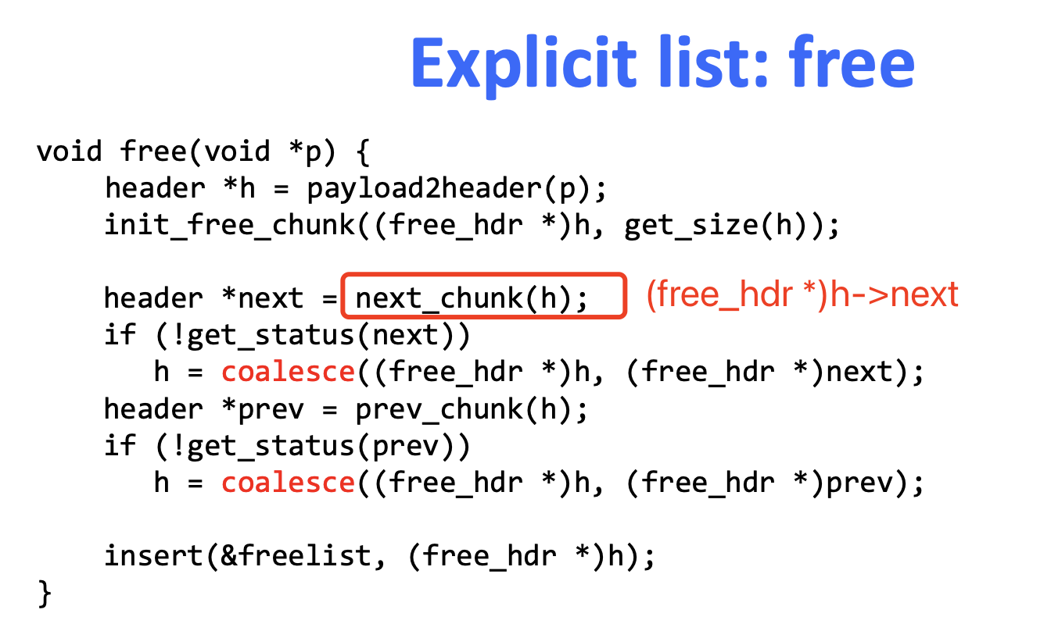
Lab4 FAQ
Free_head
h1
free
Alloc
Alloc
Alloc
free
h2
h3
h4
free
h5
h4->next == h1, not physically consecutive!
next_chunk(h4) == h5

Slide 28
Combinational logic
Building Blocks

Slide 29
How we get there..
Instruction set (e.g. X86) is the interface between software and hardware
Logic design
assumes the existence of a collection of standard logic components
made from logic gates -> made from small groups of transistors
studies the organization of primitive logic components into subsystems that perform calculation and data transfer
e.g. An arithmetic-logic unit (ALU) is the part of a CPU that carries out arithmetic and logic operations on the operands in computer instruction words

Slide 30
Combinational Logic
There is no memory
That is, the outputs are a function ONLY of the current inputs, not of anything in the past
Values are either true or false (but not both, or anything else)
We commonly represent true with 1 and false with 0
There is at least one input and at least one output
But there can be more
Each input is either true or false
Each output should be defined for all possible values for the inputs!

Slide 31
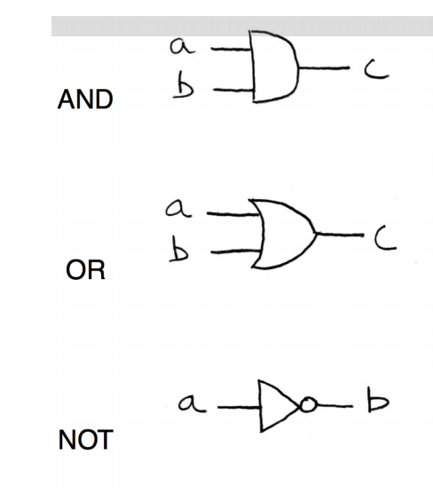
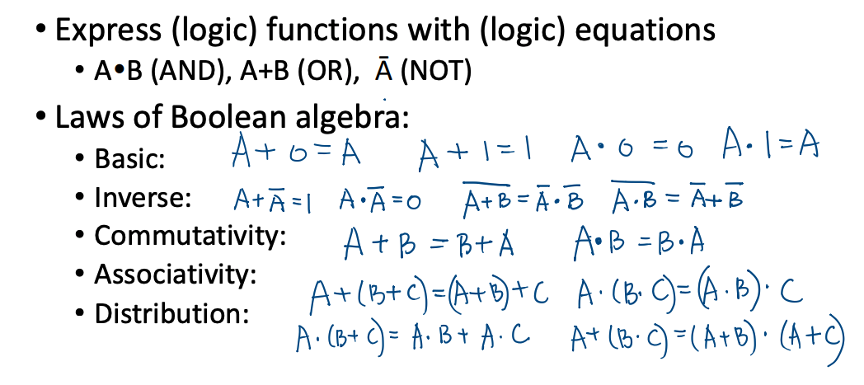
Basics

Slide 32
Boolean Algebra Exercise
Try to simplify the following equations
xy+xyz
x(x+y)

Slide 33
Boolean Algebra Exercise
Try to simplify the following equations
xy+xyz
x(x+y)
=xy(1+z)=xy
=x+xy=x(1+y)=x

Slide 34
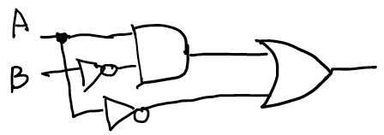

Boolean functions
Boolean function: takes in boolean inputs and return boolean output
There are three main ways to represent boolean functions
1. As a circuit diagram (built from gates)
2. As a set of boolean equations/expressions
3. As a truth table
A | B | C
0 | 0 | 1
0 | 1 | 1
1 | 0 | 1
1 | 1 | 0
$$A\overline{B}+ \overline{A}$$

Slide 35
More gates
You are already familiar with the most important ones!
AND, OR, NOT
All boolean functions can be written with these three building blocks!
There are others, like XOR and NAND
A NAND B means NOT(A AND B)
All boolean functions can be written with just NAND!!!
e.g. NOT(A) == NAND(A,A); AND(A,B) == (A NAND B) NAND (A NAND B)

Slide 36
Combinational Logic Design
Basic logic design
Logic circuits == Boolean functions
Combinational Logic circuit: a type of circuit without memory
That is, the outputs are a function ONLY of the current inputs, not of anything in the past
How to build a combinational logic circuit with AND, OR and NOT
Step1: Specify the truth table
Step2: Output is the sum of products

Slide 37
Implement XOR with Combinational Logic
Step1: specify the truth table
Enumerate every possible inputs (2^N)
Compute the output
out =A XOR B
A | B | Out
0 | 0 | 0
0 | 1 | 1
1 | 0 | 1
1 | 1 | 0

Slide 38
Implement XOR with Combinational Logic
Step2: Result is the sum (OR) of products (clauses, i.e. a AND b AND …)
Look for rows of output=1
write a clause for each row
anywhere an input a is 1, write a Anywhere an input a is 0, write ~a
AND them together
OR clauses together
out=(~A)*B + A*(~B)
out =A XOR B
A | B | Out
0 | 0 | 0
0 | 1 | 1
1 | 0 | 1
1 | 1 | 0
(~A)*B
A*(~B)

Slide 39
Filling in a truth table
First, list out all of the possible inputs
For N inputs, there are 2^N possibilities
It helps to split things in two, that is, have space for the 2^N possibilities, and for the first variable put 0 for the first half and 1 for the second half
For the next variable, put 0 for the first half of the previous variable’s 0 group and 1 for the second half, then do the same for its 1 group
Then, evaluate the expression for each possible inputs
This is tedious, so there are some shortcuts, especially if the expression is written nicely

Slide 40
Filling in a truth table
Groups of things ANDed together are typically called a clause
That is, clauses are things separated by ORs
For each clause, see what the variables present are
For any variable that is negated, keep in mind that that variable is 0
For any other variable in the clause, keep in mind it is 1
Then, look through the truth table and wherever you see a row that has all of the variables in the clause with the right value, put a 1 for the output
Then when you are out of clauses, fill in 0 for any output left

Slide 41
Getting a circuit from a truth table
Find the sum of product
For each output, look for where that output is 1 in the truth table
Look at the list of inputs
anywhere an input a is 1, write a in the clause
Anywhere an input a is 0, write ~𝑎 in the clause
Say the output equals all of the clauses ORed together
Typically you can simplify, but that’s a topic for a different day

Slide 42
Multiplexor (MUX)
A multiplexor is a device which takes in multiple signals and outputs a single signal
The purpose of using a multiplexer is to make full use of the capacity of the communication channel and greatly reduce the cost of the system
MUX

Slide 43
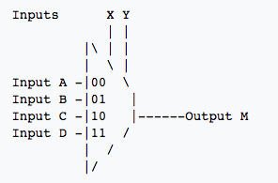
Multiplexor (MUX)
4-to-1 Multiplexor
It can be noted that 2^N input signals require N select signals
N selectors
2^N input signals

