Slide 1
C - Functions, Pointers
Jinyang Li

Slide 2
Announcement
Lab-1’s new deadline: 10/3

Slide 3
Lesson Plan
Control Flow
goto
Function & variable storage
Pointers

Slide 4
C’s Control flow
Same as Java
Conditional:
if ... else if ... else
switch
Loops: while, do while, for
continue
break

Slide 5
goto allows jump anywhere
while (cond) {
...
}
B:
...
for(...) {
for(...) {
for(...) {
goto error
}
}
}
error:
code handling error
Any control flow primitive can be
expressed as a bunch of goto’s.
A:
if (cond == false) goto B;
...
goto A
B:
...
May be the only acceptable scenario for goto
There’s no goto in Java or core Python
There’s no try/catch or try/except in C

Slide 6
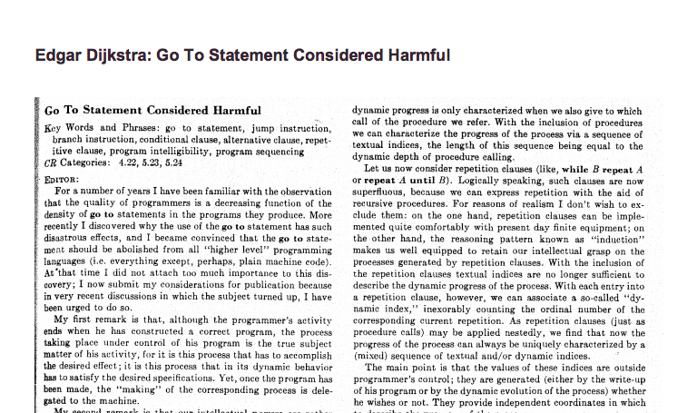
Avoid goto’s whenever possible

Slide 7
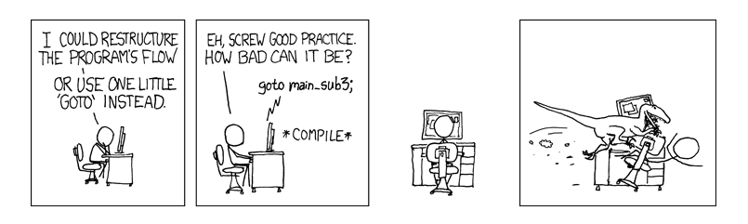
Avoid goto’s whenever possible

Slide 8
C is a procedural-language
C program consists of functions
Also called procedures or subroutines
Why breaking code into functions?
Readability and Reusability
Keep functions short
General rules of thumb
Small enough to keep the code in your head
Fits on screen without scrolling

Slide 9

Variable and its storage: local variable
Local variables are
defined inside a function
int add(int a, int b)
{
int r = a + b;
return r;
}
You can view function arguments
as local variables defined in
function body
r’s scope is in function add
Local variable scope:
Within the function/block the local variable is declared
Local variables with the same name in different scopes are unrelated
Shadowing: Nested variable “hides” the outer variable of the same name in areas where they are both in scope
int add(int a, int b)
{
int r = a;
{
int r;
r += b;
}
return r;
}
What does add compute?

Slide 10
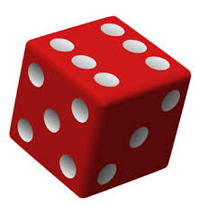
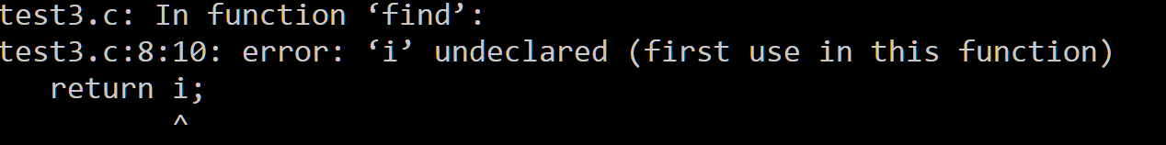
Variable and its storage: local variable scope
int find(int start, int end)
{
for (int i = start; i < end; i++) {
if ((i % 3) == 0)
break;
}
return i;
}
$gcc –std=c99 test.c

Slide 11
Variable and its storage: local variable scope
int find(int start, int end)
{
int r;
for (int i = start; i < end; i++) {
if ((i % 3) == 0) {
r = i;
break;
}
}
return r;
}
Correct?

Slide 12
Variable and its storage: local variable storage
Local variable storage:
allocated upon function invocation, not initialized
deallocated upon function return
void add(int a, int b)
{
int result = a + b;
return;
}
int main()
{
int result;
add(1, 2);
printf(“r=%d\n”, result);
}
Program output?

Slide 13
Variable and its storage: global variable
Global variables are defined
outside any function
#include <stdio.h>
int r = 0;
int sum(int a, int b)
{
r = a + b;
}
int main()
{
sum(1,2);
printf(“r=%d\n”, r);
}
int r = 0;
Global variable scope:
Can be accessed from within any function
May be shadowed
Global variable storage
Allocated upon program start, initialized to 0
Deallocated when entire program exits

Slide 14
Function invocation: pass by value
C (and Java) passes arguments by value
void swap(int x, int y)
{
int tmp = x;
x = y;
y = tmp;
}
int main()
{
int x = 1;
int y = 2;
swap(x, y);
printf(“x: %d, y: %d”, x, y);
}
?
?
Result x: 1, y: 2

Slide 15
Function invocation: pass by value
void swap(int x, int y)
{
int tmp = x;
x = y;
y = tmp;
}
int main()
{
int x = 1;
int y = 2;
swap(x, y);
printf(“x: %d, y: %d”, x, y);
}
main.x:
main.y:
…
swap.x:
swap.y:
swap.tmp:

Slide 16
Pointers
Pointer is a memory address

Slide 17
Pointer
0xff
…
...
char a = 1;
0x1c
0x1b
0x1a
0x19
0x18
0x17
0x16
0x15
0x14
Addresses are 8-byte long on 64-bit machine; for the same of brevity, I omit leading 0s.
0x13
0x12
0x11
a:
1
0x10
…

Slide 18
Pointer
0xff
…
...
char a = 1;
int b = 2;
0x1c
0x1b
0x1a
0x19
0x18
0x17
0x16
0x15
2
0x14
0x13
0x12
b:
0x11
a:
1
0x10
…

Slide 19
Pointer
Same as: char* x;
You pronounce typename from right to left
0xff
…
...
char a = 1;
0x1e
int b = 2;
0x1d
char *x;
x = &a;
& gives address of variable
0x10
0x1c
Can be combined as:
char *x = &a;
...
x:
0x15
2
0x14
0x13
0x12
what happens if I write
char x = &a;
b:
0x11
a:
1
type mismatch!
0x10
…

Slide 20

Pointer
0xff
…
...
char a = 1;
0x1e
int b = 2;
0x1d
char *x = &a;
0x10
0x1c
printf(“x=%p\n”, x);
You can print the value of a pointer variable with %p (leading zeros are not printed)
...
x:
0x15
0x10
2
0x14
Size of pointer on a 64-bit machine?
0x13
0x12
8 bytes
b:
0x11
a:
1
0x10
…

Slide 21
Pointer
…
...
char a = 1;
int b = 2;
0x1b
char *x = &a;
0x10
0x1c
...
x:
0x15
2
0x14
0x13
0x12
b:
0x11
a:
1
0x10
…

Slide 22
Pointer
…
...
char a = 1;
int b = 2;
0x1b
char *x = &a;
0x10
0x1c
* operator dereferences a pointer, not to be confused with the * in (char *) which is part of typename
*x = 3;
...
x:
0x15
2
0x14
Value of variable a after this statement?
0x13
0x12
b:
0x11
1
a:
3
0x10
…

Slide 23
Pointer
...
…
...
char a = 1;
int b = 2;
0x1b
what if x is uninitialized?
char *x = &a;
??
0x1c
Dereferencing an arbitrary address value may result in “Segmentation fault” or a random memory write
*x = 3;
...
x:
0x15
2
0x14
0x13
0x12
b:
0x11
a:
1
0x10
…

Slide 24
Pointer
...
…
...
char a = 1;
int b = 2;
Always initialize pointers!
0x1b
char *x = NULL;
0x0
0x1c
Dereferencing NULL pointer definitely results in “Segmentation fault”
*x = 3;
...
x:
0x15
2
0x14
0x13
0x12
b:
0x11
a:
1
0x10
…

Slide 25
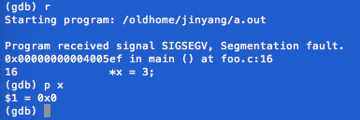
Pointer
...
…
...
char a = 1;
int b = 2;
0x1b
char *x = NULL;
0x0
0x1c
*x = 3;
...
x:
0x15
2
0x14
0x13
0x12
b:
0x11
a:
1
0x10
…

Slide 26
Pointer has different types
0x11
…
...
char a = 1;
int b = 2;
y:
0x1b
char *x = &a;
0x10
0x1c
*x = 3;
int *y = &b;
what if I write
char *y = &b;
...
*y = 127;
x:
0x15
2
0x14
127
0x13
0x12
b:
0x11
a:
3
0x10
…

Slide 27
Double Pointer
…
...
??
…
…
0x15
…
Same as:
char **xx;
xx = &x;
…
...
char a = 1;
xx:
…
0x30
int b = 2;
…
char *x = &a;
0x10
0x1c
*x = 3;
what if I write
char *xx =&x;
char **xx = &x;
...
char **xx is the same as char** xx;
x:
0x15
…
0x14
…
0x13
printf(“xx=%p *xx=%p **xx=%d\n”, xx, *xx, **xx);
…
0x12
…
0x11
a:
3
0x10
…

Slide 28
Double Pointer
...
...
0x22
0x1b
...
char a = 1;
yy:
int b = 2;
…
char *x = &a;
0x11
0x22
int *y = &b;
*x = 3;
y:
0x1b
*y = 127;
…
...
127
0x14
0x13
char **xx = &x;
0x12
int **yy = &y;
b:
0x11
printf(“yy=%p *yy=%p **yy=%d\n”, yy, *yy, **yy);
a:
3
0x10
…

Slide 29
Common confusions on *
* has two meanings!!
part of a pointer type name, e.g. char *, char **, int *
the deference operator.
C’s syntax for declaring multiple pointer variables on one line
char* b, c; does not work
char a = 1;
char *p = &a;
*p = 2;
char *b, *c;
char **d,**e;
C’s syntax for declaring and initializing multiple pointer variables on one line
char *f=p, *g=p;
char **m=&p, **n=&p;

Slide 30
Pass pointers to function
void swap(int* x, int* y)
{
int tmp = *x;
*x = *y;
*y = tmp;
}
…
1
0xf7
...
0xf4
main.x:
2
0xf3
...
0xf0
main.y:
…
int main()
{
int x = 1;
int y = 2;
swap(&x, &y);
printf(“x:%d, y:%d”,x,y);
}
??
swap.x:
??
swap.y:
Size and value of x, y, tmp
in swap upon function entrance?
??
swap.tmp:

Slide 31
Pass pointers to function
void swap(int* x, int* y)
{
int tmp = *x;
*x = *y;
*y = tmp;
}
…
1
0xf7
...
0xf4
main.x:
2
0xf3
...
0xf0
main.y:
…
int main()
{
int x = 1;
int y = 2;
swap(&x, &y);
printf(“x:%d, y:%d”,x,y);
}
0xf4
swap.x:
0xf0
swap.y:
??
swap.tmp:

Slide 32
Pass pointers to function
void swap(int* x, int* y)
{
int tmp = *x;
*x = *y;
*y = tmp;
}
…
1
0xf7
...
0xf4
main.x:
2
0xf3
...
0xf0
main.y:
…
int main()
{
int x = 1;
int y = 2;
swap(&x, &y);
printf(“x:%d, y:%d”,x,y);
}
0xf4
swap.x:
0xf0
swap.y:
swap.tmp:
1

Slide 33
Pass pointers to function
void swap(int* x, int* y)
{
int tmp = *x;
*x = *y;
*y = tmp;
}
…
1
0xf7
2
...
0xf4
main.x:
2
0xf3
...
0xf0
main.y:
…
int main()
{
int x = 1;
int y = 2;
swap(&x, &y);
printf(“x:%d, y:%d”,x,y);
}
0xf4
swap.x:
0xf0
swap.y:
1
swap.tmp:

Slide 34
Pass pointers to function
void swap(int* x, int* y)
{
int tmp = *x;
*x = *y;
*y = tmp;
}
…
2
0xf7
...
0xf4
main.x:
2
0xf3
1
...
0xf0
main.y:
…
int main()
{
int x = 1;
int y = 2;
swap(&x, &y);
printf(“x:%d, y:%d”,x,y);
}
0xf4
swap.x:
0xf0
swap.y:
1
swap.tmp:

Slide 35
Pass pointers to function
void swap(int* a, int* b)
{
int tmp = *a;
*a = *b;
*b = tmp;
}
…
2
0xf7
...
0xf4
main.x:
1
0xf3
...
0xf0
main.y:
…
int main()
{
int x = 1;
int y = 2;
swap(&x, &y);
printf(“x:%d, y:%d”,x,y);
}
0xf4
swap.a:
0xf0
swap.b:
1
swap.tmp:

Slide 36
Summary
Control Flow
goto
Local vs. global variable
Local variables allocated/deallocated upon function entrance/return
Global variable: always there
Pointers
Pointer values are memory addresses
p =&x; (makes p points to variable x)
*p … (refers to the variable pointed to by p)

