Slide 1
C - Basics, Bitwise Operator
Jinyang Li

Slide 2
Lesson plan
Overview
C program organization
Bitwise operators
Control flow

Slide 3
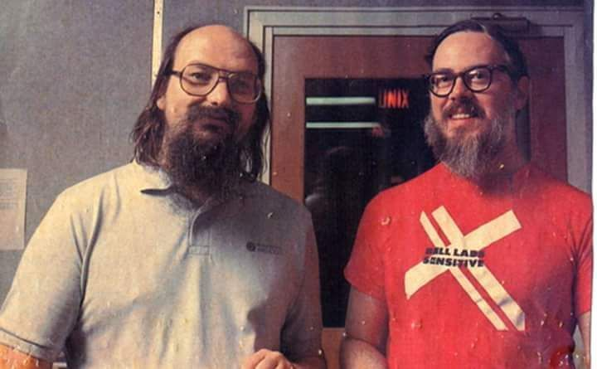

C is an old programming language
C (1972)
Java (1995) Python (2.0, 2000)
Notes:
Ken Thompson
Dennis Richie

Slide 4
C is an old programming language
C | Java | Python
1972 | 1995 | 2000 (2.0)
Procedure | Object oriented | Procedure & object oriented
Compiled to machine code, runs directly on hardware | Compiled to bytecode, runs by another piece of software | Scripting language, interpreted by software
static type | static type | dynamic type
Manual memory management | Automatic memory management with GC
Tiny standard library | Very Large library |  | Humongous library

Slide 5
Why learn C for CSO?
C is a systems language
Language for writing OS and low-level code
System software written in C:
Linux, Windows kernel, MacOS kernel
MySQL, Postgres
Apache webserver, NGIX
Java virtual machine, Python interpreter
Why learning C for CSO?
simple, low-level, “close to the hardware”

Slide 6
The simplest C program: “Hello World”
#include <stdio.h>
int main()
{
printf("hello, world\n");
return 0;
}
Equivalent to “importing” a library package
A function “exported” by stdio.h
hello.c
Compile:
gcc hello.c –o hello
Run:
./hello
If –o is not given, output executable file is a.out

Slide 7
C program with multiple files: naïve organization
int sum(int x, int y)
{
return x+y;
}
#include <stdio.h>
#include <assert.h>
void test_sum()
{
int r = sum(1,1);
assert(r == 2);
}
int main()
{
test_sum();
}
#include <stdio.h>
int main()
{
printf(“sum=%d\n”, sum(-1,1));
}
sum.c
main.c
Compile:
gcc sum.c test.c –o test
gcc sum.c main.c
test.c
Run:
./test
Sum.c compiled twice.
Wasteful
./a.out

Slide 8
C program with multiple files: *.h vs *.c files
Equivalent to “importing” a package
int sum(int x, int y)
{
return x+y;
}
#include <stdio.h>
#include <assert.h>
void test_sum()
{
int r = sum(1,1);
assert(r == 2);
}
int main()
{
test_sum();
}
#include <stdio.h>
int main()
{
printf(“sum=%d\n”, sum(-1,1));
}
#include “sum.h”
#include “sum.h”
sum.c
main.c
int sum(int x, int y);
sum.h
test.c

Slide 9
Common compilation sequence
(Binary)
object file main.o
called linking
Source Code main.c
gcc –c main.c
(Binary) Executable a.out
gcc main.o sum.o
Source Code sum.c
gcc –c sum.c
(Binary)
object file sum.o
(Binary) Executable test
Source Code test.c
gcc –c test.c
(Binary)
object file test.o
gcc test.o sum.o –o test
C project uses the make tool to automate compiling with dependencies.
all: a.out test
test: test.o sum.o
gcc $^ -o $@
a.out: main.c sum.o
gcc $^ -o $@
%.o: %.c
gcc –c $^
Makefile
Notes:
xxd -b hello

Slide 10

Basic C
C’s syntax is very similar to Java
Java borrowed its syntax from C
Initial value
If uninitialized,
variable can have any value
Variable declaration: int a = 1;
Type
Name

Slide 11
Primitive Types (64-bit machine)
Either a character or an intger
type | size (bytes) | example
(unsigned) char | 1 | char c = ‘a’
(unsigned) short | 2 | short s = 12
(unsigned) int | 4 | int i = 1
(unsigned) long | 8 | long l = 1
float | 4 | float f = 1.0
double | 8 | double d = 1.0
pointer | 8 | int *x = &i
Next lecture
Old C has no native boolean type. A non-zero integer represents true, a zero integer represents false
C99 has “bool” type, but one needs to include <stdbool.h>

Slide 12
Implicit conversion
int main()
{
int a = -1;
unsigned int b = 1;
if (a < b) {
printf("%d is smaller than %d\n", a, b);
} else if (a > b) {
printf("%d is larger than %d\n”, a, b);
}
return 0;
}
$gcc test.c
$./a.out
-1 is larger than 1
No compiler warning!
Compiler converts int types to the one with the larger value (e.g. char → unsigned char → int → unsigned int)
-1 is implicitly cast to unsigned int (4294967295)₁₀

Slide 13
Explicit conversion (casting)
int main()
{
int a = -1;
unsigned int b = 1;
if (a < (int) b) {
printf("%d is smaller than %d\n", a, b);
} else if (a > (int) b) {
printf("%d is larger than %d\n”, a, b);
}
return 0;
}

Slide 14
Operators
Arithmetic | +, -, *, /, %, ++, --
Relational | ==, !=, >, <, >=, <=
Logical | &&, ||, !
Bitwise | &, |, ^, ~, >>, <<
Arithmetic, Relational and Logical operators are identical to java’s

Slide 15
Bitwise AND: &
Truth table (of boolean function AND)
x | y | x AND y
0 | 0 | 0
0 | 1 | 0
1 | 0 | 0
1 | 1 | 1
How many rows if function has n boolean (aka 1-bit) inputs?
2^{n}
Operator & applies AND bitwise to two integers
( 0 1 1 0 1 0 0 1 )₂
&
( 0 1 0 1 0 1 0 1 )₂
Result of 0x69 & 0x55
( 0 1 0 0 0 0 0 1 )₂

Slide 16
Example use of &
& is often used to mask off bits
b & 0 = 0
b & 1 = b
?
b is any bit
?
int clear_msb(int x) {
}
return x & 0x7fffffff;

Slide 17
Bitwise OR: |
x | y | x OR y
0 | 0 | 0
0 | 1 | 1
1 | 0 | 1
1 | 1 | 1
Operator | applies OR bitwise to two integers
( 0 1 1 0 1 0 0 1 )₂
Result of 0x69 | 0x55
|
( 0 1 0 1 0 1 0 1 )₂
( 0 1 1 1 1 1 0 1 )₂

Slide 18
Example use of |
| can be used to turn some bits on
b | 1 = 1
b | 0 = b
?
?
int set_msb(int x) {
}
return x | 0x80000000;

Slide 19
Bitwise NOT: ~
x | NOT x
0 | 1
1 | 0
Operator ~ applies NOT bitwise to two integers
~
( 0 1 1 0 1 0 0 1 )₂
result of ~0x69
( 1 0 0 1 0 1 1 0 )₂

Slide 20
Bitwise XOR: ^
x | y | x XOR y
0 | 0 | 0
0 | 1 | 1
1 | 0 | 1
1 | 1 | 0
Operator ^ applies XOR bitwise to two integers
( 0 1 1 0 1 0 0 1 )₂
result of 0x69^0x55
^
( 0 1 0 1 0 1 0 1 )₂
( 0 0 1 1 1 1 0 0 )₂

Slide 21
Bitwise left-shift: <<
x << y, treat x as a bit-vector, shift x left by y positions
Throw away bits shifted out on the left
Fill in 0’s on the right
result of 0x69<<3 ?
(0 1 1 0 1 0 0 1)₂
=(0 1 0 0 1 0 0 0)₂

Slide 22
Bitwise right-shift: >>
x >> y, shift bit-vector x right by y positions
Throw away bits shifted out on the right
Logical shift: Fill with 0’s on left
Arithmetic shift: Replicate msb on the left
Result of (logical) right-shift: 0xa9 >> 3
(1 0 1 0 1 0 0 1)₂
=(0 0 0 1 0 1 0 1)₂
Result of (arithmetic) right-shift: 0xa9 >> 3
=(1 1 1 1 0 1 0 1)₂

Slide 23
Which shift is used in C ?
Arithmetic shift for signed numbers
Logical shifting on unsigned numbers
int a = 1;
a = a>>31;
int b = -1;
b = b >>31;
unsigned int b = -1;
b = b >>30;
b = 3
??
a=0 b=-1
??
??

Slide 24
Example use of shift
int multiply_by_powers_of two(int x, int p)
{
}
return x << p;
int divide_by_powers_of two(int x, int p)
{
}
return x >> p;
Caveat: right-shift rounds down, different from integer division “/” which rounds towards zero.
e.g. -1>>1=-1, but -1/2 = 0

Slide 25
Example use of shift
// clear bit at position pos
// rightmost bit is at 0th pos
int clear_bit_at_pos(int x, int pos) {
}
unsigned int mask = 1 << pos;
return x & (~mask);

Slide 26

Breakout time!
Notes:
https://forms.gle/HbKYeKWCCgREpoKm6

Slide 27
Breakout exercises
Clear fraction fields of 10.0 --> ??
Clear fraction field of 0.2 → ??
8.0
0.125
float clear_exp_field(float f)
{
int fi = *(int *)&f; //re-interpret bit-pattern of f as int
int r = 0; //TODO: add your code here
return *(float *)&r; //re-interpret bit-pattern of r as float
}
r = (fi >> 23) <<23;

Slide 28
Example use of shift
// set bit at position pos
// rightmost bit is at 0th pos
int set_bit_at_pos(int x, int pos)
{
}
unsigned int mask = 1 << pos;
return x | mask;

Slide 29
Lesson plan
Overview
C program organization
Bitwise operators
Control flow

Slide 30
C’s Control flow
Same as Java
conditional:
if ... else if... else
switch
loops: while, for
continue
break

Slide 31
goto statements allow jump anywhere
goto label
while (cond) {
...
}
B:
...
for(...) {
for(...) {
for(...) {
goto error
}
}
}
error:
code handling error
Any control flow primitive can be
expressed as a bunch of goto’s.
A:
if (cond = false) goto B;
...
goto A
B:
...
The only acceptable scenario for using goto

Slide 32
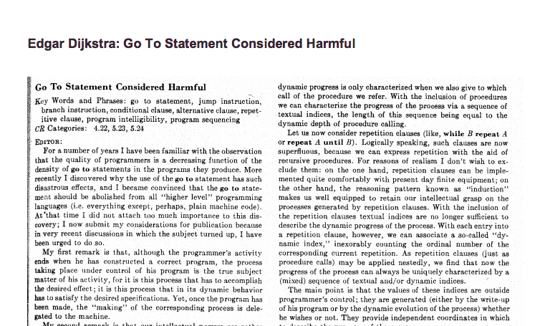
Avoid goto’s whenever possible

Slide 33
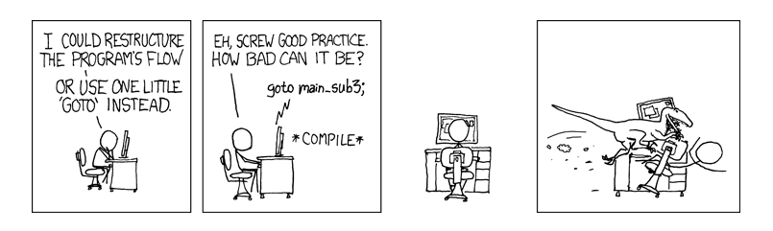
Avoid goto’s whenever possible

Slide 34
Summary
C program’s basic organization
*.c vs. *.h files
Compilation and make
Bitwise operators, &, |, ~, ^, >>, <<
>> (arithmetic vs. logical)
Control flow
goto is general, but results in spaghetti code

Slide 35
Exercises
Given a number, write a function to decide if it is even?
bool isEven(int n) {
}

Slide 36
Exercises
Given a number, write a function to decide if it is even?
bool isEven(int n) {
return (n & 0x1) == 0;
}

Slide 37
Exercises
Given a number, write a function to decide if it is even?
bool isEven(int n) {
return (n % 2) == 0;
}

Slide 38
Exercises
Given a number, write a function to decide if it is a power of two?
bool isPowerOfTwo(unsigned int n) {
}

Slide 39
Exercises
Given a number, write a function to decide if it is a power of two?
bool isPowerOfTwo(unsigned int n) {
if (n==0) return false;
while (n > 1) {
if (n % 2) // (n%2)!=0
return false;
n = n >> 1;
}
return true;
}

Slide 40
Exercises
Given a number, write a function to decide if it is a power of two?
bool isPowerOfTwo(unsigned int n) {
return (n & (n-1)) == 0;
// n&(n-1) clears rightmost bit-of-1 in n
}

Slide 41
Exercises
Given a number, write a function to decide if it is a power of two?
bool isPowerOfTwo(unsigned int n) {
return n != 0 && (n & (n-1)) == 0;
}
Notes:
-2147483648

Slide 42
Exercises
Count the number of ones in the binary representation of the given number ?
(n > 0)
int count_one(int n) {
}
Notes:
-2147483648

Slide 43
Exercises
Count the number of ones in the binary representation of the given number ?
(n > 0)
int count_one(int n) {
int count = 0;
while (n != 0 ) {
count += (n % 2);
n = (unsigned int)n>>1;
}
return count;
}
Notes:
-2147483648

Slide 44
Exercises
Count the number of ones in the binary representation of the given number ?
bool count_one(int n) {
}
A trick – clear the rightmost bit-of-1: n & (n -1)

Slide 45
Exercises
Count the number of ones in the binary representation of the given number ?
int count_one(int n) {
int count = 0;
while(n != 0) {
n = n&(n-1);
count++;
}
return count;
}

