Slide 1

Introduction to R Markdown
Yifan Xu, MPH
Asst. Research Scientist
Division of Biostatistics
Department of Population Health

Slide 2
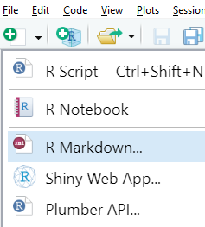
What is R Markdown
Markdown: a text-to-HTML formatting tool, by John Gruber and Aaron Swartz in 2004.
R Markdown is based on Markdown and embedded with code trunks, first introduced in the knitr package by Yihui Xie, in 2012.

Slide 3
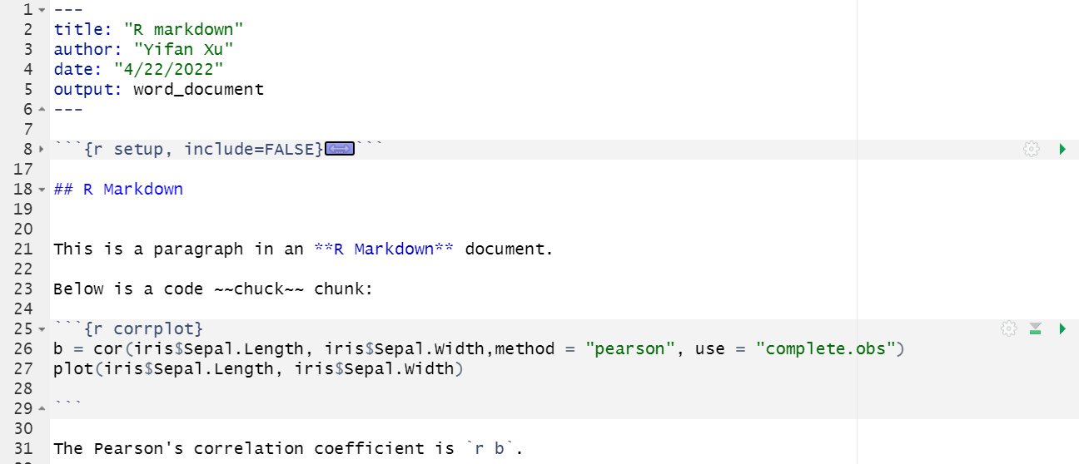
Set-up
Title →
Code trunk*→
Inline text →
Code trunk→
* For more code trunk options, please refer to https://yihui.org/knitr/options/

Slide 4
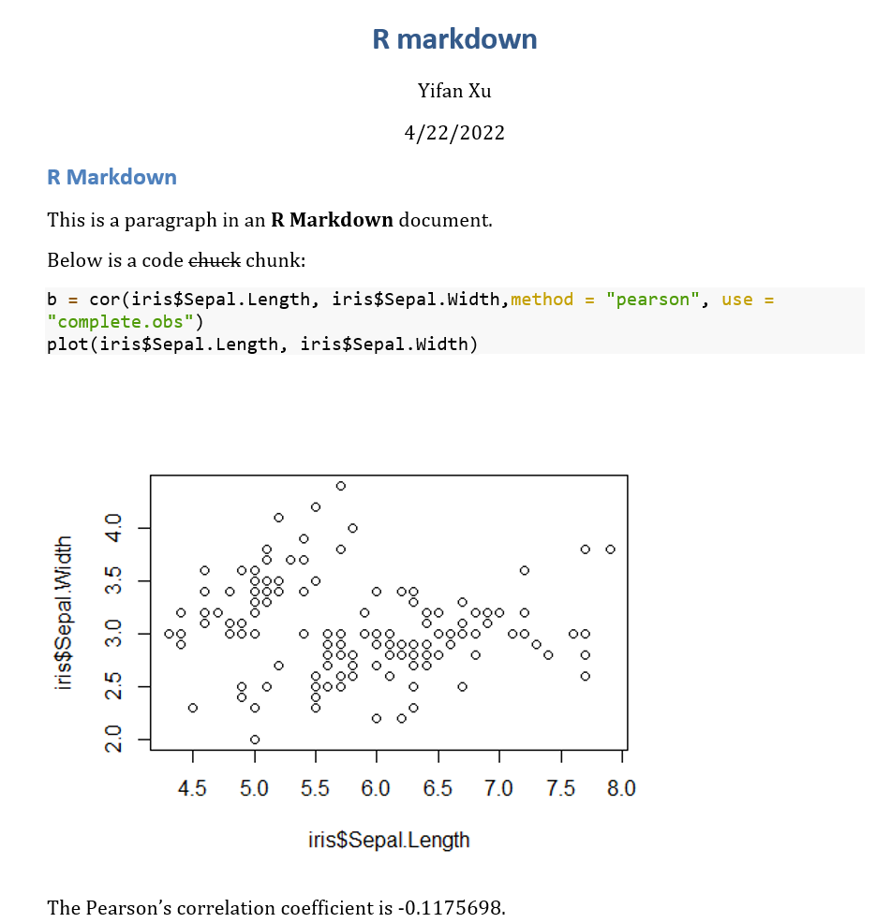
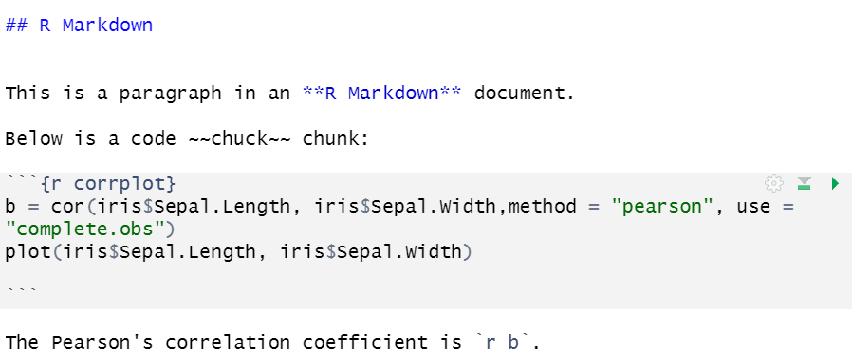
Graphs

Slide 5
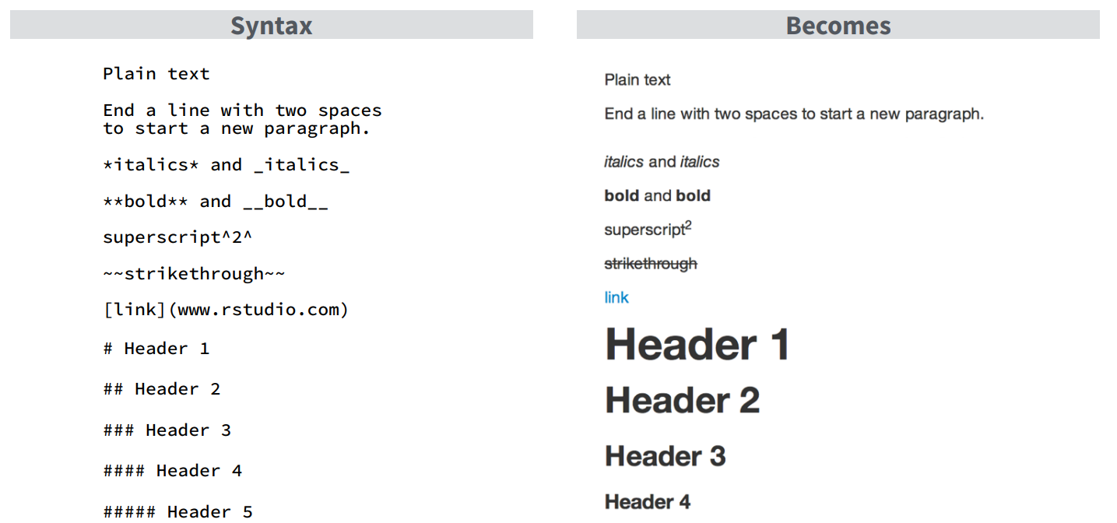
Text formatting

Slide 6
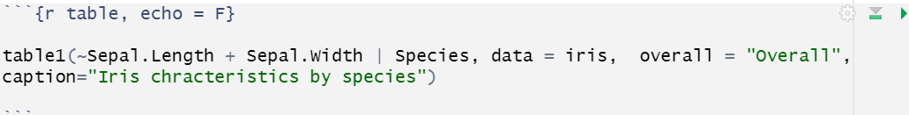
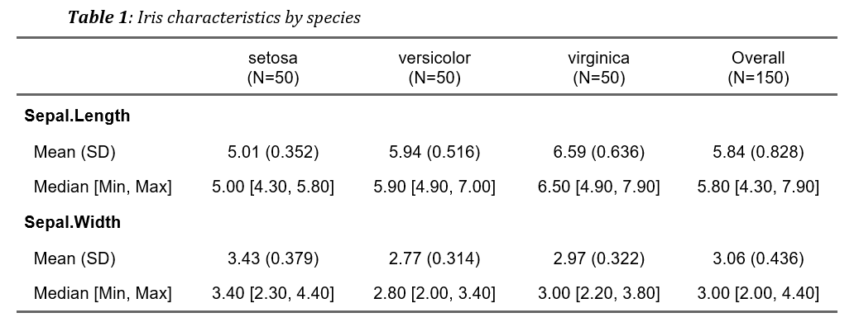
Tables

Slide 7
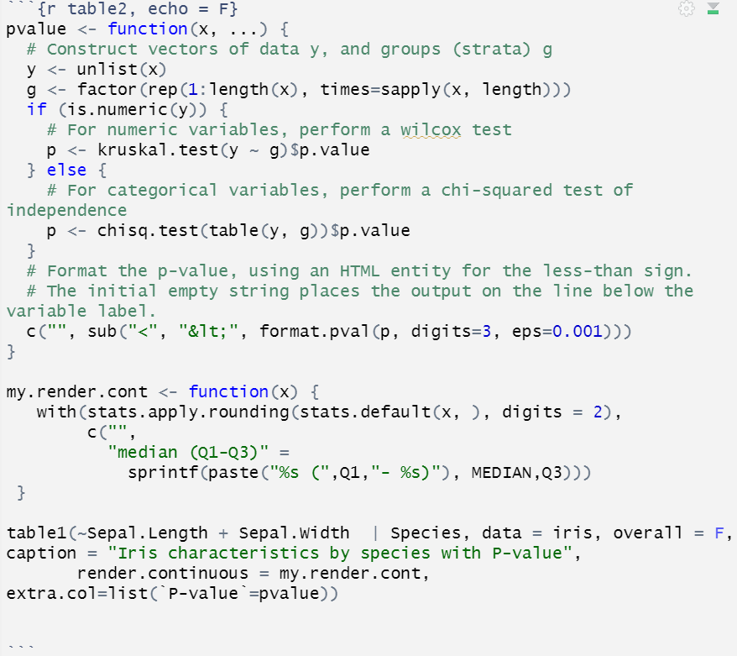
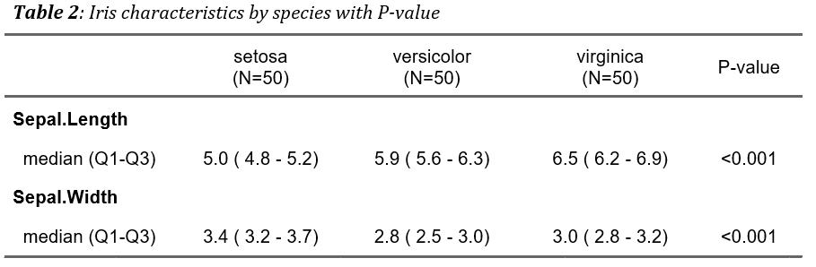
Tables

Slide 8
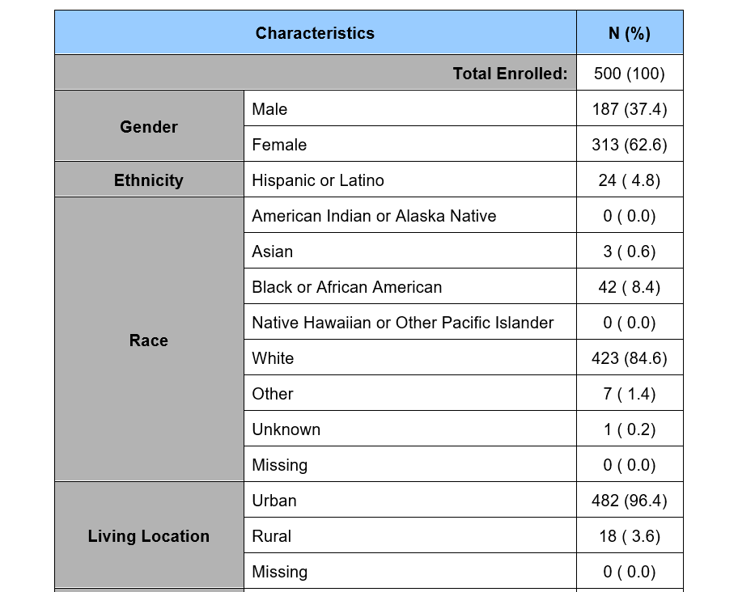
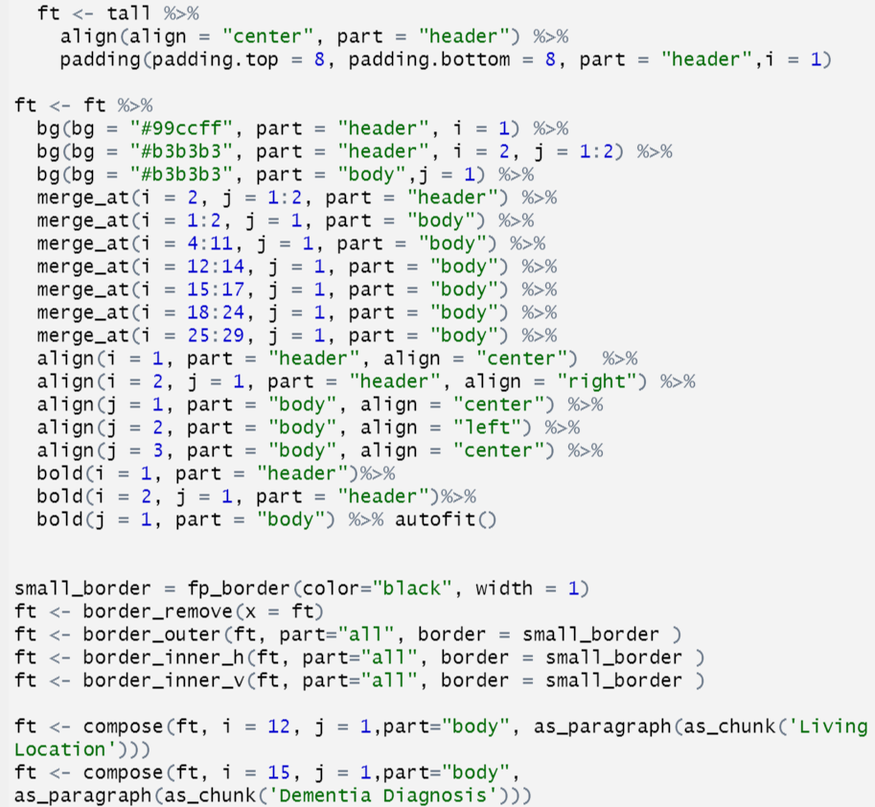
Tables
Package Flextable

Slide 9
Reference
Yihui Xie, J. J. Allaire, Garrett Grolemund, J. J. A. (2022, April 11). R markdown: The definitive guide. Retrieved April 21, 2022, from https://bookdown.org/yihui/rmarkdown/
R markdown reference guide. Retrieved April 21, 2022 https://www.rstudio.com/wp-content/uploads/2015/03/rmarkdown-reference.pdf
Yihui Xie, knitr: elegant, flexible, and fast dynamic report generation with R , Retrieved April 22, 2022, https://yihui.org/knitr/options/

