Slide 1
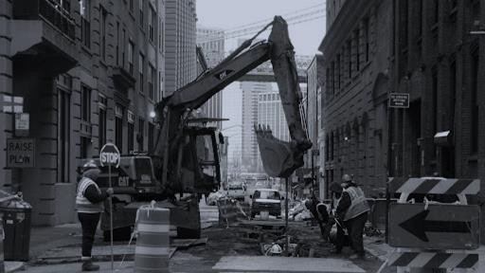










1/13/2022
NYU Tandon TMI Department | Capstone Project
1

Slide 2

Toward a "Smarter" City: Utilidors (Utilidor Working Group)
In January 2019, the Utilidor Working Group picked up from 2006 idea for pilot utilidor implementation program from Edison and OMB value engineering study
Utilidors = transitable linear subsurface infrastructures that
safely segregate public and private utility transmission infrastructure
protect infrastructure from damaging subsurface conditions, subsurface spaghetti problems, and accidental strikes
permit easier lower-cost access to infrastructure for increased periodic state of good repair activities with minimal, if any, street excavation
reduce predictable failures causing personal injury and property damage
significantly lengthen roadway design lives
permit application of remote sensoring equipment for real time asset and commodity monitoring for preventive repairs and safety purposes
produces long-term direct cost savings to NYC’s public and private utilities and NYC as a municipality

Slide 3
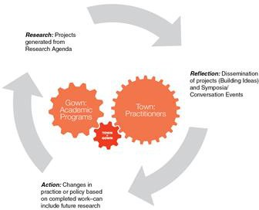
Context for this NYU/Tandon-MOT Project
1/29/20 Under the Ground: Planning, Management, and Utilization Event
2020 Columbia/SIPA lifecycle cost benefit analysis model showed benefits greater than costs
4/28/21 Under the Ground: Planning, Management, and Utilization.2 Subsurface Transformations for a Smart, Sustainable and Resilient City Event
Fall 2021 NYU/Tandon-MOT LAMP Project—today!
Spring 2022 Columbia/SIPA project will:
quantitatively assess social costs
evaluate financial benefits from subsurface public right of way accruing to private utilities that franchises do not reflect and
evaluate the costs/benefits from remote sensoring

Slide 4










Slide 5

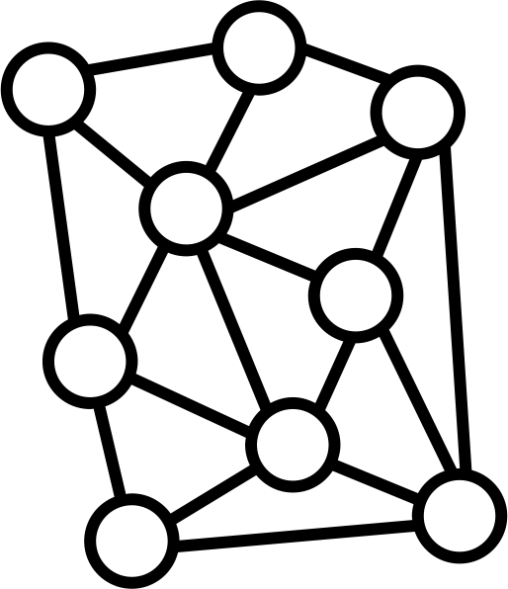
















Slide 6









Slide 7
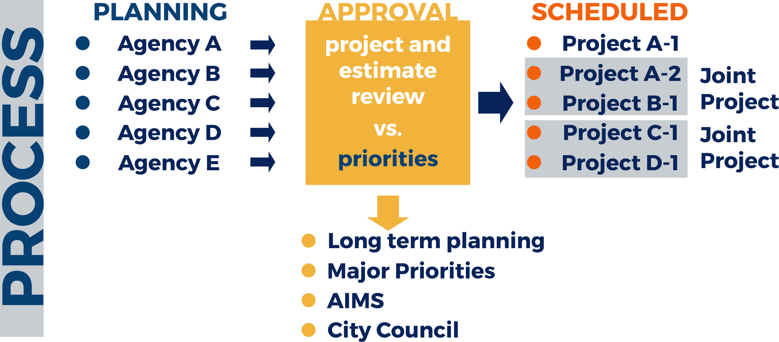





Slide 8










Slide 9










Slide 10












Slide 11





•
•
•
•
•
•

Slide 12















Slide 13



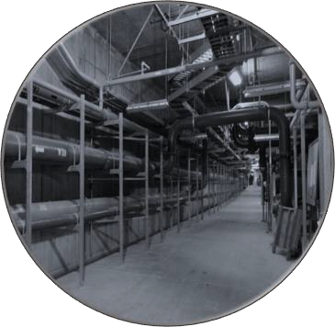

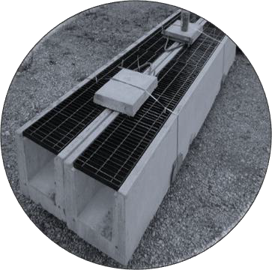
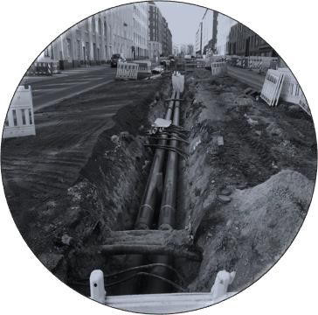






Slide 14


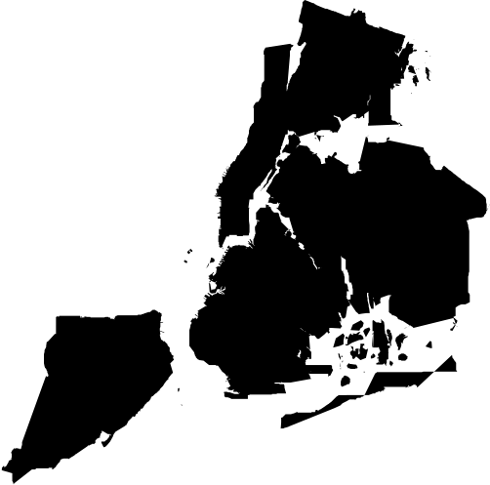










Slide 15
























•
•
•
•
•
•
•
•
•
•
•
•
•

Slide 16


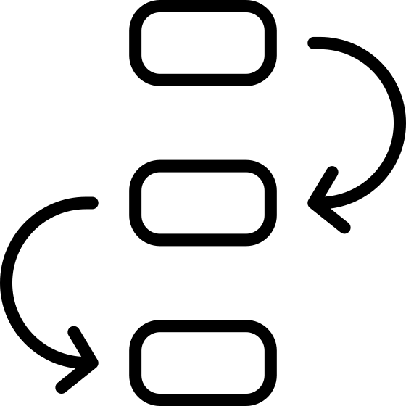










Slide 17



























Slide 18



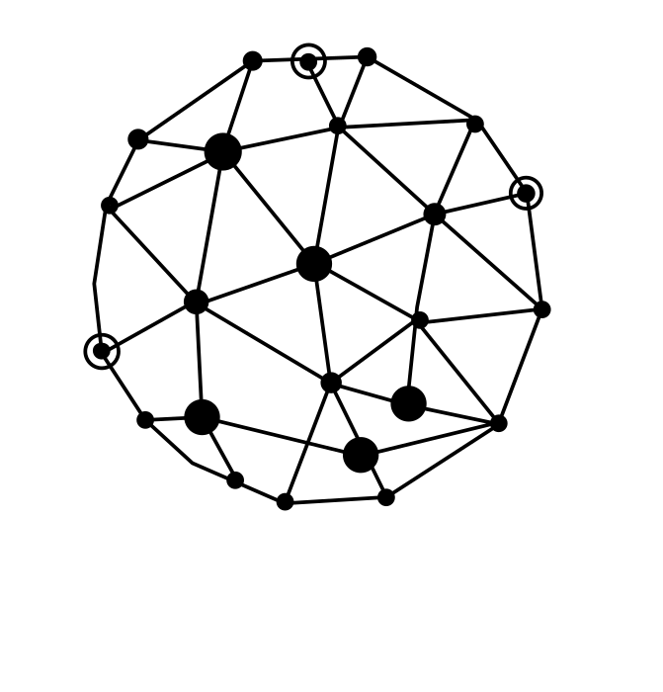





•
•
•
•
•

Slide 19























Slide 20














•
•
•
•
•
•

Slide 21

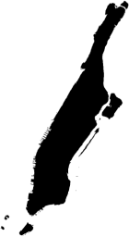

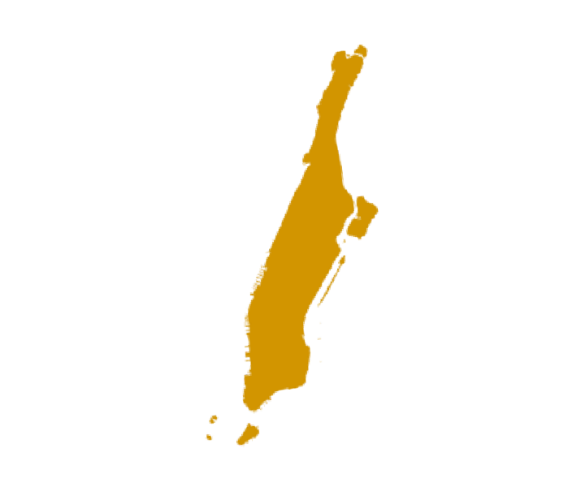









Slide 22






















Slide 23

Data Set | Cuts per Street | Cuts Freq. | Cuts Location | Const. Noise | Work Activity | Flood Risk | Downed Trees | Traffic | Density | Standards
DOT – Cuts Permits | X | X | X |  |  |  |  |  |  | X
SONYC |  |  |  | X | X |  |  | X |  | X
311 – Noise Calls |  |  |  | X | X |  |  |  |  | X
311- Flooding |  |  |  |  |  | X |  |  |  | X
311- Downed Trees |  |  |  |  |  |  | X |  |  | X
311- Traffic Accidents |  |  |  |  |  |  |  | X |  | X
CENSUS |  |  |  |  |  |  |  |  | X | X

Slide 24
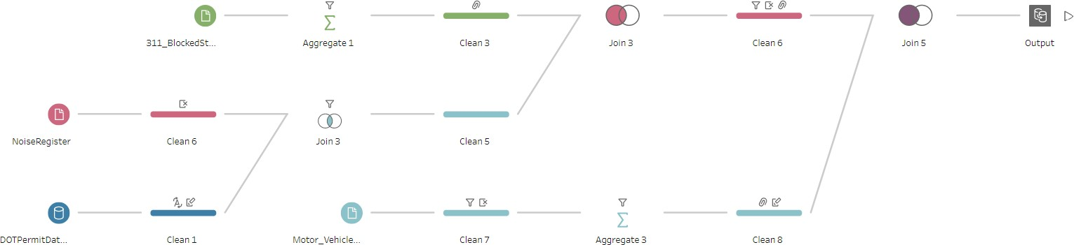





Slide 25























Slide 26
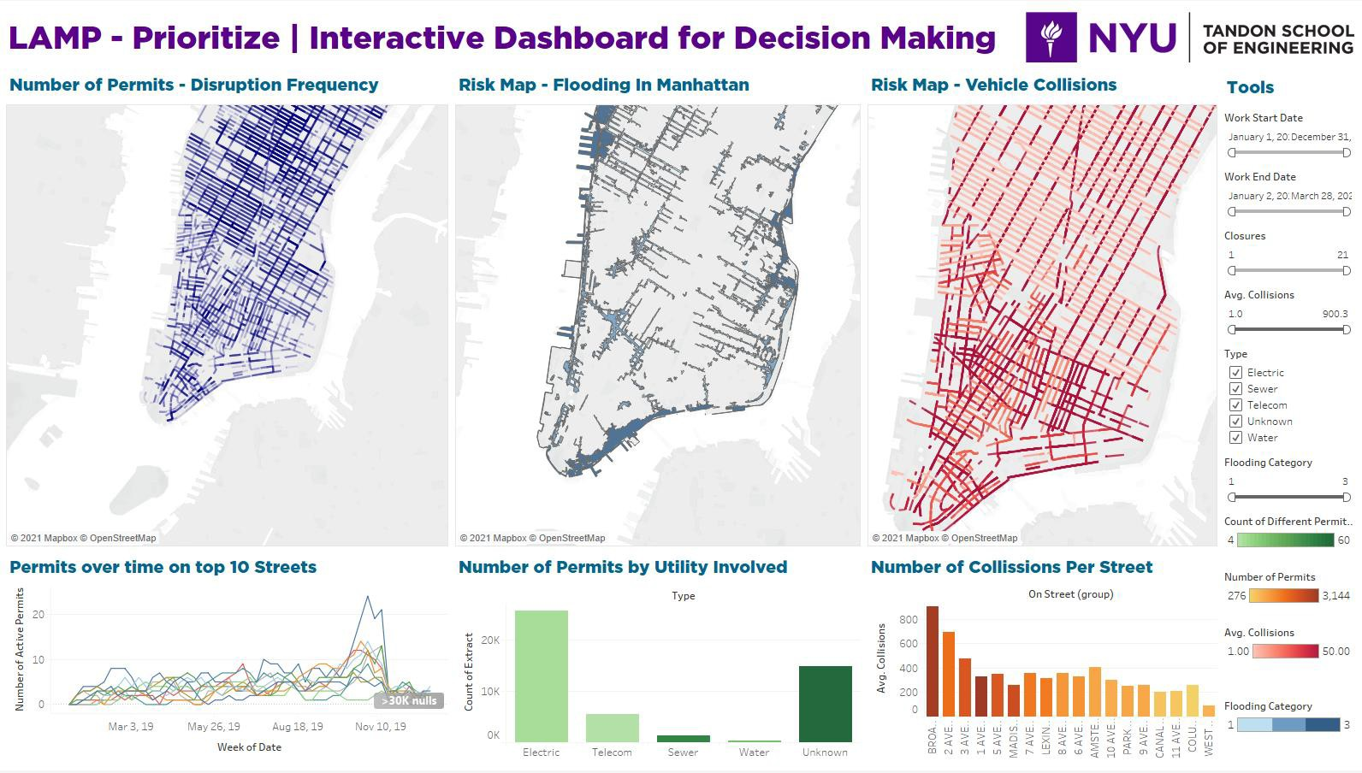




























Slide 27
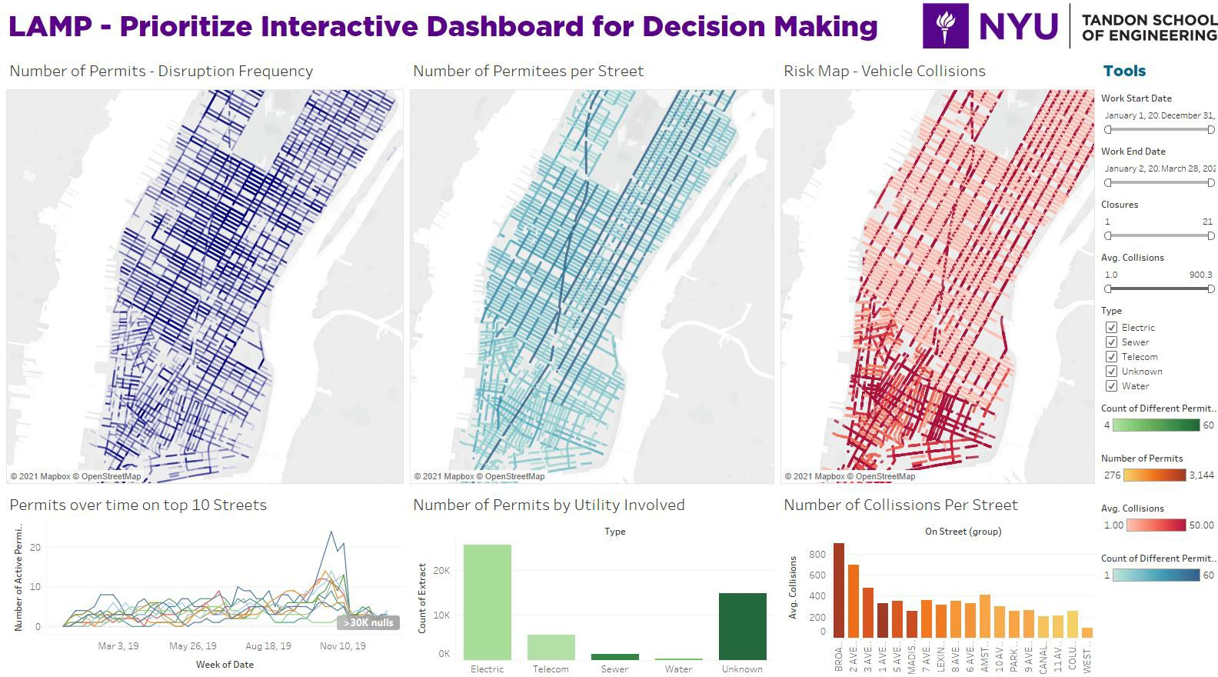




Slide 28


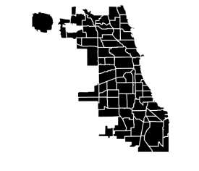
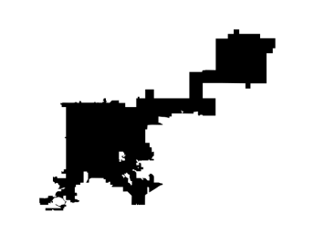










•
•
•
•

Slide 29

















Slide 30

1/13/2022
NYU Tandon TMI Department | Capstone Project
30

