Slide 1
THE AMAZING SPIDER
XIAOYU SHAN
SEBASTIAN VASQUEZ
ZHENG QIN

Slide 2
Svpply’s problem

Slide 3
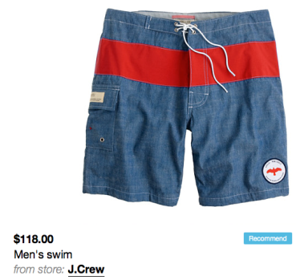
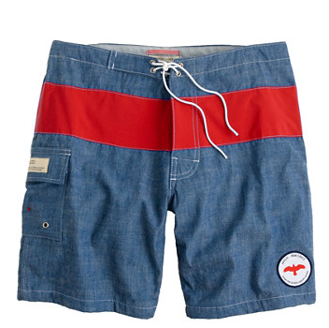

PRICE CHANGED
WHEN ADDED TO SVPPLY
TODAY AT PRODUCT’S WEBSITE

Slide 4
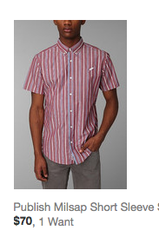
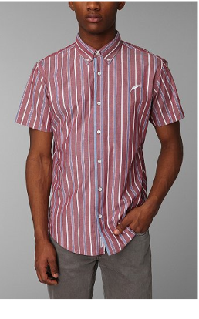

PRICED CHANGED
WHEN ADDED TO SVPPLY
TODAY AT PRODUCT’S WEBSITE

Slide 5
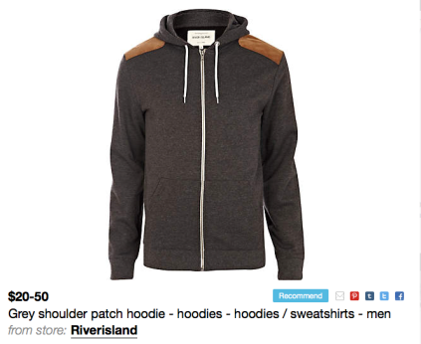
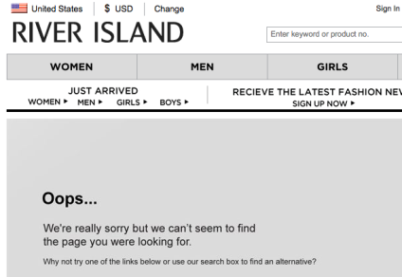
PRODUCT NOT AVAILABLE
WHEN ADDED TO SVPPLY
TODAY AT PRODUCT’S WEBSITE

Slide 6
OUR SolutionS

Slide 7
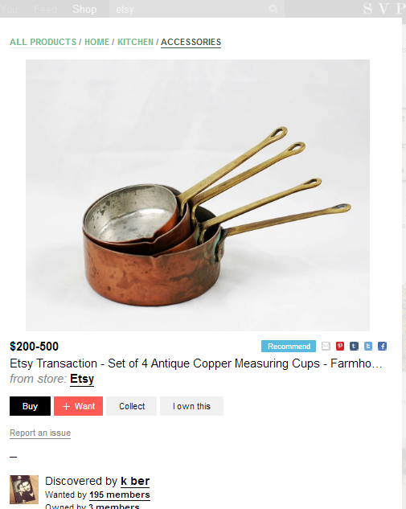
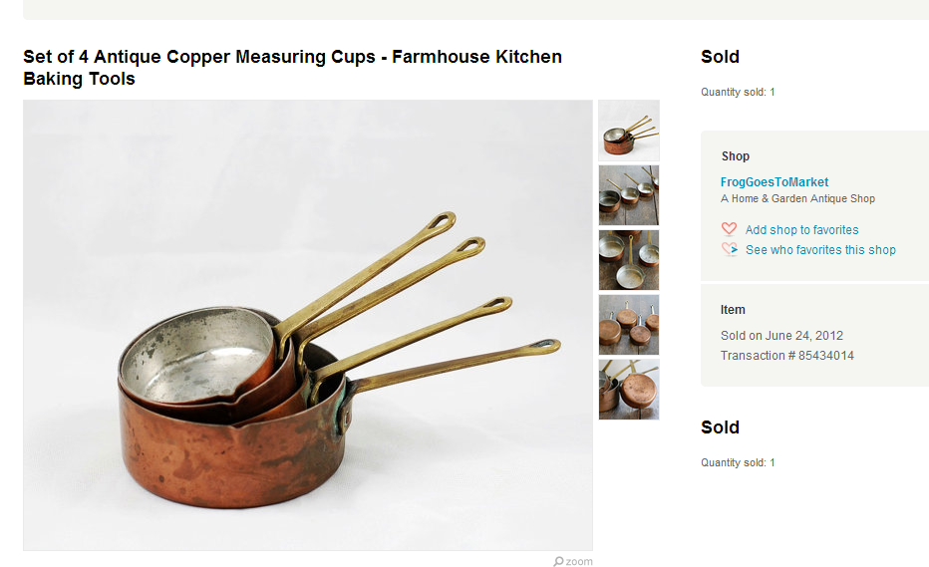
USING SPIDER TO UPDATE INFO
In SVPPLY page: show a product on sale with price range from 200-500USD.
In original page: show the product has already sold.
This is because, for non-API website, SVPPLY has no way to update information of products.
We run spider frequently to check if the information in original websites updated.

Slide 8
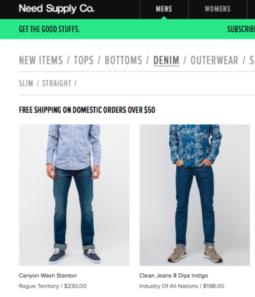
FONT DIFFERENCES IN PRODUCT LIST PAGES
The previous solution would determine $50 as the price for either of the products because of the bigger font. By lowering this weighting for product list pages we increased accuracy.

Slide 9
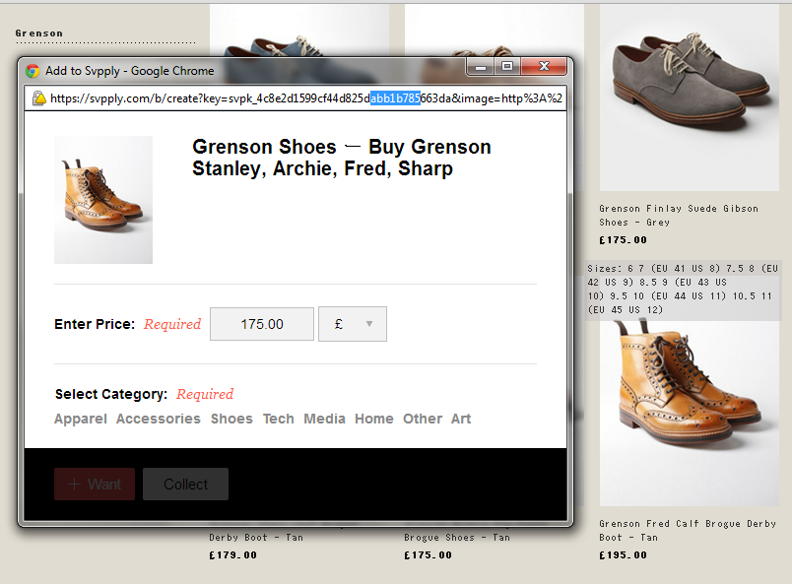
POSITION FACTOR
In product list page, the original script caught the price above the product image since it is the closest price by visual distance.
We add a position factor which is consider if the price is under the image to avoid this error.

Slide 10
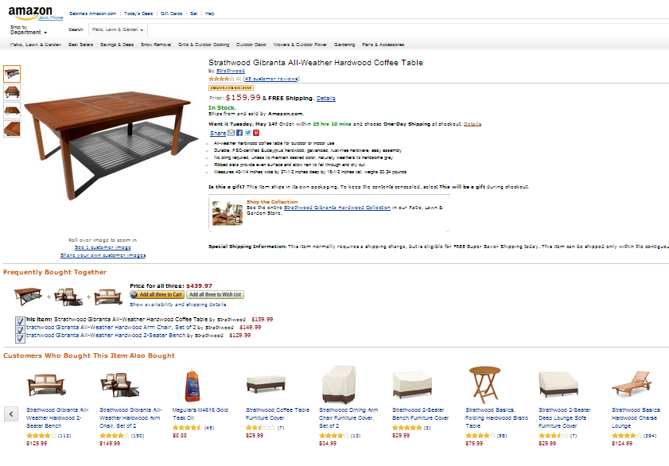
DOM DETECTION
When add a product from recommend list, the price caught by SVPPLY script is the wrong price. The price it got, is the price of main product’s price.
We add weight of if image and price share a DOM to avoid this error.

Slide 11
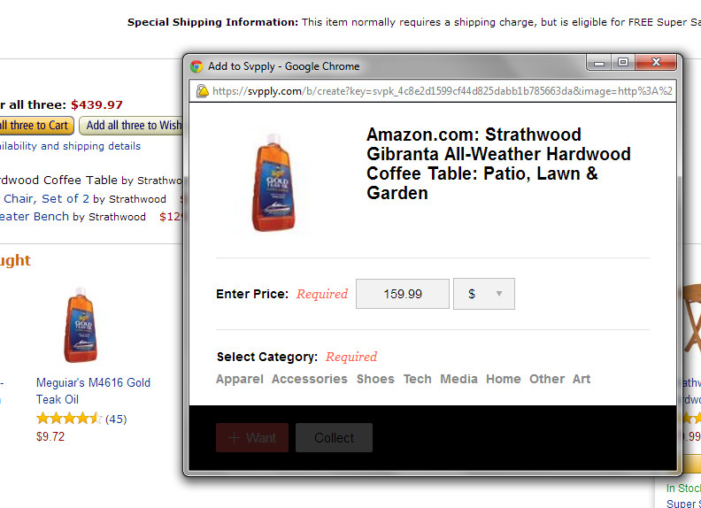
DOM DETECTION
When add a product from recommend list, the price caught by SVPPLY script is the wrong price. The price it got, is the price of main product’s price.
We add weight of if image and price share a DOM to avoid this error.

Slide 12
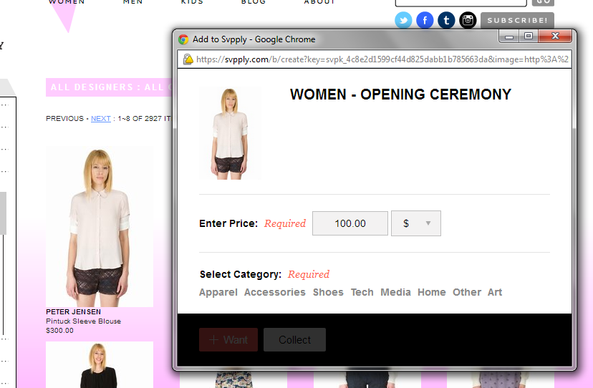
DOM DETECTION
In original SVPPLY script, it prefer to choose lower price if several candidate prices available.
This factor works on single product list page since cheaper one maybe the on sale one, but in product list page, cheaper one maybe is the neighbor product’s price. To avoid this error, we add weight if the image and price share one DOM so that it can’t treat price outside the DOM as candidate price.

Slide 13
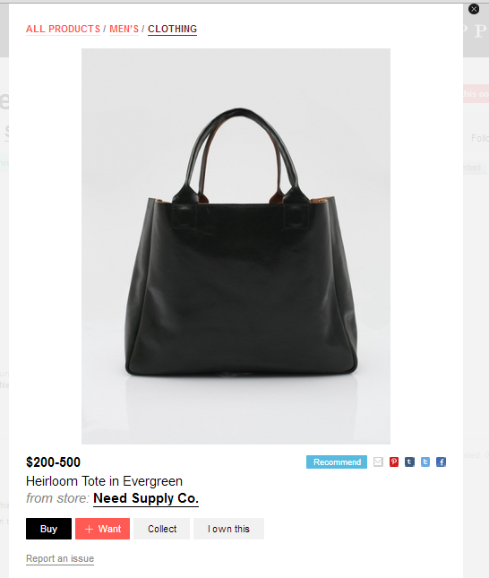
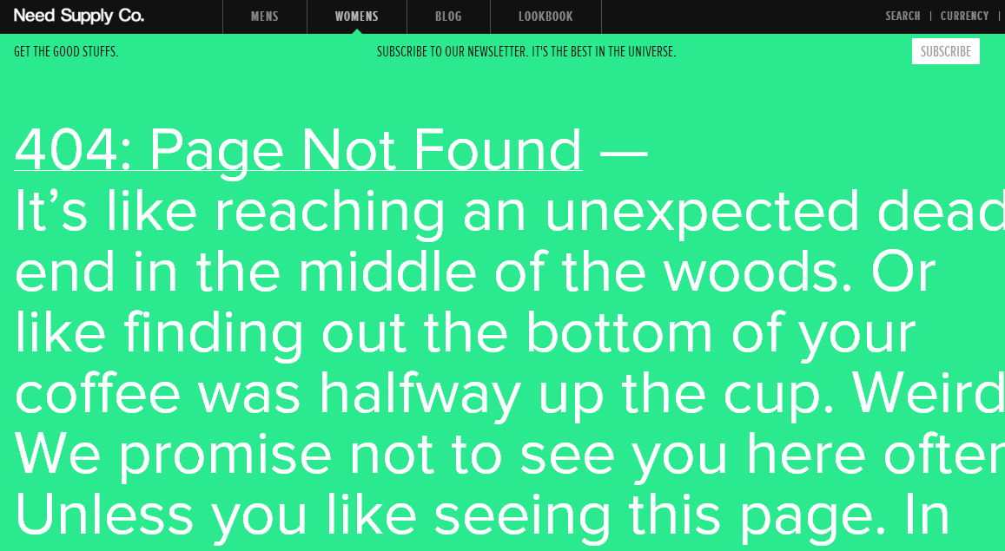
URL DETECTION
In SVPPLY page: show a product on sale with price range from 200-500USD.
In original page: show the web page doesn’t excites.
SVPPLY original script doesn’t test if web page is still available. To avoid this error, we send request to the website by given URL, if the web page doesn’t existed, return a message.

Slide 14
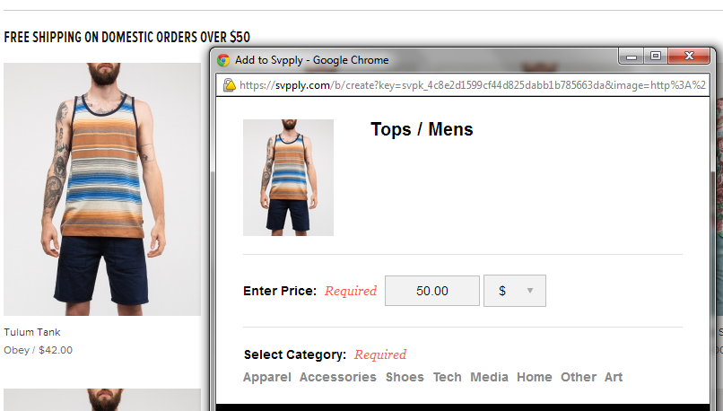
BALANCE WEIGHTING SYSTEM
In product list page, when add a new product, SVPPLY’s script catch the wrong price which is bold.
To avoid this error, we reduce the weight if the price is bold in product list pages.

Slide 15
HOW AMAZING WE ARE

Slide 16
Performance

Slide 17



OUR AMAZING TEAM
Sebastian Vasquez
Zheng Qin
Xiaoyu Shan

Slide 18
THANK YOU

