Slide 1
Error Cases Show

Slide 2
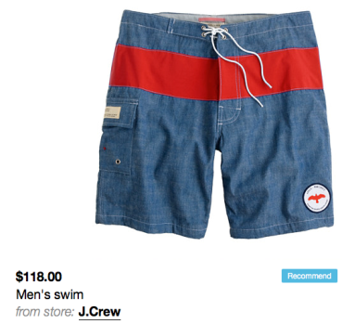
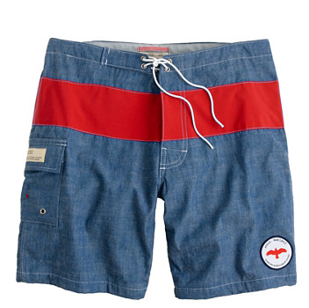

PRICE CHANGED
WHEN ADDED TO SVPPLY
TODAY AT PRODUCT’S WEBSITE

Slide 3
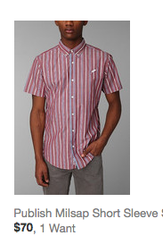
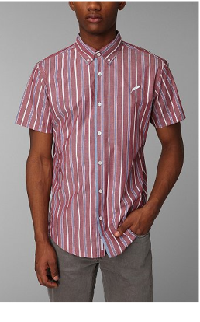

PRICED CHANGED
WHEN ADDED TO SVPPLY
TODAY AT PRODUCT’S WEBSITE

Slide 4
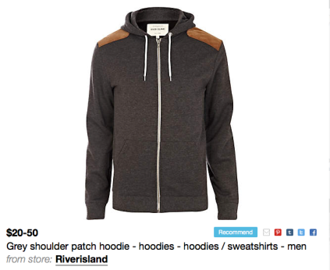
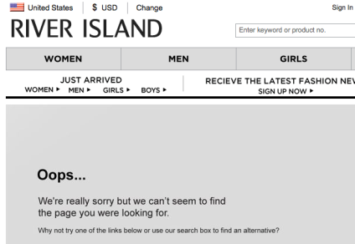
PRODUCT NOT AVAILABLE
WHEN ADDED TO SVPPLY
TODAY AT PRODUCT’S WEBSITE

Slide 5
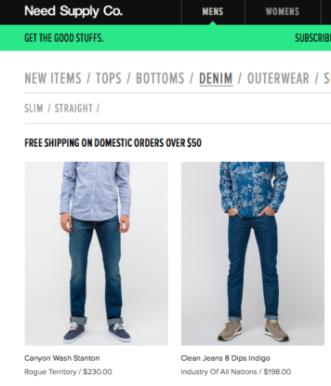
Font differences in product list pages
The previous solution would determine $50 as the price for either of the products because of the bigger font. By lowering this weighting for product list pages we increased accuracy.

Slide 6
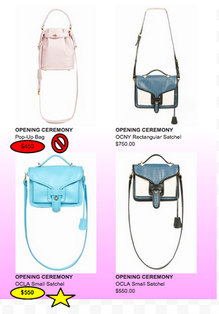
Closest price is not always the right price
We added the capability of identifying whether the price was above of below the product’s image.

