Slide 1
THE AMAZING WEB SPIDER FOR SVPPLY
XIAOYU SHAN
SEBASTIAN VASQUEZ
ZHENG QIN

Slide 2
What is svpply?
Section 1

Slide 3
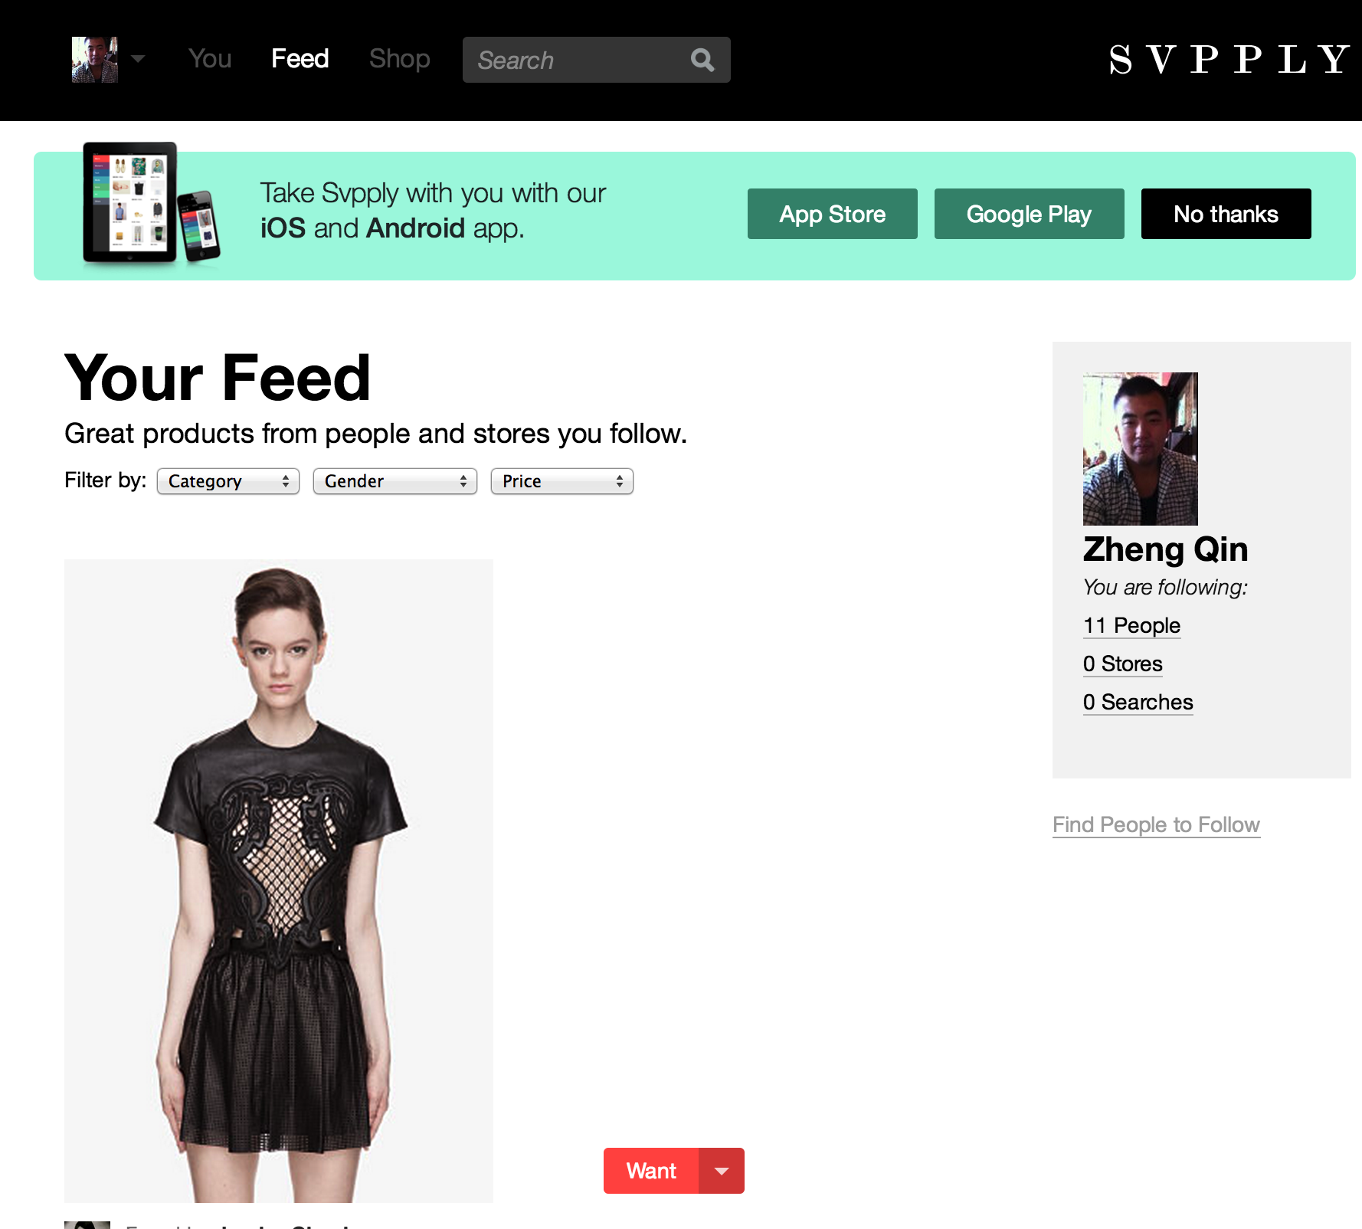
S V P P L Y
Svpply is a social shopping web site.
People share products they like or own from over the internet.

Slide 4
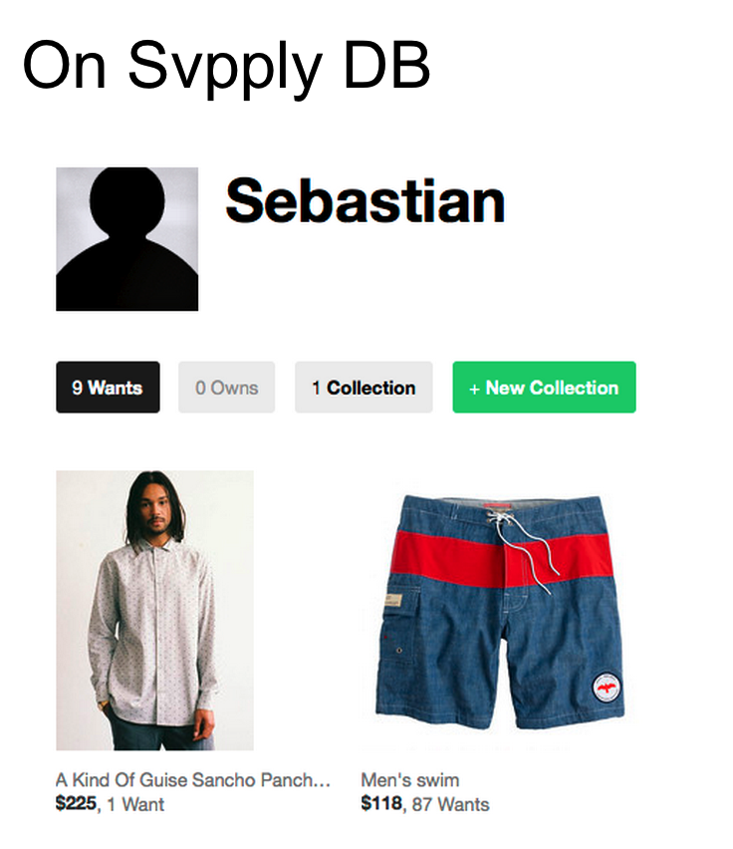

Business Problem

Slide 5
Technical Problem
Finding dynamic price information in unstructured product web sites.

Slide 6
Our solutions
Section 2

Slide 7
Our Solutions
XPATH comparison
Detecting whether is single product page or multiple products page
Is the price below or above the product’s image?
New price detection algorithm

Slide 8
Performance
Section 3

Slide 9
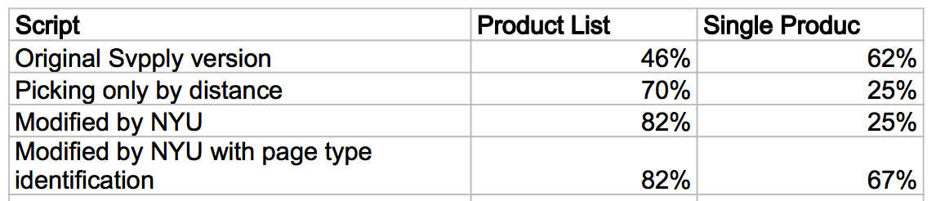
Performance

Slide 10
Performance

Slide 11
Q & A

Slide 12
Thank You

