Slide 1
Python & PyMARC
for MARC Record analysis and manipulation
Heidi Frank
New York University
hf36@nyu.edu

Slide 2
What is Python & PyMARC…
Python is an open-source programming scripting language used for wide and varied purposes, from Web development to data analysis, and more
https://www.python.org/about/
PyMARC is a Python module or library, written in Python syntax, and used to access and manipulate bibliographic MARC records
File extension for Python scripts is “.py”

Slide 3
What will be covered…
Overview of core PyMARC functions
Demos
Retrieving fields from MARC records
Adding fields/subfields to MARC records
Analyzing and modifying MARC records
Presentation Files accessible at:
https://github.com/hfrank71/presentations/tree/master/pymarc_20150625

Slide 4
PyMARC Prerequisites
PyMARC Imports
import pymarc
from pymarc import Record, Field
Importing the Record and Field modules allows direct reference to those sets of functions
e.g., you can use function: record.get_fields()
instead of: pymarc.record.get_fields()
Notes:
Python libraries are modules of code that perform various functionalities, and often serve a particular purpose. In order to utilize a library that is not built into the standard Python installation, you must import the external libraries at the beginning of your code. The parent-level import for PyMARC is just:
import pymarc
However, you can also import child-level sections of the library in order to shorten the required namespace that calls the functions at that level. For example, PyMARC had two scripts – record.py and field.py – that are often directly imported as well as the parent pymarc directory, using:
from pymarc import Record, Field
This allows you to reference the functions in those scripts directly throughout your code.

Slide 5
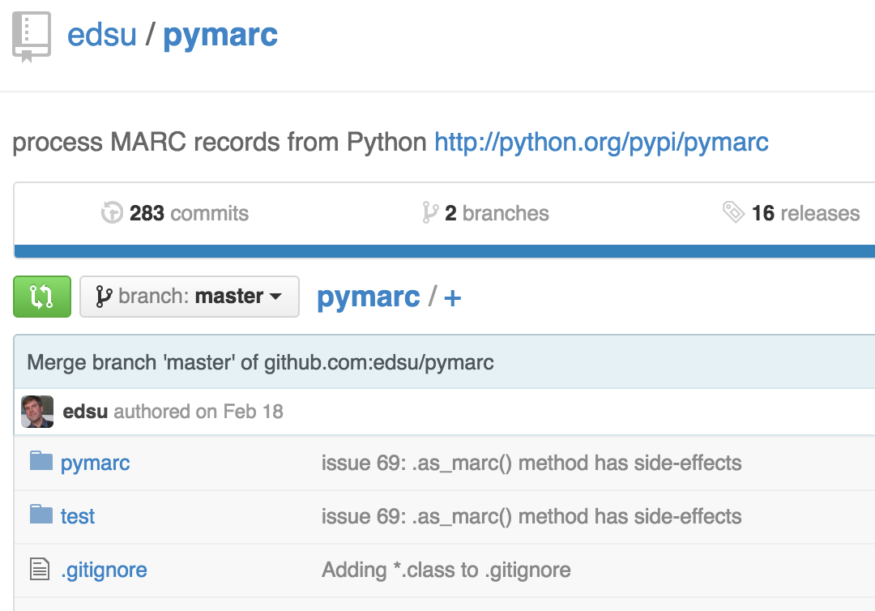
PyMARC on GitHub
https://github.com/edsu/pymarc
Notes:
Git is a free and open source distributed version control system used for many code development environments.
The PyMARC code source is available on GitHub, which is the web interface used for Git.

Slide 6
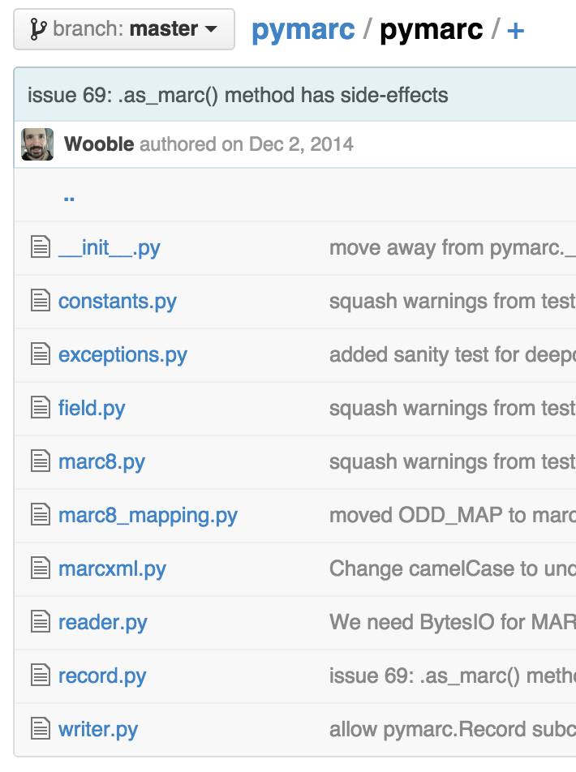
PyMARC on GitHub

Slide 7
Core PyMARC functions
File level functions:
https://github.com/edsu/pymarc/blob/master/pymarc/reader.py
https://github.com/edsu/pymarc/blob/master/pymarc/writer.py
Record level functions:
https://github.com/edsu/pymarc/blob/master/pymarc/record.py
Field level functions:
https://github.com/edsu/pymarc/blob/master/pymarc/field.py
Notes:
In my examples, any variable name that begins with “my” means it’s a variable you would create, so the name can be anything.

Slide 8
A Typical Scenario
Read in a file of MARC records
Iterate through those records
Extract fields and/or subfields from each record
Analyze and modify the fields or subfields as desired
Add or remove fields or subfields as desired
Write out the modified records to a new file

Slide 9
File Level – pymarc.MARCReader()
Read in a file of MARC records
my_records_in =
pymarc.MARCReader(
file(‘my_marc_recs_in.mrc’),
to_unicode=True, force_utf8=True
)
for my_record in my_records_in:
# core record level functions
Variable name
Function
Parameter 1
Parameters 2 & 3
Iterate through records
Notes:
In my examples, any variable name that begins with “my” means it’s a variable you would create, so the name can be anything.

Slide 10
Core Record Level Functions
Get fields out of a record
my_fields = my_record.get_fields()
Remove a field from a record
my_record.remove_field([field_object])
Add a field to a record
my_record.add_ordered_field([field_object])
Notes:
At the record level, there are 3 basic functions that are most used – Get fields, remove fields, and add fields.
These functions are found in the record.py script.
Note on the remove and add field functions, the parameter is a “field object”. I’m using the term “object” kind of loosely, in that I mean the parameter must be a variable type that is defined as a PyMARC field.

Slide 11
What is a Field Object
A field object is a type of PyMARC variable that includes attributes for the tag, indicators, and subfields of a MARC field, together as a single object
Create a new Field Object
my_field =
Field(
tag=‘245’,
indicators=[‘0’, ‘0’],
subfields=[‘a’, ‘Title :’, ‘b’, ‘subtitle /’, ‘c’, ‘responsibility.’]
)
Create a new Control Field Object
my_cntrl_field = Field(tag=‘001’, data=‘’)
Notes:
Field objects are returned from the get_fields() function, but you can also create new field objects.

Slide 12
Record Level – get_fields()
my_record.get_fields()
my_record.get_fields(‘245’)
my_record.get_fields(‘001’, ‘100’, ‘650’)
Returns a list containing the specified fields as field objects
[field1, field2, field3, …]
Returns *all* fields in the record if no parameter is specified
Returns an empty list if no specified fields are in the record
You can iterate through the list of fields to act on them
my_650s = my_record.get_fields(‘650’)
for my_650 in my_650s:
# core field level functions
Notes:
There are different methods for retrieving fields from the MARC record, but the basic one is the get_fields() function. You can either specify no field tags, a single field tag, or multiple field tags.

Slide 13
DEMO 1
Get fields from MARC records

Slide 14
Record Level – remove_field()
my_record.remove_field([field_object])
Deletes the MARC field from the Record object
Parameter must be a PyMARC Field object (e.g., returned from the get_fields() function)
my_653s = my_record.get_fields(‘653’)
for my_653 in my_653s:
my_record.remove_field(my_653)
Field object

Slide 15
Record Level – add_ordered_field()
my_record.add_ordered_field([field_object])
Adds the MARC field to the Record object
Adds the MARC field in tag-numeric order
Parameter must be a PyMARC Field object (e.g., created using the Field() function)
my_new_700 = Field(
tag=‘700’, indicators=[‘1’, ‘ ’],
subfields=[‘a’, ‘Melville, Herman’]
)
my_record.add_ordered_field(my_new_700)
Field object

Slide 16
DEMO 2
Add a field to MARC records

Slide 17
Core Field Level Functions
Get subfield values out of a field
my_subfields = my_field.get_subfields(‘a’)
Remove a subfield from a field
my_field.delete_subfield(‘a’)
Add a subfield to a field
my_field.add_subfield(‘a’, ‘value’)
Notes:
At the field level, similar to the record-level functions, there are 3 basic functions that are most used – Get subfields, remove subfields, and add subfields.
These functions are found in the field.py script.
Note on all of these functions, the parameter is a subfield code.

Slide 18
Field Level – get_subfields()
my_field.get_subfields(‘a’)
my_field.get_subfields(‘a’, ‘x’)
Similar to my_record.get_fields(), except…
Returns a list of subfield string values (versus field objects)
Requires at least one subfield code or it returns an empty list, it does not return all subfield values
When retrieving multiple subfields, you can’t tell which value goes with which code, for example:
for the field: 650 \0$aNew York$xHistory$y20th century.
my_650_subfields = my_650.get_subfields(‘a’, ‘x’)
returns a list of the specified subfield values:
[u‘New York’, u‘History’]
Notes:
NOTE: the “u” in front of the values just signifies it’s unicode.

Slide 19
Field Level – delete_subfield()
my_field.delete_subfield(‘z’)
Similar to my_record.remove_field(), except…
Parameter is a subfield code entered as a string variable, rather than a PyMARC variable type (e.g., the field object)
Can only specify one subfield code at a time
Deletes only the 1st instance of the subfield code found in the field, for example:
for the field: 650 \0$aDance$zNew York (State)$zNew York.
my_650.delete_subfield(‘z’)
the field becomes:
650 \0$aDance$zNew York.

Slide 20
Field Level – delete_subfield()
my_field.delete_subfield(‘z’)
You can iterate through the existing subfields to delete them all, for example:
my_650z_subs = my_650.get_subfields(‘z’)
for my_650z in my_650z_subs:
my_650.delete_subfield(‘z’)
print my_650
Results:
650 \0$aDance$zNew York (State)$zNew York.
650 \0$aDance$zNew York.
650 \0$aDance

Slide 21
Field Level – add_subfield()
my_field.add_subfield(‘a’, ‘value’)
Similar to my_record.add_field(), except…
There must be 2 parameters, both entered as string variables – the subfield code and the subfield content
Can only add one subfield at a time
Adds the subfield to the end of the field, for example:
for the field: 245 00$aMoby Dick /$cHerman Melville.
my_245.add_subfield(‘h’, ‘[electronic resource]’)
the field becomes:
245 00$aMoby Dick /$cHerman Melville.$h[electronic resource]

Slide 22
Field Level – Field()
You could initially create a field object without any subfields, only specifying the tag and indicators parameters:
my_new_field = Field(tag=‘700’, indicators=[‘1’, ‘ ’])
Then add the subfields individually
my_new_field.add_subfield(‘a’, ‘Melville, Herman,’)
my_new_field.add_subfield(‘d’, ‘1819-1891.’)
You can access the attributes of a field object for analysis
my_tag = my_field.tag
my_ind1 = my_field.indicator1
my_ind2 = my_field.indicator2

Slide 23
DEMO 3
Analyze a field & modify MARC records
Notes:
If 650 indicator 2 is 7, delete 650

Slide 24
File Level – pymarc.MARCWriter()
Write out a file of MARC records
Create an output PyMARC file object
my_records_out =
pymarc.MARCWriter(
file(‘my_marc_recs_out.mrc’, ‘w’)
)
Write out records to the file
my_records_out.write(my_record)
Notes:
In my examples, any variable name that begins with “my” means it’s a variable you would create, so the name can be anything.
Add in comments explaining each line of the function.

Slide 25
A Typical Scenario – with functions
Read in a file of MARC records
my_records_in = pymarc.MARCReader()
Iterate through those records
for my_record in my_records_in:
Extract fields and/or subfields from each record
my_record.get_fields() and my_field.get_subfields()
Analyze and modify the fields or subfields as desired
Add or remove fields or subfields as desired
my_record.add_field() and my_record.remove_field()
my_field.add_subfield() and my_field.delete_subfield()
Write out the modified records to a new file
my_records_out = pymarc.MARCWriter()

Slide 26
Resources
PyMARC discussion group
https://groups.google.com/d/forum/pymarc
Various Python groups
PyLadies – http://www.pyladies.com/
Python Code Clubs (newly created from Code4Lib community)
Participate in Code4Lib community

Slide 27
Thank You!
Questions?
Heidi Frank
hf36@nyu.edu

Slide 28
HANDS-ON EXERCISES
Extract the 1XX fields from each record and print each of the fields to the screen
Hint: Use the get_fields() function and a for loop
Check if the records have a 502 thesis note. If so, create a 655 genre field for “Academic theses” and add it to the record
Hint: Use the get_fields() function and an if statement, plus the Field() and add_ordered_field() functions
Notes:
If 650 indicator 2 is 7, delete 650

