Slide 1
Artificial Intelligence and Cochlear Implants
Department of Otolaryngology – Head & Neck Surgery
Elad Sagi, PhD

Slide 2
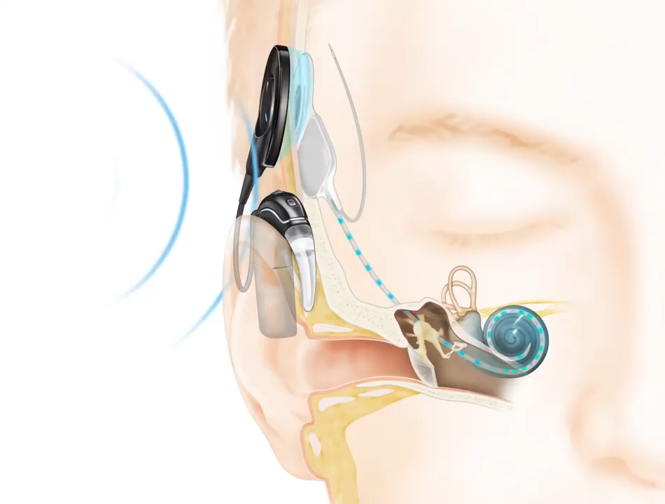
WHAT IS A COCHLEAR IMPLANT (CI)?
Cochlear implants (CIs) are prosthetic devices that partially restore hearing to individuals with severe-to-profound hearing impairment
CIs consist of:
externally worn microphone, sound processor and transmitter system
internally implanted receiver, and electrode array system inserted into the cochlea
external speech processor transforms sound picked up by the microphone into a sequence of stimulation pulses
stimulation pulses sent to implanted electrodes that activate different regions of the auditory nerve
1
2

Slide 3
HOW WELL DO CIs WORK?
Holden et al., Ear & Hear, 2013.
In comparison hearing aids, CIs offer a clear and often life-changing benefit to clinically indicated patients
Currently, ~ 800,000 devices have been implanted worldwide (NIDCD)
but less than 10% of individuals who may benefit from a CI undergo implantation
uncertain CI outcomes are a barrier to CI uptake
although CIs successfully restore functional hearing, speech understanding with CIs remains highly variable
e.g. open-set word scores in quiet with modern-day CIs range from near zero to near perfect
Cochlear implant recipients require an adaptation period before reaching “plateau” in speech perception outcomes
Cusumano et al., 2017.

Slide 4
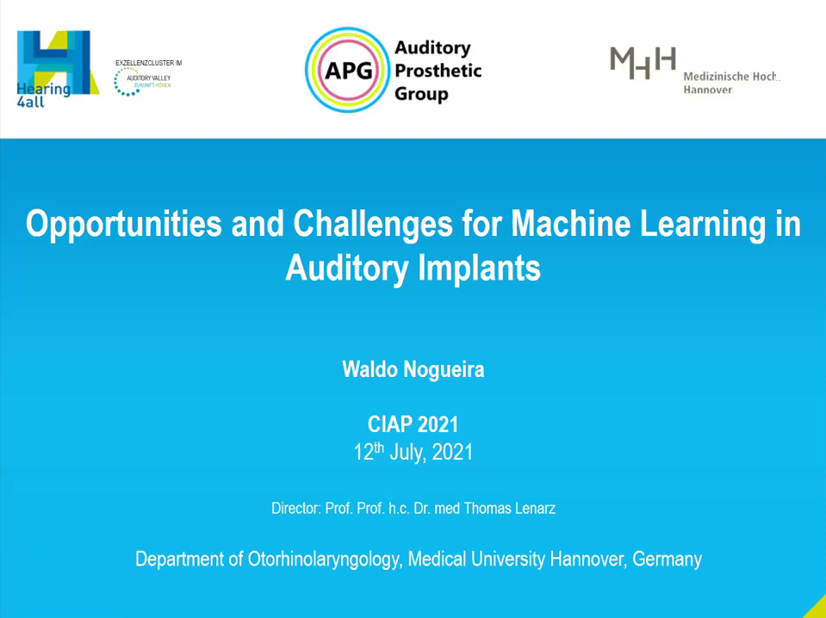

THIS TALK IS TAKEN FROM:

Slide 5
MACHINE LEARNING AND CIs: # Publications
25?
(2019-2021)
out of ~3k

Slide 6
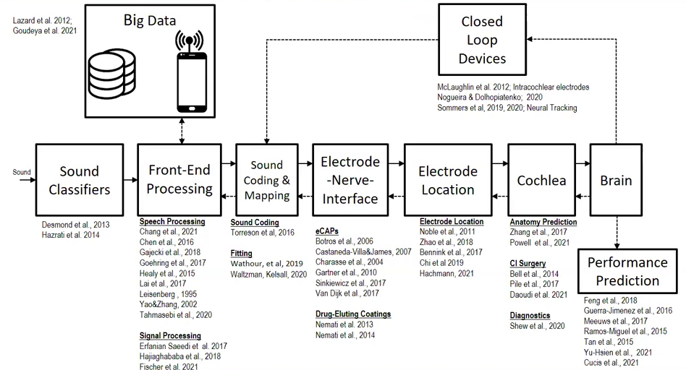
AI FOR CIs APPLIED AT MANY LEVELS

Slide 7
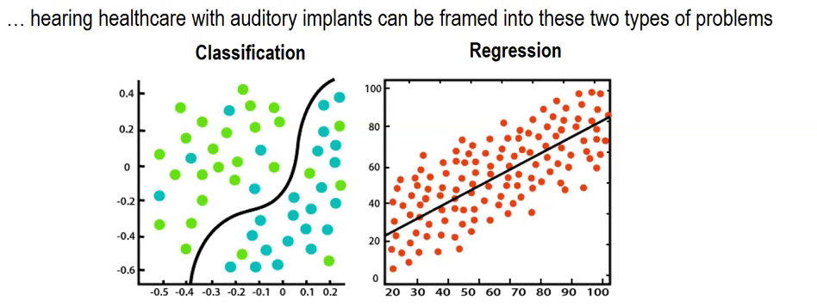
CLASSIFICATION VS REGRESSION
Outcome prediction
Automatic fitting
Image classification
Auditory models
Speech and music enhancement
Closed loop devices

Slide 8
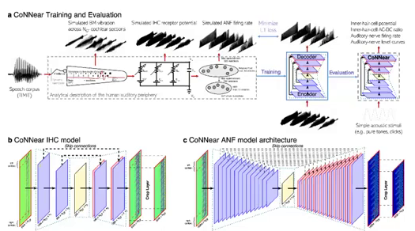
AUDITORY MODELS
Deep neural networks (DNNs) can achieve human-level performance on hearing related tasks
DNNs as models of biological sensory systems?
Faster models of hearing periphery
Better understand human auditory system
Predict outcomes
(e.g. connect peripheral DNNs with ASR DNNs)

Slide 9
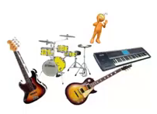

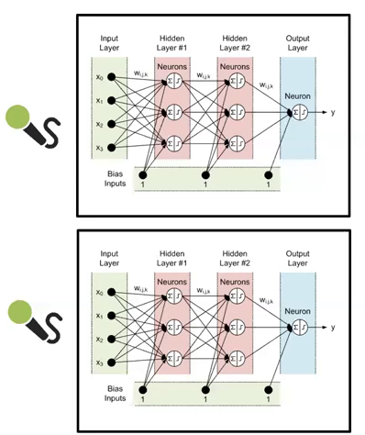
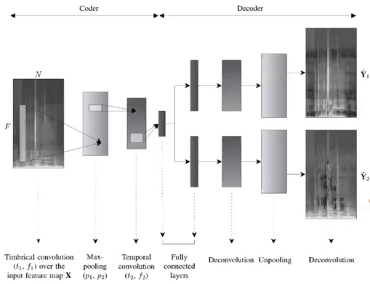
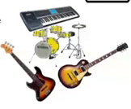

SPEECH/MUSIC ENHANCEMENT
Cocktail party effect
Identify and reduce background noise
Isolate target speaker from background noise
CIs don’t offer good representation of music
Listener may benefit from independant control of music elements (instruments, rhythm, singers)

Slide 10
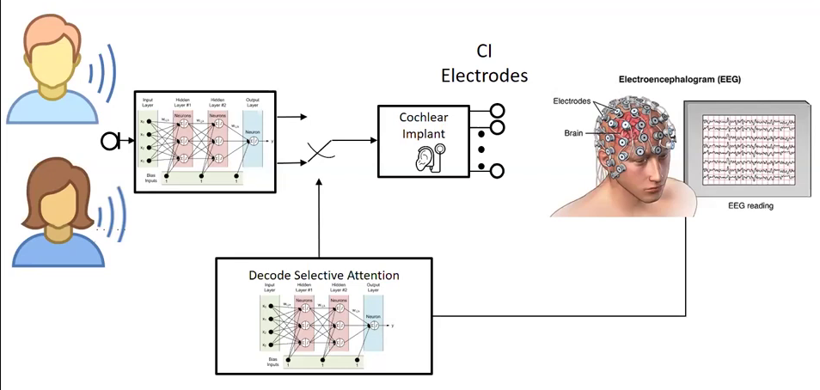
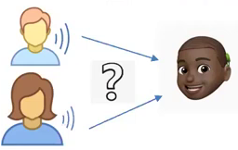
CLOSED LOOP DEVICES
channel noise reduction algorithms provide limited benefit
Monaural/Binaural algorithms highly dependent on specific acoustic environment
DNNs opportunity to outperform classical noise reduction algorithms
Must overcome DNN limitations (computation, memory, latency)
How do we know which speaker needs to be separated?

Slide 11
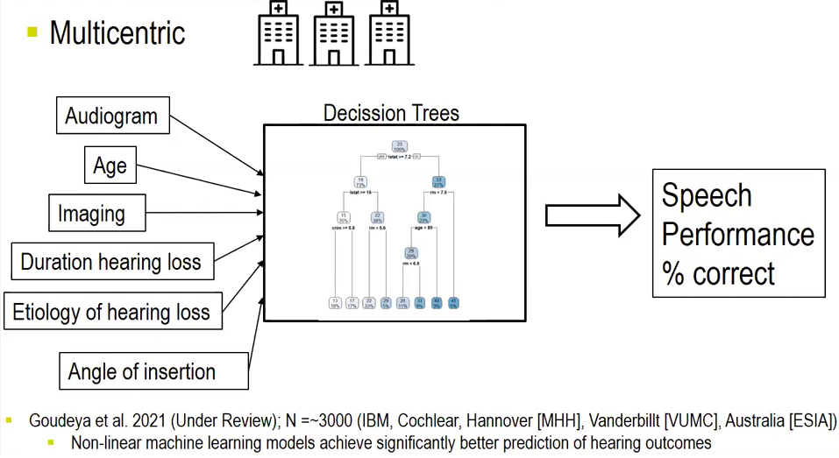
OUTCOME PREDICTION
E.g. Kim et al. 2018:
Classical regression
r = 0.7; Mean Absolute Error = 15.6 ± 9
Random Forest Regression (RFR)
r = 0.96, MAE = 6.1 ± 4.7
RFR Cross-hospital validation
r = 0.91, MAE = 9.6 ± 5.2

Slide 12
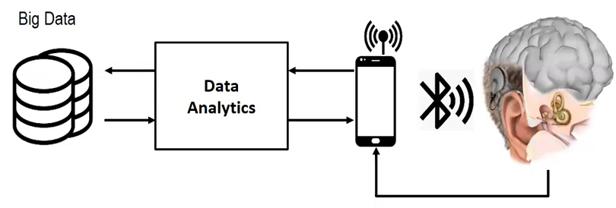
AUTOMATED/REMOTE FITTING
Enabled through communication between CIs and Smartphone
CI as sensors to capture and monitor sound, and sense neural signals
AI for monitoring of hearing status
AI based automated fitting of CI
FOX (Vaerenberg et al., 2014)
Genetic algorithms (Lineaweaver and Wakefield, 2011)

Slide 13
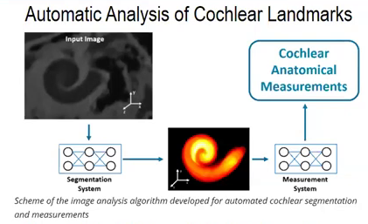
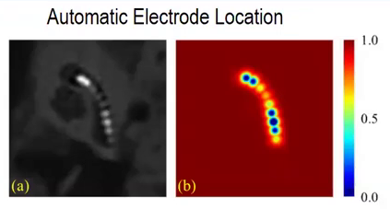
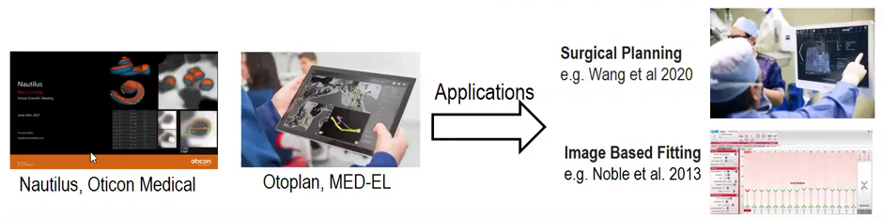
IMAGE CLASSIFICATION

Slide 14
CHALLENGES
Is there enough data?
Quality of the data
Lack of standardization and formats
Who owns the data?
Data protection vs Open data
Bias
Interpretability of the Algorithms
Performance and Quality of the models

