Slide 1
Machine Learning Machine Learning Algorithms for BIRTH classification (Caesarian or natural)
By MungunSarnai Ganbold (NYU, MS-BMI, 2019)

Slide 2
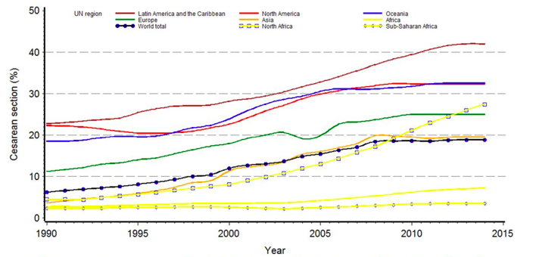
1. C-sections on the rise everywhere
In 1990, about 1/15 newborns in the world was delivered via cesarean section.
In 2014, this number went up to 1/5 newborns.
a. Trends in caesarian deliveries in UN regions, 1990-2014 Source: Center of Excellence in Maternal and Child Health, Harvard
World

Slide 3
2. Goals of this study
- Explore ML algorithms and principles of working with categorical data
- Besides improving a model’s performance, also gain insights on the data
via feature selection, extraction and engineering
- Explore what features have strong association with caesarian births

Slide 4
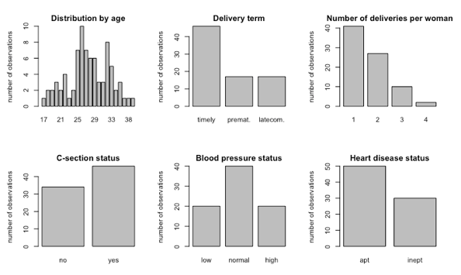
3. Description of data
- The dataset was collected for “Application of Decision Tree Algorithm for Data Mining in Healthcare Operations” study and is accessible on UCI Machine Learning Repository.
b. Univariate distribution of attributes
5 clinical features pertinent to caesarean births.
1 feature (age) is numeric and 4 others are ordinal
80 patients who delivered either by c-section or naturally
Class balance 34:46.

Slide 5
4. Methods
Supervised machine learning methods Linear: Logistic Regression, Linear Discriminant Analysis,
Naïve Bayes and Support Vector Machine
Tree-based:
Classification and Regression Trees, Random Forest
II. Unsupervised methods
K-means clustering and Random Forest unsupervised
III. Metrics for classifiers
Accuracy, Precision, Recall, F1 rate and ROC AUC
IV. Statistics Kappa statics

Slide 6
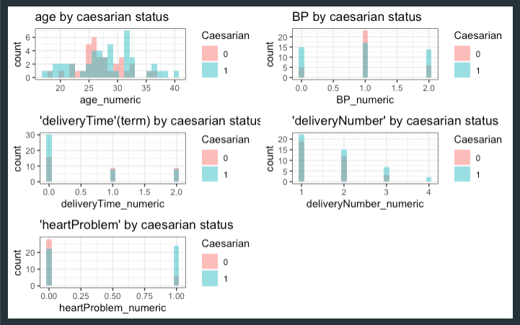
c. Count of predictors by response levels
5. Data curation and exploratory data analysis
Steps:
- NAs
ChiSq and Cramer’s V tests for categorical data
For numeric attribute - Wilcoxon test
Data normalization (min-max scaling and BoxCox transform.)
Split data

Slide 7
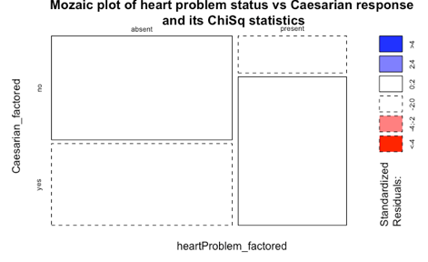
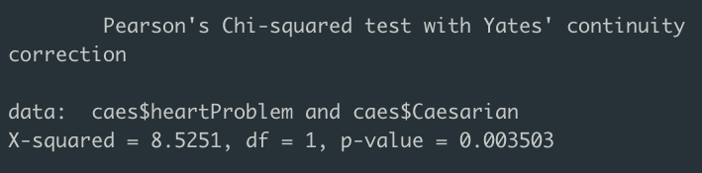
6.1 ChiSq test
The chi-square test is statistically significant, indicating that there is an association between heart problem and caesarian delivery
Total sum of standardized residuals

Slide 8
6.2 ChiSq and Cramer’s V tests for categ. variables
Variable | X-sq | DF | p-value | association with caesarian
Heart Problem | 8.5251 | 1 | 0.0035 | Yes
Blood Pressure | 7.4680 | 2 | 0.0239 | Yes
Number of deliveries | 2.4070 | 3 | 0.4923 | Merge factor levels 3 and 4
Delivery Term | 2.6379 | 2 | 0.2674 | ?
Cramer’s V (strength of association)
0.3264
0.3055
0.1735
0.1816
There is a medium strong and positive association between Heart Problem and Caesarian status as well as between Blood Pressure and Caesarian status.
6.3 Wilcoxon test results for numeric ones
For Age, Wilcoxon’s p-value=0.00 -> association with Caesarian status is significant

Slide 9
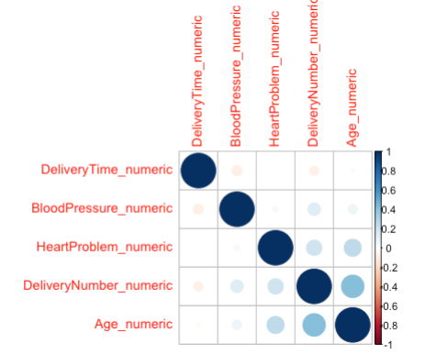
d. Correlation matrix
6.4 Conclusion on stats
From ChiSq, Cramer’s and Wilcoxon’s tests, Blood Pressure, Heart Problem and Age have positive and medium strong association with response
“Age” and “Delivery Number” have highest corr=0.43, p=0.00

Slide 10
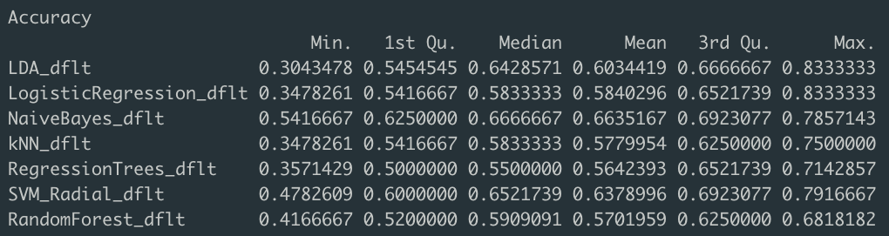
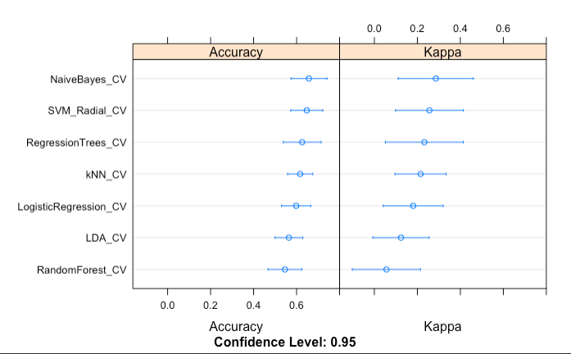
6.4 Started with training 7 models
Step 1.
Among 7 basic models trained, linear models (LDA, SVM and NB) performed the best.
Step 2.
Integrating Cross validation changed the list to NB, SVM and CART

Slide 11
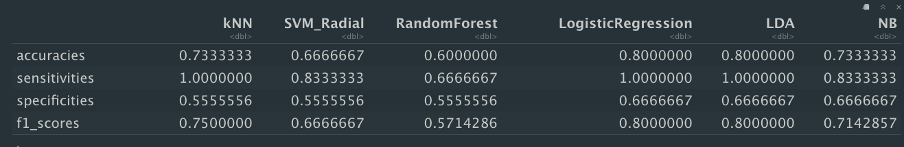
Step 3. Preprocessing data (scaling and centering)
kNN and CART improved by ~7% from preprocessing data.
Validation Accuracy, Precision, Recall and F-1 of basic selected models
Next
Improve models by tuning, introducing different data transformation, Ensemble method and perform feature selection as well as feature extraction not only with the best of the above (LR, LDA and NB) but also with kNN, SVM and Random Forest as these are usually well performing algorithms for binary classification task.

Slide 12
#1 SVM models
Package and Method | Validation accuracy | Notes
e1071::svm() (SVM-Linear or no method specified, Radial Kernel) | 90%, AUC=0.90 93%, AUC=0.92 | Categorical values! Model optimized at cost C=1 Numerical. No method specified. Radial Kernel. C=1, SV=15
caret::train() (SVM-Linear with ‘linear’ kernel) | 66.7% | Numerical. Same accuracy for: 1. Default setting. 2. Separately or together performed: Data preprocessed: centered and scaled. Cross validated (10 folds, 3 repeats). 3. Tuned with expand.grid: sigma = 0.2274459 (=const), range(C)= (0.01: 5.0) Optimal accuracy with C=0.25.
caret::train() (SVM-Radial, ‘rbf’ kernel) | 66.7% | Numerical. Data preprocessed: centered and scaled. Cross validated (10 folds, 3 repeats). Optimal accuracy at cost C=0.5 and sigma = 0.2294869 (=const)
 | 64.7% | Numerical. The model optimized with cost C = 0.5 Bootstrapped x15, settings by default.
 | 73.33% | Numerical. Data preprocessed: BoxCox transformation. Cross validated (10 folds, 3 repeats). Tuned with different values of hyperparameters Sigma=c(0:0.9) and C=c(0:2.5) Optimal accuracy with sigma = 0.08 and C = 0.75

Slide 13

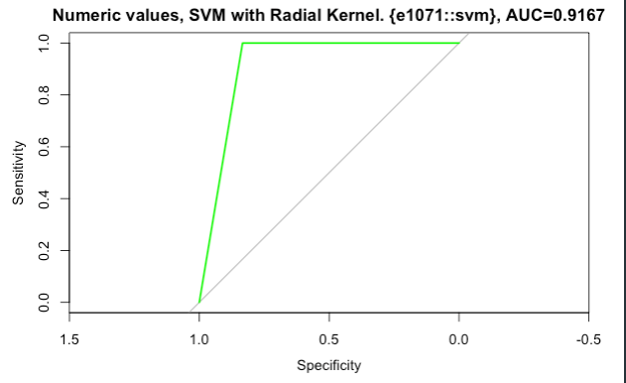
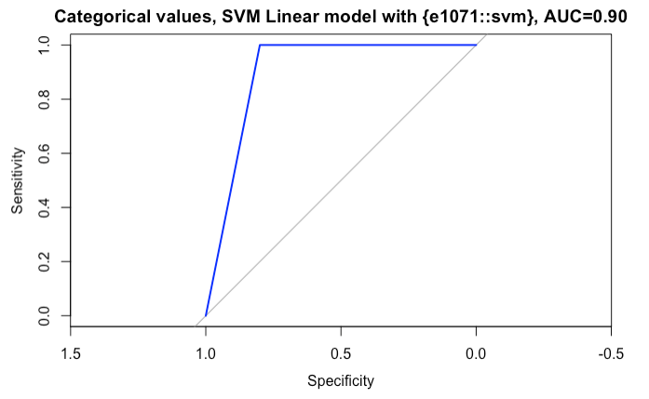

Best performing SVM models
Note: Original features selection combined with features engineering (via MCA method) dropped the accuracy by 5%.

Slide 14
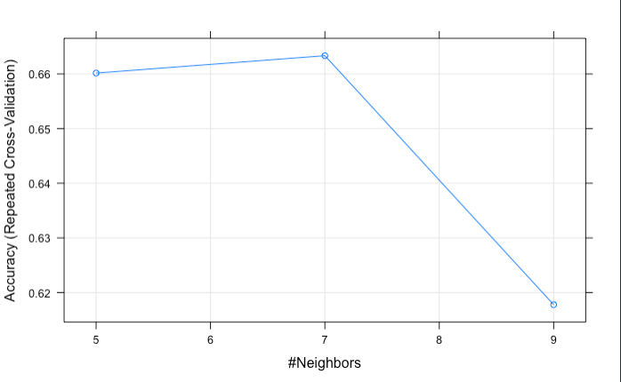
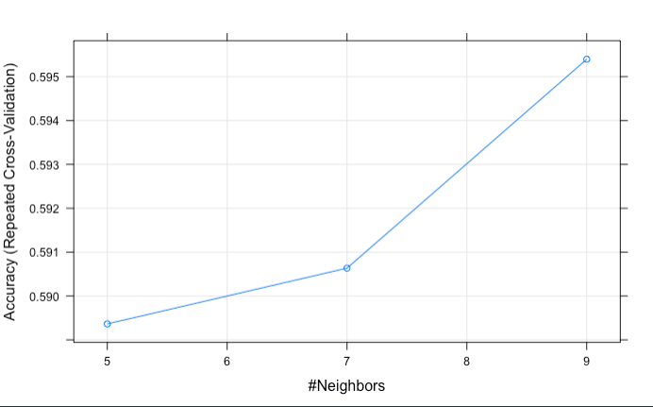
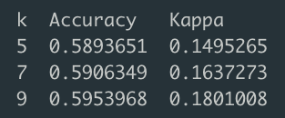
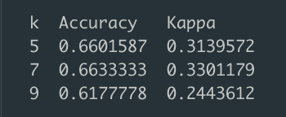
#2 kNN models
Data: numeric
Pre-processed: centered, scaled
and cross-validated (x10, 3repeats)
Validation accuracy=73%
K=7
Data: categorical
Pre-processed: centered, scaled
and cross-validated (x10, 3repeats)
Validation accuracy= 85%
K=9
Training accuracies:
Training accuracies:

Slide 15
#3 Logistic Regression
So far, for Logistic Regression, the highest validation accuracy is 80% with the model by default. Data transformation, tuning with a grid and bootstrapping only have degraded the model accuracy.
Method | Validation accuracy | Notes
Method = “glm” and “glmnet”, Package = {caret::train}, Data = <as.numeric > | 66.67%, AUC=0.7593 | 2 predictors used (ChiSq), “Boot”x15, not processed data
 | 66.67%, AUC=0.7593 | 2 predictors used, “cv” x 10
 | 80%, AUC=0.83 | 5 predictors used ,“cv”x 10
 | 80%, AUC=0.87 ::glm | 5 predictors used, all settings by default
 | 66.67% | 5 predictors used, data centered and scaled
 | 66.67% | 5 predictors used, BoxCox transformation used
 | 66.67% | The best so far model (by default) is tuned with a grid (with and w/o data transformation)
Method = “MCA” Package: { FactoMineR::MCA } Method = glm() <categorical data> | AUC 0.89 90%, AUC = 1.0 | MCA dim1 row coordinates are piped into “glm” model MCA dim1+dim2 coordinates used as predictors for “glm” model

Slide 16
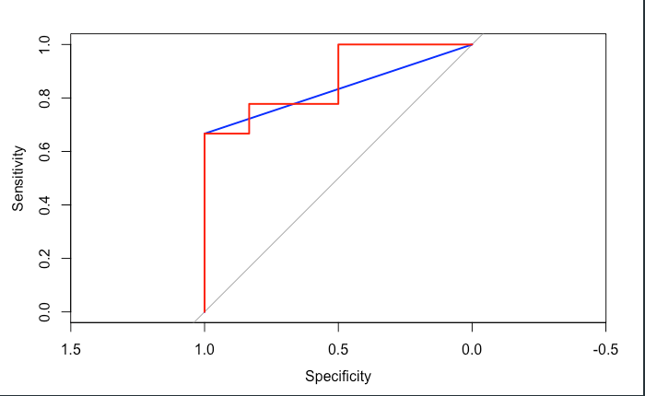
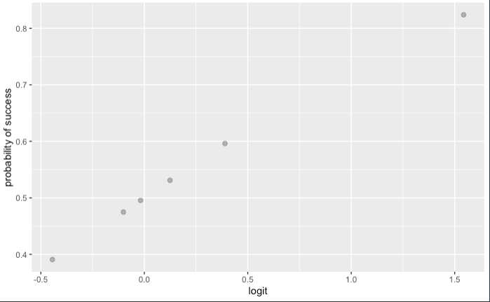
Conclusion on best models
with Logistic Regression
(features taken as numeric values)
AUC = 0.8667 , glm() ordinary AUC = 0.8333 , train() with CV
1. GLM outputs sequence of logits. Or log odds (coef(glm)). 2. We de-log them first (logit_seq<–exp(logit_seq))
3. We write a fun(prob<–odds) to convert odds into probability.
4. We plot logit~prob to verify the correct conversion.
5. For both AUC=0.83 and AUC=0.87 accuracy=80%

Slide 17
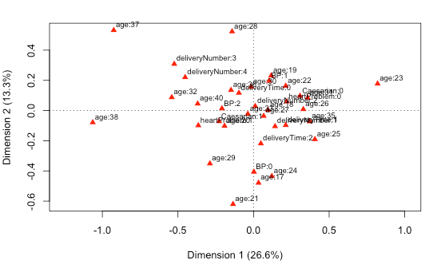
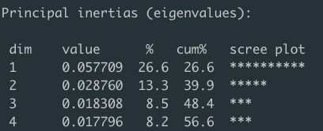

#4 Multiple Correspondence Analysis
…from Simulated Annealing Method…

Slide 18
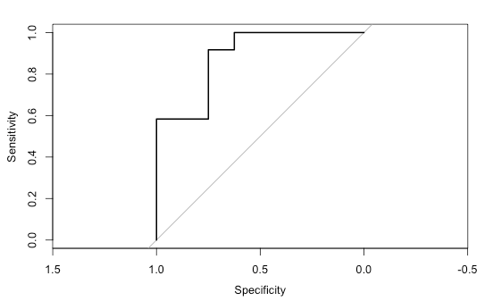
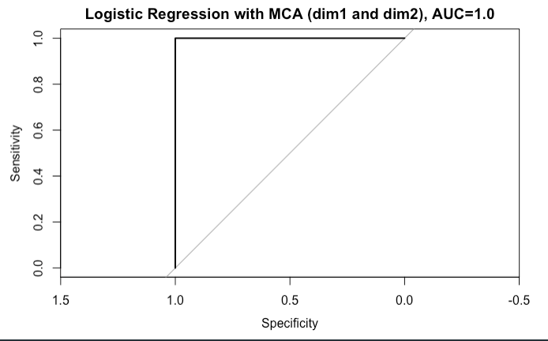

Logistic Regression models with MCA Eigenvalues:
Accuracy = 90% (logits thresholded by 0.5)
Logistic Regression with MCA (dim1), AUC =0.8854

Slide 19
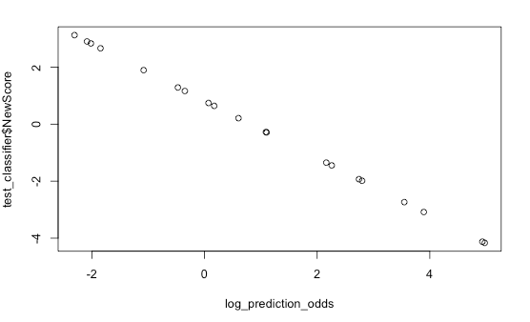
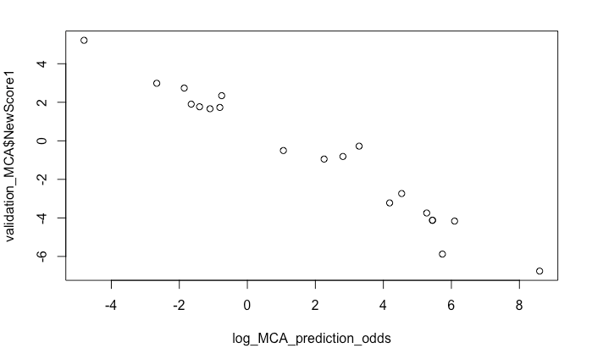
Converting model’s predicting probabilities into log odds
Checking if log odds and independent variables (MCA coordinates for its dimensions) are linearly correlated:
For the model with where only dim1 used:
We observe here perfect negative correlation between log odds and MCA scores of dim1.
They are linearly correlated.
For the model where dim1 and dim2 used:
Still distinct but weaker correlation between dim1 and a model’s log odds. That is normal.

Slide 20
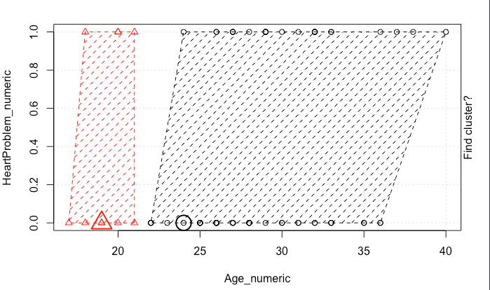
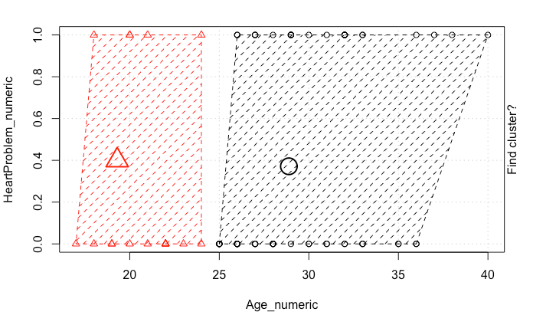
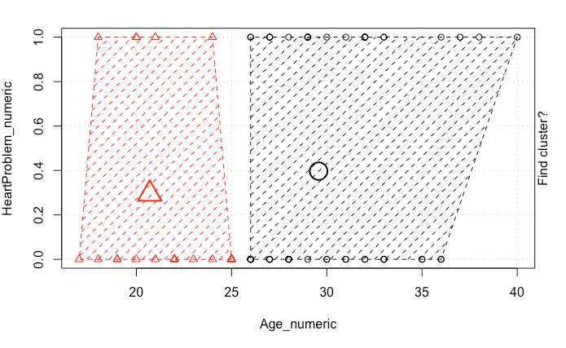
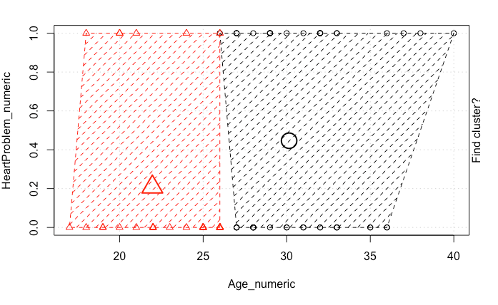
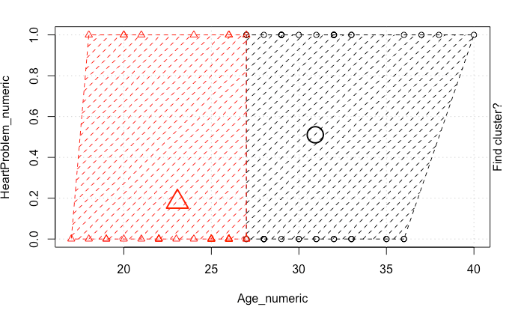
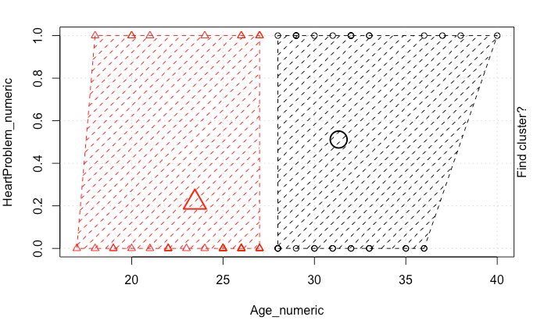

#5 K-means – unsupervised classification

Slide 21
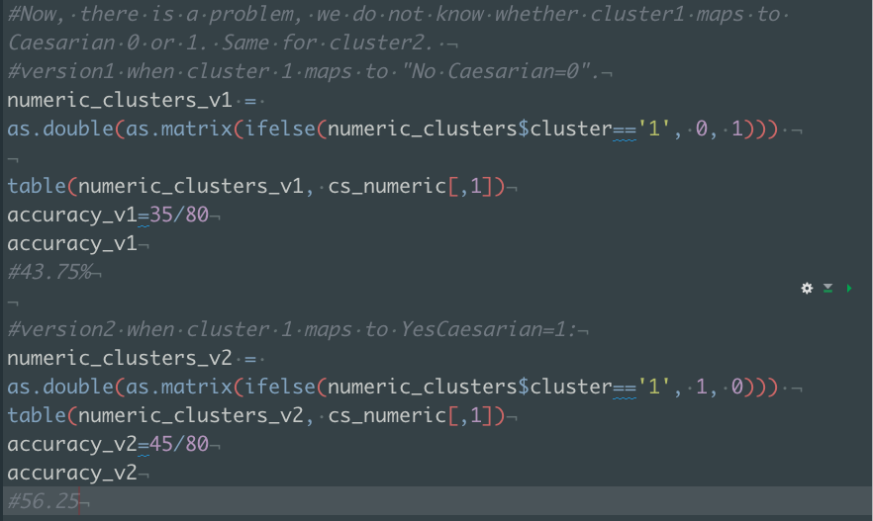


Evaluating k-means accuracies for numeric data
Unsupervised k-means method doesn't offer a good classification accuracy for this data.

Slide 22
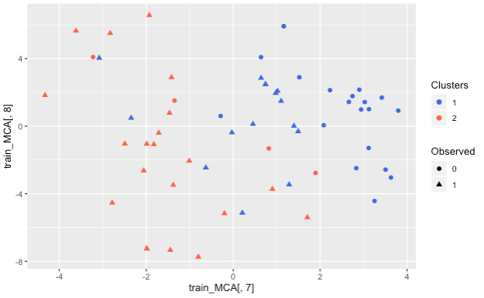
#6 Unsupervised Random Forest
Classifier’s accuracy 0.64. It is not competitive but still higher than what k-means offers

Slide 23
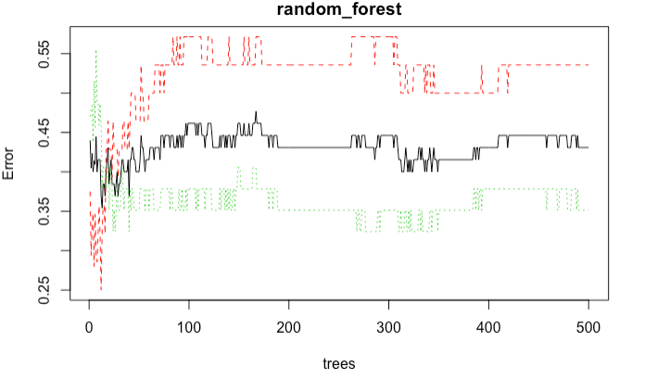
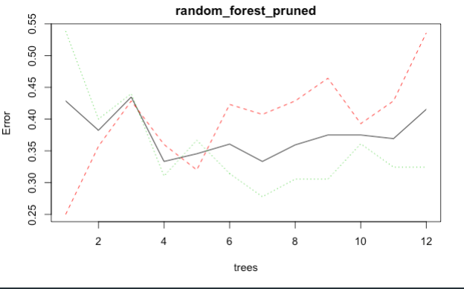
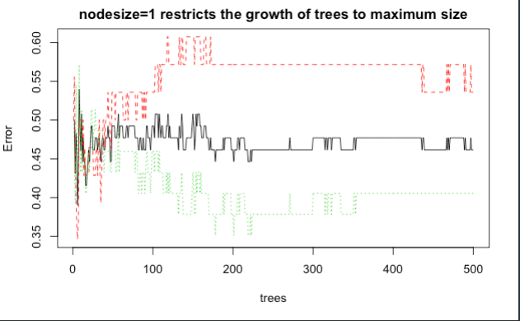
#7 Supervised Random Forest
Pruned model, OOB error =41%, validation accuracy remains the same =60%, number of trees=12, number of variables tried at each split=2
Basic model, OOB error =43%,
validation accuracy=60%, number of trees=500, number of variables tried at each split=2
Restricted model, OOB error =46.15%,
validation accuracy=67%, number of trees=500, number of variables tried at each split=2, nodesize=1

Slide 24
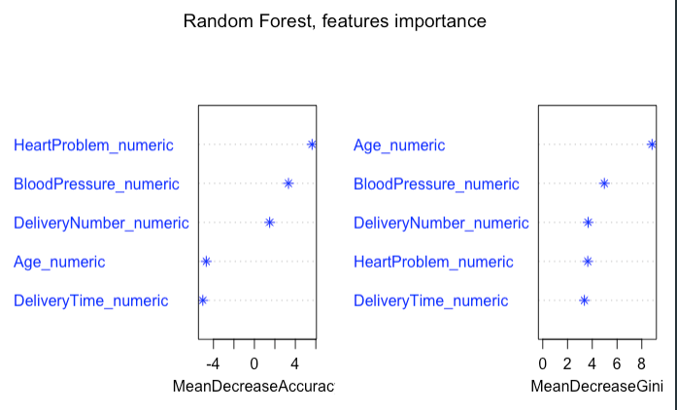
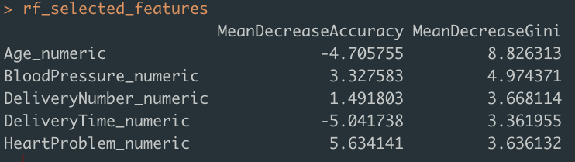
#8 Random Forest’s Feature Selection
Observation:
Importance as features selection method in RF initially could increase training accuracy by 4%. However, the feature selection model was overfit as it dramatically dropped the validation accuracy by 14%.
Conclusion:
Feature selection alone would not give sufficient information for Random Forest model

Slide 25
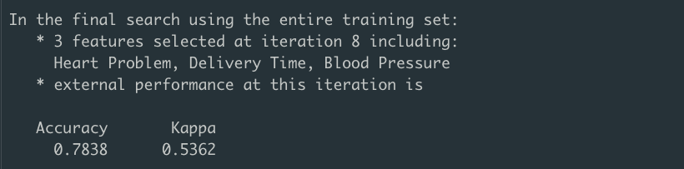
#9 Checking features selection in Random Forest with another method- Simulated Annealing (SAFS)
SAFS wrapper method gave the same selection of features with Importance method.
Though, the validation accuracy was still low (65%).

Slide 26
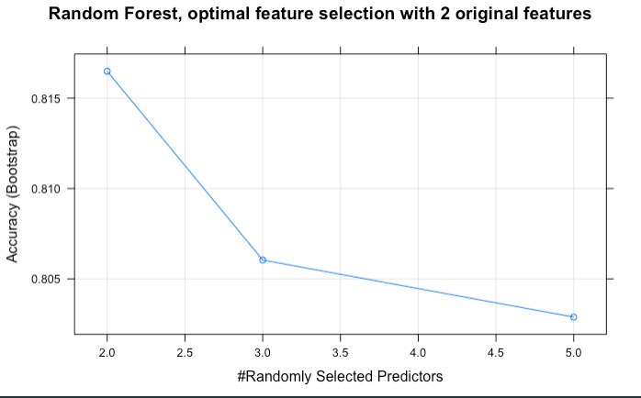
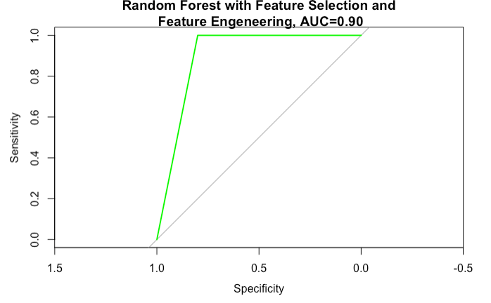

However, feature selection combined with feature extraction (MCA Principal Inertias 1 and 2) increased RF validation by ~25%!
#10 Feature selection combined with feature extraction for Random Forest (categorical values)

Slide 27
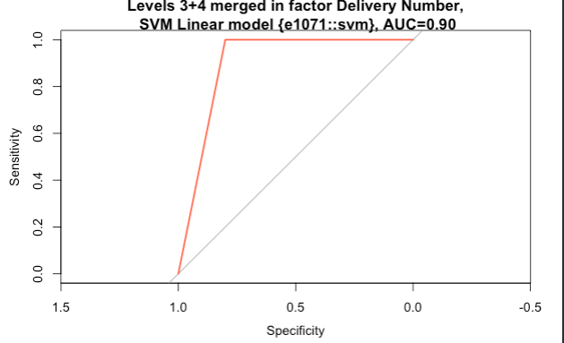
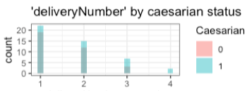

Merging Levels 3 and 4 of factor ‘Delivery Number’, testing best models again
Merging levels in a factor neither improved, nor degraded the previous accuracy of 90%
of svmLinear and Logistic Regression models both with MCA eigenvalues.

Slide 28
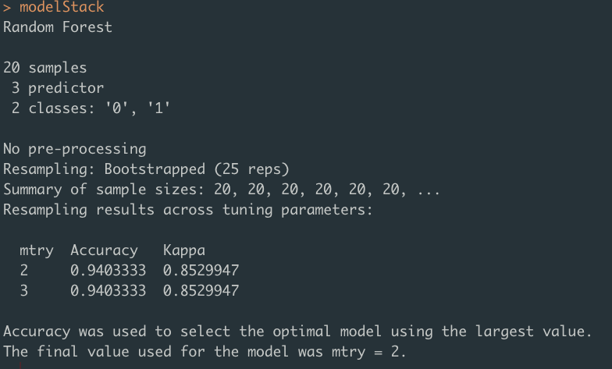
RF Ensemble Holdout Stacking method
algorithm that uses cross-validation to estimate the performance of multiple machine learning models, or the same model with different settings. It then creates an optimal weighted average of those models, which is also called an “ensemble”, using the test data performance.
Best models predictions (glmnet_MCA, svmLinear, rfFS_c3) as one dataframe serve in place of training data for stacked model.

Slide 29
Conclusion
1. Caesarian and normal delivery data can be well classified with hyperplane build by linear and or tree algorithms.
2. Among high accuracy models, AUC=1 only for Logistic Regression model with feature selection and new feature extraction.
3. For my data, extracted features integration was the only way to improve the model performance.
4. The given clinical features alone (maternal age, blood pressure and heart problem status) assuming feature extraction are sufficient for successful classification of deliveries by caesarian or normal.
Thank you!

Slide 30
Thank you!

